Slide 1

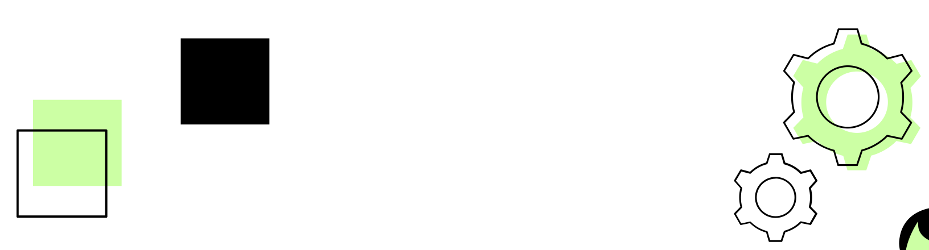

Re-architecting
2021-SE-15
2021-SE-24
2021-SE-39

Slide 2
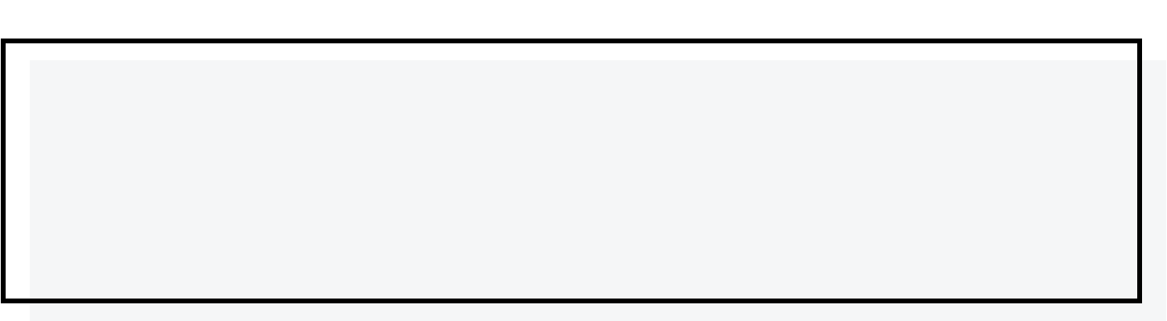

TABLE OF
CONTENTS
01
Introduction
02
Research Insights
03
Conclusion

Slide 3

01
INTRODUCTION

Slide 4



Re-architecting
Overview
Goals
Re-architecting is refactoring at a higher level
Quality through modularity.
Maintainability through good design
Autonomy through independence.

Slide 5
02
RESEARCH INSIGHTS
2021-SE-24

Slide 6

Object-Oriented Re-Architecturing
Author: Harald Gall1 , Ren´e Kl¨osch1 , Roland Mittermeir Journal: : 5th European Software Engineering Conference
Purpose of Research:
Modernizing the architecture of old software helps to gain control over maintenance cost, to improve system performance re-architecting of old procedural software to an object-oriented architecture.

Slide 7

Transformation Process
01
02
Design Recovery
App Modeling
03
04
Object Mapping
Source Code Adoptation

Slide 8
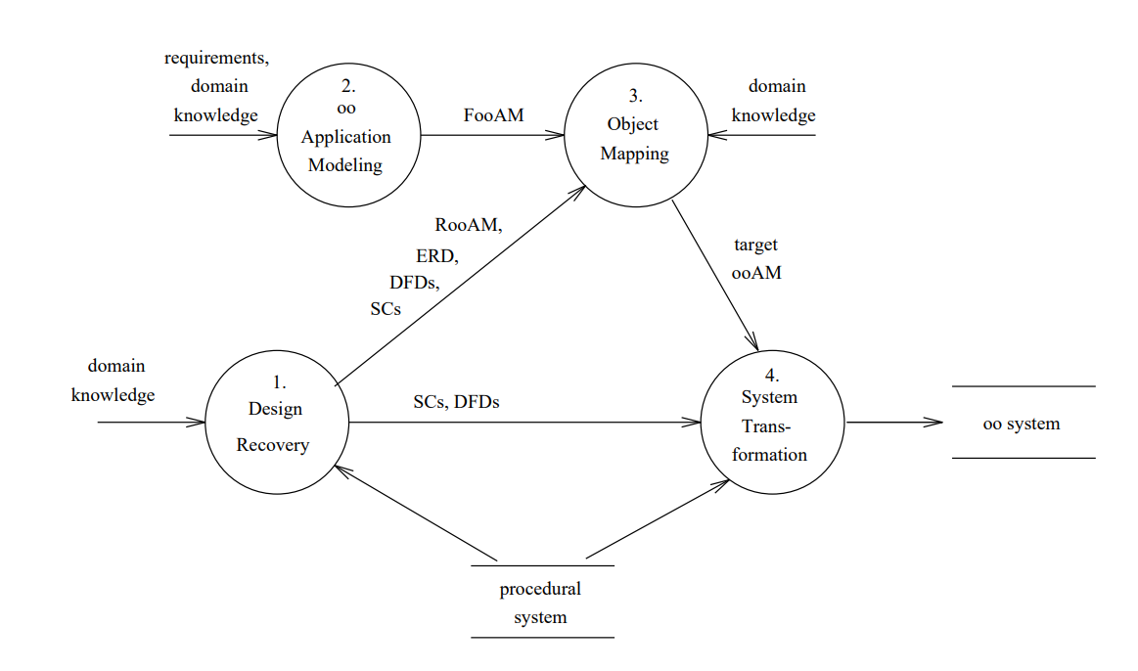
Transformation Process -cont

Slide 9
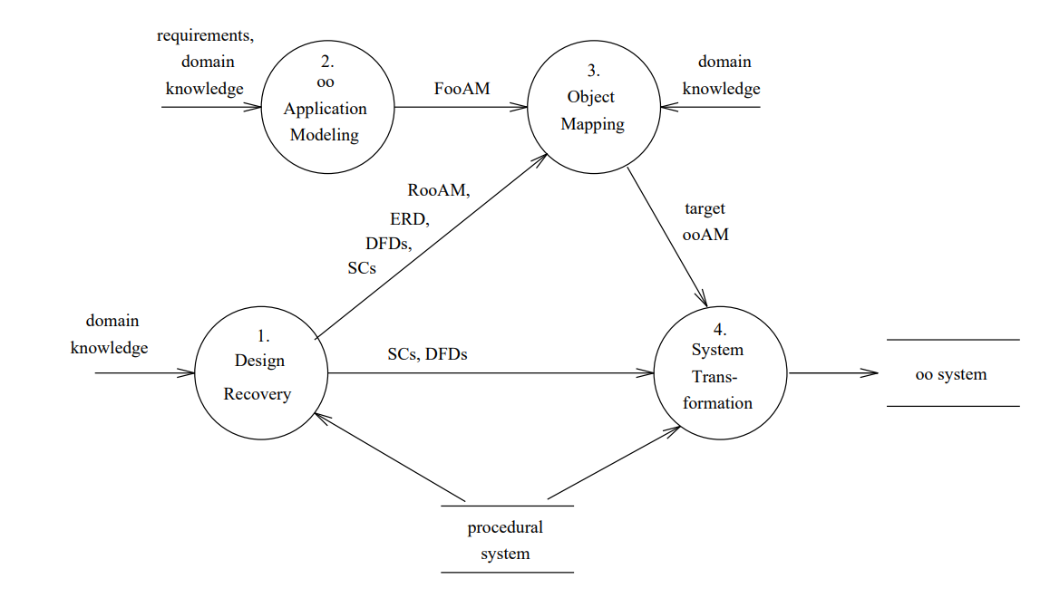
Transformation Process -cont
1- Design Recovery:
In this step different low-level design documents (i.e. structure charts, dataflow diagrams), an entity-relationship diagram, and an object-oriented application model (called reverse generated object-oriented application model, RooAM ) are generated from the source code of the procedural program.

Slide 10
Transformation Process -cont
2- Application Modeling:
Based on the requirements analysis of the procedural input program, an object oriented application model (called forward generated object-oriented application model, FooAM) is generated, working as input for the following object-mapping process

Slide 11
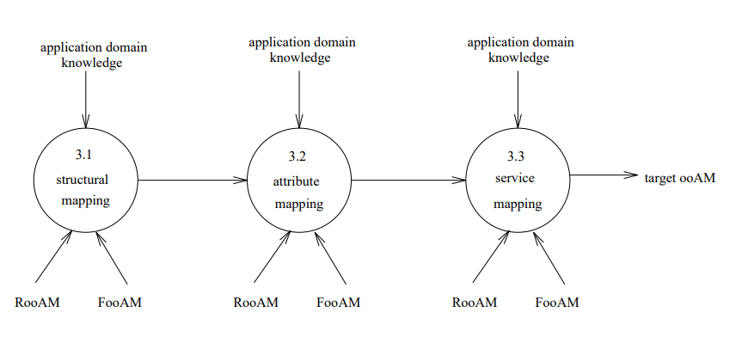
Transformation Process -cont
3- Object Mapping:
In this step the elements of the RooAM are mapped to the elements of the FooAM resulting in a target application model (target ooAM). The target ooAM represents the desired object-oriented architecture and is used for performing the needed source-code adaptations.

Slide 12
Transformation Process -cont
4- Source-Code Adaptation:
The source-code adaptation step completes the program transformation process on the source-code level and is based upon the results of the previous steps, especially the target ooAM.

Slide 13
Conclusion
The research proposed the refinement process as a core element in the rearchitecting process.
Also the proposed framework is considered as a strong tool for providing a well structured documentation for non-documented software.

Slide 14
Approaches to Software Re-architecting
Author: Galal Hassan, Mohamed Abbas, Nissreen Abdel-Ghaffar Journal: 37th International Conference on Computers and Industrial Engineering
Purpose of Research:
Architectures are lost or eroded over a system's lifetime due to their intangibility. This results in the need of techniques to recover or extract an architecture from a legacy system

Slide 15
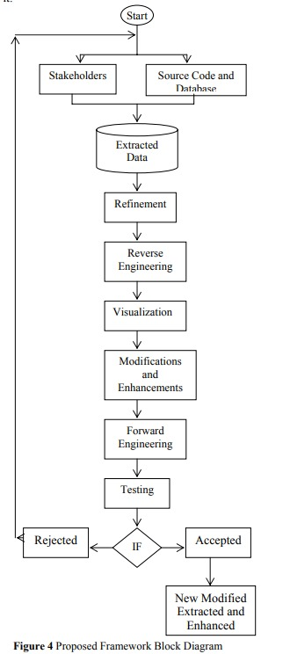
Proposed Framework
Extracting Source Code: Gather source code and database structures.
Collecting Stakeholders' Perspectives: Engage stakeholders for system understanding.
Refining Collected Data: Filter and organize gathered information.
Reverse Engineering: Create higher-level abstractions from the refined data.
Visualization Tool: Use tools for clear architectural representation.

Slide 16
Proposed Framework
Modifications and Enhancements: Apply necessary improvements to the system.
Forward Engineering: Generate updated code from the new architecture.
Testing the System: Ensure the updated system functions as expected.
Validation and Verification: Confirm accuracy and completeness of changes.
Feedback and Reconfiguration: Incorporate feedback for continuous improvement.

Slide 17
Conclusion
The research proposed the refinement process as a core element in the rearchitecting process
Also the proposed framework is considered as a strong tool for providing a well structured documentation for non-documented software.

Slide 18

Software Reengineering at the Architectural Level: Transformation of Legacy Systems
Author: R. Correia1, C. Matos, M. El-Ramly, R. Heckel, L. Andrade Journal: ResearchGate
Objective: Transformation of legacy systems.
Challenges:
Target code generation not covered.
Solution:
Categorize source code using pre-defined rules.
Represent code as a type graph model.
Use graph transformations for target architecture.

Slide 19
02
RESEARCH INSIGHTS
2021-SE-15

Slide 20
A Methodology and Heuristics for Re-Architecting a
Legacy System
Author: Richard Wise, Lindsey Sheppard, John Huggins Journal: IEEE
Objective: Re-architecture of a legacy system.
Challenges:
Lack of system documentation
Absence of subject matter expertise.
Solution:
Model-Based Systems Engineering (MBSE) using SysML.
New process for re-definition of system architecture.

Slide 21


Results & Conclusion
Transition from the traditional
waterfall-Model to MBSE using SysML
Refine the models over time.
Redefine system architecture as needed.

Slide 22
Migrating a Legacy System to a Microservice Architecture
Author: Kristian Tuusjärvi , Jussi Kasurinen, Sami Hyrynsalmi Journal: e-Informatica Software Engineering Journal
Objective: Migrating legacy systems to microservice architecture.
Challenges:
Systematic mapping.
microservice migration

Slide 23

Results & Conclusion
Key Findings :
Focus is mainly on the transformation phase.
Convert into components (microservices).
More cohesive research about project is needed for successful migration practices.

Slide 24

An Approach to Software Architecture Analysis for Evolution and Reusability
Author: Chung-Horng Lung, Sonia Bot, Kalai Kalaichelvan Journal: Proc. of CASCON (Centre for Advanced Studies Conf.)
Objective: Promote software evolution and reuse through architecture analysis and redefining.
Challenges:
Framework for modeling and analyzing software architecture.
Application to large-scale telecommunications systems.

Slide 25
Results & Conclusion
Approach :
Promoting software evolution and reuse through architecture analysis

Slide 26

02
RESEARCH INSIGHTS
2021-SE-39

Slide 27
A Perspective on Architectural Re-engineering
Author: Alejandro Sancheza, Nuno Oliveirab, Luis S. , Pedro Henriques Journal: ELSEVIER
Objective: Propose a flexible approach for modifying and re-engineering legacy systems.
Key Insights:
Combines analysis stage to identify patterns in legacy code.
Introduces iterative re-engineering at a higher abstraction level.
Provides tools: CoordPat (for analysis) and Archery (for re-engineering).

Slide 28

Results & Conclusion
Approach: Use bi-directional model transformations to connect code-level and design-level models.
Case Study: Demonstrated using a partial case study.
Key Insights :
Successfully integrates analysis and re-engineering with tool support.
Enables highter-level abstraction for better system modifications.

Slide 29
Software Architecture Reconstruction: A Process-Oriented Taxonomy
Author: Richard Wise, Lindsey Sheppard, John Huggins Journal: IEEE
Objective: a framework to understand and compare different reconstruction techniques.
Challenges:
Software architecture is not explicitly represented in the code
making it hard to maintain.
Architecture drift occurs as systems evolve, requiring
reconstruction to validate and restore the design.

Slide 30

Results & Conclusion
Approach : Conducted a survey and analysed a wide range of architecture reconstruction techniques.
Key Insights :
Delivered a detailed state-of-the-art taxonomy.
Provided a comparative understanding of
reconstruction methods, aiding practitioners
in choosing appropriate techniques.

Slide 31
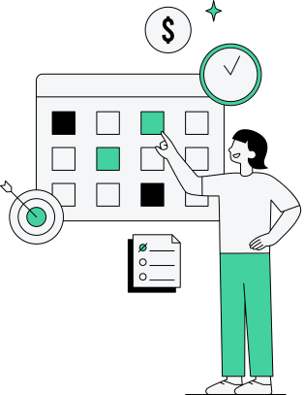
Towards a Reference Process for Software Architecture Reconstruction
Author: Daniel Guamán1,2 , Jennifer Pérez1, Jessica Diaz1, Carlos E. Cuesta Journal: IET
Objective: Define a systematic reference process, SIRA, for software architecture reconstruction.
Challenges:
Software systems must adapt to new platforms and architectures to remain competitive.
Lack of standardized processes for architecture reconstruction, leading to inefficiencies.
Solution:
SIRA integrates findings common reconstruction activities and techniques.

Slide 32
Results & Conclusion
Approach : Identified common elements: techniques, activities, patterns, and automation mechanisms.
Key Insight :
Enhanced understanding of reconstruction techniques and their systematic integration into architecture evolution.

Slide 33
03
CONCLUSION
2021-SE-39

Slide 34
Results & Conclusion
Re-architecting plays a critical role in the evolution and maintenance of software systems.
The research papers reviewed provide valuable insights into methods, tools, and processes for systematically re-engineering legacy systems and reconstructing software architectures.
By integrating practical techniques like iterative model transformations, taxonomies, and reference processes such as SIRA, the field of re-architecting continues to address the challenges posed by evolving technologies and system complexity

Slide 35
THANK YOU

Slide 36































Resource Page
Use these design resources in your Canva Presentation.
Fonts
This presentation template uses the following free fonts:
Titles
Rajdhani
Headers
Lato
Body Copy
Lato
You can find these fonts online too.
Colors
#CCFFA4
#43D29F
#000000
#08524D
#F5F6F7

