Slide 1
AUTOMATIDATA
NYC Taxi & Limousine Commission
Statistical Analysis — A/B Test
Payment Type vs. Fare Amount
ANALYST
CLIENT
STAGE
DATE
Walid
NYC TLC
PACE: Analyze → Execute
June 2026
Course 3 — The Power of Statistics

Slide 2
Project Overview
A/B test: does payment method affect fare amount?
Background
Luana Rodriguez (Senior Data Analyst, Automatidata) assigned this A/B test to investigate whether customers who pay by credit card tend to pay higher fare amounts than cash customers. This is part of the broader NYC TLC fare prediction project.
H₀ Null Hypothesis
Hₐ Alternative Hypothesis
There is NO difference in the average fare amount between credit card and cash customers.
There IS a difference in the average fare amount between credit card and cash customers.
Significance Level
Test Type
α = 0.05 (5%) — standard threshold for statistical significance.
Two-sample Welch's t-test (equal_var=False) — accounts for unequal group sizes and variances.

Slide 3
Dataset at a Glance
2017 NYC Yellow Taxi Trip Data
22,699
18
0
Total Records
Columns
Missing Values
2
$13.43
$12.21
Groups Tested (CC vs Cash)
Mean Fare — Credit Card
Mean Fare — Cash

Slide 4
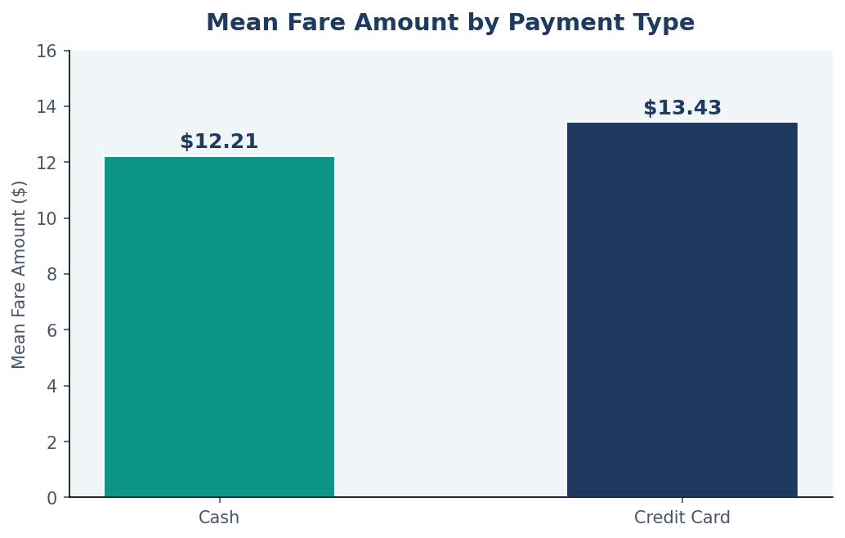
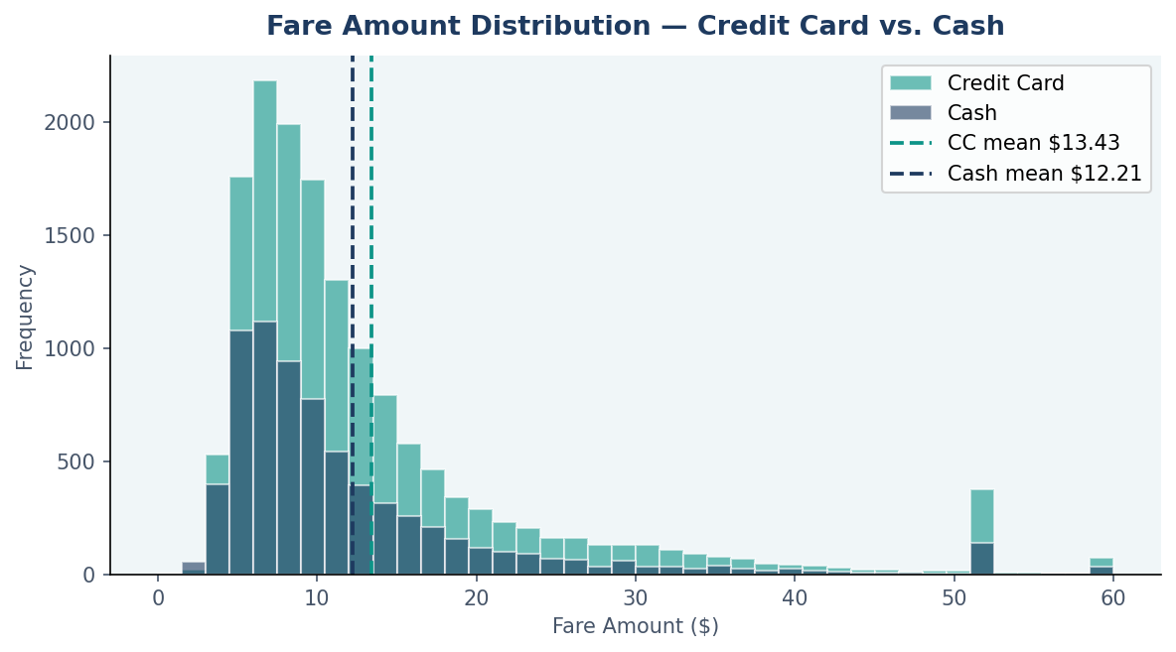
Fare Amount Analysis
Distribution and mean comparison — Credit Card vs. Cash
$1.22 gap
Right-skewed
~67% credit card
Credit card mean ($13.43) exceeds cash mean ($12.21) — consistent across the full dataset
Both distributions are right-skewed; credit card has a slightly heavier upper tail
Credit card is the dominant payment type, giving a larger and more representative sample

Slide 5
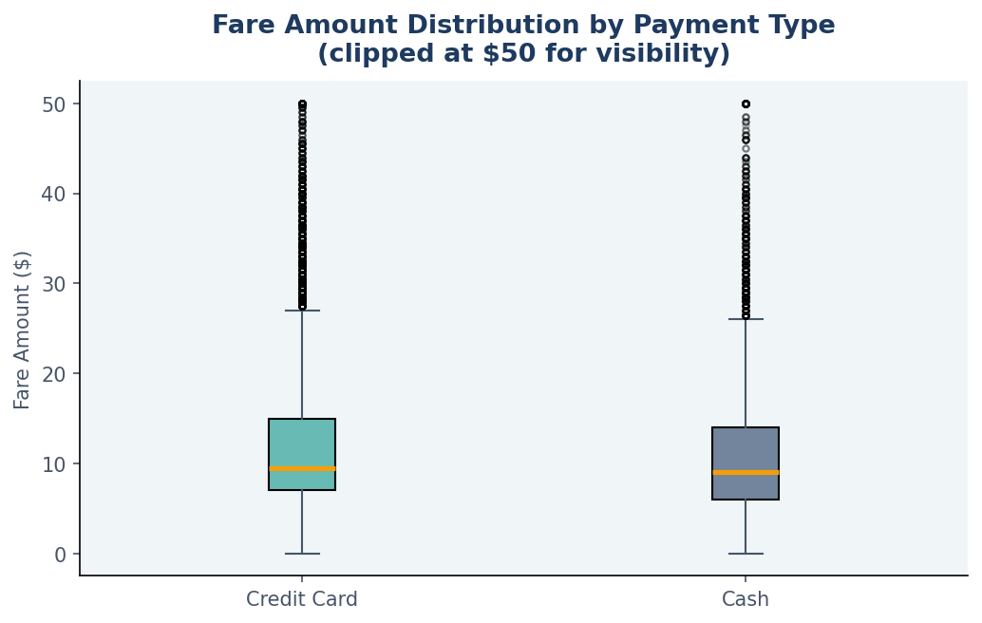
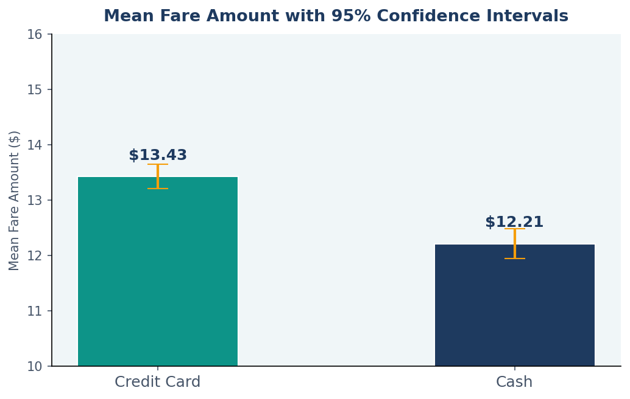
Distributions & Confidence Intervals
Non-overlapping 95% CIs confirm statistical significance
📦 Box plots (clipped at $50): The credit card distribution shows a slightly higher median and wider spread than cash, with outliers present in both groups.
📊 Confidence intervals: The 95% CIs for the two group means do not overlap, providing visual confirmation that the difference is statistically significant.

Slide 6
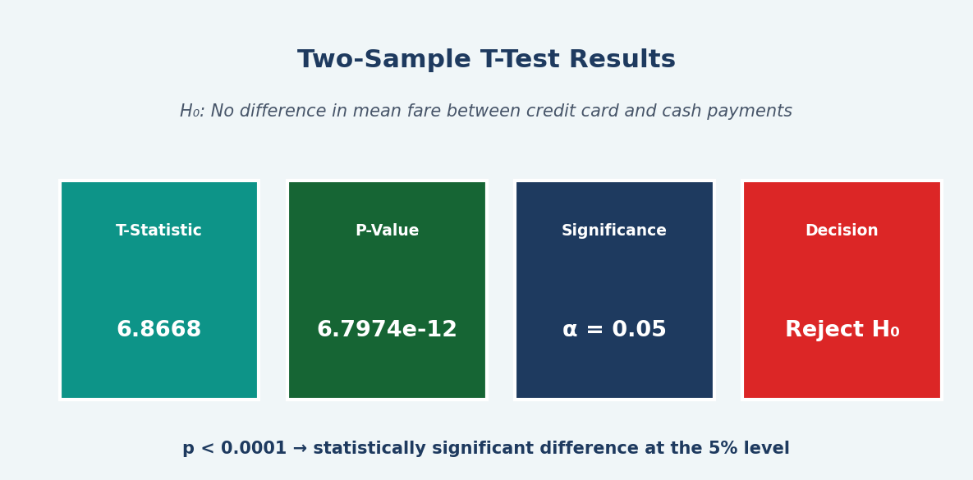
Hypothesis Test Results
Two-sample Welch's t-test at α = 0.05
Metric
Value
Interpretation
T-Statistic
6.8668
Strong positive — credit card mean significantly higher
P-Value
< 0.0001
Far below α = 0.05 threshold
Significance Level
α = 0.05
5% — chosen at project outset
Decision
Reject H₀
Sufficient evidence; difference is not due to chance

Slide 7
Business Insights & Limitations
What the results mean — and what they don't
💳 Credit card → higher fares
📊 Strong statistical evidence
💡 Revenue strategy opportunity
Credit card customers pay ~$1.22 more per trip on average. Longer trips (e.g., airports) are more likely paid by card, making payment type a revenue signal.
t = 6.8668, p < 0.0001 — the difference is highly unlikely to be due to random chance across 22,699 records.
Encouraging credit card adoption could improve TLC revenue visibility and driver income tracking, as cash tips go unrecorded.
⚠️ Limitations & Assumptions
Self-selection bias: Customers choose their payment method — this is not a true randomized experiment. Causal conclusions cannot be drawn.
Confounders: The fare difference may be driven by trip distance, time of day, or RatecodeID (airport trips) rather than payment type itself.
Cash tip underreporting: ~33% of trips are cash; tips recorded as $0, biasing any tip-based analysis.
Data quality: fare_amount ranges from -$120 to $999.99 — anomalous records must be cleaned before regression modeling.

Slide 8
Recommended Next Steps
Actions before proceeding to regression model construction
Clean anomalous records
Investigate confounders
01
Remove negative fares, zero-distance trips, and negative duration records before model training.
02
Multivariate analysis to separate payment type effect from trip distance and RatecodeID effects.
Expand tip analysis
Build regression model
03
Explore credit card tipping patterns by hour, vendor, and trip duration to identify revenue drivers.
04
Use trip_distance as primary predictor of fare_amount with engineered time features (Course 4).
Stakeholder dashboard
Validate with more data
05
Build Tableau map of fare distributions and payment trends for Juliana Soto and Titus Nelson at TLC.
06
Re-run the A/B test on a larger, properly randomized sample to support causal conclusions.

Slide 9
Conclusion
The two-sample t-test (t = 6.8668, p < 0.0001) rejects the null hypothesis at α = 0.05.
Credit card customers pay statistically significantly higher average fares ($13.43 vs. $12.21).
The ~$1.22 gap likely reflects longer trips being paid by card, not a direct effect of payment method.
Six data quality issues remain — cleaning is required before regression model training.
The team is ready to proceed to Course 4: regression model construction.
Automatidata | NYC TLC Project | Course 3 Statistical Analysis | June 2026

