Slide 1
AUTOMATIDATA
NYC Taxi & Limousine Commission
Exploratory Data Analysis
Executive Summary
ANALYST
CLIENT
STAGE
DATE
Walid
NYC TLC
PACE: Analyze → Construct
June 2026
Course 2 — Go Beyond the Numbers: Translate Data into Insights

Slide 2
Dataset at a Glance
2017 Yellow Taxi Trip Data — NYC TLC
22,699
18
0
Total Trip Records
Columns
Missing Values
0.91
$13.03
67%
trip_distance ↔ fare r
Mean Fare Amount
Credit Card Trips

Slide 3
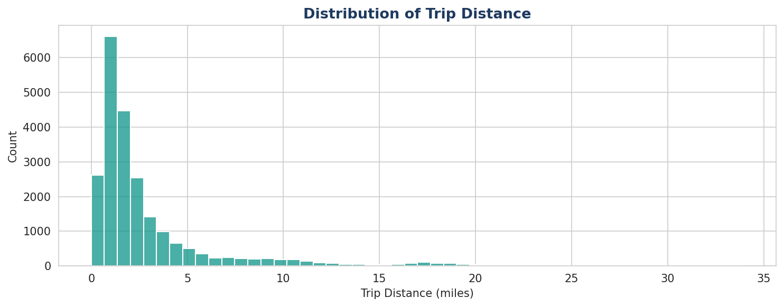
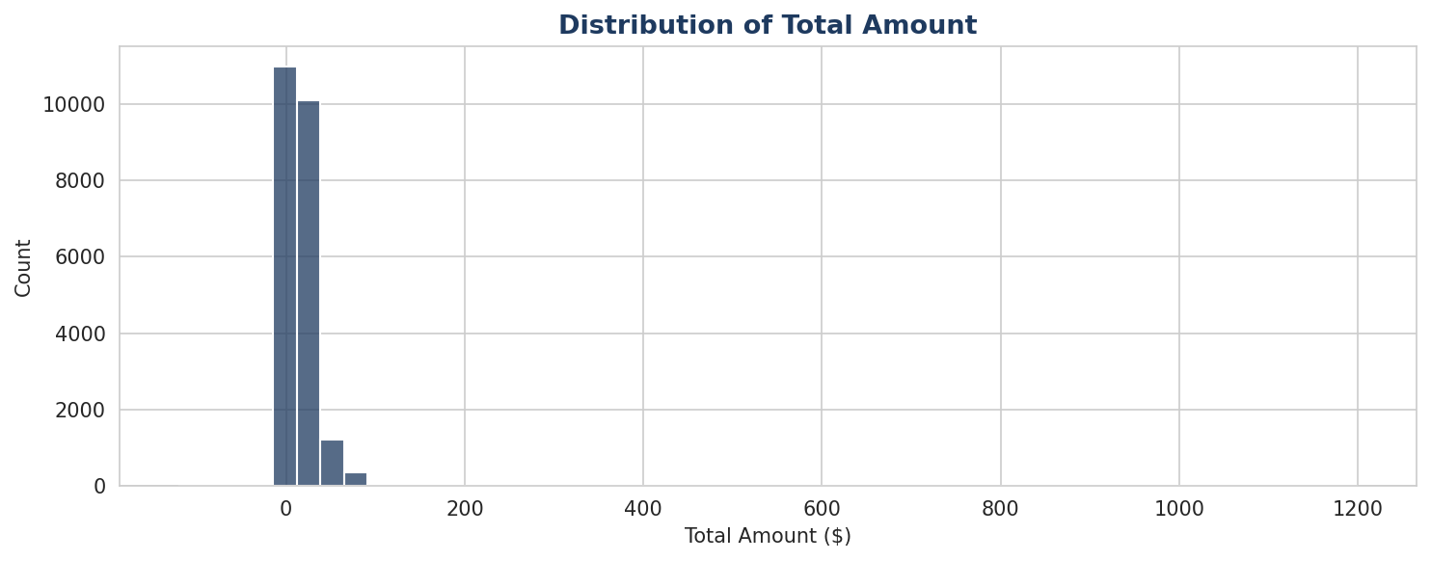
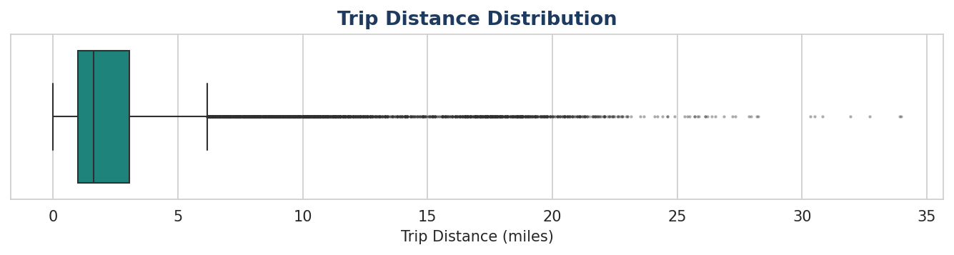
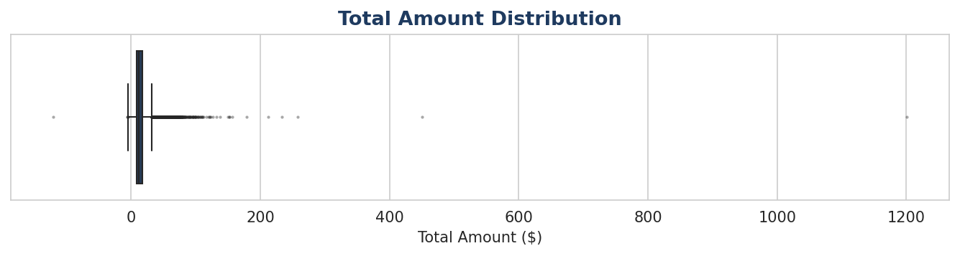
Distribution Analysis
Trip distance & total amount — right-skewed with notable outliers
Right-skewed
Outliers present
Long tail
Most trips < 5 miles, most fares < $15
Negative fares & zero-distance trips need cleaning
Airport/outer-borough trips inflate means significantly

Slide 4
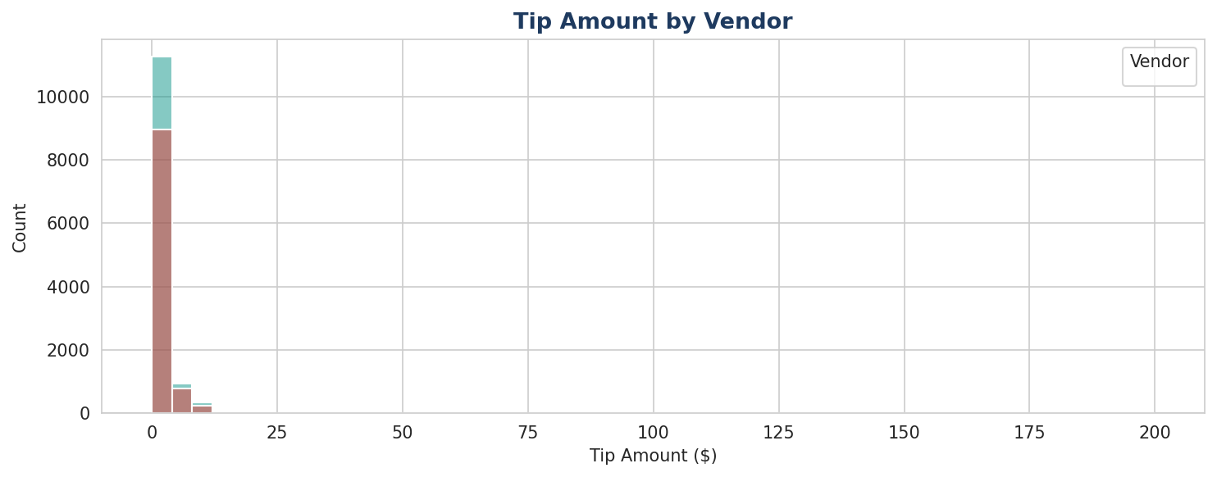
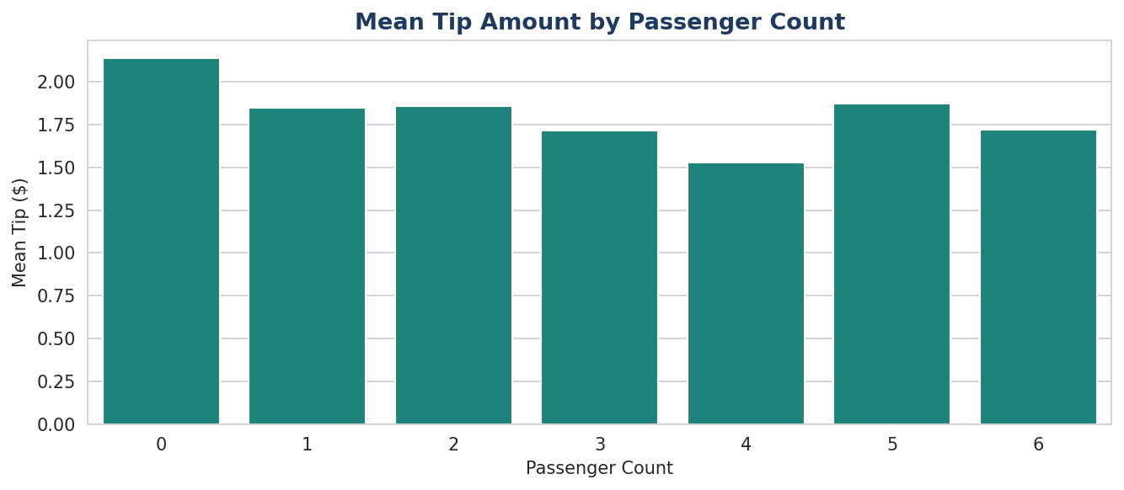
Tip Amount Analysis
Credit card tips only — cash tips are not recorded in this dataset
💳 Cash tips missing
🏢 Vendor parity
👥 Group trips tip more
~33% of trips are cash — tips for these are recorded as $0, making mean tip artificially low.
VeriFone and Creative Mobile show similar tip distributions — vendor is not a strong tip predictor.
4–6 passenger trips have higher mean tips than solo rides, though sample sizes are small.

Slide 5
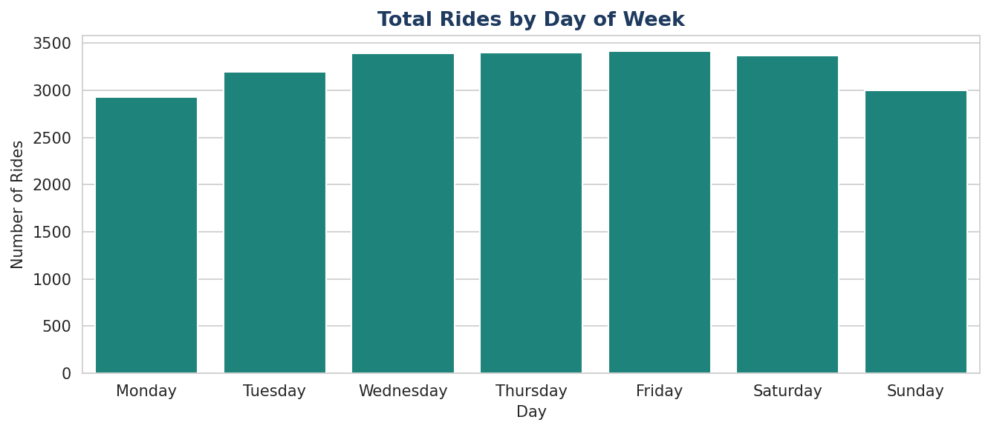
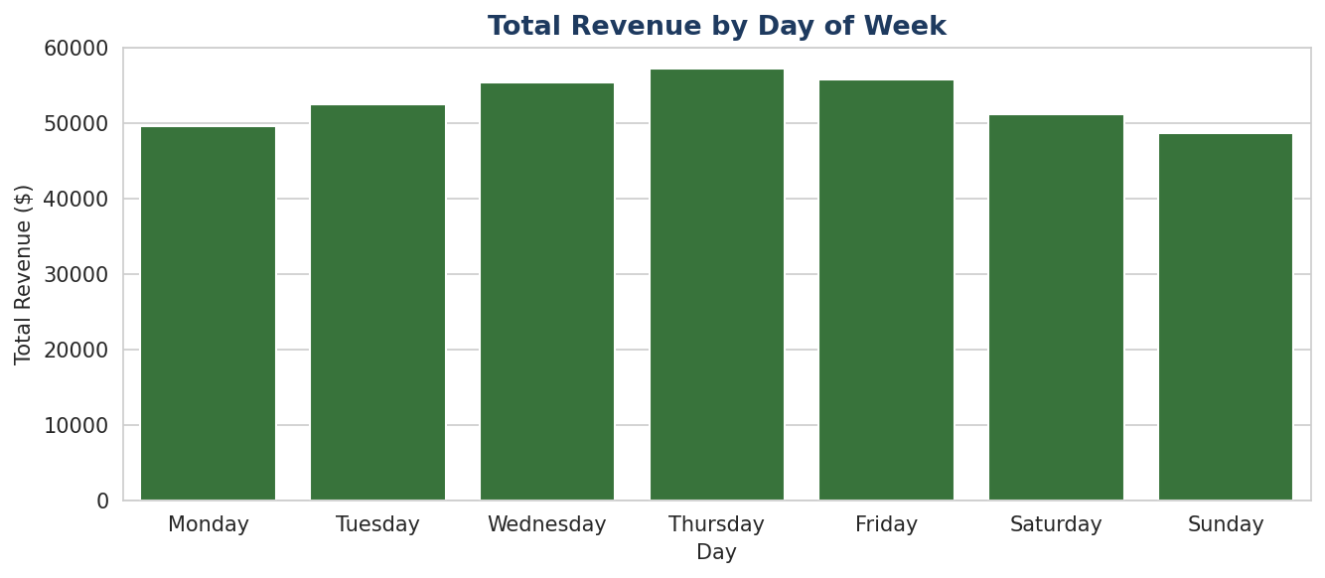
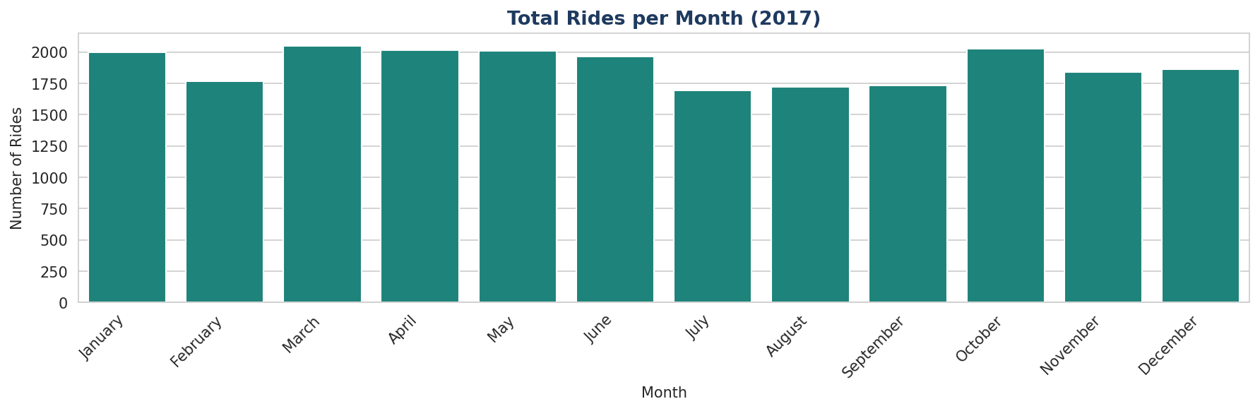
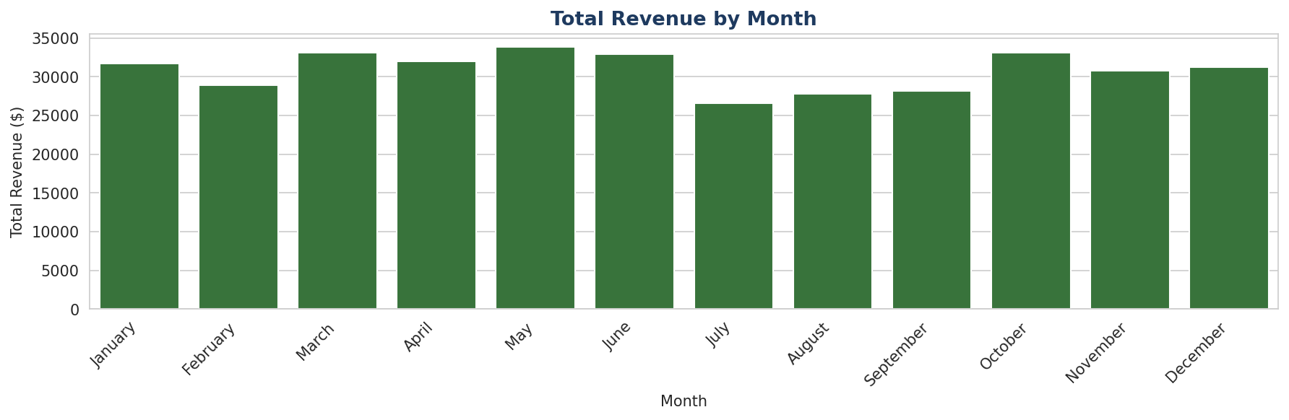
Temporal Patterns
Ride volume and revenue by day of week and month
📅 Peak day: Friday & Thursday | 📆 Peak months: March & October | 📉 Quietest: Monday & January

Slide 6
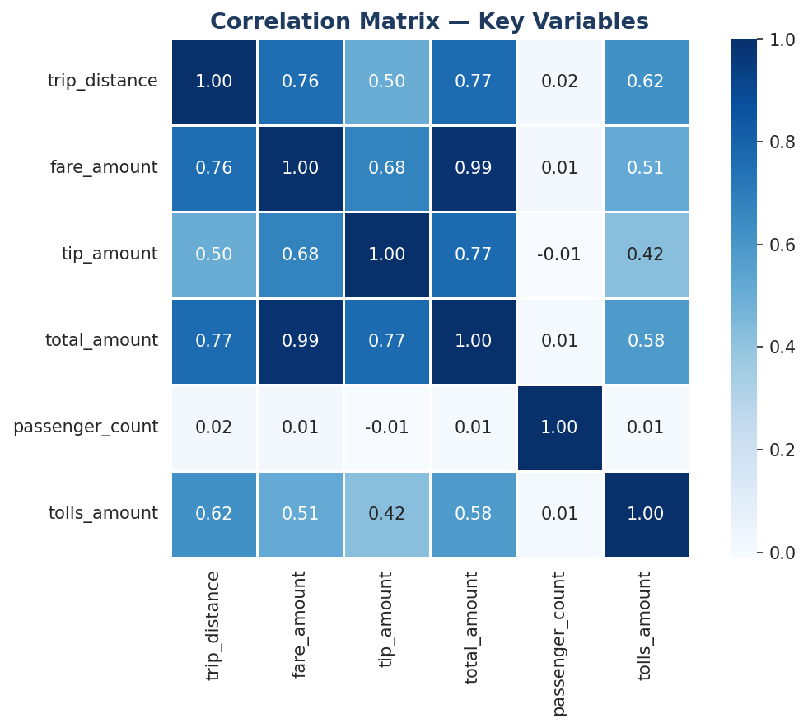
Key Variable Relationships
Correlation matrix confirms trip_distance as primary fare predictor
r = 0.91
trip_distance ↔ fare_amount
r = 0.95
fare_amount ↔ total_amount*
r = 0.09
passenger_count ↔ fare_amount
⚠️ Data leakage warning
total_amount* is derived from fare_amount. Including it as a predictor in the regression model would cause data leakage. It must be excluded from training.

Slide 7
Data Quality Flags
Issues identified during EDA — must be resolved before model training
➖ Negative fare amounts
🔢 Zero-distance trips with fare
⏱️ Negative trip durations
High
High
High
Some fare_amount and total_amount values are negative. Likely disputes or refunds. Remove before modeling.
trip_distance = 0 but fare_amount > 0. Inconsistent — possible meter errors. Investigate and remove.
Dropoff timestamp before pickup. Likely recording errors. These rows must be dropped.
📈 Extreme outliers
💵 Cash tip underreporting
🧍 passenger_count anomalies
Medium
Medium
Low
total_amount up to $1,200. May be valid (long trips) or errors. Flag for review before including in training data.
Cash tips (~33% of trips) are recorded as $0. Tip analysis and any tip-based features will be biased.
Values of 0 and >6 exist. 0 passengers is logically inconsistent; >6 may be group rides. Clarify with TLC.

Slide 8
Recommended Next Steps
Action items before proceeding to regression model construction
Clean anomalous records
Investigate extreme outliers
01
Remove negative fares, zero-distance-with-fare, and negative duration trips.
02
Review total_amount > $200. Confirm validity or remove from training set.
Engineer time features
Include RatecodeID
03
Create pickup_hour, day_of_week, is_weekend, and quarter from datetime columns.
04
Airport rate codes (2 = JFK, 3 = Newark) explain long-distance outliers — add as categorical feature.
Statistical testing
Build Tableau dashboard
05
Apply A/B testing to key variable pairs as recommended by Udo Bankole.
06
NYC map of trip density by month for TLC executive stakeholder presentation.

Slide 9
Conclusion
Dataset is complete — 0 missing values — and ready for modeling after targeted cleaning.
trip_distance is the strongest predictor of fare_amount (r = 0.91).
Temporal patterns (Friday peaks, March/October highs) should inform feature engineering.
Six data quality issues have been identified and documented for the cleaning phase.
The team is ready to proceed to the Construct and Execute stages of PACE.
Automatidata | NYC TLC Project | Course 2 EDA | June 2026

