Slide 1
Team 08
Name: Walid Ibne Hasan
ID: 20301103
ST: Sadiul Arefin Rafi
RA: MD Humaion Kabir Mehedi
Section: 01

Slide 2
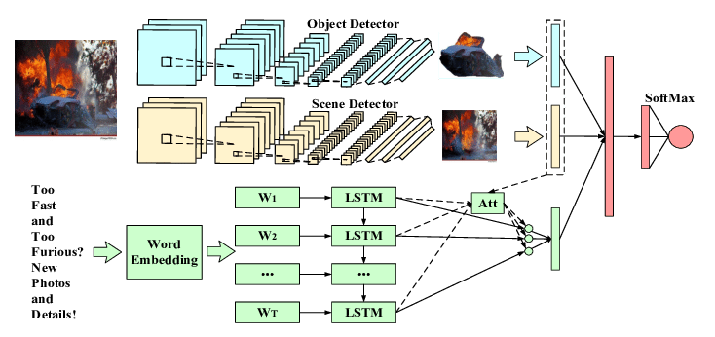
Multimodal Sentiment Analysis With Image-Text Interaction Network

Slide 3
Multimodal Sentiment Analysis
Importance: Booming use of mobile devices and social networks
Potential applications: Personalized advertising, affective cross-modal retrieval, opinion mining, decision making

Slide 4
Challenges and Opportunities
Early Multimodal Approaches
Advancements
Proposed Method
Handcrafted features limitations
Deep learning
Convolutional neural networks
Image-Text Interaction Network (ITIN)
Align affective regions in images with corresponding words in text
Capture cross-modal interactions effectively

Slide 5
Methodology
Cross-modal alignment module
Cross-modal gating module
Fuses multimodal features adaptively
Strengthens interaction between image and text
Integration of individual-modal context representations
Comprehensively analyze multimodal sentiment
Cross-modal attention mechanism selects word-level textual information for each image region

Slide 6
Contributions and Results
Contributions of the paper
Superiority of proposed method
Outperforms baselines in accuracy and F1-score
Ablation studies conducted to analyze module contributions
Image-Text Interaction Network
Cross-modal alignment and gating modules
Incorporation of individual-modal context features

Slide 7
Conclusion and Future Directions
Importance of multimodal sentiment analysis
Joint effect of multiple modalities for accurate sentiment evaluation
Possibilities for personalized advertising, affective cross-modal retrieval, opinion mining, decision making
Research advancements in understanding and interpreting emotions
Future directions in the field

Slide 8
Thank You
THE END

