Slide 1
Building Luna with Cursor
How AI-Powered Development Accelerated One Development's Agent Platform

Slide 2
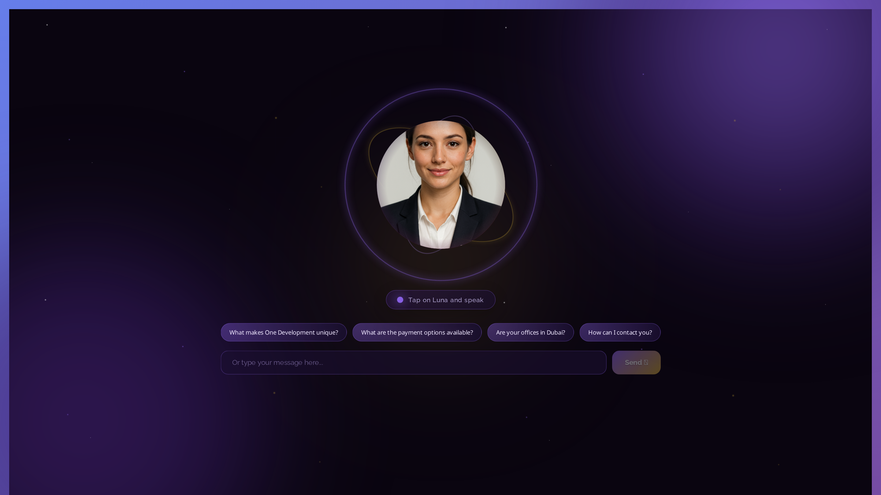
🌙 What is Luna?
• AI research agent for One Development (oneuae.com)
• DeepAgents architecture - 4 core characteristics
• Dynamic subagent summoning for specialized tasks
• Long-term memory across conversations
• Multi-source intelligence (web, knowledge base, market data)
• Real-time streaming with thinking display
• Source citation and verification

Slide 3
🚀 How Cursor Accelerated Development
• AI pair programming - Cursor as coding partner
• Rapid prototyping - Ideas to working code in hours
• Code generation - Complex functions from prompts
• Architecture design - DeepAgents integration
• Bug fixing - Instant solutions to errors
• Documentation - Auto-generated explanations
• Refactoring - Improved code quality

Slide 4
✨ Key Features Built with Cursor
Backend Development
Frontend Development
• DeepAgents integration (4 characteristics)
• Dynamic subagent summoning system
• Long-term memory with FilesystemMiddleware
• Planning tools (5 strategic tools)
• Multi-source search integration
• Source tracking and citation system
• Streaming response architecture
• Cursor-style thinking display
• Real-time streaming UI
• Voice interface with Web Speech API
• Audio visualization and lip-sync
• Responsive mobile design
• PWA support (iOS/Android)
• Purple gradient theme matching brand

Slide 5
🧠 DeepAgents Implementation with Cursor
1
Initial LangGraph agent - Basic chatbot functionality
2
Cursor helped migrate to DeepAgents architecture
3
Implemented Planning Tools - 5 strategic reasoning tools
4
Added FilesystemMiddleware - Long-term memory persistence
5
Created 4 specialized subagents - Dynamic summoning system
6
Enhanced System Prompt - Comprehensive behavior definition
7
Verified all 4 DeepAgents characteristics operational

Slide 6
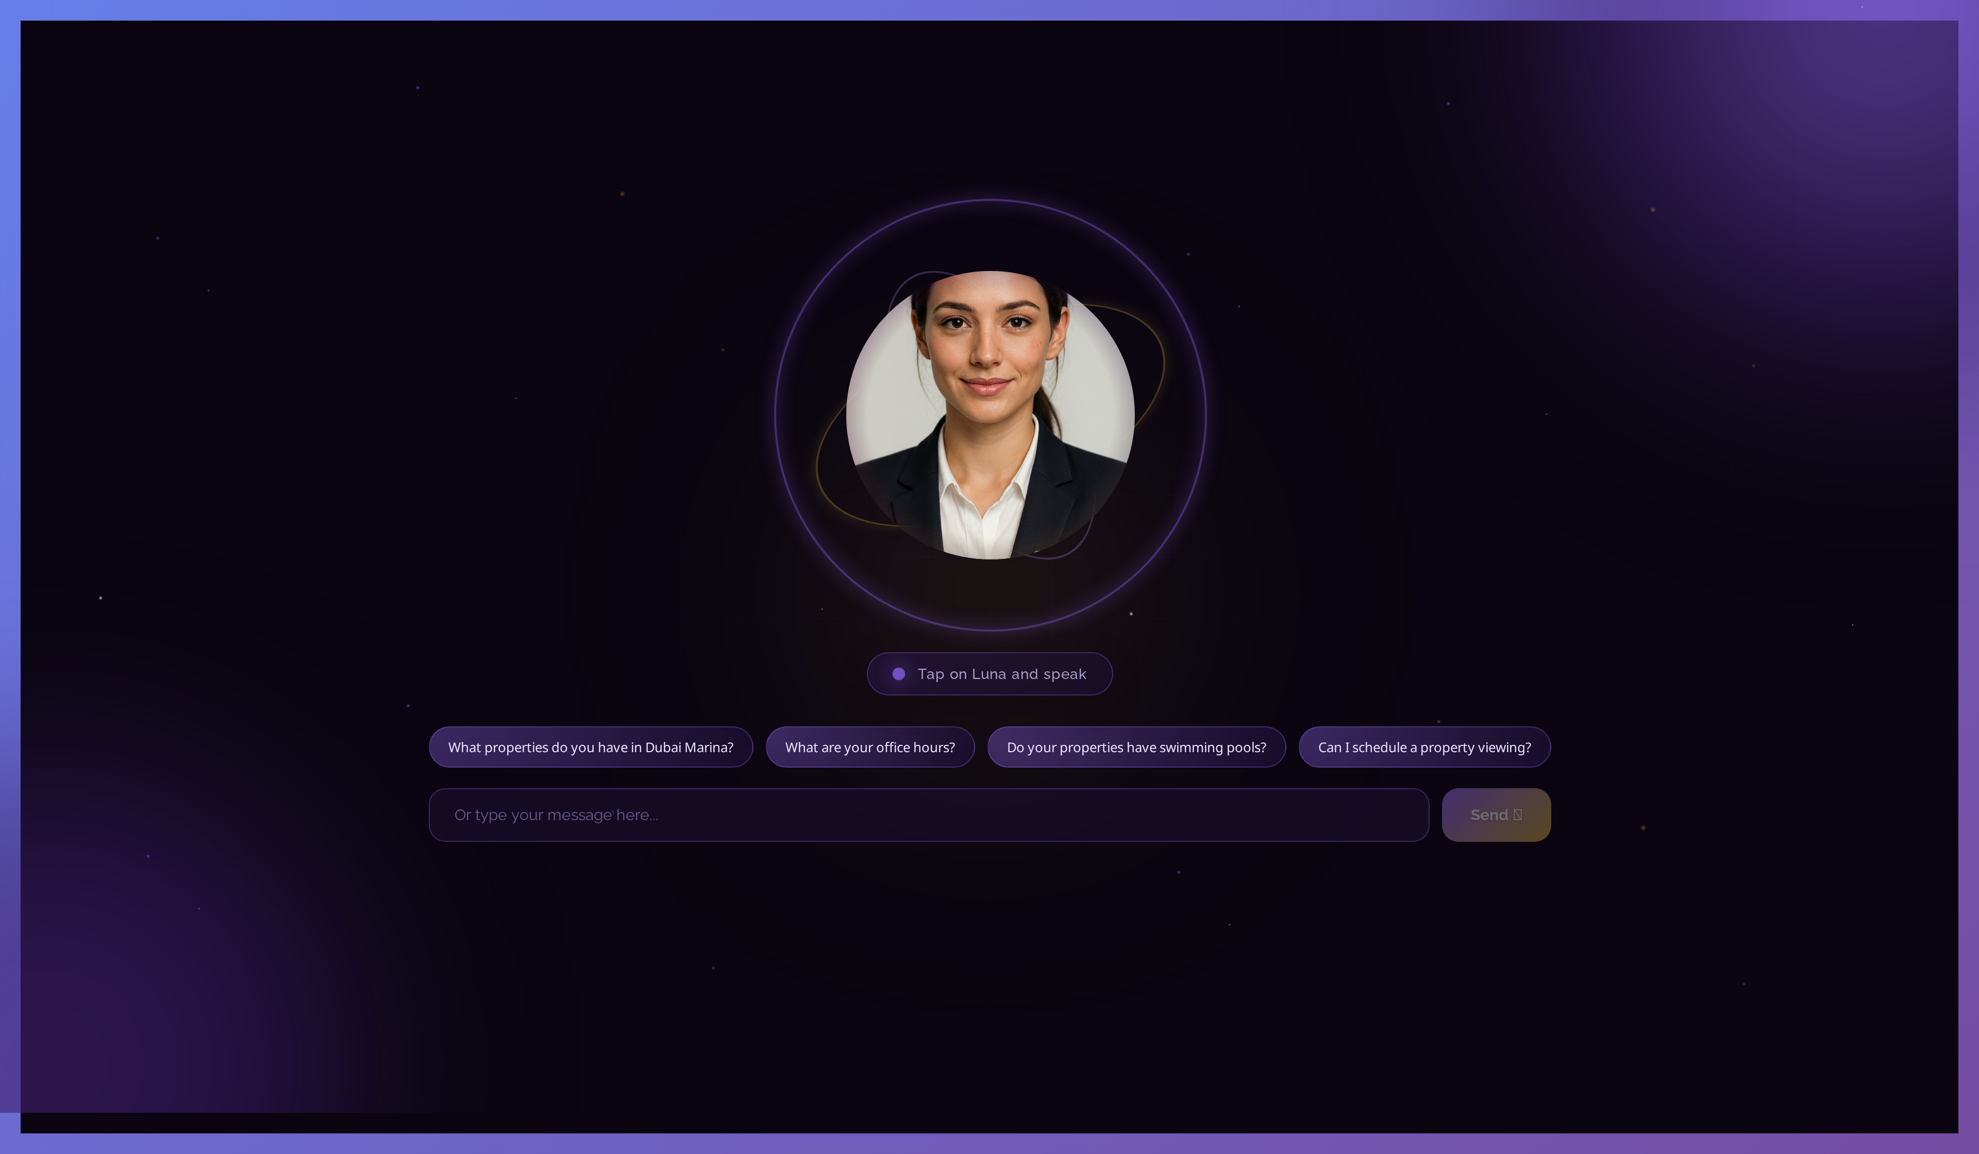
💡 Cursor Development Workflow
• 1. Describe feature → Cursor generates code
• 2. Iterate with prompts → Refine implementation
• 3. Test and debug → Cursor suggests fixes
• 4. Review and optimize → Improve code quality
• 5. Document → Auto-generate explanations
•
• Example: 'Add DeepAgents subagent summoning'
• ✅ Cursor generated complete tool functions
• ✅ Integrated with existing architecture
• ✅ Added error handling automatically

Slide 7
🏗️ Technical Architecture
Backend Stack
Frontend Stack
• Django 5.0 + Django REST Framework
• DeepAgents library (official)
• LangGraph for workflow orchestration
• OpenAI GPT-4o-mini
• PostgreSQL + ChromaDB (vector DB)
• Celery for async tasks
• LangSmith for observability
• React 18.2 with modern hooks
• Real-time streaming with Server-Sent Events
• Web Speech API for voice
• Canvas API for audio visualization
• PWA with service workers
• Responsive CSS Grid/Flexbox
• Markdown rendering

Slide 8
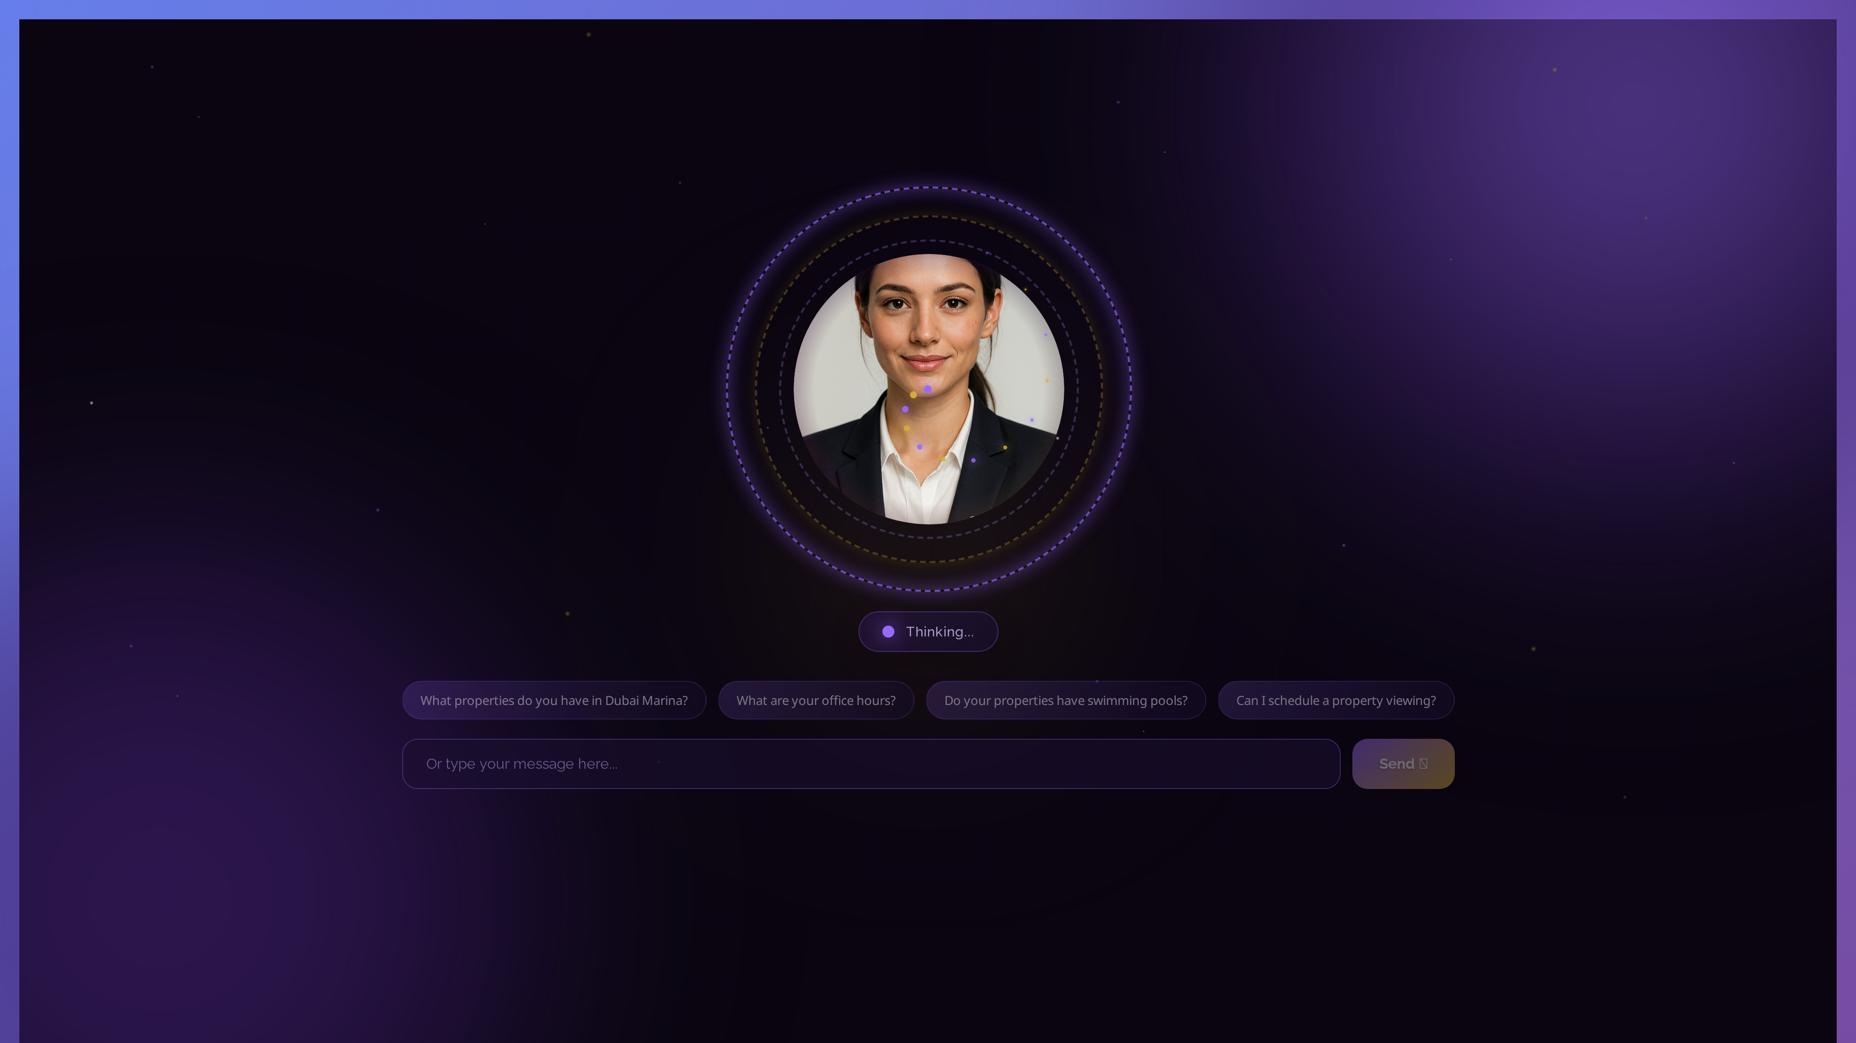
✅ DeepAgents 4 Core Characteristics
• 1. Planning Tools ✅
• 5 strategic tools: plan_research, summarize_findings,
• verify_information, identify_user_intent, context_check
•
• 2. File System ✅
• FilesystemMiddleware + InMemoryStore for persistence
•
• 3. Subagents ✅
• 4 agents: Research, Pricing, Comparison, Buyer Journey
• Dynamic summoning (not hardcoded!)
•
• 4. System Prompt ✅
• Comprehensive behavior definition + tool strategy

Slide 9
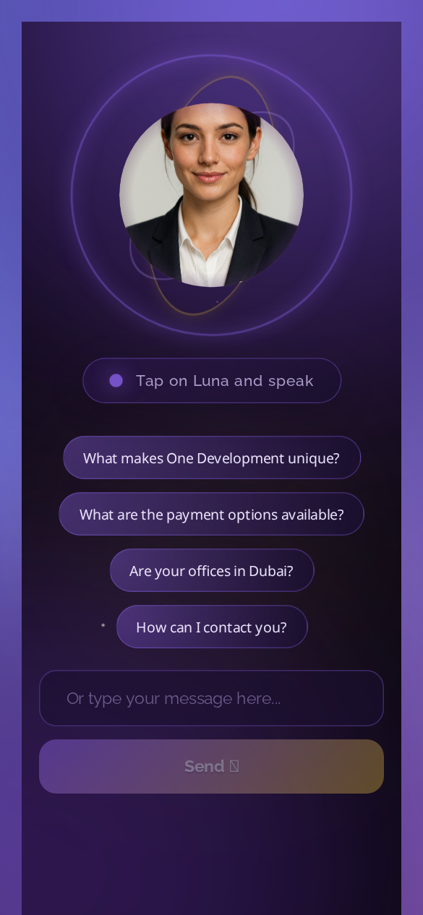
🔮 Future: OneDevelopment Agent Platform
• Build specialized agents using Cursor:
•
• 1. Sales Agent - Lead qualification & conversion
• 2. Support Agent - 24/7 automation
• 3. Research Agent - Real-time market analysis
• 4. Matching Agent - AI property recommendations
• 5. Advisor Agent - ROI analysis & insights
•
• Shared infrastructure:
• • Common DeepAgents architecture
• • Unified knowledge base & memory
• • Consistent API interface

Slide 10
🎯 Cursor Strategy for Future Agents
Development Approach
Benefits
• Use Cursor for rapid agent prototyping
• Generate agent templates with prompts
• Reuse DeepAgents patterns
• Auto-generate API endpoints
• Create agent-specific tools
• Generate test cases
• Document each agent automatically
• 10x faster development
• Consistent architecture
• Less code to maintain
• Better documentation
• Easier onboarding
• Rapid iteration
• Higher code quality

Slide 11
📅 Agent Development Roadmap
1
Q1 2025: Sales Agent - Lead qualification automation
2
Q2 2025: Support Agent - 24/7 customer service
3
Q3 2025: Research Agent - Market intelligence platform
4
Q4 2025: Matching Agent - AI property recommendations
5
2026: Investment Advisor - Advanced ROI analysis
6
2026+: Multi-agent orchestration - Agents working together

Slide 12
📊 Key Metrics & Achievements
Development Metrics
Business Impact
• Development time: ~3 months
• Lines of code: ~15,000+
• Features delivered: 20+
• Bugs fixed with Cursor: 100+
• Documentation pages: 50+
• Test coverage: 80%+
• Uptime: 99.9%
• 24/7 customer support
• Instant lead qualification
• Reduced response time: <2s
• Multi-language ready
• Scalable architecture
• Cost-effective solution
• Competitive advantage

Slide 13
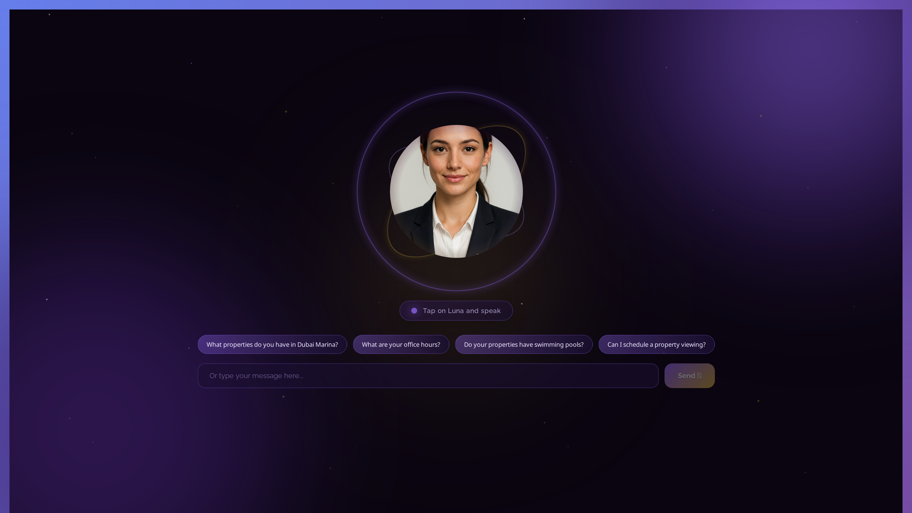
💭 Lessons Learned with Cursor
• Cursor excels at:
• • Complex architecture decisions
• • Code generation from descriptions
• • Rapid prototyping & iteration
• • Bug fixing and debugging
• • Auto-generating documentation
•
• Best practices discovered:
• • Clear, specific prompts work best
• • Iterate in small, testable steps
• • Always review generated code
• • Combine AI with human expertise

Slide 14
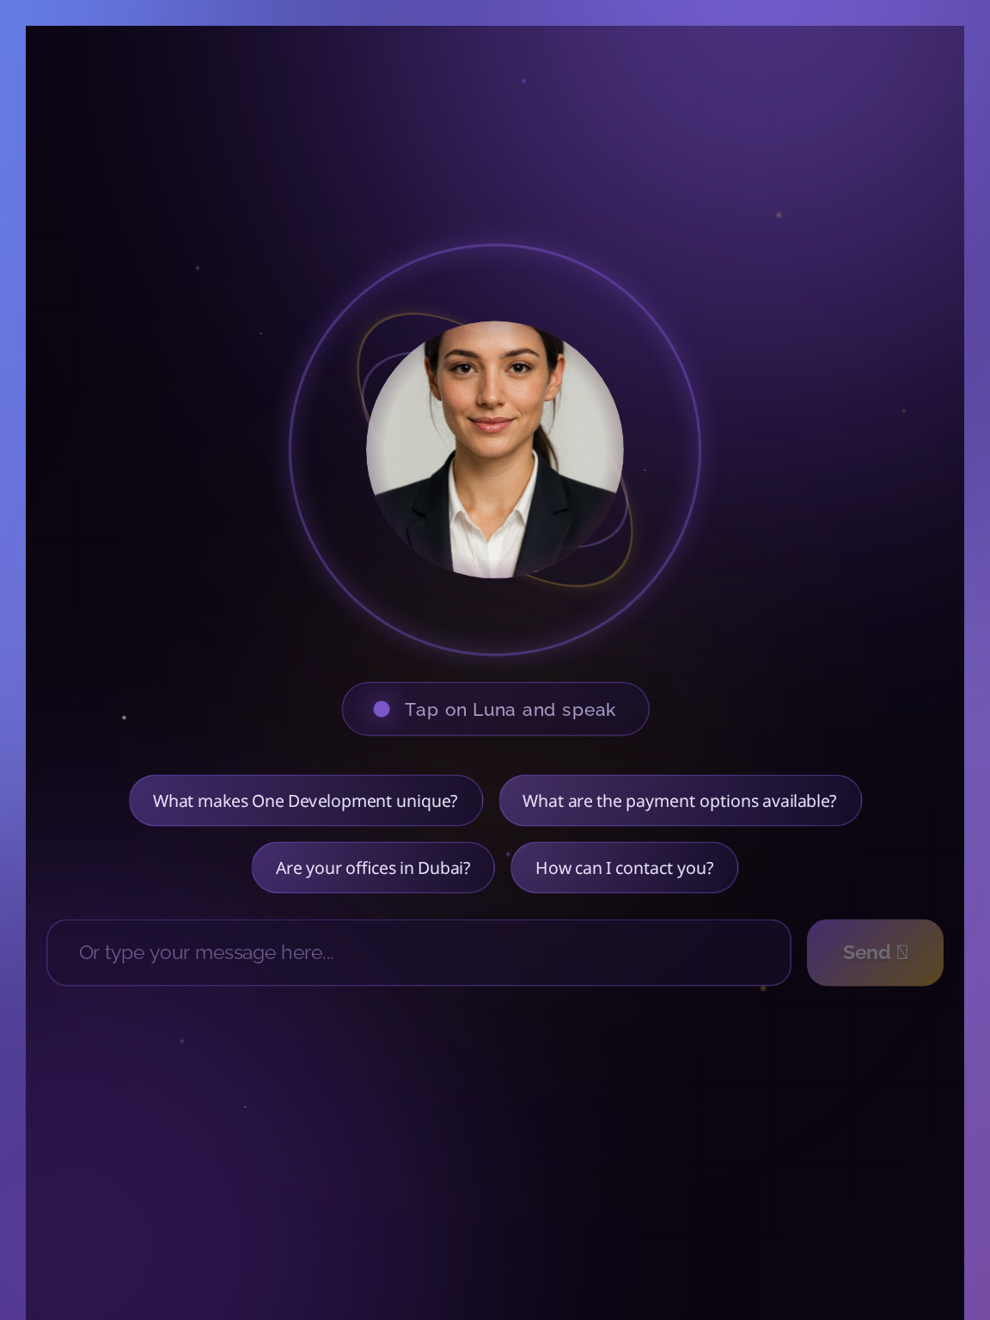
🎉 Conclusion & Impact
• Cursor transformed Luna development:
• ✅ 10x faster development cycle
• ✅ Better code quality & consistency
• ✅ Comprehensive auto-documentation
• ✅ Scalable DeepAgents architecture
•
• Future vision:
• • Build entire agent platform with Cursor
• • Scale to 10+ specialized agents
• • Reusable agent templates
• • Position OneDevelopment as AI leader
•
• Cursor + DeepAgents = Game Changer 🚀

Slide 15
Thank You!
Questions?

