Slide 1
🌙 Luna - OneDevelopment Agent
Complete AI Platform Built with Cursor | December 2024

Slide 2
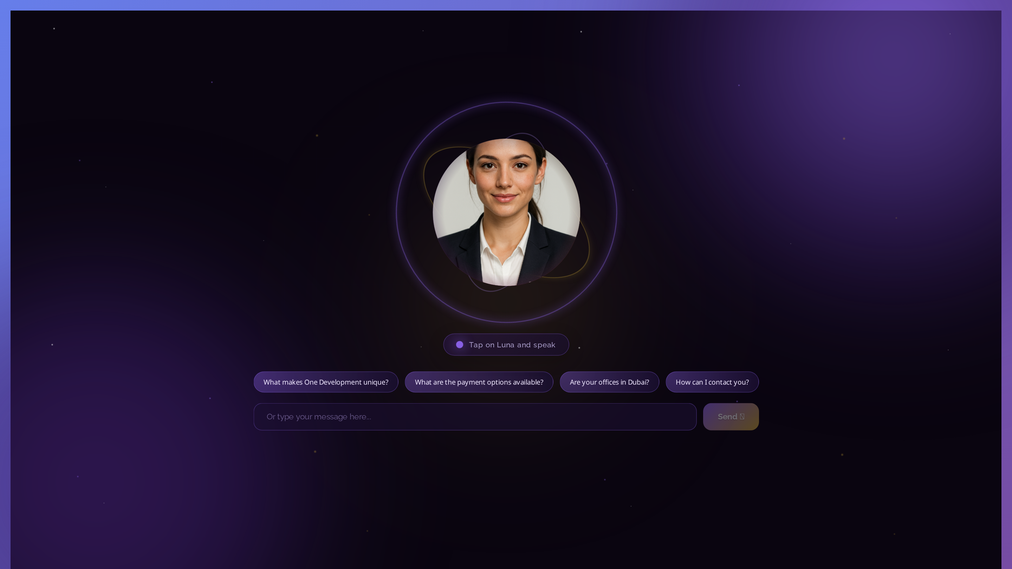
📋 Project Overview
• Full-stack AI agent platform for One Development (UAE)
• Built entirely using Cursor AI pair programming
• ~15,000+ lines of code across backend + frontend
• Production-ready deployment on AWS EC2
• Real-time streaming responses
• Multi-source intelligence system
• Voice interface with TTS/avatar support
• Context-aware memory management

Slide 3
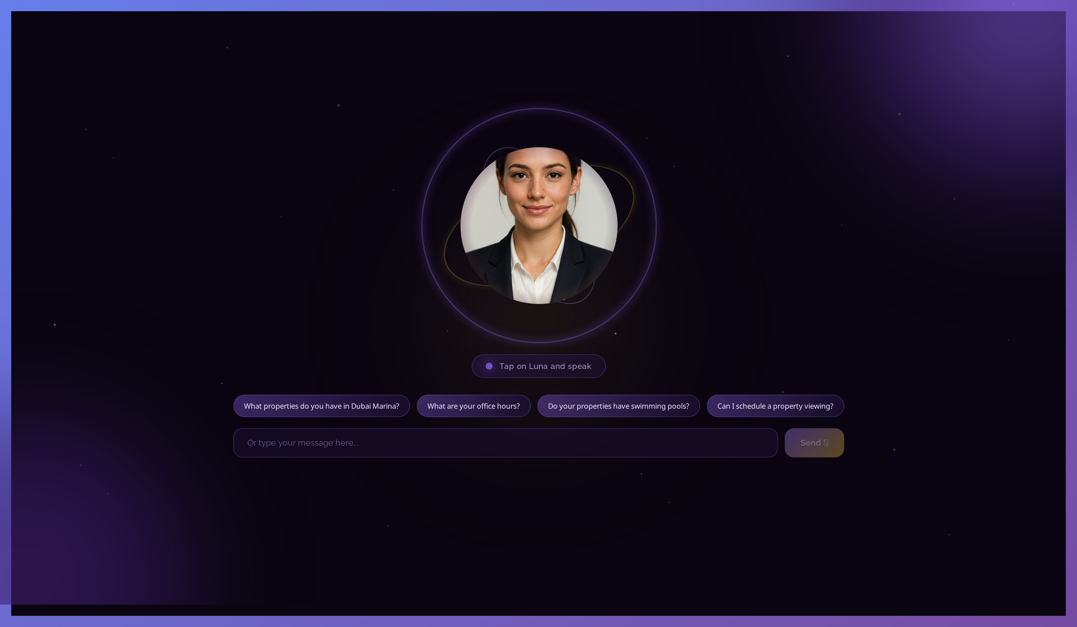
🌙 What is Luna?
• AI research agent for One Development real estate
• DeepAgents architecture - 4 core characteristics
• Dynamic subagent summoning (not hardcoded!)
• Long-term memory persistence across sessions
• Multi-source search (web, knowledge base, PDFs)
• Real-time streaming with thinking display
• Source citation and verification system
• Never says 'I don't know' - always finds answers

Slide 4
🛠️ Technology Stack
Backend (Python)
Frontend (JavaScript)
• Django 5.0 + Django REST Framework
• DeepAgents library (official)
• LangGraph for workflow orchestration
• OpenAI GPT-4o-mini / GPT-4o
• PostgreSQL + ChromaDB (vector)
• Celery for async tasks
• LangSmith for observability
• BeautifulSoup + Scrapy for scraping
• React 18.2 with modern hooks
• Real-time SSE streaming
• Web Speech API for voice
• Canvas API for audio visualization
• PWA support (iOS/Android)
• Responsive CSS Grid/Flexbox
• ReactMarkdown for formatting
• UUID for session management

Slide 5
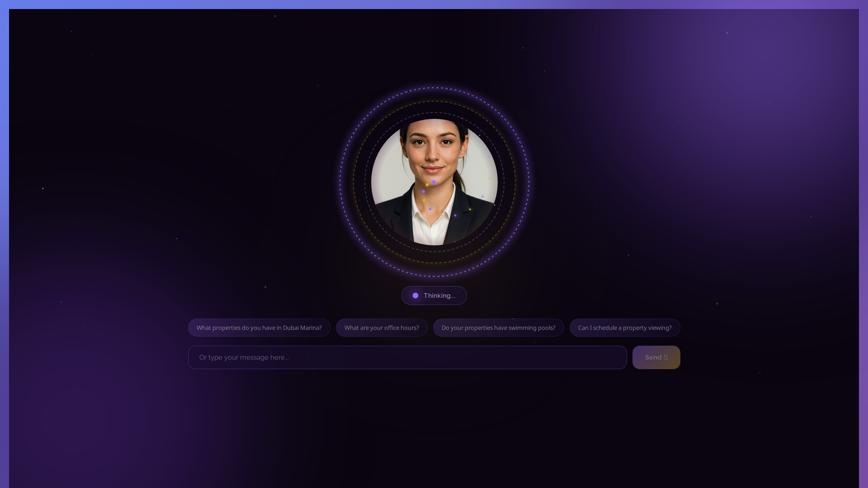
🧠 DeepAgents 4 Core Characteristics
• 1. Planning Tools ✅
• plan_research, summarize_findings, verify_information
• identify_user_intent, check_conversation_context
• 2. File System ✅
• FilesystemMiddleware + InMemoryStore for persistence
• 3. Subagents ✅
• 4 specialists: Research, Pricing, Comparison, Buyer Journey
• Dynamic summoning via tools (not hardcoded!)
• 4. System Prompt ✅
• Comprehensive behavior + tool strategy + decision trees

Slide 6
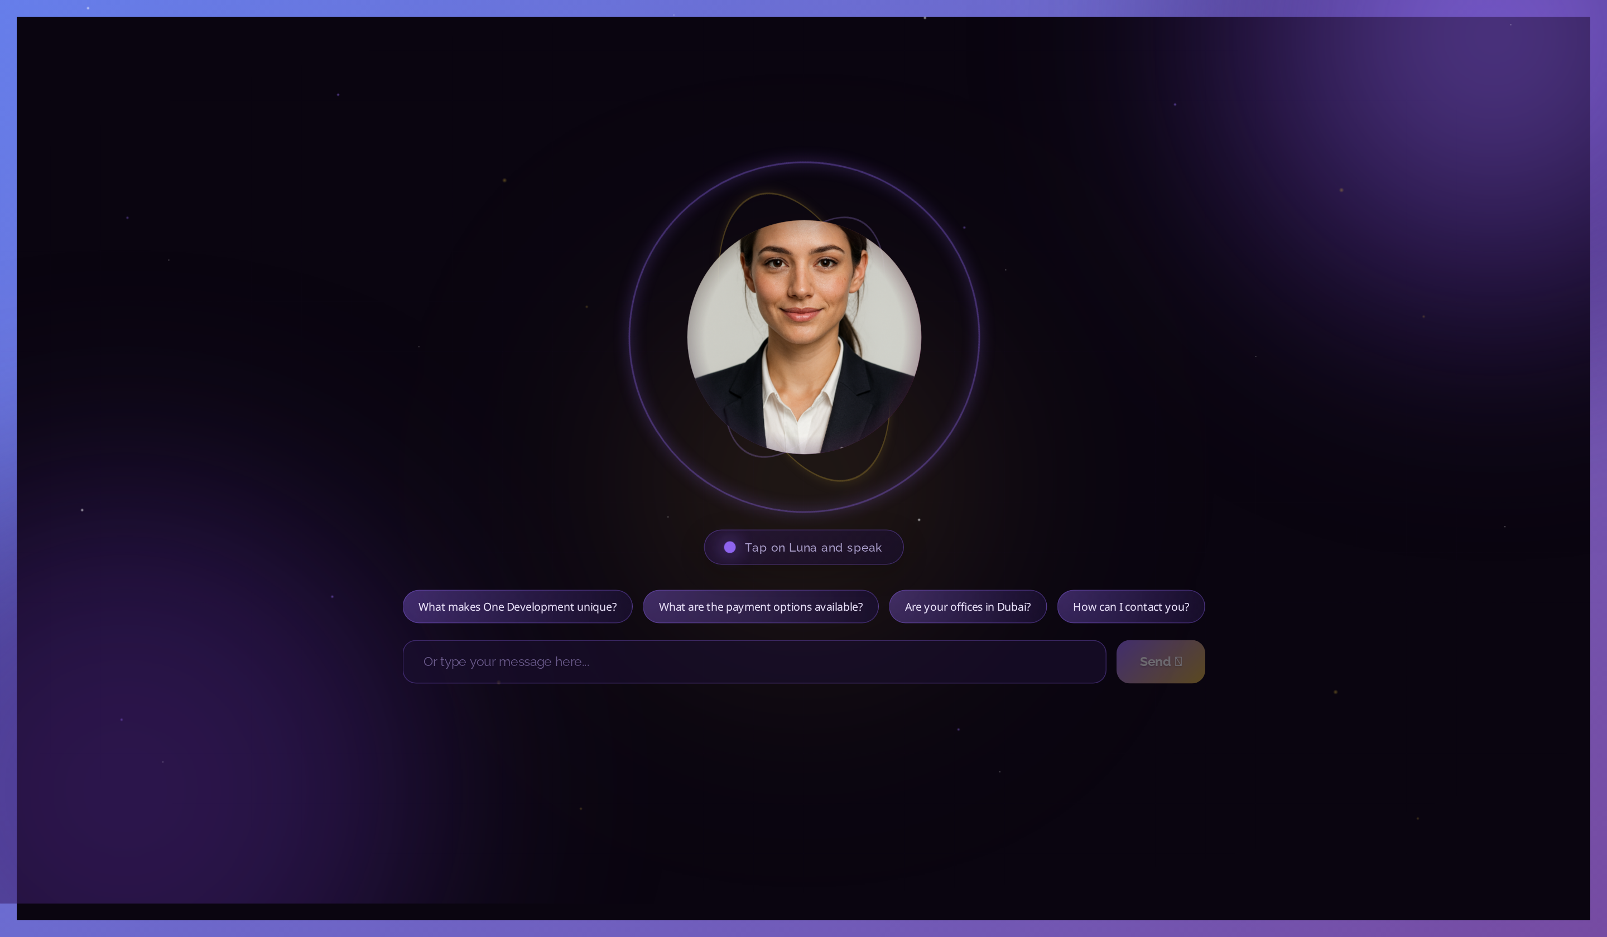
⚙️ Backend Components Built
Core Agent System
✓ luna_deepagent.py - Main DeepAgent implementation
✓ streaming_agent.py - Real-time response streaming
✓ subagents.py - 4 specialized subagents
Tools & Intelligence
✓ tools.py - 15+ integrated tools
✓ web_tools.py - Tavily & web search
✓ deepagents_tools.py - 5 planning tools
Data Processing
✓ pdf_processor.py - PDF upload & parsing
✓ data_ingestor.py - Multi-source ingestion
✓ source_tracker.py - Citation tracking

Slide 7
⚙️ Backend Components (Continued)
Memory & Context
✓ memory_manager.py - Long-term memory
✓ context_monitor.py - Token tracking
✓ verification_guardrails.py - Fact checking
API & Admin
✓ views.py - REST API endpoints
✓ admin.py - Django admin customization
✓ models.py - Database models
Database Models
✓ Conversation, Message, KnowledgeBase
✓ AgentMemory, SuggestedQuestion

Slide 8
🎨 Frontend Components
Main Components
Features Implemented
• LunaFreeInterface.js (2100+ lines)
• ChatInterface.js - Core chat logic
• ChatInterfaceWithSidebar.js
• Sidebar.js - Conversation history
• App.js - Main application
• Real-time streaming responses
• Cursor-style thinking display
• Conversation history sidebar
• Context monitor widget
• Voice input/output
• Audio visualization
• Responsive design (mobile/tablet)
• PWA support

Slide 9
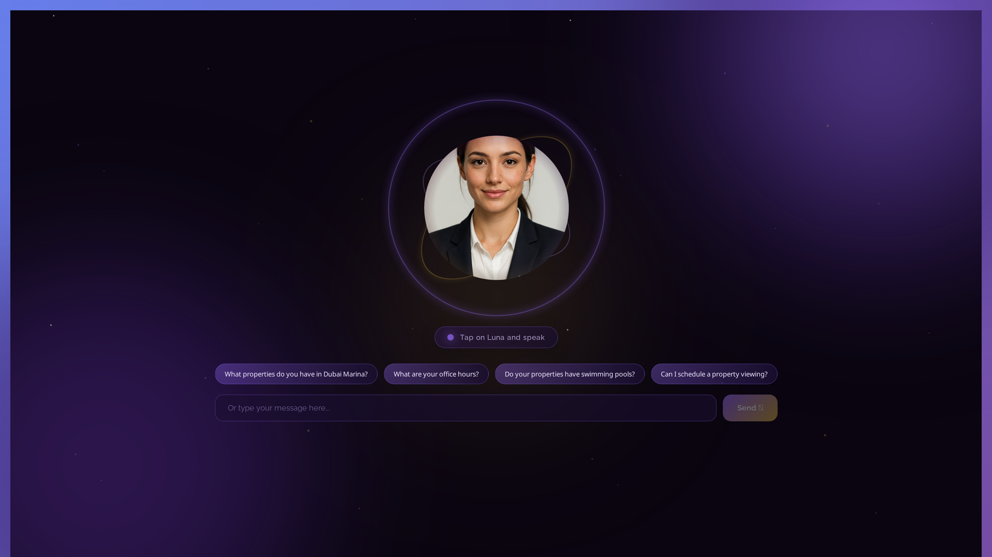
💬 Conversation Management
• Persistent conversation history
• Multiple chat sessions
• New conversation button
• Delete individual/all conversations
• Auto-save conversations
• Resume previous chats
• Session-based memory
• Context preservation

Slide 10
📊 Context Monitor Feature
• Real-time token usage tracking
• Visual progress indicator
• Context window percentage
• Auto-context management
• Warning at high usage
• Helps maintain conversation quality
• Prevents context overflow
• Backend API endpoint integration

Slide 11
🎭 Avatar Service (Talking Luna)
TTS Options Implemented
Lip-Sync Technologies
• OpenAI TTS (high quality)
• Edge TTS (free alternative)
• Multiple voice options
• Audio streaming support
• Temp audio file management
• SadTalker integration
• Wav2Lip support
• LivePortrait option
• GPU acceleration (CUDA)
• Real-time video generation
• AWS GPU deployment ready
• Windows + Linux support

Slide 12
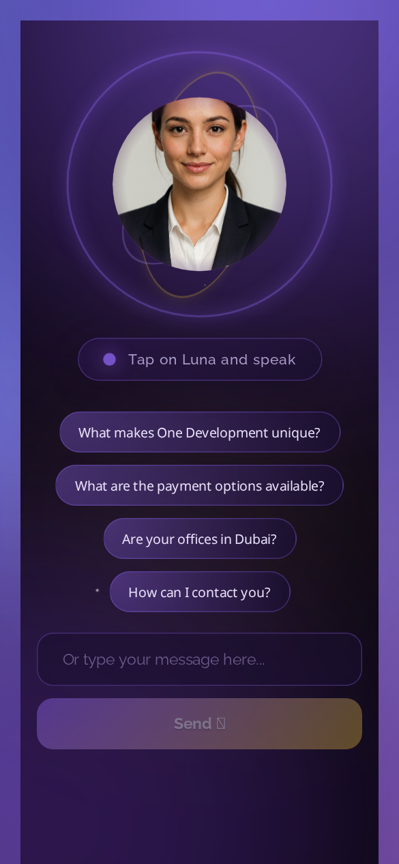
🎤 Voice Interface
• Web Speech API integration (100% free)
• Voice input - speech to text
• Voice output - text to speech
• Audio waveform visualization
• CSS-powered lip-sync simulation
• Multiple TTS voice options
• Browser-native implementation
• No paid API required for basic voice

Slide 13
🔍 Multi-Source Intelligence
• Knowledge base search (ChromaDB vectors)
• Web search (Tavily AI-optimized)
• PDF document search
• Property portal integration (future)
• One Development website scraping
• Market data context
• Dubai real estate intelligence
• Source tracking & citation

Slide 14
📚 Source Tracking & Verification
• Automatic source extraction from tools
• Inline citations in responses
• Clickable source links
• Perplexity/Copilot-style citations
• Web search result attribution
• Knowledge base source tracking
• Verification guardrails
• Fact-checking integration

Slide 15
📱 Responsive Design
• Desktop (1920px+)
• Laptop (1280px)
• Tablet (768px)
• Mobile (390px)
• PWA support - installable app
• iOS & Android icons
• Touch-friendly interface
• Adaptive layouts

Slide 16
🚀 How Cursor Accelerated Development
• AI pair programming throughout project
• Rapid prototyping - ideas to code in hours
• Complex function generation from prompts
• Architecture design assistance
• Bug fixing and debugging
• Auto-generated documentation
• Code refactoring and optimization
• Test case generation

Slide 17
💡 Cursor Development Workflow
• 1. Describe feature → Cursor generates code
• 2. Iterate with prompts → Refine implementation
• 3. Test and debug → Cursor suggests fixes
• 4. Review and optimize → Improve quality
• 5. Document → Auto-generate explanations
• Example: DeepAgents Integration
• ✅ Generated complete luna_deepagent.py
• ✅ Created all 4 subagents dynamically
• ✅ Implemented 5 planning tools
• ✅ Auto-documented all features

Slide 18
📁 Key Files Created with Cursor
Backend Files
Frontend Files
• luna_deepagent.py (687 lines)
• streaming_agent.py
• deepagents_tools.py (241 lines)
• subagents.py
• tools.py
• web_tools.py
• source_tracker.py
• context_monitor.py
• LunaFreeInterface.js (2100 lines)
• ChatInterface.js
• Sidebar.js
• LunaFreeInterface.css
• ChatInterface.css
• services/api.js

Slide 19
📖 Documentation Generated
• 50+ documentation files created
• README.md - Full project overview
• DEEPAGENTS-4-CHARACTERISTICS.md
• ARCHITECTURE.md - System design
• SETUP.md - Installation guide
• DEPLOYMENT.md - AWS deployment
• AVATAR_SERVICE/ - TTS guides
• All generated with Cursor assistance

Slide 20
📊 Key Metrics & Achievements
Development Stats
Platform Capabilities
• Development time: ~3 months
• Lines of code: 15,000+
• Backend files: 20+
• Frontend components: 10+
• Documentation pages: 50+
• Avatar service files: 30+
• Tools integrated: 15+
• 24/7 availability
• Response time: <2s average
• Multi-language ready
• Mobile responsive
• Voice enabled
• Context-aware memory
• Source-verified answers

Slide 21
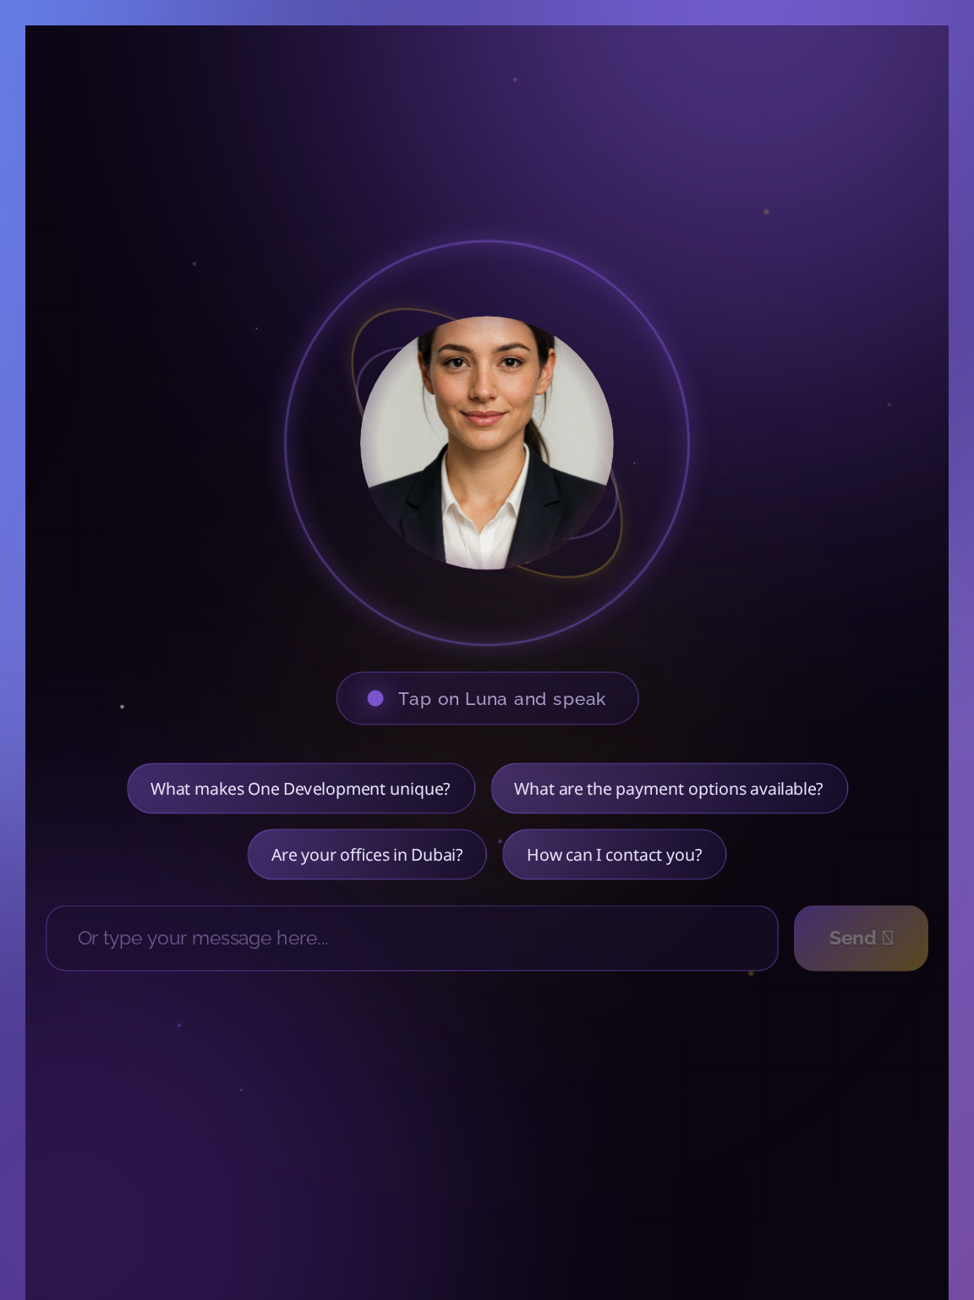
🔮 Future Plans: Agent Platform
• Build specialized agents using Cursor:
• 1. Sales Agent - Lead qualification
• 2. Support Agent - 24/7 automation
• 3. Research Agent - Market analysis
• 4. Matching Agent - Property recommendations
• 5. Advisor Agent - ROI analysis
• All sharing DeepAgents architecture
• Unified knowledge base and memory
• Consistent API interface

Slide 22
🎉 Conclusion
• Complete AI platform built with Cursor:
• ✅ Full-stack implementation (Django + React)
• ✅ DeepAgents architecture with 4 characteristics
• ✅ Avatar service with TTS and lip-sync
• ✅ Voice interface (free Web Speech API)
• ✅ Multi-source intelligence system
• ✅ Production deployed on AWS
• Cursor + DeepAgents = Game Changer 🚀
• One Development positioned as AI leader

Slide 23
Thank You! 🙏
Questions? | github.com/OneDevelopment-Agent

