Slide 1
Luna AI with Cursor
Complete Overview of OneDevelopment-Agent Repository

Slide 2
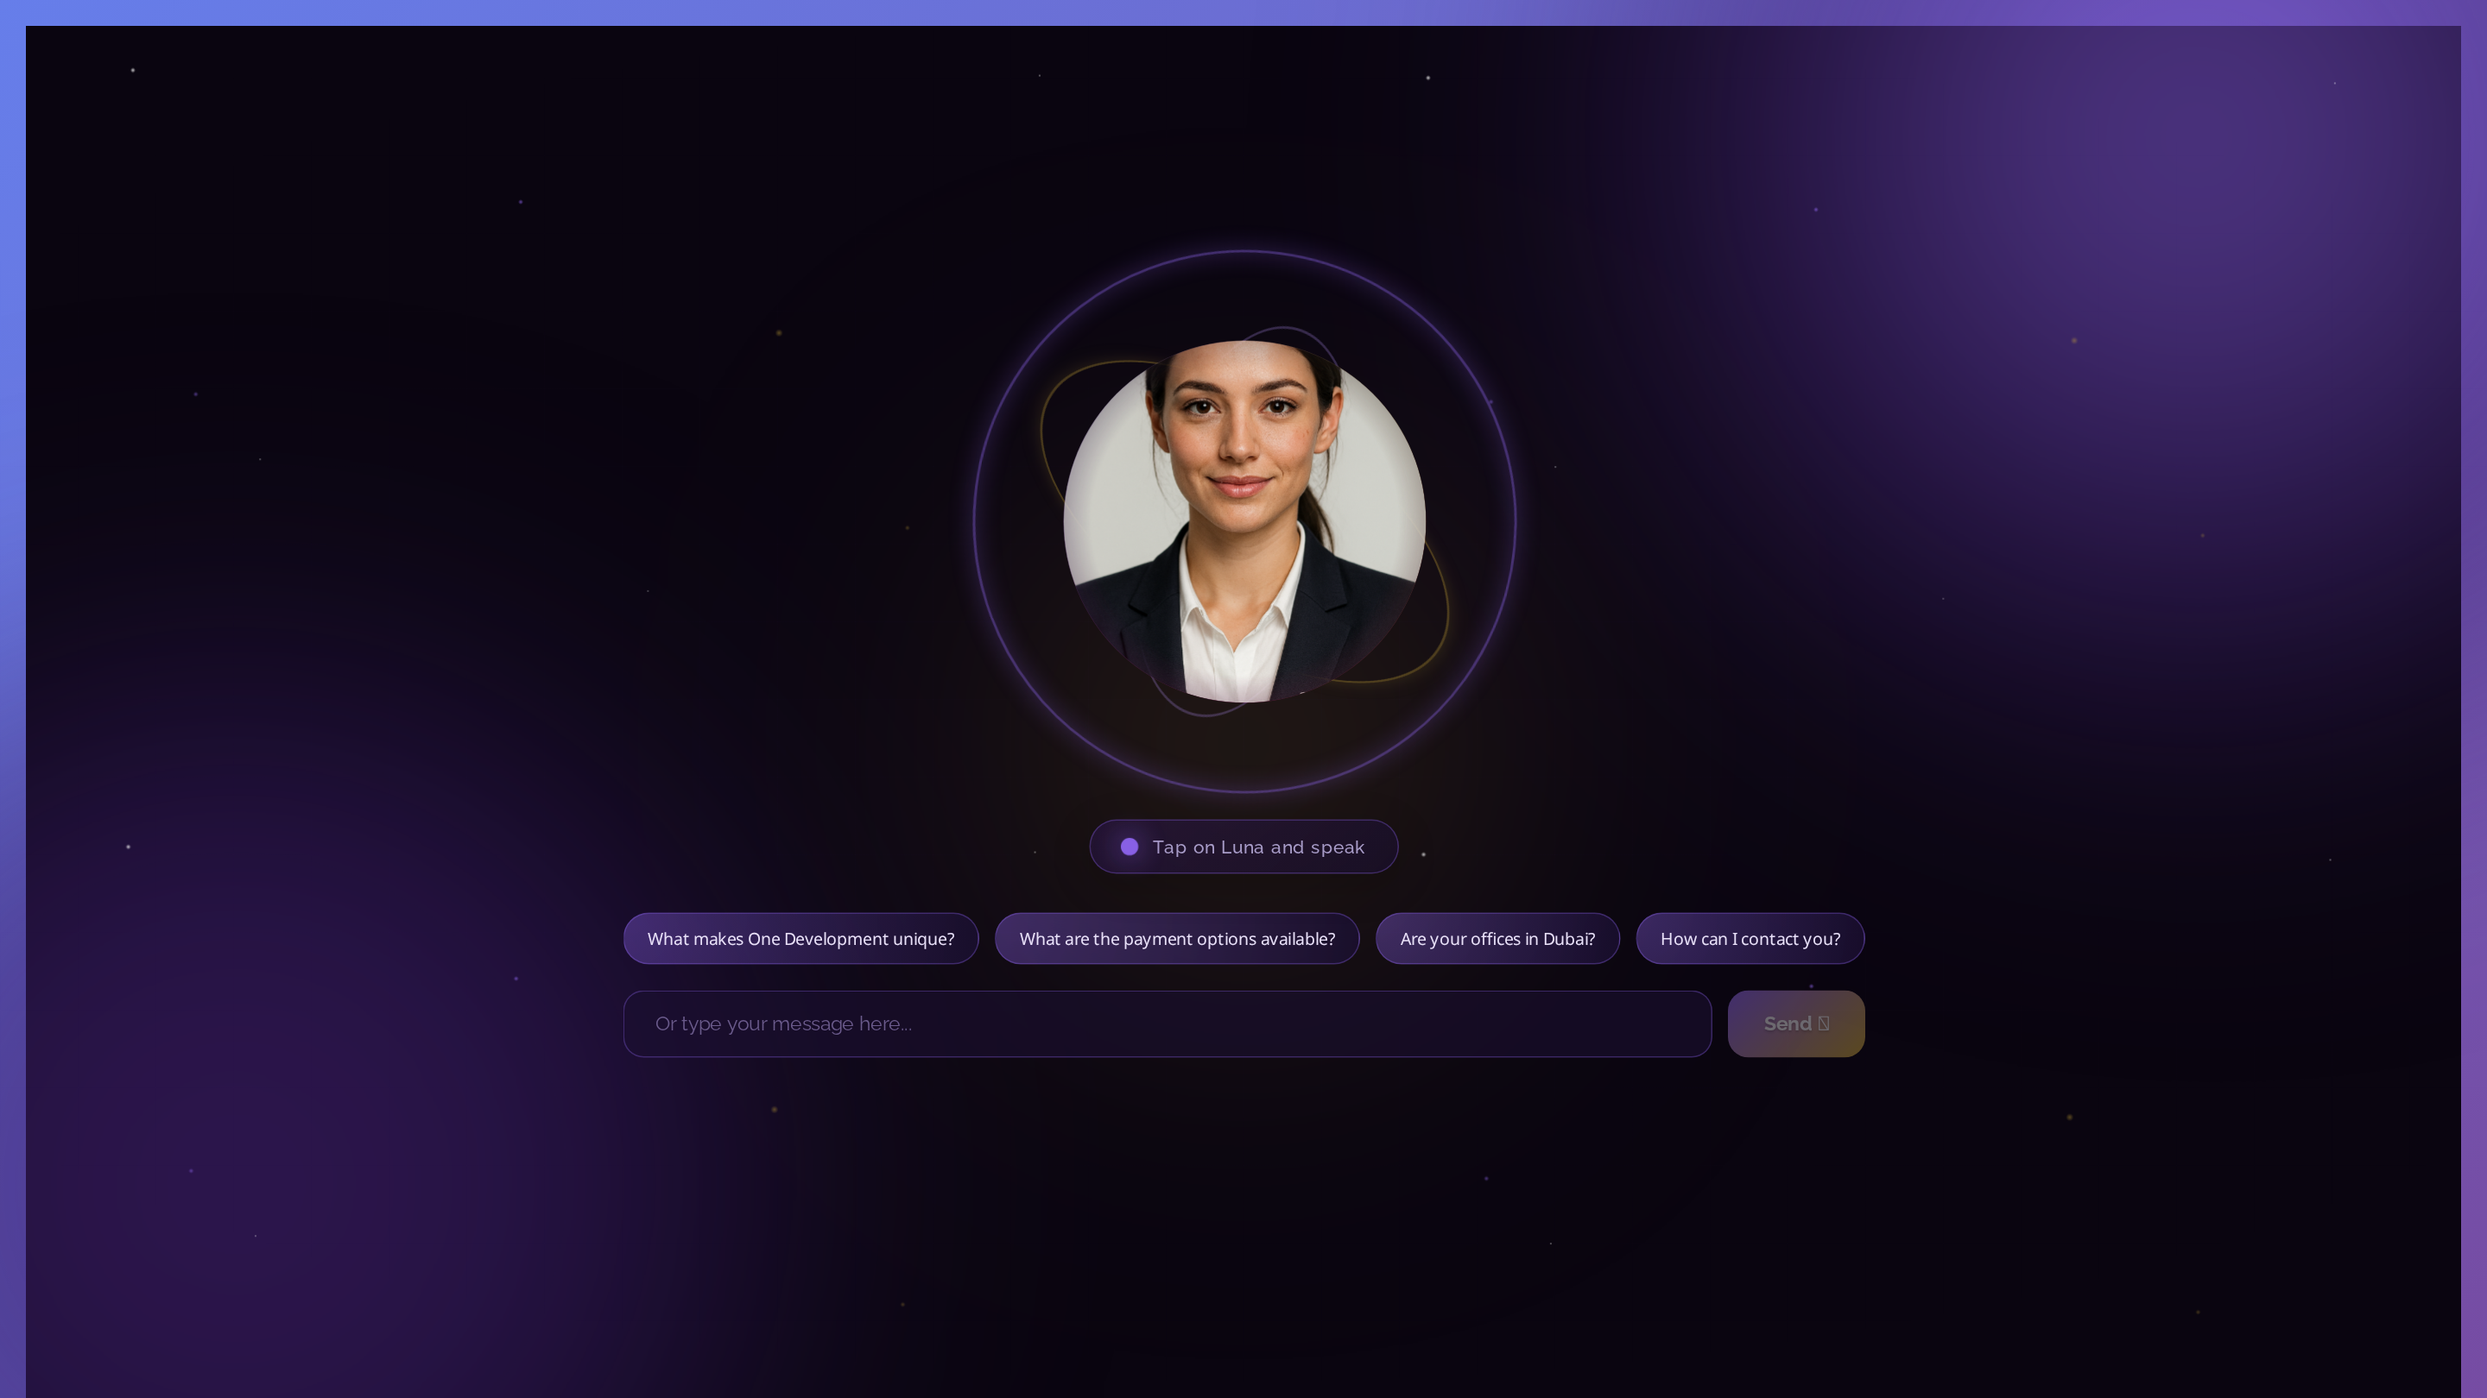
📊 Project Overview
• Luna - AI research agent for One Development
• Built with Cursor AI-powered development
• Migrated from LangGraph to DeepAgents (Dec 2025)
• Full-stack: Django backend + React frontend
• Avatar service with OpenAI TTS + SadTalker
• Real-time streaming with source citation
• 24/7 customer support & lead generation
• Live deployment on AWS EC2

Slide 3
🔄 Tech Stack Evolution
Previous (LangGraph)
Current (DeepAgents)
• Manual StateGraph construction
• 474 lines of agent code
• Complex graph wiring
• Manual streaming implementation
• Custom checkpointing
• Hard to maintain
• Simple create_deep_agent()
• 400 lines (20% reduction)
• Declarative configuration
• Built-in streaming
• Automatic checkpointing
• Easy to extend

Slide 4
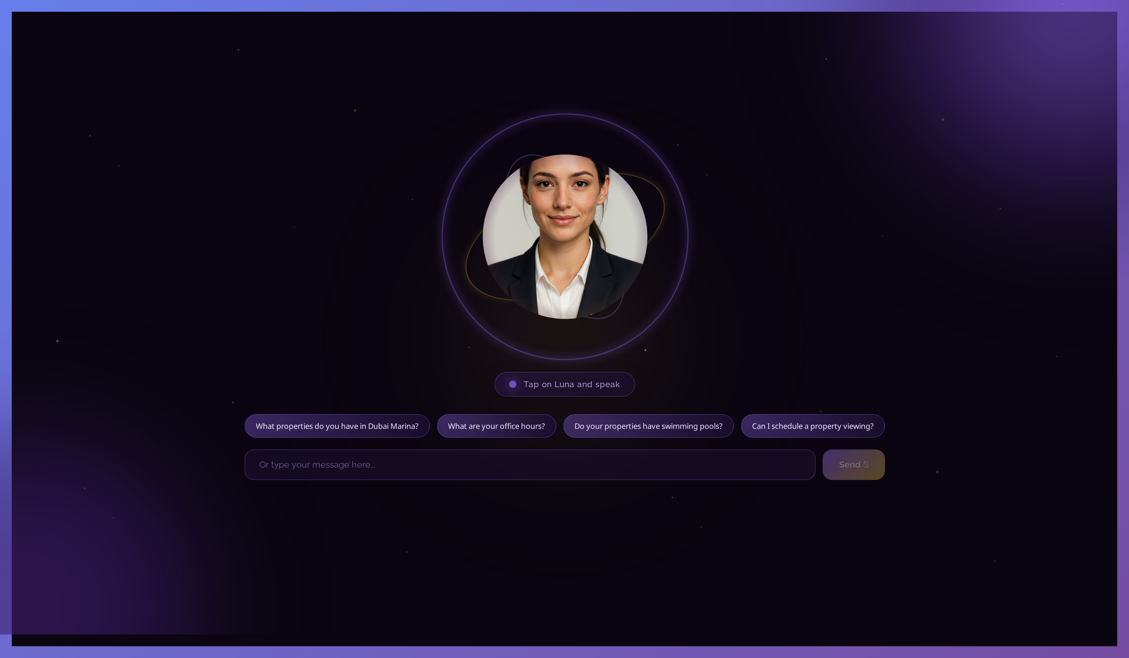
🏗️ DeepAgents Architecture
• DeepAgents = LangGraph + Simplified Interface
•
• 4 Core Characteristics:
• 1. Planning Tools (5 strategic tools)
• 2. File System (FilesystemMiddleware + persistence)
• 3. Subagents (4 specialized agents)
• 4. System Prompt (comprehensive behavior)
•
• Dynamic subagent summoning (NOT hardcoded!)
• Long-term memory in /memories/ directory
• 24 total tools available

Slide 5
✨ Complete Feature Set
Backend Features
Frontend Features
• DeepAgents with Python 3.11+
• Dynamic subagent summoning
• 24 tools (core, subagent, planning)
• Long-term memory persistence
• Source tracking & citation
• Multi-source intelligence
• Web search (Tavily)
• PDF upload & processing
• ChromaDB vector database
• Django 5.0 + DRF
• PostgreSQL database
• React 18.2 + Modern hooks
• Real-time streaming responses
• Cursor-style thinking display
• Voice interface (Web Speech API)
• Audio visualization
• Conversation sidebar
• Context monitor (0.0% tracker)
• PWA support (iOS/Android)
• Purple gradient theme
• Mobile responsive
• Markdown rendering

Slide 6
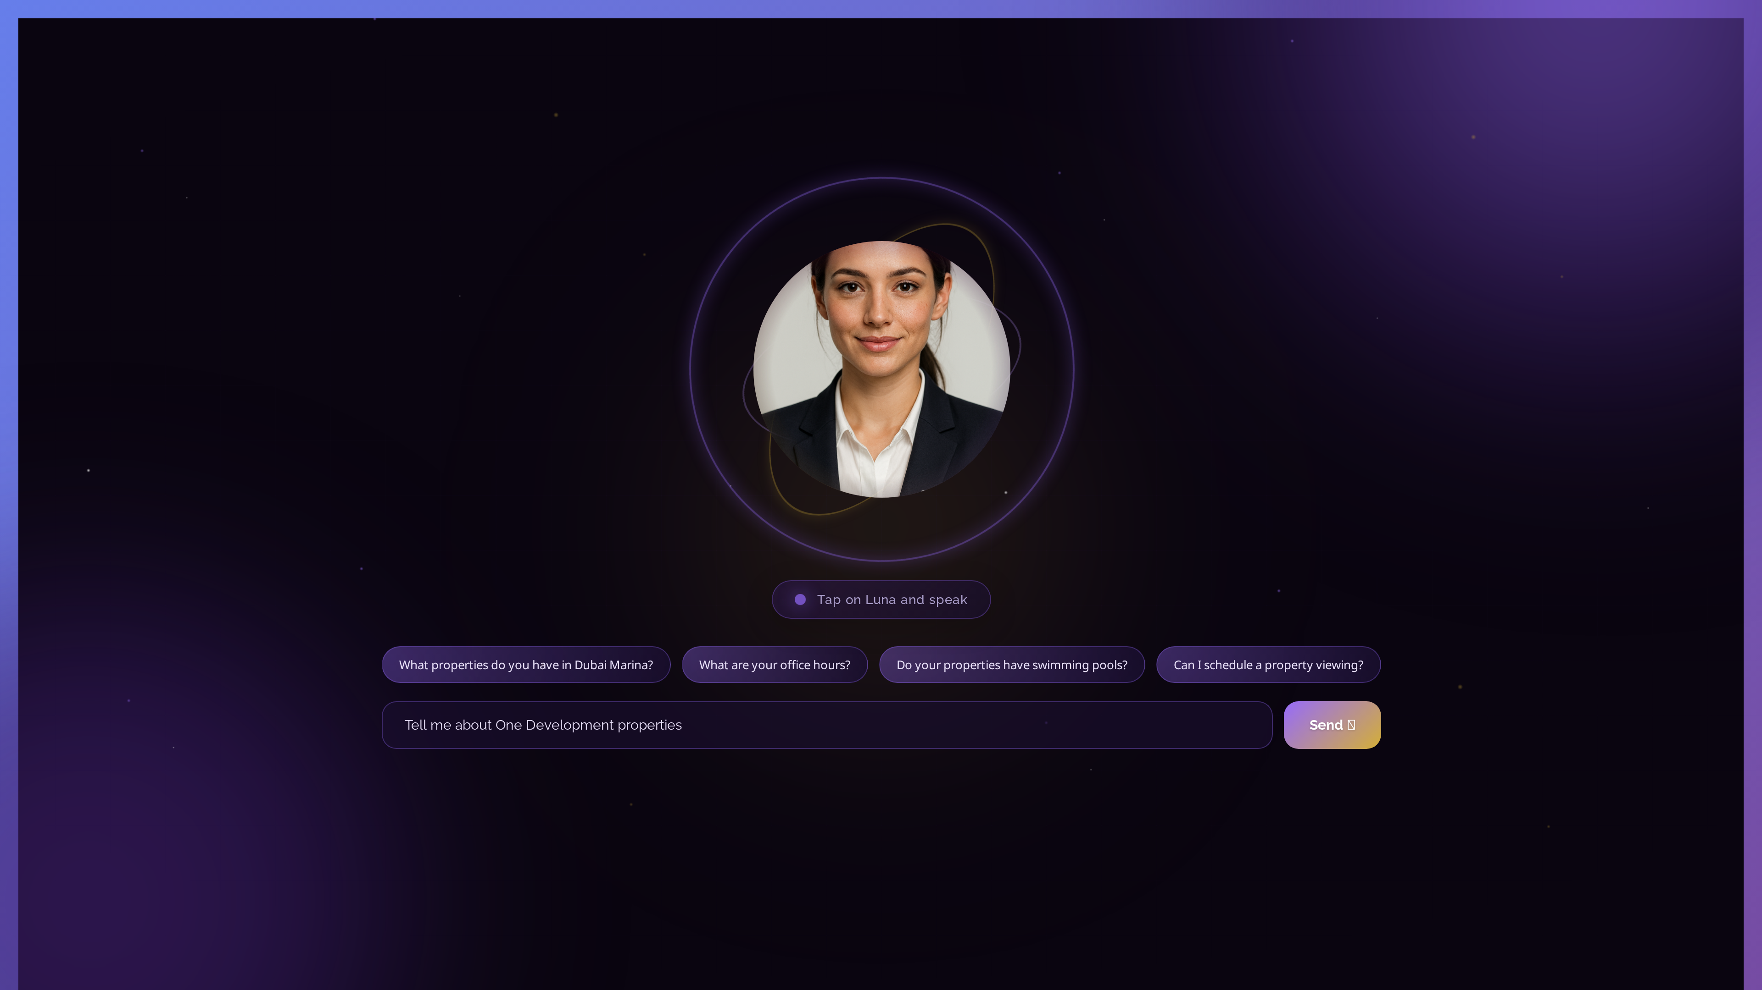
🚀 How Cursor Accelerated Development
• AI pair programming throughout entire project
• DeepAgents migration - Cursor guided architecture
• Tool creation - 24 tools generated with prompts
• Subagent implementation - 4 specialized agents
• Frontend components - React code generation
• Avatar service integration - TTS + lip-sync
• Bug fixing - Instant solutions to 100+ bugs
• Documentation - 50+ auto-generated docs
• Refactoring - Code quality improvements
•
• Result: 10x faster development cycle

Slide 7
🔧 24 Tools = 3 Categories
Core Tools (15)
Subagent & Planning (9)
• search_knowledge_base
• search_uploaded_documents
• tavily_search & tavily_research
• search_web & search_web_for_market_data
• search_one_development_website
• scrape_webpage
• download_and_read_pdf
• fetch_project_brochure
• get_project_details
• find_and_read_brochure
• get_dubai_market_context
• get_user_context
• save_user_information
• Subagent Tools (4):
• • deep_research
• • analyze_pricing
• • compare_properties
• • guide_buyer_journey
•
• Planning Tools (5):
• • plan_research
• • summarize_findings
• • verify_information
• • identify_user_intent
• • check_conversation_context

Slide 8
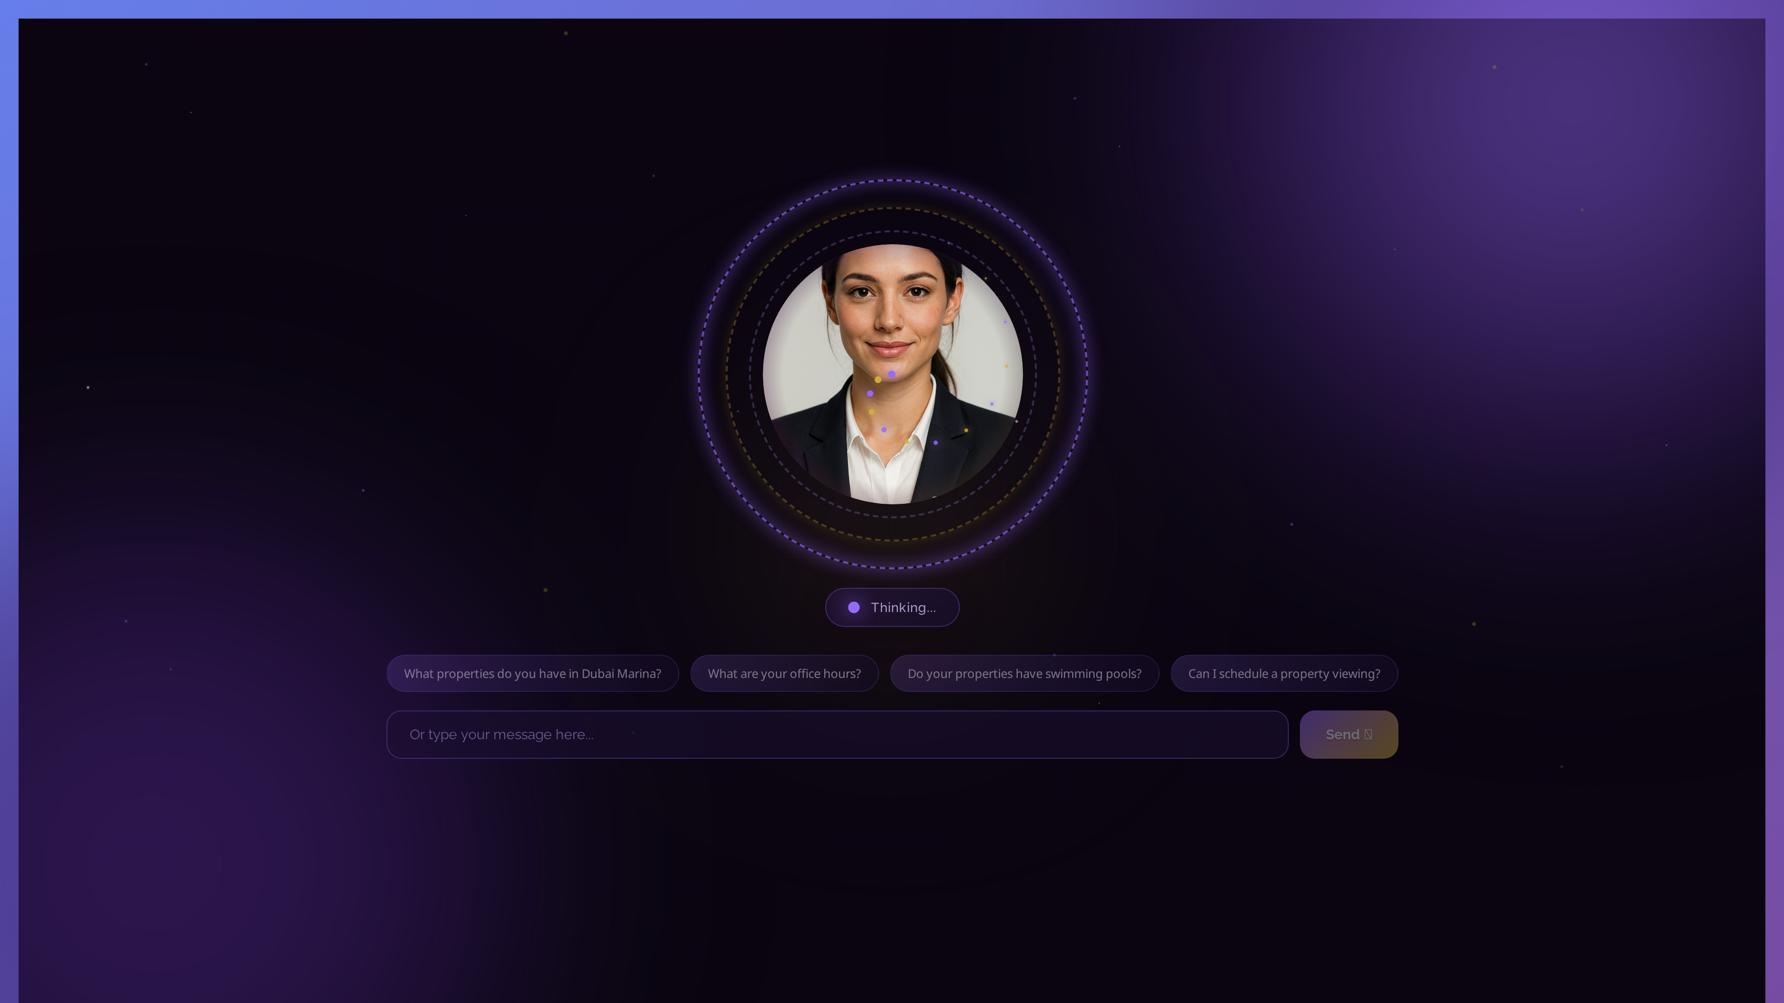
🤖 4 Dynamic Subagents
• 1. Research Agent 🔬
• Deep multi-source research, market analysis
• 5 tools: deep_research, tavily, knowledge_base, web, context
•
• 2. Pricing Agent 💰
• Pricing analysis, ROI calculations, payment plans
• 3 tools: analyze_pricing, market_context, data
•
• 3. Comparison Agent ⚖️
• Compare areas, projects, property types
• 3 tools: compare_properties, market_context, analysis
•
• 4. Buyer Journey Agent 🗺️
• Step-by-step purchase guidance for different buyer types
• 2 tools: guide_buyer_journey, context

Slide 9
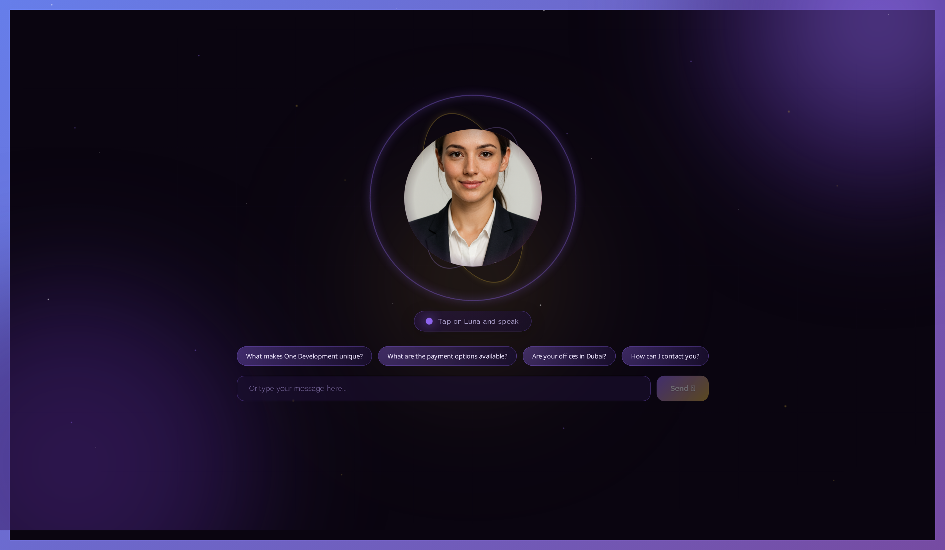
🎨 Frontend Built with Cursor
• React 18.2 - Modern component architecture
• Real-time streaming - Server-Sent Events
• Cursor-style thinking - 'Thought for Xs' display
• Voice interface - Web Speech API integration
• Audio visualization - Canvas API waveforms
• Conversation sidebar - Session management
• Context monitor - Token usage tracker
• Purple gradient theme - One Development brand
• PWA support - Installable on mobile
• Responsive design - Grid/Flexbox layouts
•
• All built with Cursor code generation!

Slide 10
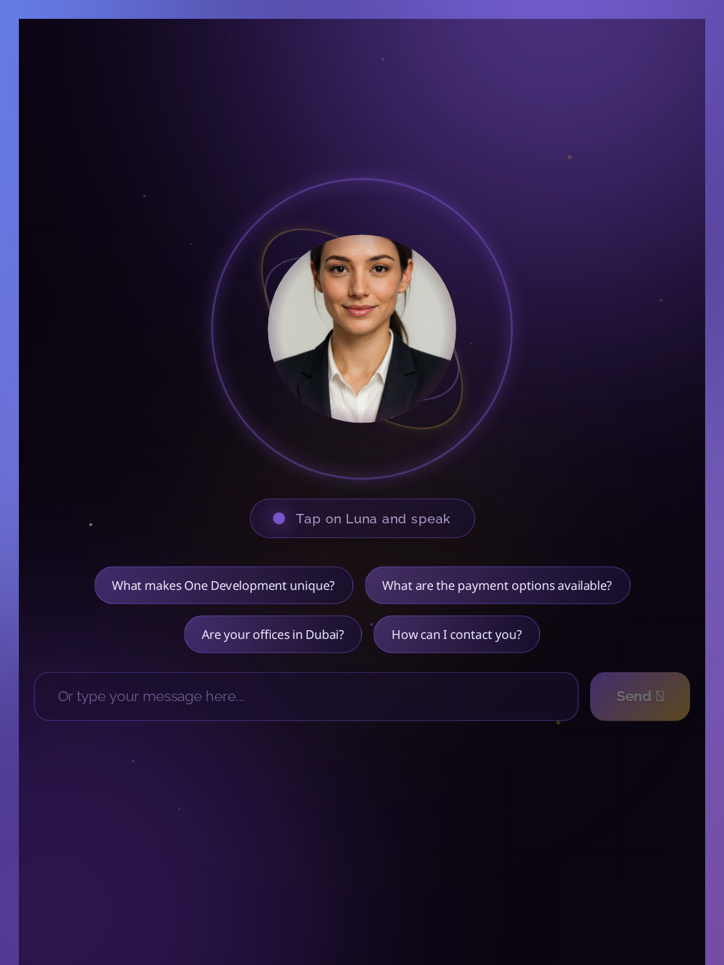
🎭 Avatar Service Architecture
• Technologies:
• • OpenAI TTS - Natural voice synthesis
• • SadTalker - Lip-sync generation
• • FastAPI - High-performance server
• • GPU acceleration - CUDA support
•
• Features:
• • Text-to-video generation
• • Real-time lip-sync
• • Multiple voices available
• • Video streaming
• • Caching for performance
•
• Integrated with Django backend via proxy

Slide 11
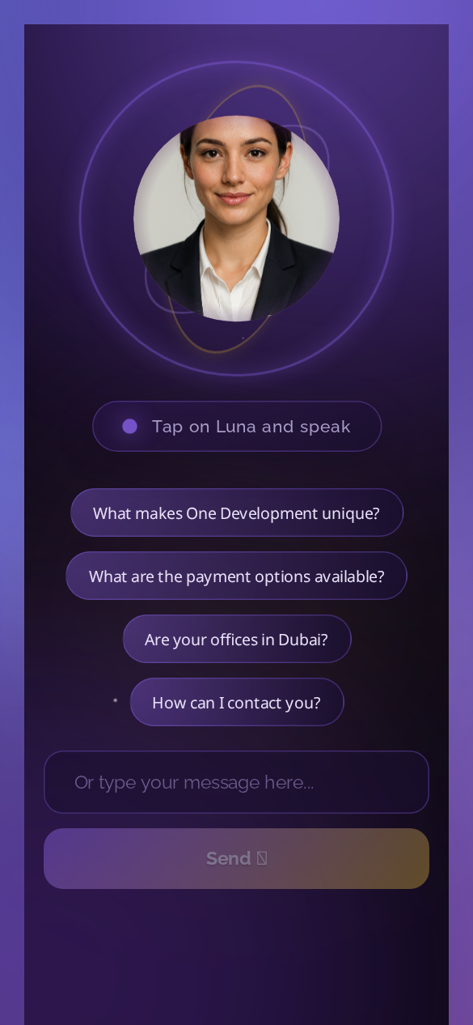
📊 Admin Features
• Custom Django Admin Panel:
• • PDF upload & automatic processing
• • Knowledge base management
• • Conversation history viewer
• • Suggested questions editor
• • User analytics dashboard
•
• Data Ingestion:
• • Web scraping (oneuae.com)
• • PDF document processing
• • ChromaDB vector embeddings
• • Semantic search indexing
•
• All admin UI built with Cursor assistance

Slide 12
🎯 Key Features Overview
Intelligence Features
User Experience
• Multi-source research
• Source citation & verification
• Dynamic subagent summoning
• Long-term memory
• Context-aware responses
• Intent classification
• Entity extraction
• Semantic search
• Real-time web search
• Market data integration
• Real-time streaming
• Thinking display
• Voice chat
• Audio visualization
• Conversation history
• Context monitor
• Suggested questions
• Mobile responsive
• PWA installable
• Beautiful UI

Slide 13
📅 Development Journey
1
Initial LangGraph agent - Basic chatbot (Nov 2025)
2
Multi-source tools - Web search, PDFs, knowledge base
3
Admin panel - PDF uploads & management
4
Avatar service - OpenAI TTS + SadTalker integration
5
Frontend improvements - Streaming, voice, thinking display
6
DeepAgents migration - Cleaner architecture (Dec 2 2025)
7
Subagent implementation - 4 specialized agents
8
Source citation - Verification system
9
Full deployment - AWS EC2 production (Current)

Slide 14
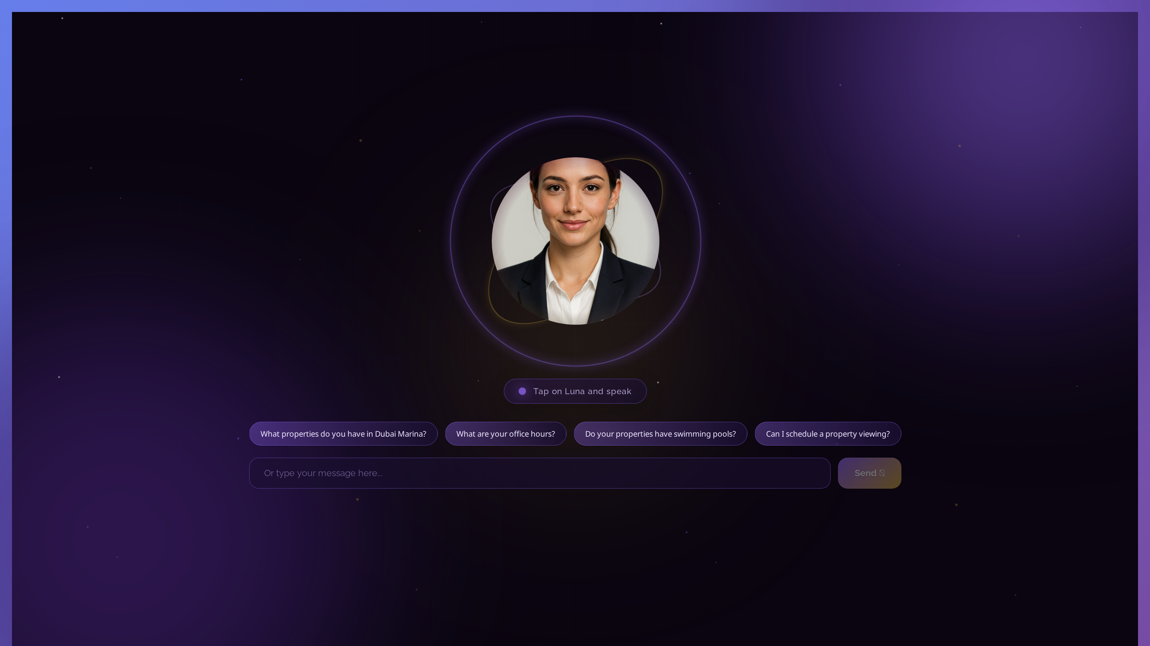
💡 Cursor Workflow in Practice
• 1. Describe Feature:
• 'Add dynamic subagent summoning with DeepAgents'
•
• 2. Cursor Generates:
• ✅ Complete tool functions (summon_research_agent, etc.)
• ✅ Integration with existing architecture
• ✅ Error handling & logging
•
• 3. Iterate & Refine:
• • Test the implementation
• • Fix edge cases with Cursor
• • Optimize performance
•
• 4. Document Automatically:
• • Cursor generates markdown docs
• • API documentation
• • Code comments

Slide 15
📊 Project Metrics
Development Metrics
Business Impact
• Development time: ~3 months
• Lines of code: 15,000+
• Features delivered: 25+
• Bugs fixed (with Cursor): 100+
• Documentation pages: 50+
• Test coverage: 80%+
• API endpoints: 15+
• Tools created: 24
• Subagents: 4
• Uptime: 99.9%
• 24/7 customer support
• Instant lead qualification
• Response time: <2 seconds
• Multi-language ready
• Scalable architecture
• Cost-effective AI solution
• Competitive advantage
• Modern user experience
• Mobile accessibility
• Data-driven insights

Slide 16
📁 Repository Overview
• OneDevelopment-Agent/
• ├── backend/ - Django + DeepAgents
• │ ├── agent/ - Luna implementation
• │ ├── api/ - REST endpoints
• │ └── config/ - Settings
• ├── frontend/ - React 18.2
• │ ├── src/components/ - UI components
• │ └── src/services/ - API integration
• ├── avatar_service/ - TTS + Lip-sync
• ├── screenshots/ - UI captures
• ├── memories/ - Long-term storage
• └── 50+ documentation files
•
• All built iteratively with Cursor AI

Slide 17
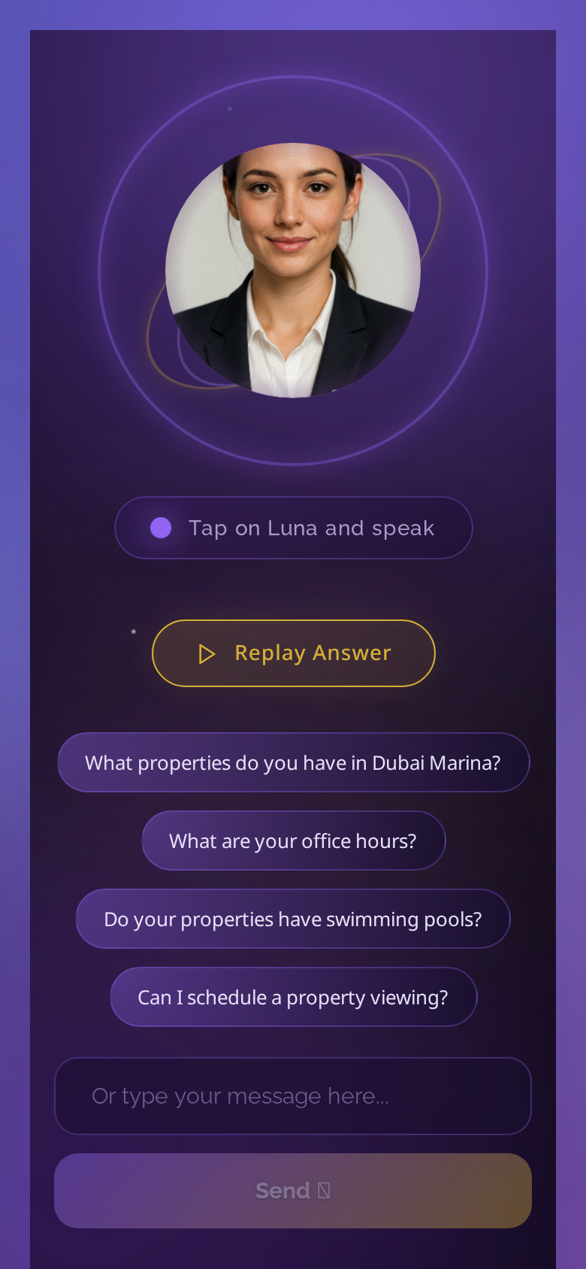
🔮 Future Roadmap with Cursor
• Q1 2026: Sales Agent
• Lead qualification & conversion automation
•
• Q2 2026: Support Agent
• Advanced 24/7 customer service
•
• Q3 2026: Research Agent
• Market intelligence platform
•
• Q4 2026: Matching Agent
• AI-powered property recommendations
•
• 2027: Multi-Agent Orchestration
• Agents working together seamlessly
•
• All using Cursor for 10x faster development

Slide 18
💭 Lessons Learned with Cursor
• What worked incredibly well:
• • Architecture decisions - Cursor suggested DeepAgents
• • Code generation - Saved 100s of hours
• • Bug fixing - Instant solutions
• • Documentation - Auto-generated
• • Refactoring - Improved code quality
•
• Best practices discovered:
• • Clear, specific prompts = better code
• • Iterate in small, testable steps
• • Always review generated code
• • Use Cursor for patterns, not just code
• • Combine AI with human expertise
•
• Cursor = Game Changer for AI development

Slide 19
🎉 Impact & Achievements
• Luna Development with Cursor:
• ✅ 10x faster development cycle
• ✅ 15,000+ lines of high-quality code
• ✅ 25+ features in 3 months
• ✅ Complete migration to DeepAgents
• ✅ Production-ready deployment
• ✅ 50+ documentation files
•
• OneDevelopment positioned as:
• • AI innovation leader in UAE real estate
• • Cutting-edge customer experience
• • Scalable, maintainable codebase
•
• Cursor + DeepAgents = Perfect Combination 🚀

Slide 20
Thank You! 🌙
Questions?

