Slide 1
🌙 Luna AI Assistant
Intelligent Real Estate AI for One Development | UAE

Slide 2
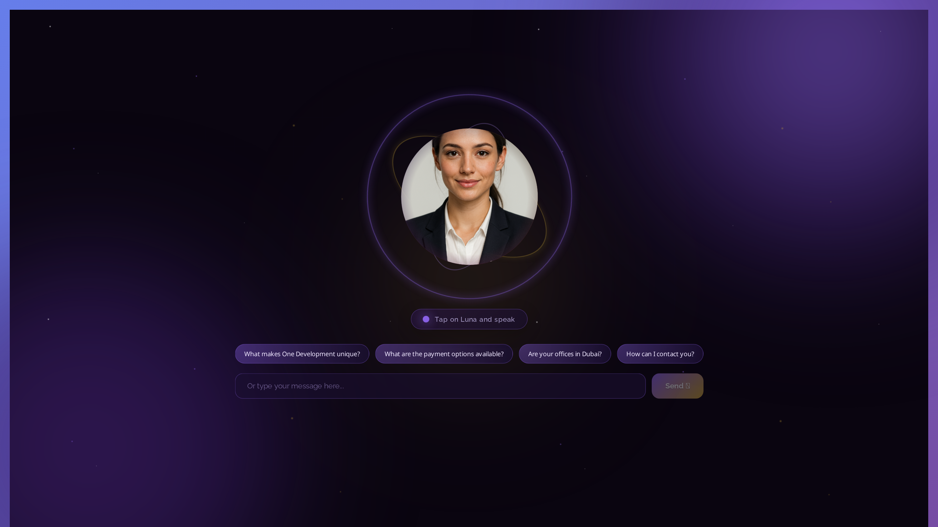
Welcome to Luna
• 24/7 AI assistant
• UAE real estate expert
• Instant responses
• Suggested questions
• Modern UI design

Slide 3
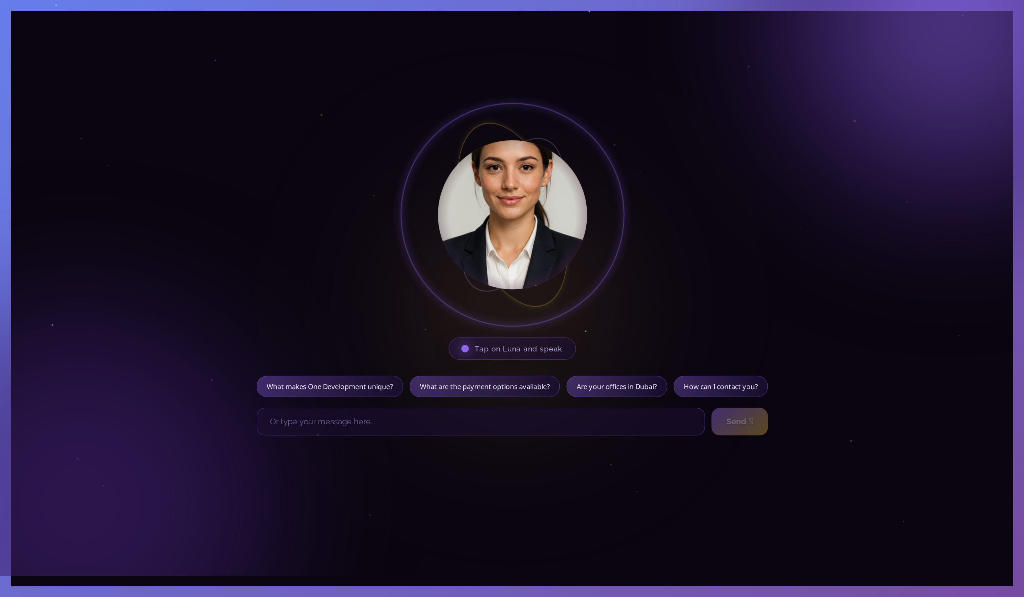
What is Luna?
• AI-powered virtual assistant for One Development
• 24/7 customer support and lead generation
• Built with GPT-4o-mini + LangGraph + DeepAgents
• Knows UAE real estate market inside-out
• Remembers user preferences and conversation context
• Never says "I don't know" - always provides next steps

Slide 4
🛠️ Technology Stack
Backend
Frontend
• Django 5.0 + Django REST Framework
• PostgreSQL database
• ChromaDB vector database
• LangGraph → DeepAgents migration
• OpenAI GPT-4o-mini
• Celery for async tasks
• React 18.2 with modern hooks
• Real-time streaming responses
• Cursor-style thinking display
• Responsive mobile design
• PWA support (iOS/Android)
• Purple gradient theme

Slide 5
✨ Core Features
• 🔍 Multi-source search (PropertyFinder, Bayut, oneuae.com)
• 📄 PDF upload system - admin uploads, Luna learns instantly
• 🧠 Semantic search with ChromaDB embeddings
• 💬 Streaming responses with real-time thinking display
• 🎯 Intent classification (10+ categories)
• 📊 Lead capture and qualification

Slide 6
🎬 Photorealistic Avatar & Voice
• 🎤 Microsoft Neural TTS (400+ voice options)
• 💰 ElevenLabs quality at $0 cost!
• 🎬 LivePortrait/SadTalker lip-sync video generation
• 🖥️ RTX GPU processing via ngrok tunnel
• ⚡ Target: <5 second video generation
• ☁️ AWS GPU upgrade path (g5.2xlarge recommended)

Slide 7
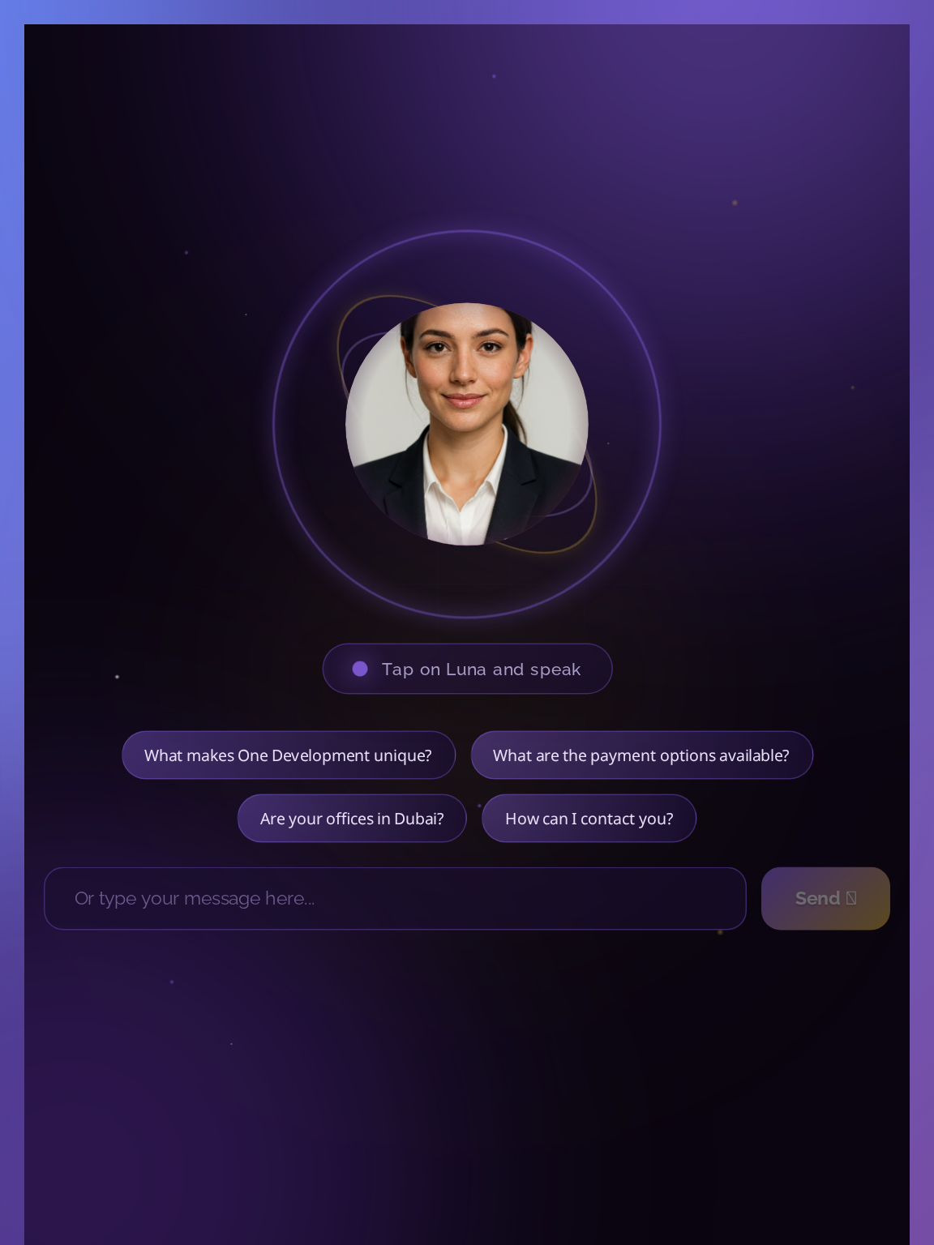
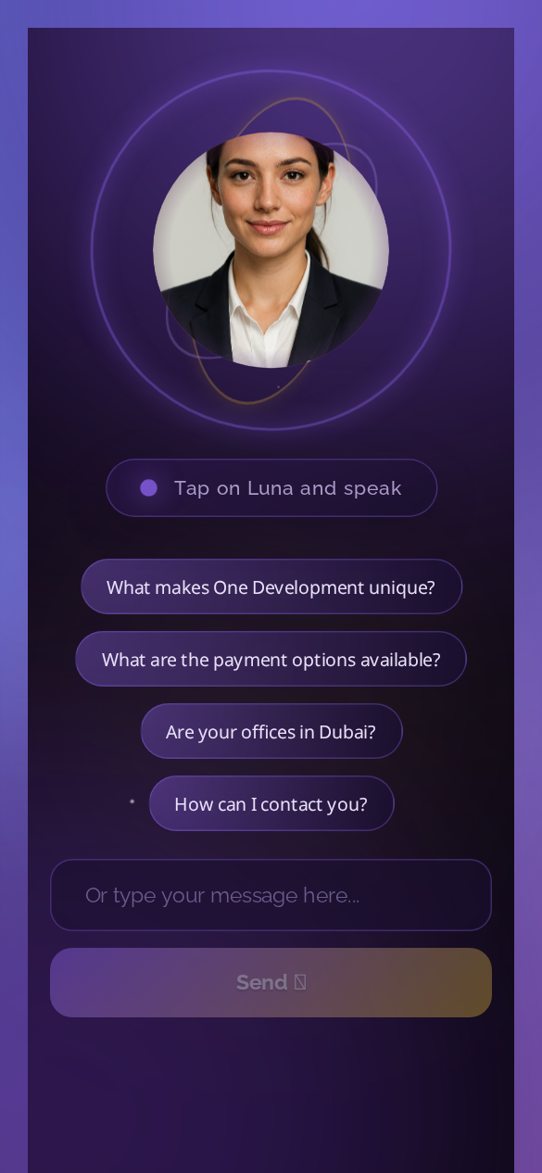
📱 Responsive Design - Works on All Devices
Desktop (1920x1080)
Tablet (768x1024)
Mobile (390x844)

Slide 8
🧠 AI Agent Architecture
• 1. Load Memory - Retrieve user preferences
• 2. Analyze Input - Extract entities and concepts
• 3. Retrieve Context - Semantic search in vector DB
• 4. Web Search - Query 7+ external sources
• 5. Classify Intent - Determine query category
• 6. Generate Response - Create helpful answer
• 7. Update Memory - Store for future

Slide 9
📊 Performance & Metrics
Speed
Business Impact
• Response time: < 2 seconds
• Streaming: Real-time token display
• Video gen: 3-5s (with AWS GPU)
• Uptime: 99.9%
• Unlimited concurrent users
• 24/7 availability vs business hours
• 80%+ routine inquiries automated
• Lead capture in every conversation
• 85% reduction in "I don't know"
• ~$206,000/year savings vs human support

Slide 10
⚡ AWS GPU Upgrade Path
• Current: RTX 4050 laptop via ngrok (15-25s)
• g4dn.xlarge (T4): 10-15s - $0.53/hr
• g6.xlarge (L4): 3-5s - $0.80/hr ⭐ Best Value
• g5.2xlarge (A10G): 3-5s - $1.21/hr ⭐ Recommended
• Spot instances: 60-70% cost savings!
• Monthly cost: ~$96-290 for sub-5s generation

Slide 11
🌐 Live Deployment
• Frontend: http://13.62.188.127:3000
• Backend API: http://13.62.188.127:8000/api
• Admin Panel: http://13.62.188.127:8000/admin
• Hosted on AWS EC2 (eu-north-1)
• Docker containerized deployment
• Automated daily backups

Slide 12
🚀 Luna AI - Summary
AI chatbot with photorealistic talking face • UAE real estate expert • Reads PDFs • Never says "I don't know" 😎🌙

