Slide 1

PRINCE SULTAN UNIVERSITY · COLLEGE OF ENGINEERING
Curriculum Intelligence Portal
Undergraduate EE curriculum intelligence and continuous-improvement platform
CIP
CIP Desktop 1.0.0 · Release 003
Curriculum Committee
Department of Communications and Networks Engineering
Presented to the Department Council
Curriculum Intelligence Portal · Curriculum Committee · Undergraduate Electrical Engineering
1
Notes:
Framing: CIP is a Curriculum Committee software asset, built by and for the committee. This session covers the undergraduate Electrical Engineering program only. MSc/graduate modules exist but are under construction and pending approval.

Slide 2
THE PROBLEM WE SET OUT TO SOLVE
Why CIP was needed
One undergraduate program carries thousands of curriculum relationships, held in files rather than in a system.
1
Curriculum data is distributed
THE PROGRAM IN DATA
Course specifications, CLOs, mappings, assessment material and committee records live in separate files.
32
courses modelled
171
course learning outcomes
2
Faculty need one clear view
Coordinators and instructors need their course, its outcomes and its mappings without chasing documents.
7
ABET student outcomes
20
performance indicators
3
Committee work needs traceability
466
CLO → PI relationships
Review must be consistent and evidence-based across terms, and fast enough to finish inside a review cycle.
Every one of these has to stay consistent, defensible and documented.
Curriculum Intelligence Portal · Curriculum Committee · Undergraduate Electrical Engineering
2
Notes:
The point is scale, not complaint. These numbers cannot be reviewed reliably by opening files one at a time. Every figure is read from the committee's own approved data.

Slide 3
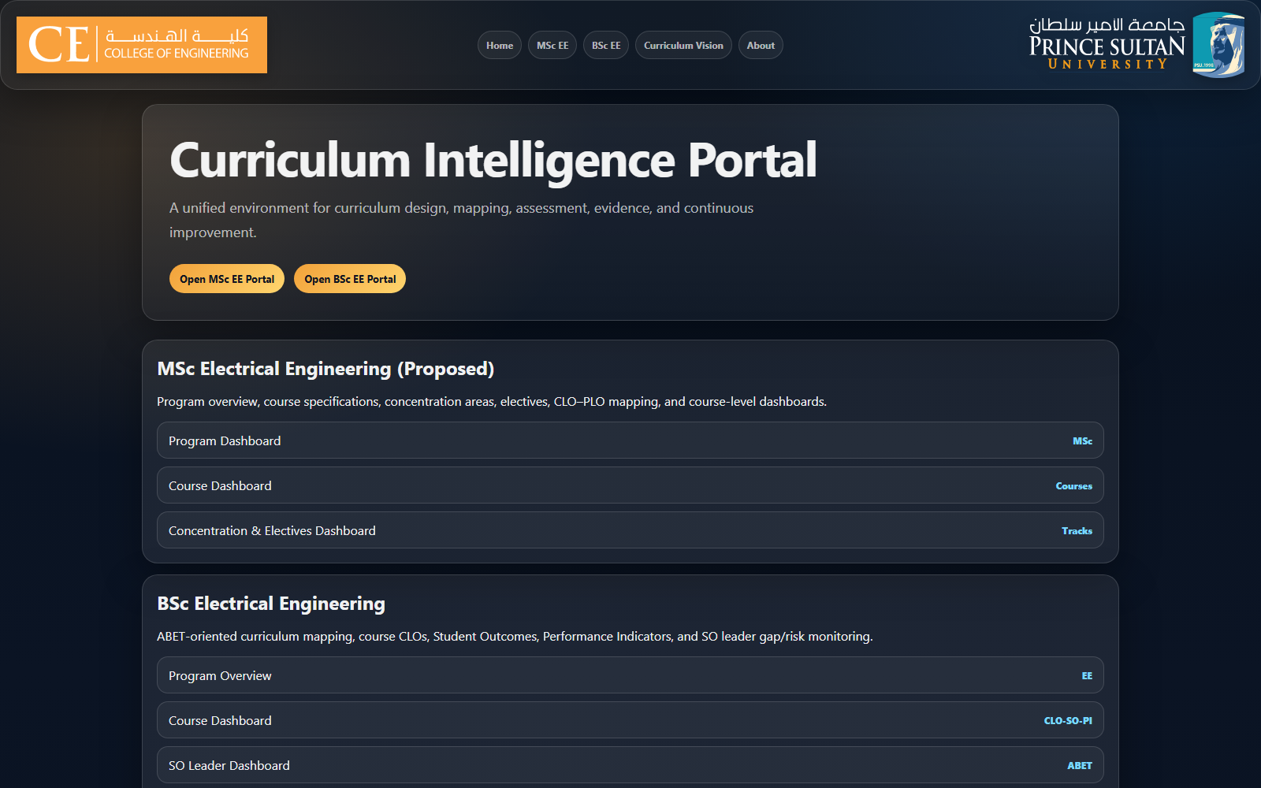
DEFINITION
What CIP is
A secure desktop curriculum portal: installed by faculty, delivered under committee control, usable offline.
A
Curriculum intelligence portal
Structured access to courses, outcomes, mappings, assessment and improvement views.
B
Desktop application
Faculty install CIP Desktop. The portal opens from a validated local copy.
C
Authenticated download
Content is obtained once through an authorized session, then held locally.
D
Offline and controlled updates
Works without a network; new releases arrive through a managed channel.
MSc / graduate modules are under construction and pending approval, and are not part of this presentation.
Portal entry view, undergraduate and graduate program areas
Curriculum Intelligence Portal · Curriculum Committee · Undergraduate Electrical Engineering
3
Notes:
Keep this short. CIP is a portal that happens to be delivered as a desktop application; the desktop part is a governance decision, covered later. Note the MSc status once, in passing.

Slide 4
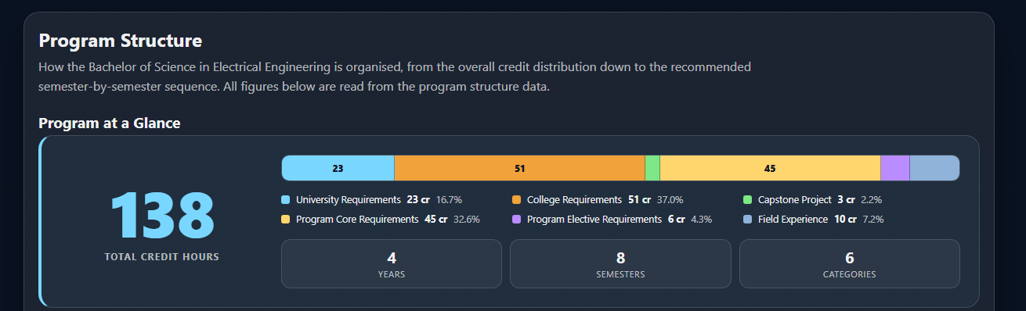
PROGRAM LEVEL
Undergraduate program dashboard
The whole degree in one place: structure, outcomes, mappings, assessment and improvement views.
WHAT IT COVERS
Program overview and objectives
Course structure and prerequisites
CLO / SO / PI relationships
Curriculum maps and coverage
Assessment and improvement views
Navigation across modules
Program structure, rendered from the committee's approved curriculum data
138 credit hours
Nothing is retyped
Read from the program structure data, so the figures cannot drift from the study plan.
Mission, objectives and the seven Student Outcomes come from the same file the mappings use.
Curriculum Intelligence Portal · Curriculum Committee · Undergraduate Electrical Engineering
4
Notes:
Demonstrate live if the room allows. Emphasise that nothing here is re-typed: the credit distribution, the study plan and the outcome statements all render from one authoritative dataset.

Slide 5
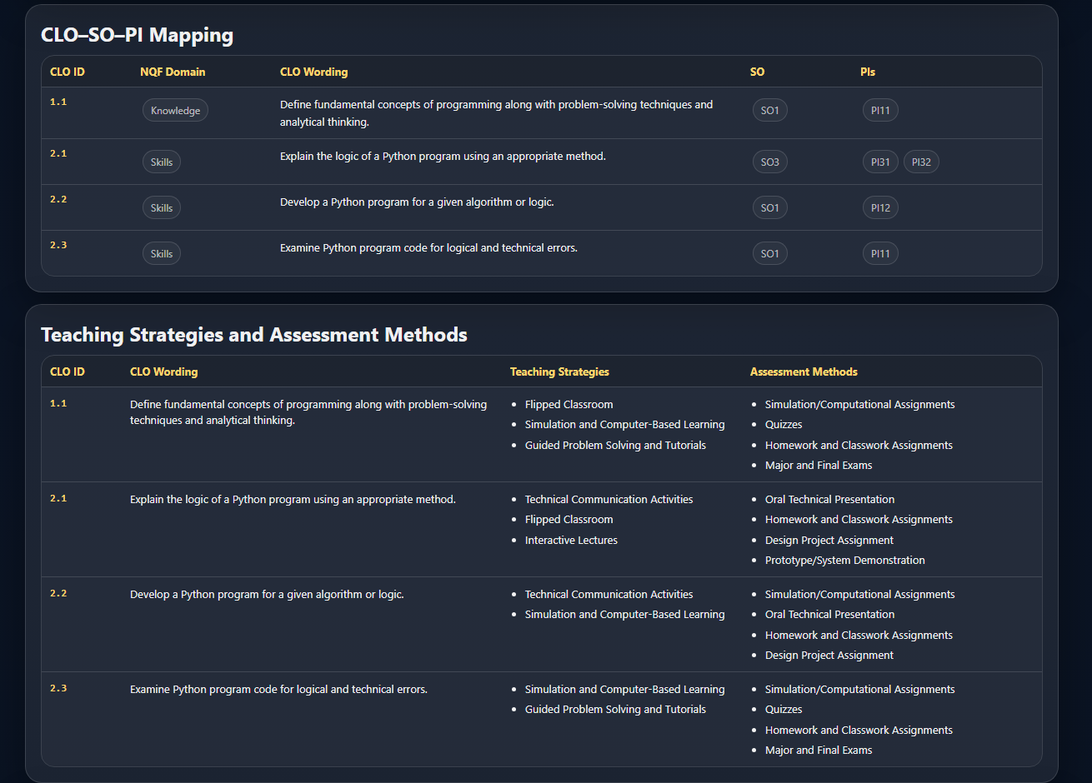
COURSE LEVEL
Course-level intelligence
Every course on one page: outcomes, mappings, teaching strategies and assessment methods.
Course dashboards
Description, objectives, credits, prerequisites and topics.
CLO visibility
Every course learning outcome with its NQF domain and approved wording.
Teaching and assessment
15 approved teaching strategies and 16 assessment methods.
Course-to-program alignment
Each CLO against the outcomes and indicators it supports.
Course dashboard: CLO–SO–PI mapping and approved methods
Faculty, coordinators and reviewers work from one page.
Curriculum Intelligence Portal · Curriculum Committee · Undergraduate Electrical Engineering
5
Notes:
A coordinator preparing a syllabus, an instructor checking their CLOs and a committee reviewer all look at the same page, which removes most version disagreements.

Slide 6
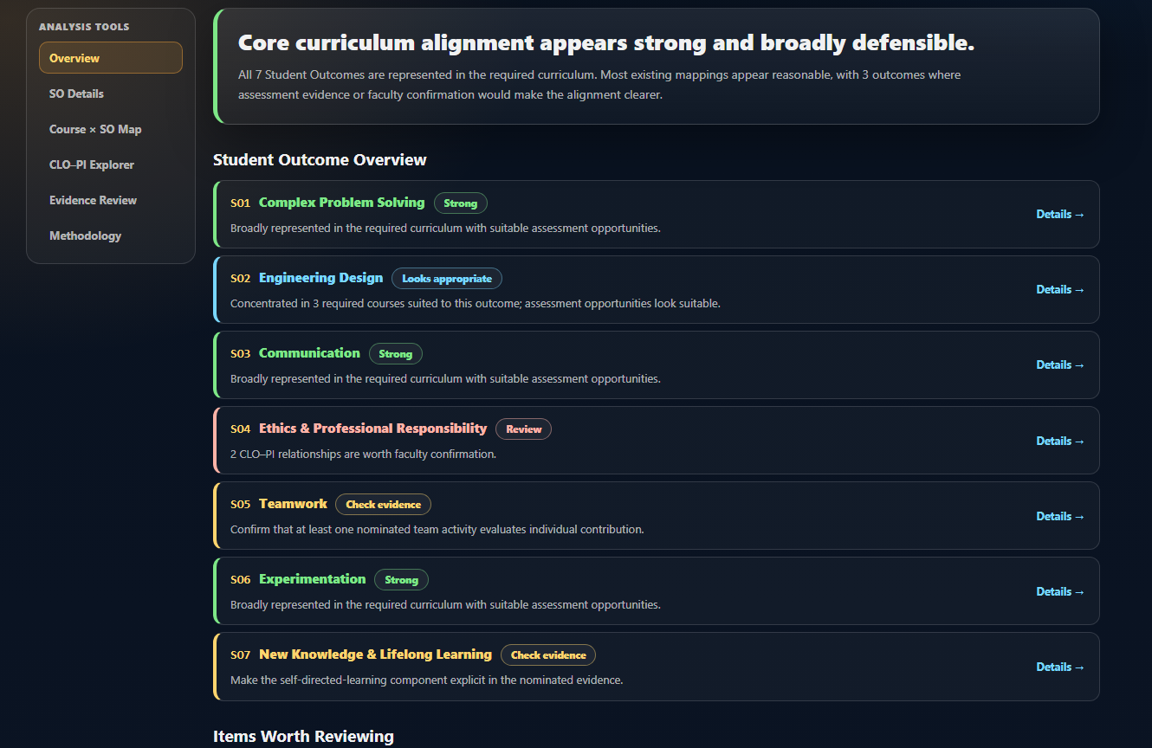
REVIEW
Alignment and review tools
Evidence-oriented review of how the curriculum supports the seven ABET Student Outcomes.
1
CLO–SO–PI mapping visibility
Outcome coverage, per-course contribution and the CLO–PI explorer.
2
Review analysis engine
Reads approved CLO wording, artefacts and assessment methods against each indicator.
3
Gaps, overlaps and documentation
Surfaces what is thin, what is duplicated and what needs confirming.
Supportive, not punitive. The engine reports status and suggests confirmation. It never grades a colleague and stores no student performance data.
Alignment review: conclusions first, then the items worth confirming
Curriculum Intelligence Portal · Curriculum Committee · Undergraduate Electrical Engineering
6
Notes:
Stress the philosophy. Labels are descriptive and point at documentation to confirm, not at a person. The Measurement and Improvement layers are deliberately empty: no attainment value is stored or displayed.

Slide 7
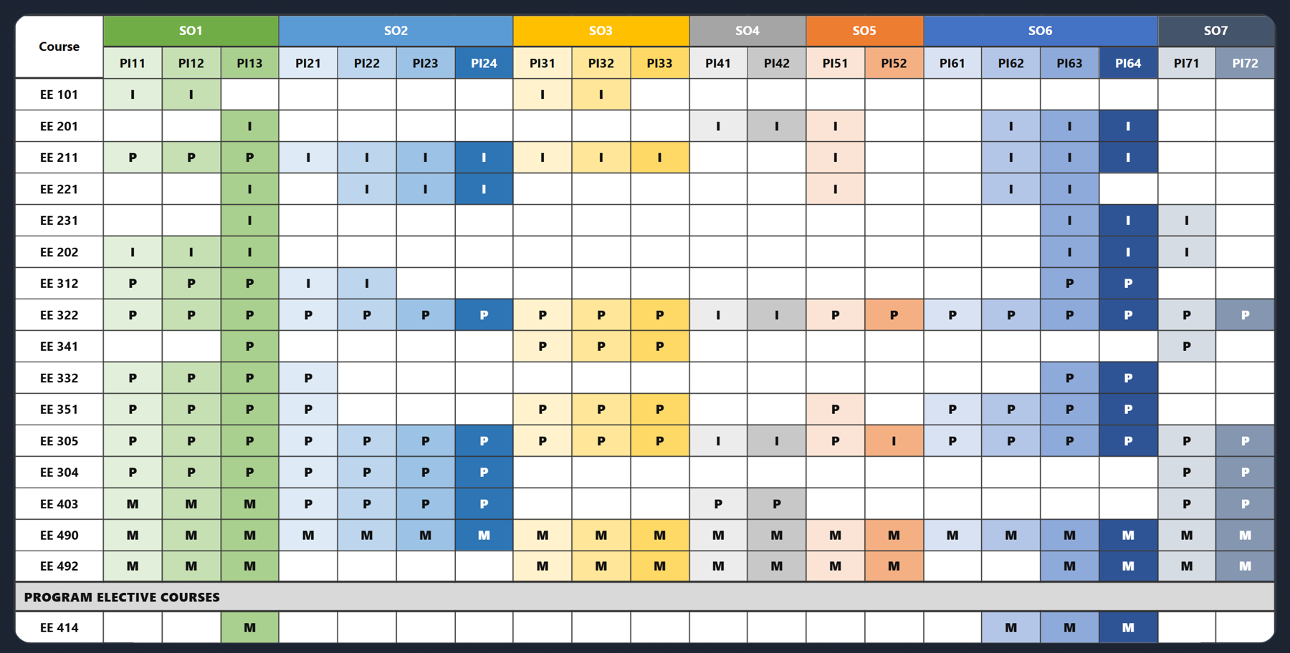
CAPABILITIES
What the portal can do today
Everything below is produced from the same curriculum record, not from separate working copies.
See
Program structure, prerequisite flow and the four-year study plan
Course–SO–PI performance heatmaps, exportable as PNG
Textbooks and references for every course
Teaching strategies and assessment methods
Review
CLO review with per-CLO faculty comments
SO mapping review across all seven Student Outcomes
CLO–SO–PI alignment and evidence analysis
PI heatmap: approved I / P / M levels per course
Produce
NCAAA course specifications in Word, from the approved template
CLO revision reports in Word
Course, CLO-review, SO-mapping and change-request PDFs
Generated, not maintained by hand. Course specifications and review reports are built from the live data, so they cannot fall out of step with it.
Curriculum Intelligence Portal · Curriculum Committee · Undergraduate Electrical Engineering
7
Notes:
This is the consolidated answer to "what does it actually do". Worth pausing on the Word generation: the NCAAA course specification uses the department's approved template and the committee's own data.

Slide 8
THE CYCLE
Continuous improvement support
Curriculum evidence moves from source files, through CIP, into committee decisions, and back again.
Source data
CIP intelligence
Committee decisions
Continuous improvement
Specs, CLOs, mappings,
assessment plans
One linked, searchable
curriculum view
Evidence-based review,
recorded outcomes
CLO revisions, mapping
and documentation updates
Improvement evidence feeds the next curriculum revision cycle
Structured evidence for discussion
Change and review outputs tracked
Less manual searching
Committee conversations start from the same view of the curriculum.
Reports are produced from live data and kept with the release.
The current version of a mapping or a CLO is where everyone expects it.
Curriculum Intelligence Portal · Curriculum Committee · Undergraduate Electrical Engineering
8
Notes:
The value argument for the department: CIP does not make curriculum decisions. It makes the evidence for those decisions available quickly and consistently, and keeps the result with the release.

Slide 9
ARCHITECTURE DECISION
From public web portal to controlled desktop platform
Curriculum information is institutional data. The delivery model was changed to match that.
STAGE 1
STAGE 2
STAGE 3
GitHub Pages model
A deliberate evolution
CIP Desktop
Simple deployment
Browser access anywhere
Fast iteration
Proved the concept
Protection by design
Authorization before delivery
Least exposure
Controlled distribution
Authenticated gateway
Private release storage
Verified package
Validated local copy
DATA-GOVERNANCE LIMITATION
WHY WE MOVED
RELEASE MANAGEMENT
Static public web hosting. Files are served from a publicly reachable location, knowing the URL can make static resources retrievable, and no server-side authorization protects the package.
The committee chose a controlled desktop architecture so that governance of curriculum data is enforced by the delivery model, not by the obscurity of a link.
Release identifiers and integrity hashes, delivered through a managed update channel so faculty machines do not diverge into unmanaged curriculum copies.
GitHub Pages is not being called insecure. Its public static-hosting model does not match our data-governance requirements.
Curriculum Intelligence Portal · Curriculum Committee · Undergraduate Electrical Engineering
9
Notes:
Be precise. Stage 1 was the right choice for proving the concept and we are not disowning it. What changed is the requirement: once the portal held the approved curriculum record, we needed authorization before delivery.

Slide 10
SECURITY AND DEPLOYMENT MODEL
How controlled delivery works
Authorized faculty, private storage, verified package, local trusted copy.
FACULTY ACCESS CHAIN
CURRENT SECURITY AND DATA ARCHITECTURE
Authorized PSU email
Faculty are authorized by email; release metadata and downloads require a valid session.
Session credentials are held by the desktop application in the operating system credential store.
Release packages sit in private cloud object storage; the bucket is not publicly exposed.
The portal runs from the validated local release and keeps working offline.
Releases carry identifiers and integrity hashes, delivered through one controlled channel.
One-time verification code
Authenticated faculty session
Private CIP release service
Private cloud object storage
Verified release package
Local copy on the faculty computer
THE OBJECTIVE, STATED ACCURATELY
Offline-capable operation
Controlled access, controlled distribution, reduced public exposure, release integrity, and managed synchronization of authorized local copies. Not digital rights management.
Windows is the first validated desktop platform.
Curriculum Intelligence Portal · Curriculum Committee · Undergraduate Electrical Engineering
10
Notes:
If asked about local files: an authorized faculty member can of course inspect what is on their own machine, and we do not claim otherwise. The gain is no public URL, a hash-verified copy, and one managed release.

Slide 11
WHERE WE ARE TODAY
Current production status
The undergraduate platform is prepared and tested; graduate modules remain under construction.
CIP Desktop 1.0.0
Prepared
Content release r000000000003
Current
Windows desktop application, built and packaged for faculty installation.
Identified release with a per-file integrity manifest.
Automatic content updates
Tested
First trusted-user testing
Completed
A new content release was delivered to an installed client and verified.
Initial authorized faculty test completed successfully.
Undergraduate EE modules
In use
MSc / graduate modules
Under construction
Program, course, alignment and improvement views in active use.
Pending approval; outside the scope of this presentation.
Curriculum Intelligence Portal · Curriculum Committee · Undergraduate Electrical Engineering
11
Notes:
Status, not promises. Everything marked here has actually been done, and the release identifier is the one currently packaged in the repository. Broader faculty rollout follows once the committee agrees.

Slide 12
NEXT STEPS
Roadmap and committee value
A maintained departmental asset, not a one-off project.
1
Automate content releases
PLATFORM COVERAGE
2
Desktop self-update
Windows is the first validated desktop platform. The architecture is cross-platform in principle, allowing CIP to be extended to macOS while retaining the same authentication and private content-delivery model.
3
Visible version indicator
4
Documentation and user guide
5
Extend to other programs
VALUE TO THE DEPARTMENT
Curriculum intelligence in a controlled lifecycle.
Faculty authorization
Controlled delivery
ASKED OF THE COUNCIL
Endorsement to continue development, and agreement on the faculty rollout list.
Validated local operation
Managed releases
Continuous improvement
Curriculum Intelligence Portal · Curriculum Committee · Undergraduate Electrical Engineering
12
Notes:
Close on ownership: this is the committee's asset and the roadmap is modest. Ask the council for endorsement of continued development and for agreement on the faculty rollout list.

