Slide 1
University-Level Requirements Compared
Four-year plan only , preparatory-year (PYP) courses excluded. Built from the official study plans.
Component
PSU
Alfaisal
KFUPM
PMU
KSU
KAU
Islamic studies
8
0
6
6
8
8
ISC 101/103/105/203
none
IAS 111, 212 + elective
ALIS 1211/1212/2212
IC 107 + 3 IC electives
ISLS 101/201/301/401
Arabic language
6
0
2
2
0
6
ARAB 101/103/203
none
IAS 121 Lang. Foundation
ALIS 2211
ARAB 100 sits in the PYP
ARAB 101 and 201
ARABIC + ISLAMIC STUDIES, COMBINED
14
0
8
8
8
14
English & communication
6
6
9
12
0
0
ENG 101, COM 201
ENG 101 , ENG222
ENGL 101, 102, ENG222
COMM 1311/1312/2311, 2312
ENGS 100/110 in the PYP
ELIS 110/120 are PYP
Computing & AI literacy
0
3
12
0
0
0
none
AI 102
—
—
CT 101 in the PYP
CPIT 110 is PYP
Professional & study skills
0
0
1
9
0
0
none
none
CGS 392
UNIV × 3, ASSE × 2
CUR 101, ENT 101 (PYP)
0
Student-chosen breadth electives
0
9
3
3
0
0
none
A&H + Social Sci. × 2
GS elective
Social Science elective
none
none
Other prescribed (psychology, PE, health)
3
0
1
2
0
0
PSY 101
—
PE 101
PHED 1111/1112
EPH 101 in the PYP
—
UNIVERSITY-LEVEL TOTAL
23
18
34
34
8
14
COOP CHs and Duration
10 (7 months)
0 (8 weeks)
Internship option 6 (16 weeks)
3 (8 weeks)
1 (10 weeks)
2 (8 weeks)
Technical ELECs (CHs)
6
15
13
6
30
6
Degree total, preparatory year excluded
138
133
128
139
133
130
Notes:
Preparatory-year exclusion is the dean's instruction and it changes two columns sharply: KSU falls from 29 to 8 because all 12 English credits, Arabic, university skills, entrepreneurship and PE sit inside its 32-credit Common First Year; KAU falls from 23 to 14. Alfaisal is corrected from 13 to 15 — the earlier figure missed AI 102 (3) and wrongly placed CoE 100 at university level when their plan puts it under College Engineering Requirements. PMU's 8-credit ALIS block splits 6 Islamic studies plus 2 Arabic, since ALIS 2211 is Linguistic Communication Skills (Arabic); the same applies at KFUPM, where IAS 121 is Language Foundation. That is why the combined row, not the Islamic-studies row, is the robust comparison: four of five comparators sit on exactly 8 combined and PSU sits on 14. Alfaisal requires no Arabic and no Islamic studies at all, which is not a design choice PSU can copy. PMU's 31 is the highest in the set but is spent on communication, professional development and learning-outcome assessment rather than on language and religious studies.

Slide 2
PSU
Berkeley
Cornell
Michigan
Illinois
University-level block (credits)
23
18
24
16
16
Arabic, Islamic studies, English, psychology
6 H/SS courses incl. 2 Reading & Composition
2 first-year writing seminars + liberal studies
Intellectual Breadth (humanities / social sci.)
Liberal education electives incl. cultural studies
of which prescribed, named courses
23
0
0
0
0
of which chosen by the student
0
18
24
16
16
SHARE THE STUDENT CHOOSES
0%
100%
100%
100%
100%
Ranking
0
5
12
35
46
DEGREE TOTAL (CREDIT HOURS)
138
120
126
128
128
Notes:
This set answers the dean's request without curating by outcome: the inclusion rule is stated on the slide, and every programme meeting it is reported. UT Austin is not here because Texas mandates a 42-hour core curriculum by state statute, which is a legislative fact about Texas rather than an engineering-curriculum choice — if asked, say exactly that rather than implying it was dropped for being inconvenient, and note that its 42 credits are almost entirely student-selected, which supports our flexibility argument anyway. Illinois replaces it as the additional top-50 semester-credit comparator. Do not run the Arabic and Islamic studies argument against these programmes: those are national requirements and no US comparator is relevant to them. The domestic slide carries that point. The argument here is prescription and total length only. Hopkins can be added if someone can pull the BS requirement from the Whiting School advising sheet.

Slide 3
PSU
Johns Hopkins University
Minnesota
Georgia Tech
Texas A&M
University-level block (credits)
23
23-24
18-24
42
21
of which prescribed, named courses
23
0
0
0
0
of which chosen by the student
0
23-24
18-24
42
21
SHARE THE STUDENT CHOOSES
0%
100%
100%
100%
100%
Ranking
0
23
52
151-200
201-300
DEGREE TOTAL (CREDIT HOURS)
138
126
122
129
128
Notes:
This set answers the dean's request without curating by outcome: the inclusion rule is stated on the slide, and every programme meeting it is reported. UT Austin is not here because Texas mandates a 42-hour core curriculum by state statute, which is a legislative fact about Texas rather than an engineering-curriculum choice — if asked, say exactly that rather than implying it was dropped for being inconvenient, and note that its 42 credits are almost entirely student-selected, which supports our flexibility argument anyway. Illinois replaces it as the additional top-50 semester-credit comparator. Do not run the Arabic and Islamic studies argument against these programmes: those are national requirements and no US comparator is relevant to them. The domestic slide carries that point. The argument here is prescription and total length only. Hopkins can be added if someone can pull the BS requirement from the Whiting School advising sheet.

Slide 4

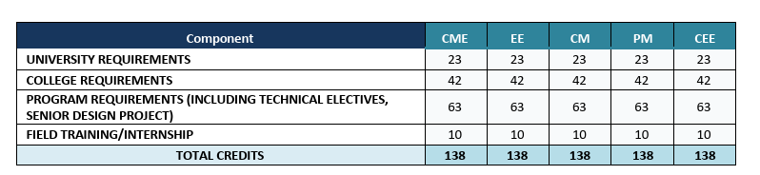
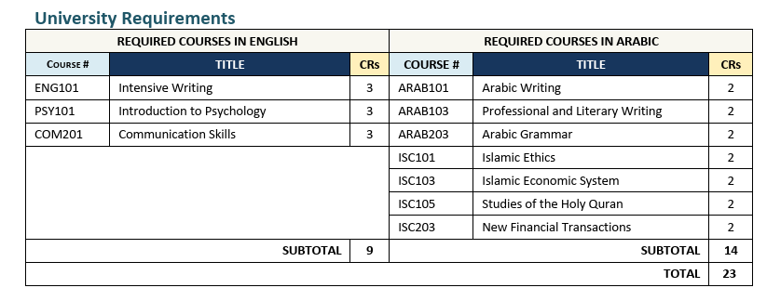

Slide 5
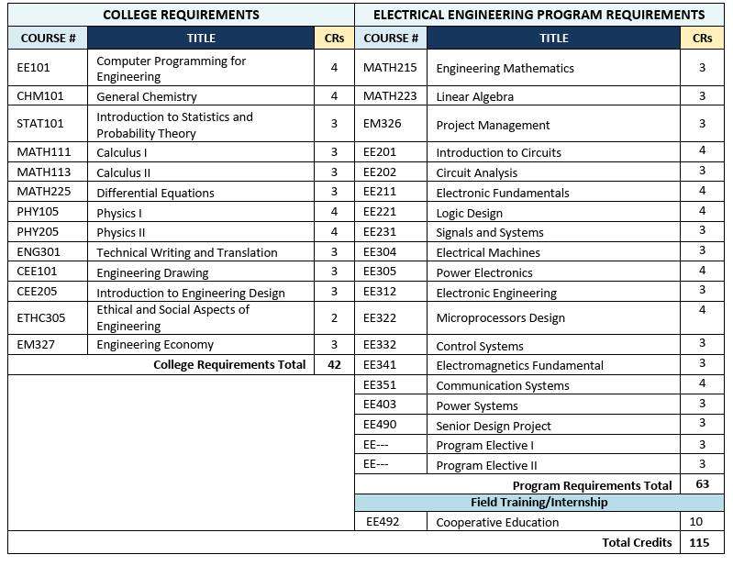

Slide 6

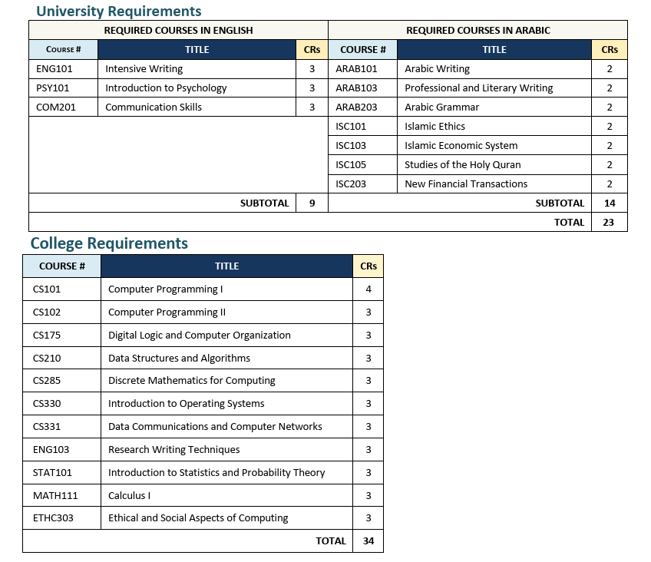
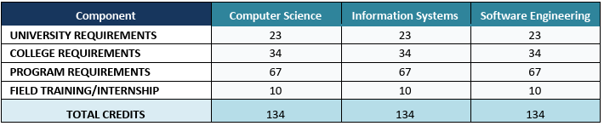

Slide 7
