Slide 1
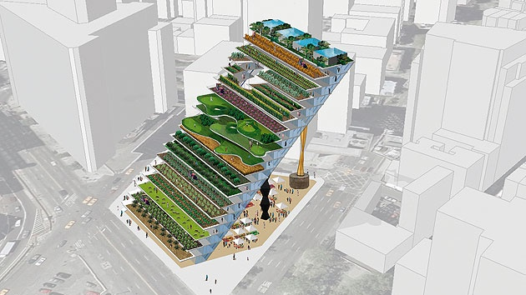



LiDAR Data Processing Methodology
Walid Ghariani
EAGLE MSc.

Slide 2

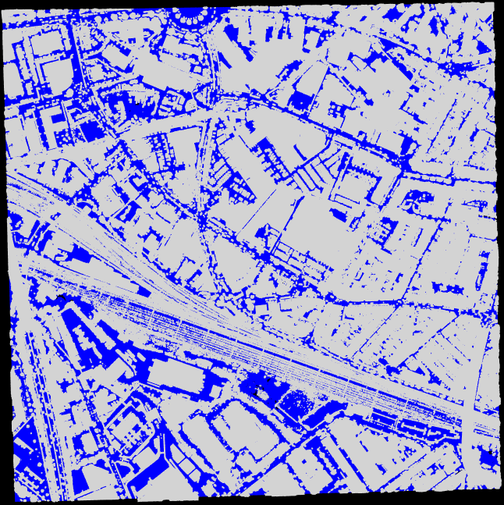
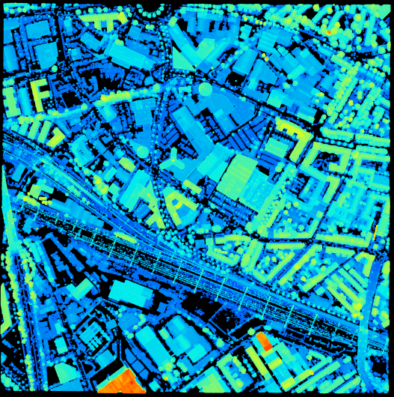
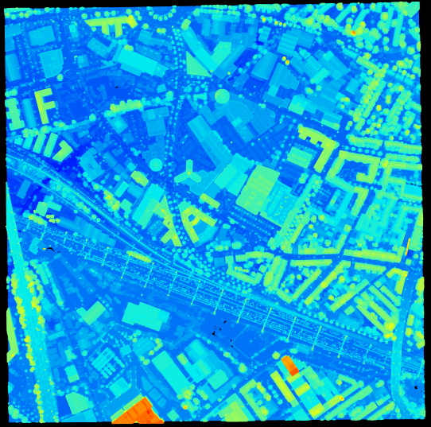
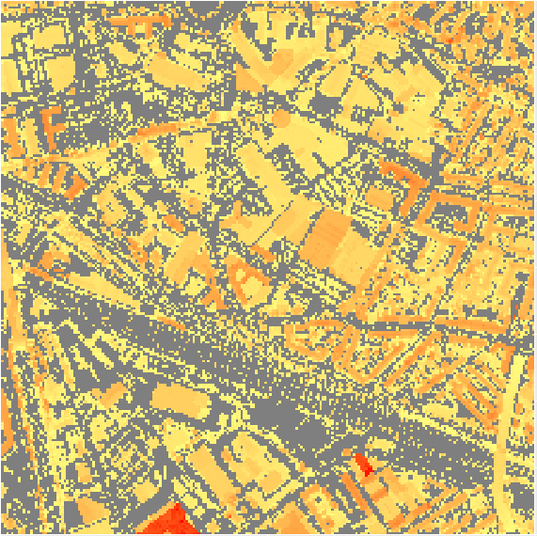

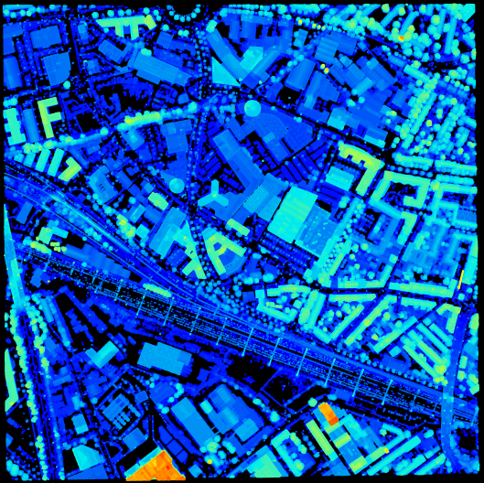
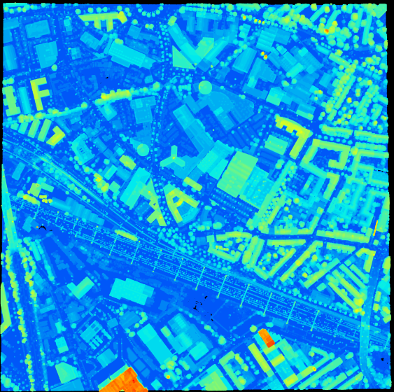
I. INPUT DATA
II. PROCESSING
III. OUTPUT DATA
2. Ground - Nonground
5. Filter the point clouds from the first return classified as ground
1. LiDAR data
7. Generate the nDSM
3. Generate the DTM
6. Remove the outlines/errors
4. Normalize the lidar data

