Slide 1
BAHÇEŞEHİR UNIVERSITY
Faculty of Engineering and Natural Sciences | Department of Artificial Intelligence Engineering
DESIGN AND IMPLEMENTATION OF AN OPTIMAL BINARY SEARCH TREE (OBST)
USING DYNAMIC PROGRAMMING (DP)
CMP3005 — Analysis of Algorithms | Course Project
Presented by WALID M. W. KOBAHALABI Student ID: 2477317
Under the guidance of Dr. MD IMRAN HOSEN Course Instructor
Academic Year 25/26 - Summer 2026

Slide 2
The Problem
Searching a key costs one comparison per level. So, the cost of a search is the depth of the key.
E(T) = Σ pᵢ × depth(kᵢ)
Probabilities are fixed by the input.
Depths are the only thing we control.
Goal: put frequent keys near the root.
Objective
Given sorted keys and their search probabilities, build the binary search tree with the smallest expected number of comparisons.
Why not just try every tree?
42 trees
6.56 × 10⁹ trees
1,540 operations
n = 5
n = 20
n = 20 with DP
The number of possible trees grows exponentially (Catalan numbers), so brute force is impossible.

Slide 3
Dynamic Programming Formulation
State
Base case
C[i, j] = minimum expected cost for keys kᵢ … kⱼ
C[i, j] = 0 when i > j (empty sub-tree)
Depth is measured from that sub-tree's own root
Keeping the subproblems independent
The single-key case C[i,i] = pᵢ follows from this
Not a separate rule
Recurrence
C[i, j] = min over r in [i..j] of { C[i, r−1] + C[r+1, j] } + W(i, j)
Why the + W(i, j) term?
1
Pick kᵣ as root
2
Both halves drop one level
3
Total extra cost
The range splits into two independent halves.
Every key inside needs one extra comparison.
W(i, j) = pᵢ + … + pⱼ, the sum of the range.

Slide 4
Algorithm - Filling the Tables
src/obst.py
for length in range(1, n + 1):
for i in range(1, n - length + 2):
j = i + length – 1
# Calculate the summation term for the successful-search probabilities
weight = interval_probability(prefix, i, j)
best_cost = float("inf")
best_root = i
# Evaluate every possible root k in the interval to minimize the search cost
for r in range(i, j + 1):
# Recurrence relation applying the minimum expected search cost of subtrees
sub = (cost[i][r-1] + cost[r+1][j])
if sub < best_cost:
best_cost = sub
best_root = r
# Update the DP state C[i,j] and record the optimal root
cost[i][j] = best_cost + weight
root[i][j] = best_root
Fill by range length, shortest first.
C[i, j] needs shorter ranges, so those must already be final.
For each range, try every key as root and keep the smallest.
Store the winner in the root table R[i, j].
Pre-compute prefix sums so W(i, j) is O(1).
Without prefix sums the algorithm would be O(n⁴) instead of O(n³).

Slide 5
The Two Tables - Example: keys 10…50
Probabilities: 0.10, 0.20, 0.40, 0.20, 0.10
Cost table C[i, j]
Root table R[i, j]
i\j | 1 | 2 | 3 | 4 | 5
1 | 0.10 | 0.40 | 1.10 | 1.50 | 1.80
2 |  | 0.20 | 0.80 | 1.20 | 1.50
3 |  |  | 0.40 | 0.80 | 1.10
4 |  |  |  | 0.20 | 0.40
5 |  |  |  |  | 0.10
i\j | 1 | 2 | 3 | 4 | 5
1 | 1 | 2 | 3 | 3 | 3
2 |  | 2 | 3 | 3 | 3
3 |  |  | 3 | 3 | 3
4 |  |  |  | 4 | 4
5 |  |  |  |  | 5
C[1, 5] = 1.80
R[1, 5] = 3
The minimum expected search cost
The top-right cell of the cost table.
Key 30 is the root of the whole tree.
The root table is what lets us rebuild the tree itself.
Only the upper triangle is used (i ≤ j).

Slide 6
Rebuilding the Tree from the Root Table
R[1,5] = 3 → key 30 is the root
Left range [1,2]: R[1,2] = 2 → key 20
Right range [4,5]: R[4,5] = 4 → key 40
Recurse until every key is placed.
30
20
40
Verification - the cost is checked twice
Key | p | Depth | p × depth
10 | 0.10 | 3 | 0.30
20 | 0.20 | 2 | 0.40
30 | 0.40 | 1 | 0.40
40 | 0.20 | 2 | 0.40
50 | 0.10 | 3 | 0.30
Total |  |  | 1.80
10
50
Two independent computations agree
The DP table says 1.80. Walking the rebuilt tree and
summing p × depth also gives 1.80 - without ever reading the cost table.
Difference: 2.22 × 10⁻¹⁶ (floating-point only).

Slide 7
Comparison with a Conventional BST
Tree | Expected cost | Avg. depth | Height
Sequential insertion | 3.0000 | 3.0000 | 5
Balanced (midpoint) | 1.9000 | 2.2000 | 3
Optimal BST | 1.8000 | 2.2000 | 3
The key insight
The balanced tree and the optimal tree have the SAME height (3) and the SAME average depth (2.2).
Structurally they are identical: one key at depth 1, two at depth 2, two at depth 3.
The whole 5.26% improvement comes from WHICH key sits at each depth.
Balanced puts key 10 (p = 0.10) at depth 2
and key 20 (p = 0.20) at depth 3.
The optimal tree swaps them.
That single swap is worth exactly 0.10.

Slide 8
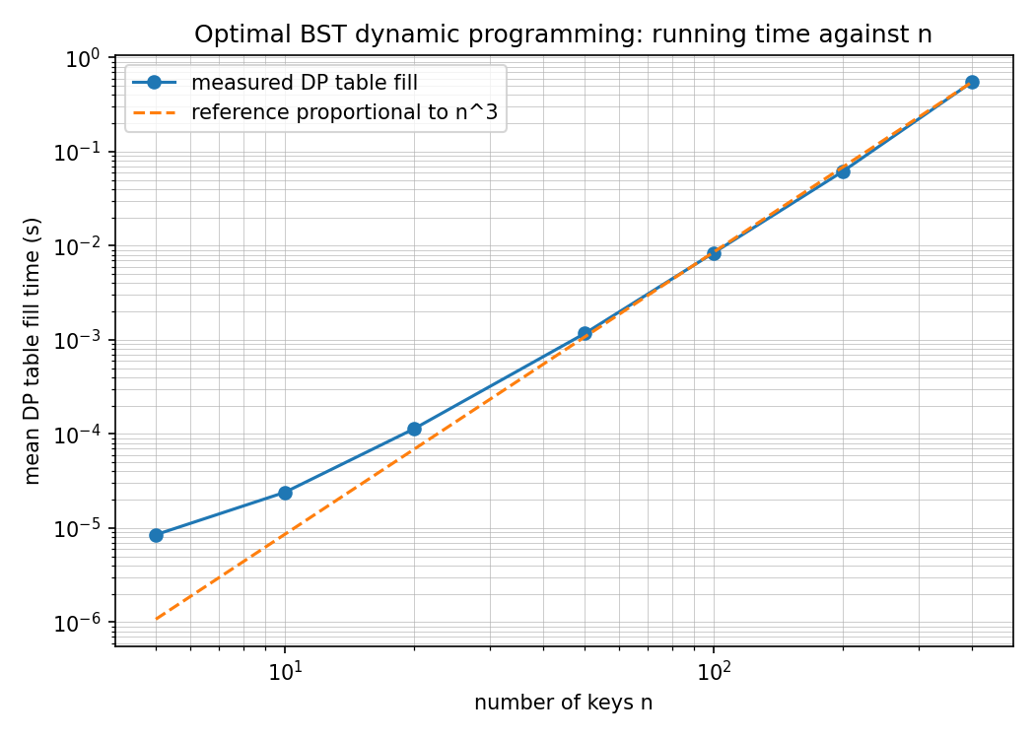
Experimental Analysis
Seven input sizes, five random runs each, timed with time.perf_counter()
n | Time (s) | Operations | µs / operation
5 | 0.000008 | 35 | 0.243
10 | 0.000024 | 220 | 0.109
20 | 0.000113 | 1,540 | 0.074
50 | 0.001168 | 22,100 | 0.053
100 | 0.008437 | 171,700 | 0.049
200 | 0.061855 | 1,353,400 | 0.046
400 | 0.550207 | 10,746,800 | 0.051
Cost per operation settles near 0.05 µs
If total time = operations × a constant, the algorithm really is cubic.
The last three sizes confirm it.
Doubling n from 200 to 400 multiplied the time by 8.9 — cubic predicts 8.
Measured curve follows the n³ reference line.
Small sizes sit above it because of fixed overhead.

Slide 9
Complexity Analysis
Time: O(n³)
Space: O(n²)
Θ(n²) sub-problems — one per range [i, j]
Each tries up to O(n) candidate roots
Exact count: n(n+1)(n+2) / 6
Two tables, each one entry per (i, j)
Prefix-sum array adds only Θ(n)
The tables dominate
Theory matches measurement
0.05 µs
8.9×
2.836
cost per operation converges to a constant
time growth when n doubles
(cubic predicts 8)
fitted exponent for n ≥ 20 (theory says 3)

Slide 10
Summary
Formulated
Implemented
State, recurrence and base case derived from first principles.
Python, 7 modules, no hard-coded results, input validated.
Verified
Analysed
185 automated tests + brute force for n ≤ 7 (429 trees).
O(n³) / O(n²) confirmed across seven input sizes.
What I learned
A greedy rule fails:
In my ten-key test the second-highest-probability key is NOT placed nearest the root, because a root choice affects every other key in the range.
Source code: github.com/WalidMWH/optimal-bst-dynamic-programming
Thank you — questions welcome

