Slide 1

Afrolance
Capstone Project
SE265 Walid Amar

Slide 2
Afrolance Overview
Afrolance is a job recruiting website for inexperienced freelancers and company that want work to be done without paying an expert.
Afrolance is based on Africa.

Slide 3
Features
Choice of type of user : Employer or Freelancer
Sign / Up
Data Validation
Login
Access restriction depending on user
Job Posting
Job Listing

Slide 4
Users Accesses
Employer:
Dashboard
Employer List and Applicant list
Employer Profile Pages
Job List
Application Page
Freelancer:
Dashboard
Job List
Employer List
Access to Employer’s contact page
Admin:
All other users functionalities
Detailed Lists with Ids and Password
Edit / Delete Data

Slide 5
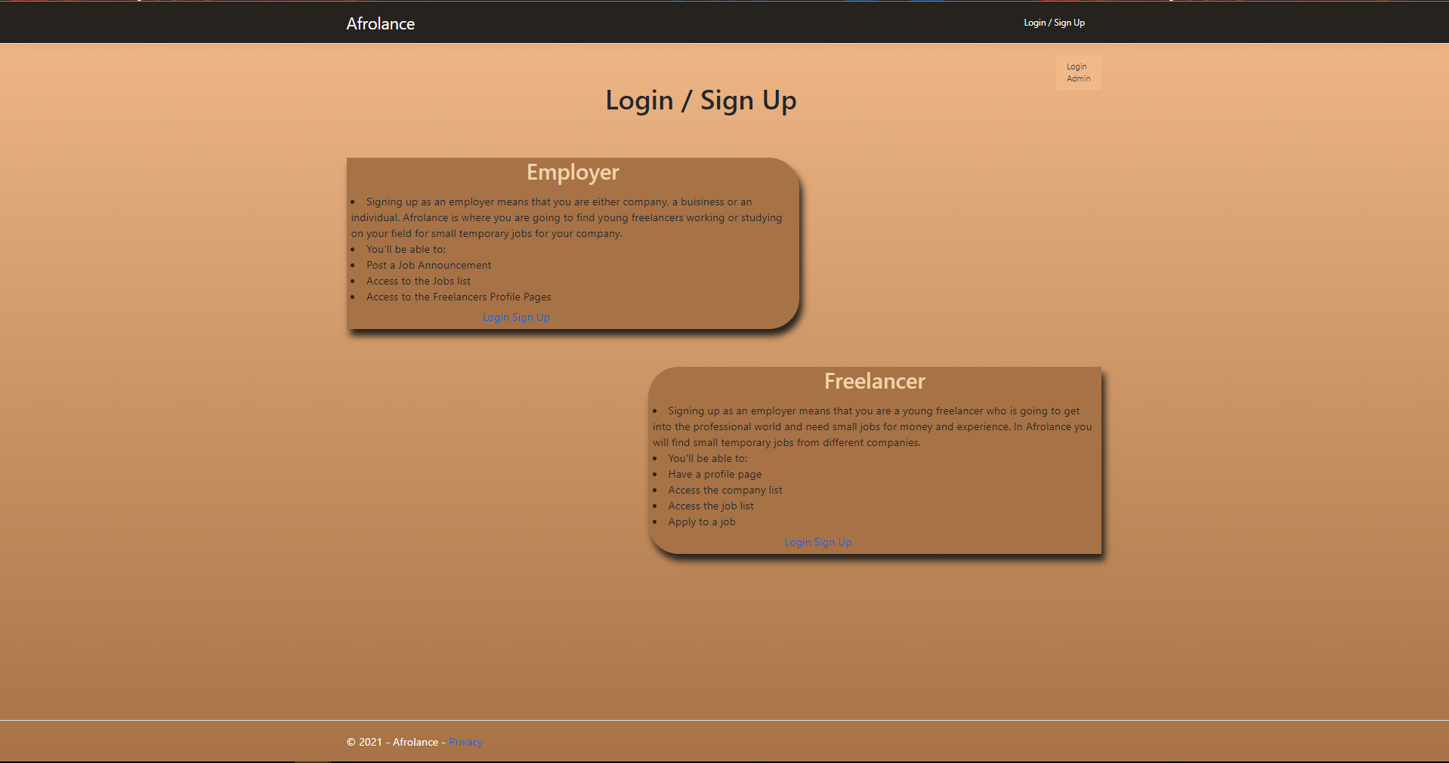
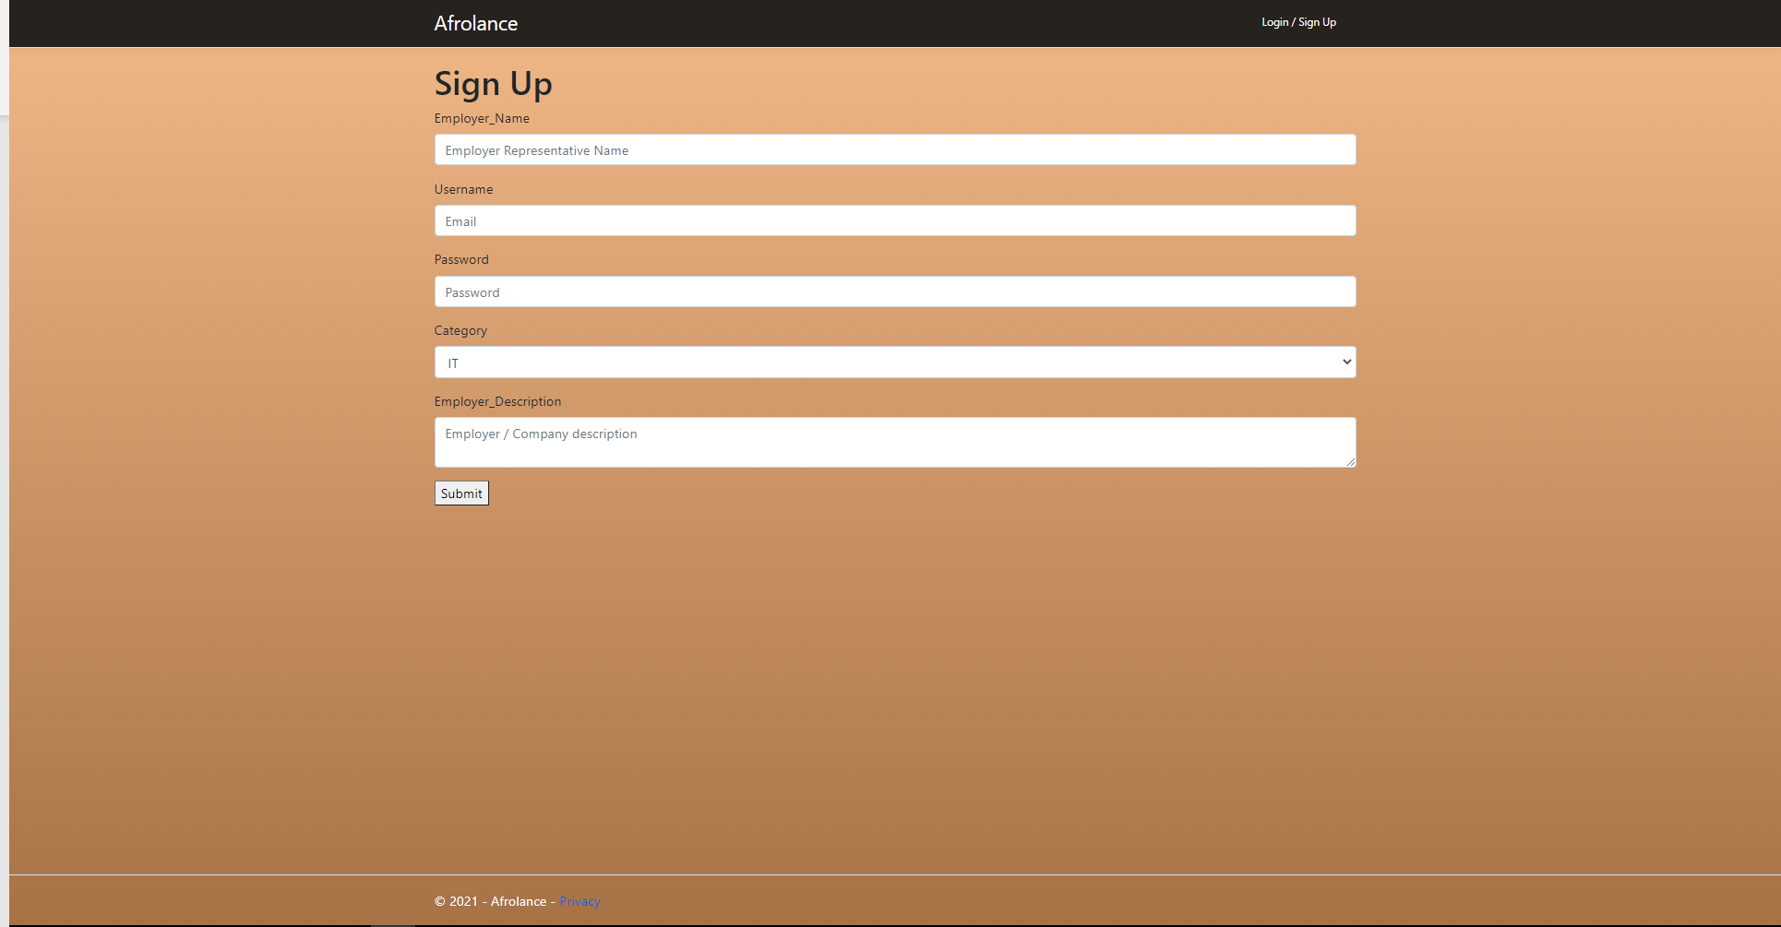
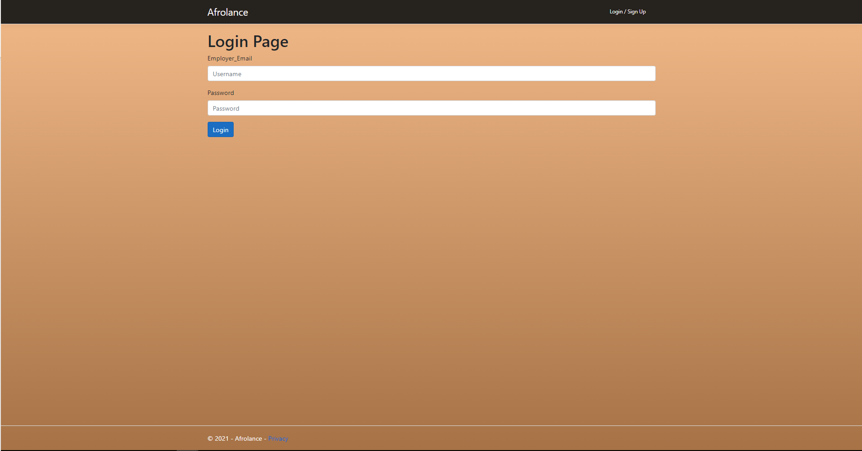
Login / Sign Up Pages (New)

Slide 6
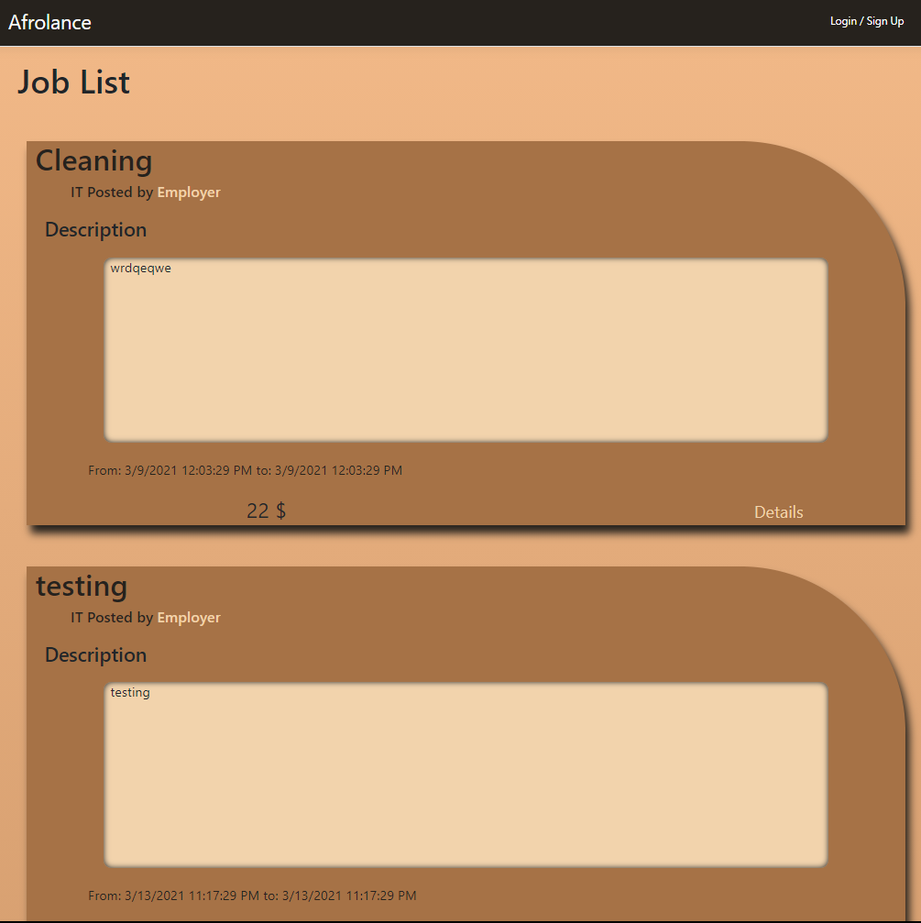
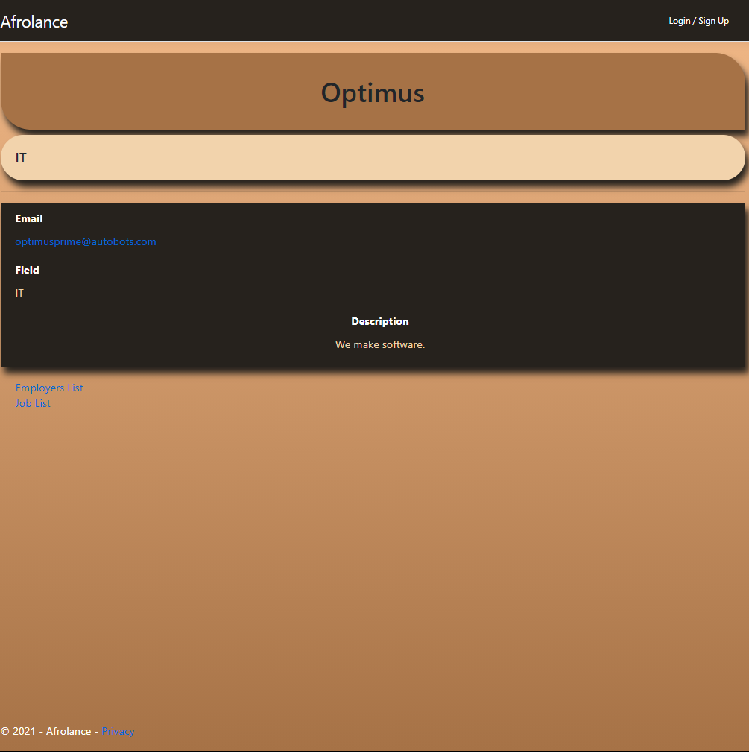

Slide 7
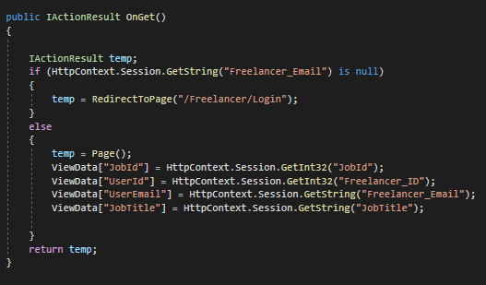

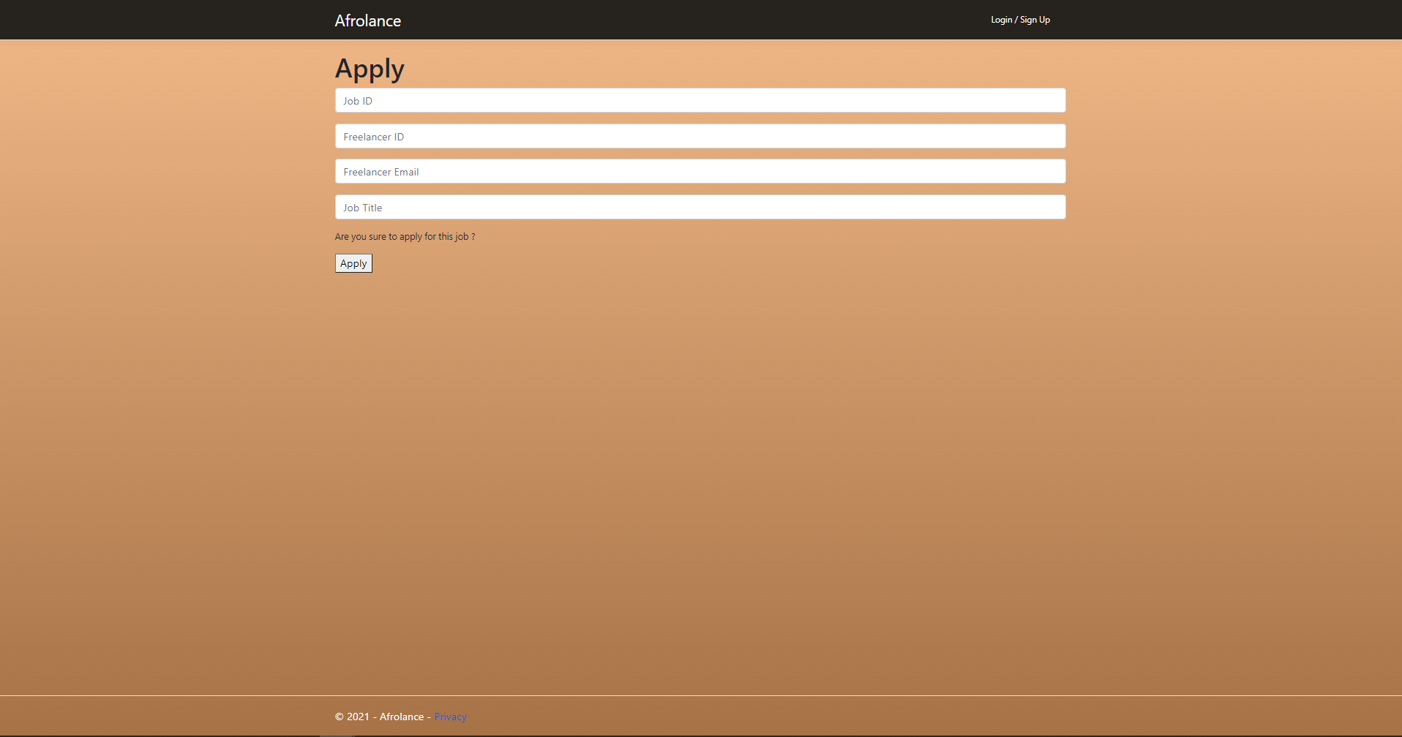
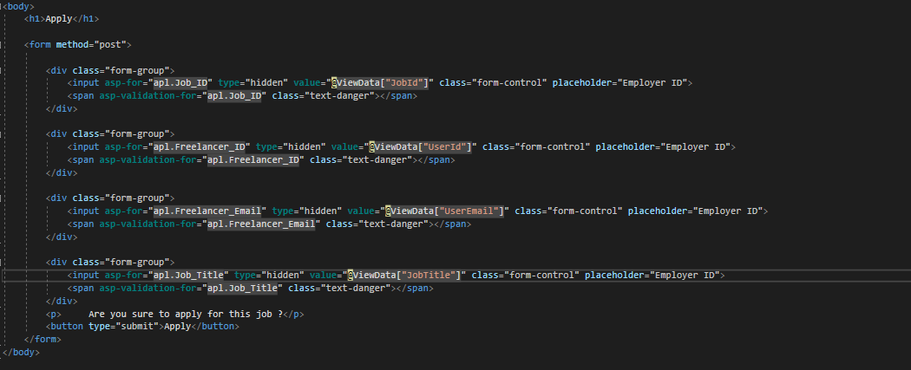
Major Programming Hurdle

Slide 8
If I had more time
Sorting Data
Search function for all Data types
Take time to understand the foreign key functionalities in ASP.Net

Slide 9
Thank you

