Slide 1

Name: Walid Salah Alden Mohamed.
Username: svgpdv25wasalah
Path:/home/svgpdv25wasalah/old/ALU_UVM_PROJ

Slide 2
Table of content
TEST CASES
VERIFICATION ENVIRONEMT
Environment EXPLANATION
RESULTS

Slide 3
TEST CASES:
Notes:
****************NOTE : in fault injection case we enter the permitted values to DUT to check the behavioral of the DUT in this scenarios For details
Check the verification Plan in the EXCEL sheet **************************************************

Slide 4
ALU_TOP
ALU_TEST
ALU_Sequences
ALU_coverage_collector
ALU_env
ALU_agent
ALU_monitor_inp
ALU_
golden_model
ALU_sequencer
ALU_monitor_out
ALU_
checker
ALU_driver
Virtual_interface
ALU_interface
ALU_DUT

Slide 5
ENVIRONMENT EXPLANATION
1. ALU_TOP:
This is the container of the overall system.
At first ,we import the uvm_pkg and environment classes package.
We generate the clock inside it and instantiate the DUT .
We pass the interface throw the config_db and call the run task.

Slide 6
ENVIRONMENT EXPLANATION
2. ALU_DUT:
This is a parameterized design ALU module.
It is a module connected to the interface in the TOP module.
We define extra output signal called
error_flag assert in case non permitted
cases.
In case of non-permitted opcode cases, we put the previous values in the design refer to no response on these values and assert the error flag .
Incase A or B equal to -16 value DUT should assert error flag too.

Slide 7
ENVIRONMENT EXPLANATION
3. ALU_Interface:
This is a parameterized interface.
It is content all signals which connect
the design unit with the environment .
there is inside it clocking block to avoid
racing when we send data.
It is content concurrent assertions to check the correctness of the design during simulation.
Virtual interface It is responsible for connecting the static element “DUT” with the dynamic element ”class” to establish the connection during run time.

Slide 8
ENVIRONMENT EXPLANATION
4. ALU_test:
The test class is a component class extends from
uvm_test and is instantiated under the top
module.
It connects to the DUT via an interface passed
through config_db to child classes.
It constructs components like env and sequences, then initiates scenarios.
Different test versions start specific sequences, e.g., base_test triggers DUT reset.

Slide 9
ENVIRONMENT EXPLANATION
5. ALU_sequences:
The sequence class is an object class is
instantiated under the test class.
Within the body task, transactions are
randomized with specific constraints to achieve
the desired testing scenario.
Multiple sequence variations exist, each tailored different testing scenarios.

Slide 10
ENVIRONMENT EXPLANATION
6. ALU_Env:
The env is a component class is instantiated
under the test class.
It connects to the DUT via an interface from the
test class and passed through config_db to child
classes.
It is responsible for creating classes like “checker” and connecting the classes with each
other.

Slide 11
ENVIRONMENT EXPLANATION
7. ALU_Agent:
It is a component class is instantiated
under the env class.
We pass the obtained interface from the env
class to the driver and monitors throw config_db.
It create other classes and is responsible for connecting them.

Slide 12
ENVIRONMENT EXPLANATION
8. Coverage_Collector:
It is a component class is instantiated
under the env class.
It is responsible for collecting coverage of inputs
and outputs at the same time.
We define flags based on the values of the input transaction to facilitate the sampling of effective transactions for testing the DUT.
This approach is functionally equivalent to performing a cross between bins while optimizing code efficiency.
We define two write functions for received transactions “input and output”.

Slide 13
ENVIRONMENT EXPLANATION
9. Golden_Model:
It is a component class is instantiated
under the env class.
It is a class we use to get the correct expected output from DUT by sending to it the input transaction from the Monitor_inp class.
After finishing it send the result to the checker class
To compare it with the output from DUT.

Slide 14
ENVIRONMENT EXPLANATION
10. ALU_Checker:
It is a component class is instantiated
under the env class.
It is a class we use to compare the outputs that come from the DUT and the Golden Model and calculate the correct and incorrect comparison.
We define two write functions with two analysis_imp to get the data from DUT and the model in different passes.

Slide 15
ENVIRONMENT EXPLANATION
11. ALU_Sequencer:
It is a component class is instantiated
under the agent class.
This class responsible for organizing the operation
from sequence class to driver.

Slide 16
ENVIRONMENT EXPLANATION
12. ALU_Driver:
It is a component class is instantiated
under the agent class.
It is a class we use to send the transaction from
the generator after translating it from the
transaction level to the bin level .

Slide 17
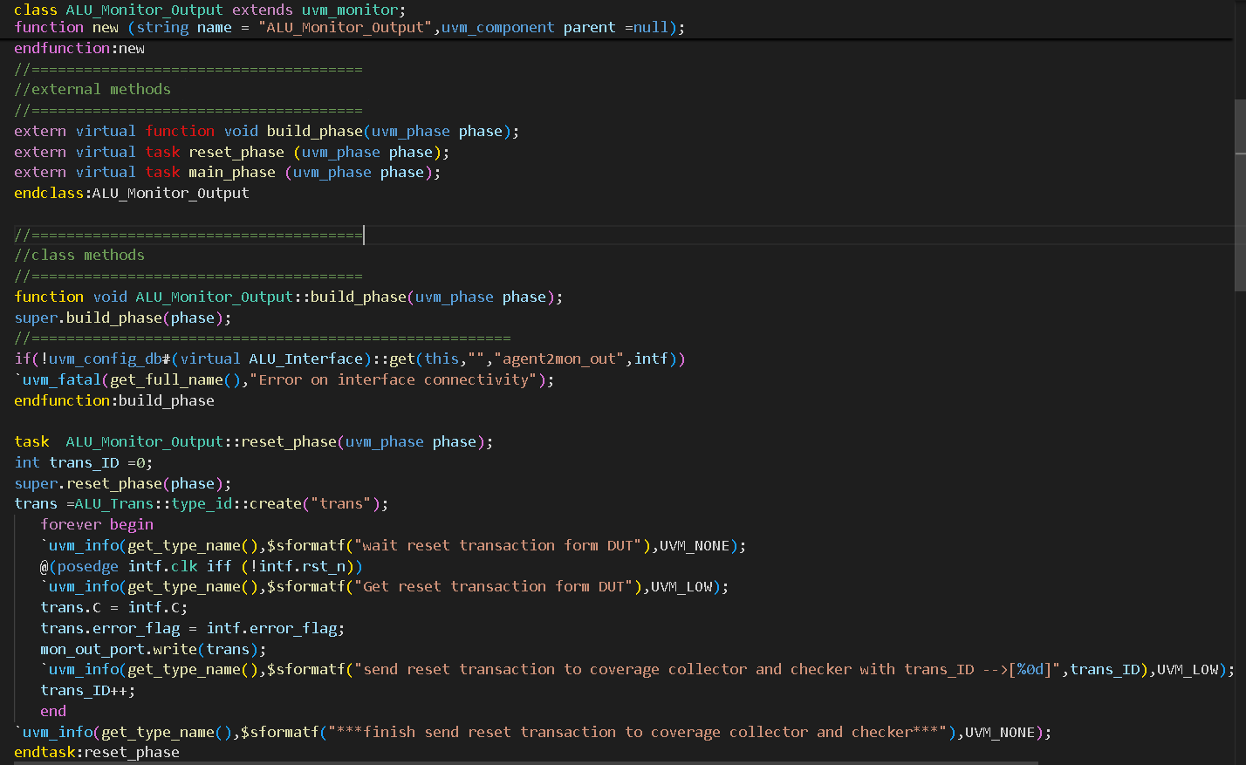
ENVIRONMENT EXPLANATION
13. ALU_Monitor_out:
It is a class we use it to monitor the output from
The interface and convert it to transaction level.
Then it sends the transaction to the checker to check the correctness with the Golden Model output and the coverage collector throw the mailboxes.
The monitoring logic is activated for the monitor only when ALU_en = 1, while assertions are utilized when ALU_en = 0 to reduce sampling operations and enhance the efficiency of the sampling process.
The #0 delay is used in the code to establish priority between threads, ensuring that one executes before the other in cases where both would otherwise run concurrently.

Slide 18
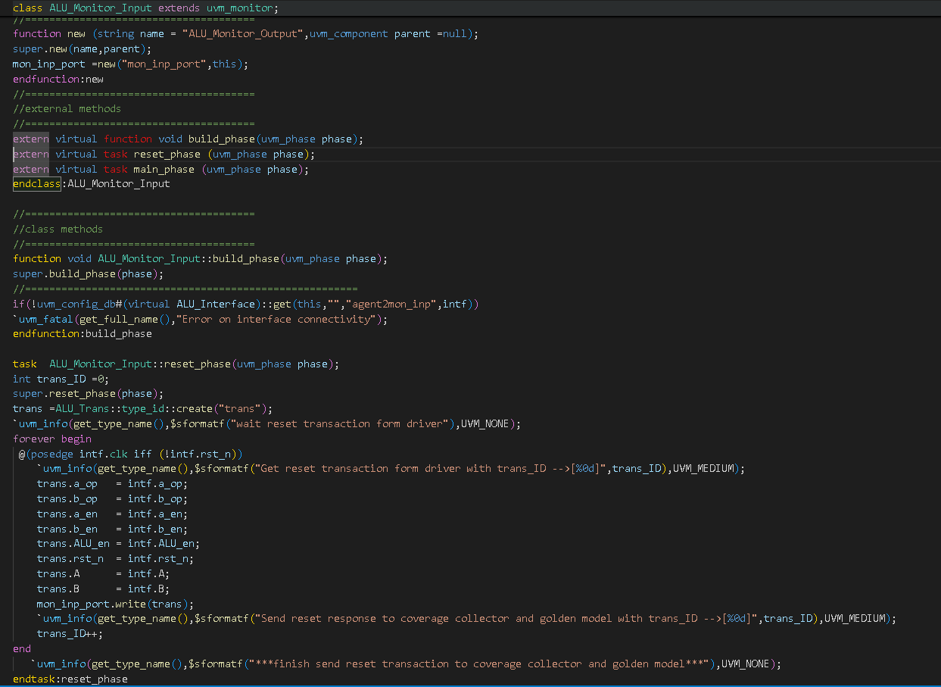
ENVIRONMENT EXPLANATION
14. ALU_Monitor_inp:
It is a component class is instantiated
under the agent class.
Then it sends the transaction to the Golden Model and the coverage collector.

Slide 19
ENVIRONMENT EXPLANATION
15. ALU_Trans:
The ALU_trans is an object class.
The transaction class is defined with variables
that are utilized for communication between
different classes.
It includes generic constraints along with additional constraints tailored to specific scenarios.
Additionally, we add transaction methods on the class to reduces the repeated code on the component and make it more readable.

Slide 20
ENVIRONMENT EXPLANATION
16. ALU_Package:
This package contains all necessary .svh files inclusions and import the uvm_pkg.
We incorporate the testing scenarios and sequences as part of the process.

Slide 21
ENVIRONMENT EXPLANATION
17. Makefile:

Slide 22
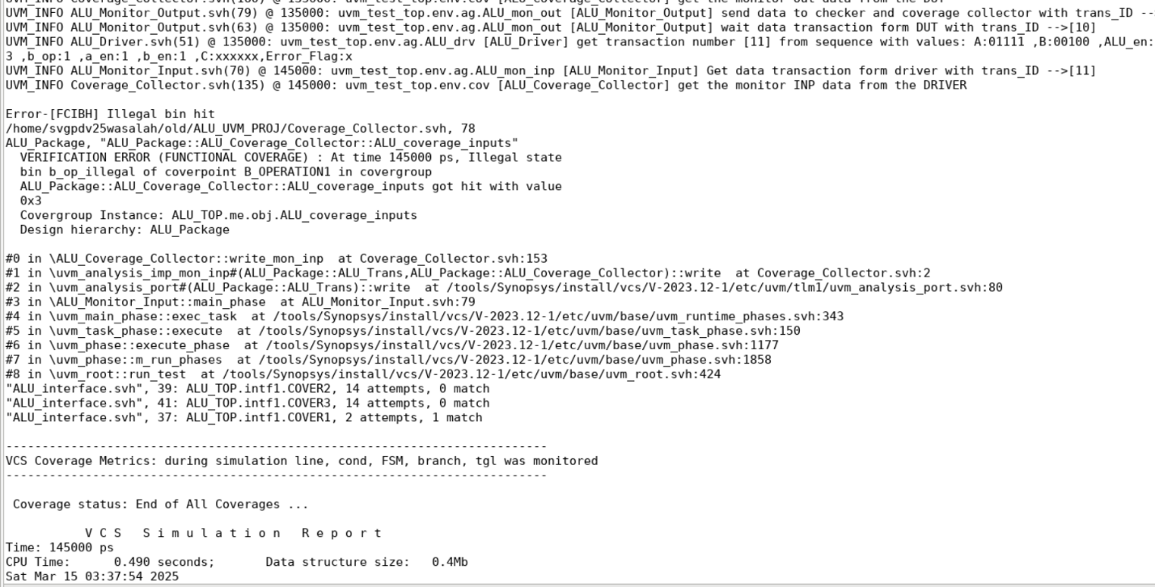
RESULTS:Transcript
In this case, illegal bins would terminate the simulation. To ensure scenario completion, we replace them with ignore bins, allowing the simulation to proceed while still reporting their occurrences.

Slide 23
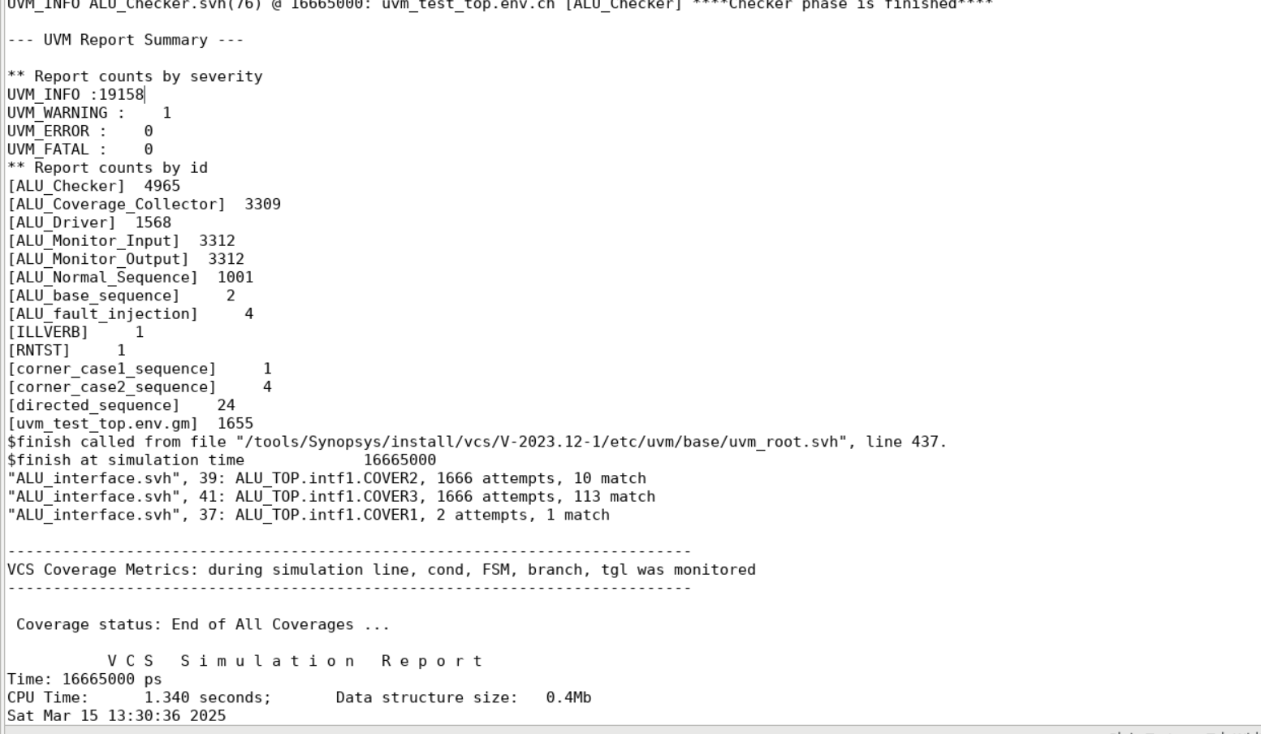
RESULTS:Transcript

Slide 24
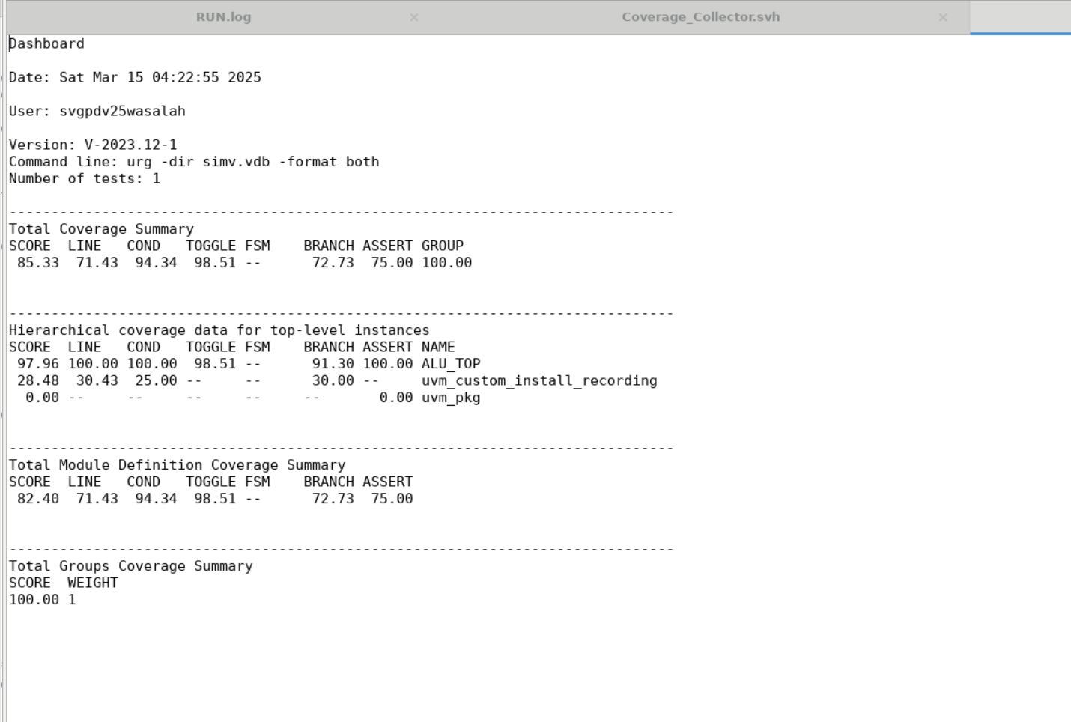
RESULTS :COVERAGE

Slide 25
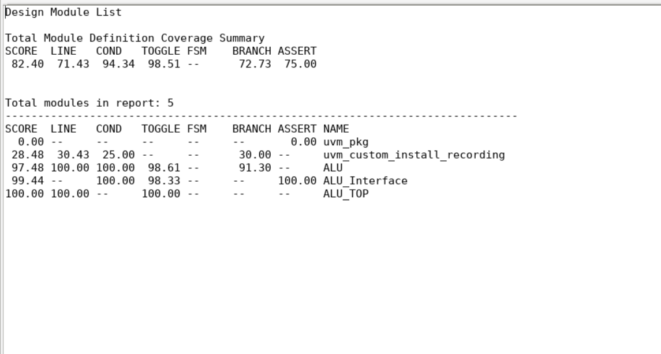
RESULTS :COVERAGE
Code Coverage:
In this case, we observe that code coverage is not fully achieved, as certain default branches are not included, and the toggling of the reset signal from 0 to 1 is not captured, given that the reset state is applied at the beginning of the operation.
We note on uvm_pkg the coverage is low as we don’t pass throw all lines code.

Slide 26
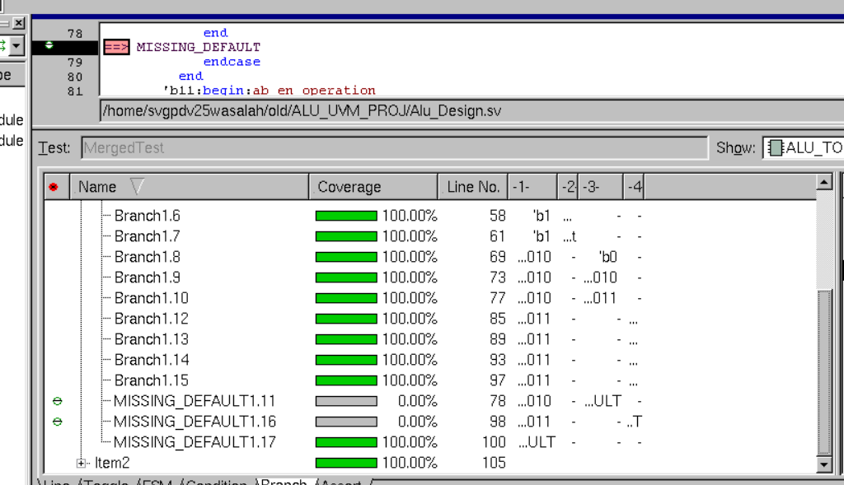
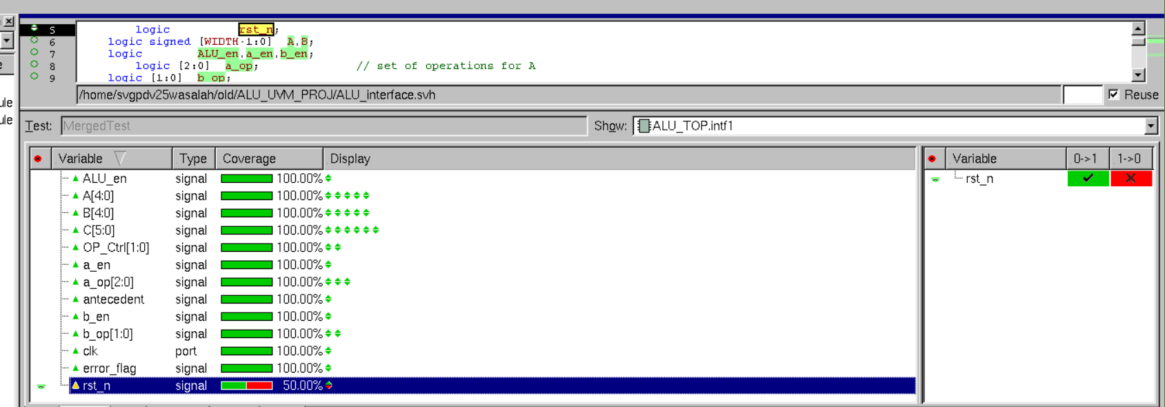
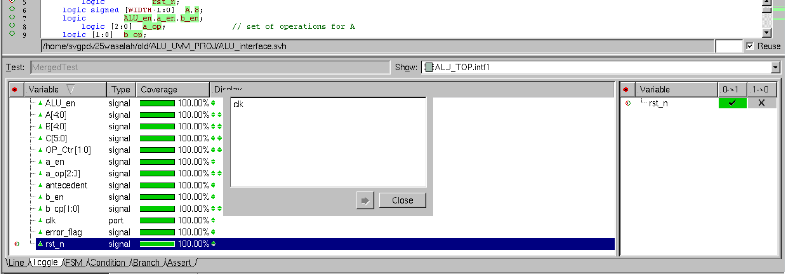
RESULTS :COVERAGE
Code Coverage:

Slide 27
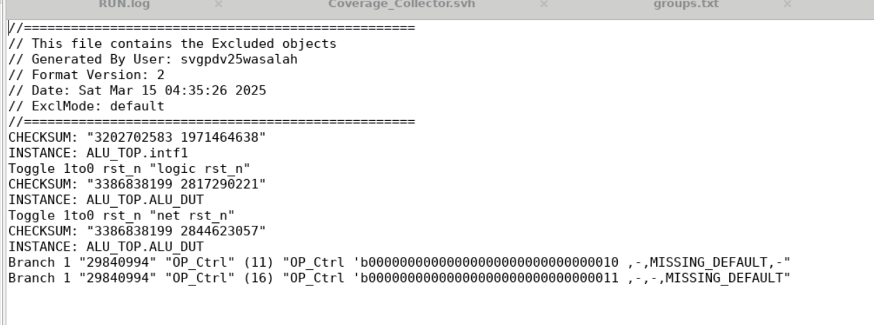
RESULTS :COVERAGE
Code Coverage:
This is the file and code coverage data excluded from the DUT after the exclusion process.

Slide 28
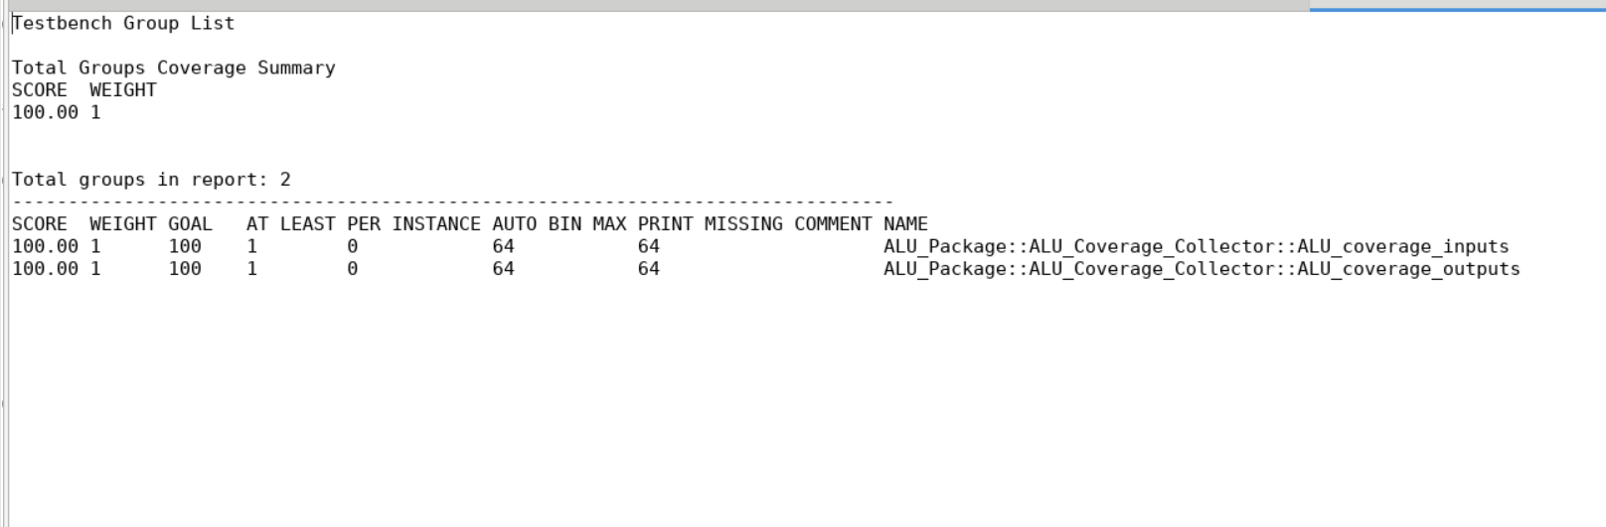
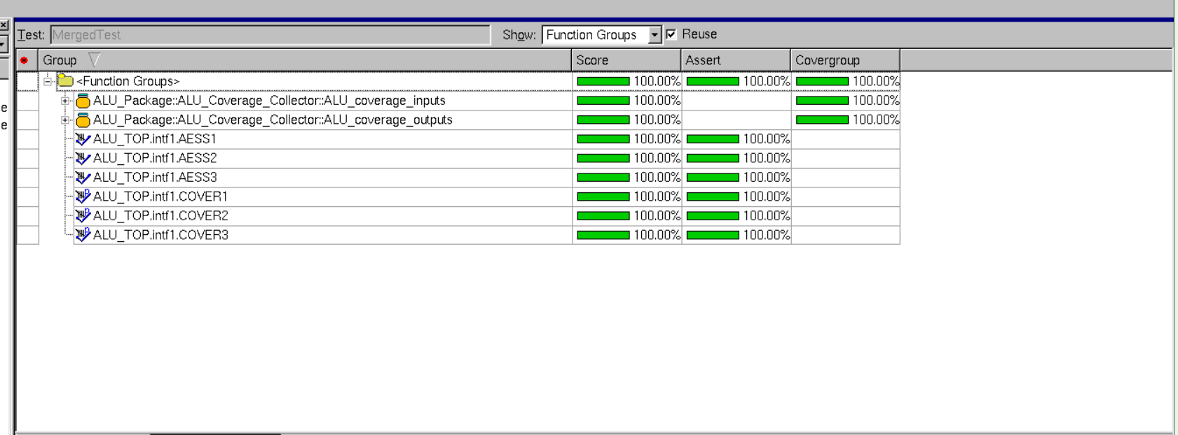
RESULTS :COVERAGE
2. Functional Coverage:

Slide 29
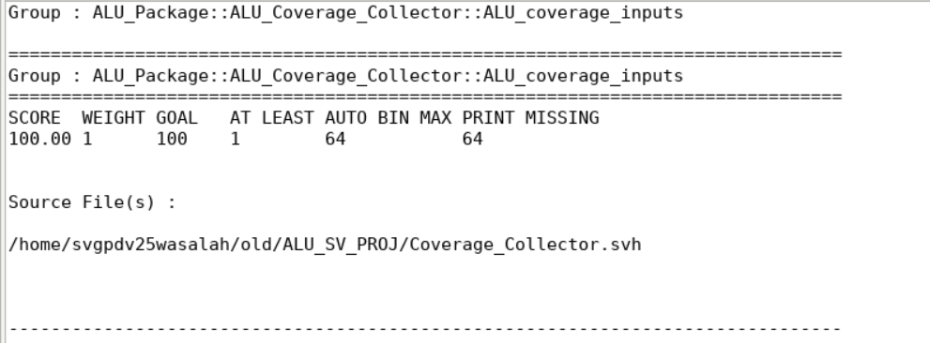
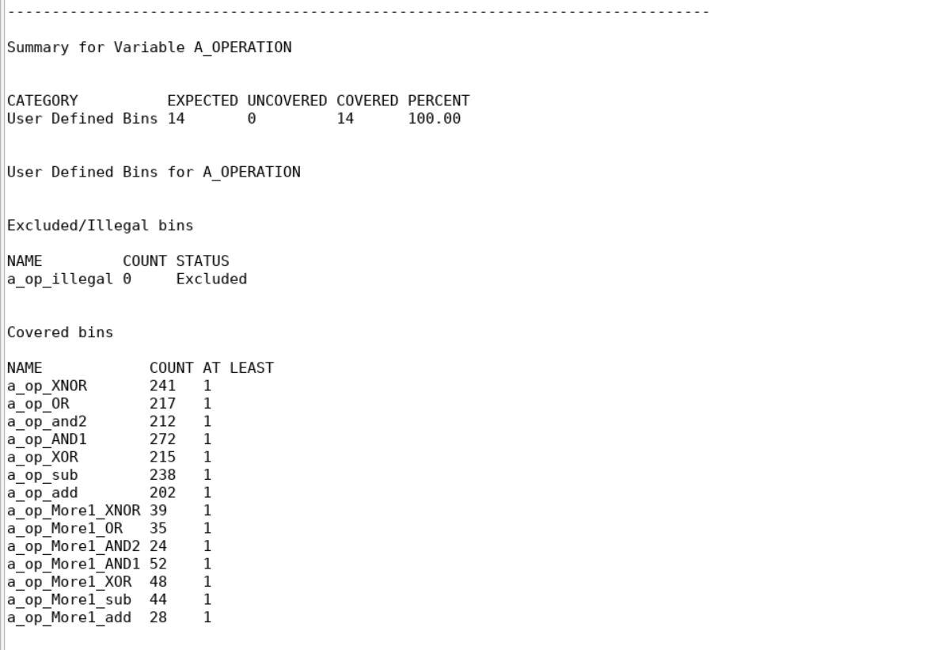
RESULTS :COVERAGE
2. Functional Coverage:

Slide 30

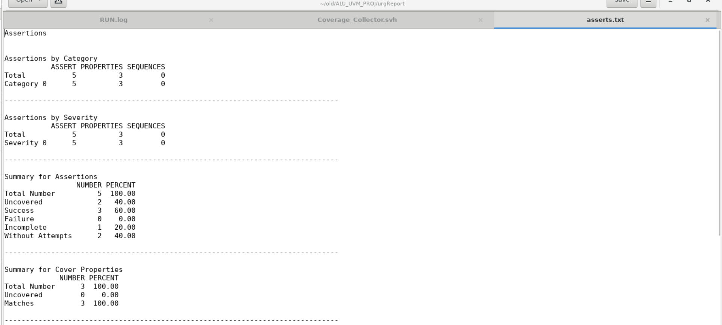
RESULTS :COVERAGE
3. Assertion Coverage:

Slide 31
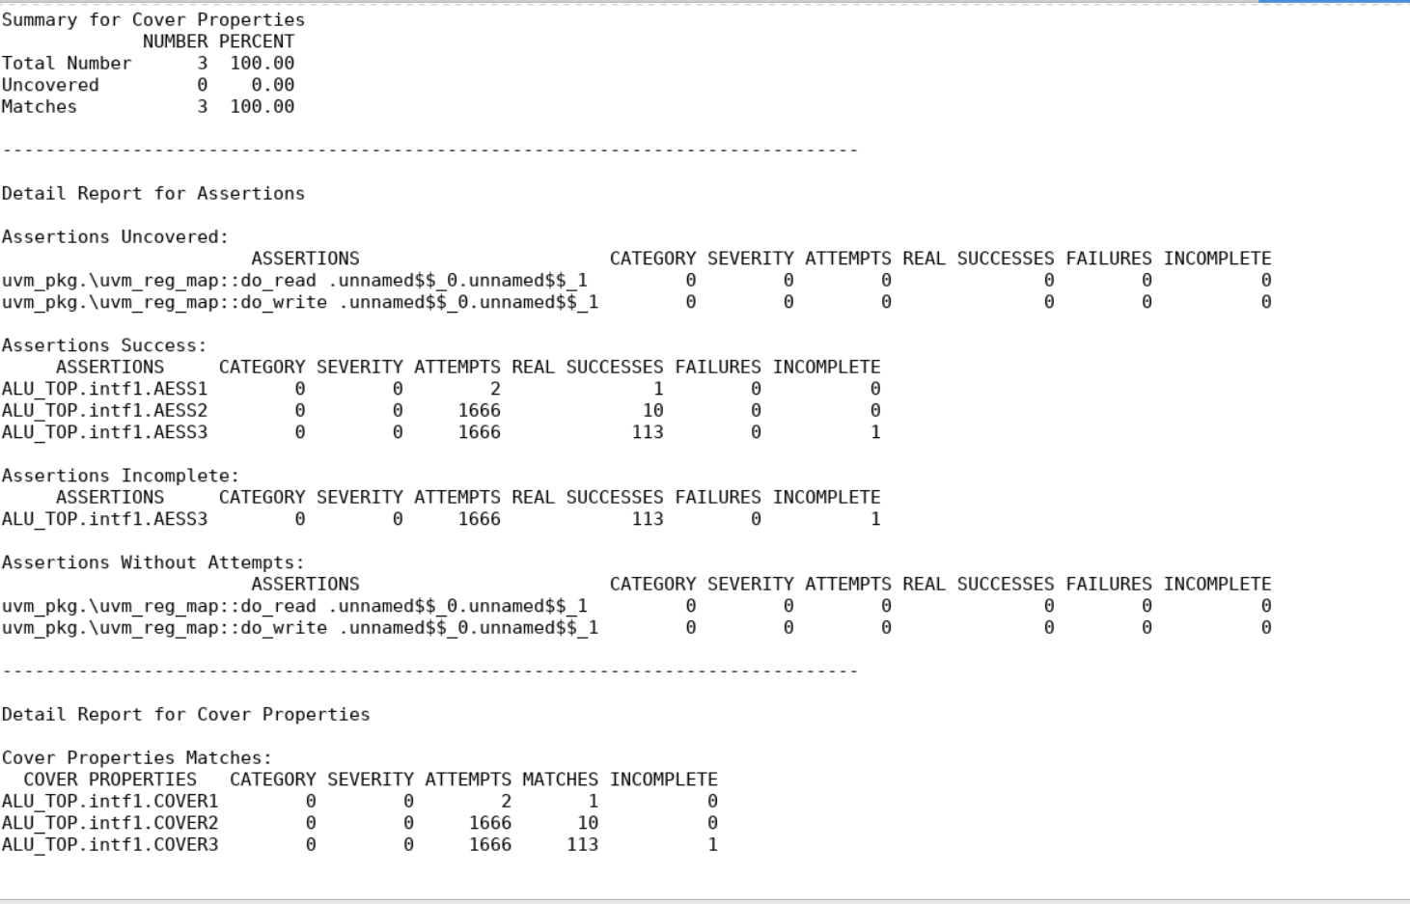
RESULTS :COVERAGE
3. Assertion Coverage:

Slide 32
Thank You

