Slide 1


-Name: Walid Salah Alden Mohamed.
-Username: svgpdv25wasalah

Slide 2
Table of content
TEST CASES
VERIFICATION ENVIRONEMT
Environment EXPLANATION
RESULTS

Slide 3
TEST CASES:
Notes:
****************NOTE : in fault injection case we enter the permitted values to DUT to check the behavioral of the DUT in this scenarios For details
Check the verification Plan in the EXCEL sheet **************************************************

Slide 4
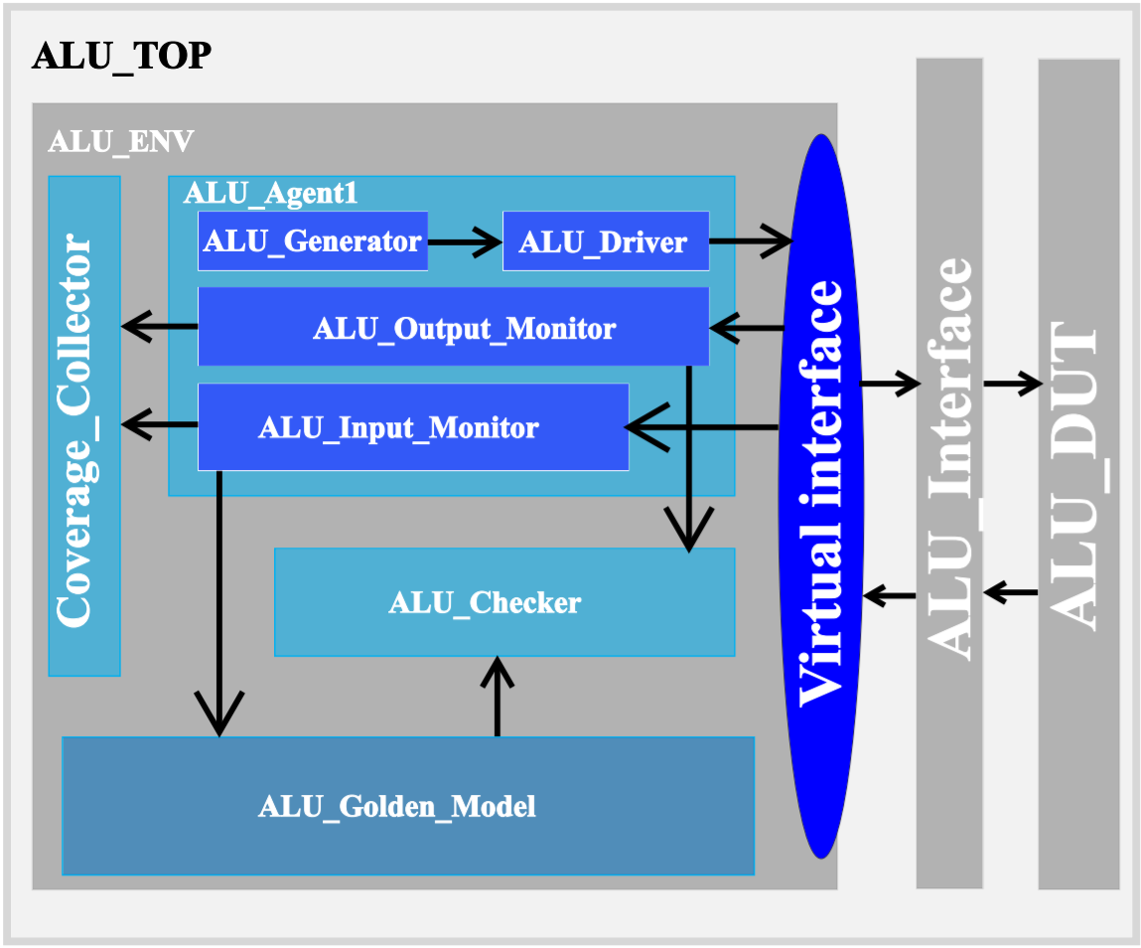
VERIFICATION ENVIRONEMT

Slide 5
ENVIRONMENT EXPLANATION
1. ALU_TOP:
This is the container of the overall system.
Inside it we instantiate the DUT and connect it with the ENV class by the interface.
We generate the clock inside it.
The ENV run task is called inside the
TOP To build the hierarchy .

Slide 6
ENVIRONMENT EXPLANATION
2. ALU_DUT:
This is a parameterized design ALU module.
It is a module connected to the interface in the TOP module.
We define extra output signal called
error_flag assert in case non permitted
cases.
In case of non-permitted opcode cases, we put the previous values in the design refer to no response on these values and assert the error flag .
Incase A or B equal to -16 value DUT should assert error flag too.

Slide 7
ENVIRONMENT EXPLANATION
3. ALU_Interface:
This is a parameterized interface.
It is content all signals which connect
the design unit with the environment .
there is inside it clocking block to avoid
racing when we send data.
It is content concurrent assertions to check the correctness of the design during simulation.
Virtual interface It is responsible for connecting the static element “DUT” with the dynamic element ”class” to establish the connection during run time.

Slide 8
ENVIRONMENT EXPLANATION
3. ALU_ENV:
The environment is class-based.
This class under the TOP module and connected
with the DUT Throw the interface [connected it by instantiating inside it the virtual interface].
It is responsible for constructing classes like “Agent1,” connecting the interface to the inner classes and connecting the classes with each other.
At the end, it calls the run function inside the classes.

Slide 9
ENVIRONMENT EXPLANATION
4. ALU_Agent1:
It is a class inside the ENV class and contains other classes inside it.
We encapsulate the insider class in one class that gives an advantage in using this agent inside any another environment.
It instantiates other classes and is responsible for connecting them with the interface and the mailboxes.
It calls the run task of the classes that are inside the agent.

Slide 10
ENVIRONMENT EXPLANATION
5. Coverage_Collector:
It is a class inside the ENV class.
It is responsible for collecting coverage of inputs
and outputs at the same time.
We define flags based on the values of the input transaction to facilitate the sampling of effective transactions for testing the DUT.
This approach is functionally equivalent to performing a cross between bins while optimizing code efficiency.
It is connected by Monitor_inp and Monitor _out
To collect the data by mailboxes.

Slide 11
ENVIRONMENT EXPLANATION
5. Golden_Model:
It is a class we use to get the correct expected output from DUT by sending to it the input transaction from the Monitor_inp class using Mailbox.
After finishing it send the result to the checker class
To compare it with the output from DUT using
The mailbox too.

Slide 12
ENVIRONMENT EXPLANATION
6. ALU_Checker:
It is a class we use to compare the outputs that come from the DUT and the Golden Model and calculate the correct and incorrect comparison.

Slide 13
ENVIRONMENT EXPLANATION
7. ALU_Generator:
It is a class we use to generate transactions based on the verification plan using the constraint and send it to the driver.
The connection with the driver with the mailbox to synchronize the connection

Slide 14
ENVIRONMENT EXPLANATION
8. ALU_Driver:
It is a class we use to send the transaction from the generator after translating it from the transaction level to the bin level .

Slide 15
ENVIRONMENT EXPLANATION
9. ALU_Monitor_inp:
It is a class we use it to monitor the inputs from
The interface and convert it to transaction level.
Then it sends the transaction to the Golden Model and the coverage collector throws
the mailboxes.

Slide 16
ENVIRONMENT EXPLANATION
10. ALU_Monitor_out:
It is a class we use it to monitor the output from
The interface and convert it to transaction level.
Then it sends the transaction to the checker to check the correctness with the Golden Model output and the coverage collector throw the mailboxes.
The monitoring logic is activated for the monitor only when ALU_en = 1, while assertions are utilized when ALU_en = 0 to reduce sampling operations and enhance the efficiency of the sampling process.
The #0 delay is used in the code to establish priority between threads, ensuring that one executes before the other in cases where both would otherwise run concurrently.

Slide 17
ENVIRONMENT EXPLANATION
11. ALU_Trans:
The transaction class is defined with variables that are utilized for communication between different classes.
It includes generic constraints along with additional constraints tailored to specific scenarios.
Additionally, a void display function is implemented to print the contents of the transaction.

Slide 18
ENVIRONMENT EXPLANATION
11. ALU_Package:
This package contains all necessary .svh files inclusions and an enumeration that facilitates the selection of the required test scenario.

Slide 19
ENVIRONMENT EXPLANATION
11. Makefile:
This file automates the compilation and execution process within the tool.

Slide 20
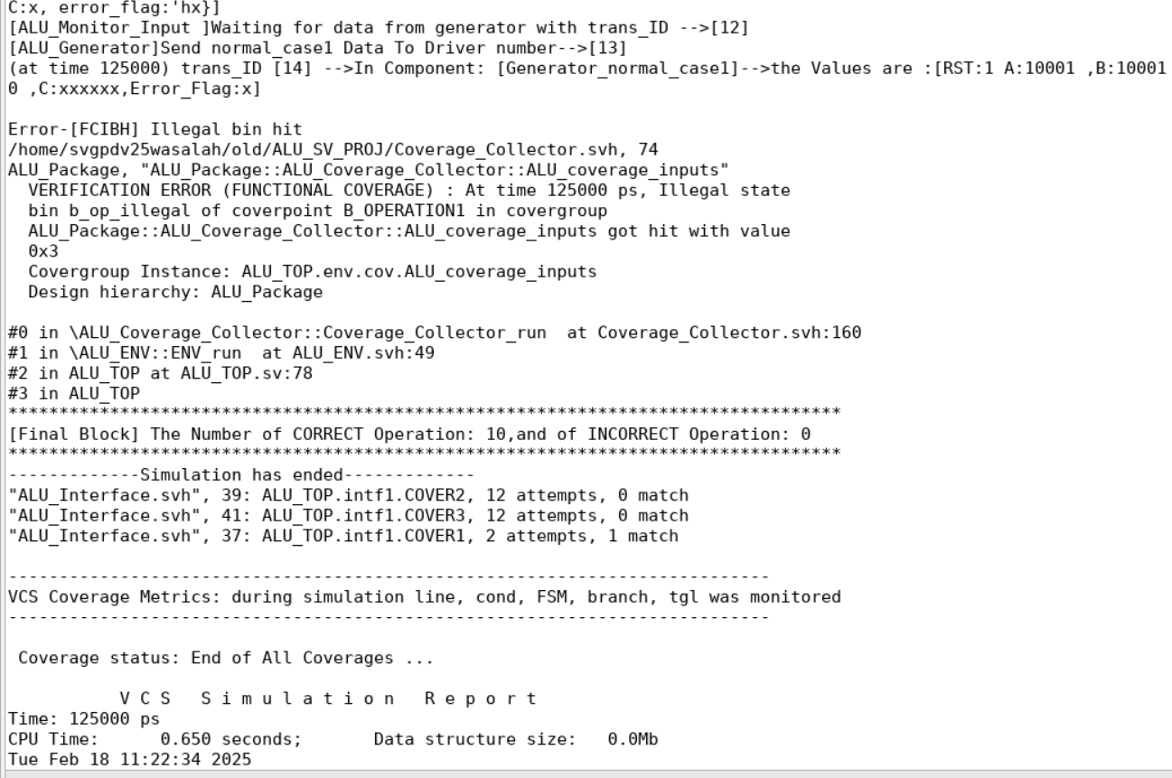
RESULTS:Transcript
In this case, illegal bins would terminate the simulation. To ensure scenario completion, we replace them with ignore bins, allowing the simulation to proceed while still reporting their occurrences.

Slide 21
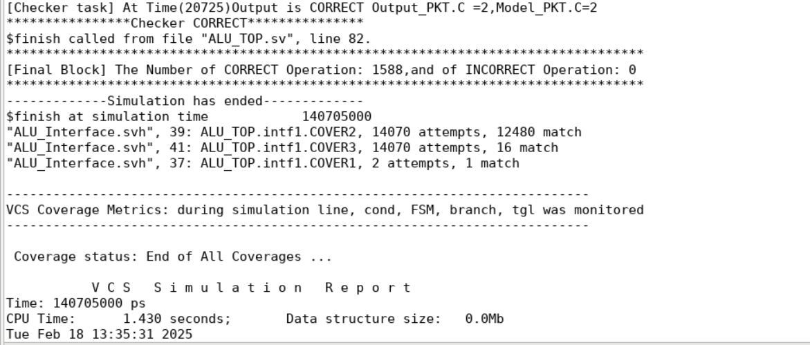
RESULTS: Transcript
In this case, after performing the replacement and reaching the end of the simulation.

Slide 22
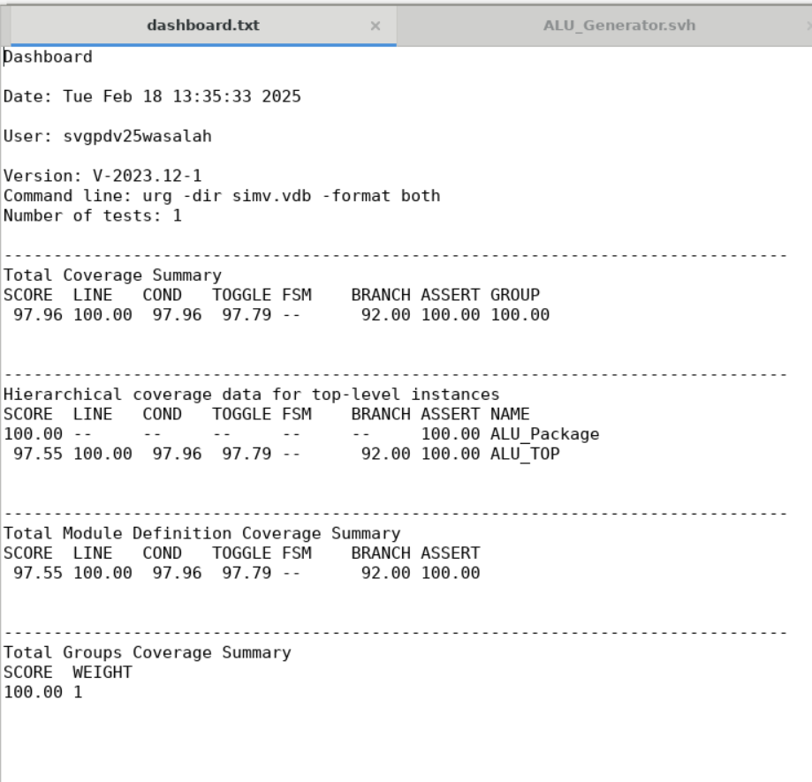
RESULTS :COVERAGE
Notes:
****************************IMPORTANT: FOR MORE DETAILS CHECK “coverage_report.txt” FILE ****************************

Slide 23
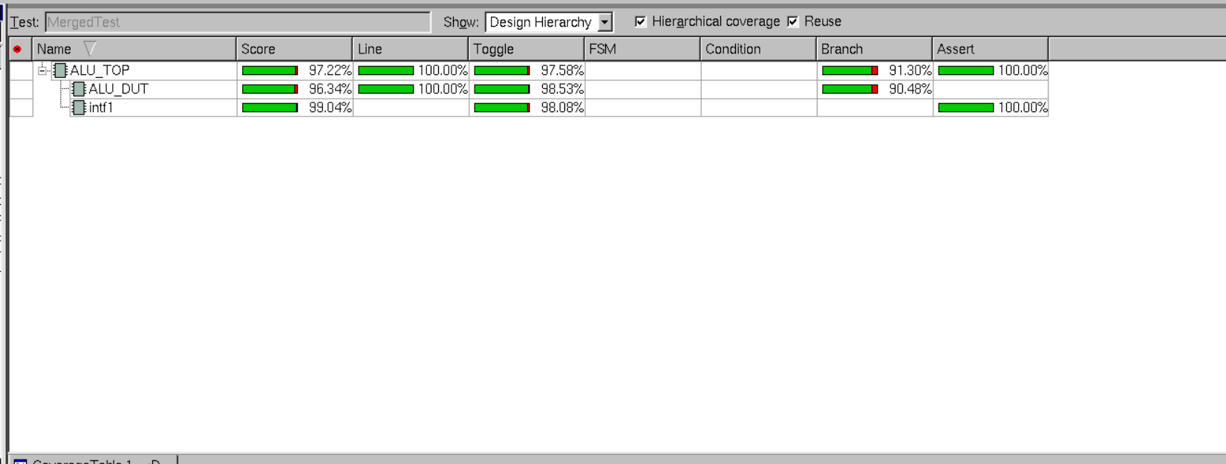
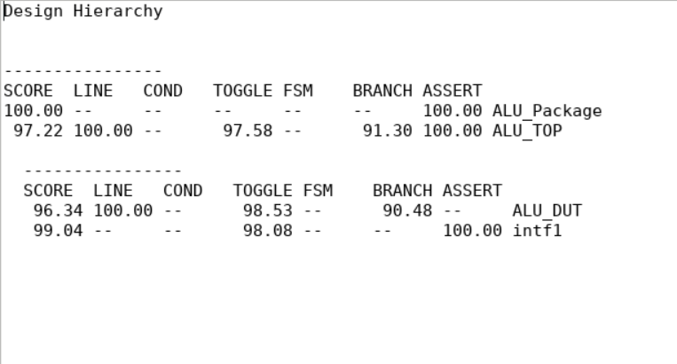
RESULTS :COVERAGE
Code Coverage:
In this case, we observe that code coverage is not fully achieved, as certain default branches are not included, and the toggling of the reset signal from 0 to 1 is not captured, given that the reset state is applied at the beginning of the operation.
Notes:
****************************IMPORTANT: FOR MORE DETAILS CHECK “coverage_report.txt” FILE ****************************

Slide 24
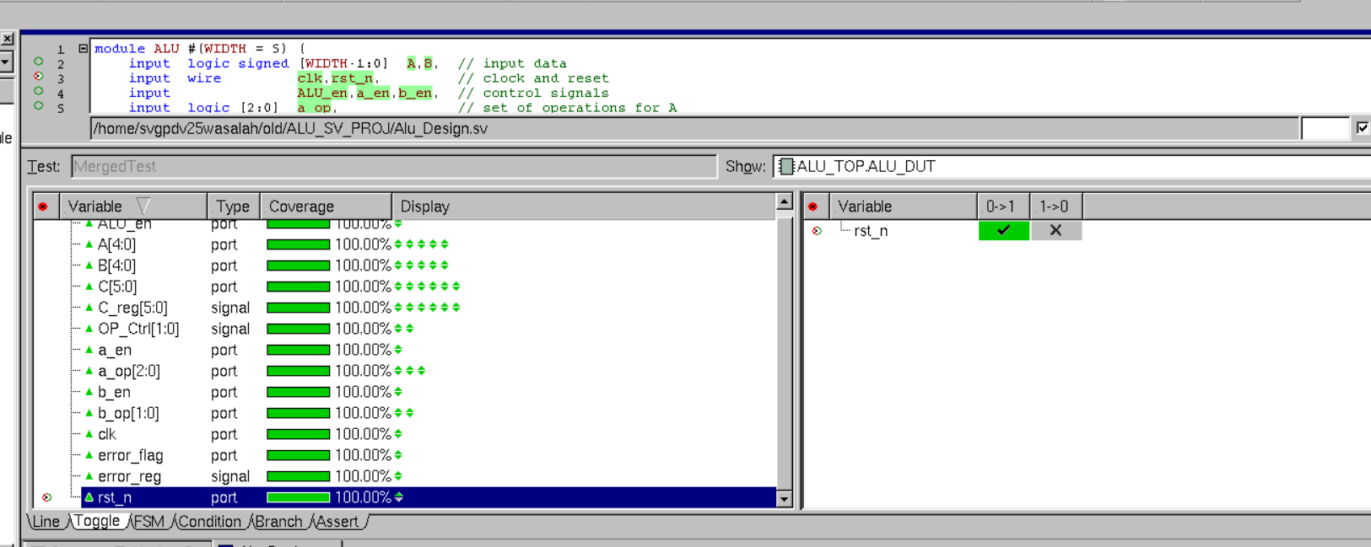
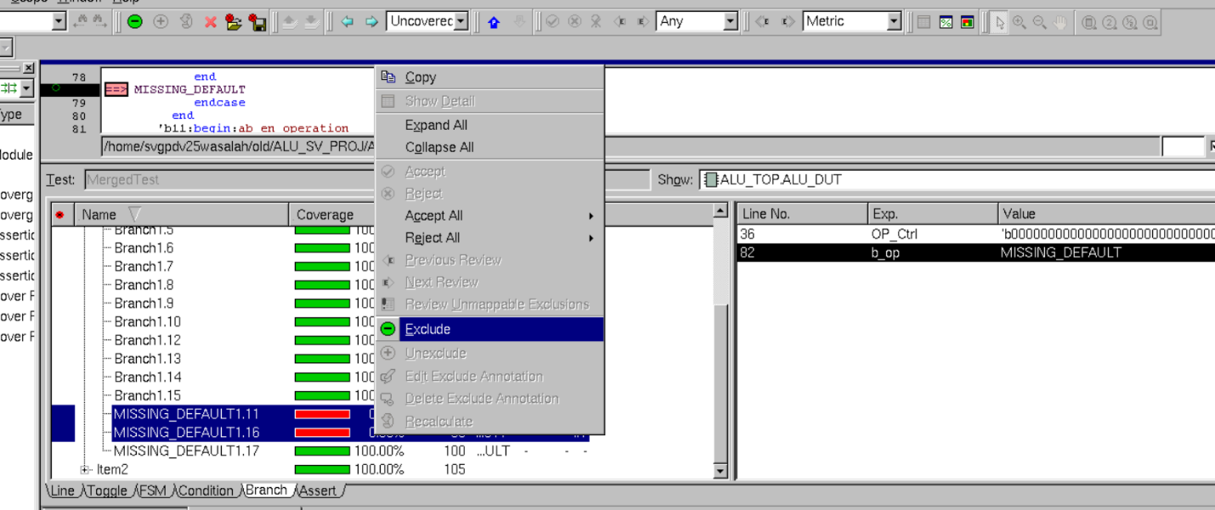
RESULTS :COVERAGE
Code Coverage:
Notes:
****************************IMPORTANT: FOR MORE DETAILS CHECK “coverage_report.txt” FILE ****************************

Slide 25
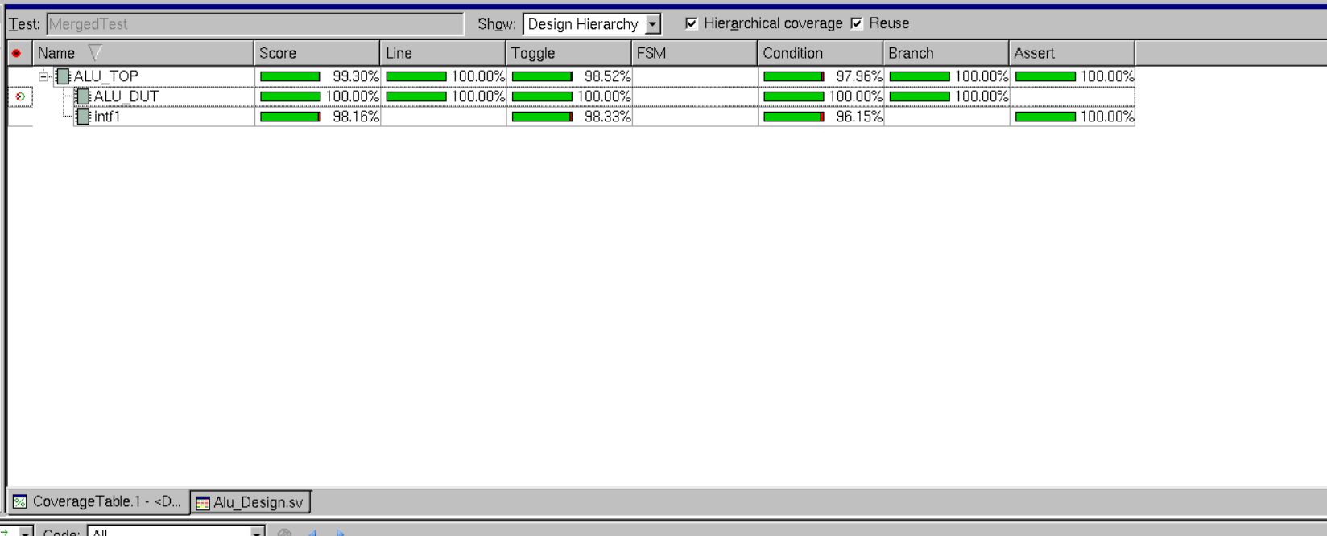
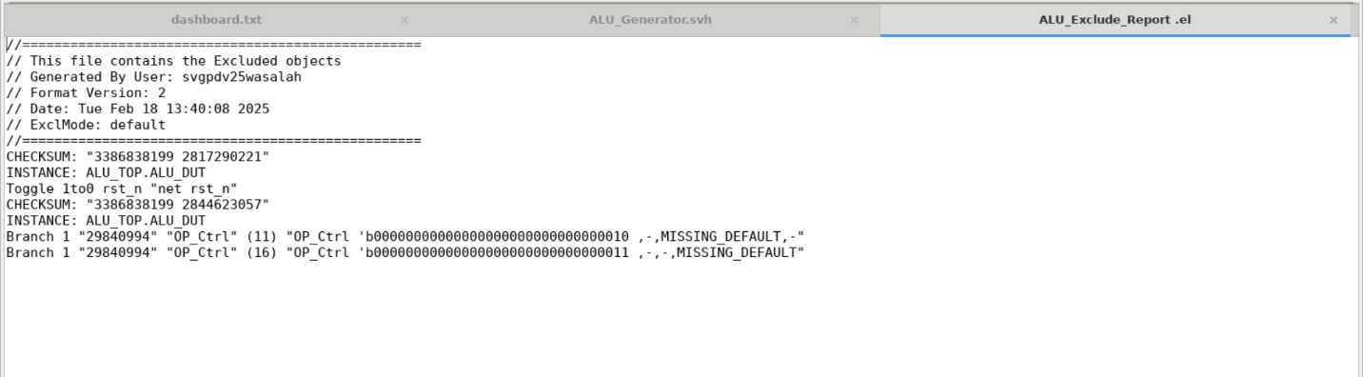
RESULTS :COVERAGE
Code Coverage:
This is the file and code coverage data excluded from the DUT after the exclusion process.
Notes:
****************************IMPORTANT: FOR MORE DETAILS CHECK “coverage_report.txt” FILE ****************************

Slide 26
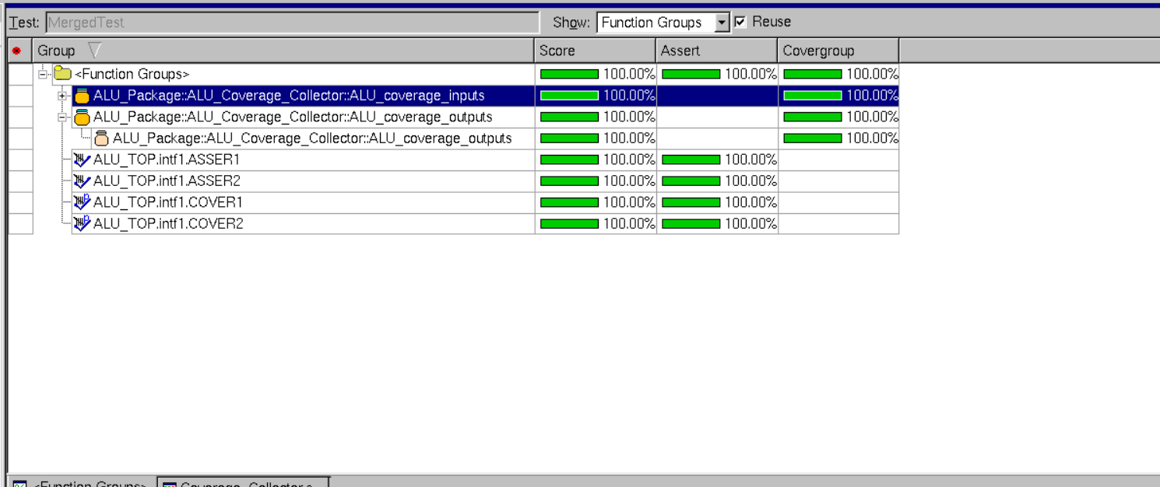
RESULTS :COVERAGE
2. Functional Coverage:

Slide 27
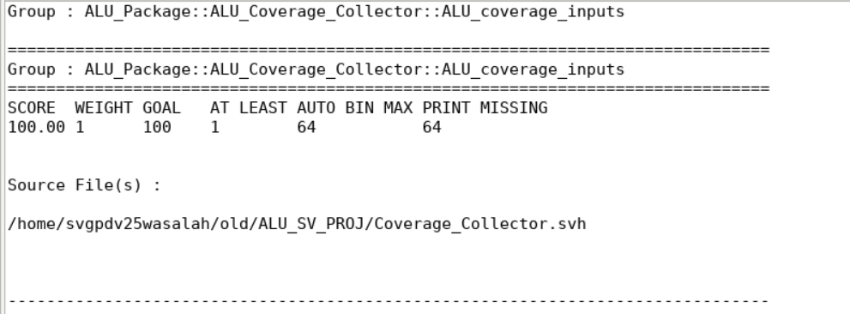
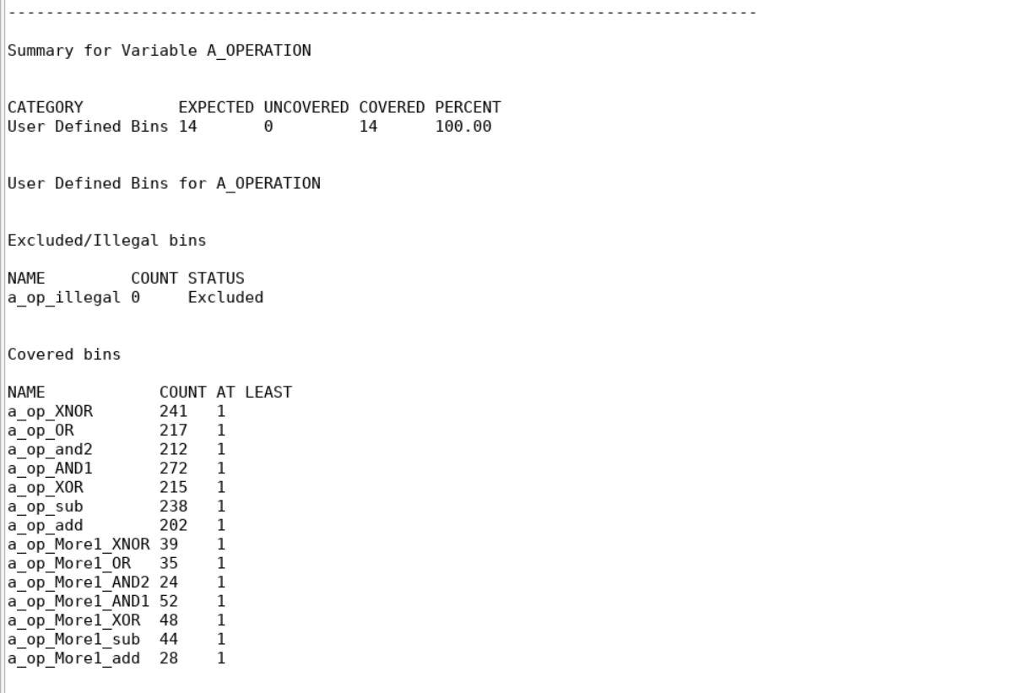
RESULTS :COVERAGE
2. Functional Coverage:

Slide 28
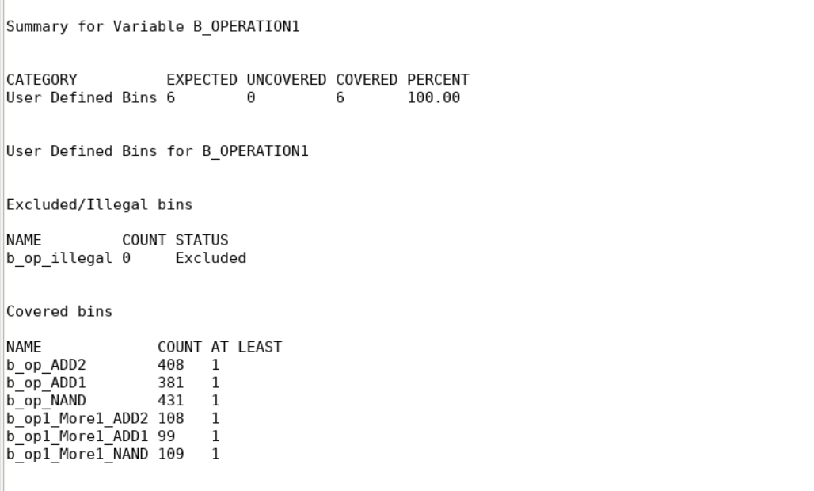
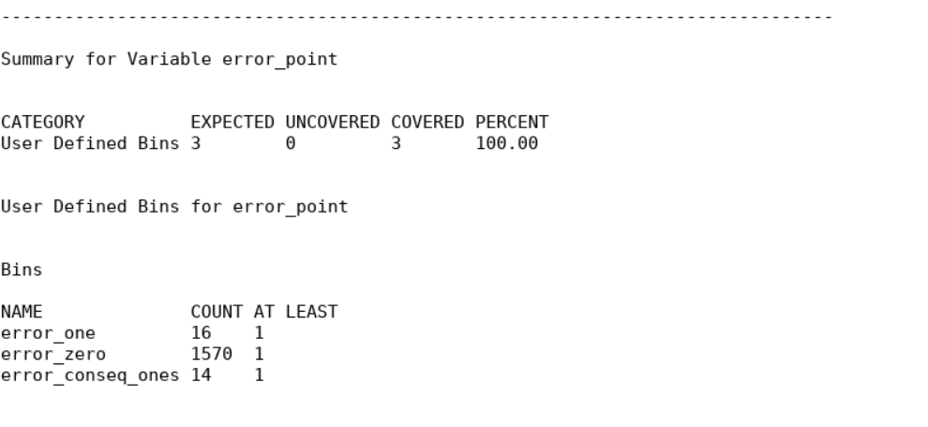
RESULTS :COVERAGE
2. Functional Coverage:

Slide 29
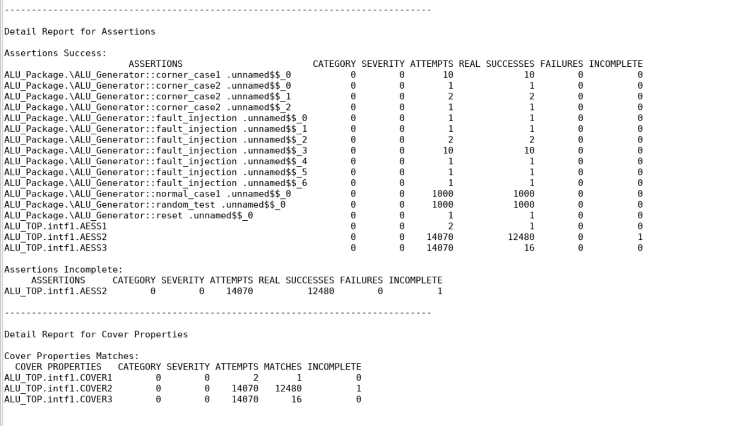
RESULTS :COVERAGE
3. Assertion Coverage:

Slide 30
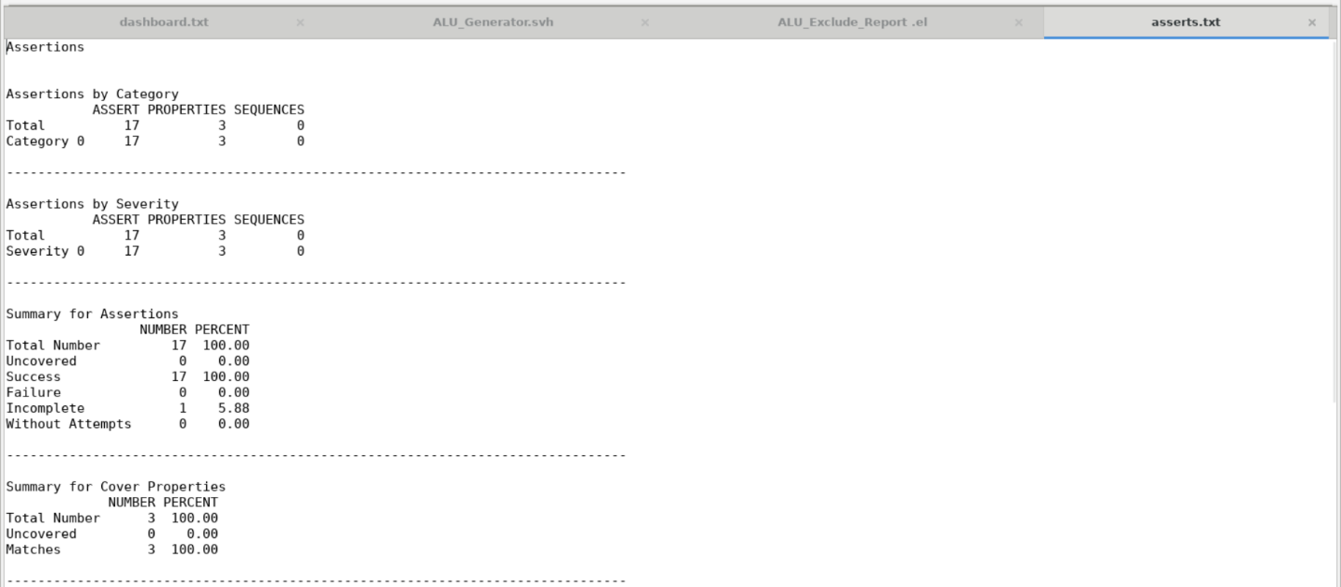
RESULTS :COVERAGE
3. Assertion Coverage:

Slide 31
Thank You

