Slide 1
Fifteen Puzzle Game
Project Presentation
Team Name:
JS GAME CRAFTERS
Team members:
Walid Abdullahi(Leader), Stuart Idehen

Slide 2
Team Information
Team Members and Roles:
Walid Abdullahi:
Responsible for implementing game logic, dynamic animations, and solving algorithms.
Led the project and implemented critical features, including game logic, solving algorithms, and animations.
Created the winning notification system and integrated multiple interactive features.
Stuart Idehen:
Developed the UI layout, shuffle functionality, and ensured the game is visually appealing and interactive.
Designed the UI layout, ensuring a visually appealing grid structure and interactive buttons.
Developed the shuffle algorithm to guarantee solvability and contributed to CSS responsiveness.

Slide 3
Problem Statement & Objectives
Problem Statement:
While the Fifteen Puzzle is a timeless game, it often lacks features that resonate with modern audiences, such as dynamic visuals, animations, and guaranteed solvability. Without these enhancements, the gameplay can feel dated and less engaging.
Objectives:
Implement an interactive Fifteen Puzzle game that not only replicates the classic experience but also introduces modern features to make it visually compelling and accessible.
Key objectives include:
Ensuring solvability of the puzzle using a robust shuffle algorithm.
Adding real-time feedback mechanisms such as a timer, move counter, and winning notification.
Enhancing the user experience with hover effects, animations, and selectable backgrounds.

Slide 4
Project Overview
Key Features:
Solvable 4x4 grid: The game ensures all shuffled puzzles are solvable, thanks to the custom algorithm.
Dynamic animations: Tiles respond to user actions with hover effects, transitions, and winning notifications.
Timer and move counter: Tracks player performance in real-time.
Background customization: Players can switch between multiple background images to personalize their experience.
Winning popup: A visually engaging notification appears when the puzzle is successfully solved.

Slide 5
Architecture and Design
Application Architecture:
fifteen.js: Game logic and event handling.
fifteen.css: Styling for the grid, tiles, and transitions.
fifteen.html: HTML structure of the game.
UI components (e.g., puzzle grid, buttons, timer).
Design principles (e.g., mobile responsiveness, clean grid-based layout).

Slide 6
Scrum/Kanban Method in Project Management
Benefits of Scrum:
Clear Task Communication, Improved Collaboration, Efficiency.
How we applied Kanban/Scrum:
Daily Stand-ups:
15-minute meetings to discuss:
What was completed yesterday.
What will be worked on today.
Any blockers.
Kanban Task Breakdown:
To-Do:
Design UI and layout in HTML/CSS.
Implement initializeBoard() logic.
In Progress:
Develop moveTile() and canMove() functions.
Debug shuffle logic to ensure solvability.
Completed:
Add animations for tile movements.
Implement background selector feature.
Sprint Example:
Sprint Goal: Finish game logic and basic UI in 1 week.
Tasks Assigned:
Walid Abdullahi: Create board logic (initializeBoard, moveTile).
Stuart Idehen: Style the grid and buttons, ensure layout responsiveness.

Slide 7
Code Demo and Walkthrough
Gameplay Demo:
Demonstration of gameflow.
Key Functions in JavaScript:
initializeBoard: Dynamically generates a 4x4 grid, assigns tiles their respective positions, and prepares the empty space for movement.
canMove: Validates whether a clicked tile is adjacent to the empty space and eligible for movement.
moveTile: Updates tile positions and visual states, ensuring smooth transitions.
shuffle: Randomly moves tiles to create a solvable configuration.

Slide 8
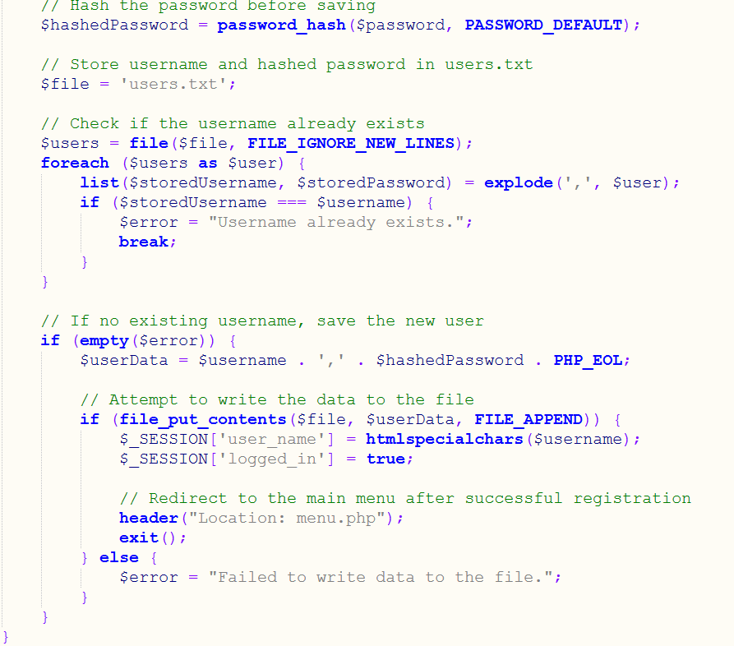
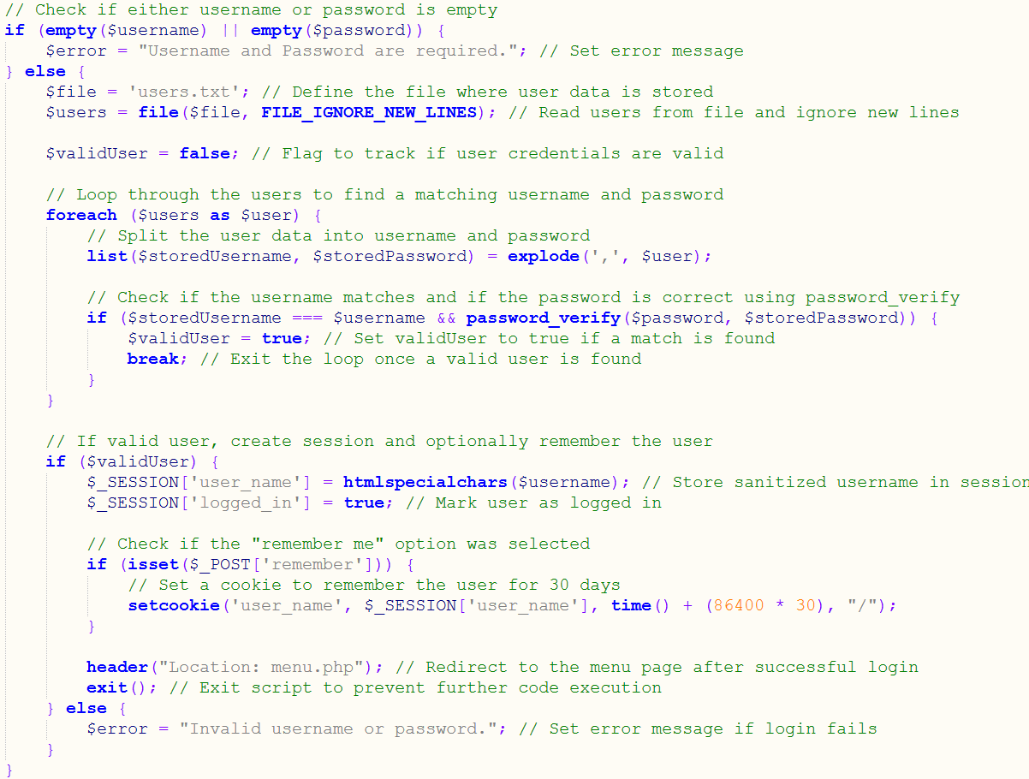
Technical Implementation: Game Logic
Walkthrough the user registration process:
Handle user input (username, password)
Hash password using 'password_hash()' function
Store user data in the 'users.txt' file
Code (from register.php):
Explanation: The registration process involves checking if the username already exists, hashing the password using `password_hash()`, and storing the user data in a `users.txt` file. If the registration is successful, the user's session is started, and they are redirected to the main menu.
Demonstrate the login process:
Verify username and password
Manage user sessions with session_start()
Implement "remember me" functionality with cookies
Code (from login.php):
Explanation: The login process involves reading the user data from the `users.txt` file, verifying the username and password using `password_verify()`, and starting the user's session. The "Remember me" functionality is implemented using a cookie.

Slide 9
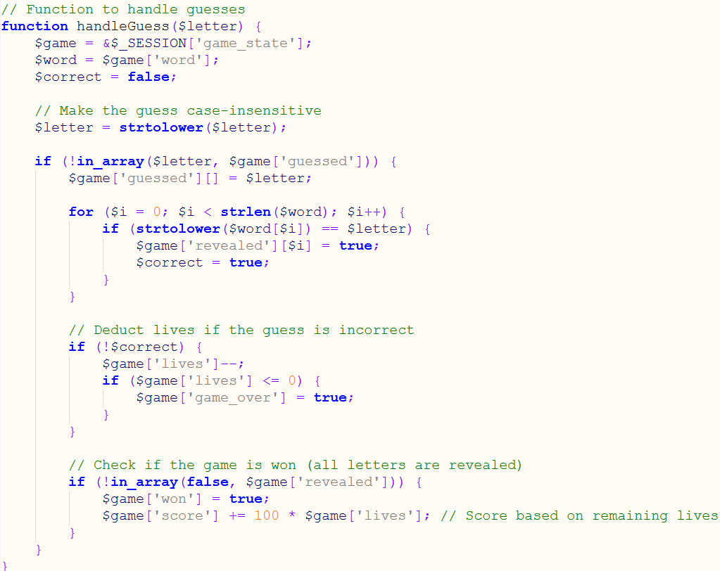
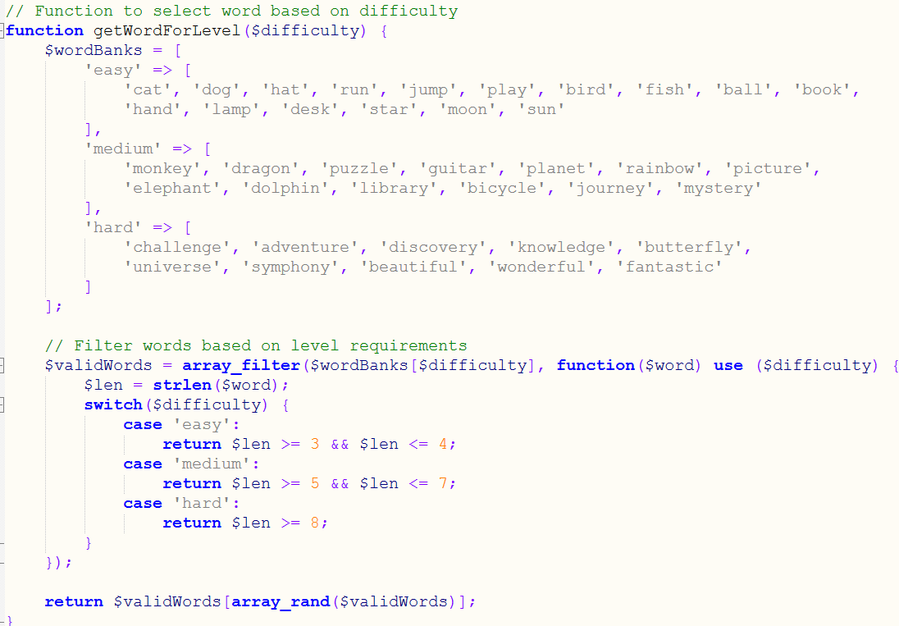
Technical Implementation: Animations & Notifications
Explain the game logic flow:
Word selection based on difficulty level using the 'getWordForLevel()' function
Handling user guesses with 'handleGuess()' function and updating game state.
Calculating score based on remaining lives
Detecting game over and win conditions
Code (from game.php):
Explanation: The `getWordForLevel()` function selects a random word from a predefined word bank based on the chosen difficulty level. The function uses `array_filter()` to filter the words based on length requirements for each difficulty.
Code (from game.php):
Explanation: The `handleGuess()` function processes user guesses, updating the game state accordingly. It checks if the guessed letter is correct, deducts lives for incorrect guesses, and updates the game state to track the revealed letters and the player's score.

Slide 10
Technical Implementation: Testing
Testing Methodology:
Comprehensive manual testing was conducted to validate the functionality and performance of the game.
Focused on edge cases and user interactions to ensure robust behavior.
Continuous testing was incorporated during each development sprint to catch bugs early.
Key Areas of Testing:
Tile Movement: Ensure only adjacent tiles can move and that all moves update the grid correctly.
Shuffle Algorithm: Verify that all randomized states are solvable and the shuffle executes efficiently.
Winning Notification: Confirm that the notification triggers only when the puzzle is solved correctly.
Timer and Move Counter: Test accurate tracking and display of elapsed time and total moves.
Background Selector: Ensure the selected background applies instantly to all tiles.
Example Test Cases:
Test Scenario | Expected Outcome | Result
Clicking a non-adjacent tile | Tile does not move, and the board remains unchanged. | Passed
Clicking an adjacent tile | Tile swaps positions with the empty space. | Passed
Solving the puzzle | Winning notification appears, showing the final time and move count. | Passed

Slide 11
Future Enhancements Conclusion
Potential Additions:
Additional features to consider:
Multiple grid sizes (e.g., 3x3, 6x6).
Sliding multiple tiles at once.
Multiplayer modes.
Adding music or sound effects.
Summary:
Successfully created a modern 15-puzzle game with interactive features.
Learned and applied advanced JavaScript techniques for DOM manipulation and animations.
Strengthened teamwork and project management skills using Scrum and Kanban methodologies.

Slide 12


Thank you!

