Slide 1
Fifteen Puzzle Game
Project Presentation
Team Name:
JS GAME CRAFTERS
Team members:
Walid Abdullahi(Leader), Stuart Idehen

Slide 2
Team Information
Team Members and Roles:
Walid Abdullahi:
Responsible for implementing game logic, dynamic animations, and solving algorithms.
Led the project and implemented critical features, including game logic, solving algorithms, and animations.
Created the winning notification system and integrated multiple interactive features.
Stuart Idehen:
Developed the UI layout, shuffle functionality, and ensured the game is visually appealing and interactive.
Designed the UI layout, ensuring a visually appealing grid structure and interactive buttons.
Developed the shuffle algorithm to guarantee solvability and contributed to CSS responsiveness.

Slide 3
Problem Statement & Objectives
Problem Statement:
While the Fifteen Puzzle is a timeless game, it often lacks features that resonate with modern audiences, such as dynamic visuals, animations, and guaranteed solvability. Without these enhancements, the gameplay can feel dated and less engaging.
Objectives:
Implement an interactive Fifteen Puzzle game that not only replicates the classic experience but also introduces modern features to make it visually compelling and accessible.
Key objectives include:
Ensuring solvability of the puzzle using a robust shuffle algorithm.
Adding real-time feedback mechanisms such as a timer, move counter, and winning notification.
Enhancing the user experience with hover effects, animations, and selectable backgrounds.

Slide 4
Project Overview
Key Features:
Solvable 4x4 grid: The game ensures all shuffled puzzles are solvable, thanks to the custom algorithm.
Dynamic animations: Tiles respond to user actions with hover effects, transitions, and winning notifications.
Timer and move counter: Tracks player performance in real-time.
Background customization: Players can switch between multiple background images to personalize their experience.
Winning popup: A visually engaging notification appears when the puzzle is successfully solved.

Slide 5
Architecture and Design
Application Architecture:
fifteen.js: Game logic and event handling.
fifteen.css: Styling for the grid, tiles, and transitions.
fifteen.html: HTML structure of the game.
UI components (e.g., puzzle grid, buttons, timer).
Design principles (e.g., mobile responsiveness, clean grid-based layout).

Slide 6
Scrum/Kanban Method in Project Management
Benefits of Scrum:
Clear Task Communication, Improved Collaboration, Efficiency.
How we applied Kanban/Scrum:
Daily Stand-ups:
15-minute meetings to discuss:
What was completed yesterday.
What will be worked on today.
Any blockers.
Kanban Task Breakdown:
To-Do:
Design UI and layout in HTML/CSS.
Implement initializeBoard() logic.
In Progress:
Develop moveTile() and canMove() functions.
Debug shuffle logic to ensure solvability.
Completed:
Add animations for tile movements.
Implement background selector feature.
Sprint Example:
Sprint Goal: Finish game logic and basic UI in 1 week.
Tasks Assigned:
Walid Abdullahi: Create board logic (initializeBoard, moveTile).
Stuart Idehen: Style the grid and buttons, ensure layout responsiveness.

Slide 7
Code Demo and Walkthrough
Gameplay Demo:
Demonstration of gameflow.
Key Functions in JavaScript:
initializeBoard: Dynamically generates a 4x4 grid, assigns tiles their respective positions, and prepares the empty space for movement.
canMove: Validates whether a clicked tile is adjacent to the empty space and eligible for movement.
moveTile: Updates tile positions and visual states, ensuring smooth transitions.
shuffle: Randomly moves tiles to create a solvable configuration.

Slide 8
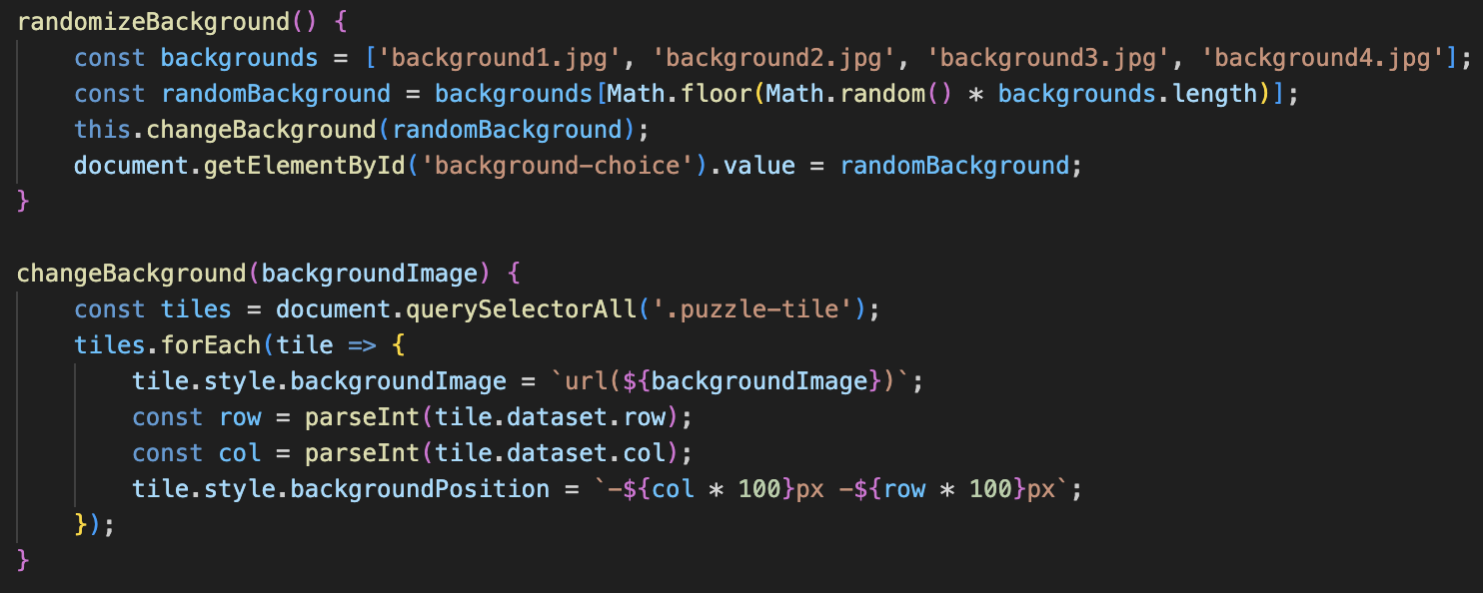
Technical Implementation: Game Logic
Code (from fifteen.js):
Multiple Background Selection:
Players are able to select/randomize the background of the puzzle using the methods below:
Explanation:
randomizeBackground(): At random will pick one of the available backgrounds (backgroundx.jpg) and applies it to the tiles.
changeBackground(backgroundImage): This will change all tile backgrounds to the selected image, and make sure their positions align correctly within the grid of the puzzle.

Slide 9
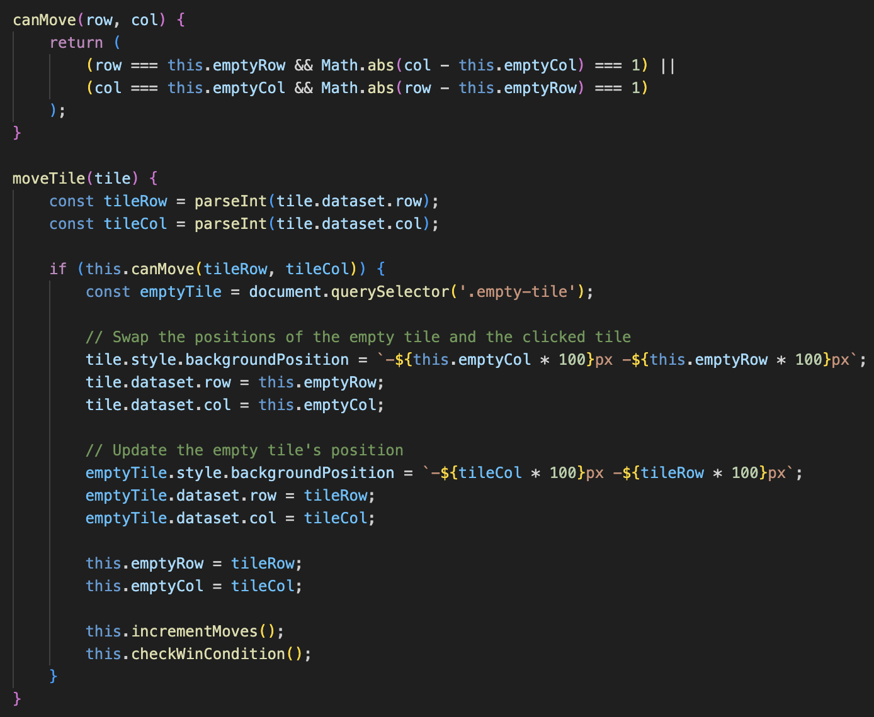
Technical Implementation: Game Mechanics
Code (from fifteen.js):
Core Functions (Game Mechanics):
The puzzle contains mechanics that involve tile movement, valid move shuffling, checking and detecting the win condition.
Explanation:
canMove(row, col): Checks if a tile can move by being adjacent to the empty space.
moveTile(tile): Handles moving a valid tile and updating positions.
shuffle(): Randomly rearranges the tiles while ensuring the puzzle is solvable.
checkWinCondition(): Validates if the tiles are in the correct order and triggers the win notification.

Slide 10
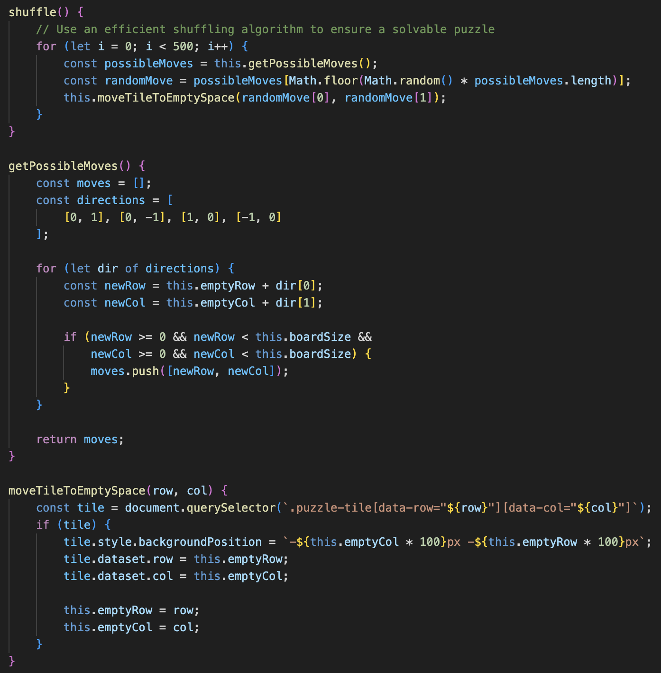
Technical Implementation: Game Mechanics
Code (from fifteen.js):
Core Functions (Game Mechanics):
Integrated the ability to randomly rearrange the tiles while ensuring the puzzle is solvable.
Explanation:
shuffle(): Repeatedly moves a tile randomly from the valid moves list to shuffle the puzzle.
getPossibleMoves(): Returns a list of tiles that can be moved into the empty space.
moveTileToEmptySpace(row, col): Performs the actual movement of a tile into the empty space.

Slide 11
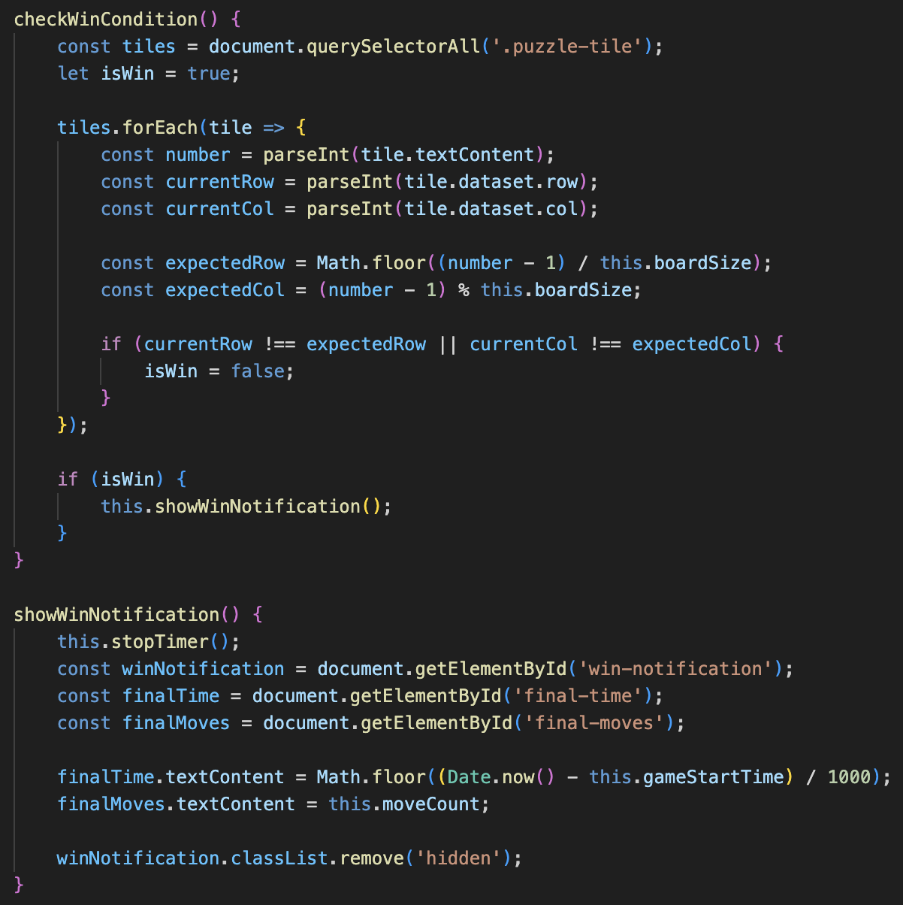
Technical Implementation: Game Mechanics
Code (from fifteen.js):
Core Functions (Game Mechanics):
This function allows for the game to validate that the tiles are in the correct order and if so, triggers the win notification. All tiles must be in their correct positions.
Explanation:
checkWinCondition(): Compares each tile’s current position with its expected position in the solved state.
showWinNotification(): Displays a victory message with stats like time and moves taken when the puzzle is solved.

Slide 12
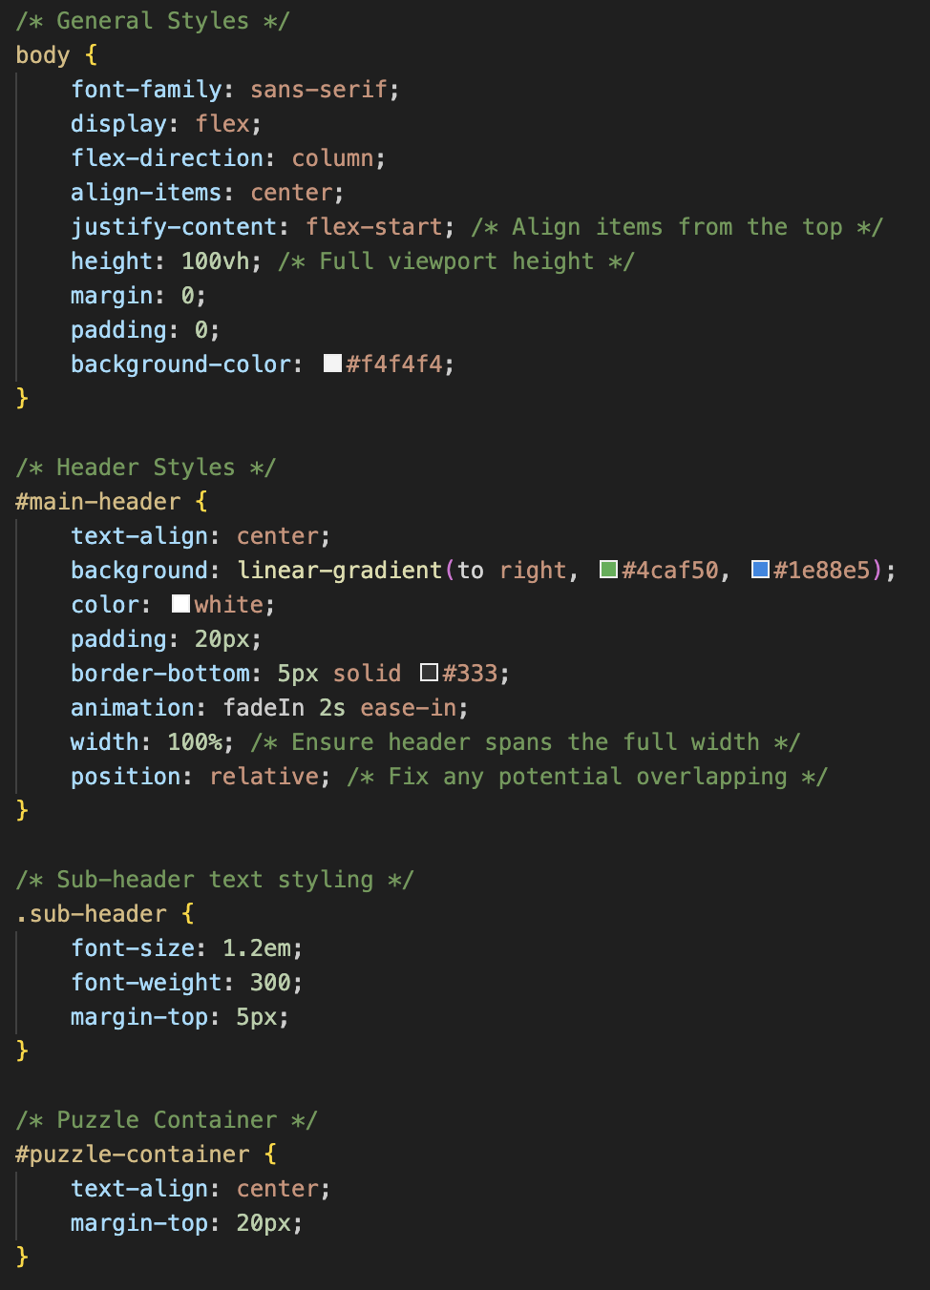
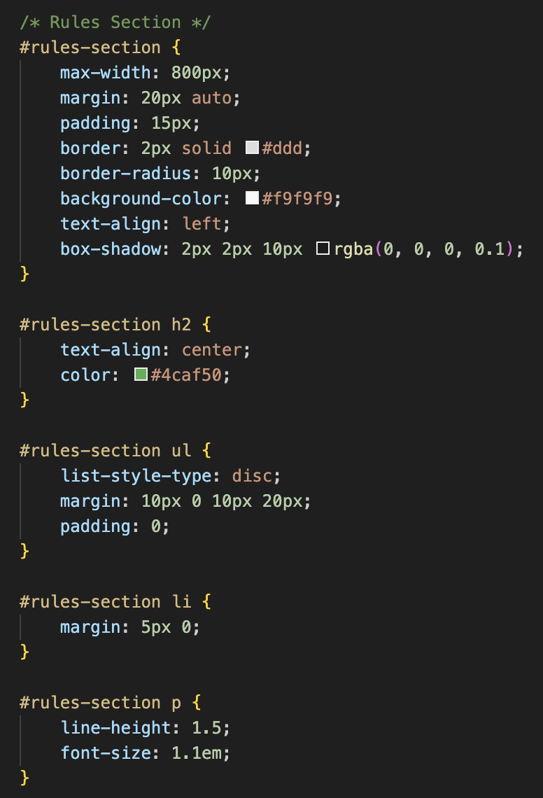
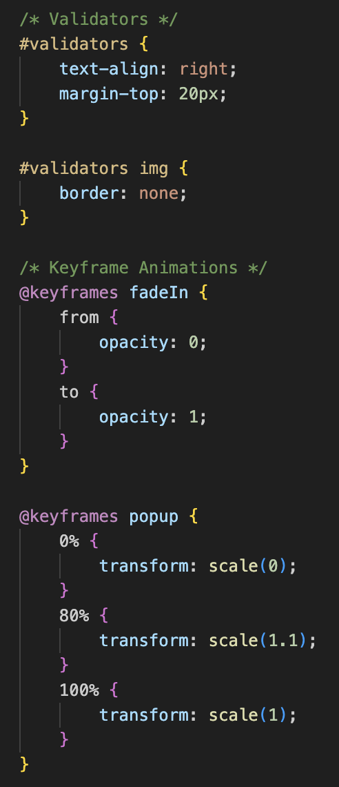
Technical Implementation: General Layout & Visual Design
Code (from fifteen.css):
Explanation:
This code snippets convey the aesthetics of the page. We implemented centered and flexible layout with a header that has a gradient background with fade-in animation and has a rules section with card-like appearance.
Animations such as fadeIn allow for smooth opacity transitions and popup for scaling effects.

Slide 13
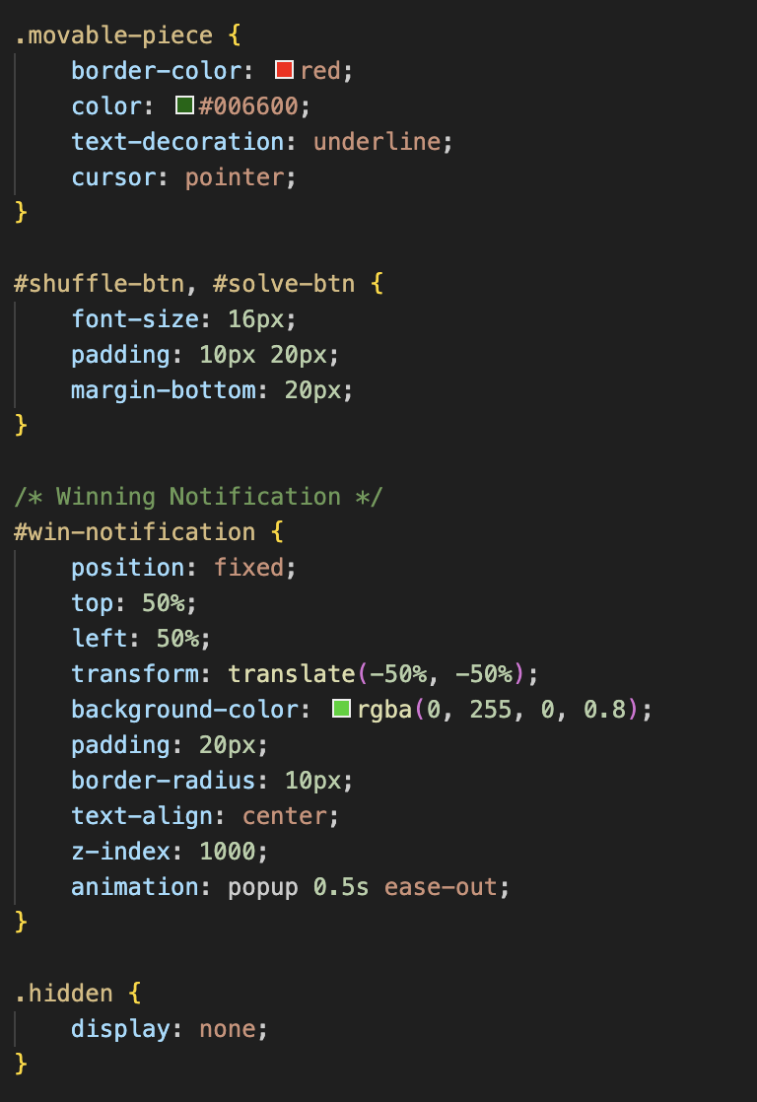
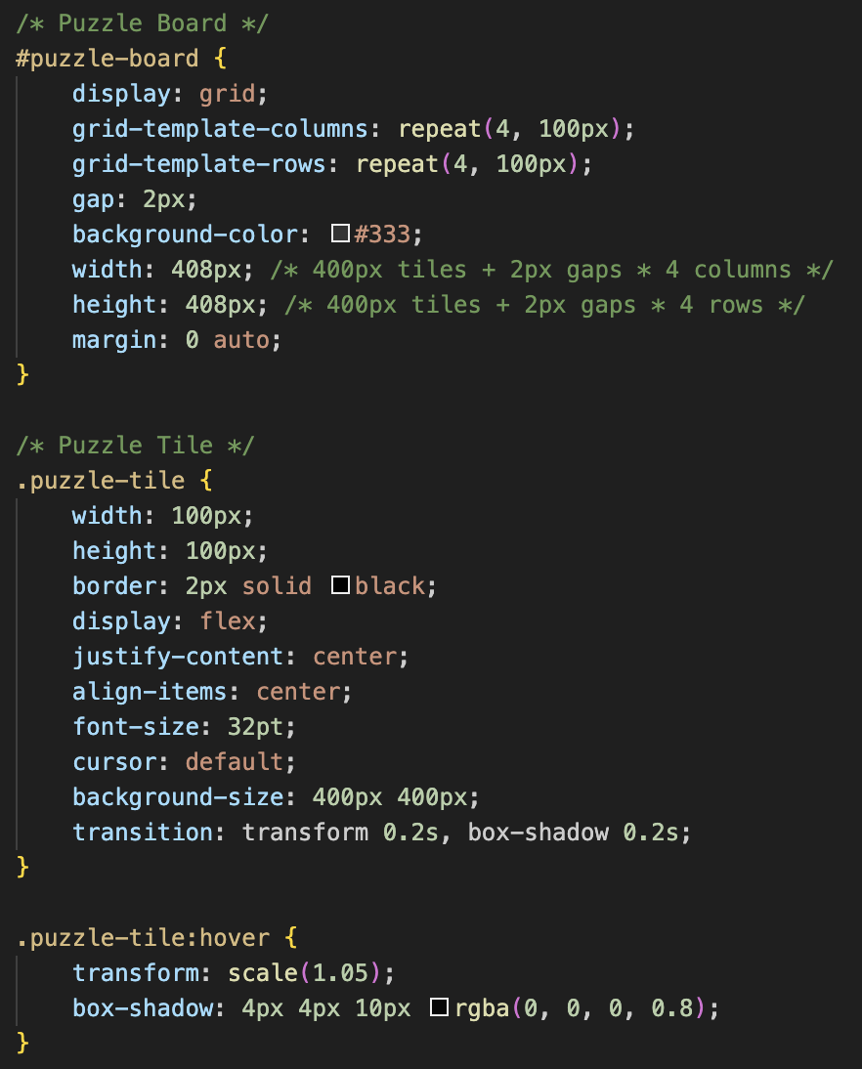
Technical Implementation: Puzzle Mechanics and Interactive Features
Code (from fifteen.css):
Explanation:
Here we showcase how we style the puzzle grid, tiles, button and victory notification. We use a grid layout for the puzzle board and integrate hover effects and transitions to create interactive tiles.
The buttons have functional styling and movable tiles feature highlighting to create unique styling. Moreover, the victory notification is centered with pop=up effect animations.

Slide 14
Technical Implementation: Testing
Testing Methodology:
Comprehensive manual testing was conducted to validate the functionality and performance of the game.
Focused on edge cases and user interactions to ensure robust behavior.
Continuous testing was incorporated during each development sprint to catch bugs early.
Key Areas of Testing:
Tile Movement: Ensure only adjacent tiles can move and that all moves update the grid correctly.
Shuffle Algorithm: Verify that all randomized states are solvable and the shuffle executes efficiently.
Winning Notification: Confirm that the notification triggers only when the puzzle is solved correctly.
Timer and Move Counter: Test accurate tracking and display of elapsed time and total moves.
Background Selector: Ensure the selected background applies instantly to all tiles.
Example Test Cases:
Test Scenario | Expected Outcome | Result
Clicking a non-adjacent tile | Tile does not move, and the board remains unchanged. | Passed
Clicking an adjacent tile | Tile swaps positions with the empty space. | Passed
Solving the puzzle | Winning notification appears, showing the final time and move count. | Passed

Slide 15
Extra Features Implemented
Multiple Backgrounds:
Users can choose from 4 different background images.
End-of-Game Notification:
A win screen appears when the puzzle is solved
Animations:
Tiles have smooth transitions when moving.
Tracking Game Time and Moves:
Time and move count are displayed and tracked

Slide 16
Future Enhancements Conclusion
Potential Additions:
Additional features to consider:
Multiple grid sizes (e.g., 3x3, 6x6).
Sliding multiple tiles at once.
Multiplayer modes.
Adding music or sound effects.
Summary:
Successfully created a modern 15-puzzle game with interactive features.
Learned and applied advanced JavaScript techniques for DOM manipulation and animations.
Strengthened teamwork and project management skills using Scrum and Kanban methodologies.

Slide 17


Thank you!

