Slide 1
Go Fish Card Game
Project Presentation
Team members:
Walid Abdullahi(Leader), Stuart Idehen

Slide 2
Team Organization
Roles Assigned:
Walid Abdullahi (Project Leader / Coder)
Oversees project timelines and coordinates communication.
Manages version control and ensures project requirements are met.
Structures HTML and writes CSS for the game interface.
Stuart Idehen (Designer / Tester)
Designs the user interface and visual elements using HTML and CSS.
Creates animations and ensures a user-friendly layout.
Tests the game for layout issues and usability problems, providing feedback for improvements.

Slide 3
Introduction
Problem Statement: Many classic card games today lack engaging interfaces. The project aims to bridge this gap by creating an interactive Go Fish game that utilizes modern web technologies.
Goals: To develop a user-friendly, animated Go Fish card game interface using only HTML and CSS, highlighting the capabilities of CSS for animations and transitions.
Significance: This project demonstrates the power of CSS in web design, offering a playful experience while improving coding skills in a team environment.

Slide 4
Project Overview
Go Fish is a widely loved card game, known for its simplicity and engaging gameplay. Players take turns asking one another for cards to complete sets of four, fostering both strategy and interaction.
Our implementation allows users to play the game virtually with enhanced modern web technology using features like:
Smooth animations for card shuffling and dealing.
Responsive Design for different screen sizes and devices.
Interactive Elements for hover effects, transitions, and feedback mechanisms.

Slide 5
Kanban Method in Project Management
What is Kanban?
A visual workflow management method that helps track project progress. Focuses on continuous delivery, maximizing efficiency, and managing work in progress (WIP).
Benefits of Kanban:
Clear Task Visibility: Enabled us to track the entire project and see individual progress.
Improved Collaboration: Allowed the team to stay aligned and avoid task overlap.
Efficiency: Helped manage workload effectively by keeping focus on key tasks.
How We Applied Kanban:
Task Breakdown:
Divided the project into specific tasks (e.g., coding, design, testing).
Each team member was responsible for their own tasks and communicated progress regularly.
Kanban Process:
Stages:
To Do: New tasks identified and prioritized (e.g., card animations, styling).
In Progress: Active tasks being worked on (e.g., finalizing hover effects).
Completed: Finished tasks ready for review (e.g., CSS transitions, Flexbox layout).

Slide 6
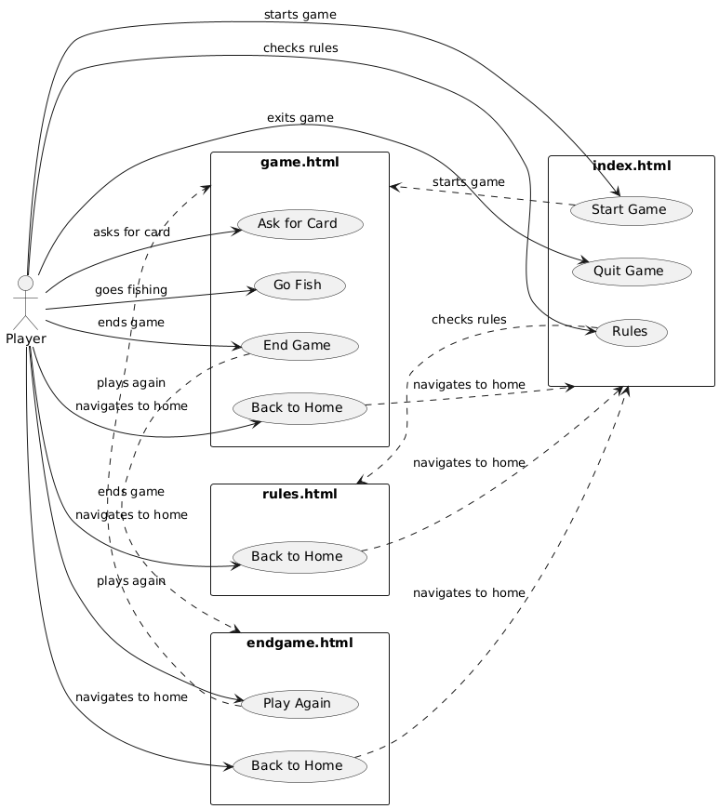
UML Diagram
Use Case Diagram showcasing the structure and flow. This diagram illustrates the interactions between the player and various functionalities of the Go Fish Card Game. Each rectangle represents a different HTML file in the project, containing specific use cases (actions) available to the player.

Slide 7
Live Demo
This demo will showcase the game interface, transitions, and card interactions.
Key Features:
Animated Card Interactions: Cards smoothly animate as they are dealt and shuffled, enhancing the user experience.
Responsive Flexbox Layout: The game’s layout adapts to various screen sizes, ensuring a seamless experience across devices.
Hover Effects and Transitions: Interactive elements, such as cards, respond with hover effects and smooth transitions to provide feedback to the user.

Slide 8
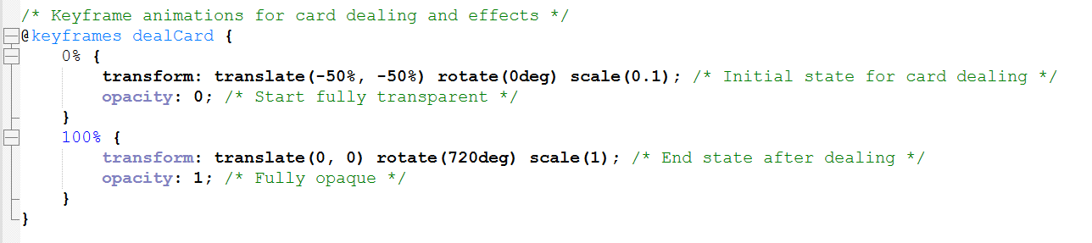
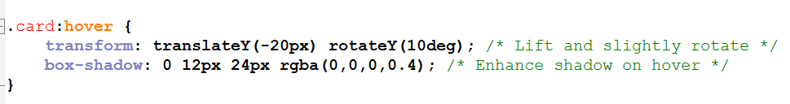
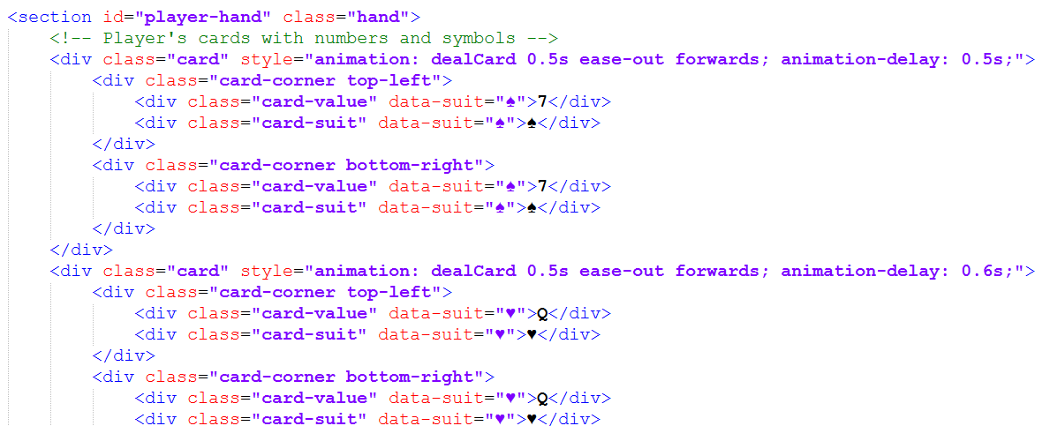
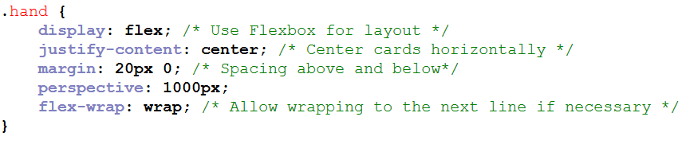
Code Highlights
CSS for Card Animation:
Explanation: This animation smoothly deals the cards by moving them from off-screen while rotating them 720 degrees and scaling them up from small to normal size. This provides a dynamic, visually appealing way of introducing new cards into the game.
Flexbox Layout for Hands:
Explanation: Flexbox is used to align the cards horizontally within the player's or opponent's hand. The flex-wrap ensures that cards automatically move to the next line when there are too many to fit in one row. This makes the game responsive and ensures the layout looks neat on all screen sizes.
Card Hover Effect:
Explanation: When a player hovers over a card, it lifts slightly and rotates for a 3D effect, making it feel interactive. The increased shadow adds to the illusion of depth, giving the user feedback that the card is being interacted with.
Game Layout Structure (HTML):
Explanation: This HTML structure defines how the cards are displayed in the player’s hand. Each card shows its value and suit using data attributes, ensuring that the game dynamically represents each card accurately. The animation delay ensures that cards are dealt one after another with a smooth transition.

Slide 9
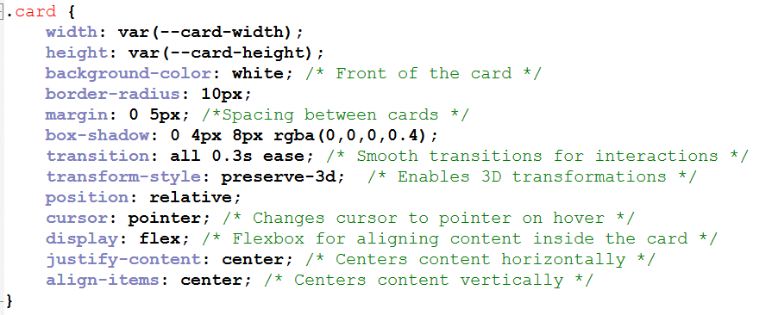
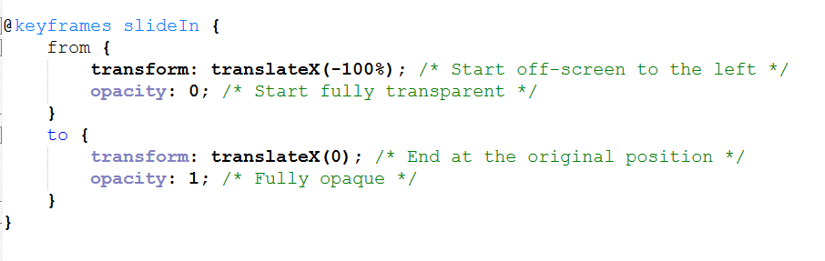
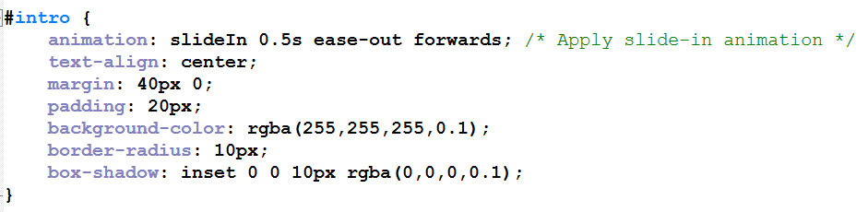
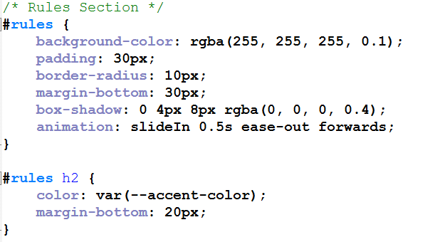
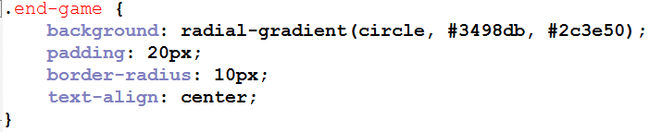
Code Highlights continuing
Styling for the Cards:
Explanation: General styling for cards to ensure a consistent appearance. This CSS defines the look and feel of each card. The cards have rounded corners, shadows for depth, and smooth hover transitions. Using Flexbox ensures that card content, like numbers and suits, is centered perfectly. The transform-style: preserve-3d enables 3D transformations, which is useful for hover effects or card flipping animations.
End Game Page Styling:
Explanation: The end-game section has a visually appealing gradient background, rounded corners, and centered text. This provides a polished and professional look when the game ends, enhancing the user experience with smooth visual transitions.
Animations and Transitions:
Explanation: This animation smoothly slides in elements like the intro or rules page from the left while fading them into view. It gives a more dynamic feel to the interface, making it more engaging for users as content appears with smooth transitions.
Rules Page Layout:
Explanation: The rules page is styled with a translucent background, rounded corners, slide-in animation, and subtle shadows, providing a clean and modern look for the game's instructions.

Slide 10
Future Plans Conclusion
Next Plans:
Additional Game Modes: Expanding the project to include variations of Go Fish or other card games.
Enhanced Animations: Exploring more intricate animations for card interactions to elevate the user experience.
User Feedback: Gathering insights from players to improve gameplay and interface based on real-world usage.
Key Takeaways:
Objectives Met: Successfully created a functional and visually appealing Go Fish game using only CSS and HTML.
Skills Developed: Enhanced coding abilities and collaborative skills while working as part of a team.
Positive User Experience: The project effectively showcases how CSS can be utilized to create engaging and interactive web applications.

Slide 11


Thank you!

