Slide 1
Workshop iOS SDK
Jithin Krishnan
November 20, 2017

Slide 2
Outline
Introduction
Technical Questions
Customization
Route calculation
Nearby
Add-ons / Features
Technical details
Road Map/ General
Car Integration
2
Workshop IOS SDK | November, 2017
Notes:
2

Slide 3
Introduction

Slide 4
Technical Questions

Slide 5


Customization : Maps
Customizable Map Display
Map elements can be changed by color, size and style
All customizations can be applied and changed on application runtime
Supported for client-site map rendering using vector data for both offline and online mode
5
Workshop IOS SDK | November, 2017
Notes:
https://developer.here.com/documentation/ios-premium/topics/map-customization.html
https://developer.here.com/documentation/ios-premium/topics_api_nlp_hybrid_plus/group--nma--map.html#topic-apiref__nmacustomizablepropertytype
5

Slide 6

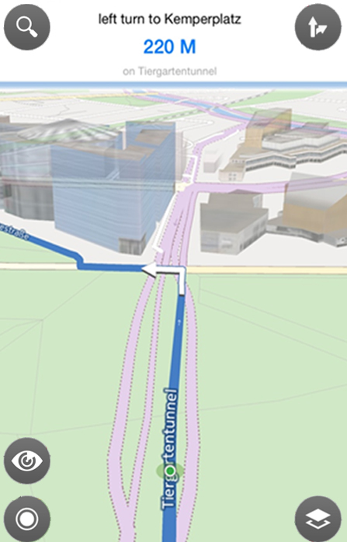
Guidance Voice guidance languages mobile TTS*
English (GB)
English (US)
French (France)
French (Canada)
German
Spanish (Spain)
Spanish (Mexico)
Italian
Portuguese (Portugal)
Portuguese (Brazil)
Russian
Swedish
Norwegian
Finnish
Danish
Korean
Chinese (Taiwanese Mandarin)
Turkish
Czech
Polish
*This is a list of the potential languages that are supported. Actual audio playback depends on the TTS engine that is installed on the user's device.
6
Workshop IOS SDK | November, 2017
Notes:
6

Slide 7
Guidance Pre-recorded voice package languages
Afrikaans – female
Arabic(North African) – female
Arabic(Saudi) – male
Basque – female Italian – female
Bulgarian – female
Catalan – female
Cantonese – female
Croatian – female
Czech - female
Danish - female
Dutch – male/female
English (UK) - (male/female)
English (US) – male
Estonian – female
Farsi – female
Finnish – male / female
French(Canada) – female
French - female
Galician - female
German – male/female
Greek – female
Hindi – female
Hungarian – male/female
Icelandic – female
Indonesian – male
Korean(South Korea) -female
Latvian - female
Lithuanian - female
Malay – female
Mandarin(China) – female
Mandarin(Taiwan) – female
Norwegian – female
Polish – female
Portuguese(Port.) – female
Portuguese(Brazil) - female
Romanian – female
Russian - female
Serbian – male
Slovenian – female
Spanish(Mexico) – male
Spanish(Spain) – female
Spanish(Latin America) – female
Slovak – female
Swahili - male
Swedish – female
Tagalog – female
Tamil – male
Thai – male
Turkish - female
Ukrainian - female
Urdu - female
Vietnamese – female
7
Notes:
7

Slide 8
Customization : Guidance
Voice guidance for car and walk
Voice guidance with spoken street names (selected languages)
Natural guidance (spoken POIs)
NMAAudioManagerDelegate provies some degree of customization.
audioManager:shouldPlayOutput called when the audio manager has output to play
8
Workshop IOS SDK | November, 2017
Notes:
8

Slide 9

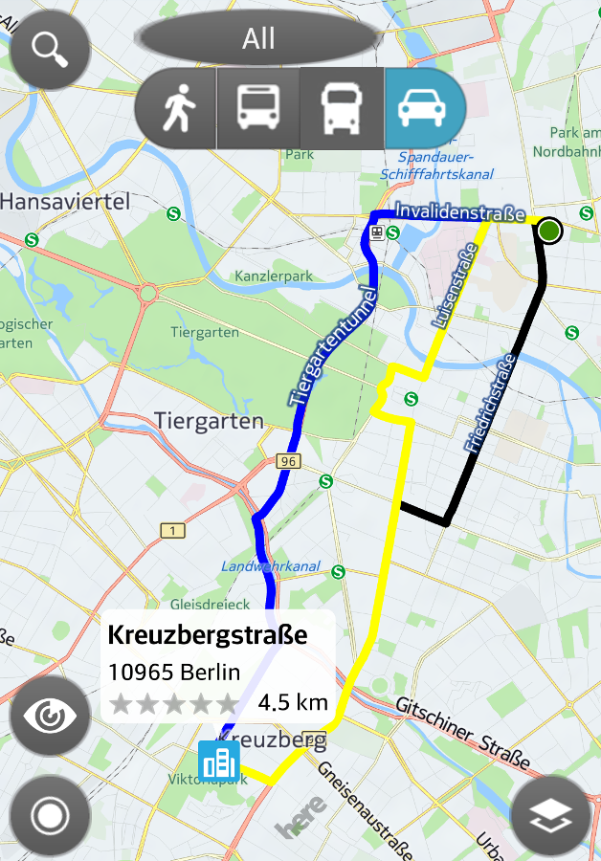
Directions
Basic routing
Considers real-time traffic conditions
Routing options
type (fastest/shortest)
avoid options (toll roads, motorways, parks etc.)
alternative routes
Offline route calculation
Automatic Recalculation when deviating from route
Waypoint limit 128 with SDK 3.5, to be removed with SDK 3.6
ETA to StopOver to be available in SDK 3.6
Skip Stopover ?
9
Workshop IOS SDK | November, 2017
Notes:
122 navigable countries
9

Slide 10

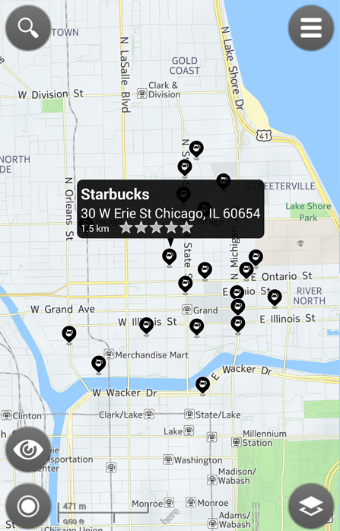
Nearby : Places
Places search
> 75 million places available
Explore places by categories
[NMAPlaces sharedPlaces] topLevelCategories
NMACategoryFilter *categoryFilter = [NMACategoryFilter new];
[categoryFilter addCategoryFilterFromUniqueId:restCategory.uniqueId]; createHereRequestWithLocation:vancouver filters:categoryFilter];
topLevel categories include Petrol Station, Rest Areas, Parking Facility
10
Workshop IOS SDK | November, 2017
Notes:
10

Slide 11
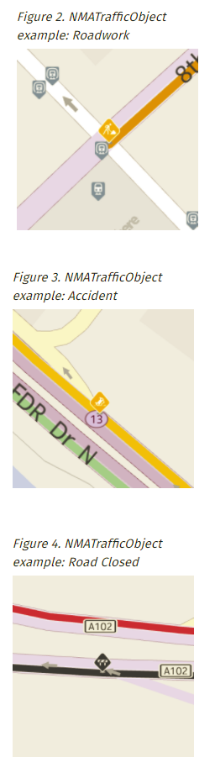
Addons / Features
Traffic information
Available from SDK as traffic tiles for flow data.
Traffic events on Route available from Traffic NMATrafficManager ->
getTrafficEventsOnRoute
Weather information
Available only as REST API, not integrated into SDK
Swarm data ?
Guessing traffic congestion data, only available as Flow tiles on the map
11
Workshop IOS SDK | November, 2017

Slide 12
NMANavigationManagerDelegate
NMANavigationManager notifies the client of navigation events through its delegates that implement the NMANavigationManagerDelegate protocol.
navigationManager didReachStopover:(nonnull NMAWaypoint *) stopover) never called – Should have been fixed with SDK 3.3.1
Permanent Speedinfo (just called when didUpdateSpeedingStatus is triggered) ?
12
Workshop IOS SDK | November, 2017
Notes:
https://developer.here.com/documentation/ios-premium/topics_api_nlp_hybrid_plus/protocolnmanavigationmanagerdelegate-p.html#topic-apiref
12

Slide 13
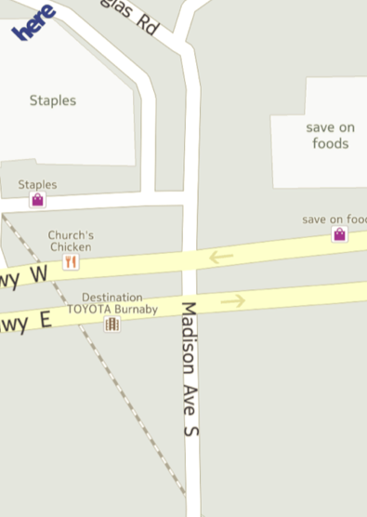
Display POIs
Hide/Show Default POIs
NMAMapView provides the following methods to show and hide categories of places on the map
[mapview setVisibility:NO forPoiCategory:NMAMapPoiCategoryPetrolStation];
POI objects cannot be modified, but can be selected
13
Workshop IOS SDK | November, 2017
Notes:
13

Slide 14


Marker
NMAMapMarker
The NMAMapMarker class is used to display a custom icon at a fixed geographical position on the map. Formats
BMP
SVG
JPEG
PNG
NMAMapGeoModel
A NMAMapLocalModel is an arbitrary 3D map object that is drawn using a local coordinate
14
Workshop IOS SDK | November, 2017
Notes:
14

Slide 15

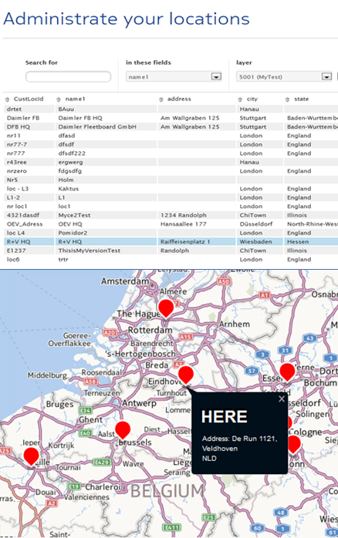
Platform Extensions
Custom Location Extension
Allows customer upload and management of private POI and polygon databases
Upload of POIs in CSV and XML files
Upload of polygons in shape format
Automatic and manual geocoding
Administration of POIs and polygons in database
User management module
Flexible, customizable POI database format
Support for complex search queries
Geospatial - corridor, polygon, and proximity
Logical – on all attributes
Combination of both
15
Workshop IOS SDK | November, 2017
Notes:
15

Slide 16
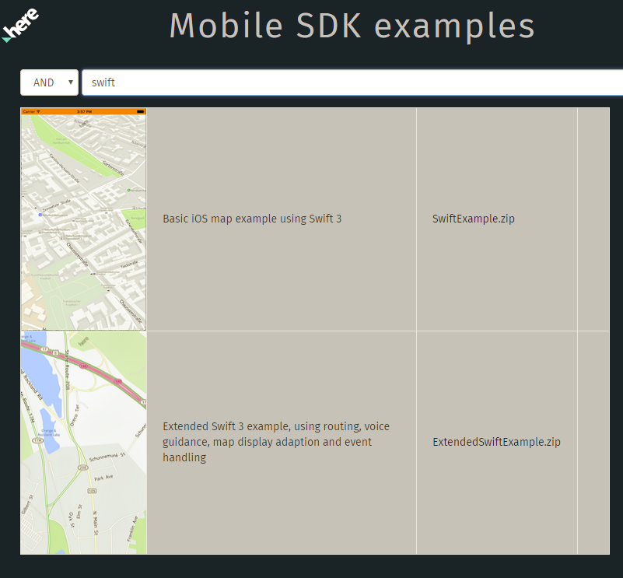
General
SDK 3.4 onwards swift supported for IOS
The HERE SDK contains suggested Swift method names to better align with standard Swift naming conventions. For example, createGeocodeRequestWithQuery:searchArea:locationContext: is create(query:searchArea:locationContext:) in Swift
Sample available on https://tcs.ext.here.com/mobilesdk_examples
If further examples are required, contact tcsplatform@here.com
16
Workshop IOS SDK | November, 2017
Notes:
https://developer.here.com/documentation/ios-premium/topics/swift-support.html
16

Slide 17
Car Integration
Possible syncronization with HERE car SDK / integrated in MIB2+ projects (submitting of calculated route / targets)
Not supported with IOS Premium SDK , only supported by Companion SDK part of MIB2+ Project
If required in mSDK , it would need to go through the MRF process in HERE
17
Workshop IOS SDK | November, 2017

Slide 18
Jithin Krishnan@here.com

