Slide 1
Chapter 6 Data Models (Phase 2 : Analysis Phase)

Slide 2
Topics covered
Conceptual Data Models
Logical Data Models
Physical Data Models
Entity Relationship Diagram
Data Dictionary
Normalization

Slide 3
Data Modelling
Data modeling (data modelling) is the process of creating a data model for the data to be stored in a database. This data model is a conceptual representation of Data objects, the associations between different data objects, and the rules.
Data modeling helps in the visual representation of data and enforces business rules, regulatory compliances, and government policies on the data. Data Models ensure consistency in naming conventions, default values, semantics, security while ensuring quality of the data.

Slide 4
Conceptual Data Model
Conceptual Data Model: This Data Model defines WHAT the system contains. This model is typically created by Business stakeholders and Data Architects. The purpose is to organize, scope and define business concepts and rules.
A Conceptual Data Model is an organized view of database concepts and their relationships. The purpose of creating a conceptual data model is to establish entities, their attributes, and relationships. In this data modeling level, there is hardly any detail available on the actual database structure. Business stakeholders and data architects typically create a conceptual data model.

Slide 5
Conceptual Data Model
The 3 basic tenants of Conceptual Data Model are
Entity: A real-world thing
Attribute: Characteristics or properties of an entity
Relationship: Dependency or association between two entities
Data model example:
Customer and Product are two entities. Customer number and name are attributes of the Customer entity
Product name and price are attributes of product entity
Sale is the relationship between the customer and product

Slide 6
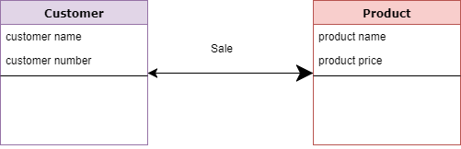
Conceptual Data Model

Slide 8
Characteristics of a conceptual data model
Offers Organization wide coverage of the business concepts.
This type of Data Models are designed and developed for a business audience.
The conceptual model is developed independently of hardware specifications like data storage capacity, location or software specifications like DBMS vendor and technology. The focus is to represent data as a user will see it in the “real world.”
Conceptual data models known as Domain models create a common vocabulary for all stakeholders by establishing basic concepts and scope.

Slide 9
Logical Data Model
Logical Data Model: Defines HOW the system should be implemented regardless of the DBMS. This model is typically created by Data Architects and Business Analysts. The purpose is to developed technical map of rules and data structures.
The Logical Data Model is used to define the structure of data elements and to set relationships between them. The logical data model adds further information to the conceptual data model elements. The advantage of using a Logical data model is to provide a foundation to form the base for the Physical model. However, the modeling structure remains generic.

Slide 10
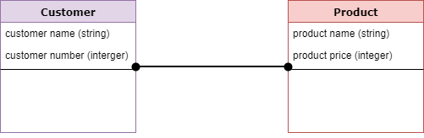
Logical Data Model

Slide 11
Logical Data Model
At this Data Modeling level, no primary or secondary key is defined. At this Data modeling level, you need to verify and adjust the connector details that were set earlier for relationships.

Slide 12
Characteristics of a Logical data model
Describes data needs for a single project but could integrate with other logical data models based on the scope of the project.
Designed and developed independently from the DBMS.
Data attributes will have datatypes with exact precisions and length.
Normalization processes to the model is applied typically till 3NF.

Slide 13
Physical Data Model
Physical Data Model: This Data Model describes HOW the system will be implemented using a specific DBMS system. This model is typically created by DBA and developers. The purpose is actual implementation of the database.
A Physical Data Model describes a database-specific implementation of the data model. It offers database abstraction and helps generate the schema. This is because of the richness of meta-data offered by a Physical Data Model. The physical data model also helps in visualizing database structure by replicating database column keys, constraints, indexes, triggers, and other RDBMS features.

Slide 14
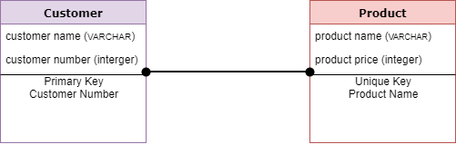
Physical Data Model

Slide 15
Characteristics of a physical data model:
The physical data model describes data need for a single project or application though it maybe integrated with other physical data models based on project scope.
Data Model contains relationships between tables that which addresses cardinality and nullability of the relationships.
Developed for a specific version of a DBMS, location, data storage or technology to be used in the project.
Columns should have exact datatypes, lengths assigned and default values.
Primary and Foreign keys, views, indexes, access profiles, and authorizations, etc. are defined.

Slide 16
Advantages and Disadvantages of Data Model:
Advantages of Data model:
The main goal of a designing data model is to make certain that data objects offered by the functional team are represented accurately.
The data model should be detailed enough to be used for building the physical database.
The information in the data model can be used for defining the relationship between tables, primary and foreign keys, and stored procedures.
Data Model helps business to communicate the within and across organizations.
Data model helps to documents data mappings in ETL process
Help to recognize correct sources of data to populate the model

Slide 17
Disadvantages of Data model
To develop Data model one should know physical data stored characteristics.
This is a navigational system produces complex application development, management. Thus, it requires a knowledge of the biographical truth.
Even smaller change made in structure require modification in the entire application.
There is no set data manipulation language in DBMS.

Slide 18
Conclusion
Data modeling is the process of developing data model for the data to be stored in a Database.
Data Models ensure consistency in naming conventions, default values, semantics, security while ensuring quality of the data.
Data Model structure helps to define the relational tables, primary and foreign keys and stored procedures.
There are three types of conceptual, logical, and physical.

Slide 19
Conclusion
The main aim of conceptual model is to establish the entities, their attributes, and their relationships.
Logical data model defines the structure of the data elements and set the relationships between them.
A Physical Data Model describes the database specific implementation of the data model.
The main goal of a designing data model is to make certain that data objects offered by the functional team are represented accurately.

Slide 20
Entity Relationship Diagram

Slide 21
Entity Relationship Diagram
An Entity Relationship (ER) Diagram is a type of flowchart that illustrates how “entities” such as people, objects or concepts relate to each other within a system.
ER Diagrams are most often used to design or debug relational databases in the fields of software engineering, business information systems, education and research. Also known as ERDs or ER Models, they use a defined set of symbols such as rectangles, diamonds, ovals and connecting lines to depict the interconnectedness of entities, relationships and their attributes.

Slide 22
When to draw ER Diagrams?
While ER models are mostly developed for designing relational databases in terms of concept visualization and in terms of physical database design

Slide 23
ERD notations guide
An ER Diagram contains entities, attributes, and relationships. In this section, we will go through the ERD symbols in detail.

Slide 24

1. Entity
An ERD entity is a definable thing or concept within a system, such as a person/role (e.g. Student), object (e.g. Invoice), concept (e.g. Profile) or event (e.g. Transaction) (note: In ERD, the term "entity" is often used instead of "table", but they are the same). When determining entities, think of them as nouns. In ER models, an entity is shown as a rounded rectangle, with its name on top and its attributes listed in the body of the entity shape. The ERD example below shows an example of an ER entity.

Slide 25
2. Entity Attributes
Also known as a column, an attribute is a property or characteristic of the entity that holds it.
An attribute has a name that describes the property and a type that describes the kind of attribute it is, such as varchar for a string, and int for integer. When an ERD is drawn for physical database development, it is important to ensure the use of types that are supported by the target RDBMS.

Slide 26
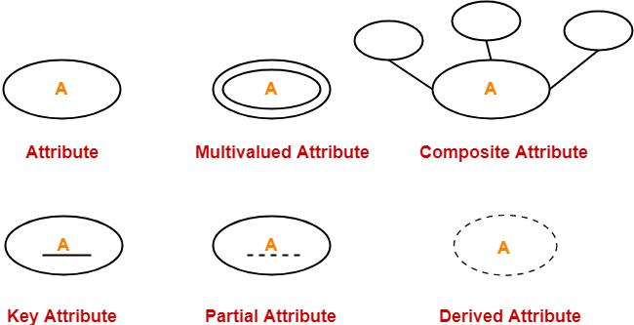
2. Entity Attributes

Slide 27
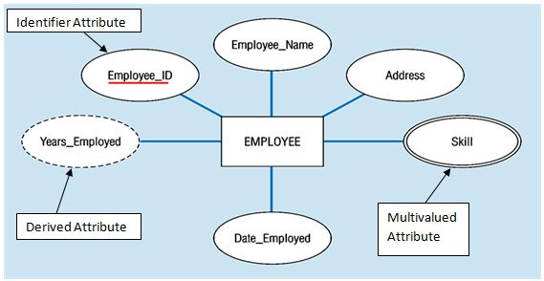
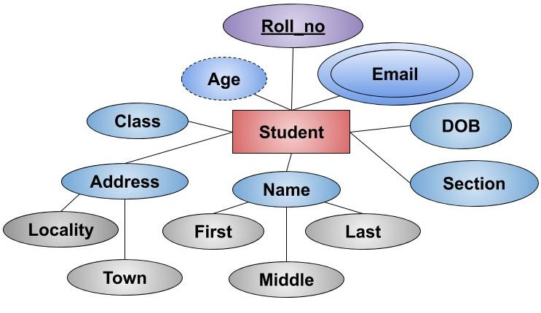

Slide 28
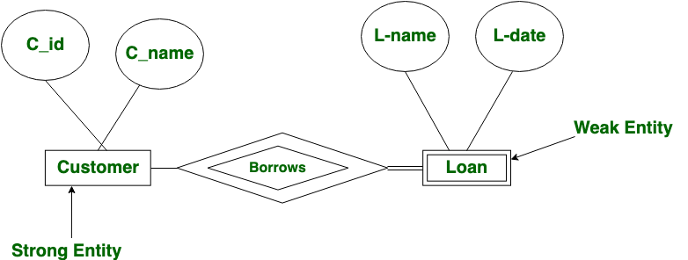
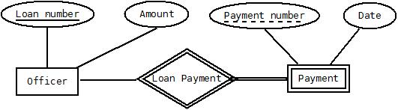

Slide 29
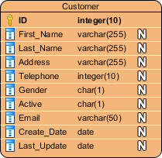
2. Entity Attributes
The ER diagram example below shows an entity with some attributes in it.

Slide 30
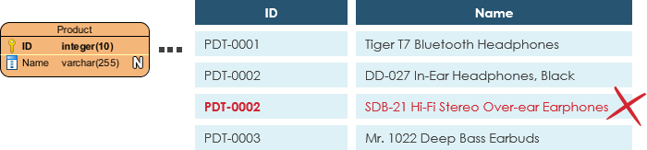
2. Entity Attributes
Primary Key
Also known as PK, a primary key is a special kind of entity attribute that uniquely defines a record in a database table. In other words, there must not be two (or more) records that share the same value for the primary key attribute. The ERD example below shows an entity 'Product' with a primary key attribute 'ID', and a preview of table records in the database. The third record is invalid because the value of ID 'PDT-0002' is already used by another record.

Slide 31
2. Entity Attributes
Foreign Key
Also known as FK, a foreign key is a reference to a primary key in a table. It is used to identify the relationships between entities. Note that foreign keys need not be unique. Multiple records can share the same values. The ER Diagram example below shows an entity with some columns, among which a foreign key is used in referencing another entity.

Slide 32
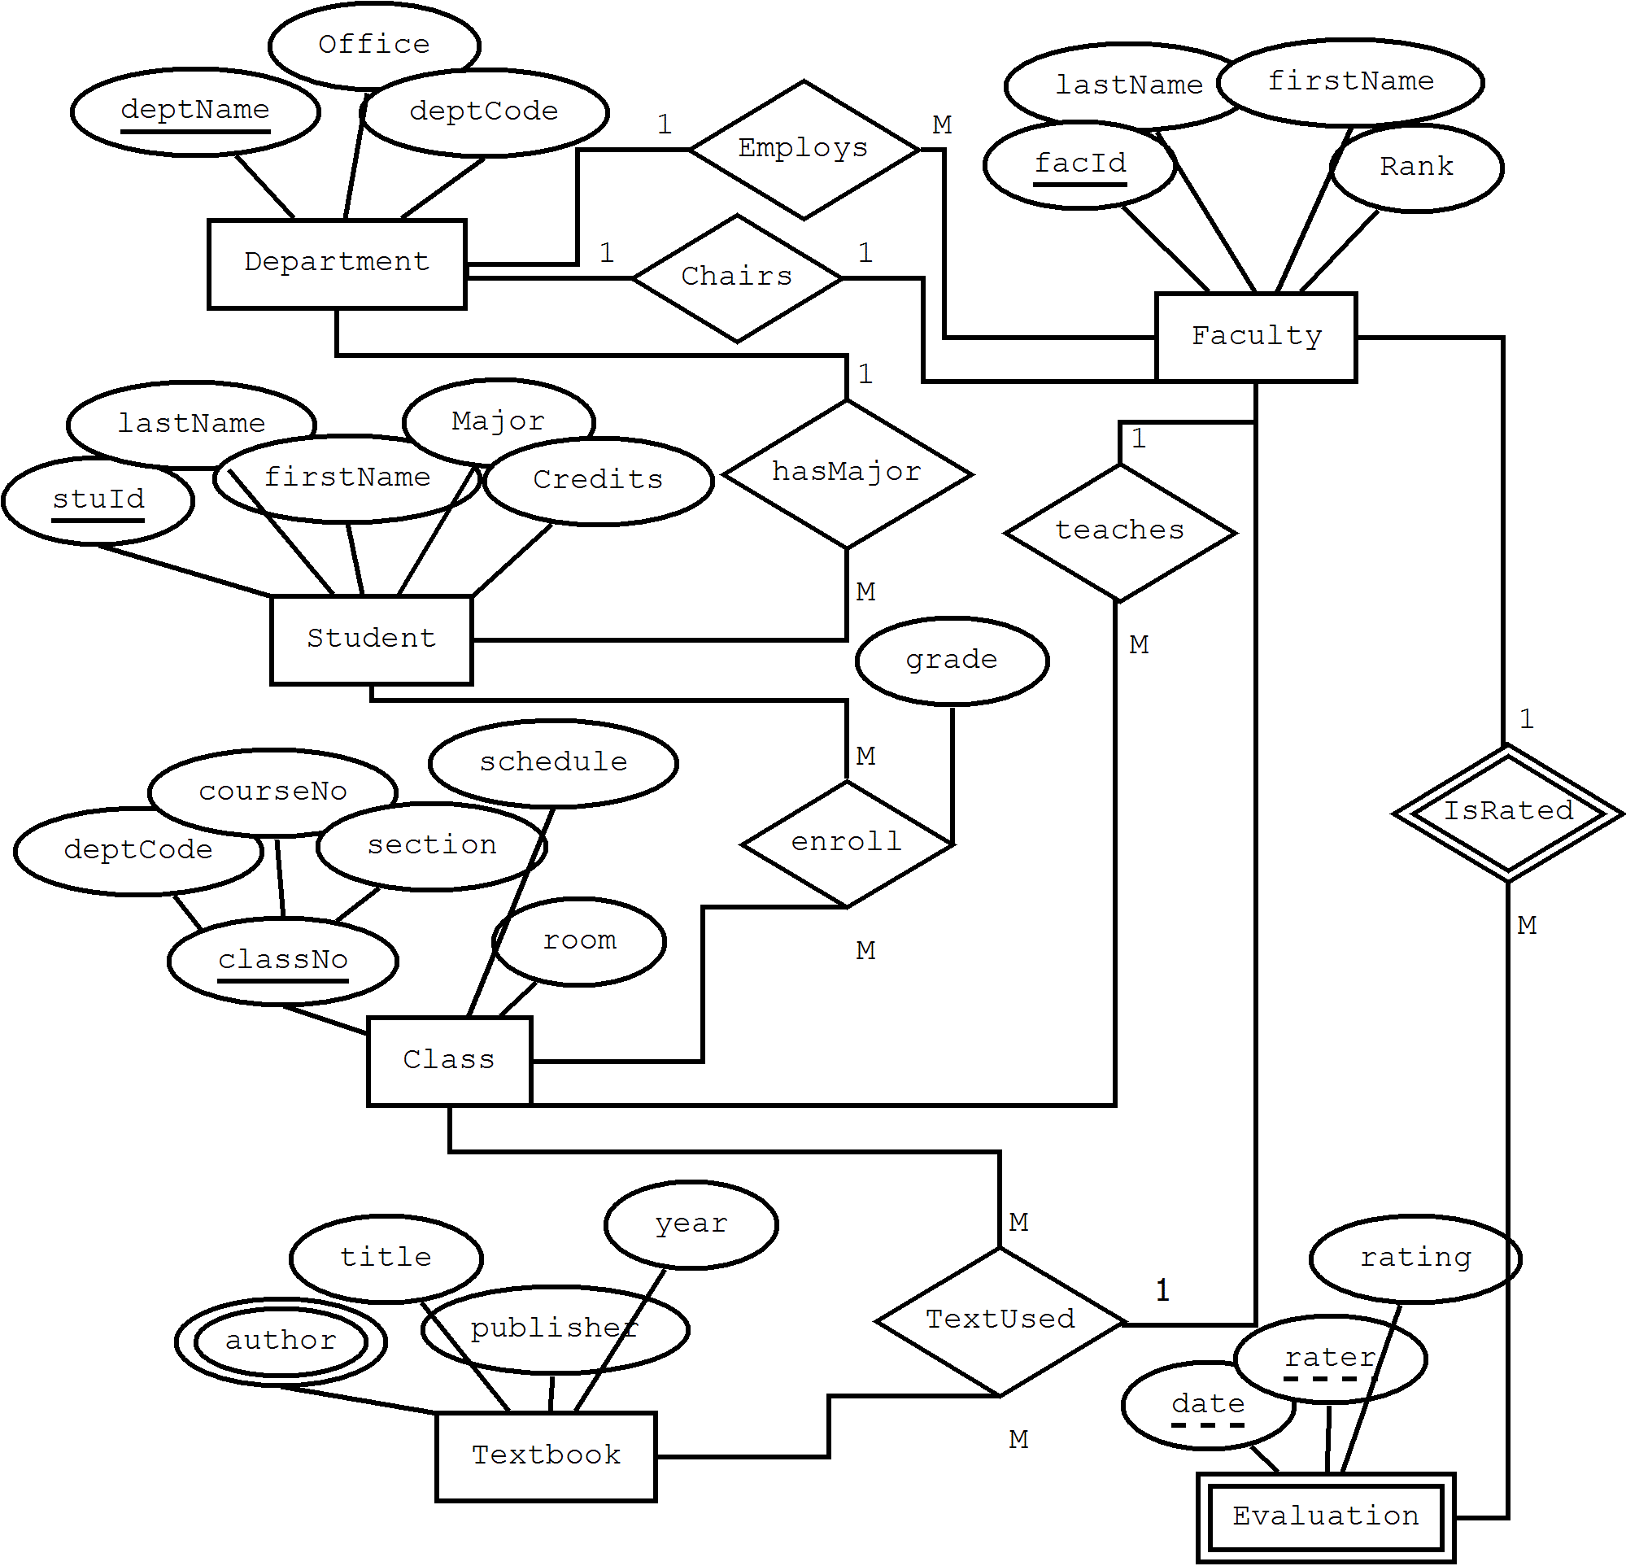

Slide 33
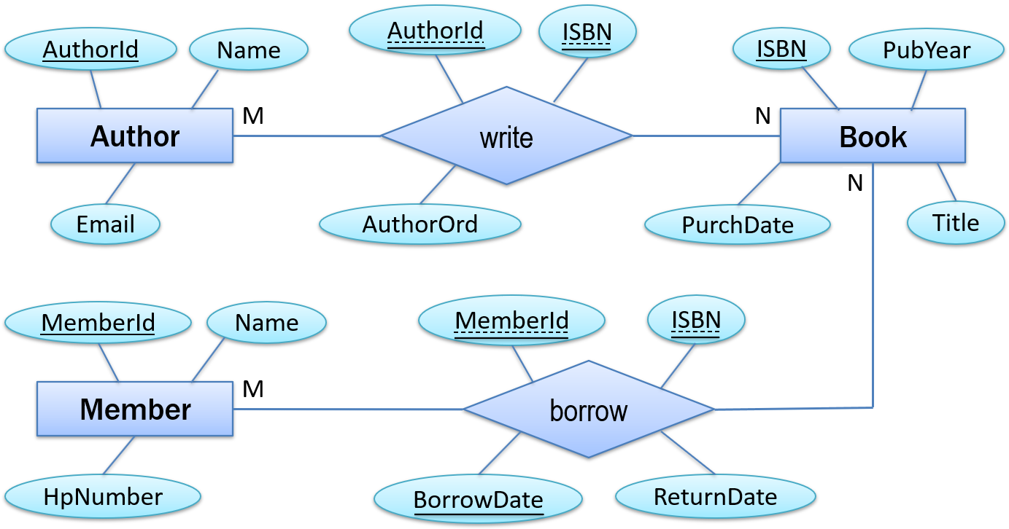

Slide 34
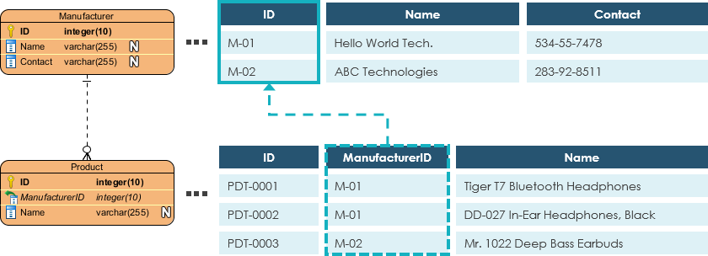
2. Entity Attributes
Foreign Key

Slide 35
3. Relationship
A relationship between two entities signifies that the two entities are associated with each other somehow. For example, a student might enroll in a course. The entity Student is therefore related to Course, and a relationship is presented as a connector connecting between them.
Enroll
Student
Course
relationship

Slide 36
4. Cardinality
Cardinality defines the possible number of occurrences in one entity which is associated with the number of occurrences in another. For example, ONE team has MANY players. When present in an ERD, the entity Team and Player are inter-connected with a one-to-many relationship.
In an ER diagram, cardinality is represented as a crow's foot at the connector's ends. The three common cardinal relationships are one-to-one, one-to-many, and many-to-many.

Slide 37

4. Cardinality
One-to-One cardinality example
A one-to-one relationship is mostly used to split an entity in two to provide information concisely and make it more understandable. The figure below shows an example of a one-to-one relationship.

Slide 38

4. Cardinality
One-to-Many cardinality example
A one-to-many relationship refers to the relationship between two entities X and Y in which an instance of X may be linked to many instances of Y, but an instance of Y is linked to only one instance of X. The figure below shows an example of a one-to-many relationship.

Slide 39
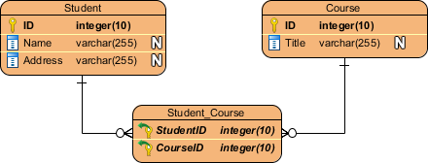
4. Cardinality
Many-to-Many cardinality example
A many-to-many relationship refers to the relationship between two entities X and Y in which X may be linked to many instances of Y and vice versa. The figure below shows an example of a many-to-many relationship. Note that a many-to-many relationship is split into a pair of one-to-many relationships in a physical ERD. You will know what a physical ERD is in the next section.

Slide 40
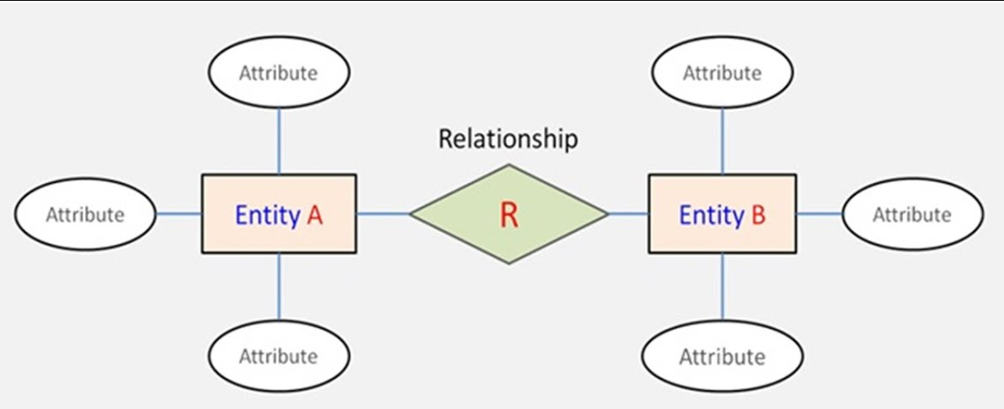

Slide 41
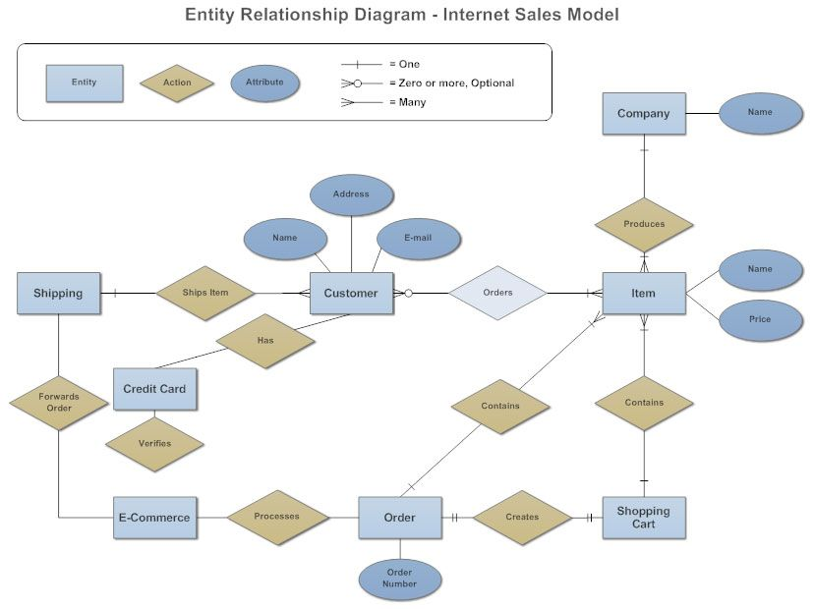

Slide 42
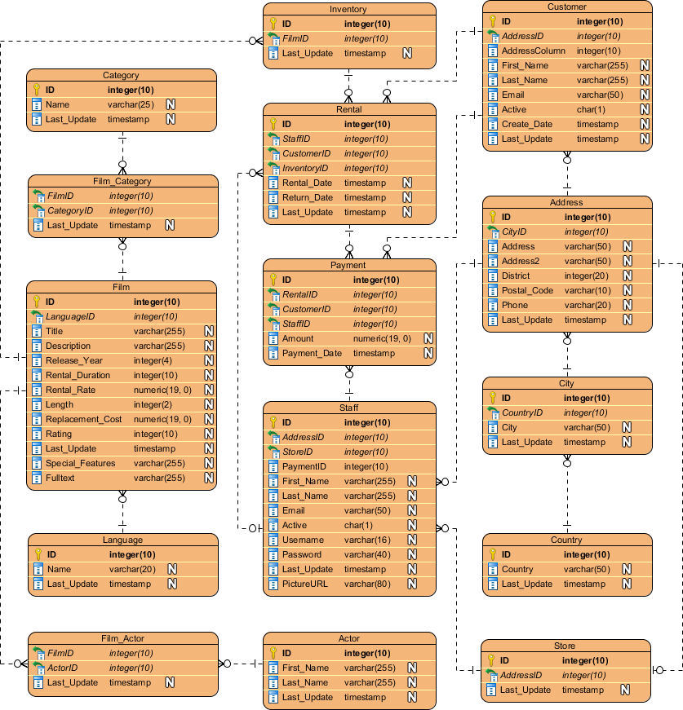
Example of ERD

Slide 43

Choosing an ERD tool

Slide 44
Data Dictionary

Slide 45
What Is a Data Dictionary?
A Data Dictionary is a collection of names, definitions, and attributes about data elements that are being used or captured in a database, information system, or part of a research project. It describes the meanings and purposes of data elements within the context of a project, and provides guidance on interpretation, accepted meanings and representation. A Data Dictionary also provides metadata about data elements. The metadata included in a Data Dictionary can assist in defining the scope and characteristics of data elements, as well the rules for their usage and application.
A data dictionary is a collection of metadata such as object name, data type, size, classification, and relationships with other data assets. Think of it as a list along with a description of tables, fields, and columns. The primary goal of a data dictionary is to help data teams understand data assets.

Slide 46
What is a data dictionary used for?
A data dictionary is used by data administrators, analysts, and engineers to understand and trust data assets. It helps in the creation of authentic, transparent, and consistent data throughout the organization.

Slide 47
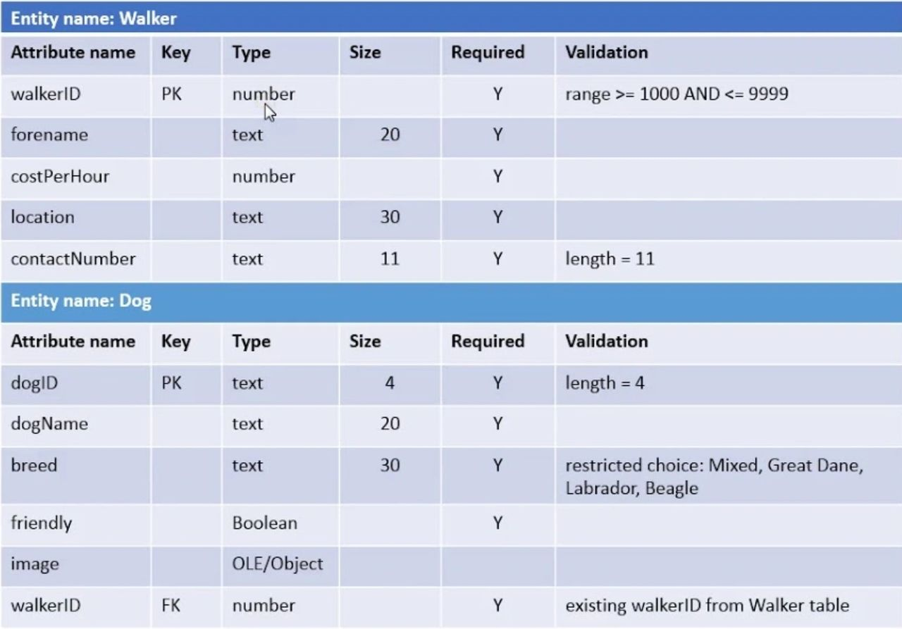
Example of Data Dictionary

Slide 48
Normalization
A large database defined as a single relation may result in data duplication. This repetition of data may result in:
Making relations very large.
It isn't easy to maintain and update data as it would involve searching many records in relation.
Wastage and poor utilization of disk space and resources.
The likelihood of errors and inconsistencies increases.
So to handle these problems, we should analyze and decompose the relations with redundant data into smaller, simpler, and well-structured relations that are satisfy desirable properties. Normalization is a process of decomposing the relations into relations with fewer attributes.

Slide 49
What is Normalization?
Normalization is the process of organizing the data in the database.
Normalization is used to minimize the redundancy from a relation or set of relations. It is also used to eliminate undesirable characteristics like Insertion, Update, and Deletion Anomalies.
Normalization divides the larger table into smaller and links them using relationships.
The normal form is used to reduce redundancy from the database table.
Normalization is a database design technique that reduces data redundancy and eliminates undesirable characteristics like Insertion, Update and Deletion Anomalies. Normalization rules divides larger tables into smaller tables and links them using relationships. The purpose of Normalization in SQL is to eliminate redundant (repetitive) data and ensure data is stored logically.

Slide 50
Why do we need Normalization?
The main reason for normalizing the relations is removing these anomalies. Failure to eliminate anomalies leads to data redundancy and can cause data integrity and other problems as the database grows. Normalization consists of a series of guidelines that helps to guide you in creating a good database structure.

Slide 51
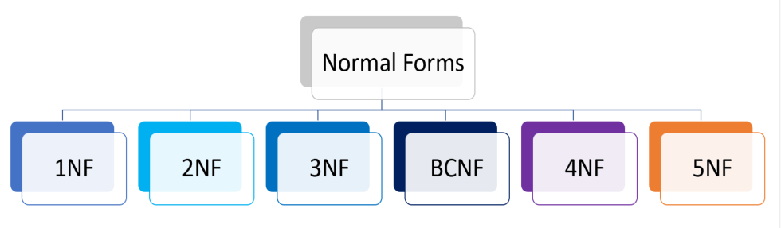
Steps of Normalization

Slide 52


Slide 53
Order amount
Customer Name | Days | Food Allergies | Shipping Address | Newsletter | Area | Delivery Branch | Branch Phone | Price
AMAL KALAEPEH | 5 days | Sea Foods | Yala City | lose weight and exercise | Yala | mueang district | 02-000-3000 | 1,225
NASRUDIN YUSOH | 45 Days, 25 Days | crab | Tak Bai, Narathiwat | healthy cooking, lose weight and exercise | Narathiwat | Tak Bai | 02-000-4000 | 16,100 6,075
HILMI ARWAEKACHI | 25 Days | No | Saiburee, Pattani | healthy cooking | Pattani | Saiburee | 02-000-5000 | 6,075
ARSISAH KAMPHUAN | 75Days | No | Ranong 85120 | lose weight and exercise | Ranong | Pak Nam | 02-000-5000 | 16,250

Slide 54
1NF (First Normal Form) Rules
Each table cell should contain a single value.
Each record needs to be unique
Each table must be identified with a unique column or concatenated columns called the primary key
A table is referred to as being in its First Normal Form if atomicity of the table is 1.
Here, atomicity states that a single cell cannot hold multiple values. It must hold only a single-valued attribute.
The First normal form disallows the multi-valued attribute, composite attribute, and their combinations.

Slide 55
Example of 1NF
Customer ID | Customer Name | Days | Food Allergies | Shipping Address | Newsletter | Area | Delivery Branch | Branch Phone | Price
F001 | AMAL KALAEPEH | 5 days | Sea Foods | Yala City | lose weight and exercise | Yala | mueang district | 02-000-3000 | 1,225
M001 | NASRUDIN YUSOH | 45 Days | crab | Tak Bai, Narathiwat | healthy cooking, | Narathiwat | Tak Bai | 02-000-4000 | 16,100
M001 | NASRUDIN YUSOH | 25 Days | crab | Tak Bai, Narathiwat | lose weight and exercise | Narathiwat | Tak Bai | 02-000-4000 | 6,075
M002 | HILMI ARWAEKACHI | 25 Days | No | Saiburee, Pattani | healthy cooking | Pattani | Saiburee | 02-000-5000 | 6,075
F002 | ARSISAH KAMPHUAN | 75Days | No | Ranong | lose weight and exercise | Ranong | Pak Nam | 02-000-5000 | 16,250

Slide 56
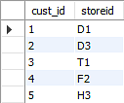
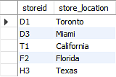
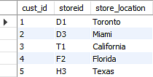
2NF (Second Normal Form) Rules
Rule 1- Be in 1NF
Rule 2- Single Column Primary Key that does not functionally dependent on any subset of candidate key relation
The first condition for the table to be in Second Normal Form is that the table has to be in First Normal Form. The table should not possess partial dependency. The partial dependency here means the proper subset of the candidate key should give a non-prime attribute.

Slide 57
1NF
Customer ID | Customer Name | Days | Food Allergies | Shipping Address | Newsletter | Area | Delivery Branch | Branch Phone | Price
F001 | AMAL KALAEPEH | 5 days | Sea Foods | Yala City | lose weight and exercise | Yala | mueang district | 02-000-3000 | 1,225
M001 | NASRUDIN YUSOH | 45 Days | crab | Tak Bai, Narathiwat | healthy cooking, | Narathiwat | Tak Bai | 02-000-4000 | 16,100
M001 | NASRUDIN YUSOH | 25 Days | crab | Tak Bai, Narathiwat | lose weight and exercise | Narathiwat | Tak Bai | 02-000-4000 | 6,075
M002 | HILMI ARWAEKACHI | 25 Days | No | Saiburee, Pattani | healthy cooking | Pattani | Saiburee | 02-000-5000 | 6,075
F002 | ARSISAH KAMPHUAN | 75Days | No | Ranong | lose weight and exercise | Ranong | Pak Nam | 02-000-5000 | 16,250

Slide 58
2NF
Customer ID (pk) | Customer Name | Food Allergies | Shipping Address | Newsletter | Area | Delivery Branch | Branch Phone
F001 | AMAL KALAEPEH | Sea Foods | Yala City | lose weight and exercise | Yala | mueang district | 02-000-3000
M001 | NASRUDIN YUSOH | crab | Tak Bai, Narathiwat | healthy cooking, | Narathiwat | Tak Bai | 02-000-4000
M001 | NASRUDIN YUSOH | crab | Tak Bai, Narathiwat | lose weight and exercise | Narathiwat | Tak Bai | 02-000-4000
M002 | HILMI ARWAEKACHI | No | Saiburee, Pattani | healthy cooking | Pattani | Saiburee | 02-000-5000
F002 | ARSISAH KAMPHUAN | No | Ranong 85120 | lose weight and exercise | Ranong | Pak Nam | 02-000-5000
Program no (pk) | Days | Price
ST001 | 5 days | 1,225
MT001 | 45 Days | 16,100
MT002 | 25 Days | 6,075
MT002 | 25 Days | 6,075
LT001 | 75Days | 16,250
No (PK) | Program no (fk) | Customer ID (fk)
01 | ST001 | F001
02 | MT001 | M001
03 | MT002 | M001
04 | MT002 | M002
05 | LT001 | F002

Slide 59
3NF (Third Normal Form) Rules
Rule 1- Be in 2NF
Rule 2- Has no transitive functional dependencies
The first condition for the table to be in Third Normal Form is that the table should be in the Second Normal Form.
The second condition is that there should be no transitive dependency for non-prime attributes, which indicates that non-prime attributes (which are not a part of the candidate key) should not depend on other non-prime attributes in a table. Therefore, a transitive dependency is a functional dependency in which A → C (A determines C) indirectly, because of A → B and B → C (where it is not the case that B → A).
The third Normal Form ensures the reduction of data duplication. It is also used to achieve data integrity.

Slide 60
2NF
Customer ID (pk) | Customer Name | Food Allergies | Shipping Address | Newsletter | Area | Delivery Branch | Branch Phone
F001 | AMAL KALAEPEH | Sea Foods | Yala City | lose weight and exercise | Yala | mueang district | 02-000-3000
M001 | NASRUDIN YUSOH | crab | Tak Bai, Narathiwat | healthy cooking, | Narathiwat | Tak Bai | 02-000-4000
M001 | NASRUDIN YUSOH | crab | Tak Bai, Narathiwat | lose weight and exercise | Narathiwat | Tak Bai | 02-000-4000
M002 | HILMI ARWAEKACHI | No | Saiburee, Pattani | healthy cooking | Pattani | Saiburee | 02-000-5000
F002 | ARSISAH KAMPHUAN | No | Ranong 85120 | lose weight and exercise | Ranong | Pak Nam | 02-000-5000
Program no (pk) | Days | Price
ST001 | 5 days | 1,225
MT001 | 45 Days | 16,100
MT002 | 25 Days | 6,075
MT002 | 25 Days | 6,075
LT001 | 75Days | 16,250
No (PK) | Program no (fk) | Customer ID (fk)
01 | ST001 | F001
02 | MT001 | M001
03 | MT002 | M001
04 | MT002 | M002
05 | LT001 | F002

Slide 61
3NF
Customer ID (PK) | Customer Name | Food Allergies | Shipping Address | Newsletter | Area ID (FK)
F001 | AMAL KALAEPEH | Sea Foods | Yala City | lose weight and exercise | Y001
M001 | NASRUDIN YUSOH | crab | Tak Bai, Narathiwat | healthy cooking, | N001
M001 | NASRUDIN YUSOH | crab | Tak Bai, Narathiwat | lose weight and exercise | N001
M002 | HILMI ARWAEKACHI | No | Saiburee, Pattani | healthy cooking | P001
F002 | ARSISAH KAMPHUAN | No | Ranong 85120 | lose weight and exercise | R001
Area ID (PK) | Area_Name | Delivery Branch | Branch Phone
Y001 | Yala | mueang district | 02-000-3000
N001 | Narathiwat | Tak Bai | 02-000-4000
N001 | Narathiwat | Tak Bai | 02-000-4000
P001 | Pattani | Saiburee | 02-000-5000
R001 | Ranong | Pak Nam | 02-000-5000
No (PK) | Program no (fk) | Customer ID (fk)
01 | ST001 | F001
02 | MT001 | M001
03 | MT002 | M001
04 | MT002 | M002
05 | LT001 | F002
Program no (PK) | Days | Price
ST001 | 5 days | 1,225
MT001 | 45 Days | 16,100
MT002 | 25 Days | 6,075
MT002 | 25 Days | 6,075
LT001 | 75Days | 16,250

Slide 62
BCNF (Boyce-Codd Normal Form)
Even when a database is in 3rd Normal Form, still there would be anomalies resulted if it has more than one Candidate Key.
Sometimes is BCNF is also referred as 3.5 Normal Form.
The first condition for the table to be in Boyce Codd Normal Form is that the table should be in the third normal form. Secondly, every Right-Hand Side (RHS) attribute of the functional dependencies should depend on the super key of that particular table.

Slide 63
3NF
Customer ID (PK) | Customer Name | Food Allergies | Shipping Address | Newsletter | Area ID (FK)
F001 | AMAL KALAEPEH | Sea Foods | Yala City | lose weight and exercise | Y001
M001 | NASRUDIN YUSOH | crab | Tak Bai, Narathiwat | healthy cooking, | N001
M001 | NASRUDIN YUSOH | crab | Tak Bai, Narathiwat | lose weight and exercise | N001
M002 | HILMI ARWAEKACHI | No | Saiburee, Pattani | healthy cooking | P001
F002 | ARSISAH KAMPHUAN | No | Ranong 85120 | lose weight and exercise | R001
Area ID (PK) | Area_Name | Delivery Branch | Branch Phone
Y001 | Yala | mueang district | 02-000-3000
N001 | Narathiwat | Tak Bai | 02-000-4000
N001 | Narathiwat | Tak Bai | 02-000-4000
P001 | Pattani | Saiburee | 02-000-5000
R001 | Ranong | Pak Nam | 02-000-5000
No (PK) | Program no (fk) | Customer ID (fk)
01 | ST001 | F001
02 | MT001 | M001
03 | MT002 | M001
04 | MT002 | M002
05 | LT001 | F002
Program no (PK) | Days | Price
ST001 | 5 days | 1,225
MT001 | 45 Days | 16,100
MT002 | 25 Days | 6,075
MT002 | 25 Days | 6,075
LT001 | 75Days | 16,250

Slide 64
BCNF
Customer ID (PK) | Customer Name | Food Allergies | Shipping Address | Newsletter | Area ID (FK)
F001 | AMAL KALAEPEH | Sea Foods | Yala City | lose weight and exercise | Y001
M001 | NASRUDIN YUSOH | crab | Tak Bai, Narathiwat | healthy cooking, | N001
M001 | NASRUDIN YUSOH | crab | Tak Bai, Narathiwat | lose weight and exercise | N001
M002 | HILMI ARWAEKACHI | No | Saiburee, Pattani | healthy cooking | P001
F002 | ARSISAH KAMPHUAN | No | Ranong 85120 | lose weight and exercise | R001
Area ID (PK) | Area_Name
Y001 | Yala
N001 | Narathiwat
N001 | Narathiwat
P001 | Pattani
R001 | Ranong
Area ID (FK) | BranchID (PK) | Delivery Branch | Branch Phone
Y001 | YM01 | mueang district | 02-000-3000
N001 | NT01 | Tak Bai | 02-000-4000
N001 | NT01 | Tak Bai | 02-000-4000
P001 | PS01 | Saiburee | 02-000-5000
R001 | RP01 | Pak Nam | 02-000-5000
No (FK) | Program no (fk) | Customer ID (fk)
01 | ST001 | F001
02 | MT001 | M001
03 | MT002 | M001
04 | MT002 | M002
05 | LT001 | F002
Program no (PK) | Days | Price
ST001 | 5 days | 1,225
MT001 | 45 Days | 16,100
MT002 | 25 Days | 6,075
MT002 | 25 Days | 6,075
LT001 | 75Days | 16,250

Slide 65
4NF (Fourth Normal Form) Rules
If no database table instance contains two or more, independent and multivalued data describing the relevant entity, then it is in 4th Normal Form.

Slide 66
BCNF
Customer ID (PK) | Customer Name | Food Allergies | Shipping Address | Newsletter | Area ID (FK)
F001 | AMAL KALAEPEH | Sea Foods | Yala City | lose weight and exercise | Y001
M001 | NASRUDIN YUSOH | crab | Tak Bai, Narathiwat | healthy cooking, | N001
M001 | NASRUDIN YUSOH | crab | Tak Bai, Narathiwat | lose weight and exercise | N001
M002 | HILMI ARWAEKACHI | No | Saiburee, Pattani | healthy cooking | P001
F002 | ARSISAH KAMPHUAN | No | Ranong 85120 | lose weight and exercise | R001
Area ID (PK) | Area_Name
Y001 | Yala
N001 | Narathiwat
N001 | Narathiwat
P001 | Pattani
R001 | Ranong
Area ID (FK) | BranchID (PK) | Delivery Branch | Branch Phone
Y001 | YM01 | mueang district | 02-000-3000
N001 | NT01 | Tak Bai | 02-000-4000
N001 | NT01 | Tak Bai | 02-000-4000
P001 | PS01 | Saiburee | 02-000-5000
R001 | RP01 | Pak Nam | 02-000-5000
No (FK) | Program no (fk) | Customer ID (fk)
01 | ST001 | F001
02 | MT001 | M001
03 | MT002 | M001
04 | MT002 | M002
05 | LT001 | F002
Program no (PK) | Days | Price
ST001 | 5 days | 1,225
MT001 | 45 Days | 16,100
MT002 | 25 Days | 6,075
MT002 | 25 Days | 6,075
LT001 | 75Days | 16,250

Slide 67
4NF
Customer ID (PK) | Customer Name | Food Allergies | Shipping Address | Area ID (FK)
F001 | AMAL KALAEPEH | Sea Foods | Yala City | Y001
M001 | NASRUDIN YUSOH | crab | Tak Bai, Narathiwat | N001
M001 | NASRUDIN YUSOH | crab | Tak Bai, Narathiwat | N001
M002 | HILMI ARWAEKACHI | No | Saiburee, Pattani | P001
F002 | ARSISAH KAMPHUAN | No | Ranong 85120 | R001
News_ID (PK) | Newsletter
LW001 | lose weight and exercise
HC001 | healthy cooking,
LW001 | lose weight and exercise
HC001 | healthy cooking
LW001 | lose weight and exercise
No (PK) | Customer ID (FK) | News_ID (FK)
01 | F001 | LW001
02 | M001 | HC001
03 | M001 | LW001
04 | M002 | HC001
05 | F002 | LW001
No (PK) | Program no (fk) | Customer ID (fk)
01 | ST001 | F001
02 | MT001 | M001
03 | MT002 | M001
04 | MT002 | M002
05 | LT001 | F002
Program no (PK) | Days | Price
ST001 | 5 days | 1,225
MT001 | 45 Days | 16,100
MT002 | 25 Days | 6,075
MT002 | 25 Days | 6,075
LT001 | 75Days | 16,250
Area ID (PK) | Area_Name
Y001 | Yala
N001 | Narathiwat
N001 | Narathiwat
P001 | Pattani
R001 | Ranong
Area ID (FK) | BranchID (PK) | Delivery Branch | Branch Phone
Y001 | YM01 | mueang district | 02-000-3000
N001 | NT01 | Tak Bai | 02-000-4000
N001 | NT01 | Tak Bai | 02-000-4000
P001 | PS01 | Saiburee | 02-000-5000
R001 | RP01 | Pak Nam | 02-000-5000

Slide 68
4NF
Customer ID (PK) | Customer Name | Food Allergies | Shipping Address | Area ID (FK)
F001 | AMAL KALAEPEH | Sea Foods | Yala City | Y001
M001 | NASRUDIN YUSOH | crab | Tak Bai, Narathiwat | N001
M002 | HILMI ARWAEKACHI | No | Saiburee, Pattani | P001
F002 | ARSISAH KAMPHUAN | No | Ranong 85120 | R001
News_ID (PK) | Newsletter
LW001 | lose weight and exercise
HC001 | healthy cooking
No (PK) | Customer ID (FK) | News_ID (FK)
01 | F001 | LW001
02 | M001 | HC001
03 | M001 | LW001
04 | M002 | HC001
05 | F002 | LW001
No (PK) | Program no (fk) | Customer ID (fk)
01 | ST001 | F001
02 | MT001 | M001
03 | MT002 | M001
04 | MT002 | M002
05 | LT001 | F002
Program no (PK) | Days | Price
ST001 | 5 days | 1,225
MT001 | 45 Days | 16,100
MT002 | 25 Days | 6,075
LT001 | 75Days | 16,250
Area ID (PK) | Area_Name
Y001 | Yala
N001 | Narathiwat
P001 | Pattani
R001 | Ranong
Area ID (FK) | BranchID (PK) | Delivery Branch | Branch Phone
Y001 | YM01 | mueang district | 02-000-3000
N001 | NT01 | Tak Bai | 02-000-4000
P001 | PS01 | Saiburee | 02-000-5000
R001 | RP01 | Pak Nam | 02-000-5000

Slide 69
Order amount
Customer Name | Days | Food Allergies | Shipping Address | Newsletter | Area | Delivery Branch | Branch Phone | Price
AMAL KALAEPEH | 5 days | Sea Foods | Yala City | lose weight and exercise | Yala | mueang district | 02-000-3000 | 1,225
NASRUDIN YUSOH | 45 Days, 25 Days | crab | Tak Bai, Narathiwat | healthy cooking, lose weight and exercise | Narathiwat | Tak Bai | 02-000-4000 | 16,100 6,075
HILMI ARWAEKACHI | 25 Days | No | Saiburee, Pattani | healthy cooking | Pattani | Saiburee | 02-000-5000 | 6,075
ARSISAH KAMPHUAN | 75Days | No | Ranong 85120 | lose weight and exercise | Ranong | Pak Nam | 02-000-5000 | 16,250

Slide 70
5NF (Fifth Normal Form) Rules
A table is in 5th Normal Form only if it is in 4NF and it cannot be decomposed into any number of smaller tables without loss of data.

Slide 71
Step to do Normalization
Normal Form | Description
1NF | A relation is in 1NF if it contains an atomic value.
2NF | A relation will be in 2NF if it is in 1NF and all non-key attributes are fully functional dependent on the primary key.
3NF | A relation will be in 3NF if it is in 2NF and no transition dependency exists.
BCNF | A stronger definition of 3NF is known as Boyce Codd's normal form.
4NF | A relation will be in 4NF if it is in Boyce Codd's normal form and has no multi-valued dependency.
5NF | A relation is in 5NF. If it is in 4NF and does not contain any join dependency, joining should be lossless.

Slide 72
Assignment
Data Dictionary
ERD

Slide 73
Thank You

