Slide 1
T3h NTWrk B4 tym3 Social network’s effect on literacy
Instructor Katie Ross Course Digital Literacy (DGL1012-L)
Notes:
Authority/Credibility:
Current/Continuity:
Content/Bias:
Citations/Links:
Navigation/Copyright:

Slide 2
Presentation order:
Presenter | Topic | Slides
Justin “MrClean” Crowley | Intro/Comprehension | 1-6
Orlando “Bloom” Torres Borrero | Speed Reading | 7-8
Valerie “The Valkyrie” Wolford | Vocabulary | 9-10
Ryan “Green Ranger” Zachinni | Spelling | 11-12
Mike Siegfriend “and Roy” | Puntuation | 13-14
Freddy “Krueger” Villamizar Nieves | Grammar | 15-16
Alex “Thunderfists” Aldana | Language Evolution/Examples | 17-20
T3H NTWRK B4 TYM3/Saucy Bacon | Group Conclusion | 21-24
Notes:
A schedule design for optional periods of time/objectives.
Authority/Credibility:
Current/Continuity:
Content/Bias:
Citations/Links:
Navigation/Copyright:

Slide 3
Introduction/Course Description
Social Networks have not increased literacy skills
Social Networks:
Facebook
Twitter
MySpace
MyYearbook
Literacy degradation in society
Dis, dat, sup, dude, emojis
Can you read this? Yes? You are doing good so far
Notes:
Introductory notes.
Authority/Credibility:
Current/Continuity:
Content/Bias:
Citations/Links:
Navigation/Copyright:

Slide 4
Comprehension
Comprehension decline from Social Networks
63 million Americans possessed only basic literacy skills. A person with basic literacy skills can, for example, extract simple facts from a short newspaper article or determine the expiration date on a driver's license, but would be unable to understand a list of qualifications posted in an employment ad or fill out the forms required to obtain a driver's license in the first place.
Notes:
A list of procedures and steps, or a lecture slide with media.
Authority/Credibility:
Current/Continuity:
Content/Bias:
Citations/Links:
Navigation/Copyright:
Cite? Cite link?

Slide 5

Comprehension (Contd.)
Battling lack of Comprehension
Not just cursory sentence galloping but the constant social network and e-mail temptations that lurk on our gadgets — the bings and dings that interrupt “Call me Ishmael.”
Notes:
A list of procedures and steps, or a lecture slide with media.
Authority/Credibility:
Current/Continuity:
Content/Bias:
Citations/Links:
Navigation/Copyright:

Slide 6
Speed Reading
Teenagers are having declining scores on basic reading tests. Why is this happening? It is because they’re spending too much time on Social Media sites instead of reading a book.
They are taking shortcuts trough words, videos and sounds instead of strengthening their reading.
Everyone has a reading speed and a personal process to help them read, taking these shortcuts affect how we process the information and how much we learn from it.
Notes:
A list of procedures and steps, or a lecture slide with media.

Slide 7
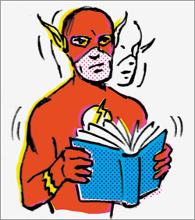
Speed Reading (Contd.)
Children and young adults of recent years process reading at the speed of full grown adult, and when they encounter the learning speed for their age at school they found it’s hard to follow.
Children now have to adjust their speed levels according to the circumstances, like the education programs designed for their age.
Notes:
A list of procedures and steps, or a lecture slide with media.
Authority/Credibility:
Current/Continuity:
Content/Bias:
Citations/Links:
Navigation/Copyright:

Slide 8
Vocabulary
RT
IDK
Btw
OMG
TTyl
OMG! Becky did U C dat?
ROFLMAO
BrB
Smh
2b or not 2b
FTW
LoL
Notes:
A list of procedures and steps, or a lecture slide with media.
Authority/Credibility:
Current/Continuity:
Content/Bias:
Citations/Links:
Navigation/Copyright:

Slide 9
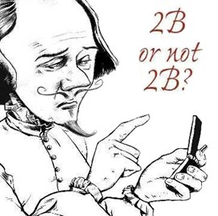
Vocabulary (Contd.)
Lack of vocabulary develops bad habits in the classroom
Slang speak limits communication abilities
As technology develops this will be a growing problem
Notes:
Relative vocabulary list.
Authority/Credibility:
Current/Continuity:
Content/Bias:
Citations/Links:
Navigation/Copyright:

Slide 10
Spelling
How social media is effecting our youth’s spelling
Research suggests social networking/media is encouraging children and teens to spell words incorrectly
22% percent of todays youth between the ages of 18-24 say they would not be confident writing an email without using a spellchecker
“Two thirds (66%) believe that dictionaries should contain variant spellings.” ~ English Spelling Society
Notes:
A list of procedures and steps, or a lecture slide with media.
Authority/Credibility:
Current/Continuity:
Content/Bias:
Citations/Links:
Navigation/Copyright:
Personally debunk the spelling slide with my own experience of being able to spell. I would also say that calculators would be a good example.

Slide 11
Spelling (Contd.)
The reliance on technology and social media is causing many of us to lose that valuable practice of actually thinking about how to spell words.
The practices that enable us to type, write and read at an accelerated pace are making students lazy in their ability to spell correctly
This is increasing our reliance on technology for spell correction.
Notes:
A list of procedures and steps, or a lecture slide with media.

Slide 12
Punctuation
Twitter originally required shorthand and hash tags in posts.
Teachers start deducting points after seeing multiple punctuation and grammar errors.
Teachers dreaded reading student papers.
Notes:
A list of procedures and steps, or a lecture slide with media.
Authority/Credibility:
Current/Continuity:
Content/Bias:
Citations/Links:
Navigation/Copyright:

Slide 13
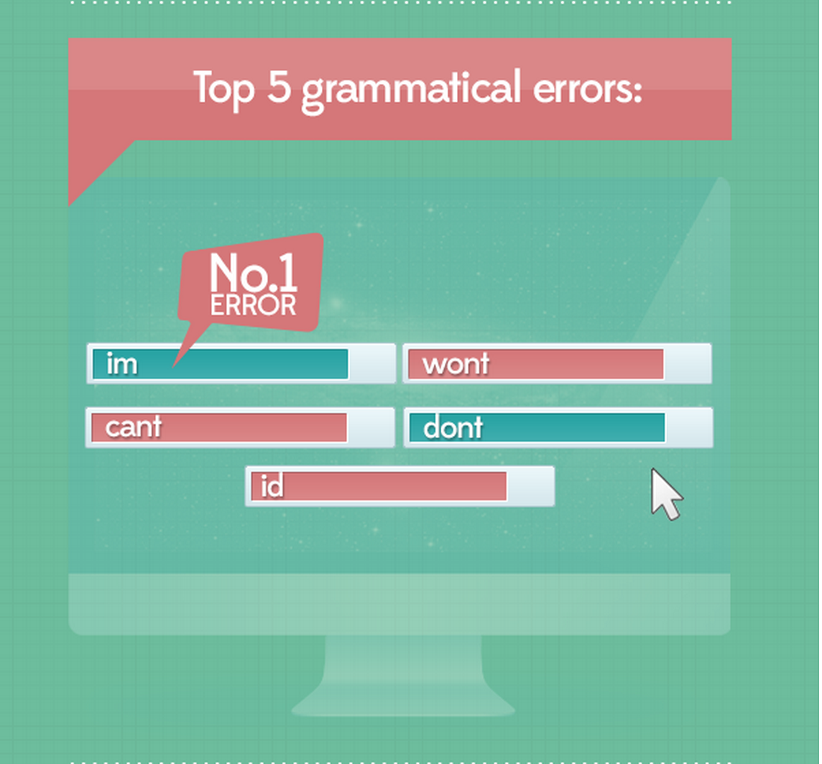
Punctuation (Contd.)
“Punctuation errors are huge, and apostrophe errors…” –Paul Budra English professor and associate dean at Simon Fraser University
Notes:
A list of procedures and steps, or a lecture slide with media.
Authority/Credibility:
Current/Continuity:
Content/Bias:
Citations/Links:
Navigation/Copyright:
THE BRAIN CAN FILL IN BECAUSE THE BRAIN IS AMAZING. CUT THE ENDS OFF THE ROAST.

Slide 14
Grammar
“General attitude”
Using as few words as possible
Convenience and speed
In 2011, America was the only free-market OECD (Organization for Economic Cooperation and Development) country where the current generation was less educated than the previous.
Notes:
A list of procedures and steps, or a lecture slide with media.
Authority/Credibility:
Current/Continuity:
Content/Bias:
Citations/Links:
Navigation/Copyright:

Slide 15
Grammar (Cont.)
Techspeak/Leet Speak / 1337$p34|<
Your vs. You’re
There vs. Their vs. They’re
It’s vs. Its
Affect vs. Effect
Double negatives
Poor communication skills
Indifference toward details
Notes:
A list of procedures and steps, or a lecture slide with media.
Authority/Credibility:
Current/Continuity:
Content/Bias:
Citations/Links:
Navigation/Copyright:

Slide 16
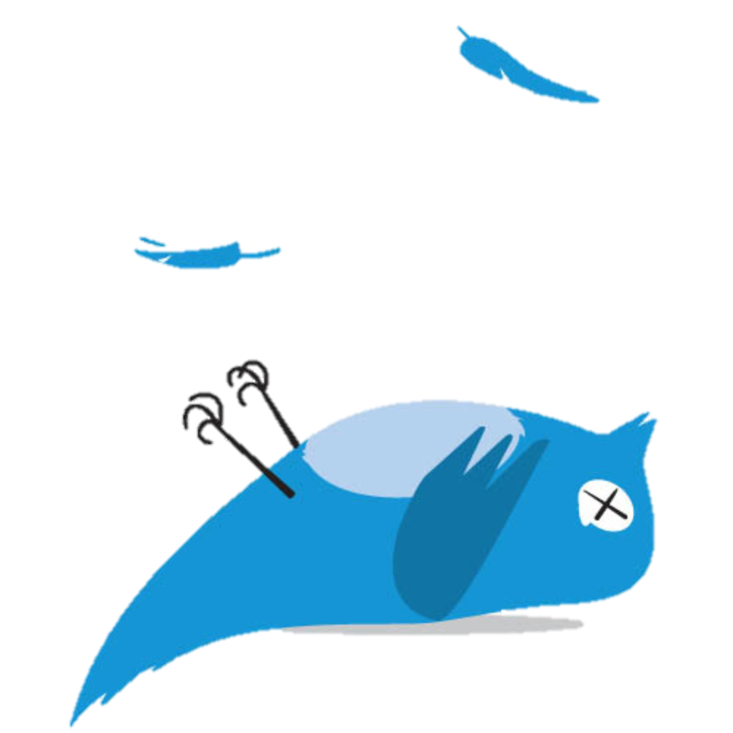
Language Evolution
Social media is putting a stopper on the ability to express thoughts with peer pressure leading to improper thought patterns.
People are reading informal content and repeating it with the thought of it being proper English.
Abbreviations have commonly infiltrated everyday speech.
Notes:
A list of procedures and steps, or a lecture slide with media.
Authority/Credibility:
Current/Continuity:
Content/Bias:
Citations/Links:
Navigation/Copyright:

Slide 17


Language Evolution (Contd.)
Truncated phrases are now mainstream.
The words we choose to use in our conversations now are often how our Internet “accent” is shown in academics.
Notes:
A list of procedures and steps, or a lecture slide with media.
Authority/Credibility:
Current/Continuity:
Content/Bias:
Citations/Links:
Navigation/Copyright:

Slide 18
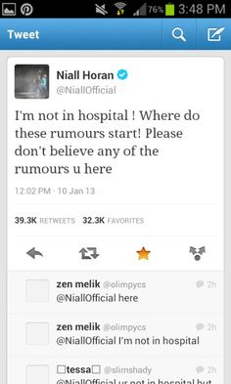
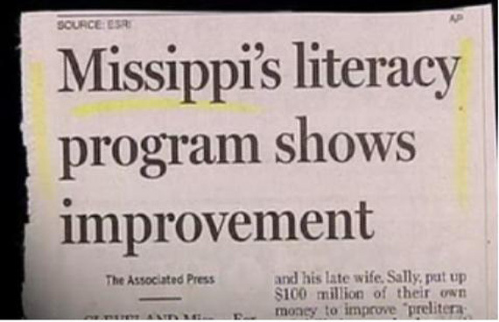
Examples:
Notes:
Conclusion to course, lecture, et al.
Authority/Credibility:
Current/Continuity:
Content/Bias:
Citations/Links:
Navigation/Copyright:

Slide 19
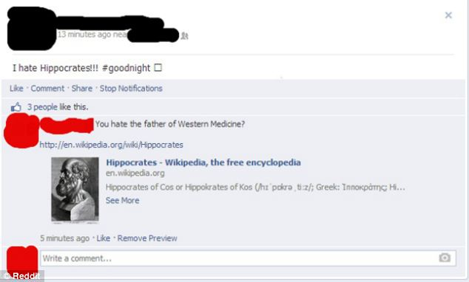
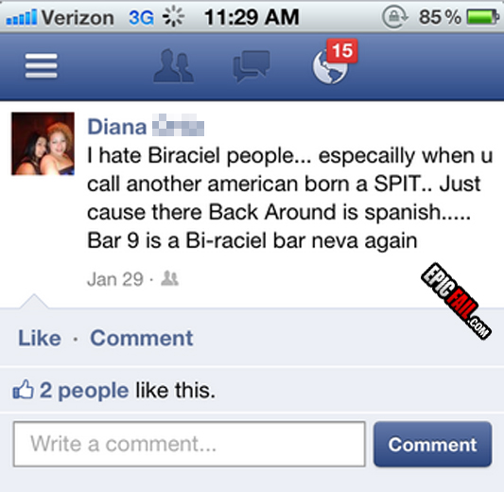
Examples
Notes:
Conclusion to course, lecture, et al.
Authority/Credibility:
Current/Continuity:
Content/Bias:
Citations/Links:
Navigation/Copyright:

Slide 20
Conclusion
In this presentation and in spoken word we have shown you factual proof that there is no doubt in a literacy decline amongst users of Social Networks and Media. Scholars have written books, articles and scientists have done studies to show this. We have undoubtedly brought this inescapable truth to your eyes and ears. Hopefully we can all learn to better ourselves and preserve the knowledge that has been passed on. Thank you for your attention.
Notes:
Conclusion to course, lecture, et al.
Authority/Credibility:
Current/Continuity:
Content/Bias:
Citations/Links:
Navigation/Copyright:

Slide 21
Questions?
NO QUESTIONS ALLOWED!!!
Notes:
An opportunity for questions and discussions.
Authority/Credibility:
Current/Continuity:
Content/Bias:
Citations/Links:
Navigation/Copyright:

Slide 22
Questions?
Just Kidding…
Ask away!
Notes:
An opportunity for questions and discussions.
Authority/Credibility:
Current/Continuity:
Content/Bias:
Citations/Links:
Navigation/Copyright:

