Slide 1

Passionately serving our partners for over 25 years.
cC

Slide 2
Our mission:
{clearfix} is a technological engine primarily made up of humans.
Fueled by passion our designers, programmers and developers
who pride themselves on clean code and flawless execution and
are supported by a world-class team of account service leaders.
Notes:
From Wikipedia, the free encyclopedia
"Statement of purpose" redirects here. For use in the university and college admissions, see admissions essay.
A mission statement is a statement of the purpose of a company, organization or person, its reason for existing.
The mission statement should guide the actions of the organization, spell out its overall goal, provide a path, and guide decision-making. It provides "the framework or context within which the company's strategies are formulated." It is like a goal for what the company wants to do for the world.^{[1]}
According to Bart Christopher,^{[2]} the commercial mission statement consists of three essential components:
Key market: Who is your target client or customer (generalize if needed)?
Contribution: What product or service do you provide to that client?
Distinction: What makes your product or service unique, so that the client would choose you?

Slide 3
Meet your team:
Debra Walker | Selena Vargas | Levance Wamley

Slide 4
Think of us as your extended office:
Full time staff of 50 full-time associates
Everlasting supply of technical experts
Contracted on a need-to-have basis
Certified
Globally networked

Slide 5
Service Packages
PWA-International
Full pack: $25,500
Design pack: $15,000
Programming Pack: $12,500
Hosting pack: $65/monthly
Custom packages are negotiable.
Account Service | Creative Design | Development | Hosting
Account Service | Creative Design
Account Service | Development
Account Service | Hosting

Slide 6
Services
PWA-International
We are an integrated, full-service interactive company.
Account Service
SWOT
(Strengths, Weakness, Opportunities, Threats)
Business Plan
Budget
Asset Management
Creative Design
Concept Development
Asset Development
Art Direction
Production
Development
ADDIO®
(Analyze, Design, Develop/Debug, Integrate/Test, Optimize)
Front End Design
Debugging
Asset Production
Hosting
Maintenance
Firewall Security
Multiple Site Backups (daily)

Slide 7
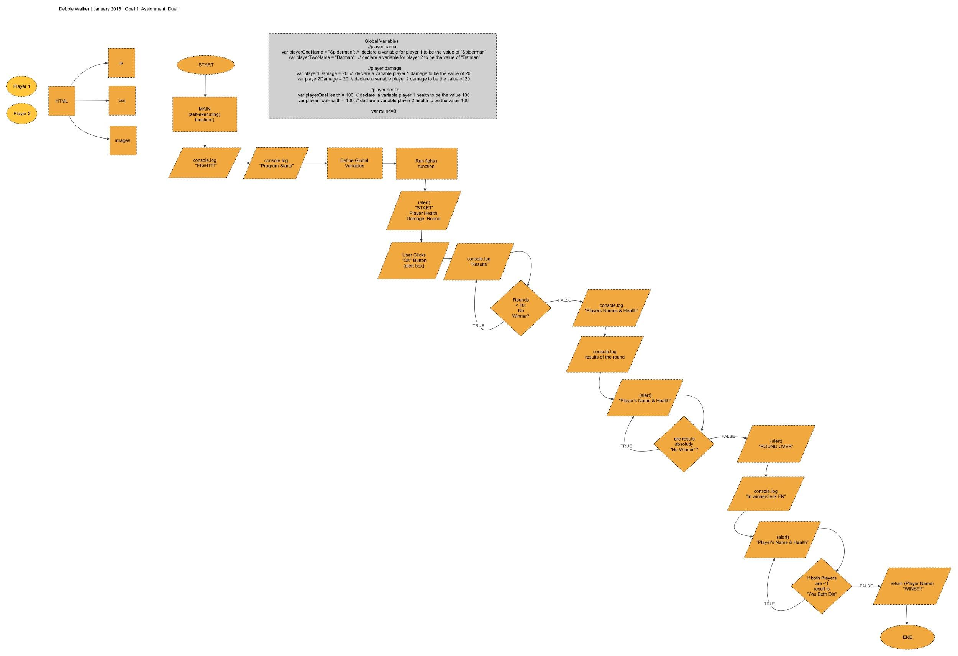
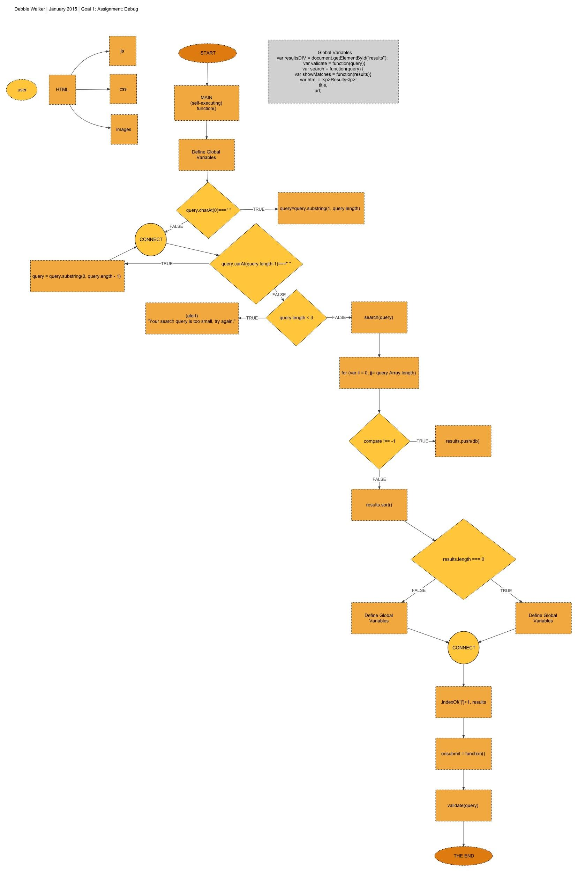

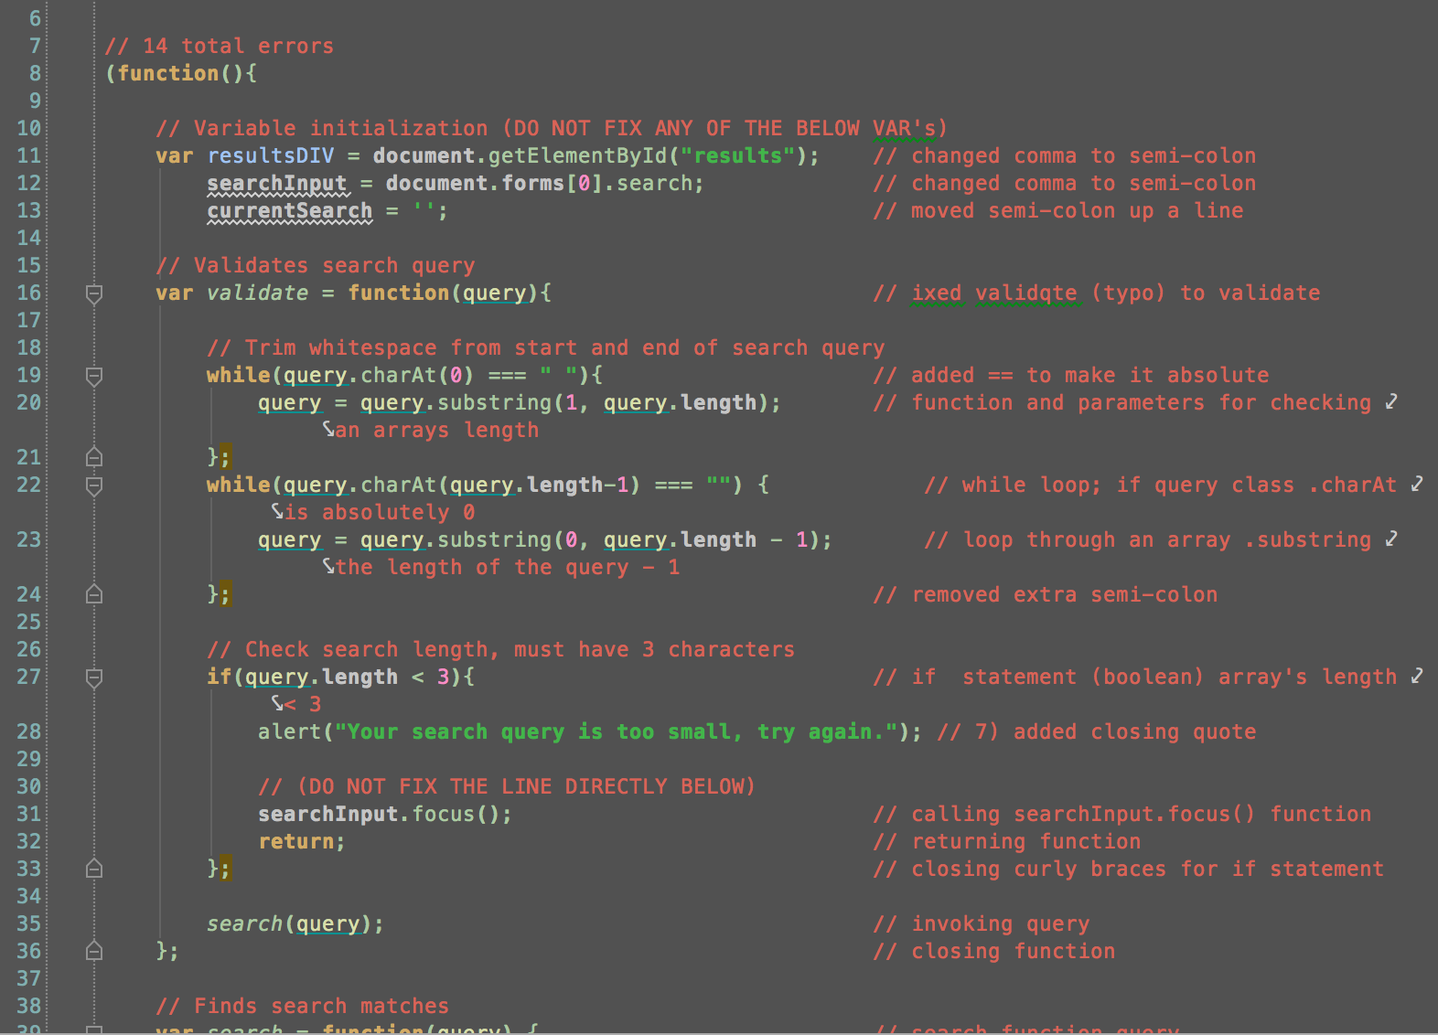
PWA-International
ADDIO®
Analyze
Design
Develop/Debug
70% of our time will
will be spent on the
first three steps
of our ADDIO process
Notes:
magnifying glass png transparent . Free cliparts that you can ...More
www.clipartbest.com

Slide 8
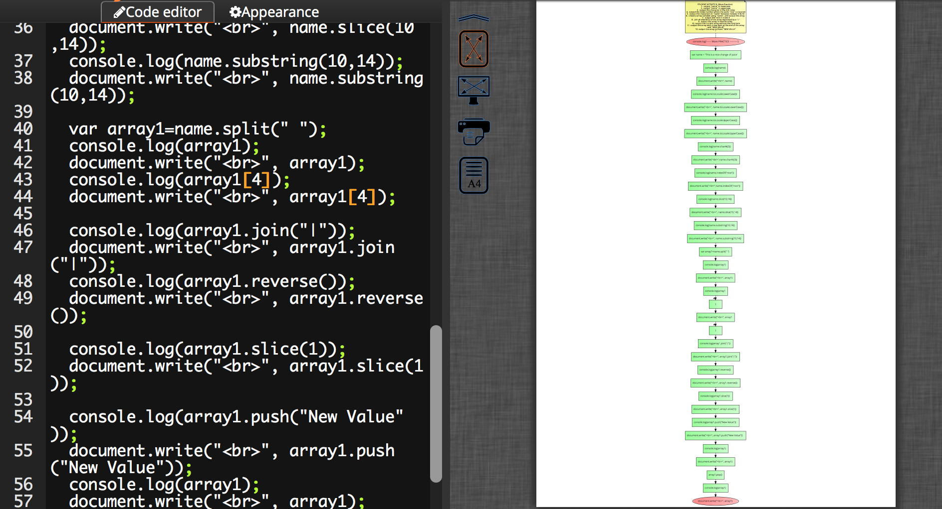
ADDIO®
Analyze
STEP 1
We begin by
running your code
through a proprietary
software called
d-bugger where your
code is automatically
flow-charted

Slide 9
ADDIO®
Analyze
STEP 1
Our staff thoroughly
analyzes the code
and flowcharts looking
for opportunities to fix
inefficiencies and to
optimize performance
Notes:
magnifying glass png transparent . Free cliparts that you can ...More
www.clipartbest.com

Slide 10
ADDIO®
2. Design
STEP 3
We find efficiencies to make your site optimize for the best customer experience
Look for
streamlining opportunities
Notes:
magnifying glass png transparent . Free cliparts that you can ...More
www.clipartbest.com

Slide 11
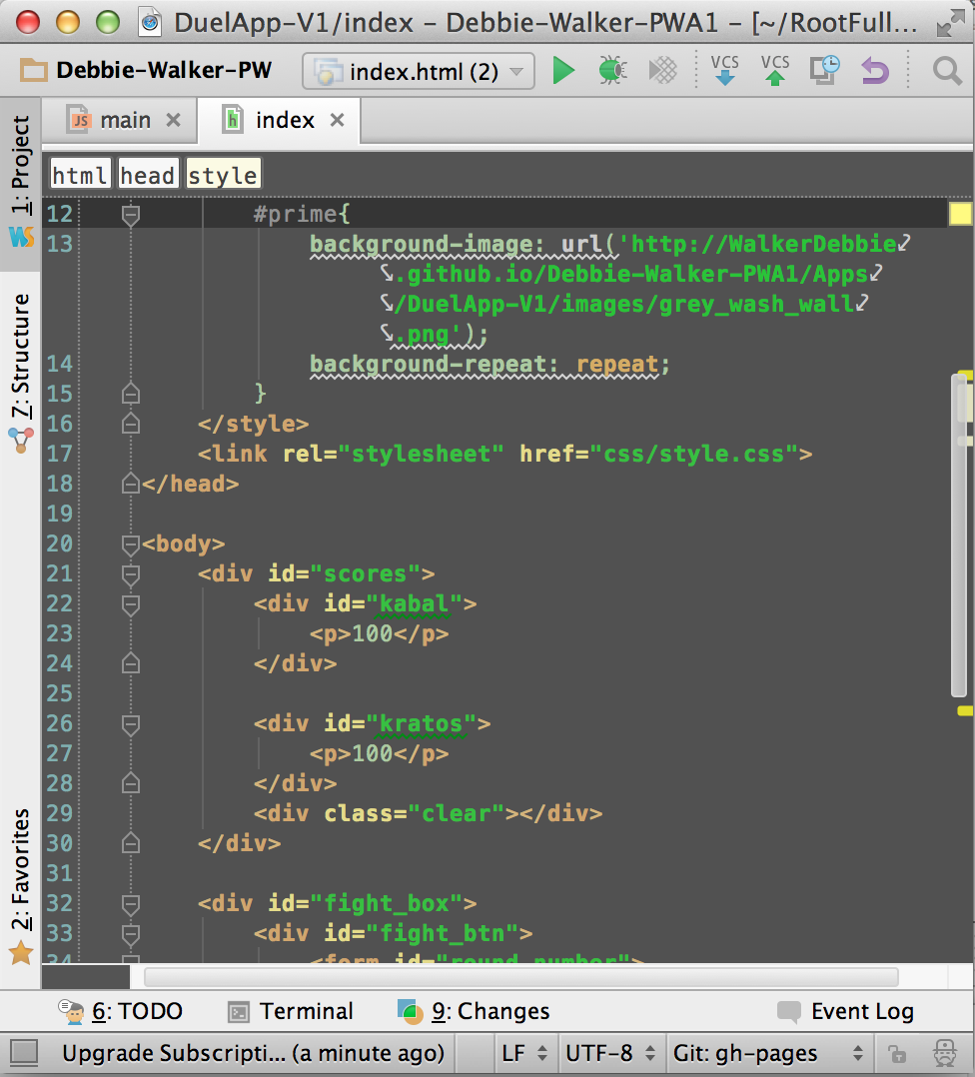
ADDIO®
2. Develop/Debug
STEP 3
We then develop new code and debug along the way so that every step is backed up to Github for additions, revisions and exploration
Notes:
magnifying glass png transparent . Free cliparts that you can ...More
www.clipartbest.com

Slide 12
Client proposals:
PWA-International
Consultation for solutions and enhancements for two existing web applications and debugging a search engine.
Must demonstrate all three Web Applications, as follows:
The Duel (Part 1‐3)
Buggy Search Engine (3 versions)
New Battleship application developed (4 weeks or less)

Slide 13
Hosting Solutions
PWA-International
http://lkwamley.wix.com/pwa1-portfolio
http://peaceatmindalways.wix.com/pwa1-portfolio
http://dwalker15.wix.com/pwa1-portfolio
Development and hosting sites are wix.com and FTP server.
Daily backups are uploaded to git.hub and downloaded to external hard drives.

Slide 14
Why choose us?
PWA-International
100% Satisfaction Guaranteed
Flexible rates and negotiable package discounts
Easy and fun team to work with
Dedicated Account Service
Daily backups and weekly (or as needed) status updates
25 years of experience

Slide 15





Client Roster
PWA-International

Slide 16




Client Profile
PWA-International
PWA-International
Technology/gaming company
Target audience: Primary teens, Secondary tweens (primarily male) Mom’s have the final say.
Competitors:
Notes:
http://static.giantbomb.com/uploads/scale_small/1/10227/285240-ea_sports_logo.jpg

Slide 17
Opportunities? No problem, we can help!
PWA-International
{clearfix} has 100% customer satisfaction, guarantee.
We never meet expectations, we ALWAYS EXCEED
Timing is everything: we live by our deadlines
We are available 24 hours a day (minus standard holidays)
We are an extension of your office (weekly status meetings)
Notes:
Operation Smile
https://images.search.yahoo.com/images/view;_ylt=AwrTcdC.kK1UrQUAypIPxQt.;_ylu=X3oDMTBsOXB2YTRjBHNlYwNzYwRjb2xvA2dxMQR2dGlkAw--?p=operation+smile+logo&back=https%3A%2F%2Fsearch.yahoo.com%2Fyhs%2Fsearch%3Fp%3Doperation%2Bsmile%2Blogo%26type%3Dmcy_frg02_15_2_sa%26param1%3Dyhsbeacon%26param2%3Df%253D4%2526b%253DChrome%2526cc%253DUS%2526p%253Dmcy%2526cd%253D2XzuyEtN2Y1L1Qzu0AtDyEyEtB0BtCtBtG0CyDyE0AtGyDyByE0CtG0AyCzztDtGyB0DtC0B0CtAyCtB0EtBzyyEtN1Q2Zzu0StCtCtDtDtN1L2XzutBtFtDtFtDtFzztN1L1Czu%2526cr%253D950653614%2526a%253Dmcy_frg02_15_2_sa%26hsimp%3Dyhs-fullyhosted_011%26hspart%3Diry%26ei%3DUTF-8&w=208&h=188&imgurl=www.outsourcedsolutions.biz%2Fwp-content%2Fuploads%2F2013%2F06%2FOPERATION-SMILE.jpg&size=60KB&name=OPERATION-SMILE.jpg&rcurl=http%3A%2F%2Fwww.outsourcedsolutions.biz%2Fbellevue%2Fresponsibility%2Foutsourced-solutions-reviews%2F&rurl=http%3A%2F%2Fwww.outsourcedsolutions.biz%2Fbellevue%2Fresponsibility%2Foutsourced-solutions-reviews%2F&type=&no=2&tt=108&oid=457d4781fa8fd640a44d7ff2d38deabc&tit=www.operationsmile.org&sigr=12oer7fi4&sigi=12avi111f&sign=10jvi48cc&sigt=103tlvovk&sigb=1bn0ehf6d&fr=yhs-iry-fullyhosted_011&hspart=iry&hsimp=yhs-fullyhosted_011
United Way
https://images.search.yahoo.com/images/view;_ylt=AwrB8pOoka1U9n0Ad5SJzbkF;_ylu=X3oDMTIyYWZldnFkBHNlYwNzcgRzbGsDaW1nBG9pZAMyNTViNjVhMGM2YTkyY2JkN2VmMzdkNzQ4ZGM5M2JmZARncG9zAzcEaXQDYmluZw--?.origin=&back=https%3A%2F%2Fimages.search.yahoo.com%2Fyhs%2Fsearch%3Fp%3Dunited%2Bway%2Blogo%26type%3Dmcy_frg02_15_2_sa%26fr2%3Dpiv-web%26hsimp%3Dyhs-fullyhosted_011%26hspart%3Diry%26tab%3Dorganic%26ri%3D7&w=800&h=592&imgurl=d2wkegjj8g6j4.cloudfront.net%2Fimages%2Fcampaign_assets%2Fphotos%2F000%2F004%2F757%2Fwidth_800%2Funited-way-logo-colortif.gif&rurl=http%3A%2F%2Fschwans.flipgive.com%2Fcampaigns%2F4294-scurry-county-united-way&size=77.5KB&name=%3Cb%3EUnited-way-logo%3C%2Fb%3E-colortif&p=united+way+logo&oid=255b65a0c6a92cbd7ef37d748dc93bfd&fr2=piv-web&fr=&tt=%3Cb%3EUnited-way-logo%3C%2Fb%3E-colortif&b=0&ni=21&no=7&ts=&tab=organic&sigr=123k6a67r&sigb=14ll0kgo0&sigi=13dtfd61l&sigt=10v58e0jt&sign=10v58e0jt&.crumb=7rWRt/I91Qf&fr2=piv-web&hs
Children’s Miracle Network
https://www.google.com/search?q=children%27s+miracle+network&biw=813&bih=393&source=lnms&tbm=isch&sa=X&ei=FZKtVOHWA8qnNqOVgqgE&sqi=2&ved=0CAYQ_AUoAQ#imgdii=_&imgrc=H4OAJrMsxXXo_M%253A%3B-9UjnTJ67iYFFM%3Bhttp%253A%252F%252Fopentimez.com%252Fwp-content%252Fuploads%252F2013%252F03%252Fchildrensmiraclenetwork.jpg%3Bhttp%253A%252F%252Fopentimez.com%252Fchildrens-miracle-network%252F%3B2998%3B1635
http://210again.blogspot.com/2012/09/day-203-motivation-tuesday-meet-these.html
Make A Wish Foundation
https://images.search.yahoo.com/images/view;_ylt=AwrB8pKdk61UKE8AyHCJzbkF;_ylu=X3oDMTIyZDdqcmE5BHNlYwNzcgRzbGsDaW1nBG9pZANkYjczMzViZGJmZTUxZTZlN2NhY2EzNDk2NzQwYzIzMgRncG9zAzEEaXQDYmluZw--?.origin=&back=https%3A%2F%2Fimages.search.yahoo.com%2Fyhs%2Fsearch%3Fp%3Dmake%2Ba%2Bwish%2Bfoundation%26type%3Dmcy_frg02_15_2_sa%26fr2%3Dpiv-web%26hsimp%3Dyhs-fullyhosted_011%26hspart%3Diry%26tab%3Dorganic%26ri%3D1&w=1050&h=300&imgurl=www.relocatecolumbus.com%2Fvsites%2F000-briankemp%2Fimage%2Fmake-a-wish-logo.jpg&rurl=http%3A%2F%2Fwww.relocatecolumbus.com%2Fhome%2Fabout-us%2Fmake-a-wish.html&size=52.6KB&name=Brian+Kemp+Real+Estate+Group+Supports+the+%3Cb%3EMake+a+Wish+Foundation%3C%2Fb%3E&p=make-a-wish+foundation&oid=db7335bdbfe51e6e7caca3496740c232&fr2=piv-web&fr=&rw=make-a-wish+foundation&tt=Brian+Kemp+Real+Estate+Group+Supports+the+%3Cb%3EMake+a+Wish+Foundation%3C%2Fb%3E&b=0&ni=21&no=1&ts=&tab=organic&sigr=11ul79c16&sigb=14sg0utj2&sigi=128e1oai4&sigt=127506hbu&sign=127506hbu&.crumb=7rWRt/I91Qf&fr2=piv-web&hsimp=yhs-fullyhosted_011&hspart=iry&type=mcy_frg02_15_2_sa

Slide 18




Community
PWA-International
Partnering to change the world, {clearfix} works to make a difference.
Notes:
Operation Smile
https://images.search.yahoo.com/images/view;_ylt=AwrB8pQYwsVUsGYARB.JzbkF;_ylu=X3oDMTIyM2IxMWpnBHNlYwNzcgRzbGsDaW1nBG9pZAMyNmMyOGQwOGNkOGEyM2RkMDJhZjhhYzFkZjM4NzIxZQRncG9zAzEEaXQDYmluZw--?.origin=&back=https%3A%2F%2Fimages.search.yahoo.com%2Fyhs%2Fsearch%3Fp%3Doperation%2Bsmile%2Blogo%26n%3D60%26ei%3DUTF-8%26y%3DSearch%26type%3Dmcy_frg02_15_2_ch%26fr%3Dyhs-iry-fullyhosted_011%26fr2%3Dsb-top-images.search.yahoo.com%26hsimp%3Dyhs-fullyhosted_011%26hspart%3Diry%26tab%3Dorganic%26ri%3D1&w=1200&h=360&imgurl=www.naturebumz.com%2Fmedia%2FOperationSmileLogo.jpg&rurl=http%3A%2F%2Fwww.investsmartuk.co.uk%2Fdonate_your_commission&size=192.0KB&name=%3Cb%3EOperation+Smile+logo%3C%2Fb%3E&p=operation+smile+logo&oid=26c28d08cd8a23dd02af8ac1df38721e&fr2=sb-top-images.search.yahoo.com&fr=yhs-iry-fullyhosted_011&tt=%3Cb%3EOperation+Smile+logo%3C%2Fb%3E&b=0&ni=480&no=1&ts=&tab=organic&sigr=11l1c788a&sigb=1733gipt1&sigi=11fojl4e2&sigt=10ra0kclq&sign=10ra0kclq&.crumb=yf5gvu51Ck/&fr=yhs-iry-fullyhosted_011&fr2=sb-top-images.search.yahoo.com&hsimp=yhs-fullyhosted_011&hspart=iry&type=mcy_frg02_15_2_ch
United Way
https://images.search.yahoo.com/images/view;_ylt=AwrB8pOoka1U9n0Ad5SJzbkF;_ylu=X3oDMTIyYWZldnFkBHNlYwNzcgRzbGsDaW1nBG9pZAMyNTViNjVhMGM2YTkyY2JkN2VmMzdkNzQ4ZGM5M2JmZARncG9zAzcEaXQDYmluZw--?.origin=&back=https%3A%2F%2Fimages.search.yahoo.com%2Fyhs%2Fsearch%3Fp%3Dunited%2Bway%2Blogo%26type%3Dmcy_frg02_15_2_sa%26fr2%3Dpiv-web%26hsimp%3Dyhs-fullyhosted_011%26hspart%3Diry%26tab%3Dorganic%26ri%3D7&w=800&h=592&imgurl=d2wkegjj8g6j4.cloudfront.net%2Fimages%2Fcampaign_assets%2Fphotos%2F000%2F004%2F757%2Fwidth_800%2Funited-way-logo-colortif.gif&rurl=http%3A%2F%2Fschwans.flipgive.com%2Fcampaigns%2F4294-scurry-county-united-way&size=77.5KB&name=%3Cb%3EUnited-way-logo%3C%2Fb%3E-colortif&p=united+way+logo&oid=255b65a0c6a92cbd7ef37d748dc93bfd&fr2=piv-web&fr=&tt=%3Cb%3EUnited-way-logo%3C%2Fb%3E-colortif&b=0&ni=21&no=7&ts=&tab=organic&sigr=123k6a67r&sigb=14ll0kgo0&sigi=13dtfd61l&sigt=10v58e0jt&sign=10v58e0jt&.crumb=7rWRt/I91Qf&fr2=piv-web&hs
Children’s Miracle Network
http://210again.blogspot.com/2012/09/day-203-motivation-tuesday-meet-these.html
Make A Wish Foundation
https://images.search.yahoo.com/images/view;_ylt=AwrB8pKdk61UKE8AyHCJzbkF;_ylu=X3oDMTIyZDdqcmE5BHNlYwNzcgRzbGsDaW1nBG9pZANkYjczMzViZGJmZTUxZTZlN2NhY2EzNDk2NzQwYzIzMgRncG9zAzEEaXQDYmluZw--?.origin=&back=https%3A%2F%2Fimages.search.yahoo.com%2Fyhs%2Fsearch%3Fp%3Dmake%2Ba%2Bwish%2Bfoundation%26type%3Dmcy_frg02_15_2_sa%26fr2%3Dpiv-web%26hsimp%3Dyhs-fullyhosted_011%26hspart%3Diry%26tab%3Dorganic%26ri%3D1&w=1050&h=300&imgurl=www.relocatecolumbus.com%2Fvsites%2F000-briankemp%2Fimage%2Fmake-a-wish-logo.jpg&rurl=http%3A%2F%2Fwww.relocatecolumbus.com%2Fhome%2Fabout-us%2Fmake-a-wish.html&size=52.6KB&name=Brian+Kemp+Real+Estate+Group+Supports+the+%3Cb%3EMake+a+Wish+Foundation%3C%2Fb%3E&p=make-a-wish+foundation&oid=db7335bdbfe51e6e7caca3496740c232&fr2=piv-web&fr=&rw=make-a-wish+foundation&tt=Brian+Kemp+Real+Estate+Group+Supports+the+%3Cb%3EMake+a+Wish+Foundation%3C%2Fb%3E&b=0&ni=21&no=1&ts=&tab=organic&sigr=11ul79c16&sigb=14sg0utj2&sigi=128e1oai4&sigt=127506hbu&sign=127506hbu&.crumb=7rWRt/I91Qf&fr2=piv-web&hsimp=yhs-fullyhosted_011&hspart=iry&type=mcy_frg02_15_2_sa

Slide 19
Evaluations
PWA-International
We all contributed to information presented during this presentation.
Each person talks and listens to everyone’s ideas - sharing thoughts, ideas and solutions.
We are more than co-workers and friends, we are family.

Slide 20
Q & A:
PWA-International
Your comments mean a lot to us.
If after the meeting you should have a comment, questions or concern, please feel free to use our
website’s “comment box”.
Thank You!

