Slide 1
FUNCTIONAL COVERAGE IN UVM
https://www.asictronix.com/coverage-collectors-in-uvm/

Slide 2
What are Environments and Agents?
Environment instantiates Agent, Scoreboard and Coverage collector.
Agent comprises Sequencer, Driver and Monitor.

Slide 3
UVM Functional Coverage
User-defined metric of how much of the design specification in the test plan has been exercised.
Measures whether interesting scenarios, corner cases, specification invariants have been observed, validated, and tested
Used to assess that the random and focused tests adequately exercise the design
SystemVerilog has a rich set of coverage constructs to enable functional coverage collection
Focus of functional coverage in UVM is on the inputs to the DUT, to check if all the valid combinations of inputs/stimulus were exercised.

Slide 4
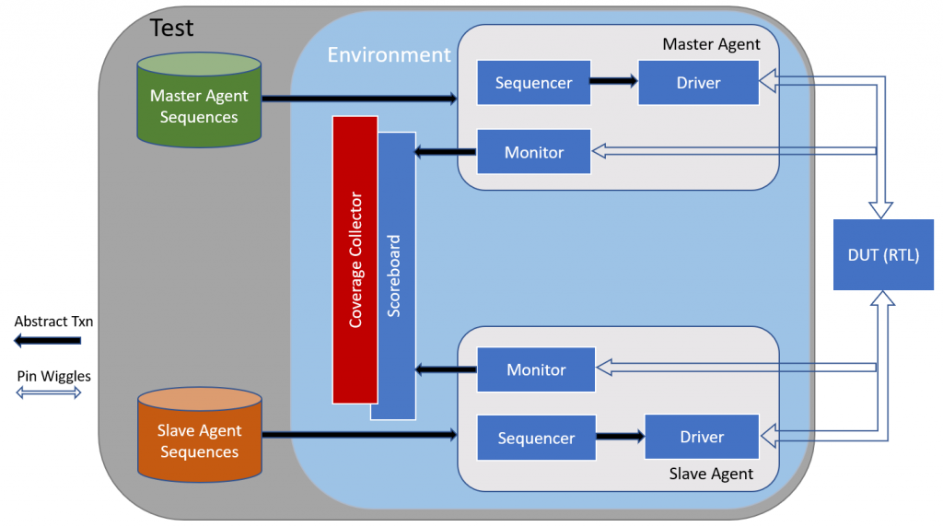
Note Coverage and Scoreboard Juxtaposition

Slide 5
Add Coverage Class Syntax
class add_coverage extends uvm_subscriber # (packet_c)
`uvm_component_utils(add_coverage)
packet_c txn;
covergroup inputs_to_dut;
cvp_1: coverpoint txn.a {
bins lo = {[0:7]}
bins hi = {[8:31]}
}
cvp_1: coverpoint txn.b {
bins lo = {[0:7]}
bins hi = {[8:31]}
}
endgroup
function new(string name, uvm_component parent);
inputs_to_dut = new();
endfunction: new
endclass

Slide 6
A Walk Through the Code
1) define add_coverage class and extend from uvm_subscriber class.
2) parameterized class handles transactions of type packet_c.
3) registered in factory by calling standard UVM macro `uvm_component_utils.
4) declare a handle with name txn and this handler of type packet_c.

Slide 7
Walk Through Code, Continued
create covergroup inputs_to_dut is created
This covergroup has two coverpoints, one each for two inputs a and b of the DUT.
As with other uvm_components, new function is defined in which inputs_to_dut are instantiated.
Then inputs_tp_dut.sample() needs to be called at appropriate place in testbench so that the tool can collect the coverage.

Slide 8
How do you get txn in above code?
Same way as the scoreboard gets it.
This is why we have placed Scoreboard and Coverage collector together in the block diagram above.

