Slide 1
Home

Slide 2
GitHub Advance security Features
Keep track of your dependencies using a variety of file formats, such as requirement.txt and package-lock.json, to look for any known vulnerabilities.
CodeQL – GitHub actions processes may be built up for code scanning, which uses the codeQL language to analyze code and find security flaws. Can be run on locally through Command line
Secret Scanning supports a broad range of providers' authenticity checks, including AWS, Google, and Azure, to verify any unintentional uploads of secrets to S3 buckets and api keys.
Dependency review- Keep track of your dependencies using a variety of file formats, including requirement.txt and package-lock. Json.
Supported language as of right now for C# C++ Java/Kotlin JavaScript/TypeScript Python Ruby Swift

Slide 3
CODEQL

Slide 4
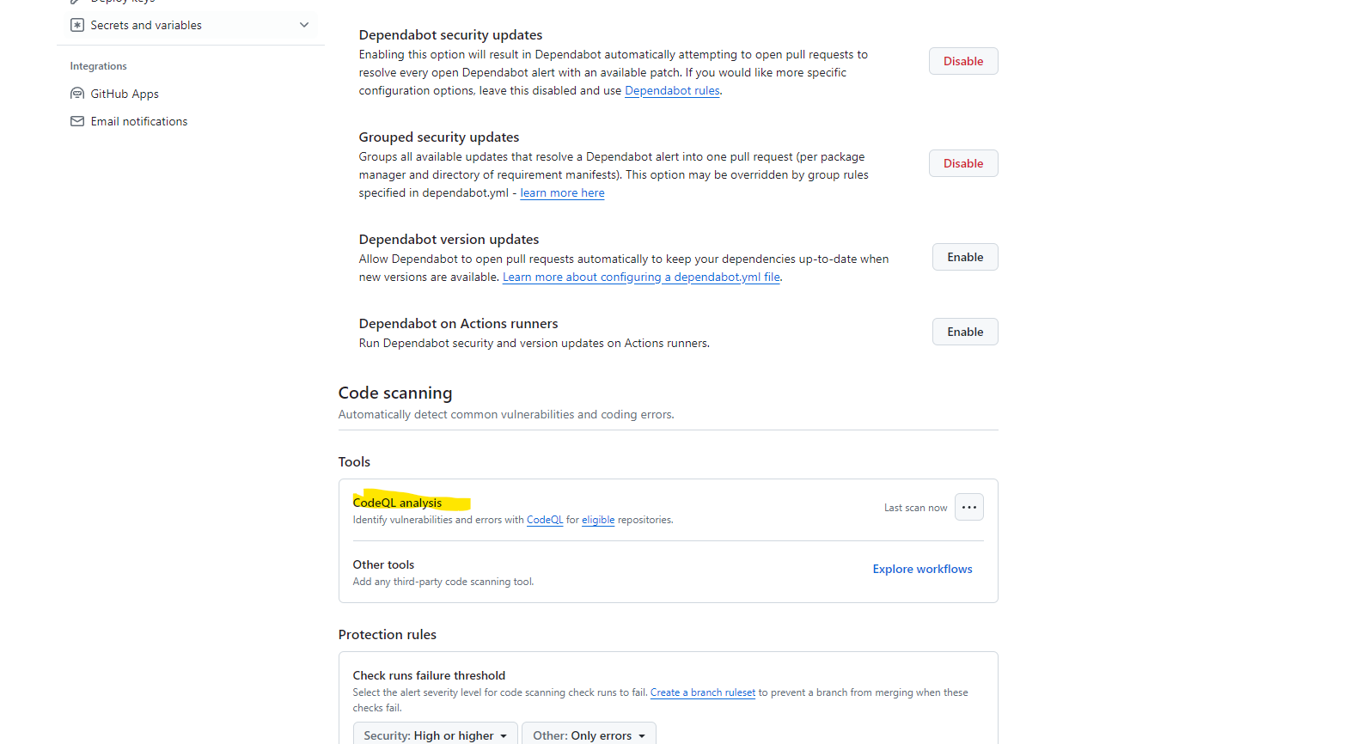

Slide 5
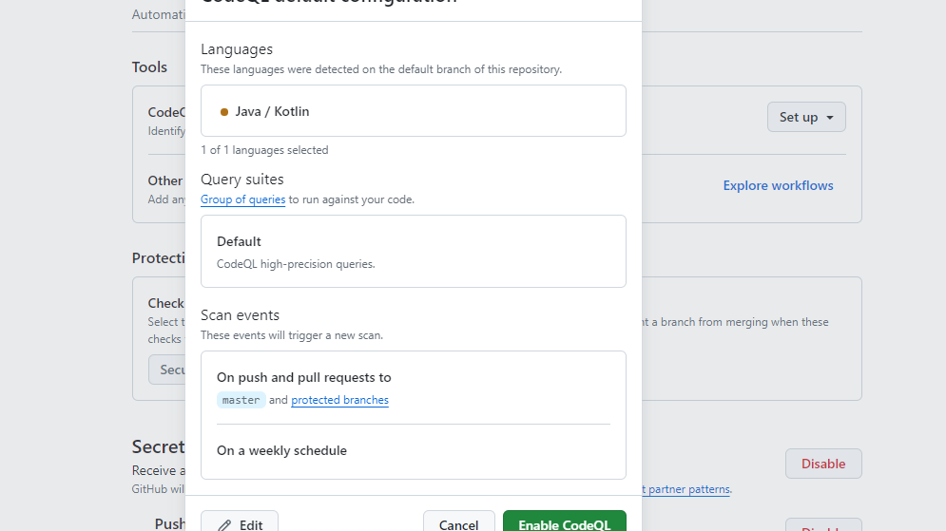

Slide 6
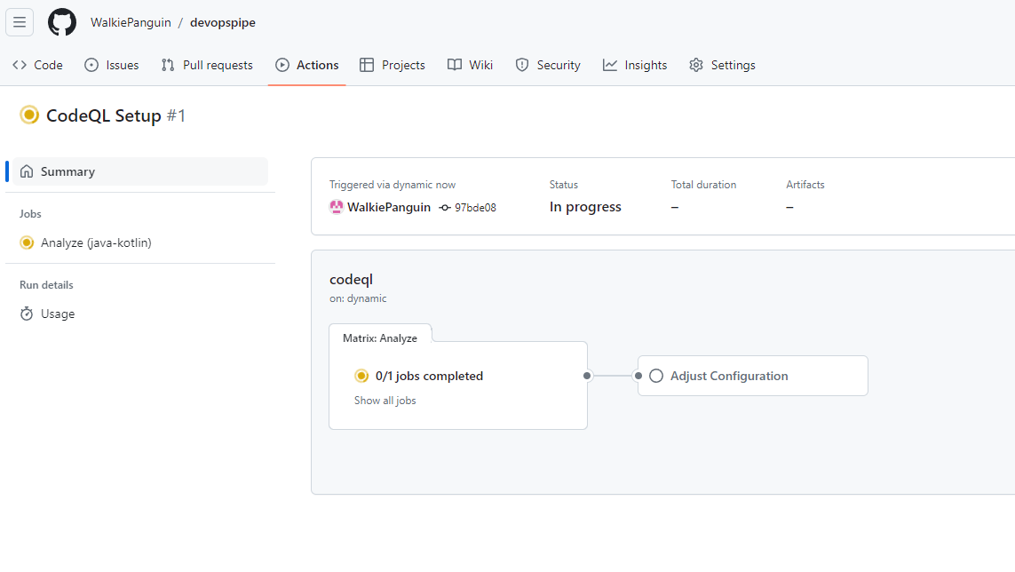

Slide 7
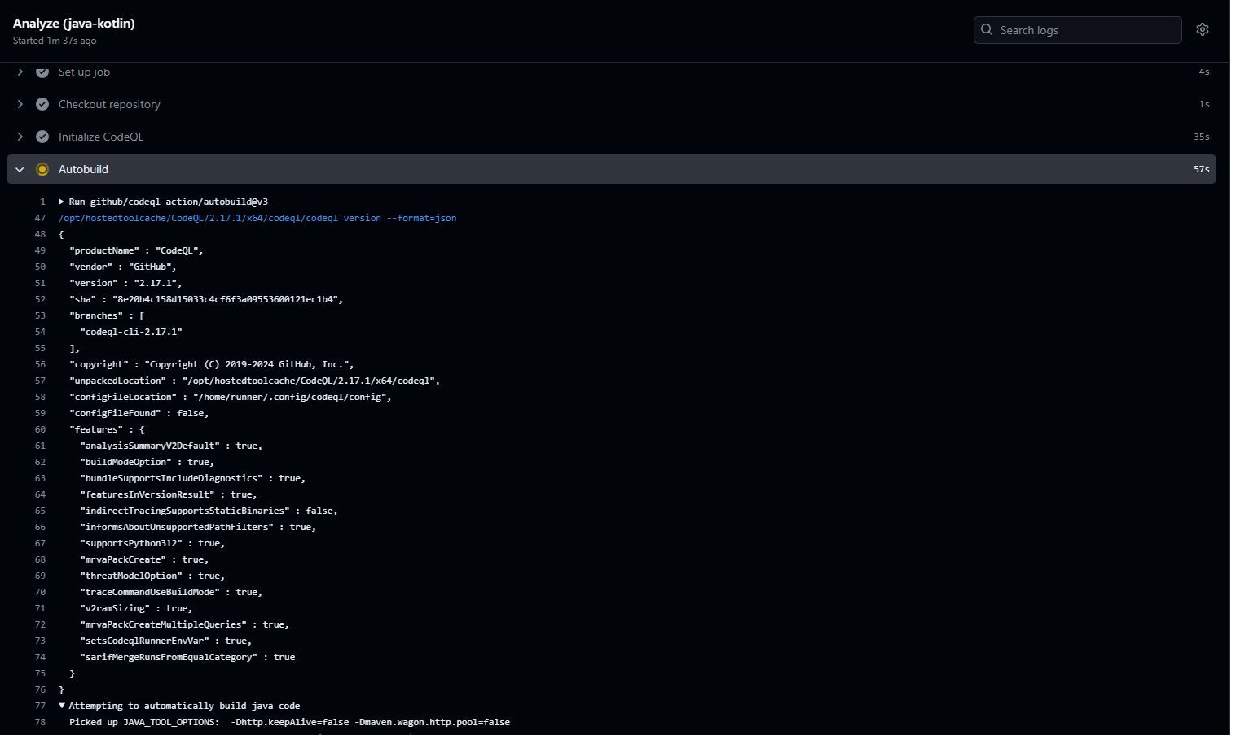

Slide 8
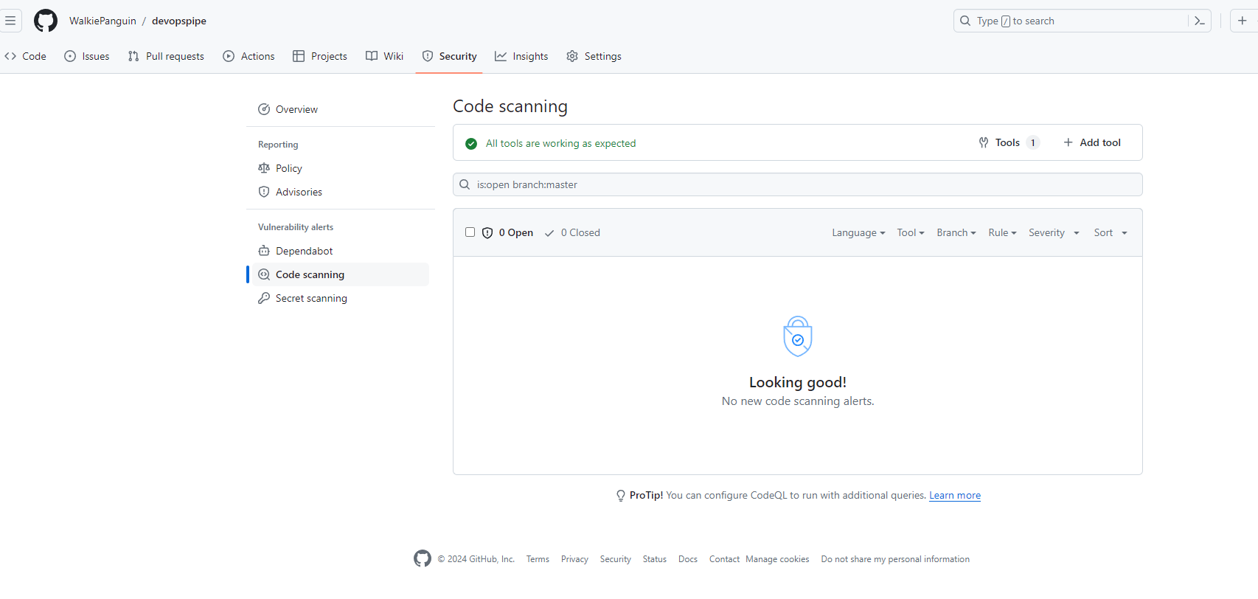

Slide 9
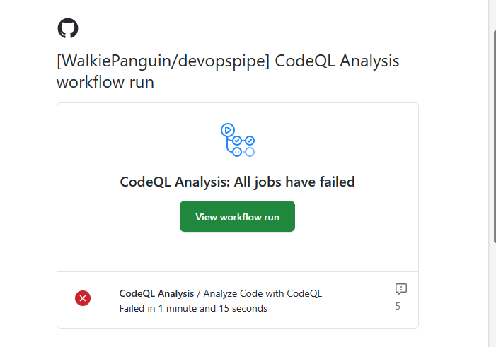
Incase of workflow failure

Slide 10
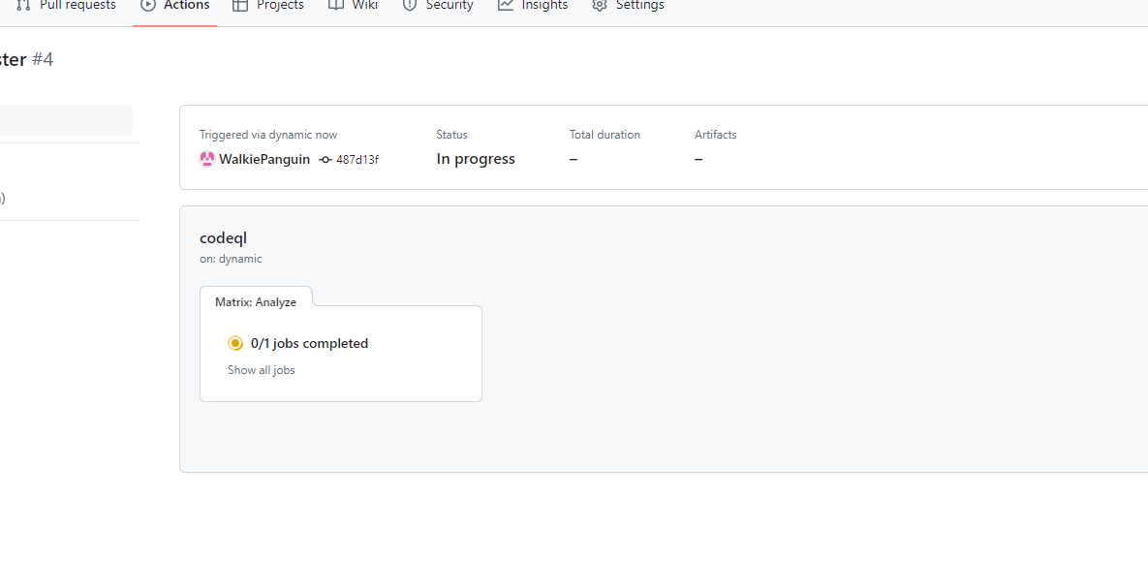

Slide 11
