Slide 1
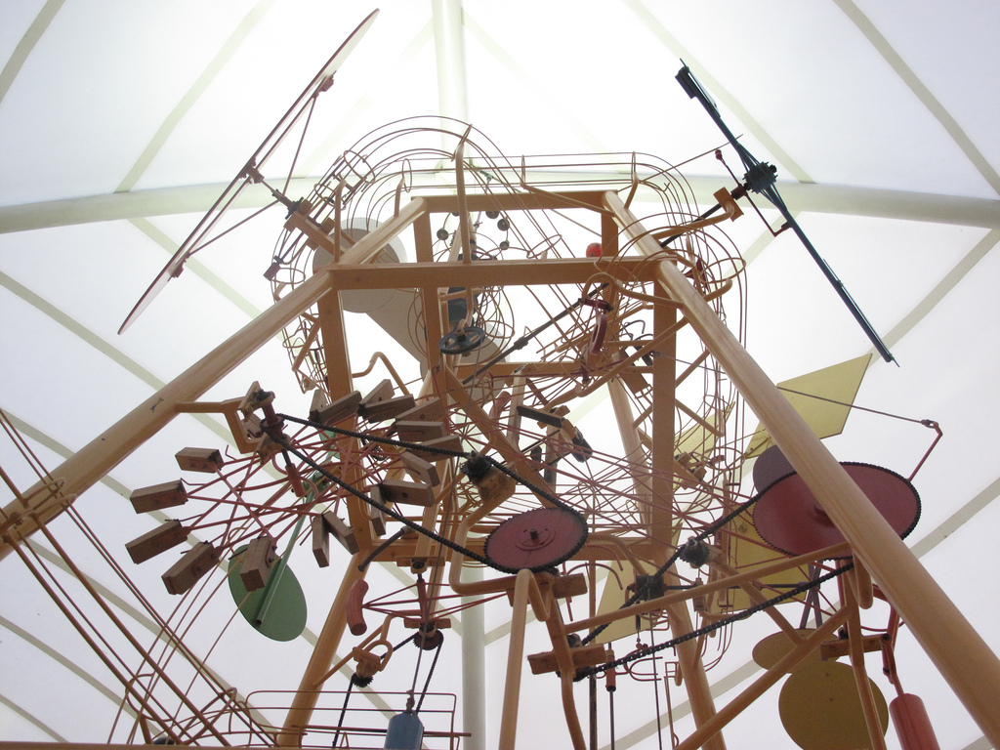
Innocuous Frameworks
Sage & Lingual
Innocuous Frameworks POC

Slide 2
Innocuous
Pronunciation: \i-ˈnä-kyə-wəs\
Function: adjective
Etymology: Latin innocuus, from in- + nocēre
Date: 1598
1 : producing no injury : harmless

Slide 3




Slide 4

http://www.flickr.com/photos/33577780@N06/3126030276/

Slide 5

http://www.flickr.com/photos/36311191@N05/3351772777/

Slide 6

http://www.flickr.com/photos/scottalangreiff/2252769350/in/set-72157613478055794

Slide 7

http://www.flickr.com/photos/alanvernon/3121731510/

Slide 8

http://www.flickr.com/photos/matthamm/357376052/

Slide 9

http://www.flickr.com/photos/jphilipson/476627480/sizes/l/

Slide 10
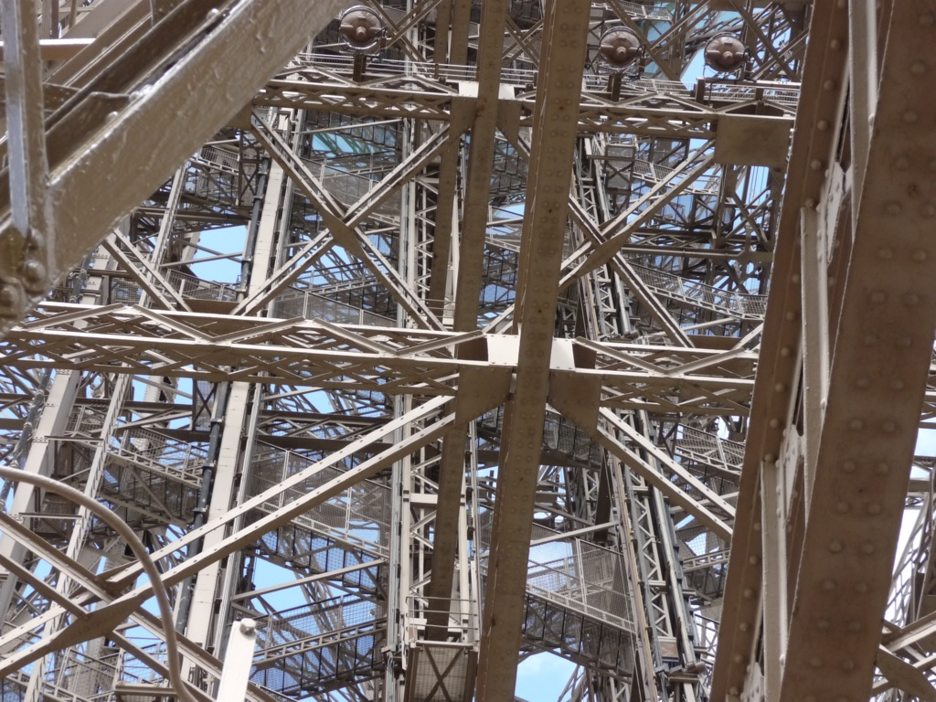
http://www.flickr.com/photos/nocallerid_man/3638360458/sizes/o/
Notes:
Frameworks:
Exist to solve problems
Create coupling
Typically influence the consumer
Leaky abstractions

Slide 11

http://www.flickr.com/photos/vogelium/103761402/sizes/o/

Slide 12

J2EE

Slide 13
Lingual
Pronunciation: \ˈliŋ-gwəl also ˈliŋ-gyə-wəl\
Function: adjective
Etymology: Latin lingua
Date: 1650
1
a : of, relating to, or resembling the tongue
b : lying near or next to the tongue;
especially : relating to or being the surface of tooth next to the tongue
c : produced by the tongue

Slide 14
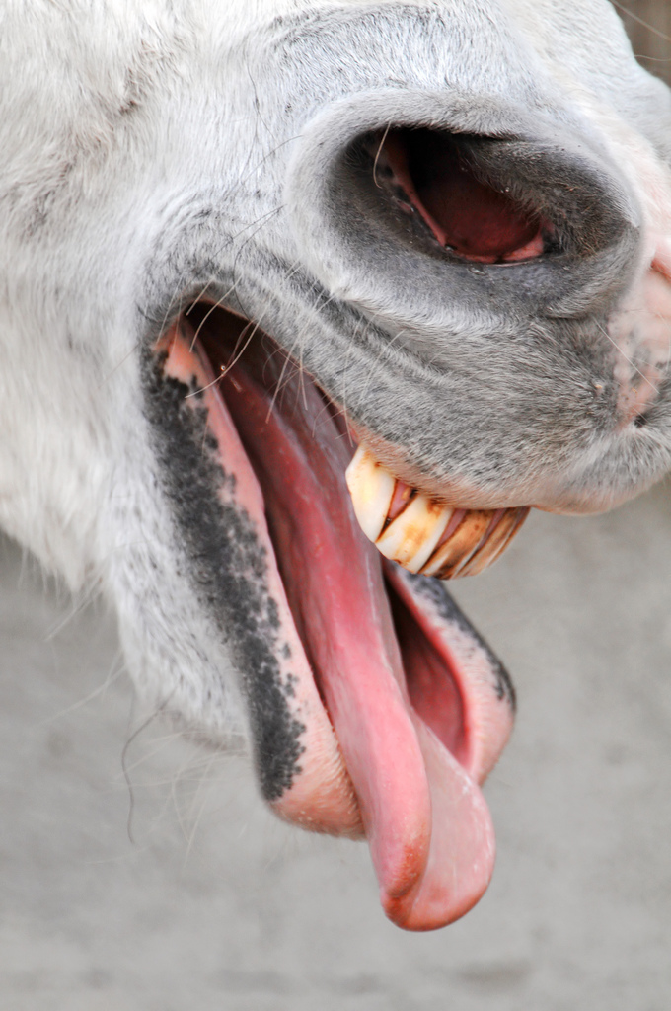
http://www.flickr.com/photos/tambako/3360310619/sizes/l/

Slide 15

http://www.flickr.com/photos/steveberardi/4511654112/

