Slide 1

PROJECT: OPEN DOOR BY DETECTION FACE USING ESP 32 CAM

Slide 2
01
03
Introduction
Conclusion
02
My project
T
🠺
🠺

Slide 3
Introduction
T
01
🠺
Anyone nowadays is concerned about security, whether it is data security or the security of their own home. Digital door locks have grown quite prevalent in recent years as technology has advanced and the use of IoT has increased. A digital lock does not require a physical key to operate, instead relying on Radio-Frequency Identification (RFID), fingerprint, Face ID, pins, passwords, and other methods to do so. Using these diverse technologies, we have previously built a number of digital door lock applications. In this article, we'll use the Espressif Systems’ Camera (ESP32 CAM) to create an IoT-based Wi-Fi Door Lock system.
🠺

Slide 4
02
All About My Project
T
1
🠺
🠺

Slide 5
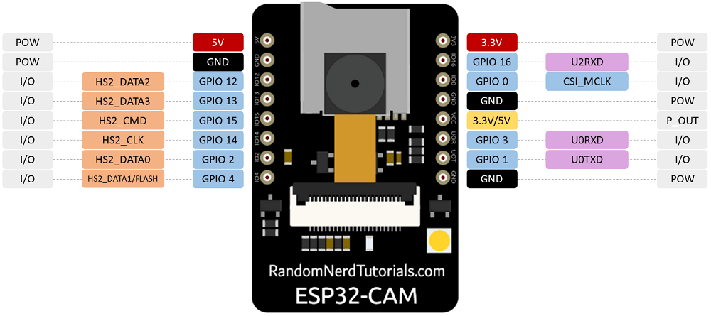
02. ESP 32 Cam
The ESP32-CAM AI-Thinker module is made up of many elements, including:
• ESP32-S Chip: The module's primary chip, which is utilised for all processing and functionality, has two very fast 32-bit LX6 CPUs and a 7-stage pipeline design.
• IPEX block output: The printed IPEX links GSM antennas to the transmitting signal.
• Tantalum capacitor: Small-size modules primarily employ this kind of capacitor. They are strong and provide fine signal quantity power supply filtering.
• Reset button: Pressing this button causes the module's code to be restarted.
• Voltage regulator chip: The module's voltage regulator chip keeps the output voltage constant despite changes in the input supply. The voltage is controlled at 3.3 volts.

Slide 6
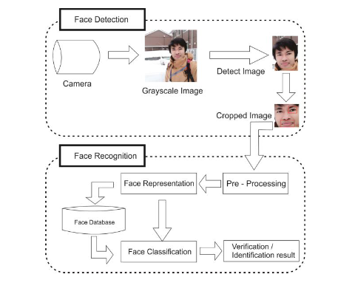
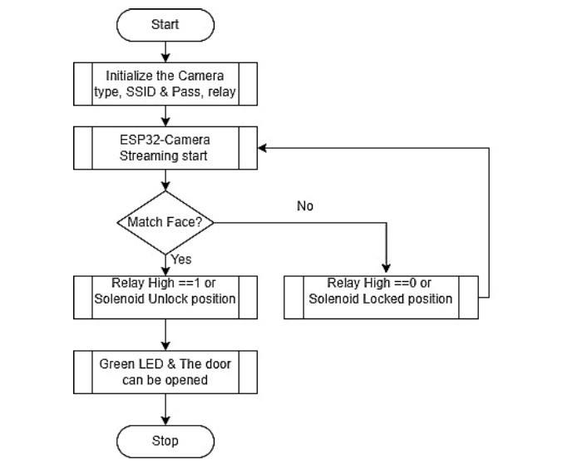
02. The flow of code

Slide 7
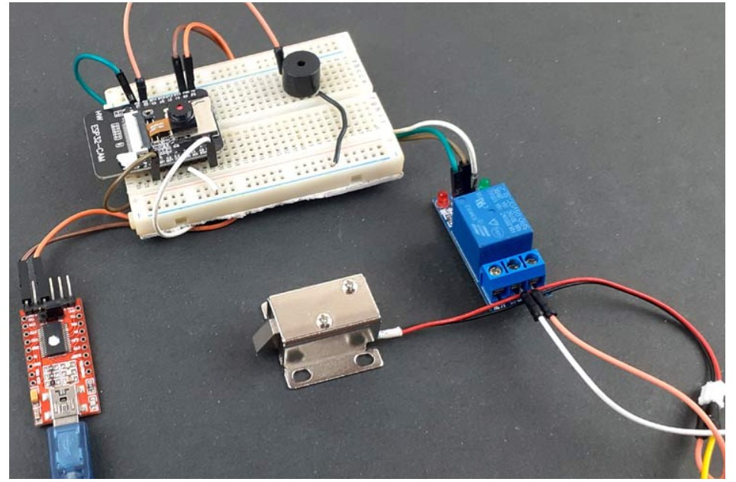
02. The final result
Results The picture below is to represent the result of this work. In this IOT based working model, we have made a Smart WIFI door lock using ESP32-CAM. In this model, when someone look at the cam, the house owner will get a notification on the mobile. After checking the photo, visitor can unlock the door from a system.

Slide 8
03
Conclusion
T
1
🠺
🠺

Slide 9
What I achieved
01
02
03
04
T
🠺
🠺
Face Detection and Recognition
Remote Door Control
Notification System
How to research

Slide 10
What will i do in the future
01
02
T
🠺
🠺
new emergency call feature to directly call the police
new feature for two-way communication between the owner of the door and the guess

Slide 11
Thanks!
T
🠺
🠺
Do you have any questions?
pvtuong20it9@vku.udn.vn
Please keep this slide for attribution.

