Slide 1
Chapter 2 Elementary Programming

Slide 2
Motivations
Suppose, for example, that you need to take out a student loan. Given the loan amount, loan term, and annual interest rate, can you write a program to compute the monthly payment and total payment? This chapter shows you how to write programs like this. Along the way, you learn the basic steps that go into analyzing a problem, designing a solution, and implementing the solution by creating a program.

Slide 3
Objectives
To write programs that perform simple computations (§2.2).
To obtain input from a program’s user by using the input function (§2.3).
To use identifiers to name variables (§2.4).
To assign data to variables (§2.5).
To define named constants (§2.6).
To use the operators +, -, *, /, //, %, and ** (§2.7).
To write and evaluate numeric expressions (§2.8).
To use augmented assignment operators to simplify coding (§2.9).
To perform numeric type conversion and rounding with the int and round functions (§2.10).
To obtain the current system time by using time.time() (§2.11).
To describe the software development process and apply it to develop the loan payment program (§2.12).
To compute and display the distance between two points (§2.13).

Slide 4
Introducing Programming with an Example
Listing 2.1 Computing the Area of a Circle
This program computes the area of the circle.
ComputeArea

Slide 5
Trace a Program Execution
animation
Assign 20 to radius
# Assign a radius
radius = 20 # radius is now 20
# Compute area
area = radius * radius * 3.14159
# Display results
print("The area for the circle of radius",
radius, "is", area)
radius
20

Slide 6
Trace a Program Execution
animation
Assign result to area
# Assign a radius
radius = 20 # radius is now 20
# Compute area
area = radius * radius * 3.14159
# Display results
print("The area for the circle of radius",
radius, "is", area)
radius
20
area
1256.636

Slide 7
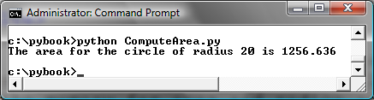
Trace a Program Execution
animation
print a message to the console
# Assign a radius
radius = 20 # radius is now 20
# Compute area
area = radius * radius * 3.14159
# Display results
print("The area for the circle of radius",
radius, "is", area)
radius
20
area
1256.636

Slide 8
Reading Input from the Console
1. Use the input function
  variable = input("Enter a string: ")
2. Use the float and int function to convert a string to a float or int.
  var = float(stringVariable)
  var = int(stringVariable)
ComputeAreaWithConsoleInput
ComputeAverage

Slide 9
Identifiers
An identifier is a sequence of characters that consists of letters, digits, underscores (_), and asterisk (*).
An identifier must start with a letter or an underscore. It cannot start with a digit.
An identifier cannot be a reserved word. (See Appendix A, "Python Keywords," for a list of reserved words.) Reserved words have special meanings in Python, which we will later discuss.
An identifier can be of any length.

Slide 10
Variables
# Compute the first area
radius = 1.0
area = radius * radius * 3.14159
print("The area is ", area,
" for radius ", radius)
# Compute the second area
radius = 2.0
area = radius * radius * 3.14159
print("The area is ", area,
" for radius ", radius)

Slide 11
Expression
x = 1 # Assign 1 to variable x
radius = 1.0 # Assign 1.0 to variable radius
# Assign the value of the expression to x
x = 5 * (3 / 2) + 3 * 2
x = y + 1 # Assign the addition of y and 1 to x
area = radius * radius * 3.14159 # Compute area

Slide 12
Assignment Statements
x = 1 # Assign 1 to x
x = x + 1
i = j = k = 1

Slide 13
Simultaneous Assignment
var1, var2, ..., varn = exp1, exp2, ..., expn
x, y = y, x # Swap x with y
ComputeAverageWithSimultaneousAssignment

Slide 14
Named Constants
The value of a variable may change during the execution of a program, but a named constant or simply constant represents permanent data that never changes. Python does not have a special syntax for naming constants. You can simply create a variable to denote a constant. To distinguish a constant from a variable, use all uppercase letters to name a constant.

Slide 15
Numerical Data Types
integer: e.g., 3, 4
float: e.g., 3.0, 4.0

Slide 16
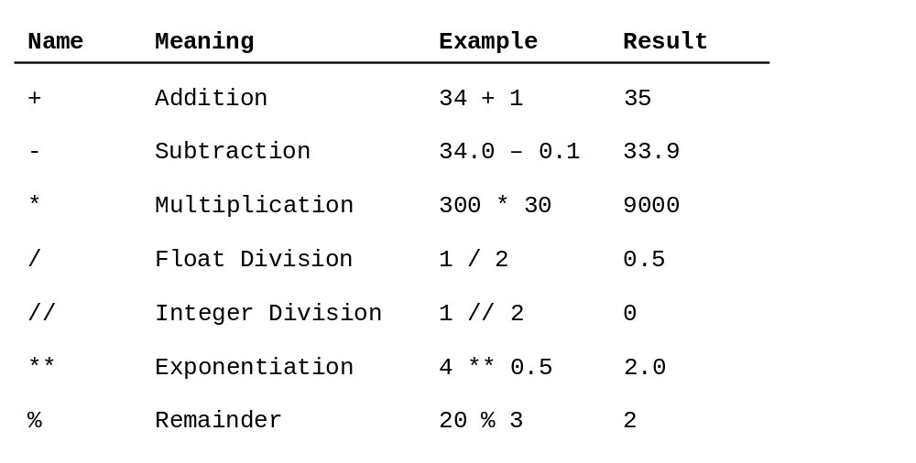
Numeric Operators

Slide 17
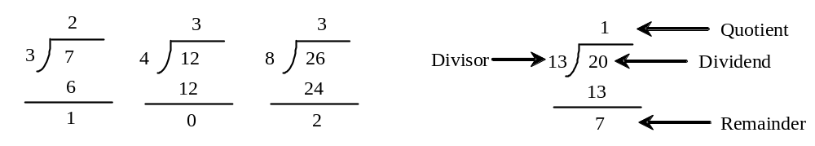
The % Operator

Slide 18

Remainder Operator
Remainder is very useful in programming. For example, an even number % 2 is always 0 and an odd number % 2 is always 1. So you can use this property to determine whether a number is even or odd. Suppose today is Saturday and you and your friends are going to meet in 10 days. What day is in 10 days? You can find that day is Tuesday using the following expression:

Slide 19
Problem: Displaying Time
Write a program that obtains minutes and remaining seconds from seconds.
DisplayTime

Slide 20
Overflow
When a variable is assigned a value that is too large (in size) to be stored, it causes overflow. For example, executing the following statement causes overflow.
>>> 245.0 ** 1000
OverflowError: 'Result too large'

Slide 21
Underflow
When a floating-point number is too small (i.e., too close to zero) to be stored, it causes underflow. Python approximates it to zero. So normally you should not be concerned with underflow.

Slide 22
Scientific Notation
Floating-point literals can also be specified in scientific notation, for example, 1.23456e+2, same as 1.23456e2, is equivalent to 123.456, and 1.23456e-2 is equivalent to 0.0123456. E (or e) represents an exponent and it can be either in lowercase or uppercase.

Slide 23

Arithmetic Expressions
is translated to
(3+4*x)/5 – 10*(y-5)*(a+b+c)/x + 9*(4/x + (9+x)/y)

Slide 24
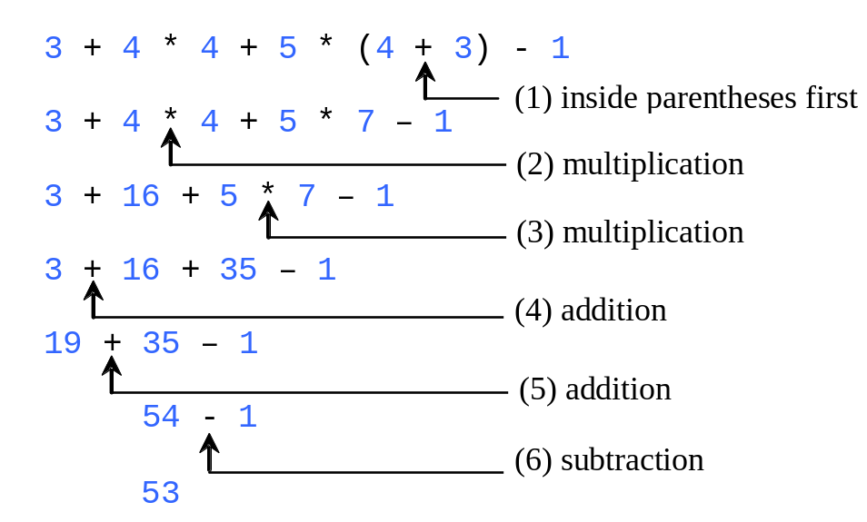
How to Evaluate an Expression
Though Python has its own way to evaluate an expression behind the scene, the result of a Python expression and its corresponding arithmetic expression are the same. Therefore, you can safely apply the arithmetic rule for evaluating a Python expression.

Slide 25
Augmented Assignment Operators
Operator Example Equivalent
+= i += 8 i = i + 8
-= f -= 8.0 f = f - 8.0
*= i *= 8 i = i * 8
/= i /= 8 i = i / 8
//= i //= 8 i = i // 8
%= i %= 8 i = i % 8
**= i **= 8 i = i ** 8

Slide 26
Type Conversion and Rounding
datatype(value)
i.e., int(4.5) => 4
float(4) => 4.0

Slide 27
Problem: Keeping Two Digits After Decimal Points
Write a program that displays the sales tax with two digits after the decimal point.
SalesTax

Slide 28
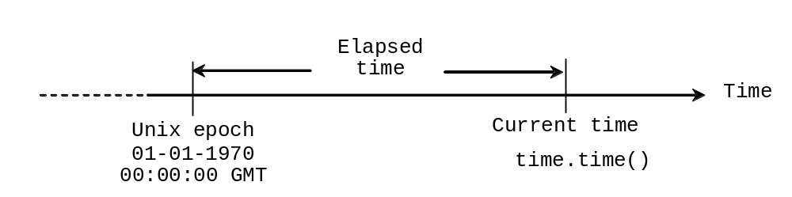
Problem: Displaying Current Time
Write a program that displays current time in GMT in the format hour:minute:second such as 1:45:19.
The time.time() function returns the current time in seconds with millisecond precision since the midnight, January 1, 1970 GMT. (1970 was the year when the Unix operating system was formally introduced.) You can use this function to obtain the current time, and then compute the current second, minute, and hour as follows.
ShowCurrentTime

Slide 29
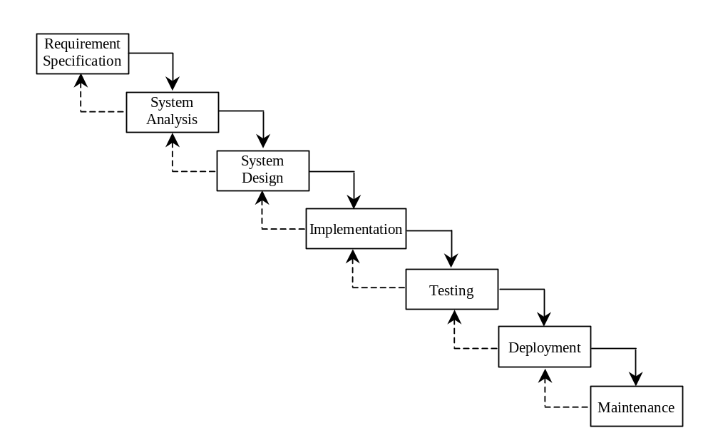
Software Development Process

Slide 30
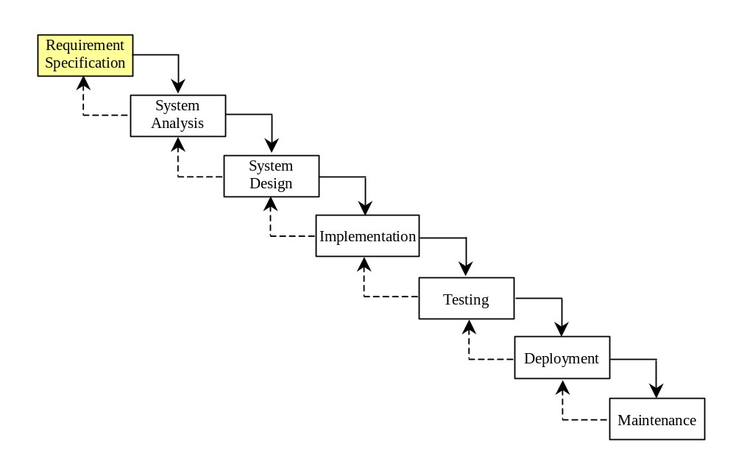
Requirement Specification
A formal process that seeks to understand the problem and document in detail what the software system needs to do. This phase involves close interaction between users and designers.
Most of the examples in this book are simple, and their requirements are clearly stated. In the real world, however, problems are not well defined. You need to study a problem carefully to identify its requirements.

Slide 31
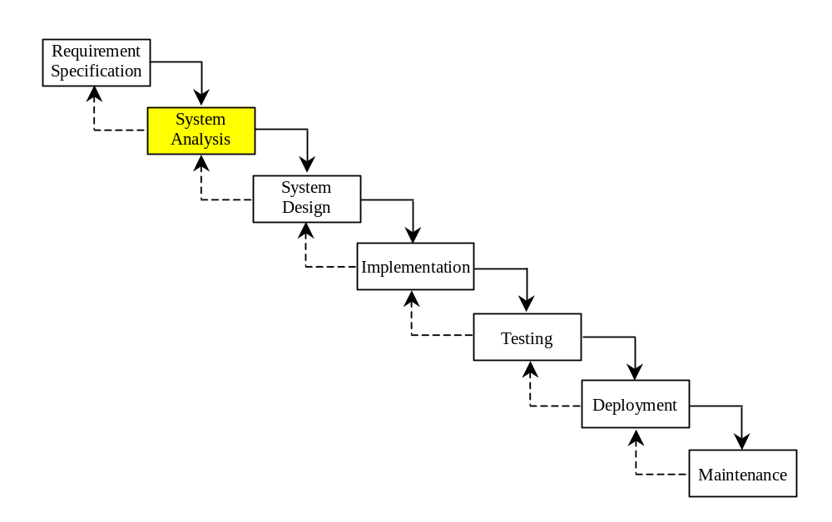
System Analysis
Seeks to analyze the business process in terms of data flow, and to identify the system’s input and output.
Part of the analysis entails modeling the system’s behavior. The model is intended to capture the essential elements of the system and to define services to the system.

Slide 32
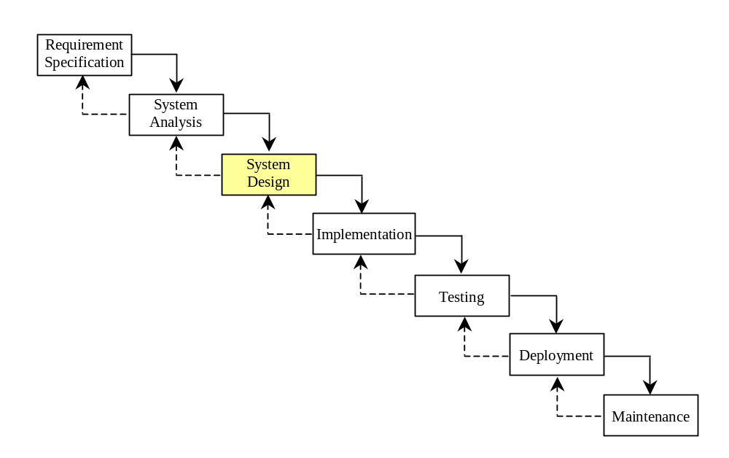
System Design
The process of designing the system’s components.
This phase involves the use of many levels of abstraction to decompose the problem into manageable components, identify classes and interfaces, and establish relationships among the classes and interfaces.

Slide 33
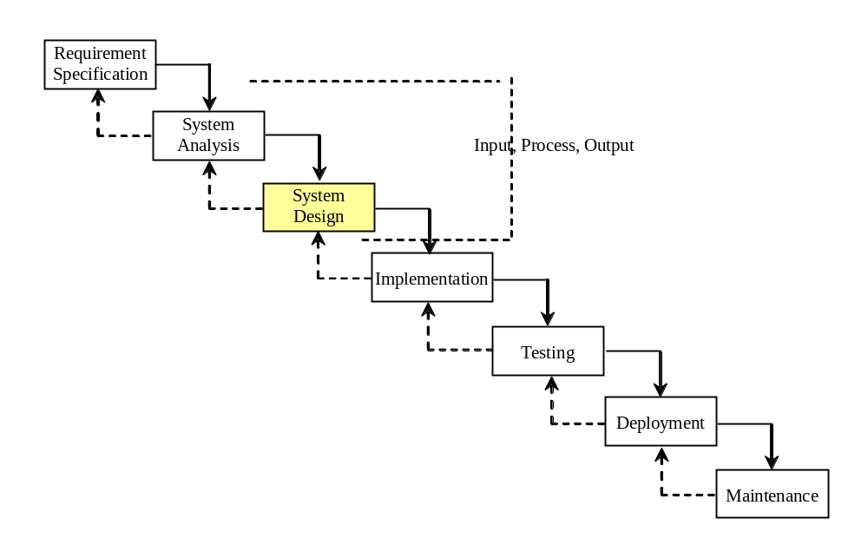
IPO
The essence of system analysis and design is input, process, and output. This is called IPO.

Slide 34
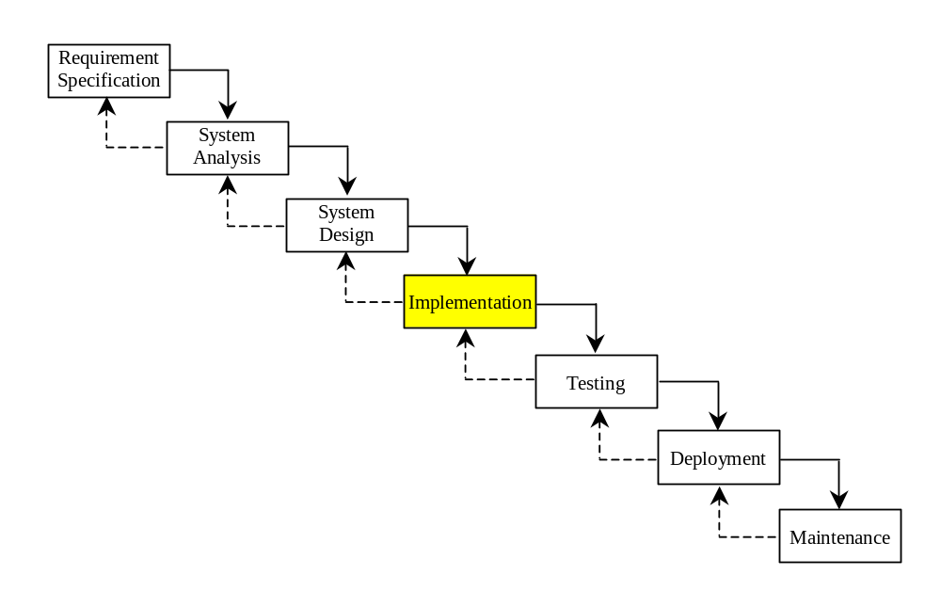
Implementation
The process of translating the system design into programs. Separate programs are written for each component and put to work together.
This phase requires the use of a programming language like Python. The implementation involves coding, testing, and debugging.

Slide 35
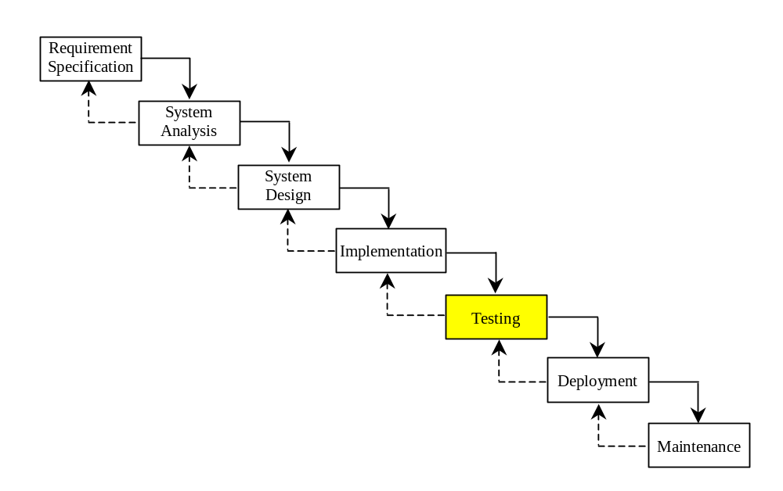
Testing
Ensures that the code meets the requirements specification and weeds out bugs.
An independent team of software engineers not involved in the design and implementation of the project usually conducts such testing.

Slide 36
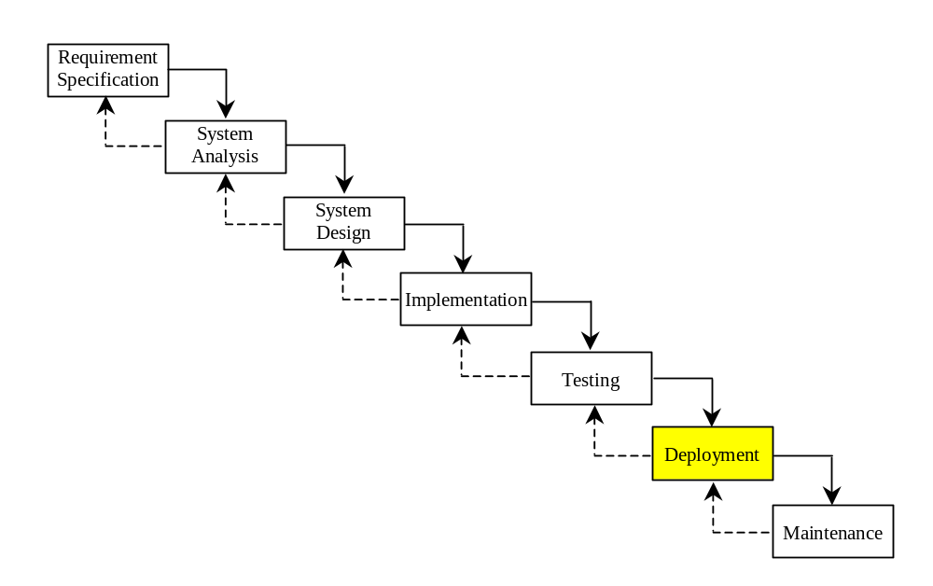
Deployment
Deployment makes the project available for use.

Slide 37
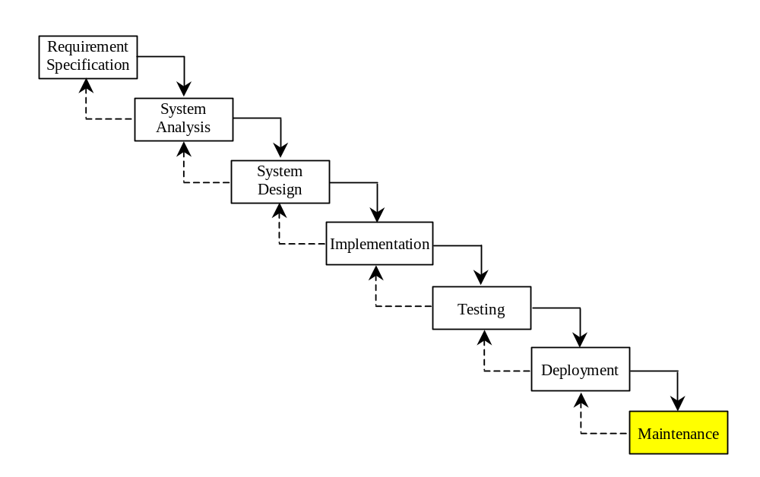
Maintenance
Maintenance is concerned with changing and improving the product.
A software product must continue to perform and improve in a changing environment. This requires periodic upgrades of the product to fix newly discovered bugs and incorporate changes.

Slide 38

Problem:
Computing Loan Payments
This program lets the user enter the interest rate, number of years, and loan amount, and computes monthly payment and total payment.
ComputeLoan

Slide 39
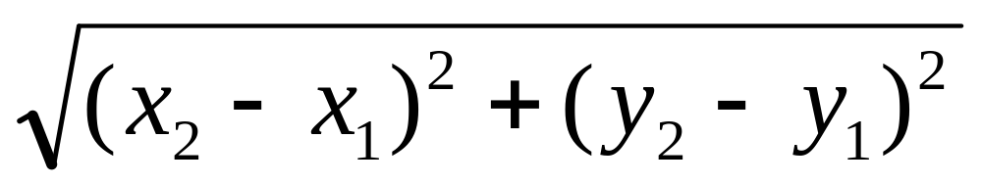
Case Study: Computing Distances
This program prompts the user to enter two points, computes their distance, and displays the distance.
ComputeDistance

Slide 40
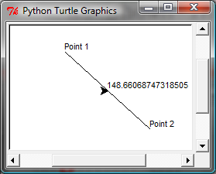
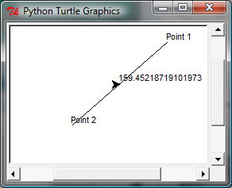
Case Study: Computing Distances
This program prompts the user to enter two points, computes their distance, and displays the points and their distances in graphics.
ComputeDistanceGraphics

