Slide 1
Chapter 4
Mathematical Functions, Strings, and Objects

Slide 2
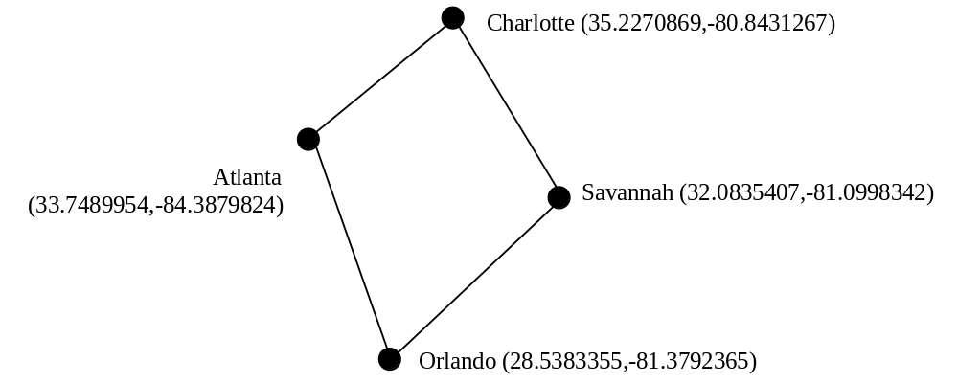
Motivations
Suppose you need to estimate the area enclosed by four cities, given the GPS locations (latitude and longitude) of these cities, as shown in the following diagram. How would you write a program to solve this problem? You will be able to write such a program after completing this chapter.

Slide 3
Objectives
To solve mathematics problems by using the functions in the math module (§4.2).
To represent and process strings and characters (§§4.3-4.4).
To encode characters using ASCII and Unicode (§§4.3.1-4.3.2).
To use the ord function to obtain a numerical code for a character and the chr function to convert a numerical code to a character (§4.3.3).
To represent special characters using the escape sequence (§4.3.4).
To invoke the print function with the end argument (§4.3.5).
To convert numbers to a string using the str function (§4.3.6).
To use the + operator to concatenate strings (§4.3.7).
To read strings from the keyboard (§4.3.8).
To solve the lottery problem using strings (§4.4).
To introduce objects and methods (§4.5).
To introduce the methods in the str class (§4.6).
To program using characters and strings (GuessBirthday) (<LINK>§4.7.1</LINK>).
To convert a hexadecimal character to a decimal value (HexDigit2Dec) (<LINK>§4.7.2</LINK>).
To format numbers and strings using the format function (§4.8).
To draw various shapes (§4.9).
To draw graphics with colors and fonts (§4.10).

Slide 4
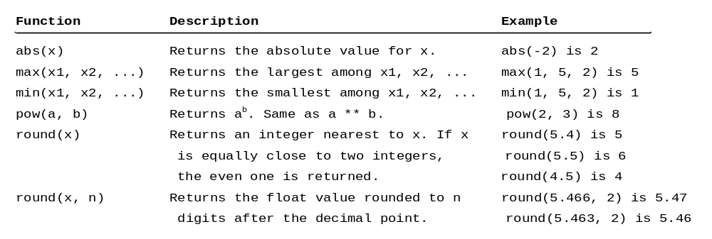
Python Built-in Functions

Slide 5
Built-in Functions
>>> max(2, 3, 4) # Returns a maximum number
4
>>> min(2, 3, 4) # Returns a minimu number
2
>>> round(4.51) # Rounds to its nearest integer
4
>>> round(4.4) # Rounds to its nearest integer
3
>>> abs(-3) # Returns the absolute value
3
>>> pow(2, 3) # Same as 2 ** 3
8

Slide 6
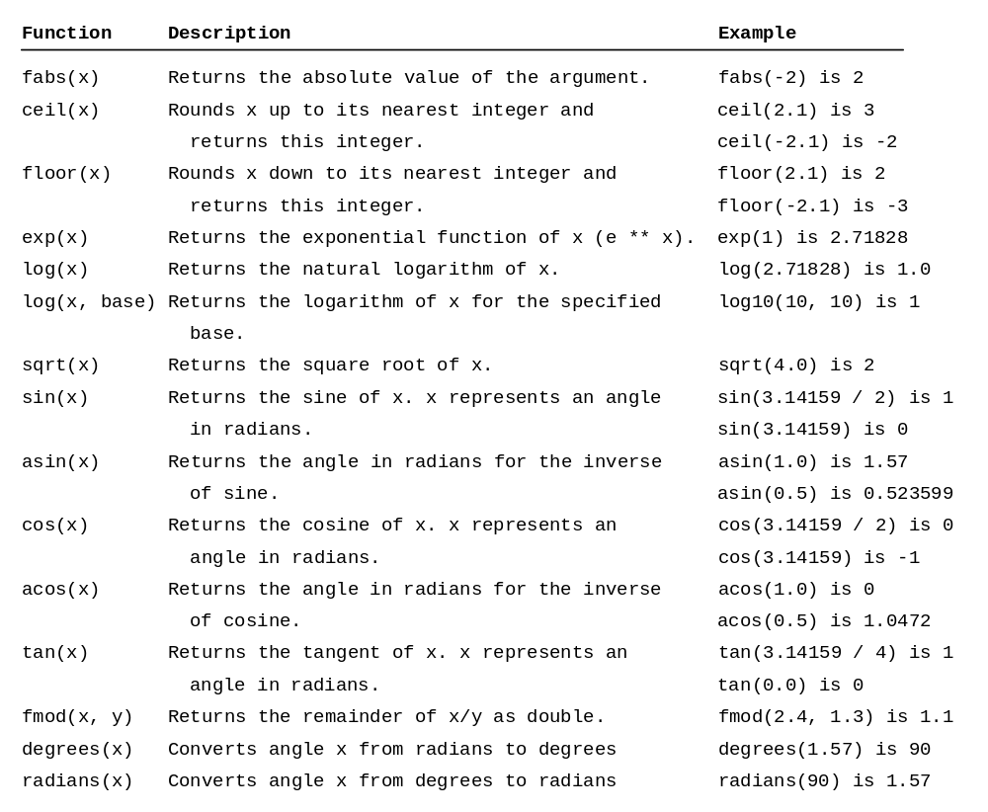
The math Functions
MathFunctions

Slide 7
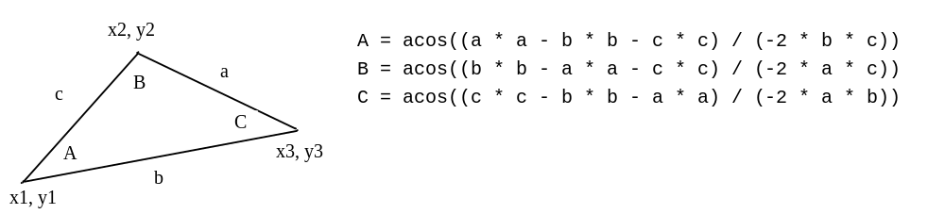
Problem: Compute Angles
Given three points of a triangle, you can compute the angles using the following formula:
ComputeAngles

Slide 8
Strings and Characters
A string is a sequence of characters. String literals can be enclosed in matching single quotes (') or double quotes ("). Python does not have a data type for characters. A single-character string represents a character.
letter = 'A' # Same as letter = "A"
numChar = '4' # Same as numChar = "4"
message = "Good morning"
# Same as message = 'Good morning'

Slide 9
NOTE
For consistency, this book uses double quotes for a string with more than one character and single quotes for a string with a single character or an empty string. This convention is consistent with other programming languages. So, it will be easy to convert a Python program to a program written in other languages.

Slide 10
Unicode and ASCII Code
Python characters use Unicode, a 16-bit encoding scheme. Unicode is an encoding scheme for representing international characters. ASCII is a small subset of Unicode.
DisplayUnicode

Slide 11

Appendix B: ASCII Character Set
ASCII Character Set is a subset of the Unicode from \u0000 to \u007f

Slide 12

ASCII Character Set, cont.
ASCII Character Set is a subset of the Unicode from \u0000 to \u007f

Slide 13
Functions ord and chr
>>> ch = 'a'
>>> ord(ch)
>>> 97
>>> chr(98)
>>> 'b'

Slide 14
Escape Sequences for Special Characters
Description Escape Sequence Unicode
Backspace \b \u0008
Tab \t \u0009
Linefeed \n \u000A
Carriage return \r \u000D
Backslash \\ \u005C
Single Quote \' \u0027
Double Quote \" \u0022

Slide 15
Printing without the Newline
print(item, end = 'anyendingstring')
print("AAA", end = ' ')
print("BBB", end = '')
print("CCC", end = '***')
print("DDD", end = '***')

Slide 16
The str Function
The str function can be used to convert a number into a string. For example,
>>> s = str(4.4) # Convert a float to string
>>> s
'4.4'
>>> s = str(3) # Convert an integer to string
>>> s
'3'
>>>

Slide 17
The String Concatenation Operator
You can use the + operator add two numbers. The + operator can also be used to concatenate (combine) two strings. Here are some examples:
>>> message = "Welcome " + "to " + "Python"
>>> message
'Weclome to Python'
>>> chapterNo = 2
>>> s = "Chapter " + str(chapterNo)
>>> s
'Chapter 2'
>>>

Slide 18
Reading Strings from the Console
To read a string from the console, use the input function. For example, the following code reads three strings from the keyboard:
s1 = input("Enter a string: ")
s2 = input("Enter a string: ")
s3 = input("Enter a string: ")
print("s1 is " + s1)
print("s2 is " + s2)
print("s3 is " + s3)

Slide 19
Case Study: Minimum Number of Coins
This program lets the user enter the amount in decimal representing dollars and cents and output a report listing the monetary equivalent in single dollars, quarters, dimes, nickels, and pennies. Your program should report maximum number of dollars, then the maximum number of quarters, and so on, in this order.
ComputeChange

Slide 20
Introduction to Objects and Methods
In Python, all data—including numbers and strings—are actually objects.
An object is an entity. Each object has an id and a type. Objects of the same kind have the same type. You can use the id function and type function to get these information for an object.

Slide 21
Object Types and Ids
The id and type functions are rarely used in programming, but they are good pedagogical tools for understanding objects.
>>> n = 3 # n is an integer
>>> id(n)
505408904
>>> type(n)
<class ’int’>
>>> f = 4.0 # f is a float
>>> id(f)
26647120
>>> type(f)
<class ’float’>
>>> s = "Welcome" # s is a string
>>> id(s)
36201472
>>> type(s)
<class ’str’>

Slide 22
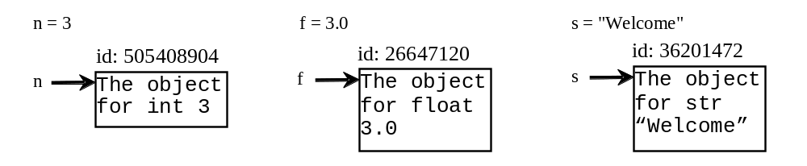
OOP and str Objects
The id and type functions are rarely used in programming, but they are good pedagogical tools for understanding objects.

Slide 23
Object vs. Object reference Variable
For n = 3, we say n is an integer variable that holds value 4. Strictly speaking, n is a variable that references an int object for value 4. For simplicity, it is fine to say n is an int variable with value 4.

Slide 24
Methods
You can perform operations on an object. The operations are defined using functions. The functions for the objects are called methods in Python. Methods can only be invoked from a specific object. For example, the string type has the methods such as lower() and upper(), which returns a new string in lowercase and uppercase. Here are the examples to invoke these methods:

Slide 25
str Object Methods
>>> s = "Welcome"
>>> s1 = s.lower() # Invoke the lower method
>>> s1
'welcome'
>>> s2 = s.upper() # Invoke the upper method
>>> s2
'WELCOME'

Slide 26
Striping beginning and ending Whitespace Characters
Another useful string method is strip(), which can be used to strip the whitespace characters from the both ends of a string.
>>> s = "\t Welcome \n"
>>> s1 = s.strip() # Invoke the strip method
>>> s1
'Welcome'

Slide 27

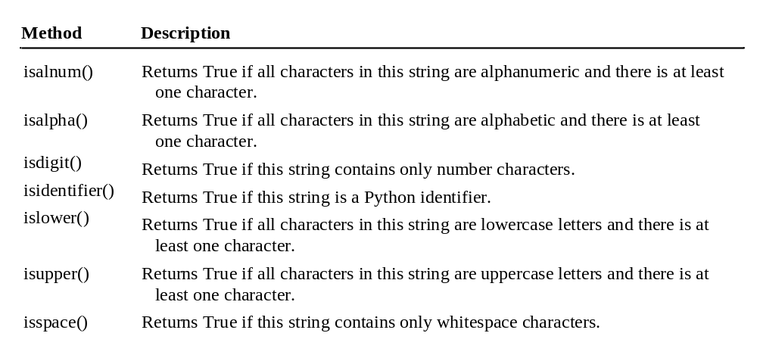
Testing Strings

Slide 28
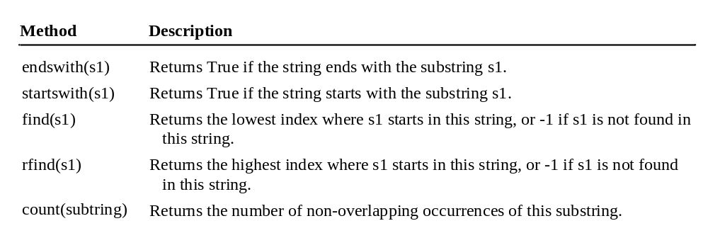
Searching for Substrings

Slide 29
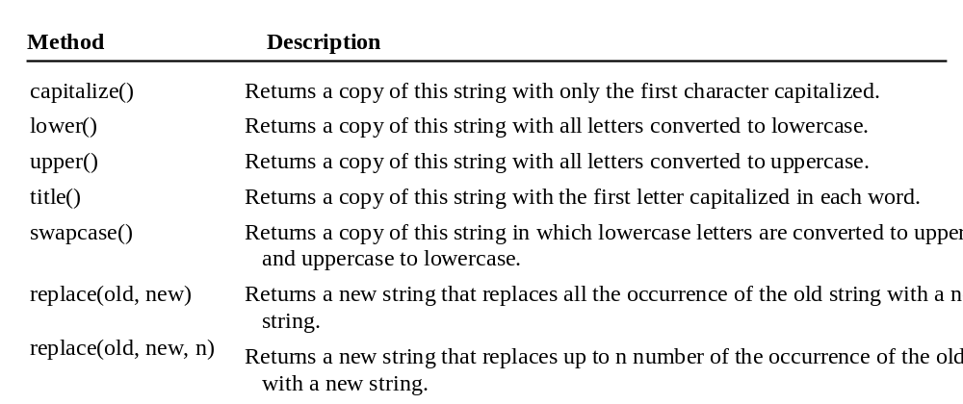
Converting Strings

Slide 30
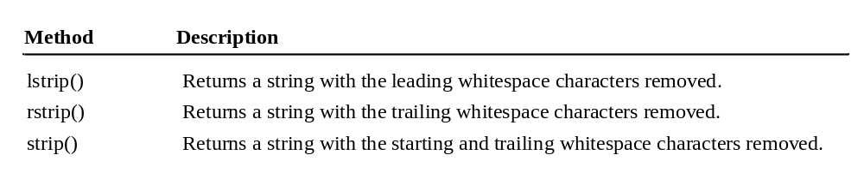
Striping Whitespace Characters

Slide 31
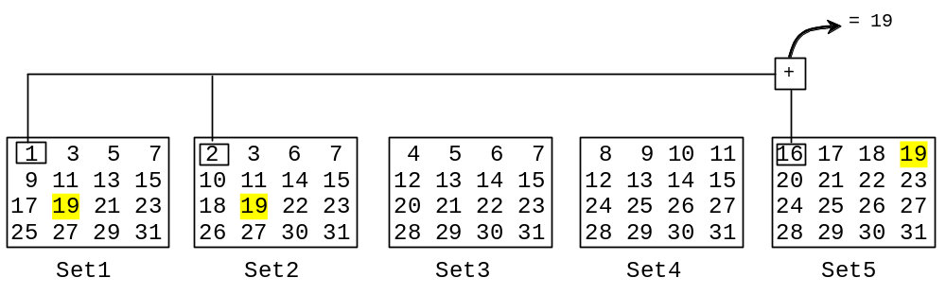
Problem: Guessing Birthday
The program can guess your birth date. Run to see how it works.
GuessBirthday

Slide 32
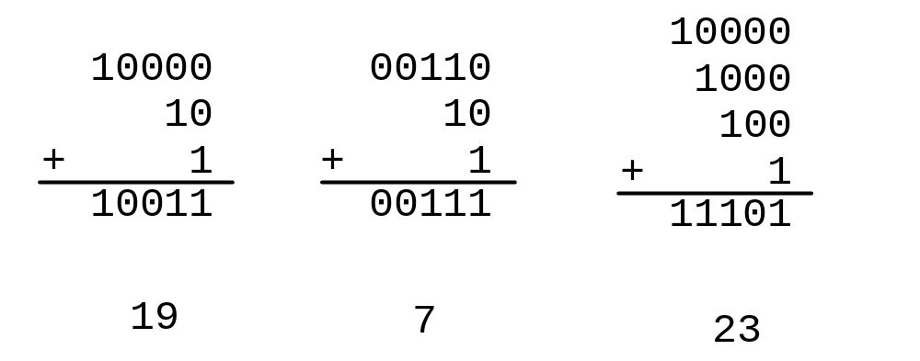
Mathematics Basis for the Game
19 is 10011 in binary. 7 is 111 in binary. 23 is 11101 in binary

Slide 33
Formatting Numbers and Strings
Often it is desirable to display numbers in certain format. For example, the following code computes the interest, given the amount and the annual interest rate.
The format function formats a number or a string and returns a string.
format(item, format-specifier)

Slide 34
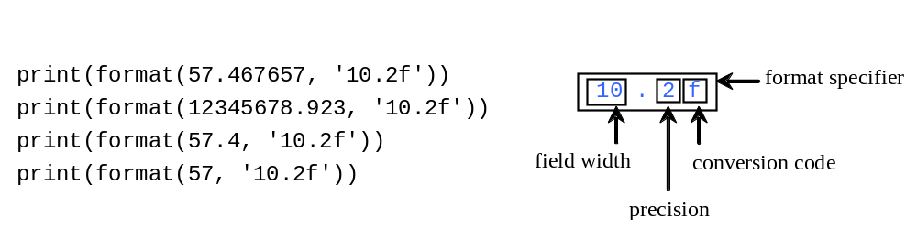
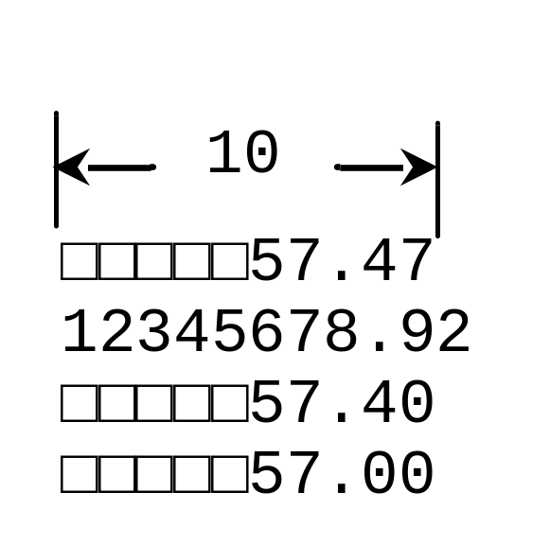
Formatting Floating-Point Numbers

Slide 35
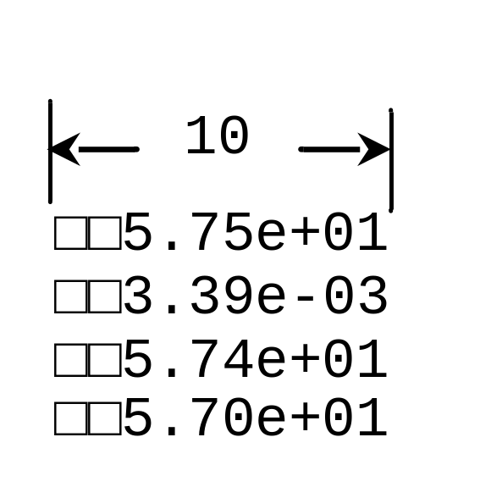
Formatting in Scientific Notation
If you change the conversion code from f to e, the number will be formatted in scientific notation. For example,
print(format(57.467657, '10.2e'))
print(format(0.0033923, '10.2e'))
print(format(57.4, '10.2e'))
print(format(57, '10.2e'))

Slide 36
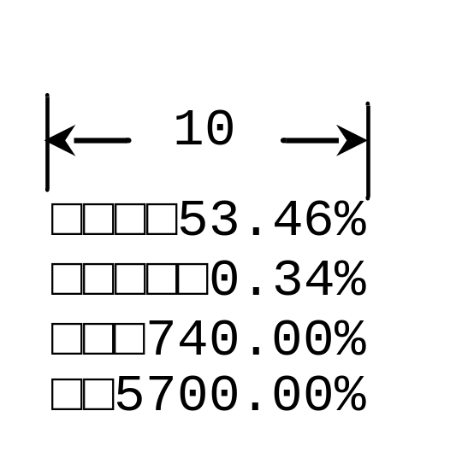
Formatting as a Percentage
You can use the conversion code % to format numbers as a percentage. For example,
print(format(0.53457, '10.2%'))
print(format(0.0033923, '10.2%'))
print(format(7.4, '10.2%'))
print(format(57, '10.2%'))

Slide 37
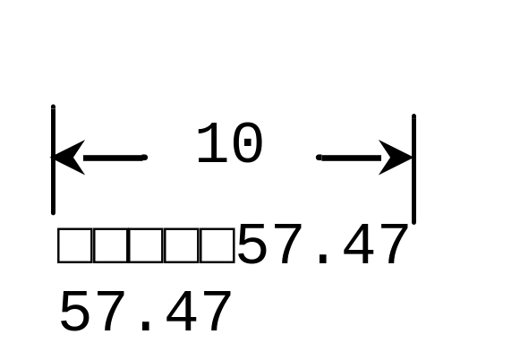
Justifying Format
By default, the format is right justified. You can put the symbol < in the format specifier to specify that the item is a left justified in the resulting format within the specified width. For example,
print(format(57.467657, '10.2f'))
print(format(57.467657, '<10.2f'))

Slide 38
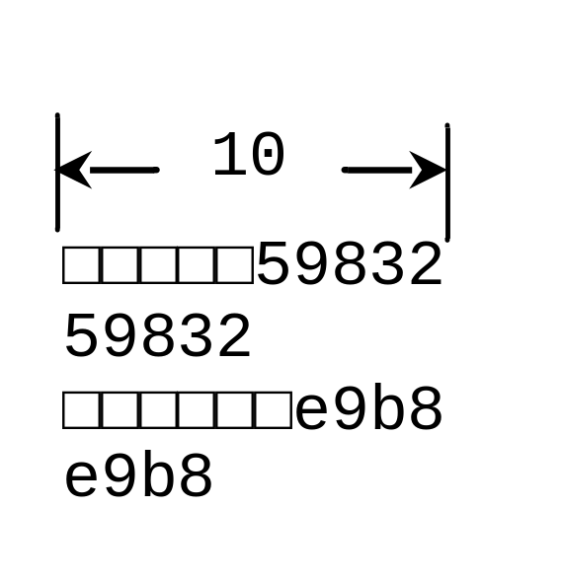
Formatting Integers
You can use the conversion code d, x, o, and b to format an integer in decimal, hexadecimal, octal, or binary. You can specify a width for the conversion. For example,
print(format(59832, '10d'))
print(format(59832, '<10d'))
print(format(59832, '10x'))
print(format(59832, '<10x'))

Slide 39
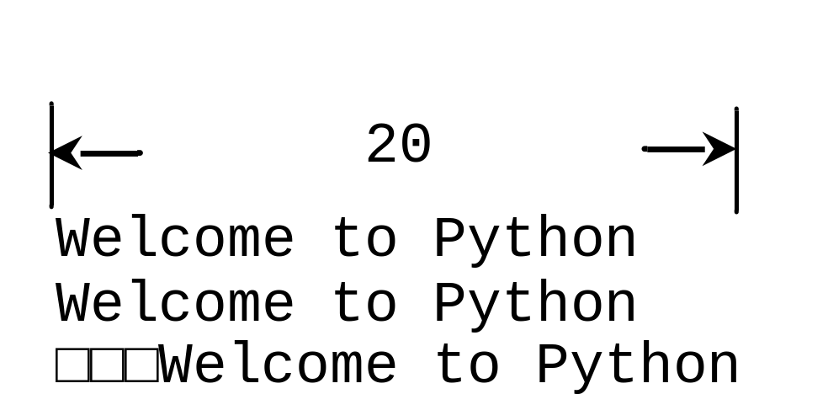
Formatting Strings
You can use the conversion code s to format a string with a specified width. For example,
print(format("Welcome to Python", '20s'))
print(format("Welcome to Python", '<20s'))
print(format("Welcome to Python", '>20s'))
FormatDemo

Slide 40
F-Strings
F-strings are new formatted strings since Python 3.6. An f-string is a string that begins with f or F. The string may contain expressions that are enclosed inside curly braces. The expressions are evaluated at runtime and formatted to strings. For example,
>>> weight = 140
>>> height = 73
>>> f"Weight is {weight} and height is {height}."
'Weight is 140 and height is 73.’
>>>
F-strings are more concise and more efficient than the format function. You can use f-strings to replace the format function. You can rewrite a format function call format(item, "format-specifier") using an f-string f"{item:format-specifier}".
FormatDemoUsingFString

Slide 41
Drawing Various Shapes
A turtle contains methods for moving the pen and setting the pen’s size and speed.

Slide 42
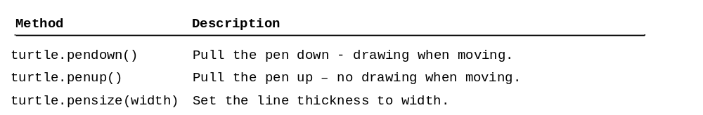
Turtle Pen Drawing State Methods

Slide 43
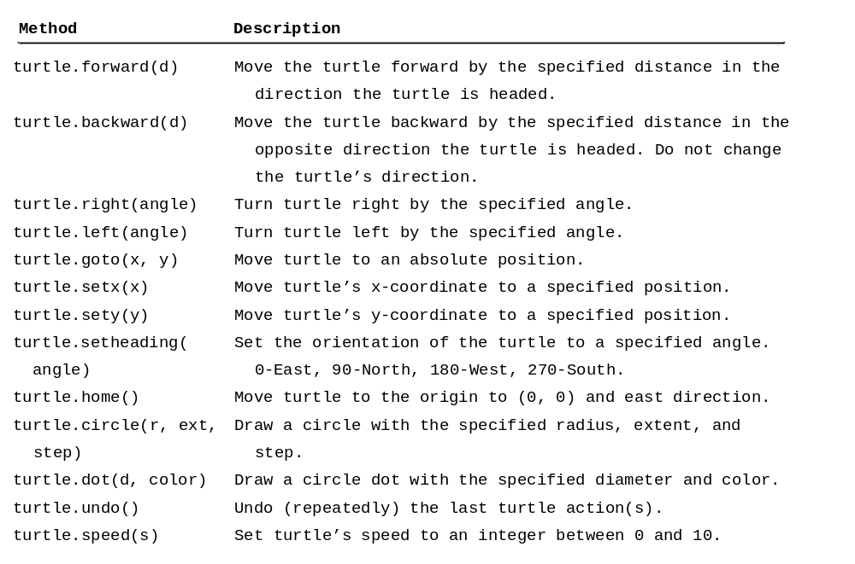
Turtle Motion Methods

Slide 44
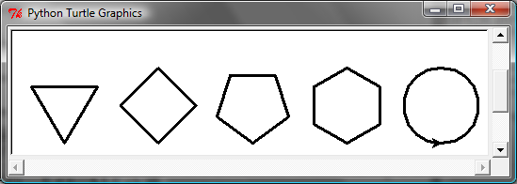
Problem: Draw Simple Shapes
SimpleShapes

Slide 45
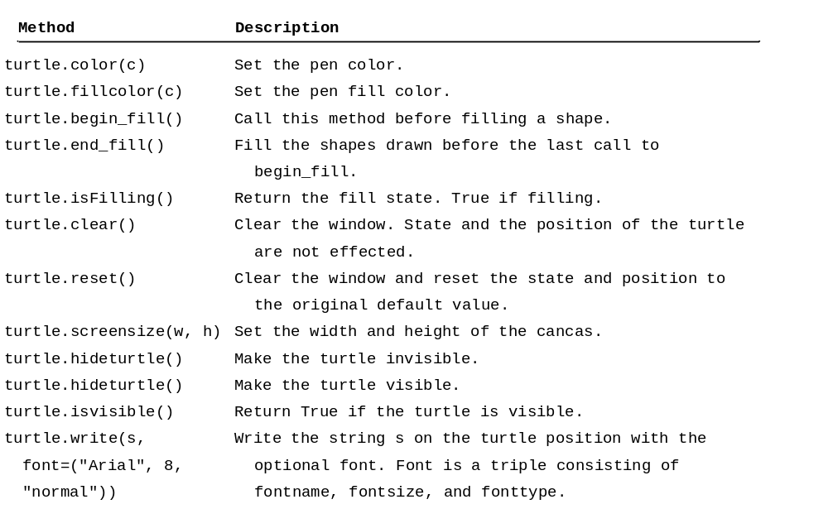
Turtle Drawing with Colors and Fonts

Slide 46
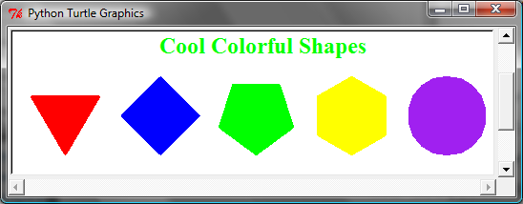
Drawing with Colors and Fonts
A turtle object contains the methods for setting colors and fonts.
ColorShapes

