Slide 1
Chapter 19 Binary Search Trees

Slide 2
Objectives
To design and implement a binary search tree (§19.2).
To represent binary trees using linked data structures (§19.2.1).
To search an element in binary search tree (§19.2.2).
To insert an element into a binary search tree (§19.2.3).
To traverse elements in a binary tree (§19.2.4).
To delete elements from a binary search tree (§19.3).
To display binary tree graphically (§19.4).
To create iterators for traversing a binary tree (§19.5).
To implement Huffman coding for compressing data using a binary tree (§19.6).

Slide 3
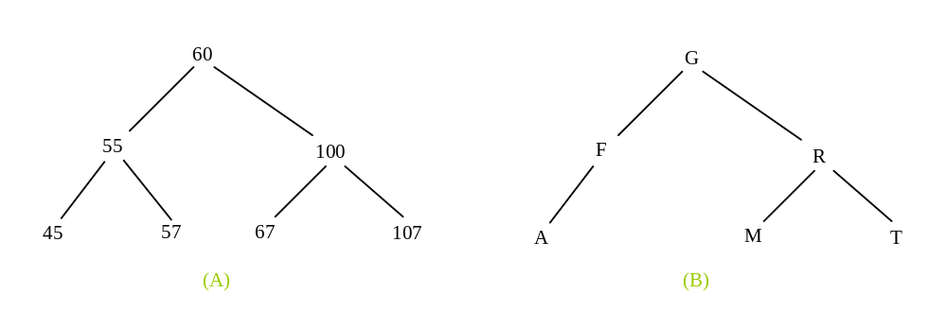
Binary Trees
A list, stack, or queue is a linear structure that consists of a sequence of elements. A binary tree is a hierarchical structure. It is either empty or consists of an element, called the root, and two distinct binary trees, called the left subtree and right subtree.

Slide 4
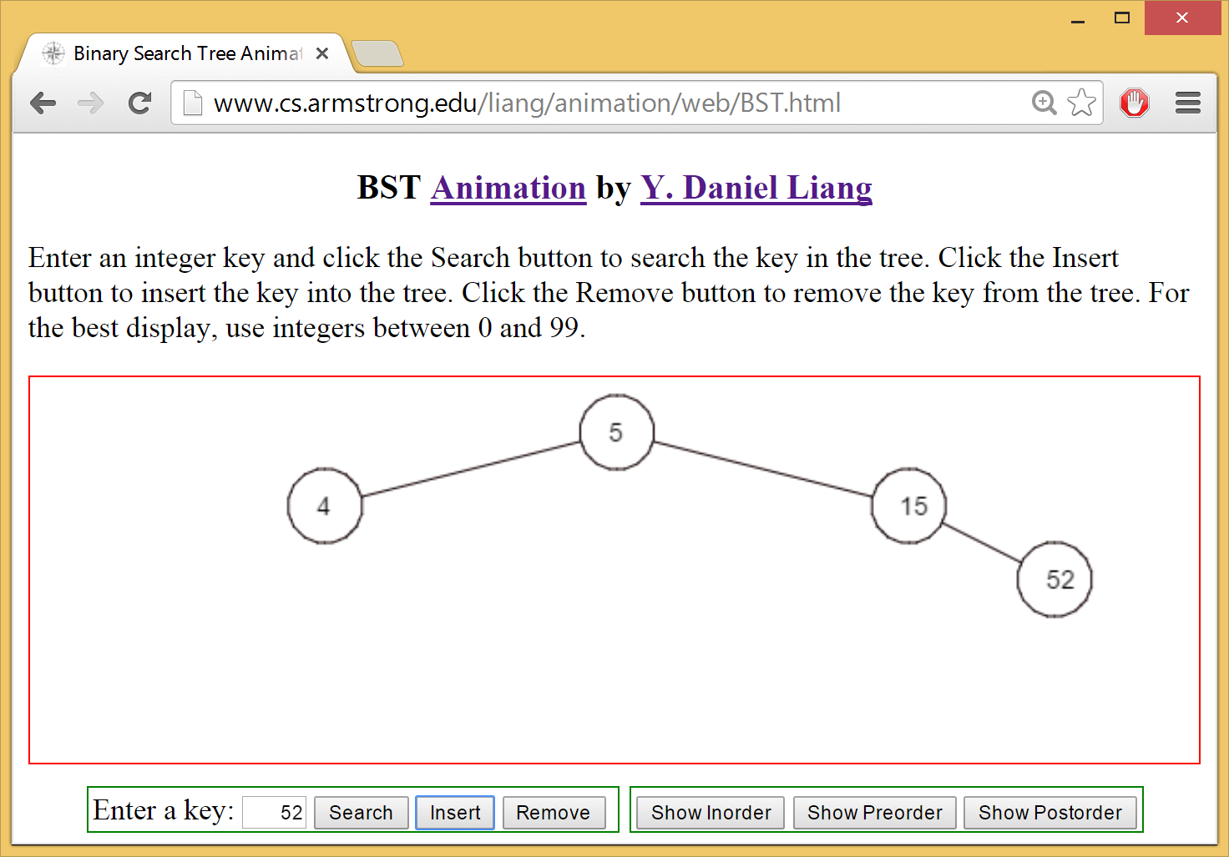
See How a Binary Search Tree Works
https://liveexample.pearsoncmg.com/dsanimation/BSTeBook.html

Slide 5
Binary Tree Terms
The root of left (right) subtree of a node is called a left (right) child of the node. A node without children is called a leaf. A special type of binary tree called a binary search tree is often useful. A binary search tree (with no duplicate elements) has the property that for every node in the tree the value of any node in its left subtree is less than the value of the node and the value of any node in its right subtree is greater than the value of the node. The binary trees in Figure 19.1 are all binary search trees. This section is concerned with binary search trees.

Slide 6
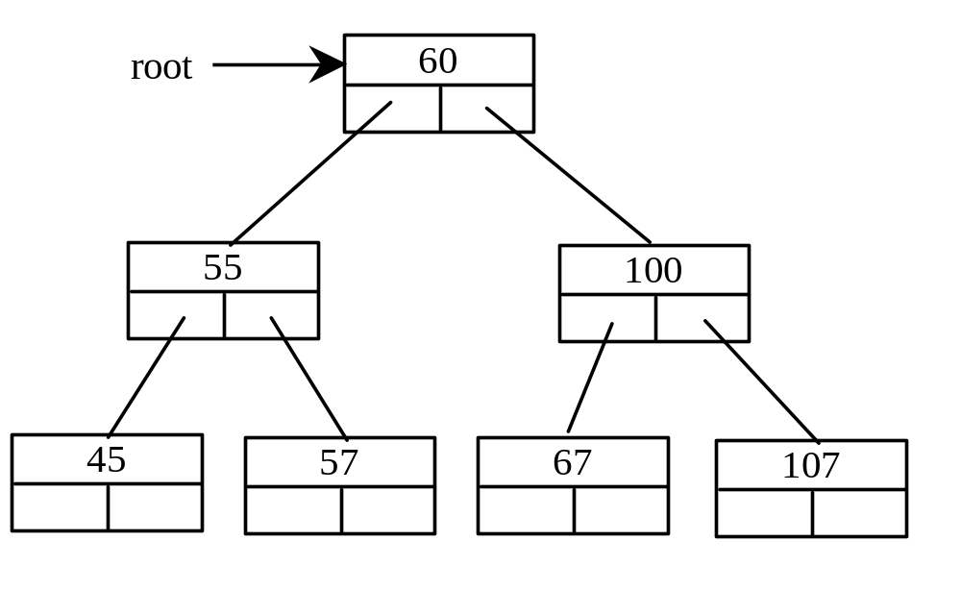
Representing Binary Trees
A binary tree can be represented using a set of linked nodes. Each node contains a value and two links named left and right that reference the left child and right child, respectively, as shown in Figure 19.2.
class TreeNode:
def _init_(self, e):
self.element = e
self.left = None
self.right = None

Slide 7
Searching an Element in a Binary Tree
def search(element):
current = root # Start from the root
while current != None:
if element < current.element:
current = current.left # Go left
elif element > current.element:
current = current.right # Go right
else: # Element matches current.element
return True # Element is found
return False # Element is not in the tree

Slide 8
Inserting an Element to a Binary Tree
If a binary tree is empty, create a root node with the new element. Otherwise, locate the parent node for the new element node. If the new element is less than the parent element, the node for the new element becomes the left child of the parent. If the new element is greater than the parent element, the node for the new element becomes the right child of the parent. Here is the algorithm:

Slide 9
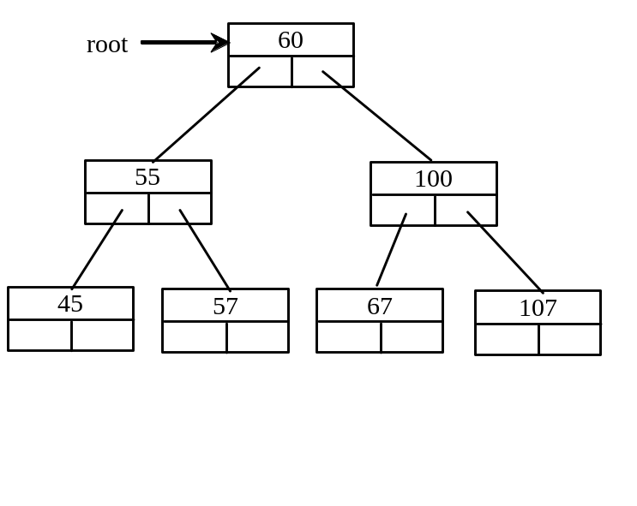
Inserting an Element to a Binary Tree
def insert(e):
if tree is empty:
# Create the node for e as the root
else:
# Locate the parent node
parent = current = root
while current != None:
if e < the value in current.element:
parent = current # Keep the parent
current = current.left # Go left
elif e > the value in current.element:
parent = current # Keep the parent
current = current.right # Go right
else:
return False # Duplicate node not inserted
# Create a new node for e and attach it to parent
return True # Element inserted
Insert 101 into the following tree.

Slide 10
Tree Traversal
Tree traversal is the process of visiting each node in the tree exactly once. There are several ways to traverse a tree. This section presents inorder, preorder, postorder, depth-first, and breadth-first traversals.
The inorder traversal is to visit the left subtree of the current node first recursively, then the current node itself, and finally the right subtree of the current node recursively.
The postorder traversal is to visit the left subtree of the current node first, then the right subtree of the current node, and finally the current node itself.

Slide 11
Tree Traversal, cont.
The preorder traversal is to visit the current node first, then
the left subtree of the current node, and finally the right subtree of the current node.

Slide 12
Tree Traversal, cont.
The breadth-first traversal is to visit the nodes level by level. First visit the root, then all children of the root from left to right, then grandchildren of the root from left to right, and so on.
For example, in the tree in Figure 19.2, the inorder is 45 55 57 59 60 67 100 101 107. The postorder is 45 59 57 55 67 101 107 100 60. The preorder is 60 55 45 57 59 100 67 107 101. The breadth-first traversal is 60 55 100 45 57 67 107 59 101.

Slide 13
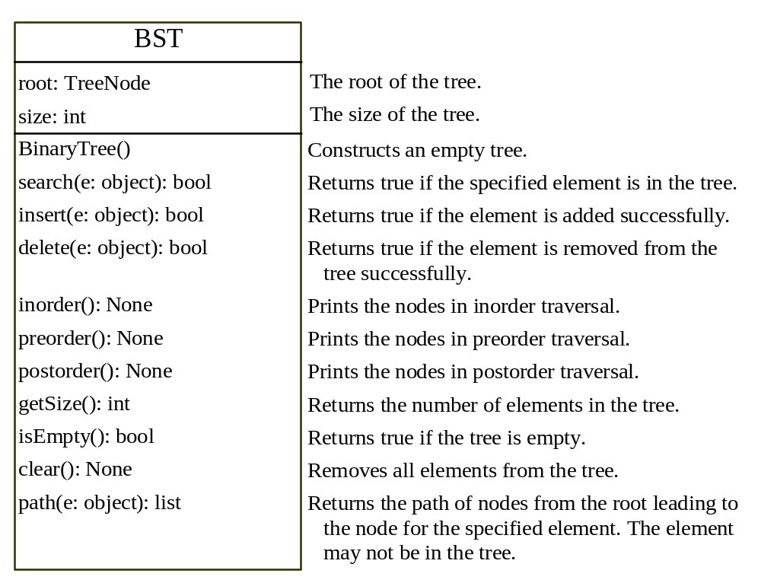
The BinaryTree Class
BST
TestBST

Slide 14
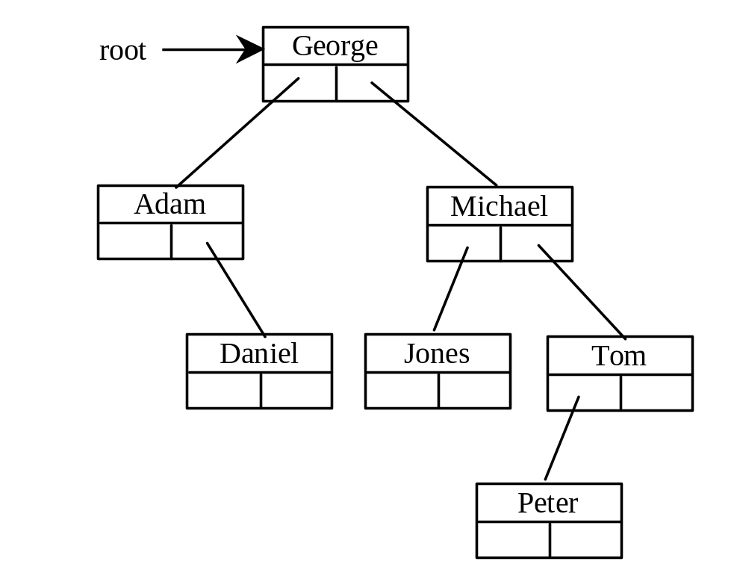
Tree After Insertions
Inorder: Adam, Daniel George, Jones, Michael, Peter, Tom
Postorder: Daniel Adam, Jones, Peter, Tom, Michael, George
Preorder: George, Adam, Daniel, Michael, Jones, Tom, Peter

Slide 15
Deleting Elements in a Binary Search Tree
To delete an element from a binary tree, you need to first locate the node that contains the element and also its parent node. Let current point to the node that contains the element in the binary tree and parent point to the parent of the current node. The current node may be a left child or a right child of the parent node. There are two cases to consider:

Slide 16
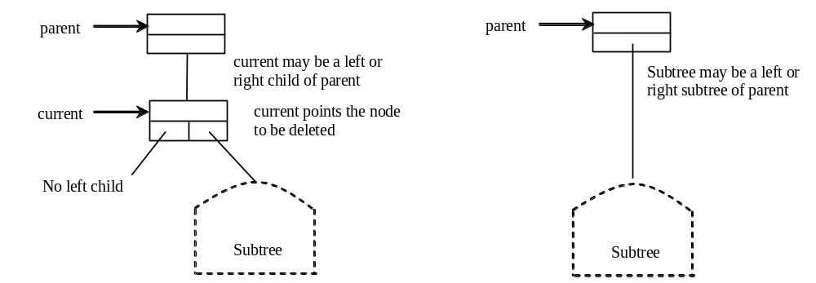
Deleting Elements in a Binary Search Tree
Case 1: The current node does not have a left child, as shown in this figure (a). Simply connect the parent with the right child of the current node, as shown in this figure (b).

Slide 17
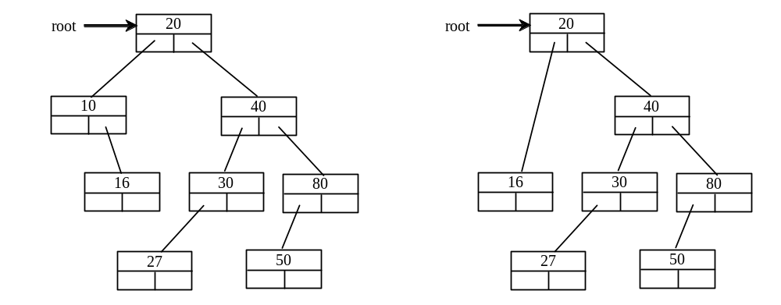
Deleting Elements in a Binary Search Tree
For example, to delete node 10 in Figure 19.9a. Connect the parent of node 10 with the right child of node 10, as shown in Figure 19.9b.

Slide 18
Deleting Elements in a Binary Search Tree
Case 2: The current node has a left child. Let rightMost point to the node that contains the largest element in the left subtree of the current node and parentOfRightMost point to the parent node of the rightMost node, as shown in Figure 19.10). Note that the rightMost node cannot have a right child, but may have a left child. Replace the element value in the current node with the one in the rightMost node, connect the parentOfRightMost node with the left child of the rightMost node, and delete the rightMost node, as shown in Figure 19.10b.

Slide 19
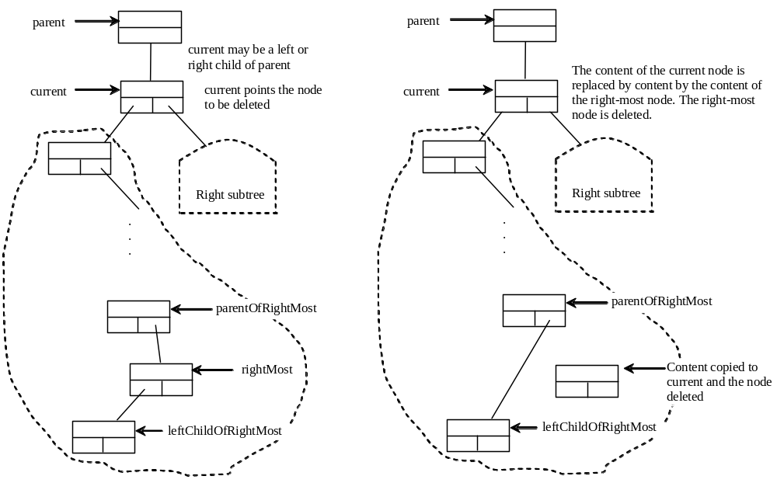
Deleting Elements in a Binary Search Tree
Case 2 diagram

Slide 20
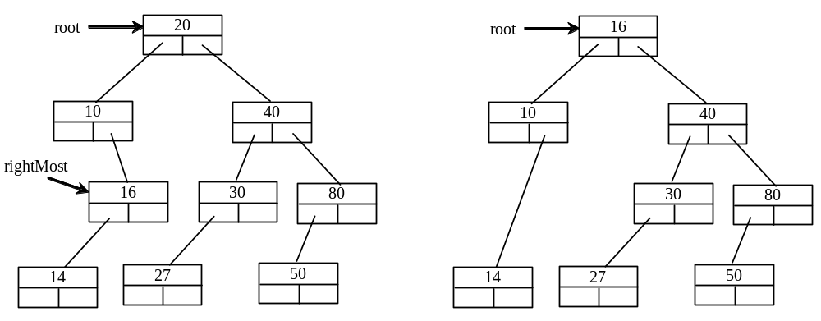
Deleting Elements in a Binary Search Tree
Case 2 example, delete 20

Slide 21
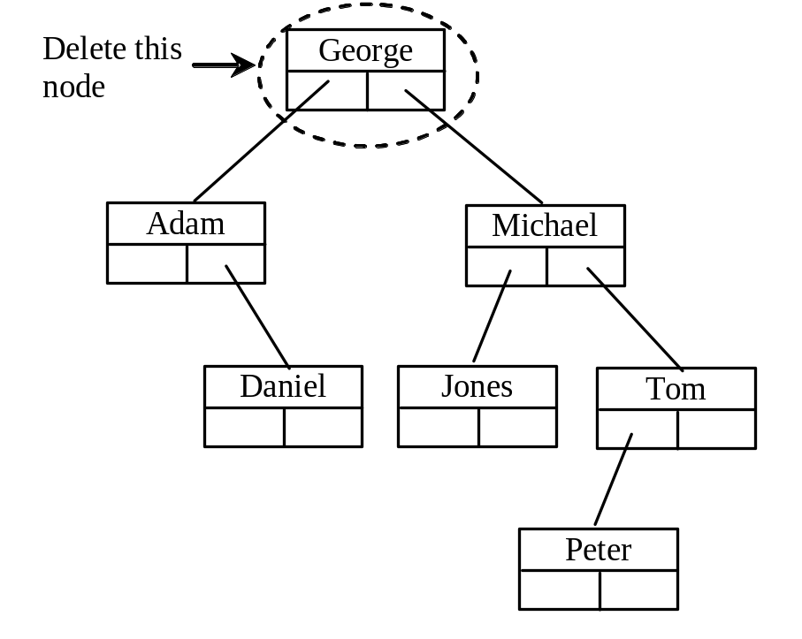
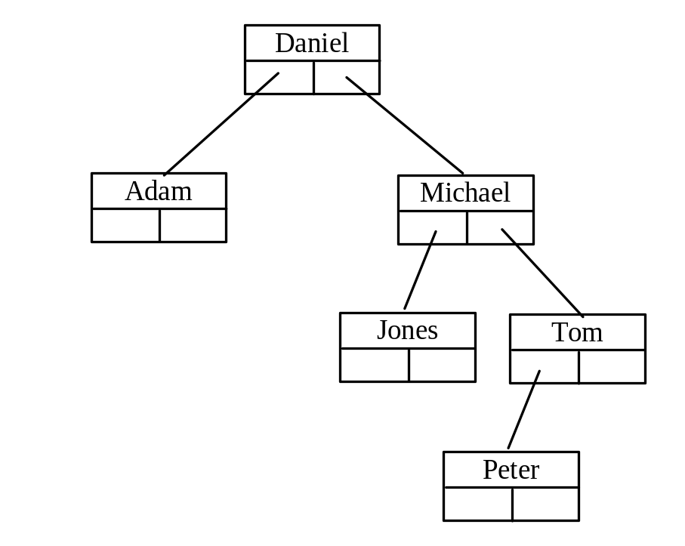
Examples

Slide 22
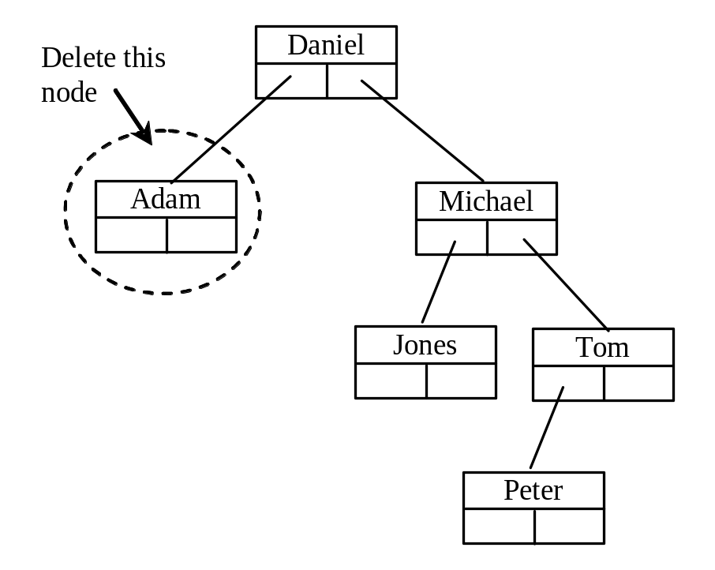
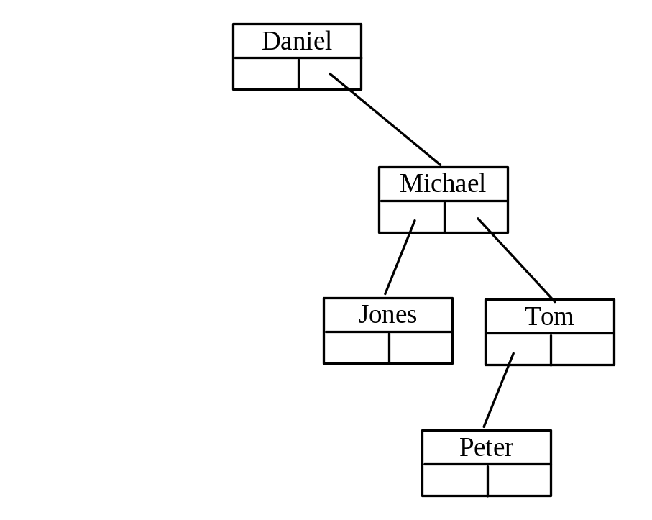
Examples

Slide 23
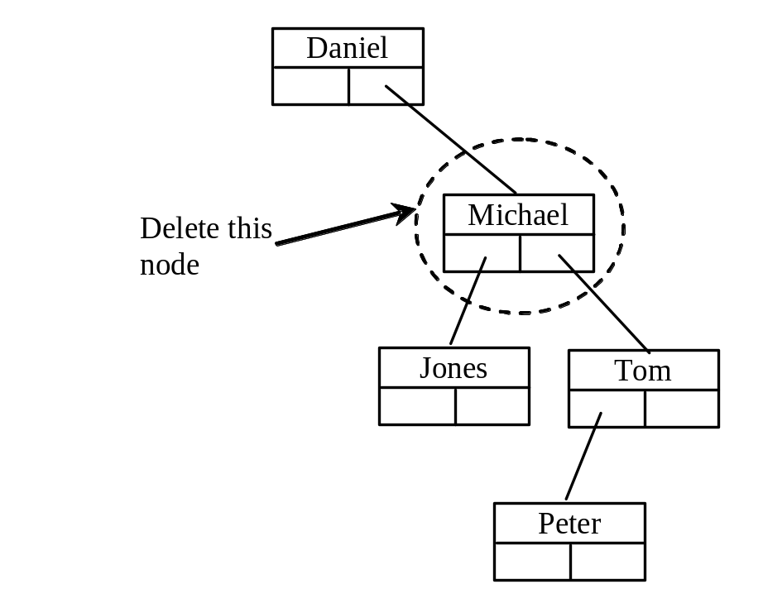
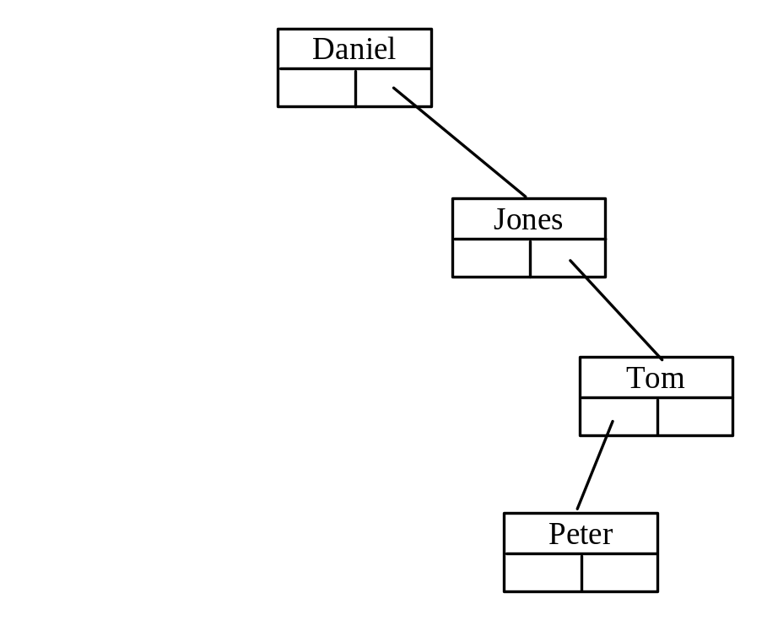
Examples
TestBinaryTreeDelete

Slide 24
binary tree time complexity
It is obvious that the time complexity for the inorder, preorder, and postorder is O(n), since each node is traversed only once. The time complexity for search, insertion and deletion is the height of the tree. In the worst case, the height of the tree is O(n).

Slide 25
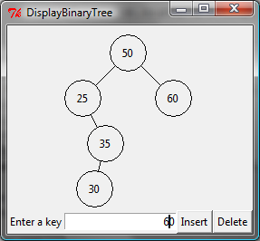
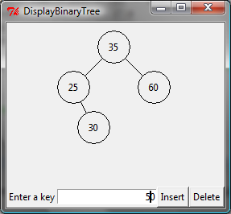
BST Visualization
DisplayBST

Slide 26
Iterators
See Exercise 19.11.

Slide 27
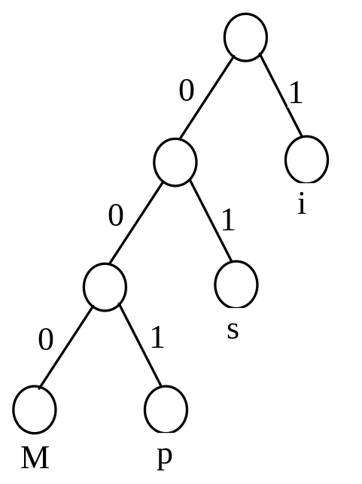
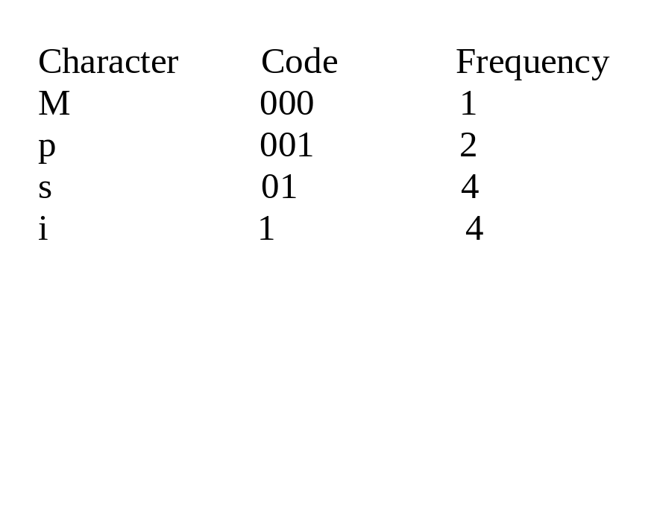
Data Compression: Huffman Coding
In ASCII, every character is encoded in 8 bits. Huffman coding compresses data by using fewer bits to encode more frequently occurring characters. The codes for characters are constructed based on the occurrence of characters in the text using a binary tree, called the Huffman coding tree.

Slide 28
Constructing Huffman Tree
To construct a Huffman coding tree, use a greedy algorithm as follows:
Begin with a forest of trees. Each tree contains a node for a character. The weight of the node is the frequency of the character in the text.
Repeat this step until there is only one tree:
Choose two trees with the smallest weight and create a new node as their parent. The weight of the new tree is the sum of the weight of the subtrees.

Slide 29
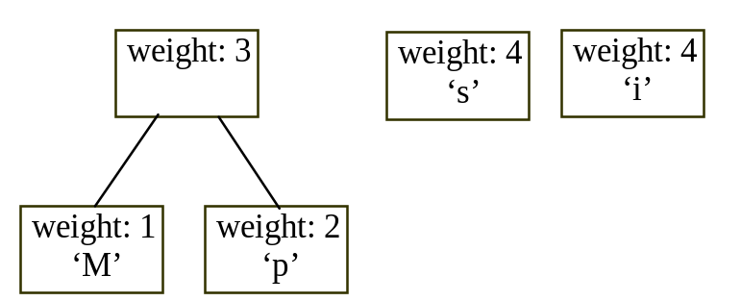
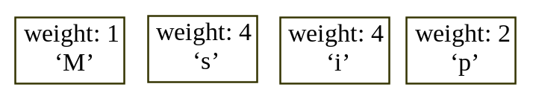
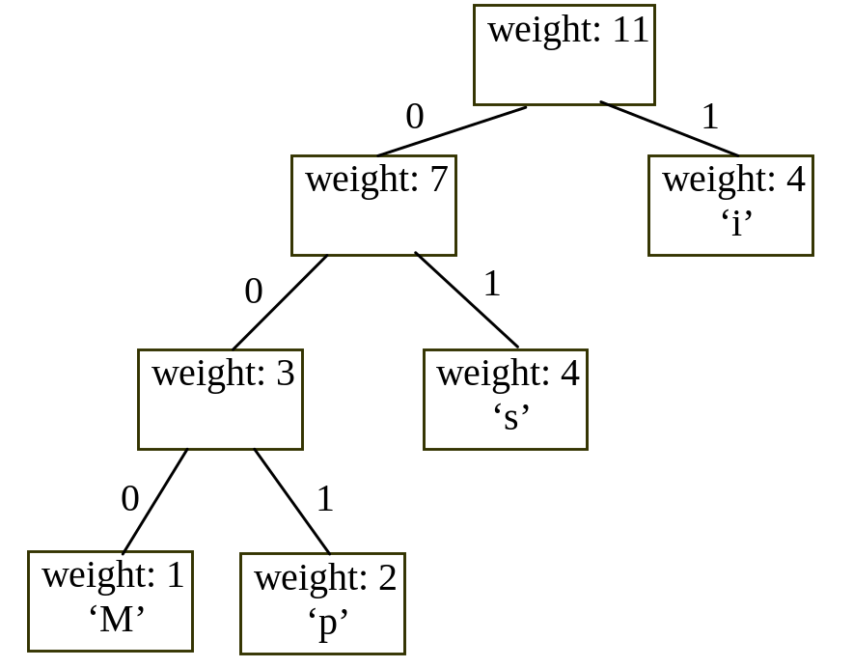
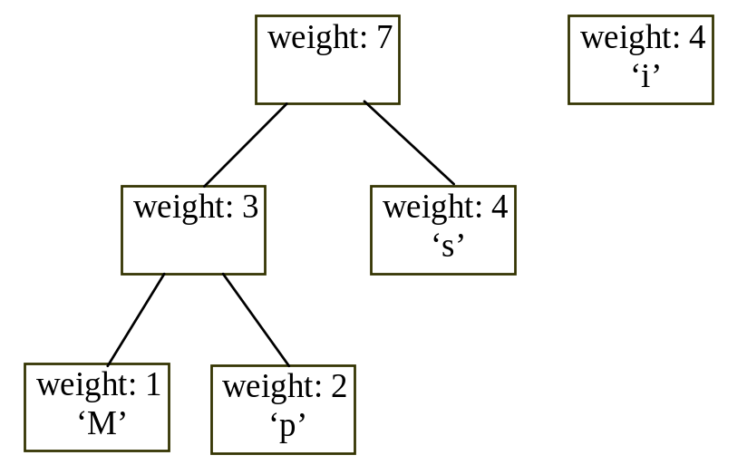
Constructing Huffman Tree

Slide 30
Constructing Huffman Tree
HuffmanCode

