Slide 1

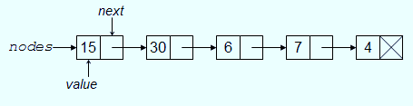
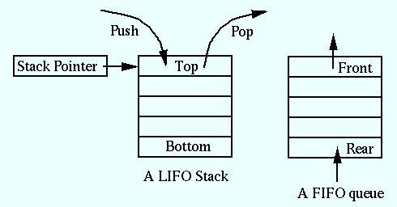
Data structure
1
Store and organize data in computer.
Linear Data Structure
Arrays
Linked List
Stacks
Queues
Notes:
1

Slide 2
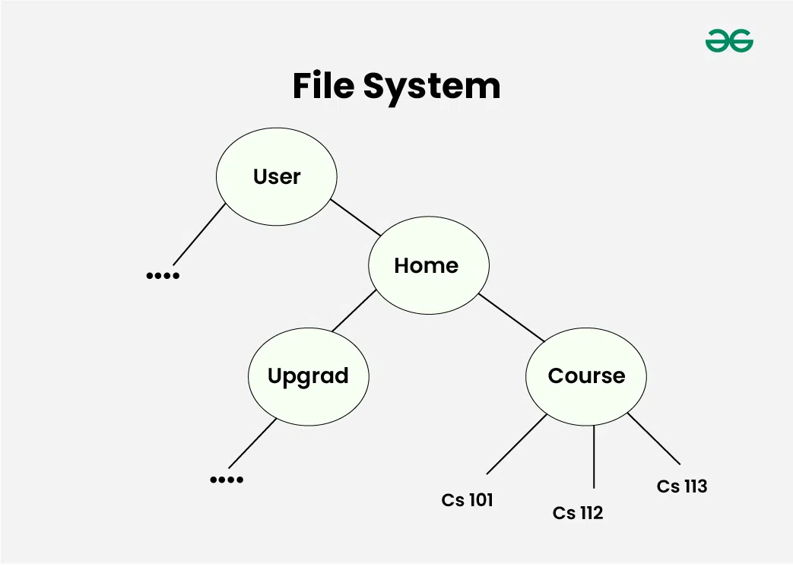
Uses of Tree Data Structure:
Unlike Array and Linked List, which are linear data structures, tree is hierarchical (or non-linear) data structure.
Hierarchical Structure: One reason to use trees might be because you want to store information that naturally forms a hierarchy.
Searching Efficiency: Trees provide an efficient way to search for data. For example, in a binary search tree,
searching for a value takes time proportional to the logarithm of the number of elements, which is much faster than
searching in a linear data structure like an array or a linked list.
Sorting: Trees can be used to sort data efficiently. For example, in a self-balancing binary search tree,
the data is automatically sorted as it is inserted into the tree, making it easy to find the minimum, maximum,
and other values in the tree.
Dynamic Data: Trees are dynamic data structures, which means that they can grow and shrink as needed.
Efficient Insertion and Deletion: Trees provide efficient algorithms for inserting and deleting data,
which is important in many applications where data needs to be added or removed frequently.
Easy to Implement: Trees are relatively easy to implement, especially when compared to other data structures like graphs.

Slide 3

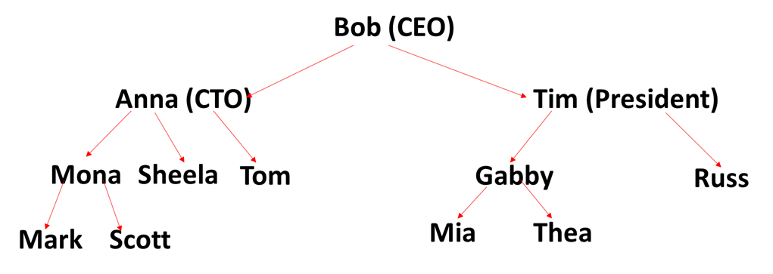
Logic of Tree

Slide 4
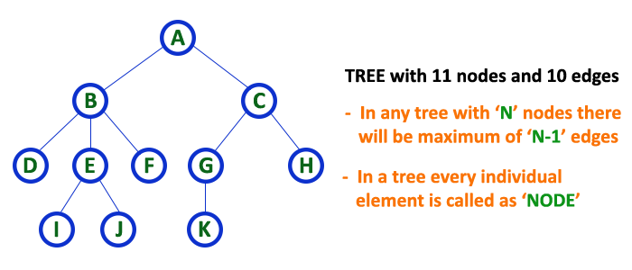
Tree Definition
Tree is a non-linear data structure which organizes data in hierarchical structure and this is a recursive definition.

Slide 5
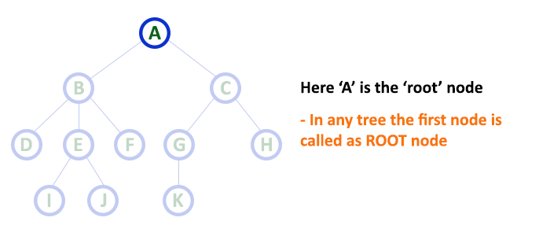
Tree terminology...
1.Root:
  The first node is called as Root Node.
  Every tree must have root node, there must be only one root node.
  Root node doesn't have any parent.

Slide 6
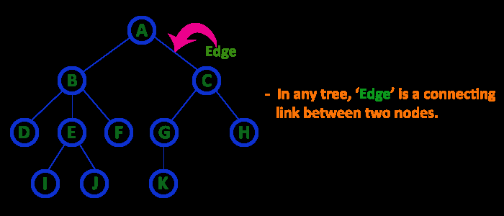
2. Edge
In a tree data structure, the connecting link between any two nodes is called as EDGE. In a tree with 'N' number of nodes there will be a maximum of 'N-1' number of edges.

Slide 7
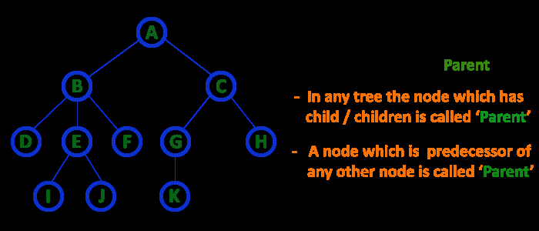
3. Parent
In a tree data structure, the node which is predecessor of any node is called as PARENT NODE. In simple words, the node which has branch from it to any other node is called as parent node. Parent node can also be defined as "The node which has child / children".

Slide 8
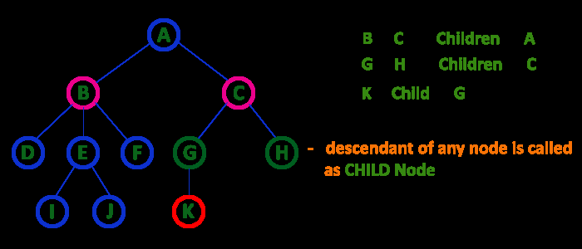
4. Child
The node which has a link from its parent node is called as child node.
In a tree, any parent node can have any number of child nodes.
In a tree, all the nodes except root are child nodes.

Slide 9
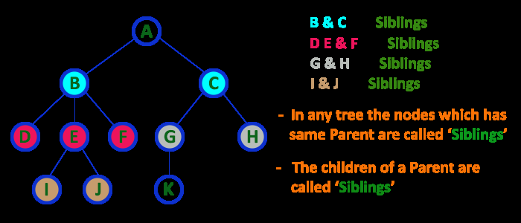
5. Siblings
The nodes with same parent are called as Sibling nodes.

Slide 10
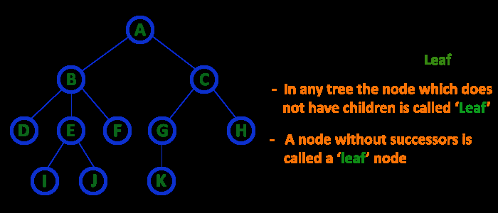
6. Leaf Node
The node which does not have a child is called as LEAF Node.
The leaf nodes are also called as External Nodes or 'Terminal' node.

Slide 11
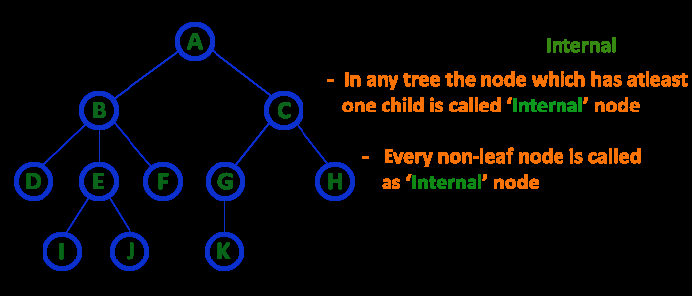
7. Internal Nodes
An internal node is a node with atleast one child.
Nodes other than leaf nodes are called as Internal Nodes.
The root node is also said to be Internal Node if the tree has more than one node. Internal nodes are also called as 'Non-Terminal' nodes.

Slide 12
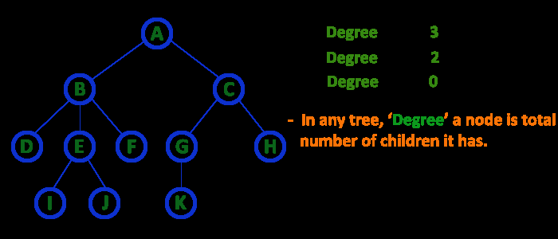
8. Degree
In a tree data structure, the total number of children of a node is called as DEGREE of that Node.

Slide 13
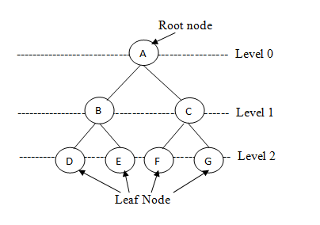
9. Level
In a tree data structure, the root node is said to be at Level 0 and the children of root node are at Level 1 and the children of the nodes which are at Level 1 will be at Level 2 and so on...
In a tree each step from top to bottom is called as a Level and the Level count starts with '0' and incremented by one at each level (Step).

Slide 14
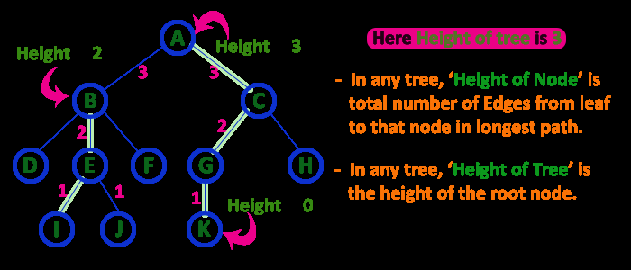
10. Height
the total number of egdes from leaf node to a particular node in the longest path is called as HEIGHT of that Node.
In a tree, height of the root node is said to be height of the tree.

Slide 15
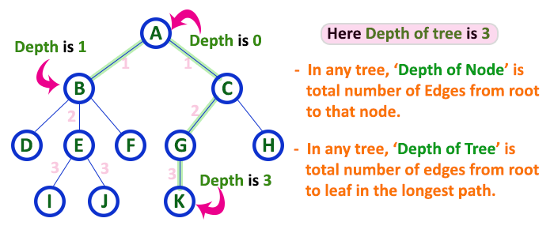
11. Depth
In a tree data structure, the total number of egdes from root node to a particular node is called as DEPTH of that Node.

Slide 16
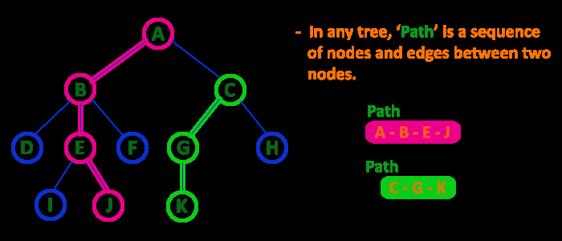
12. Path
In a tree data structure, the sequence of Nodes and Edges from one node to another node is called as PATH between that two Nodes.
Length of a Path is total number of nodes in that path. In below example the path A - B - E - J has length 4.

Slide 17
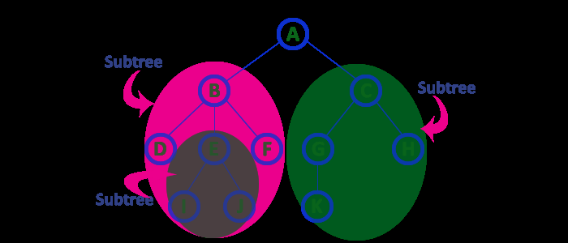
13. Sub Tree
Every child node will form a subtree on its parent node.

Slide 18
Advantages of Tree
Efficient searching: Trees are particularly efficient for searching and retrieving data. The time complexity of searching in a tree is O(log n) in AVL and Red Black Trees. This is better than arrays and linked list but not as good as hashing, but the advantages the these trees provide are sorted data, search for floor and ceiling of data.
Fast insertion and deletion: Inserting and deleting nodes in a self balancing binary search trees like AVL and Red Black can be done in O(log n) time. This is again better than arrays and linked list not as good as hashing, but the advantages the these trees provide are sorted data, search for floor and ceiling of data.
Trees provide a hierarchical representation of data, making it easy to organize and navigate large amounts of information.
The recursive nature of trees makes them easy to traverse and manipulate using recursive algorithms.
Natural organization: Trees have a natural hierarchical organization that can be used to represent many types of relationships. This makes them particularly useful for representing things like file systems, organizational structures, and taxonomies.
Flexible size: Unlike Arrays, trees can easily grow or shrink dynamically depending on the number of nodes that are added or removed. This makes them particularly useful for applications where the data size may change over time.

Slide 19
Disadvantages of Tree:
Memory overhead: Trees can require a significant amount of memory to store, especially if they are very large. This can be a problem for applications that have limited memory resources.
Imbalanced trees: If a tree is not balanced, it can result in uneven search times. This can be a problem in applications where speed is critical.
Complexity: Unlike Arrays and Linked Lists, Trees can be complex data structures, and they can be difficult to understand and implement correctly. This can be a problem for developers who are not familiar with them.
Search, Insert and Delete Times: If a problem requires only search, insert and delete, not other operations like sorted data traversal, floor, and ceiling, Hash Tables always beat Self Balancing Binary Search Trees.
The implementation and manipulation of trees can be complex and require a good understanding of the algorithms.

Slide 20
Type of Trees
General tree
Binary tree
Binary Search Tree

Slide 21
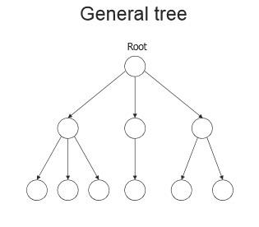
General Tree
A general tree is a data structure in that each node can have infinite number of children .
In general tree, root has in-degree 0 and maximum out-degree n.
Height of a general tree is the length of longest path from root to the leaf of tree. Height(T) = {max(height(child1) , height(child2) , … height(child-n) ) +1}

Slide 22
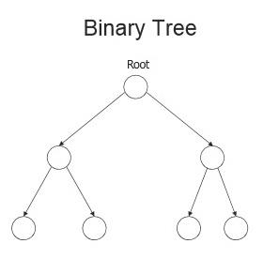
Binary tree
A Binary tree is a data structure in that each node has at most two nodes left and right
In binary tree, root has in-degree 0 and maximum out-degree 2.
In binary tree, each node have in-degree one and maximum out-degree 2.
Height of a binary tree is : Height(T) = { max (Height(Left Child) , Height(Right Child) + 1}

Slide 23
Representation of Binary Tree
Array Representation
Linked List Representation.

Slide 24
Representation of Binary Tree
Struct node { int data; struct node * left,right; };
class Node: def __init__(self, data): self.data = data self.children = []

Slide 25
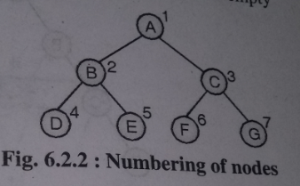

Array Representation
To represent a tree in one dimensional array nodes are marked sequentially from left to right start with root node.
First array location can be used to store no of nodes in a tree.

Slide 26
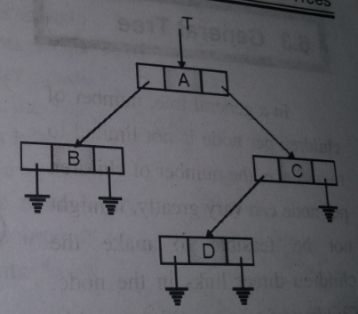
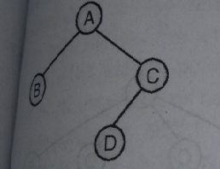
Linked Representation
This type of representation is more efficient as compared to array.
Left and right are pointer type fields left holds address of left child and right holds address of right child.

Slide 27
Binary Tree Types
Extended Binary Tree
Complete Binary Tree
Full Binary Tree
Skewed Binary Tree
Strictly Binary Tree
Expression Binary tree

Slide 28
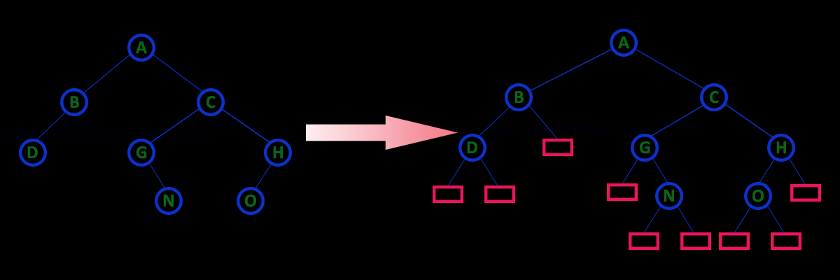
Extended Binary Tree
An extended binary tree is a transformation of any binary tree into a complete binary tree. This transformation consists of replacing every null subtree of the original tree with “special nodes” or “failure nodes” .The nodes from the original tree are then internal nodes, while the “special nodes” are external nodes.

Slide 29
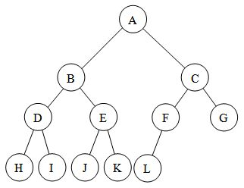
Complete Binary Tree
A complete binary tree is a tree in which
1.All leaf nodes are at n or n-1 level
2.Levels are filled from left to right

Slide 30
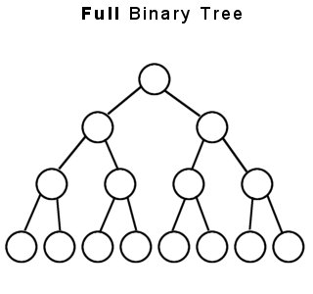
Full Binary Tree
A full binary tree (sometimes proper binary tree or 2-tree) is a tree in which every node other than the leaves has two children or no childeren. Every level is completely filled up.
No of nodes= 2^{h+1} -1

Slide 31
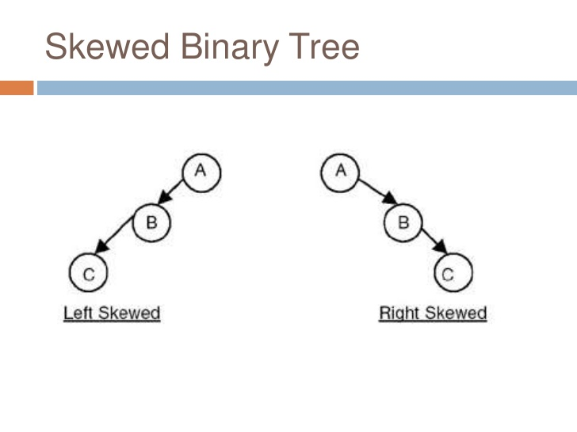
Skewed Binary Tree
A binary tree is said to be Skewed Binary Tree if every node in the tree contains either only left or only right sub tree. If the node contains only left sub tree then it is called left-skewed binary tree and if the tree contains only right sub tree then it is called right-skewed binary tree.

Slide 32
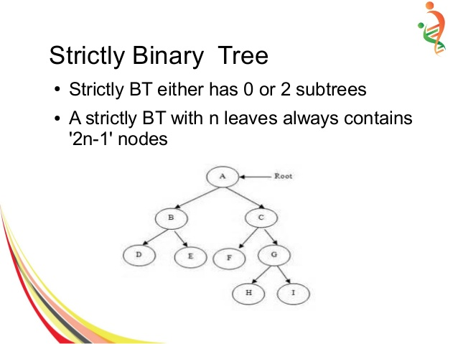
Strictly Binary Tree
A nod will have either two children or no child at all.

Slide 33
Expression Binary tree
Expression trees are a special kind of binary tree used to evaluate certain expressions.
Two common types of expressions that a binary expression tree can represent are algebraic and boolean.
These trees can represent expressions that contain both unary and binary operators.
The leaves of a binary expression tree are operands, such as constants or variable names, and the other nodes contain operators.
Expression tree are used in most compilers.

Slide 35
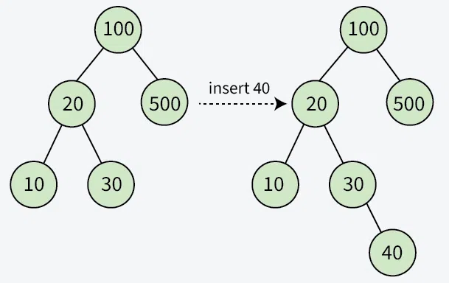
Insert a new node in Binary Search Tree
A new key is always inserted at the leaf by maintaining the property of the binary search tree. We start searching for a key from the root until we hit a leaf node. Once a leaf node is found, the new node is added as a child of the leaf node. The below steps are followed while we try to insert a node into a binary search tree:
Initilize the current node (say, currNode or node) with root node
Compare the key with the current node.
Move left if the key is less than or equal to the current node value.
Move right if the key is greater than current node value.
Repeat steps 2 and 3 until you reach a leaf node.
Attach the new key as a left or right child based on the comparison with the leaf node’s value.

Slide 36
Binary Tree Traversal
Tree Traversal refers to the process of visiting or accessing each node of the tree exactly once in a certain order. Tree traversal algorithms help us visit and process all the nodes of the tree. Since a tree is not a linear data structure, there can be multiple choices for the next node to be visited. Hence we have many ways to traverse a tree.
1. Preorder traversal:-In this traversal method first process root element, then left sub tree and then right sub tree.
Procedure:-
Step 1: Visit root node
Step 2: Visit left sub tree in preorder
Step 3: Visit right sub tree in preorder

Slide 37
Binary Tree Traversal
2. Inorder traversal:-
In this traversal method first process left element, then root element and then the right element.
Procedure:-
Step 1: Visit left sub tree in inorder
Step 2: Visit root node
Step 3: Visit right sub tree in inorder

Slide 38
Binary Tree Traversal
3. Postorder traversal:-
In this traversal first visit / process left sub tree, then right sub tree and then the root element.
Procedure:-
Step 1: Visit left sub tree in postorder
Step 2: Visit right sub tree in postorder
Step 3: Visit root node

Slide 39
Binary Search Tree
A binary search tree (BST) or "ordered binary tree" in which each node contains a key that satisfies following conditions:
    All keys are distinct.
    All elements in its left subtree are less to the node (<), and all the elements in its right subtree are greater than the node (>).

Slide 40
AVL Tree Data Structure
An AVL tree defined as a self-balancing Binary Search Tree(BST) where
the difference between heights of left and right subtrees for any node cannot
be more than one.The difference between the heights of the left subtree and the
right subtree for any node is known as the balance factor of the node.
The AVL tree is named after its inventors, Adelson, Velsky and Landis who
published it in their 1962 paper “An algorithm for the organization of information”.
https://www.tpointtech.com/avl-tree

Slide 41
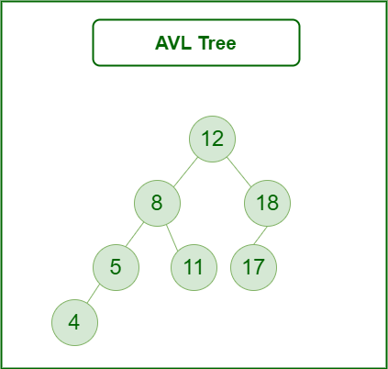
AVL Tree Data Structure
The above tree is AVL because the differences between the heights of left and right subtrees for every node are less than or equal to 1.

Slide 42
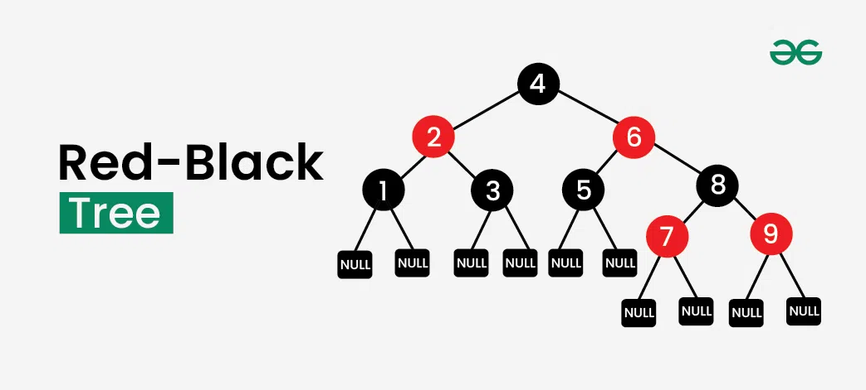
Red-Black Tree
A red-black tree is a self-balancing binary search tree in which
each node of the tree has an color, which can either be red or black.
Node Color: Each node is either red or black.
Root Property: The root of the tree is always black.
Red Property: Red nodes cannot have red children (no two consecutive red nodes on any path).
Black Property: Every path from a node to its descendant null nodes (leaves) has the same number of black nodes.
Leaf Property: All leaves (null nodes) are black.

