Slide 1
Chapter 22 Graphs and Applications

Slide 2
Objectives
To model real-world problems using graphs and explain the Seven Bridges of Königsberg problem (§22.1).
To describe the graph terminologies: vertices, edges, simple graphs, weighted/unweighted graphs, and directed/undirected graphs (§22.2).
To represent vertices and edges using lists, adjacent matrices, and adjacent lists (§22.3).
To model graphs using the Graph class (§22.4).
To display graphs visually (§22.5).
To represent the traversal of a graph using the Tree class (§22.6).
To design and implement depth-first search (§22.7).
To solve the connected-circle problem using depth-first search (§22.8).
To design and implement breadth-first search (§22.9).
To solve the nine-tail problem using breadth-first search (§22.10).

Slide 3
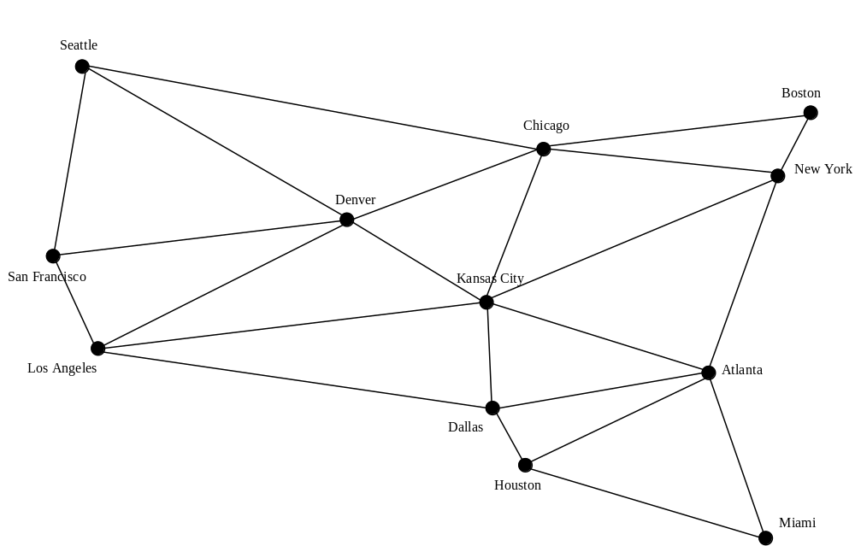
Modeling Using Graphs

Slide 4
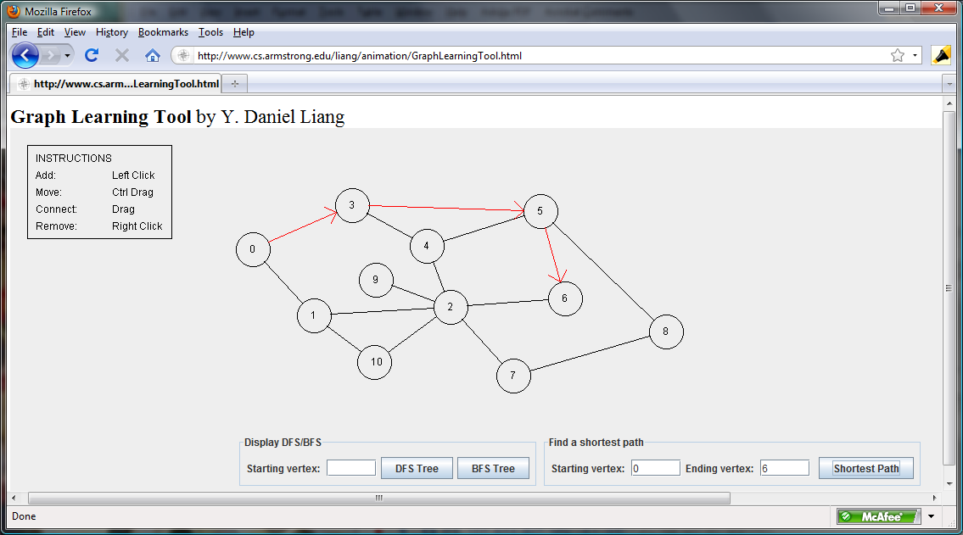
Graph Animation
https://liveexample.pearsoncmg.com/dsanimation/GraphLearningTooleBook.html

Slide 5
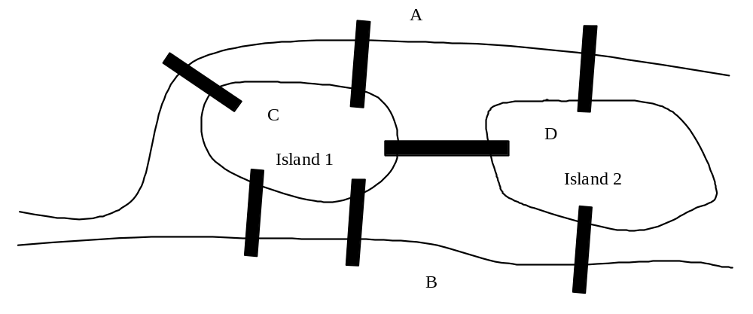
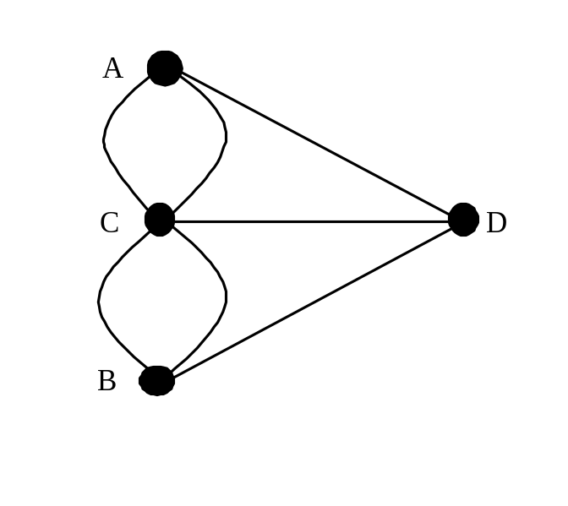
Seven Bridges of Königsberg

Slide 6
Basic Graph Terminologies
What is a graph?
Define a graph
Directed vs. undirected graphs
Weighted vs. unweighted graphs
Adjacent vertices
Incident
Degree
Neighbor
loop

Slide 7
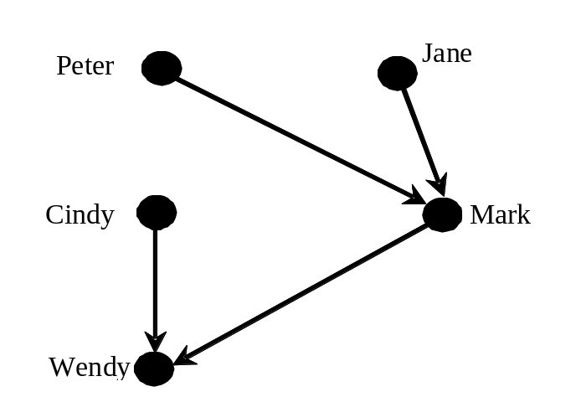
Directed vs Undirected Graph

Slide 8
Basic Graph Terminologies
Parallel edge
Simple graph
Complete graph
Spanning tree

Slide 9
Representing Graphs
Representing Vertices
Representing Edges: Edge Array
Representing Edges: Edge Objects
Representing Edges: Adjacency Matrices
Representing Edges: Adjacency Lists

Slide 10
Representing Vertices
V = ["Seattle", "San Francisco", "Los Angeles",
"Denver", "Kansas City", "Chicago", "Boston", "New York",
"Atlanta", "Miami", "Dallas", "Houston"]

Slide 11
Representing Edges: Edge List
edges = [
[0, 1], [0, 3], [0, 5],
[1, 0], [1, 2], [1, 3],
[2, 1], [2, 3], [2, 4], [2, 10],
[3, 0], [3, 1], [3, 2], [3, 4], [3, 5],
[4, 2], [4, 3], [4, 5], [4, 7], [4, 8], [4, 10],
[5, 0], [5, 3], [5, 4], [5, 6], [5, 7],
[6, 5], [6, 7],
[7, 4], [7, 5], [7, 6], [7, 8],
[8, 4], [8, 7], [8, 9], [8, 10], [8, 11],
[9, 8], [9, 11],
[10, 2], [10, 4], [10, 8], [10, 11],
[11, 8], [11, 9], [11, 10]
]

Slide 12
Representing Edges: Edge Object
class Edge:
def __init__(self, u, v):
self.u = u
self.v = v
edgeList = []
edgeList.append(Edge(0, 1))
edgeList.append(Edge(0, 3))
edgeList.append(Edge(0, 5))
...

Slide 13
Representing Edges: Adjacency Matrix
adjacencyMatrix = [
[0, 1, 0, 1, 0, 1, 0, 0, 0, 0, 0, 0], # Seattle
[1, 0, 1, 1, 0, 0, 0, 0, 0, 0, 0, 0], # San Francisco
[0, 1, 0, 1, 1, 1, 0, 0, 0, 0, 0, 0], # Los Angeles
[1, 1, 1, 0, 1, 1, 0, 0, 0, 0, 0, 0], # Denver
[0, 0, 1, 1, 0, 1, 0, 1, 1, 0, 1, 0], # Kansas City
[1, 0, 0, 1, 1, 0, 1, 1, 0, 0, 0, 0], # Chicago
[0, 0, 0, 0, 0, 1, 0, 1, 0, 0, 0, 0], # Boston
[0, 0, 0, 0, 1, 1, 1, 0, 1, 0, 0, 0], # New York
[0, 0, 0, 1, 1, 0, 0, 1, 0, 1, 1, 1], # Atlanta
[0, 0, 0, 0, 0, 0, 0, 0, 1, 0, 0, 1], # Miami
[0, 0, 1, 0, 1, 0, 0, 0, 1, 0, 0, 1], # Dallas
[0, 0, 0, 0, 0, 0, 0, 0, 1, 1, 1, 0] # Houston
]

Slide 14
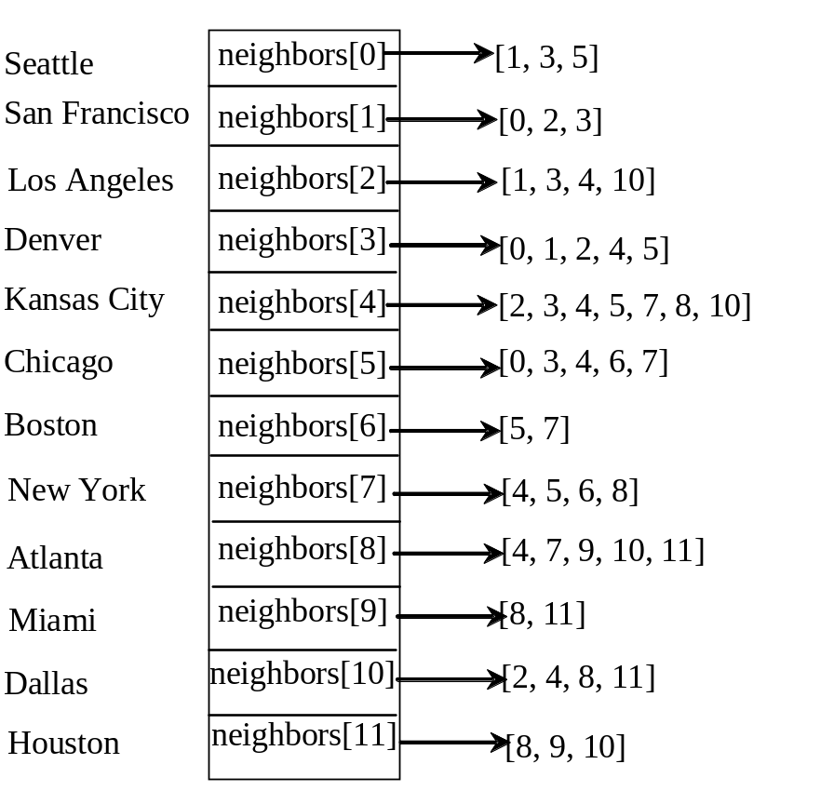
Representing Edges: Adjacency List
neighbors = [[1, 3, 5], [0, 2, 3], [1, 3, 4, 10], [0, 1, 2, 4, 5],
[2, 3, 4, 5, 7, 8, 10], [0, 3, 4, 6, 7], [5, 7],
[4, 5, 6, 8], [4, 7, 9, 10, 11], [8, 11],
[2, 4, 8, 11], [8, 9, 10]]

Slide 15
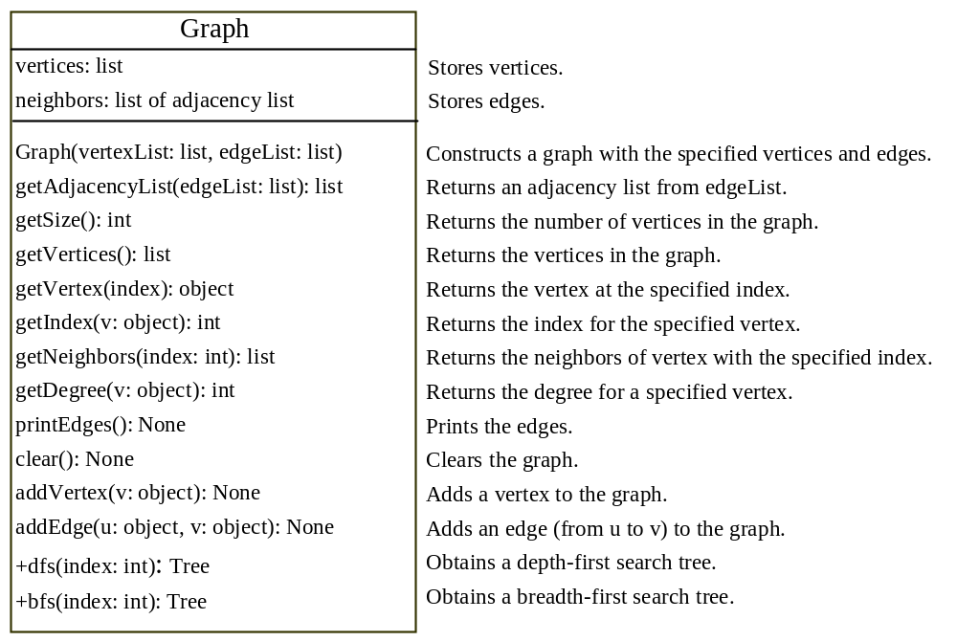
Modeling Graphs

Slide 16
Graph
TestGraph

Slide 17
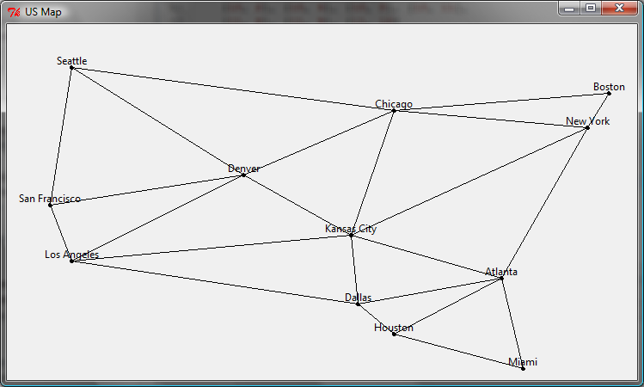
Graph Visualization
Displayable
Displayable
GraphView

Slide 18
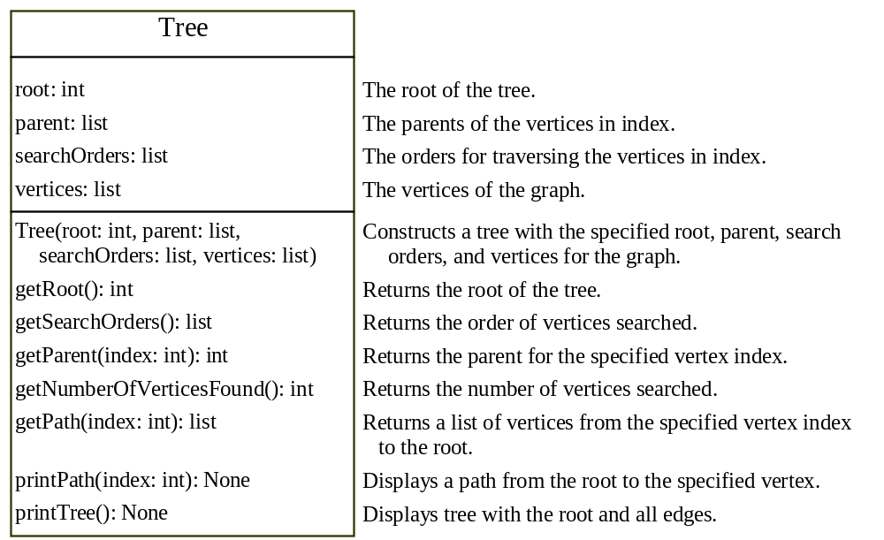
Graph Traversals
Depth-first search and breadth-first search
Both traversals result in a spanning tree, which can be modeled using a class.

Slide 19
Depth-First Search
The depth-first search of a graph is like the depth-first search of a tree discussed in §19.2.3, “Tree Traversal.” In the case of a tree, the search starts from the root. In a graph, the search can start from any vertex.
dfs(vertex v):
visit v
for each neighbor w of v:
if w has not been visited:
dfs(w)

Slide 20
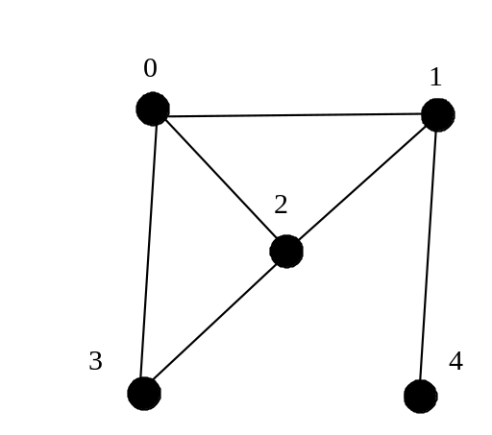
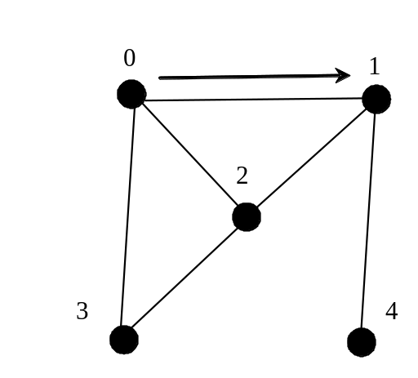
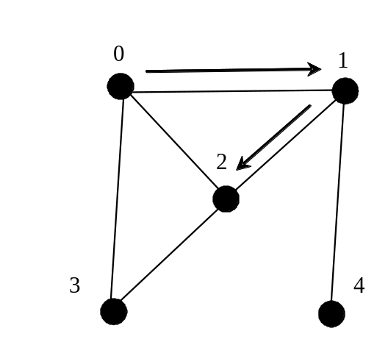
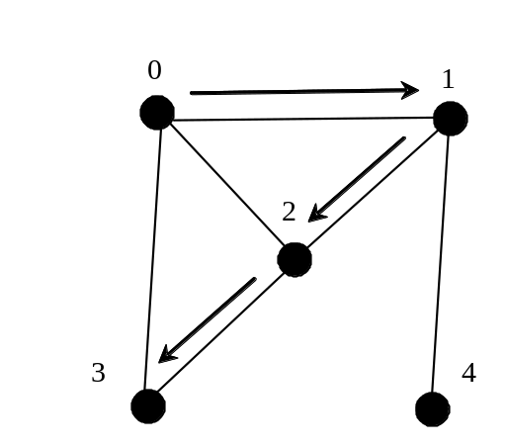
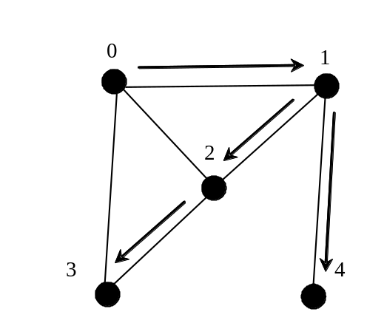
Depth-First Search Example

Slide 21
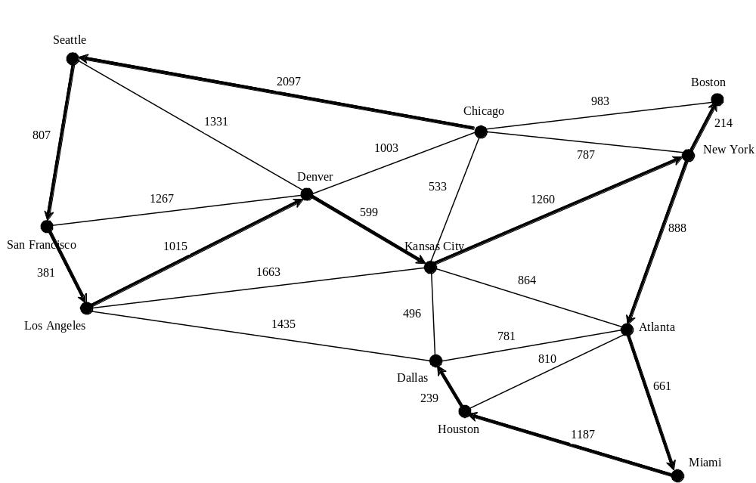
Depth-First Search Example
TestDFS

Slide 22
Applications of the DFS
Detecting whether a graph is connected. Search the graph starting from any vertex. If the number of vertices searched is the same as the number of vertices in the graph, the graph is connected. Otherwise, the graph is not connected (See Exercise 22.2.)
Detecting whether there is a path between two vertices. (See Exercise 22.3)
Finding a path between two vertices. (See Exercise 22.3)
Finding all connected components. A connected component is a maximal connected subgraph in which every pair of vertices are connected by a path. (See Exercise 22.2)
Detecting whether there is a cycle in the graph. (See Exercise 22.4)
Finding a cycle in the graph. (See Exercise 22.5)

Slide 23
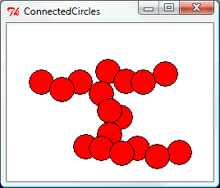
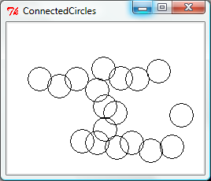
The Connected Circles Problem
ConnectedCircles

Slide 24
Breadth-First Search
The breadth-first traversal of a graph is like the breadth-first traversal of a tree discussed in §22.2.3, “Tree Traversal.” With breadth-first traversal of a tree, the nodes are visited level by level. First the root is visited, then all the children of the root, then the grandchildren of the root from left to right, and so on.

Slide 25
Breadth-First Search Algorithm
bfs(vertex v):
create an empty queue for storing vertices to be visited
add v into the queue
mark v visited
while the queue is not empty:
dequeue a vertex, say u, from the queue
add u into a list of traversed vertices
for each neighbor w of u
if w has not been visited:
add w into the queue
mark w visited

Slide 26
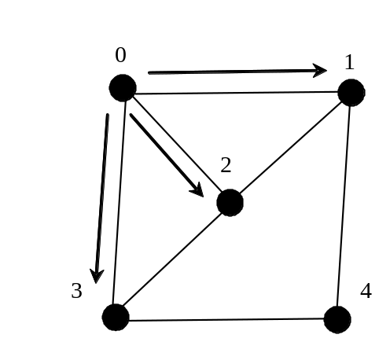
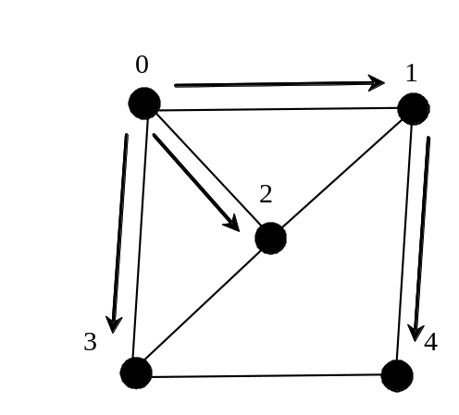
Breadth-First Search Example
Queue: 0
isVisited[0] = True
Queue: 1 2 3
isVisited[1] = True, isVisited[2] = True, isVisited[3] = True
Queue: 2 3 4
isVisited[4] = True

Slide 27
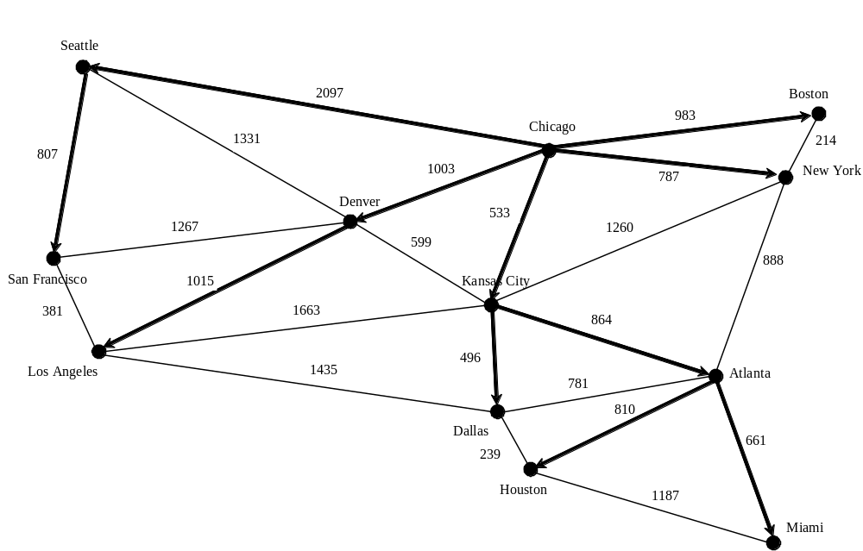
Breadth-First Search Example
TestBFS

Slide 28
Applications of the BFS
Detecting whether a graph is connected. A graph is connected if there is a path between any two vertices in the graph.
Detecting whether there is a path between two vertices.
Finding a shortest path between two vertices. You can prove that the path between the root and any node in the BFS tree is the shortest path between the root and the node (see Review Question 22.10).
Finding all connected components. A connected component is a maximal connected subgraph in which every pair of vertices are connected by a path.
Detecting whether there is a cycle in the graph. (See Exercise 22.4)
Finding a cycle in the graph. (See Exercise 22.5)
Testing whether a graph is bipartite. A graph is bipartite if the vertices of the graph can be divided into two disjoint sets such that no edges exist between vertices in the same set. (See Exercise 22.8)

Slide 29
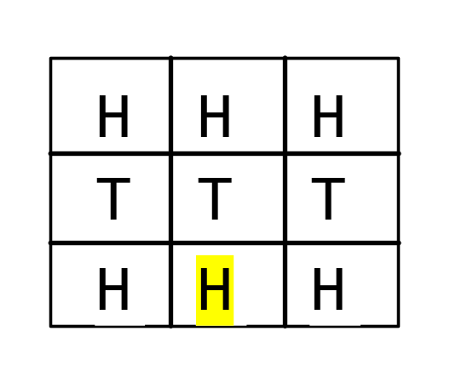
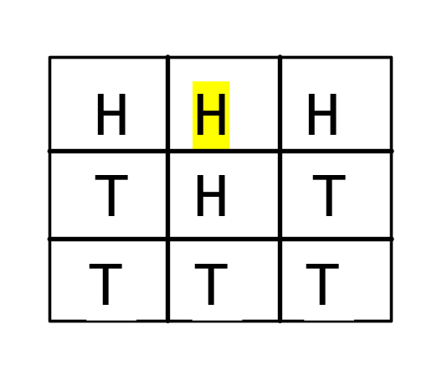
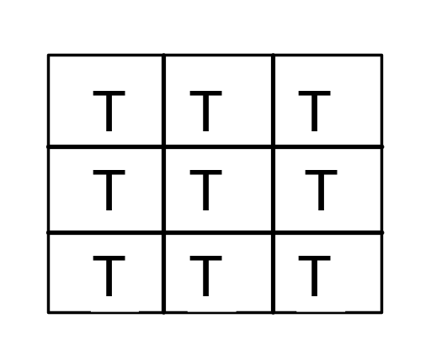
The Nine Tail Problem
The problem is stated as follows. Nine coins are placed in a three by three matrix with some face up and some face down. A legal move is to take any coin that is face up and reverse it, together with the coins adjacent to it (this does not include coins that are diagonally adjacent). Your task is to find the minimum number of the moves that lead to all coins face down.

Slide 30
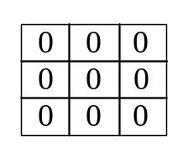
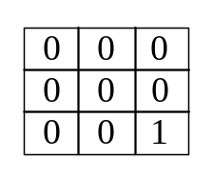
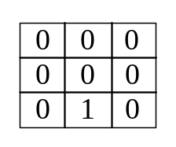
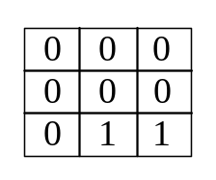

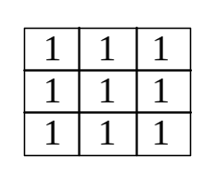
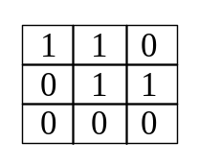
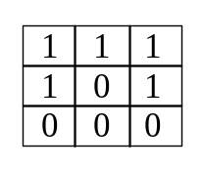
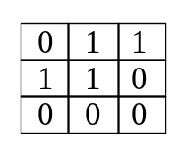
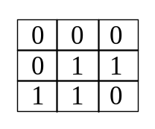
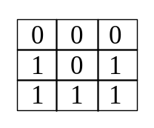
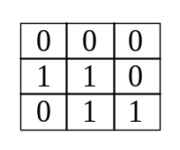
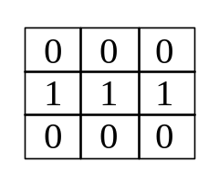
Model the Nine Tail Problem
0
1
2
3
511
408
488
240
30
47
51
56

Slide 31
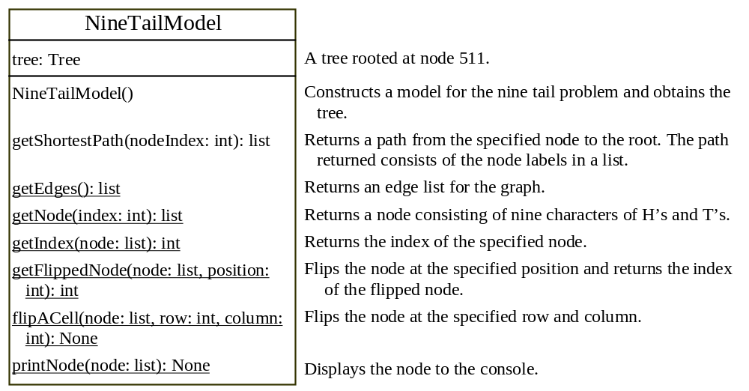
NineTailModel
NineTailModel
NineTail

