Slide 1
Chapter 14
Tuples, Sets, and Dictionaries

Slide 2
Motivations
The No Fly List is a list, created and maintained by the United States government's Terrorist Screening Center, of people who are not permitted to board a commercial aircraft for travel in or out of the United States. Suppose we need to write a program that checks whether a person is in the No Fly List. You can use a Python list to store the persons in the No Fly List. However, a more efficient data structure for this application is a set.

Slide 3
Objectives
To use tuples as immutable lists (§14.2).
To use sets for storing and fast accessing non-duplicate elements (§14.3).
To understand the performance differences between sets and lists (§14.4).
To store key/value pairs in a dictionary and access value using the key (§14.5).
To use dictionaries to develop applications (§14.6).

Slide 4
Tuples
Tuples are like lists except they are immutable. Once they are created, their contents cannot be changed.
If the contents of a list in your application do not change, you should use a tuple to prevent data from being modified accidentally. Furthermore, tuples are more efficient than lists.

Slide 5
Creating Tuples
t1 = () # Create an empty tuple
t2 = (1, 3, 5) # Create a set with three elements
# Create a tuple from a list
t3 = tuple([2 * x for x in range(1, 5)])
# Create a tuple from a string
t4 = tuple("abac") # t4 is ['a', 'b', 'a', 'c']

Slide 6
Tuples
Tuples can be used like lists except they are immutable.
TupleDemo

Slide 7
Sets
Sets are like lists to store a collection of items. Unlike lists, the elements in a set are unique and are not placed in any particular ordered. If your application does not care about the order of the elements, using a set to store elements is more efficient than using lists. The syntax for sets is braces {}.

Slide 8
Creating Sets
s1 = set() # Create an empty set
s2 = {1, 3, 5} # Create a set with three elements
s3 = set([1, 3, 5]) # Create a set from a tuple
# Create a set from a list
s4 = set([x * 2 for x in range(1, 10)])
# Create a set from a string
s5 = set("abac") # s5 is {'a', 'b', 'c'}

Slide 9
Manipulating and Accessing Sets
>>> s1 = {1, 2, 4}
>>> s1.add(6)
>>> s1
{1, 2, 4, 6}
>>> len(s1)
4
>>> max(s1)
6
>>> min(s1)
1
>>> sum(s1)
13
>>> 3 in s1
False
>>> s1.remove(4)
>>> s1
{1, 2, 6}
>>>

Slide 10
Subset and Superset
>>> s1 = {1, 2, 4}
>>> s2 = {1, 4, 5, 2, 6}
>>> s1.issubset(s2) # s1 is a subset of s2
True
>>>
>>> s1 = {1, 2, 4}
>>> s2 = {1, 4, 5, 2, 6}
>>> s2.issuperset(s1) # s2 is a superset of s1
True
>>>

Slide 11
Equality Test
>>> s1 = {1, 2, 4}
>>> s2 = {1, 4, 2}
>>> s1 == s2
True
>>> s1 != s2
False
>>>

Slide 12
Comparison Operators
Note that it makes no sense to compare the sets using the conventional comparison operators (>, >=, <=, <), because the elements in a set are not ordered. However, these operators have special meaning when used for sets.
s1 > s2 returns true is s1 is a proper superset of s2.
s1 >= s2 returns true is s1 is a superset of s2.
s1 < s2 returns true is s1 is a proper subset of s2.
s1 <= s2 returns true is s1 is a subset of s2.

Slide 13
Set Operations (union, |)
>>> s1 = {1, 2, 4}
>>> s2 = {1, 3, 5}
>>> s1.union(s2)
{1, 2, 3, 4, 5}
>>>
>>> s1 | s2
{1, 2, 3, 4, 5}
>>>

Slide 14
Set Operations (intersection, &)
>>> s1 = {1, 2, 4}
>>> s2 = {1, 3, 5}
>>> s1.intersection(s2)
{1}
>>>
>>> s1 & s2
{1}
>>>

Slide 15
Set Operations (difference, -)
>>> s1 = {1, 2, 4}
>>> s2 = {1, 3, 5}
>>> s1.difference(s2)
{2, 4}
>>>
>>> s1 - s2
{2, 4}
>>>

Slide 16
Set Operations (symetric_difference, ^)
>>> s1 = {1, 2, 4}
>>> s2 = {1, 3, 5}
>>> s1.symmetric_difference(s2)
{2, 3, 4, 5}
>>>
>>> s1 ^ s2
{2, 3, 4, 5}
>>>

Slide 17
Sets
SetDemo

Slide 18
Comparing Performance of Sets and Lists
SetListPerformanceTest

Slide 19
Dictionary
Why dictionary?
Suppose your program stores a million students and frequently searches for a student using the social security number. An efficient data structure for this task is the dictionary. A dictionary is a collection that stores the elements along with the keys. The keys are like an indexer.

Slide 20
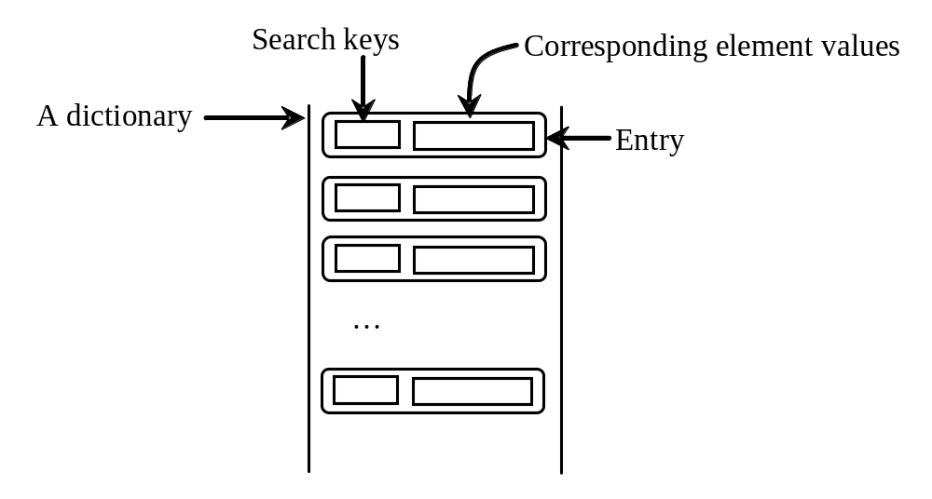
Key/value pairs

Slide 21
Creating a Dictionary
dictionary = {} # Create an empty dictionary
dictionary = {"john":40, "peter":45} # Create a dictionary

Slide 22
Adding/Modifying Entries
To add an entry to a dictionary, use
dictionary[key] = value
For example,
dictionary["susan"] = 50

Slide 23
Deleting Entries
To delete an entry from a dictionary, use
del dictionary[key]
For example,
del dictionary["susan"]

Slide 24
Looping Entries
for key in dictionary:
print(key + ":" + str(dictionary[key]))

Slide 25
The len and in operators
len(dictionary) returns the number of the elements in the dictionary.
>>> dictionary = {"john":40, "peter":45}
>>> "john" in dictionary
True
>>> "johnson" in dictionary
False

Slide 26
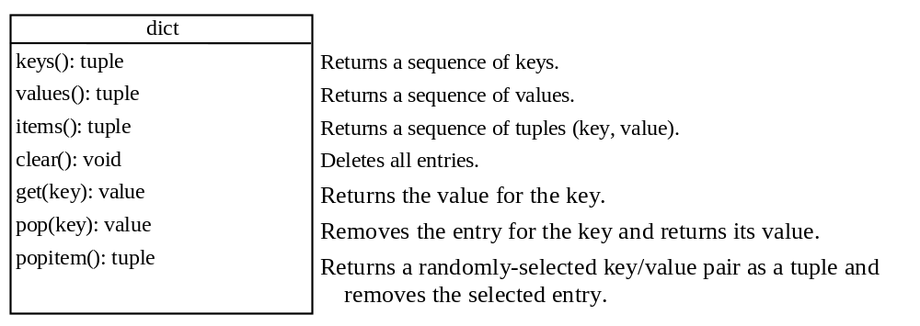
The Dictionary Methods

Slide 27
Case Studies: Occurrences of Words
This case study writes a program that counts the occurrences of words in a text file and displays the words and their occurrences in alphabetical order of words. The program uses a dictionary to store an entry consisting of a word and its count. For each word, check whether it is already a key in the dictionary. If not, add to the dictionary an entry with the word as the key and value 1. Otherwise, increase the value for the word (key) by 1 in the dictionary.
CountOccurrenceOfWords

