Slide 1
Sorting
Sorting is a process that organizes a collection of data into either ascending or descending order.
An internal sort requires that the collection of data fit entirely in the computer’s main memory.
We can use an external sort when the collection of data cannot fit in the computer’s main memory all at once but must reside in secondary storage such as on a disk.
We will analyze only internal sorting algorithms.
Any significant amount of computer output is generally arranged in some sorted order so that it can be interpreted.
Sorting also has indirect uses. An initial sort of the data can significantly enhance the performance of an algorithm.
Majority of programming projects use a sort somewhere, and in many cases, the sorting cost determines the running time.
A comparison-based sorting algorithm makes ordering decisions only on the basis of comparisons.

Slide 2
Sorting Algorithms
There are many sorting algorithms, such as:
  Selection Sort
  Insertion Sort
  Bubble Sort
  Merge Sort
  Quick Sort
The first three are the foundations for faster and more efficient algorithms.

Slide 3
Selection Sort
The list is divided into two sublists, sorted and unsorted, which are divided by an imaginary wall.
We find the smallest element from the unsorted sublist and swap it with the element at the beginning of the unsorted data.
After each selection and swapping, the imaginary wall between the two sublists move one element ahead, increasing the number of sorted elements and decreasing the number of unsorted ones.
Each time we move one element from the unsorted sublist to the sorted sublist, we say that we have completed a sort pass.
A list of n elements requires n-1 passes to completely rearrange the data.

Slide 4
Sorted
Unsorted
23 | 78 | 45 | 8 | 32 | 56
8 | 78 | 45 | 23 | 32 | 56
8 | 23 | 45 | 78 | 32 | 56
8 | 23 | 32 | 78 | 45 | 56
8 | 23 | 32 | 45 | 78 | 56
8 | 23 | 32 | 45 | 56 | 78
Original List
After pass 1
After pass 2
After pass 3
After pass 4
After pass 5

Slide 5
Selection Sort -- Analysis
In general, we compare keys and move items (or exchange items) in a sorting algorithm (which uses key comparisons).
➔ So, to analyze a sorting algorithm we should count the number of key comparisons and the number of moves.
    Ignoring other operations does not affect our final result.
In selectionSort function, the outer for loop executes n-1 times.
We invoke swap function once at each iteration.
➔ Total Swaps: n-1
➔ Total Moves: 3*(n-1) (Each swap has three moves)

Slide 6
Selection Sort – Analysis (cont.)
The inner for loop executes the size of the unsorted part minus 1 (from 1 to n-1), and in each iteration we make one key comparison.
➔ # of key comparisons = 1+2+...+n-1 = n*(n-1)/2
➔ So, Selection sort is O(n²)
The best case, the worst case, and the average case of the selection sort algorithm are same. ➔ all of them are O(n²)
  This means that the behavior of the selection sort algorithm does not depend on the initial organization of data.
  Since O(n²) grows so rapidly, the selection sort algorithm is appropriate only for small n.
  Although the selection sort algorithm requires O(n²) key comparisons, it only requires O(n) moves.
  A selection sort could be a good choice if data moves are costly but key comparisons are not costly (short keys, long records).

Slide 7
Comparison of N, logN and N²
N O(LogN) O(N²)
16 4 256
64 6 4K
256 8 64K
1,024 10 1M
16,384 14 256M
131,072 17 16G
262,144 18 6.87E+10
524,288 19 2.74E+11
1,048,576 20 1.09E+12
1,073,741,824 30 1.15E+18

Slide 8
Insertion Sort
Insertion sort is a simple sorting algorithm that is appropriate for small inputs.
  Most common sorting technique used by card players.
The list is divided into two parts: sorted and unsorted.
In each pass, the first element of the unsorted part is picked up, transferred to the sorted sublist, and inserted at the appropriate place.
A list of n elements will take at most n-1 passes to sort the data.

Slide 9
Sorted
Unsorted
23 | 78 | 45 | 8 | 32 | 56
23 | 78 | 45 | 8 | 32 | 56
23 | 45 | 78 | 8 | 32 | 56
8 | 23 | 45 | 78 | 32 | 56
8 | 23 | 32 | 45 | 78 | 56
8 | 23 | 32 | 45 | 56 | 78
Original List
After pass 1
After pass 2
After pass 3
After pass 4
After pass 5

Slide 10
Insertion Sort – Analysis
Running time depends on not only the size of the array but also the contents of the array.
Best-case: ➔ O(n)
  Array is already sorted in ascending order.
  Inner loop will not be executed.
  The number of moves: 2*(n-1) ➔ O(n)
  The number of key comparisons: (n-1) ➔ O(n)
Worst-case: ➔ O(n²)
  Array is in reverse order:
  Inner loop is executed i-1 times, for i = 2,3, …, n
  The number of moves: 2*(n-1)+(1+2+...+n-1)= 2*(n-1)+ n*(n-1)/2 ➔ O(n²)
  The number of key comparisons: (1+2+...+n-1)= n*(n-1)/2 ➔ O(n²)
Average-case: ➔ O(n²)
  We have to look at all possible initial data organizations.
So, Insertion Sort is O(n²)

Slide 11
Analysis of insertion sort
Which running time will be used to characterize this algorithm?
  Best, worst or average?
Worst:
  Longest running time (this is the upper limit for the algorithm)
  It is guaranteed that the algorithm will not be worse than this.
Sometimes we are interested in average case. But there are some problems with the average case.
  It is difficult to figure out the average case. i.e. what is average input?
  Are we going to assume all possible inputs are equally likely?
  In fact for most algorithms average case is same as the worst case.

Slide 12
Bubble Sort
The list is divided into two sublists: sorted and unsorted.
The smallest element is bubbled from the unsorted list and moved to the sorted sublist.
After that, the wall moves one element ahead, increasing the number of sorted elements and decreasing the number of unsorted ones.
Each time an element moves from the unsorted part to the sorted part one sort pass is completed.
Given a list of n elements, bubble sort requires up to n-1 passes to sort the data.

Slide 13
Bubble Sort
23 | 78 | 45 | 8 | 32 | 56
8 | 23 | 78 | 45 | 32 | 56
8 | 23 | 32 | 78 | 45 | 56
8 | 23 | 32 | 45 | 78 | 56
8 | 23 | 32 | 45 | 56 | 78
Original List
After pass 1
After pass 2
After pass 3
After pass 4

Slide 14
Bubble Sort – Analysis
Best-case: ➔ O(n)
  Array is already sorted in ascending order.
  The number of moves: 0 ➔ O(1)
  The number of key comparisons: (n-1) ➔ O(n)
Worst-case: ➔ O(n²)
  Array is in reverse order:
  Outer loop is executed n-1 times,
  The number of moves: 3*(1+2+...+n-1) = 3 * n*(n-1)/2 ➔ O(n²)
  The number of key comparisons: (1+2+...+n-1)= n*(n-1)/2 ➔ O(n²)
Average-case: ➔ O(n²)
  We have to look at all possible initial data organizations.
So, Bubble Sort is O(n²)

Slide 15
Mergesort
Mergesort algorithm is one of two important divide-and-conquer sorting algorithms (the other one is quicksort).
It is a recursive algorithm.
  Divides the list into halves,
  Sort each halve separately, and
  Then merge the sorted halves into one sorted array.

Slide 16
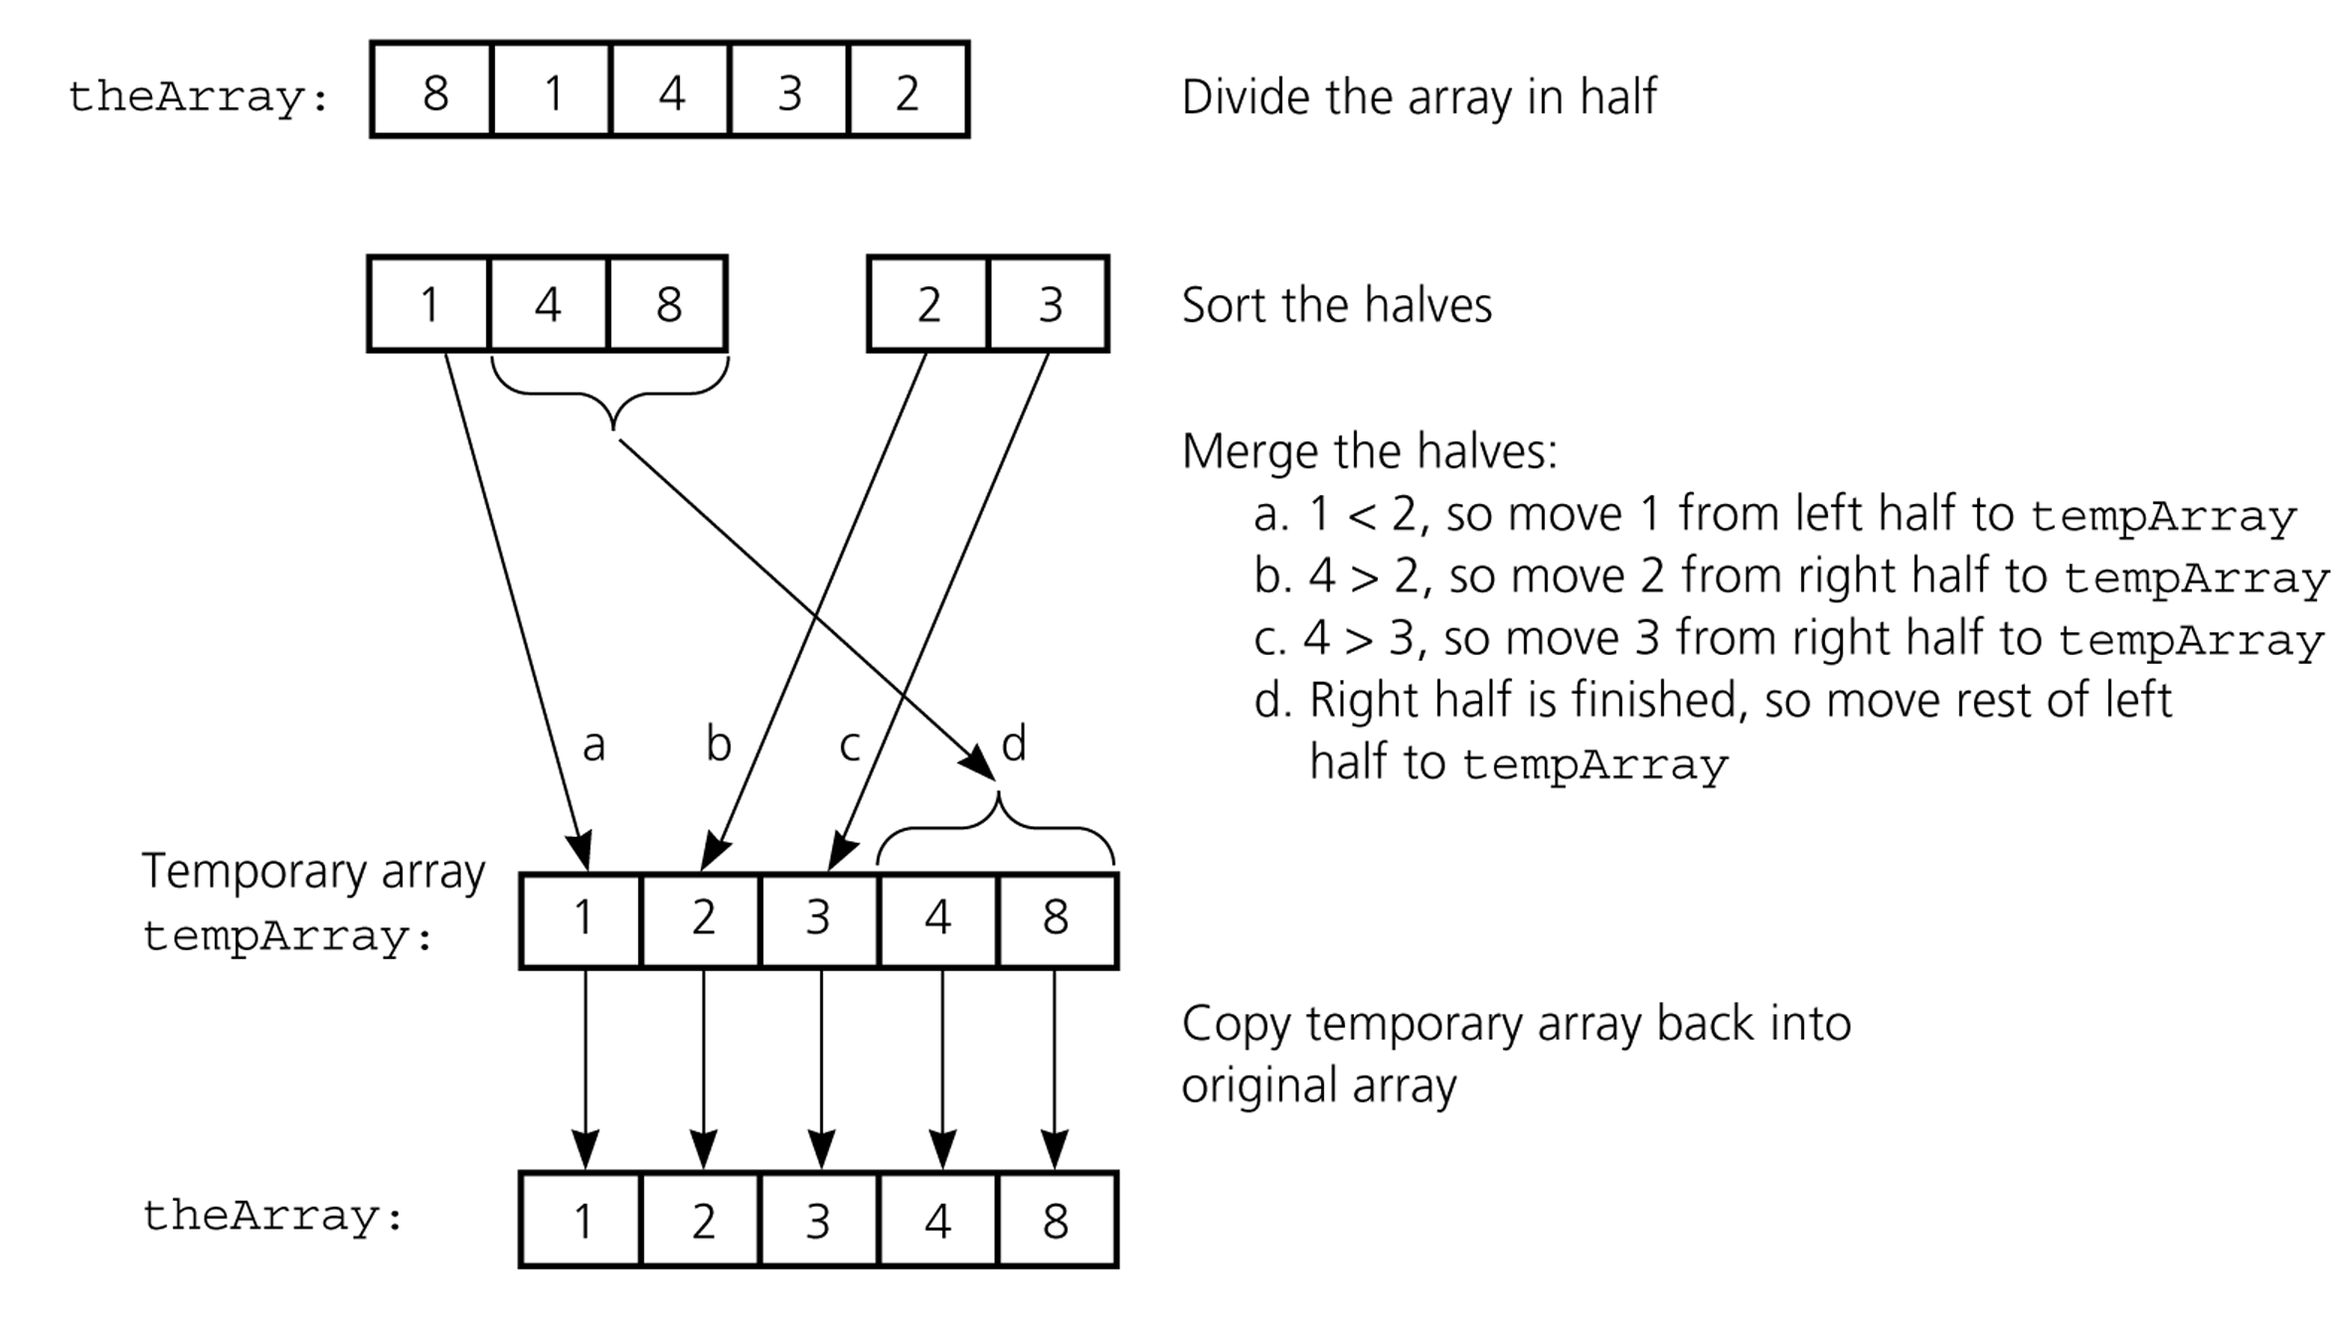
Mergesort - Example

Slide 17
Mergesort – Analysis
Mergesort is extremely efficient algorithm with respect to time.
  Both worst case and average cases are O (n * log₂n )
But, mergesort requires an extra array whose size equals to the size of the original array.
If we use a linked list, we do not need an extra array
  But, we need space for the links
  And, it will be difficult to divide the list into half ( O(n) )

Slide 18
Quicksort
Like mergesort, Quicksort is also based on
the divide-and-conquer paradigm.
But it uses this technique in a somewhat opposite manner,
as all the hard work is done before the recursive calls.
It works as follows:
  First, it partitions an array into two parts,
  Then, it sorts the parts independently,
  Finally, it combines the sorted subsequences by
  a simple concatenation.

Slide 19
Quicksort (cont.)
The quick-sort algorithm consists of the following three steps:
1. Divide: Partition the list.
  To partition the list, we first choose some element from the list for which we hope about half the elements will come before and half after. Call this element the pivot.
  Then we partition the elements so that all those with values less than the pivot come in one sublist and all those with greater values come in another.
2. Recursion: Recursively sort the sublists separately.
3. Conquer: Put the sorted sublists together.

Slide 20
Quick Sort Algorithm: Steps on how it works:
Find a “pivot” item in the array. This item is the basis for comparison for a single round.
Start a pointer (the left pointer) at the first item in the array.
Start a pointer (the right pointer) at the last item in the array.
While the value at the left pointer in the array is less than the pivot value, move the left pointer to the right (add 1). Continue until the value at the left pointer is greater than or equal to the pivot value.
While the value at the right pointer in the array is greater than the pivot value, move the right pointer to the left (subtract 1). Continue until the value at the right pointer is less than or equal to the pivot value.
If the left pointer is less than or equal to the right pointer, then swap the values at these locations in the array.
Move the left pointer to the right by one and the right pointer to the left by one.

Slide 21
Partition – Choosing the pivot
First, we have to select a pivot element among the elements of the given array, and we put this pivot into the first location of the array before partitioning.
Which array item should be selected as pivot?
  Somehow we have to select a pivot, and we hope that we will get a good partitioning.
  If the items in the array arranged randomly, we choose a pivot randomly.
  We can choose the first or last element as a pivot (it may not give a good partitioning).
  We can use different techniques to select the pivot.

Slide 22
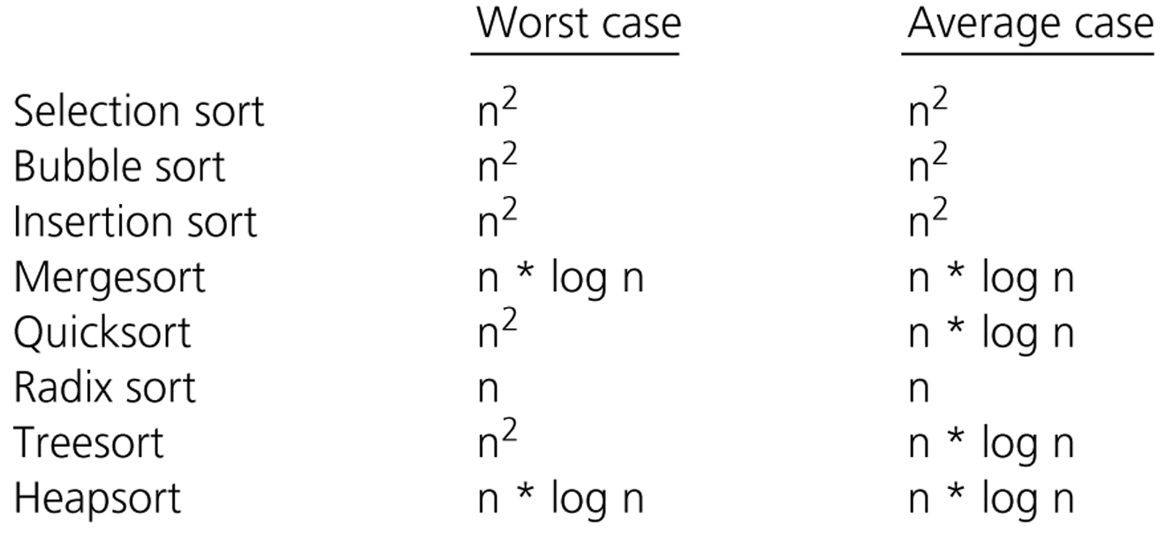
Comparison of Sorting Algorithms

