Slide 1
Chapter 18 Linked Lists, Stacks, Queues, and Priority Queues

Slide 2
Objectives
To design and implement linked lists (§18.2).
To explore variations of linked lists (§18.2).
To define and create iterators for traversing elements in a container (§18.3).
To generate iterators using generators (§18.4).
To design and implement stacks (§18.5).
To design and implement queues (§18.6).
To design and implement priority queues (§18.7).

Slide 3
What is a Data Structure?
A data structure is a collection of data organized in some fashion. A data structure not only stores data, but also supports the operations for manipulating data in the structure. For example, an array is a data structure that holds a collection of data in sequential order. You can find the size of the array, store, retrieve, and modify data in the array.
Array is simple and easy to use, but it has two limitations:

Slide 4
Limitations of arrays
Once an array is created, its size cannot be altered.
Array provides inadequate support for inserting, deleting, sorting, and searching operations.

Slide 5
Object-Oriented Data Structure
In object-oriented thinking, a data structure is an object that stores other objects, referred to as data or elements. So some people refer a data structure as a container object or a collection object. To define a data structure is essentially to declare a class. The class for a data structure should use data fields to store data and provide methods to support operations such as insertion and deletion. To create a data structure is therefore to create an instance from the class. You can then apply the methods on the instance to manipulate the data structure such as inserting an element to the data structure or deleting an element from the data structure.

Slide 6
Four Classic Data Structures
Four classic dynamic data structures to be introduced in this chapter are lists, stacks, queues, and priority queues. A list is a collection of data stored sequentially. It supports insertion and deletion anywhere in the list. A stack can be perceived as a special type of the list where insertions and deletions take place only at the one end, referred to as the top of a stack. A queue represents a waiting list, where insertions take place at the back (also referred to as the tail of) of a queue and deletions take place from the front (also referred to as the head of) of a queue. In a priority queue, elements are assigned with priorities. When accessing elements, the element with the highest priority is removed first.

Slide 7
Lists
A list is a popular data structure to store data in sequential order. For example, a list of students, a list of available rooms, a list of cities, and a list of books, etc. can be stored using lists. The common operations on a list are usually the following:
· Retrieve an element from this list.
· Insert a new element to this list.
· Delete an element from this list.
· Find how many elements are in this list.
· Find if an element is in this list.
· Find if this list is empty.

Slide 8
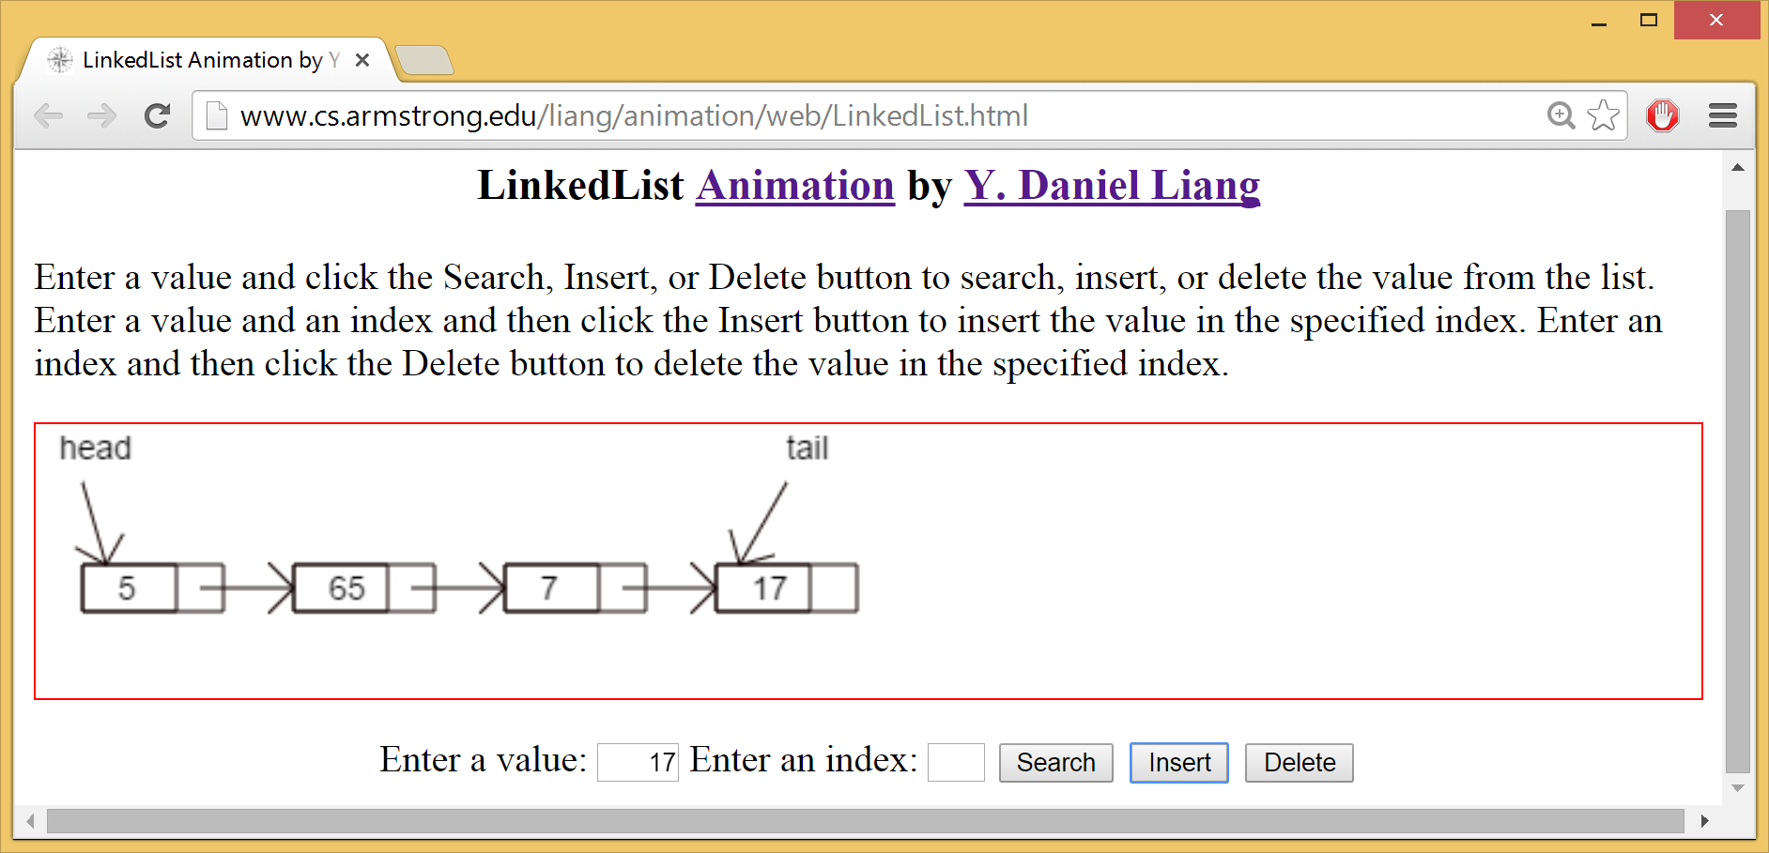
Linked List Animation
https://liveexample.pearsoncmg.com/dsanimation/LinkedListeBook.html

Slide 9
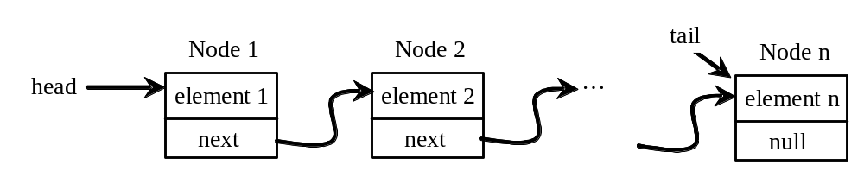
Nodes in Linked Lists
A linked list consists of nodes. Each node contains an element, and each node is linked to its next neighbor. Thus a node can be defined as a class, as follows:
class Node:
def __init__(self, element):
self.elmenet = element
self.next = None

Slide 10
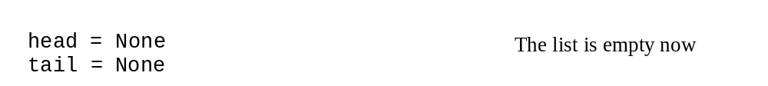
Adding Three Nodes
The variable head refers to the first node in the list, and the variable tail refers to the last node in the list. If the list is empty, both are None. For example, you can create three nodes to store three strings in a list, as follows:
Step 1: Declare head and tail:

Slide 11
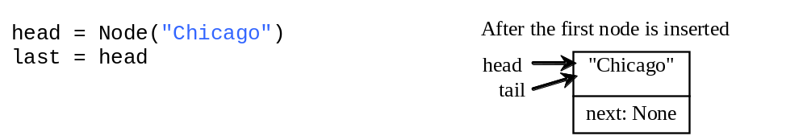
Adding Three Nodes, cont.
Step 2: Create the first node and insert it to the list:

Slide 12
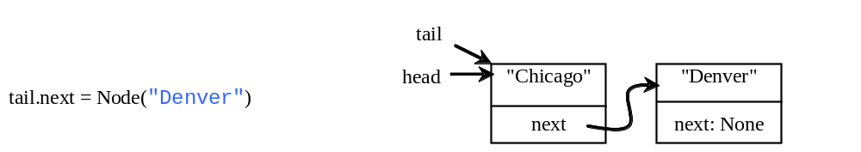
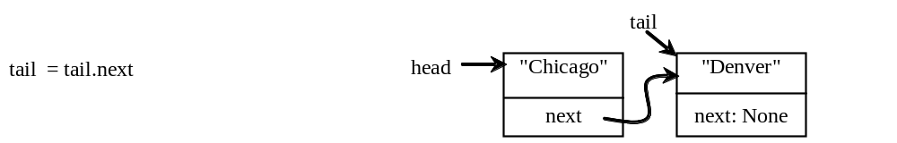
Adding Three Nodes, cont.
Step 3: Create the second node and insert it to the list:

Slide 13
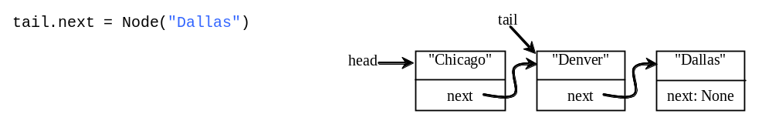
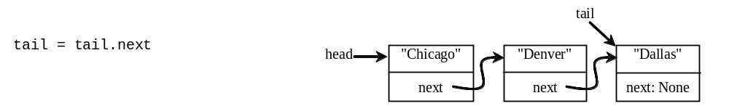
Adding Three Nodes, cont.
Step 4: Create the third node and insert it to the list:

Slide 14
Traversing All Elements in the List
Each node contains the element and a data field named next that points to the next element. If the node is the last in the list, its pointer data field next contains the value None. You can use this property to detect the last node. For example, you may write the following loop to traverse all the nodes in the list.
current = head
while current != None:
print(current.element)
current = current.next

Slide 15
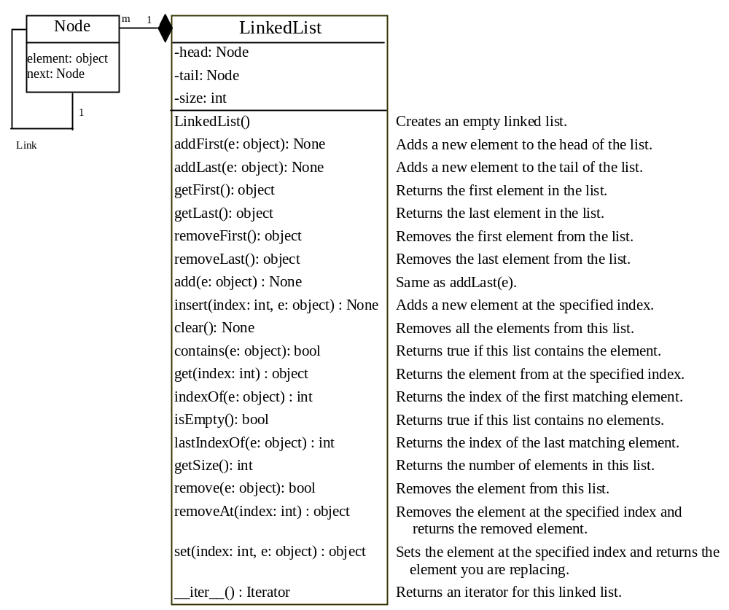
LinkedList
LinkedList
TestLinkedList

Slide 16
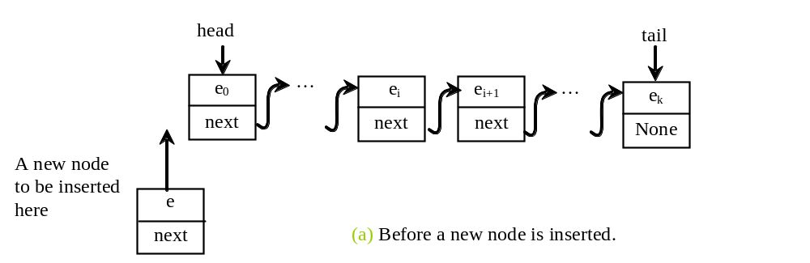
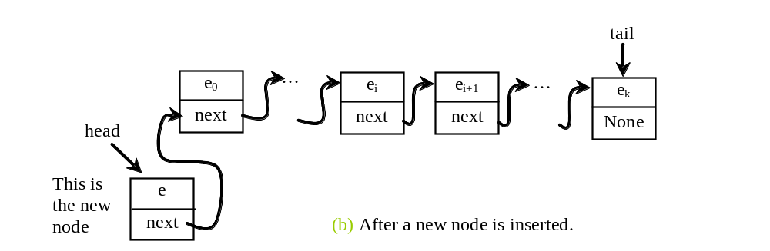
Implementing addFirst(e)
def addFirst(self, e):
newNode = Node(e) # Create a new node
newNode.next = self.__head # link the new node with the head
self.__head = newNode # head points to the new node
self.__size += 1 # Increase list size
if self.__tail == None: # the new node is the only node in list
self.__tail = self.__head

Slide 17
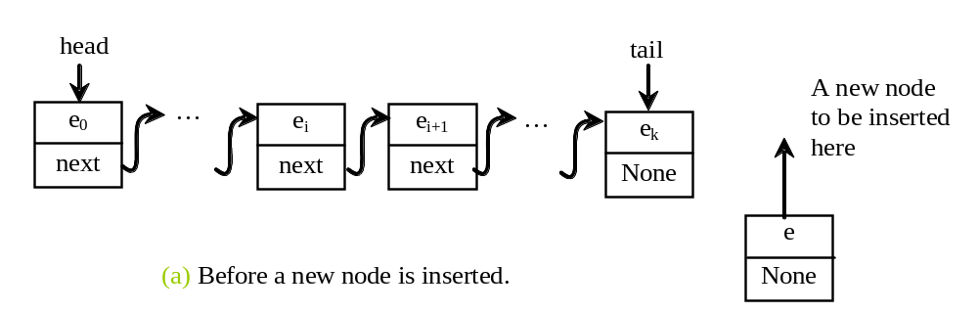
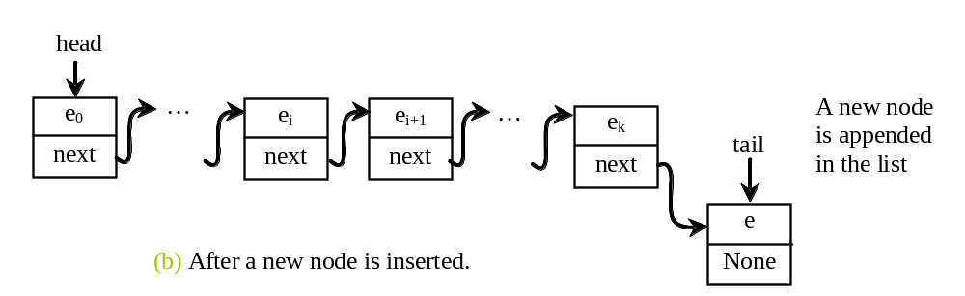
Implementing addLast(e)
def addLast(self, e):
newNode = Node(e) # Create a new node for e
if self.__tail == None:
self.__head = self.__tail = newNode # The only node in list
else:
self.__tail.next = newNode # Link the new with the last node
self.__tail = self.__tail.next # tail now points to the last node
self.__size += 1 # Increase size

Slide 18
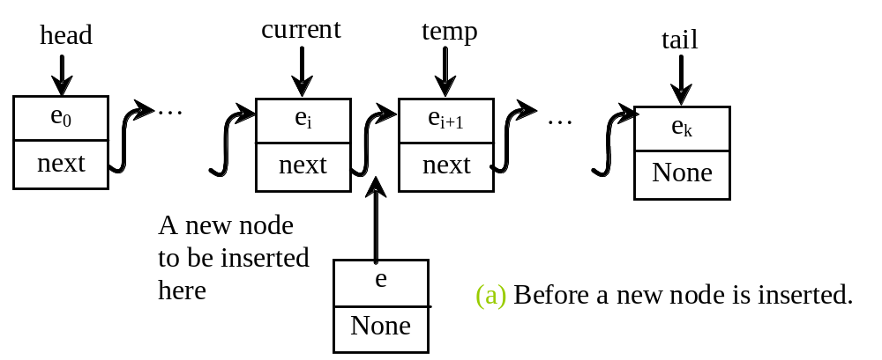
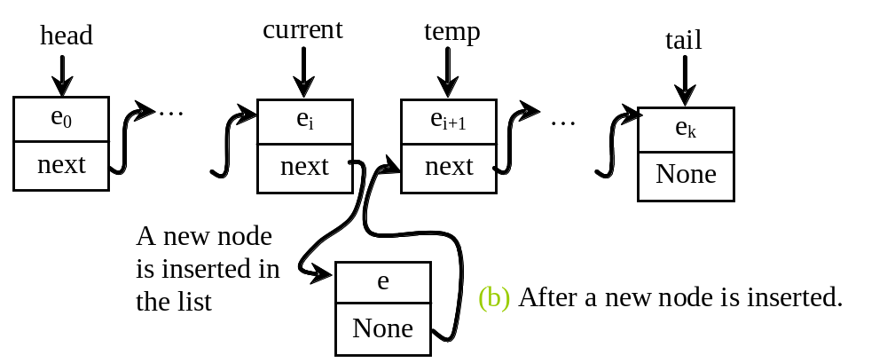
Implementing add(index, e)
def insert(self, index, e):
if index == 0:
self.addFirst(e) # Insert first
elif index >= size:
self.addLast(e) # Insert last
else: # Insert in the middle
current = head
for i in range(1, index):
current = current.next
temp = current.next
current.next = Node(e)
(current.next).next = temp
self.__size += 1

Slide 19
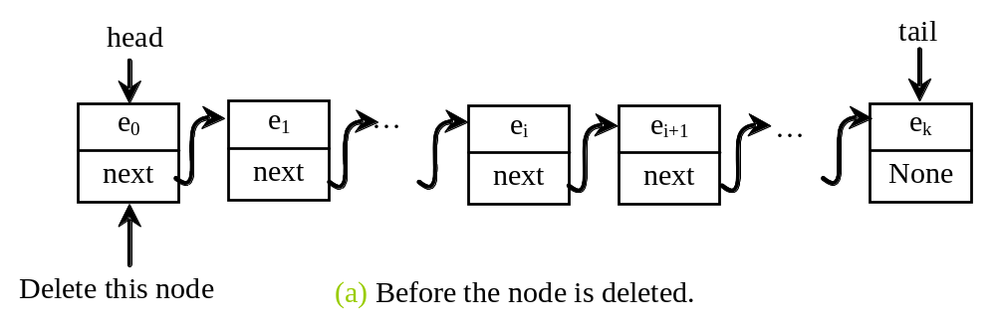
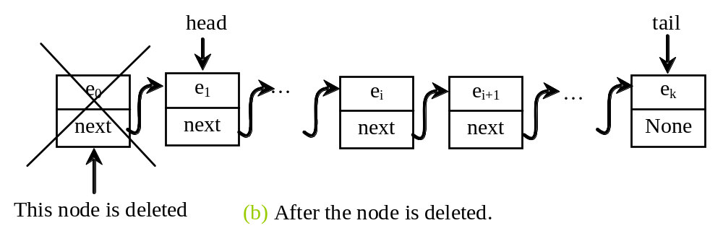
Implementing removeFirst()
def removeFirst(self):
if self.__size == 0:
return None
else:
temp = self.__head
self.__head =
self.__head.next self.__size -= 1
if self.__head == None:
self.__tail = None return temp.element

Slide 20
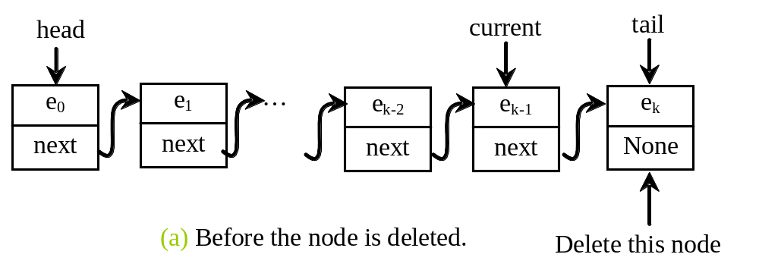
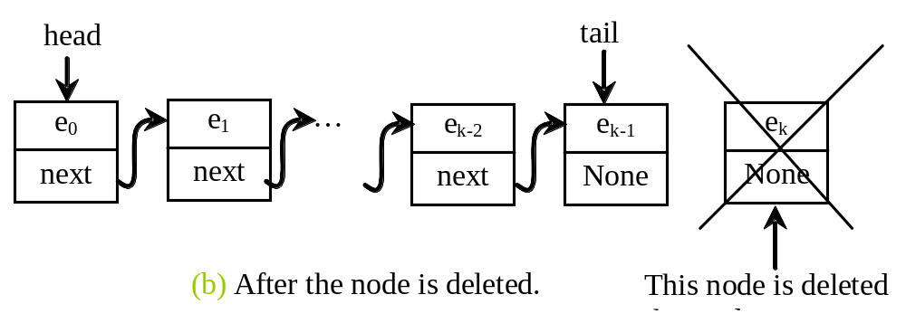
Implementing removeLast()
def removeLast(self):
if self.__size == 0:
return None
elif self.__size == 1:
temp = self.__head
self.__head = self.__tail = None
self.__size = 0
return temp.element
else:
current = self.__head
for i in range(self.__size - 2):
current = current.next
temp = self.__tail
self.__tail = current
self.__tail.next = None
self.__size -= 1
return temp.element

Slide 21
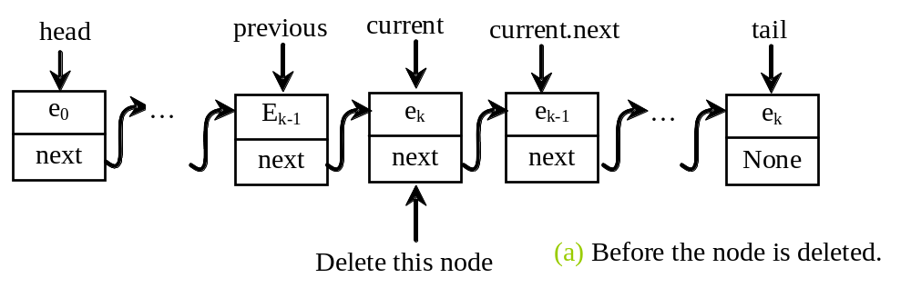
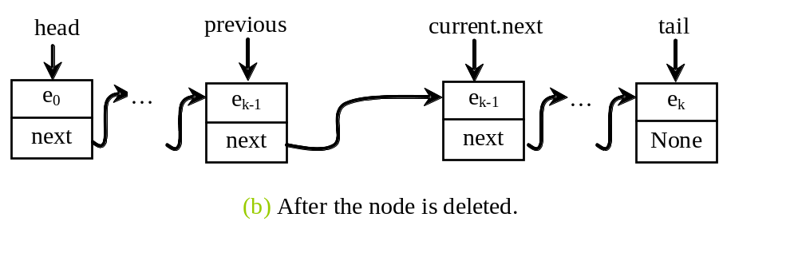
Implementing removeAt(index)
def removeAt(self, index):
if index < 0 or index >= self.__size:
return None # Out of range
elif index == 0:
return self.removeFirst() # Remove first
elif index == self.__size - 1:
return self.removeLast() # Remove last
else:
previous = self.__head
for i in range(1, index):
previous = previous.next
current = previous.next
previous.next = current.next
self.__size -= 1
return current.element

Slide 22
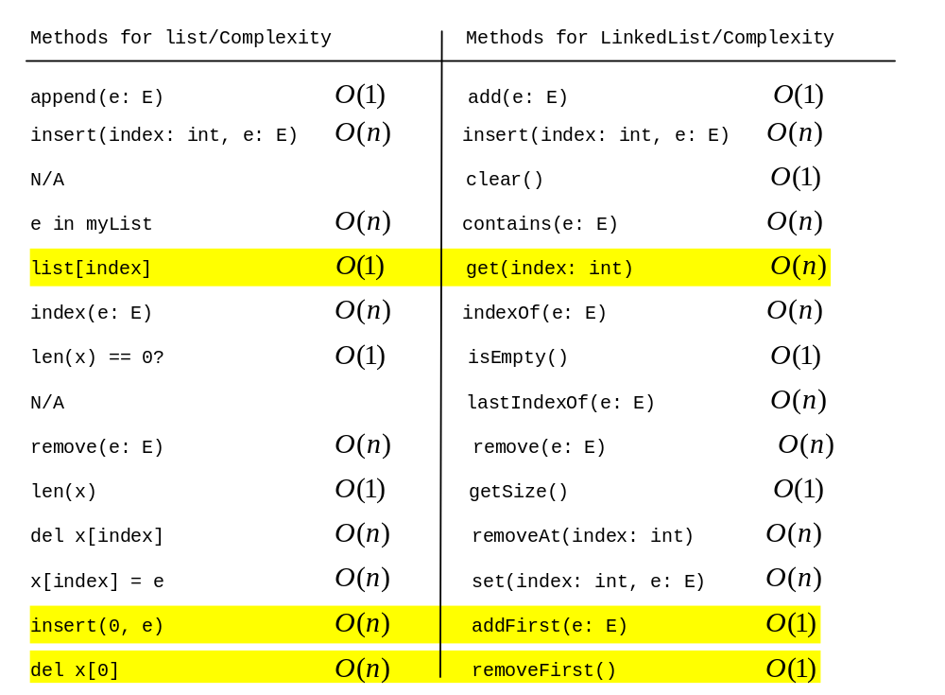
Time Complexity for list and LinkedList

Slide 23
Comparing list with LinkedList
LinkedListPerformance

Slide 24
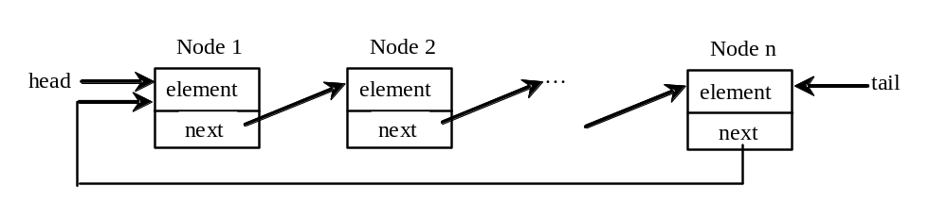
Circular Linked Lists
A circular, singly linked list is like a singly linked list, except that the pointer of the last node points back to the first node.

Slide 25
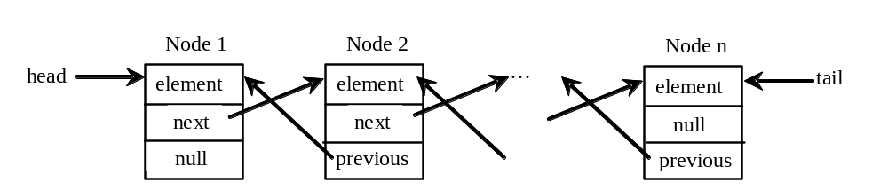
Doubly Linked Lists
A doubly linked list contains the nodes with two pointers. One points to the next node and the other points to the previous node. These two pointers are conveniently called a forward pointer and a backward pointer. So, a doubly linked list can be traversed forward and backward.

Slide 26
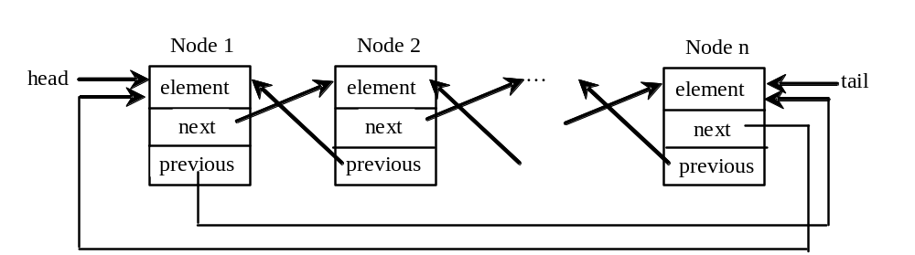
Circular Doubly Linked Lists
A circular, doubly linked list is doubly linked list, except that the forward pointer of the last node points to the first node and the backward pointer of the first pointer points to the last node.

Slide 27
Iterators
An iterator is an object that provides a uniformed way for traversing the elements in a container object. Recall that you can use a for loop to traverse the elements in a list, a tuple, a set, a dictionary, and a string. For example, the following code displays all the elements in set1 that are greater than 3.
set1 = {4, 5, 1, 9}
for e in set1:
if e > 3:
print(e, end = ' ')

Slide 28
__iter__ Method
Can you use a for loop to traverse the elements in a linked list? To enable the traversal using a for loop in a container object, the container class must implement the __iter__() method that returns an iterator as shown in lines 112-114 in Listing 18.2, LinkedList.py.
def __iter__(self):
return LinkedListIterator(self.__head)

Slide 29
__next__ Method
An iterator class must contains the __next__() method that returns the next element in the container object as shown in lines in lines 122-132 in Listing 18.2, LinkedList.py.
LinkedList
TestIterator
FibonacciNumberIterator

Slide 30
Generators
Generators are special Python functions for generating iterators. They are written like regular functions but use the yield statement to return data. To see how generators work, we rewrite Listing 18.5 FibnacciNumberIterator.py using a generator in Listing 18.6.
FibonacciNumberGenerator

Slide 31
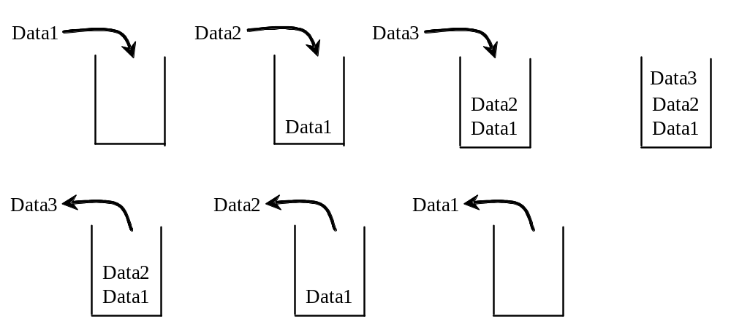
Stacks
A stack can be viewed as a special type of list, where the elements are accessed, inserted, and deleted only from the end, called the top, of the stack.

Slide 32
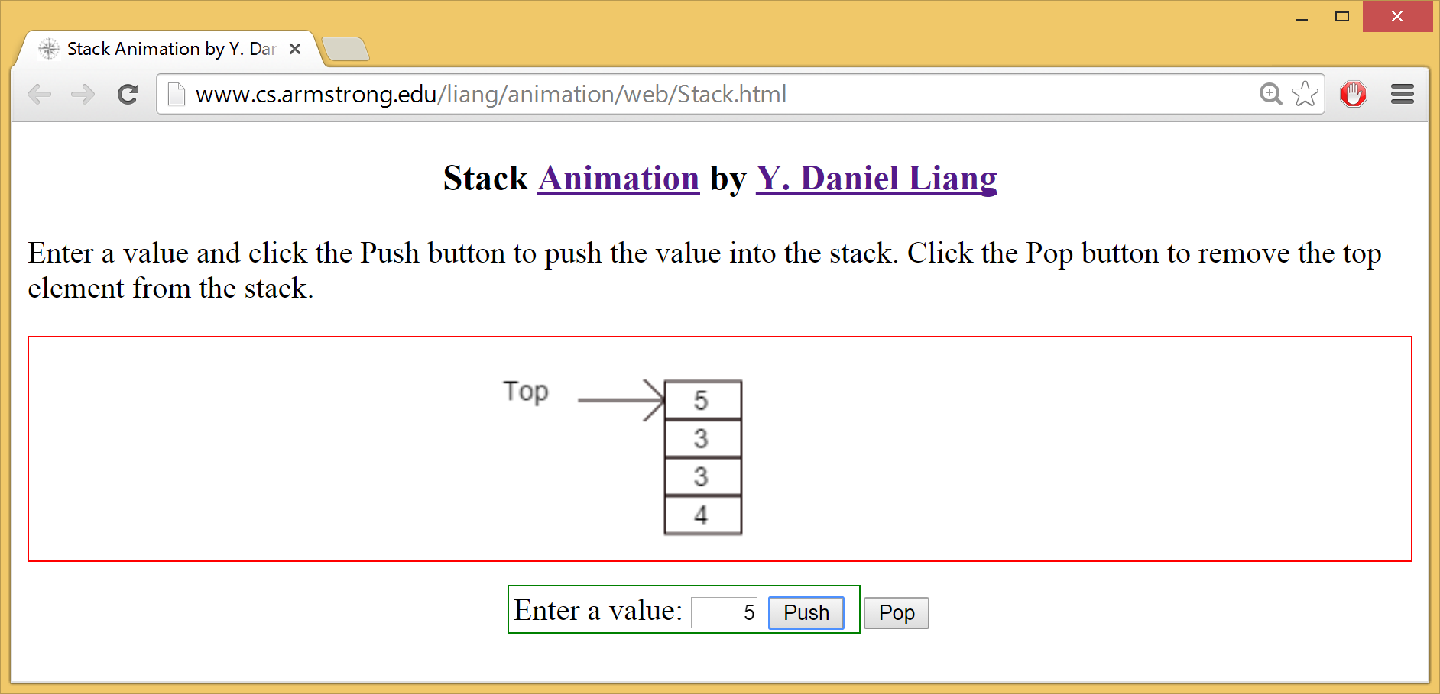
Stack Animation
https://liveexample.pearsoncmg.com/dsanimation/StackeBook.html

Slide 33
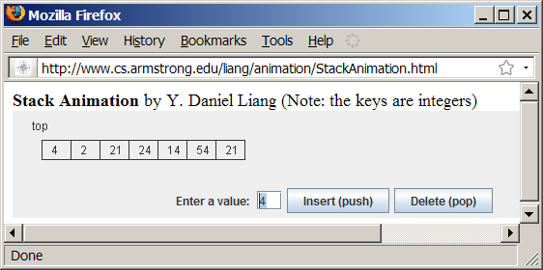
Stack Animation
www.cs.armstrong.edu/liang/animation/StackAnimation.html

Slide 34
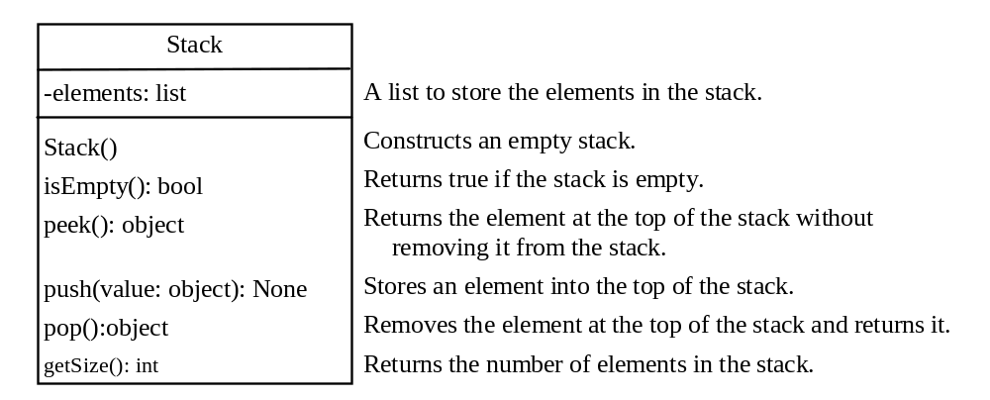
Stack
Stack
TestStack

Slide 35
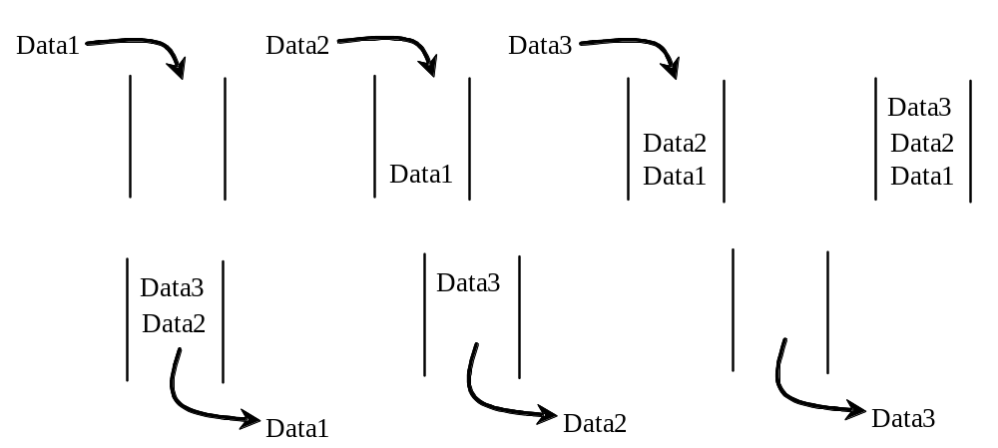
Queues
A queue represents a waiting list. A queue can be viewed as a special type of list, where the elements are inserted into the end (tail) of the queue, and are accessed and deleted from the beginning (head) of the queue.

Slide 36
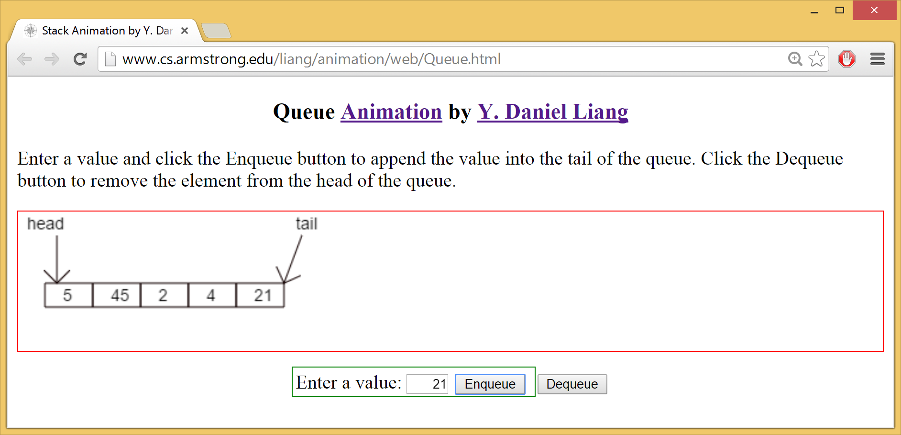
Queue Animation
https://liveexample.pearsoncmg.com/dsanimation/QueueeBook.html

Slide 37
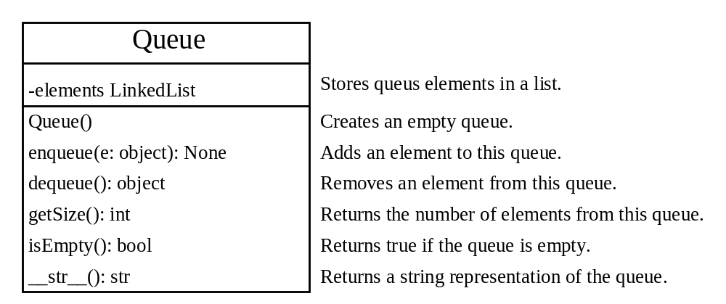
Queue
Queue
TestQueue

Slide 38
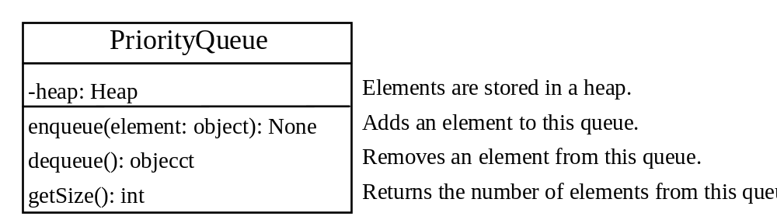
Priority Queue
A regular queue is a first-in and first-out data structure. Elements are appended to the end of the queue and are removed from the beginning of the queue. In a priority queue, elements are assigned with priorities. When accessing elements, the element with the highest priority is removed first. A priority queue has a largest-in, first-out behavior. For example, the emergency room in a hospital assigns patients with priority numbers; the patient with the highest priority is treated first.
PriorityQueue
TestPriorityQueue

