Slide 1

Exploratory Data Analysis
G2M Case Study
Name : Walquer X. Valles Ruiz Location : Peru Team : Data and Analytics Date : 15-March-2021

Slide 2

Agenda
Executive Summary
Problem Statement
Approach
EDA
EDA Summary
Recommendations

Slide 3
Executive Summary
XYZ company is planning for an investment in Cab industry so they want to understand the market.
Data of Pink Cab company and Yellow Cab company was provided to give recommendation for investment. Data of trips between 2016 and 2018 was analyzed.
Both companies have similarities in their customers characteristics and preferences.
Yellow company had more transactions and generated more profit than Pink company. Yellow company is the option recommended for investment.

Slide 4
Problem Statement
XYZ firm is planning for an investment in Cab industry so they want to understand the market before taking final decision.
Data of two Cab firms was provided for analysis. A recommendation based on the data is expected.

Slide 5
Approach
Exploratory Data Analysis (EDA) was performed to understand the data.
Comparative statistics and graphs will be presented to show similarities and differences between both companies.
Insights were extracted from the analysis and those support final recommendations.

Slide 6
Exploratory Data Analysis
Yellow Cab company vs Pink Cab company
4 files were provided: Cab_Data.csv, Customer_ID.csv, Transaction_ID.csv and City.csv.
The files contained information of transactions (trips) performed by Yellow Cab company and Pink Cab company between Jan 2016 – Dec 2018. It also contained information about their clients and the cities where the companies have presence.
Both companies are pretty similar in age and income distribution of their clients. Also are similar in distribution of transactions by month, and weekdays. The differences will be shown next.

Slide 7
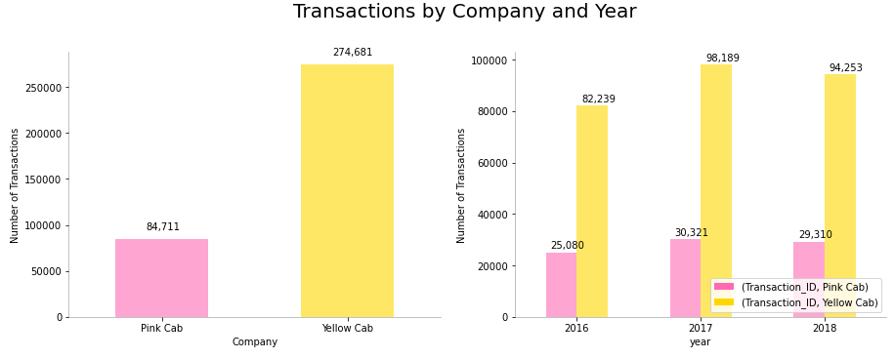
EDA
Yellow Cab company performed 3 times more trips than Pink Cab company.

Slide 8
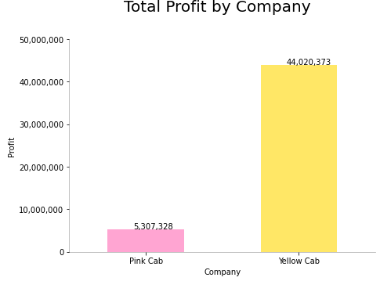

EDA
Yellow Cab company generated 8 times more profit than Pink Cab company.

Slide 9
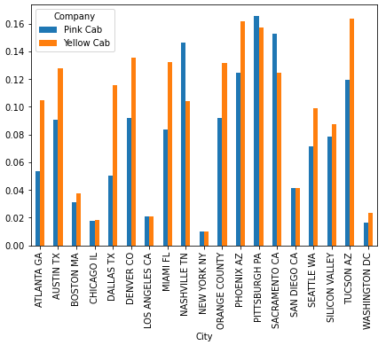
EDA
Yellow Cab company have higher customer reach than Pink Cab company in 15 of 19 cities.
Pink Cab company have more customer reach than Yellow Cab company in Nashville, Sacramento, San Diego and Pittsburgh, but in half of those just by an small difference.

Slide 10

EDA
Pink Cab company had more percentage of trips with losses instead of profit.
The following chart shows the number and percentage of trips where cost was higher than price charged by company.

Slide 11
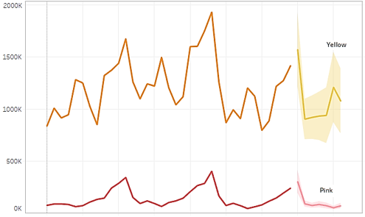
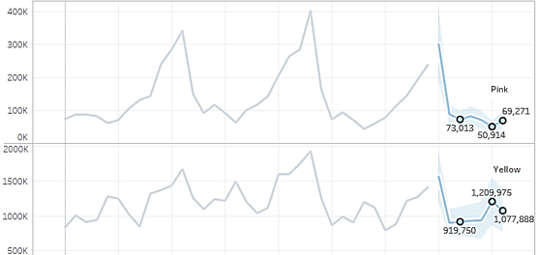
EDA
Yellow Cab company show better numbers in profit projections.

Slide 12
EDA Summary
Conclusions
Both companies have similar customer characteristics (gender distributions, age distribution, income distribution, preference by month and day of week).
Yellow Cab company have more customers than Pink Company.
Yellow Cab company generate more profit than Pink Company.
Yellow Cab company have more customer reach than Pink Company in almost all the cities where there is presence of both companies.

Slide 13

Recommendation
Based on the analysis performed we recommend Yellow cab company for investment.

Slide 14

Thank You

