Slide 1
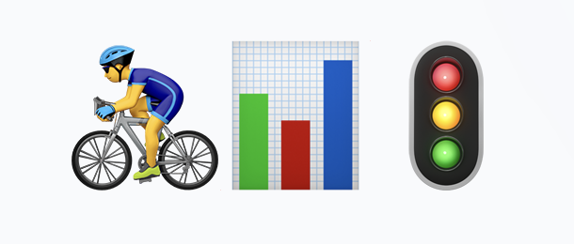
Berlin Traffic Data Pipeline
From siloed mobile sensors to public dashboards
#Batch batch-2189 - Team: Karin Schmitt, Dongming Monica Jiang, Lucia Fontana

Slide 2
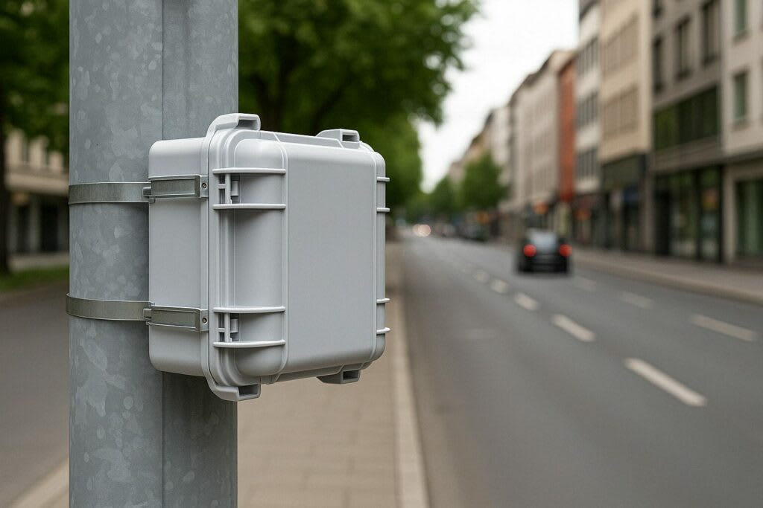
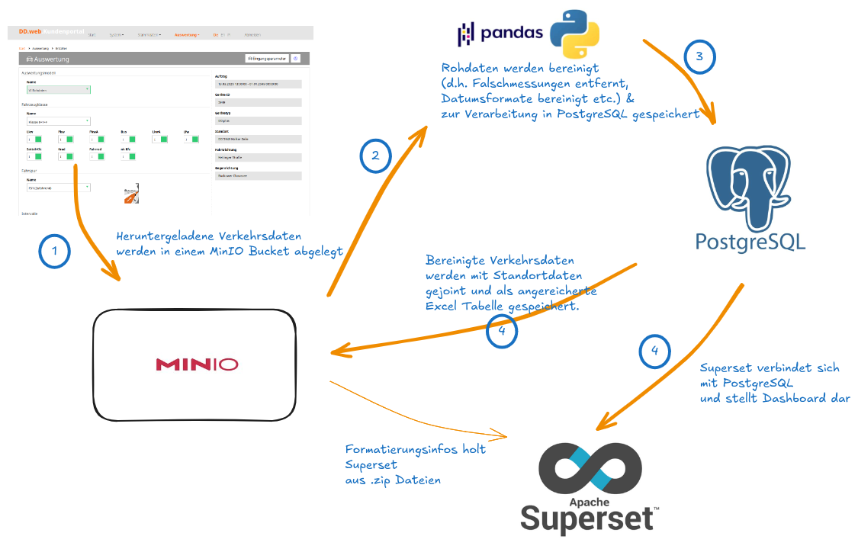
THE CHALLENGE
Unlocking Sensor Data
The Problem • 28-41 mobile traffic sensors (counts, speed, vehicle type). • Data locked in vendor web portal (DDWeb) requiring manual downloads. • Disconnected georeferencing table tracking moving sensors.
The Goal • Build automated pipeline for aggregated datasets & public dashboard. • Provide key metrics: Modal split, V85 speed, hourly flow. • Multi-district scalable architecture (one config file = one district).

Slide 3
ARCHITECTURE
The Central City Stack
Running on the strong CityLAB Berlin Open Data Hub (CIVITAS/CORE stack).
⏰
🧺
👩🏼‍🍳
📊
Airflow
Orchestration and scheduling
MinIO
Raw data archiving & final exports
PostgreSQL
Medallion storage (Bronze, Silver, Gold)
Superset
Public-facing interactive dashboard

Slide 4
WORKFLOW
The Weekly Airflow DAG
1. ingest_missions_&_files
Medallion Architecture Processing:
• Bronze Layer:
Ingests new weekly Excel files. Converted to Parquet for memory efficiency. • Silver Layer:
Cleans data, flags anomalies (e.g. 0 km/h speeds), and joins dynamic georeferencing table in chunks. • Gold Layer:
Truncates and replaces aggregations optimized directly for Superset display, preventing OOM errors.
2. branch_on_new_mission
↳ fetch_locations (skip if unchanged)
3. run_bronze_layer
4. run_silver_layer
5. run_gold_layer
6. refresh_superset_cache

Slide 5
METRICS
Key Traffic Indicators
Modal Split Share of each vehicle type (Cars, Trucks, Bikes, Vans, Motorcycles) as a percentage of total traffic.
(Class / Total) * 100
V85 Speed The speed below which 85% of motorized vehicles travel. Standard metric for speed limits.
df['speed'].quantile(0.85)
Hourly Flow Total vehicle count per hour per sensor. Shows traffic patterns over time.
Group by Date + Hour
Note: Bikes under 10km/h and the distinction between Vans/Trucks at low speeds are known sensor limitations accounted for in the analysis.

Slide 6
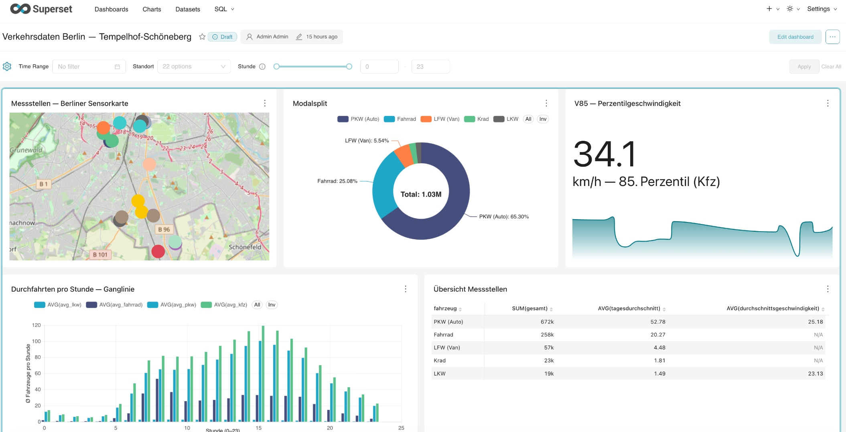
THE OUTPUT
Public Superset Dashboard: Demo ✨

Slide 7
COLLABORATION
Project Workflow & Team Synergy
A look into our agile development process, iterative problem-solving, and continuous integration.
1. Infrastructure & Setup - Docker Compose mirroring full stack (Airflow, Superset, MinIO, Postgres). - Version control with GitHub branches and PRs to avoid conflicts. - Fixed Python 3.8 and Airflow compatibility issues iteratively.
2. Data Engineering (Medallion)
Bronze: Ingested Excel files via Airflow. Solved OOM crashes by converting to Parquet.
Silver: Cleaned 8M+ rows in chunks, flagged anomalies.
Gold: Truncate/replace hourly aggregations optimized for Superset.
3. Dashboard & Design
Started with mock data, seamlessly transitioned to real Postgres data.
Implemented BerlinType fonts and CSS for brand compliance.
Deck.gl maps with OpenStreetMap basemap.

Slide 8
POTENTIALS
Next Steps
We are expecting more to come…

Slide 9


Data, Delivered.
Transforming unused vendor data into actionable insights for the public.
FULLY AUTOMATED
BERLIN OPEN DATA HUB
MULTI-DISTRICT READY

