Slide 1
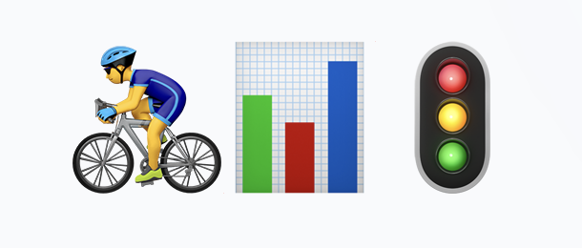
Berlin Traffic Data Pipeline
From siloed mobile sensors to public dashboards
#Batch batch-2189 - Team: Karin Schmitt, Dongming Monica Jiang, Lucia Fontana

Slide 2
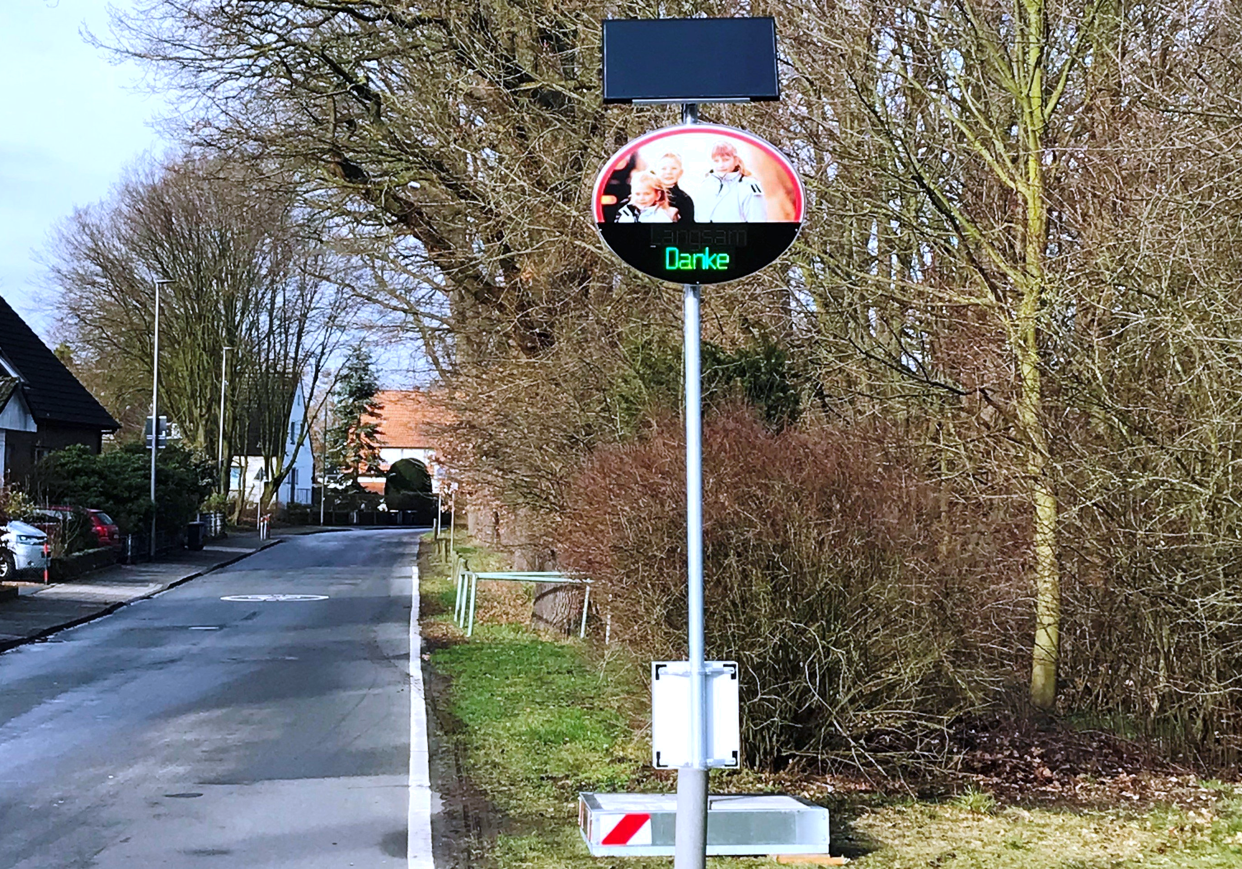
THE CHALLENGE
Unlocking Sensor Data
The Problem • 28-41 mobile traffic sensors (counts, speed, vehicle type) • Data locked in vendor web portal (DDWeb) requiring manual downloads • Disconnected georeferencing table tracking moving sensors

Slide 3
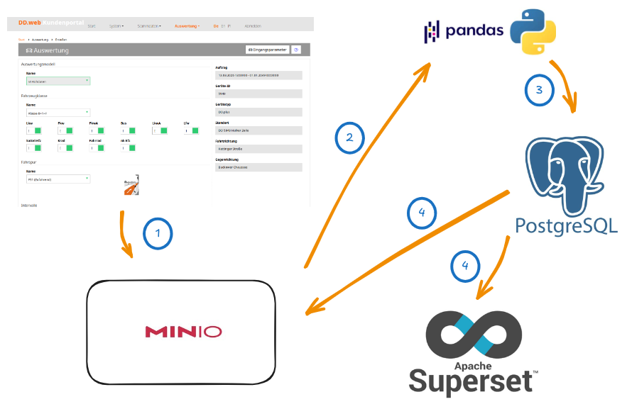
THE CHALLENGE
Unlocking Sensor Data
The Goal • Build an automated pipeline for aggregated datasets & public dashboard • Provide key metrics: Modal split, V85 speed, hourly flow • Multi-district scalable architecture (one config file = one district)

Slide 4
ARCHITECTURE
The Central City Stack
Running on the strong CityLAB Berlin Open Data Hub (CIVITAS/CORE stack).
⏰
🧺
👩🏼‍🍳
📊
Airflow
Orchestration and scheduling
MinIO
Raw data archiving & final exports
PostgreSQL
Medallion storage (Bronze, Silver, Gold)
Superset
Public-facing interactive dashboard

Slide 5
WORKFLOW
The Weekly Airflow DAG
1. ingest_ref
Medallion Architecture & QA Strategy:
Data Engineering "Best Practice": A data engineer shouldn’t just move data; they must validate it. We built a dedicated Quality Assurance (QA) pipeline. • Bronze Layer: Safely loads remote MinIO traffic files into our persistent Postgres database • Silver Layer (QA Focus): During cleaning, it flags anomalies (e.g., implausible speeds or missing source files). It then prints a formatted summary and persists a detailed QA report to a dedicated database for tracking • Gold Layer & Publish: Aggregates metrics to avoid OOM crashes, refreshes the Superset cache, and publishes the final export back to MinIO
2. ingest_traffic_files
3. load_traffic_to_bronze
4. run_silver_layer
5. run_gold_layer
6. publish
7. refresh_superset

Slide 6


Data, Delivered.
Transforming unused vendor data into actionable insights for the public.
FULLY AUTOMATED
BERLIN OPEN DATA HUB
MULTI-DISTRICT READY

