Slide 1
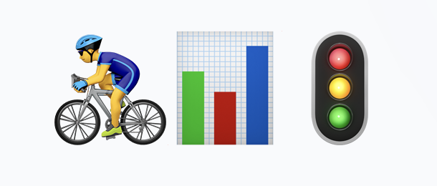
Berlin Traffic Data Pipeline
From siloed mobile sensors to public dashboards
#Batch batch-2189 - Team: Karin Schmitt, Dongming Monica Jiang, Lucia Fontana

Slide 2
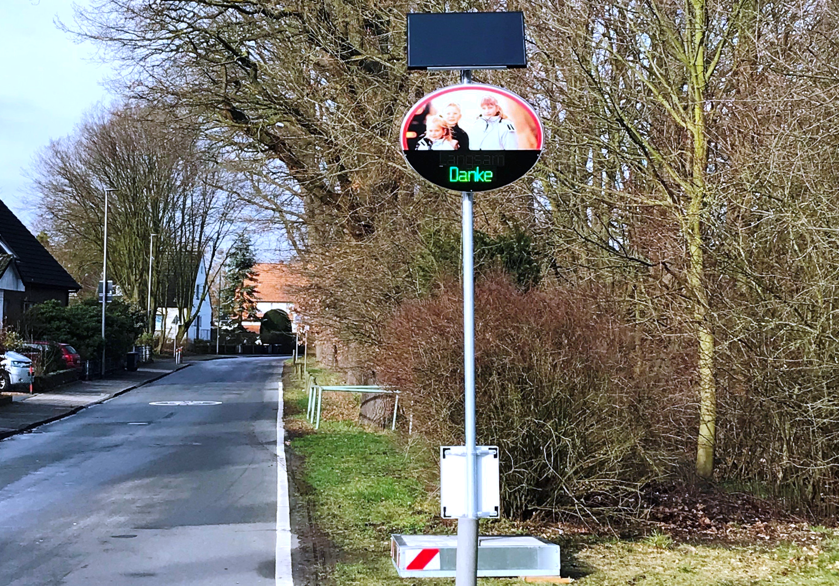
THE CHALLENGE
Unlocking Sensor Data
The Problem • 28-41 mobile traffic sensors (counts, speed, vehicle type) • Data locked in vendor web portal (DDWeb) requiring manual downloads • Disconnected georeferencing table tracking moving sensors

Slide 3
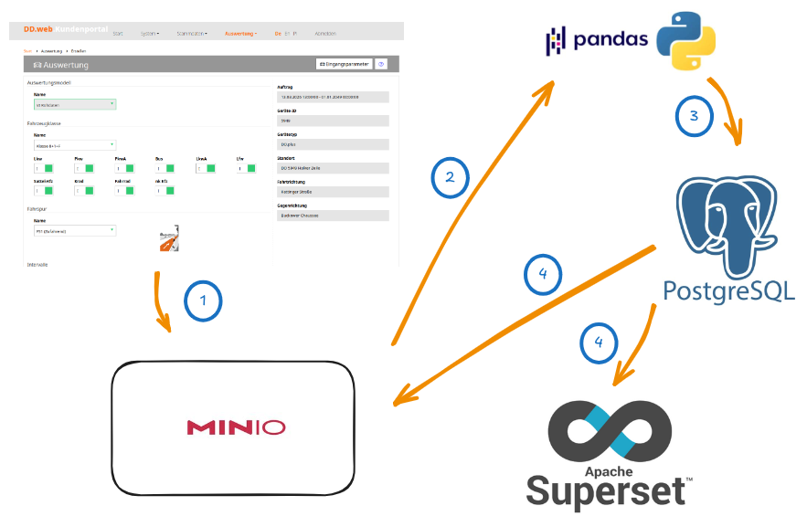
THE CHALLENGE
Unlocking Sensor Data
The Goal • Build an automated pipeline for aggregated datasets & public dashboard • Provide key metrics: Modal split, V85 speed, hourly flow • Multi-district scalable architecture (one config file = one district)

Slide 4
ARCHITECTURE
The Central City Stack
Running on the strong CityLAB Berlin Open Data Hub (CIVITAS/CORE stack).
⏰
🧺
👩🏼‍🍳
📊
Airflow
Orchestration and scheduling
MinIO
Raw data archiving & final exports
PostgreSQL
Medallion storage (Bronze, Silver, Gold)
Superset
Public-facing interactive dashboard

Slide 5
WORKFLOW
The Weekly Airflow DAG
1. ingest_ref
Medallion Architecture & QA Strategy:
Data Engineering "Best Practice": A data engineer shouldn’t just move data; they must validate it. We built a dedicated Quality Assurance (QA) pipeline. • Bronze Layer: Safely loads remote MinIO traffic files into our persistent Postgres database • Silver Layer (QA Focus): During cleaning, it flags anomalies (e.g., implausible speeds or missing source files). It then prints a formatted summary and persists a detailed QA report to a dedicated database for tracking • Gold Layer & Publish: Aggregates metrics to avoid OOM crashes, refreshes the Superset cache, and publishes the final export back to MinIO
2. ingest_traffic_files
3. load_traffic_to_bronze
4. run_silver_layer
5. run_gold_layer
6. publish
7. refresh_superset

Slide 6
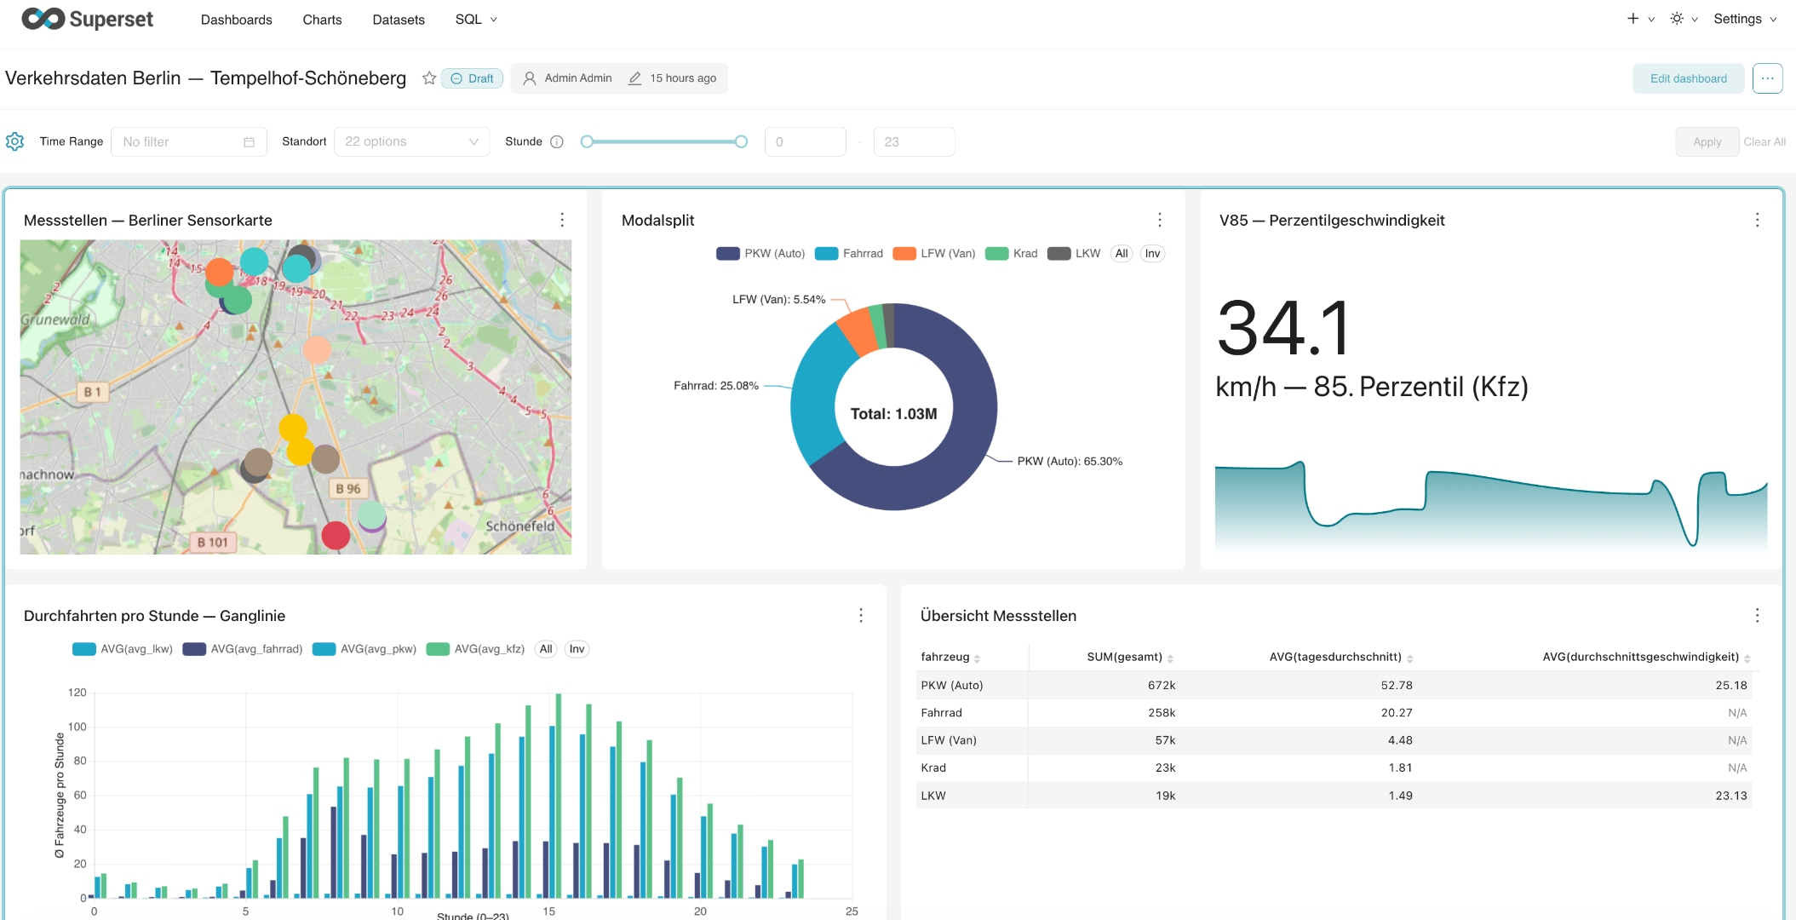
THE OUTPUT
Public Superset Dashboard: Demo ✨

Slide 7
COLLABORATION
Project Workflow & Team Synergy
1. What went well We parallelised: one person owned ingestion and architecture, one transformation and data quality, one visualisation and orchestration. We had a working pipeline before we had all the pieces
GitHub helped contain the mess: the overlaps still created duplicate work and some inconsistencies, but at least we could see what each other had written
We made a utils folder: nothing revolutionary, but having one place for repetitive stuff like DB connections and timezone parsing meant we stopped rewriting the same functions
2. What can we do better
We didn't always bother activating the virtual environment: for a quick function it felt unnecessary, but with Python 3.8 and Airflow 2.7 that casualness caught up with us at merge time
We didn't profile our data well: we expected 2.5M rows, got 8M, used Pandas, and our pipeline crashed until we figured out chunking and batching the hard way
We tested on mock data until quite late: mock data is well-behaved, real data isn't, and we felt that gap

Slide 8
POTENTIALS
Next Steps
We are expecting more to come…
Tying up loose ends
we still need to apply the city's visual guidelines, get a traffic engineer to sanity check our assumptions about cars and bikes, and make sure error alerts reach a real person
Go public
we present to the borough in early June and have been invited to showcase at the Berlin Data Lab annual conference
Take it further
all Berlin boroughs run the same sensors; if this works, each one could plug into the same pipeline and feed a single citywide dashboard

Slide 9


Data, Delivered.
Transforming unused vendor data into actionable insights for the public.
FULLY AUTOMATED
BERLIN OPEN DATA HUB
MULTI-DISTRICT READY

