Slide 1
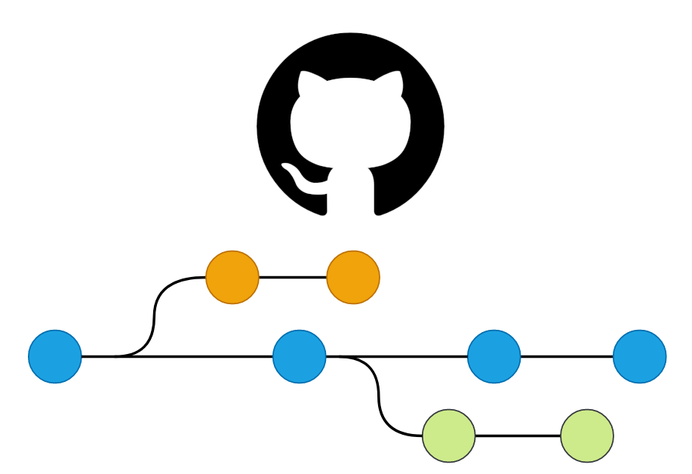
Version Control
Using git and GitHub

Slide 2
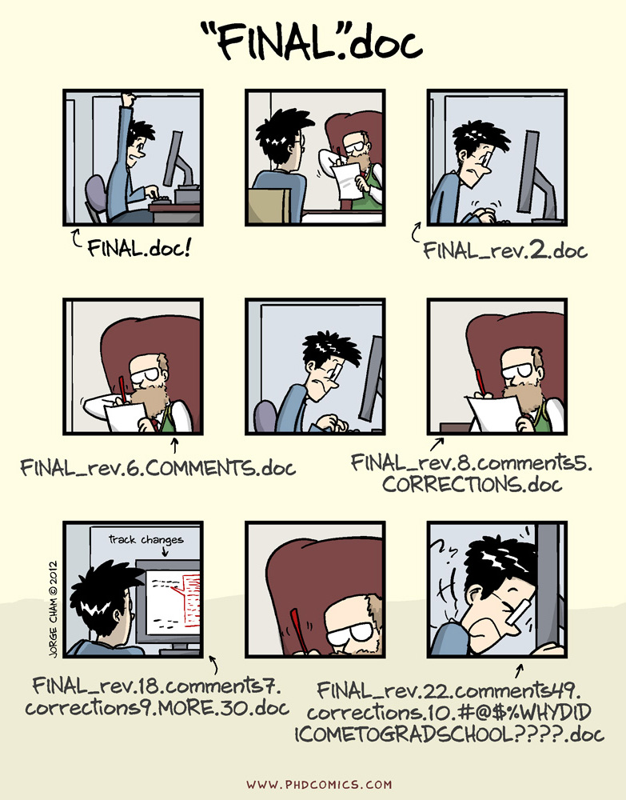

Slide 3
What is version control?
Version control is system that records changes to documents, code, data, etc. through time.
It allows us to take snapshots (“commit”) of our files and to revert back to previous snapshots if desired.
It also allows us to work collaboratively on files by keeping track of who did what and finding any conflicts (e.g., if 2 people changed the same line of code)

Slide 4

Allison Horst: https://openscapes.org/blog/2022-05-27-github-illustrated-series/

Slide 5
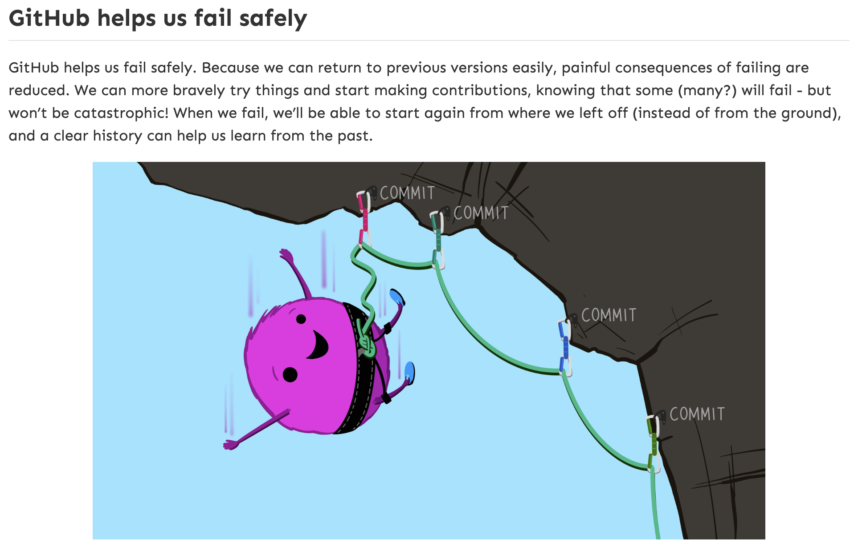
Allison Horst: https://openscapes.org/blog/2022-05-27-github-illustrated-series/

Slide 6


LOCAL
(your computer)
REMOTE
(on the Cloud)

Slide 7
Remote Repo (GitHub)
push
push
pull
pull
add
commit
add
commit
Local Repos (git)

Slide 8
Remote Repo (GitHub)
push
push
pull
pull
add
commit
add
commit
Local Repos (git)

Slide 9
Remote Repo (GitHub)
push
push
pull
pull
pull
add
commit
add
commit
Local Repos (git)

Slide 10
Remote Repo (GitHub)
push
push
pull
pull
pull
add
commit
add
commit
Local Repos (git)

Slide 11
Remote Repo (GitHub)
push
push
pull
pull
add
commit
add
commit
Local Repos (git)

Slide 12
Introduce Ourselves to git
Tell git who you are (and what your GitHub account is)

Slide 13
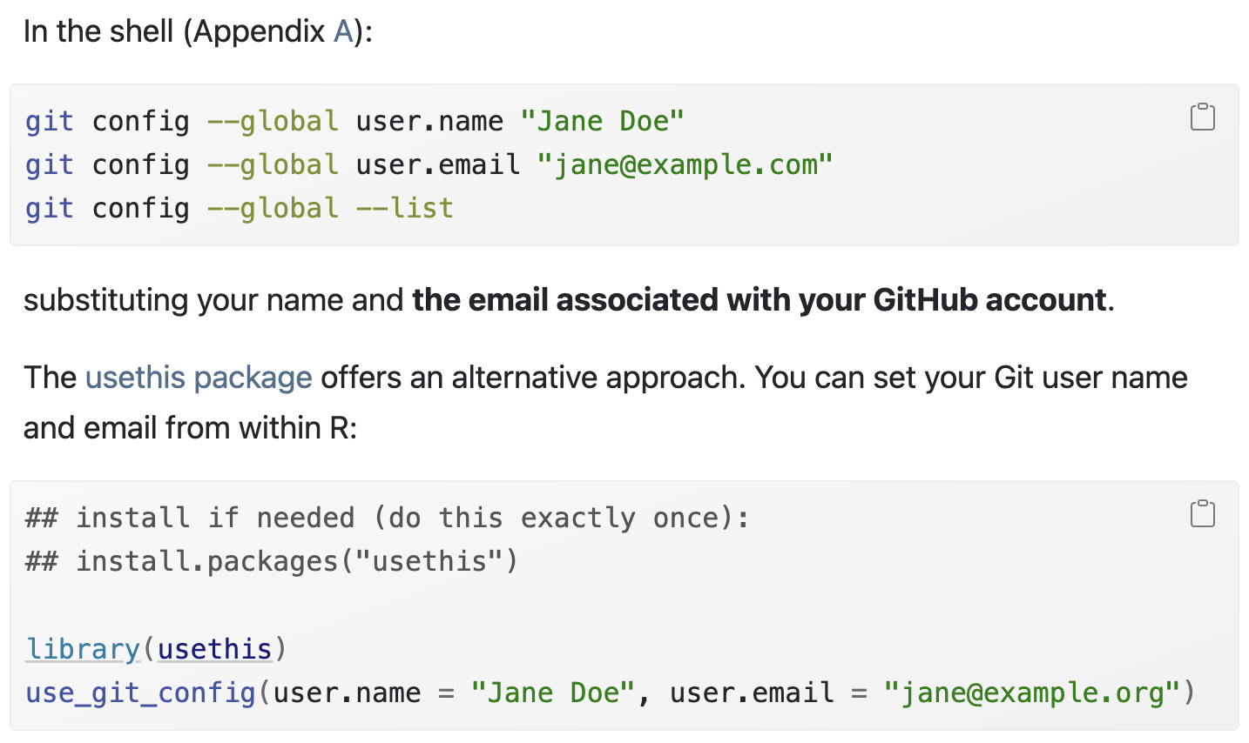
Chapter 7: Introductions

Slide 14
git/GitHub and RStudio
Version Control through RStudio Projects

Slide 15
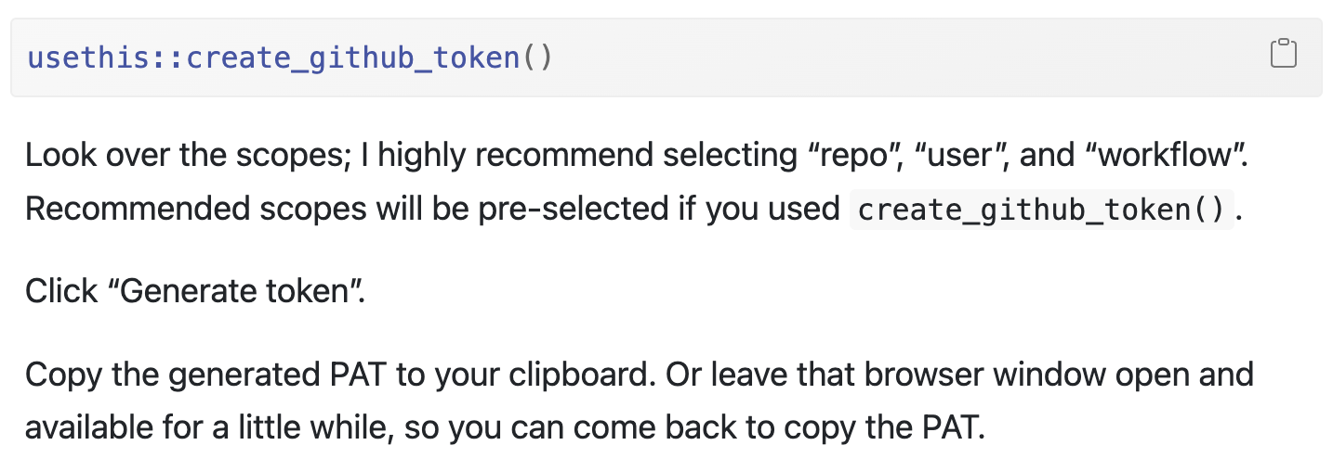
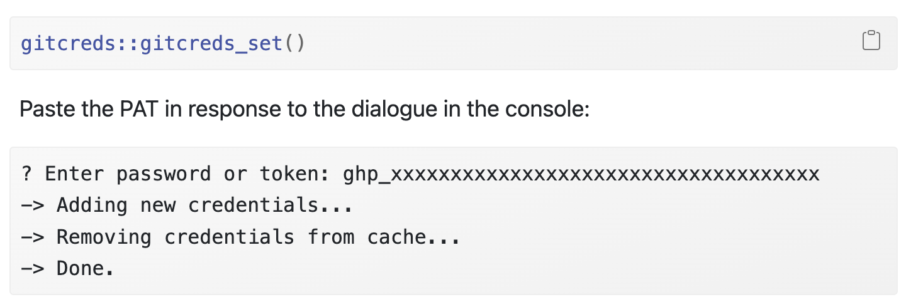
Chapter 9: PAT for HTTPS
STEP 1
* Select no expiration
STEP 2

Slide 16
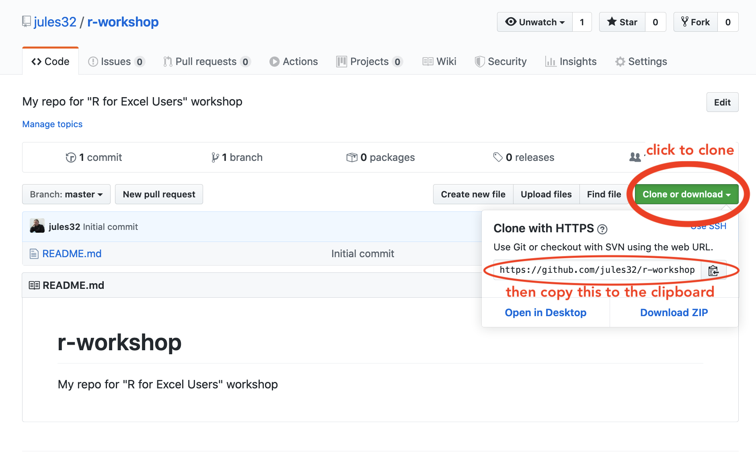
Chapter 11: Connect everything!
STEP 1: Clone the repository address (updated: green “Code” button)
Images from: https://rstudio-conf-2020.github.io/r-for-excel/github.html#github

Slide 17
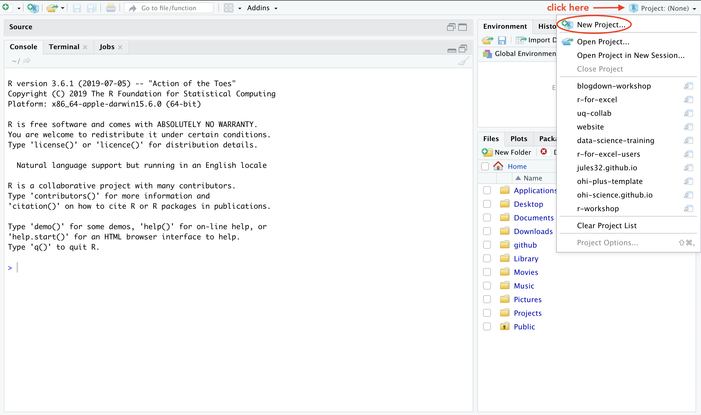
Chapter 11: Connect everything!
STEP 2: Create a new RStudio Project
Images from: https://rstudio-conf-2020.github.io/r-for-excel/github.html#github

Slide 18
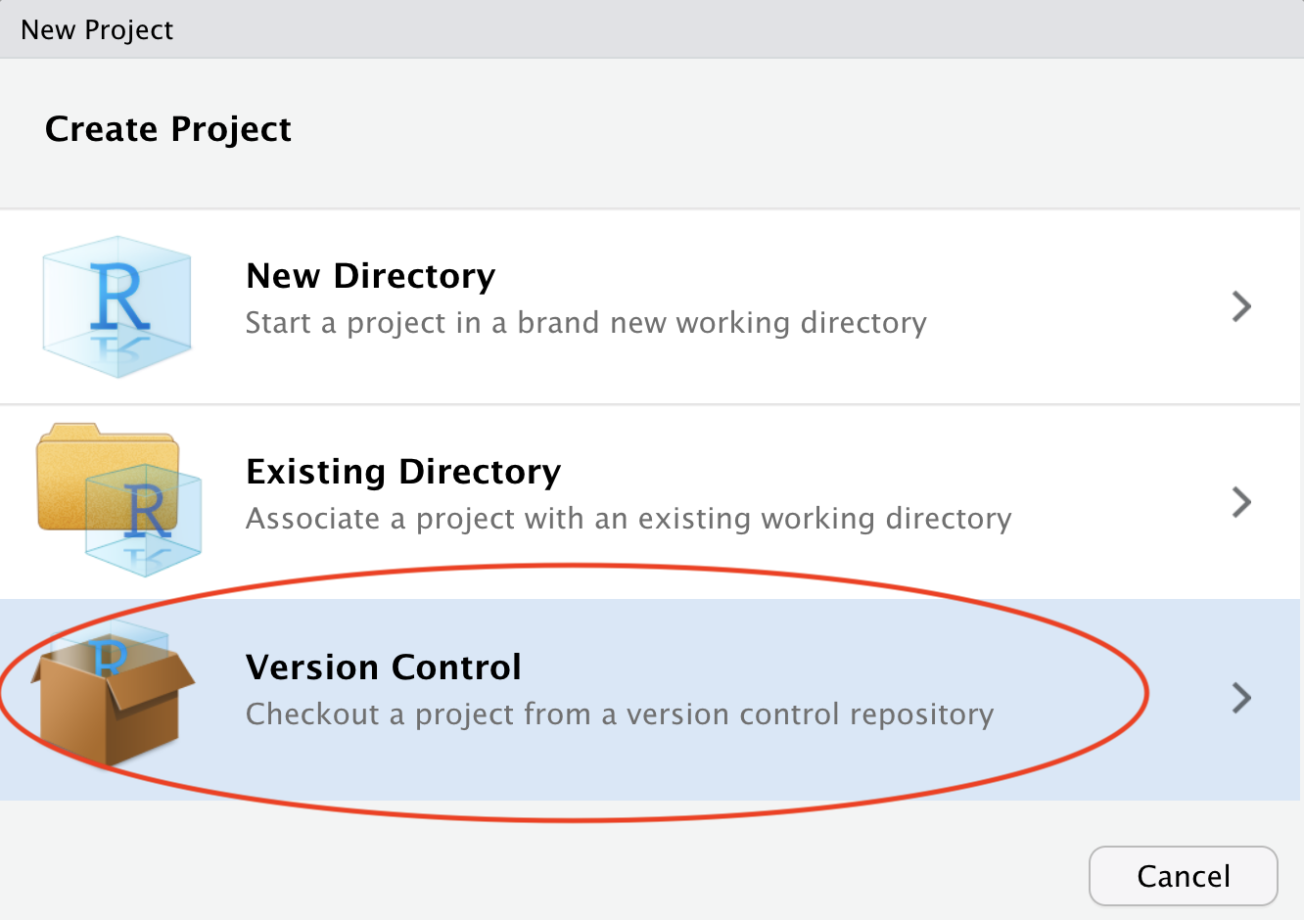
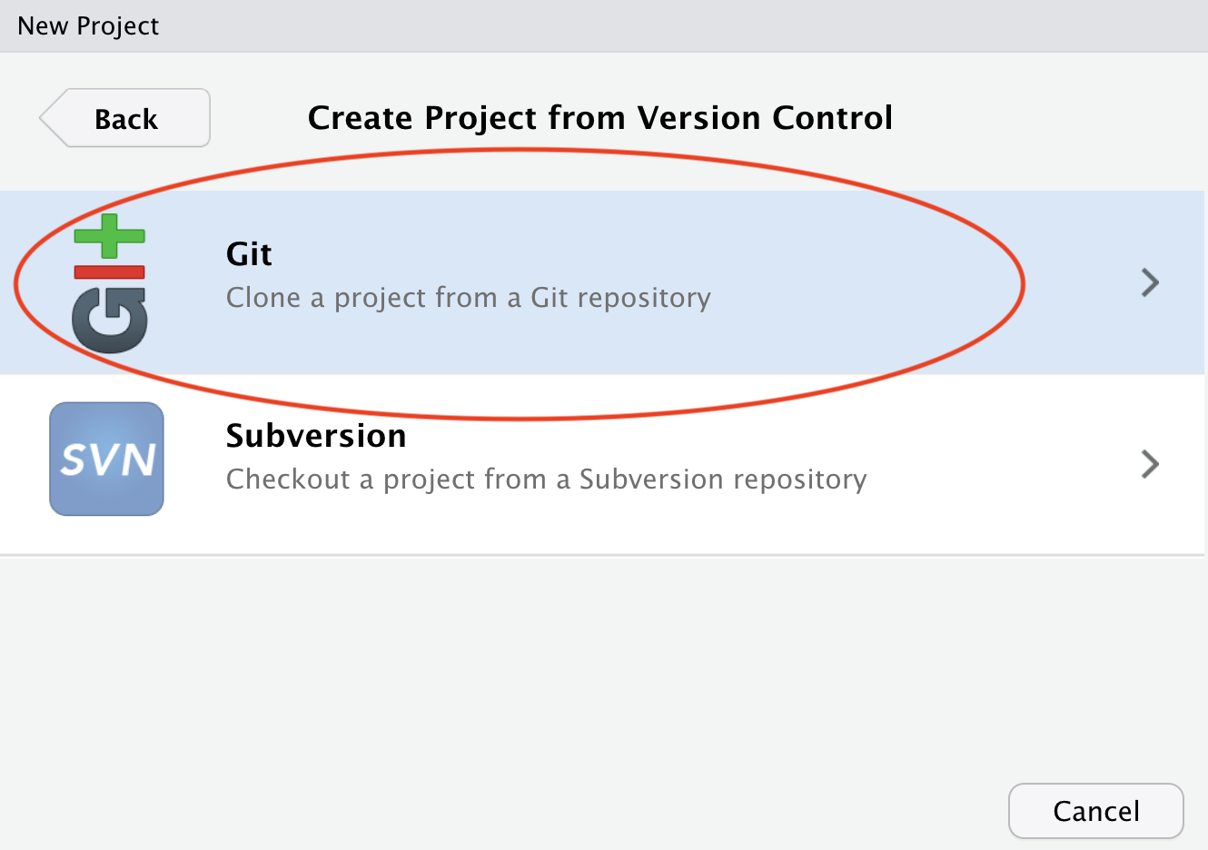
Chapter 11: Connect everything!
STEPS 3 and 4: Select “Version Control”, then “Git”
Images from: https://rstudio-conf-2020.github.io/r-for-excel/github.html#github

Slide 19
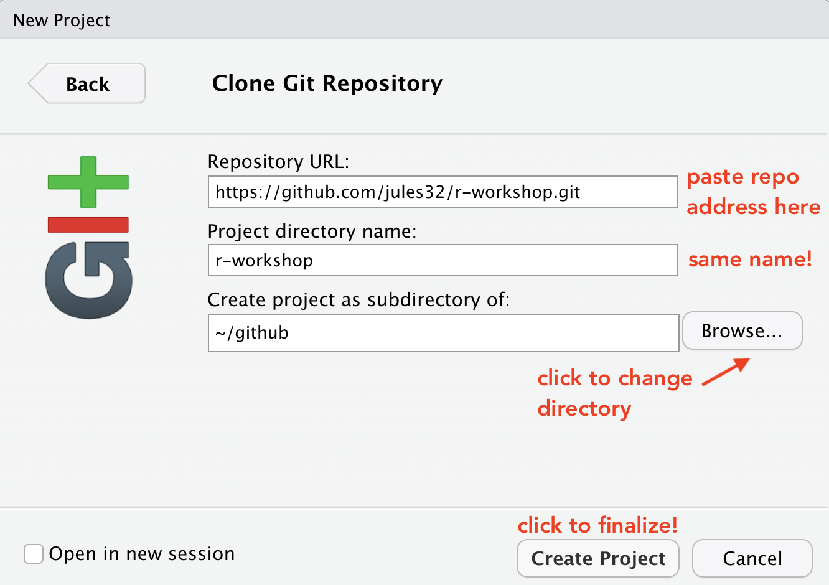
Chapter 11: Connect everything!
STEP 5: Paste the repo address in “Repository URL”
Images from: https://rstudio-conf-2020.github.io/r-for-excel/github.html#github

Slide 20
How to Commit Files
1. Save
  Save the changes in the file(s) you have been working on
2. Add
  Open the Commit window by clicking the “Commit” button in the Git tab.
  Click the empty square next to the file to “stage” the file(s).
3. Commit
  Write a descriptive commit message, then click the “commit” button
4. Pull
  Click on the “Pull” button (blue arrow pointing down). This will bring down any changes from the remote repo on GitHub (in case a collaborator has made changes will you’ve been working or you forgot to pull before)
  Fix any merge conflict that occur.
5. Push
  Click the “Push” button (green arrow pointing up) to send the changes to your local repo that you just committed up to the remote repo on GitHub

Slide 21
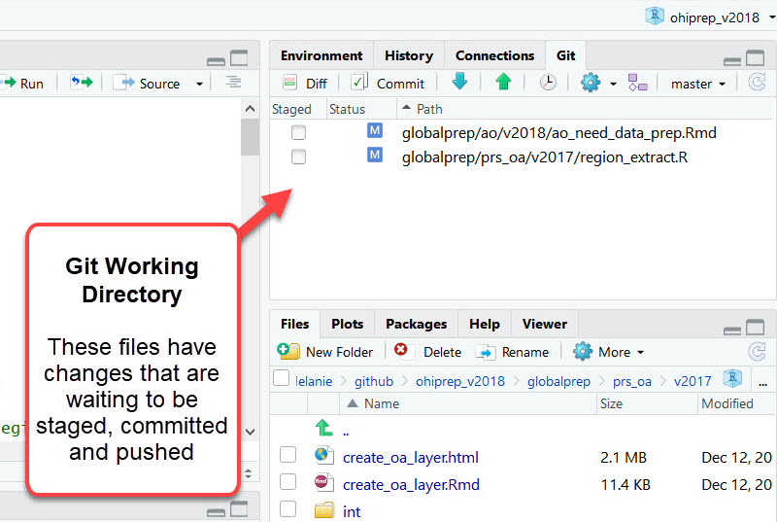

Slide 22
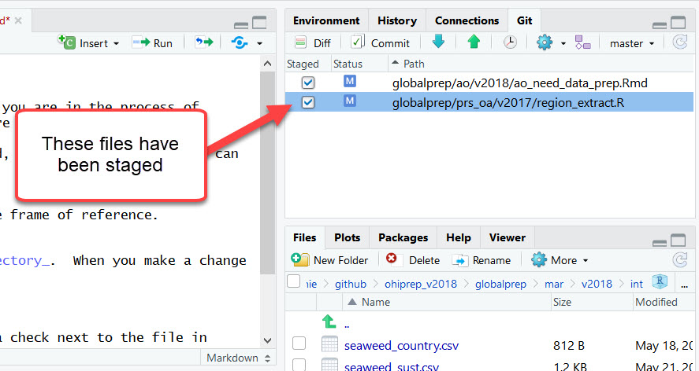

Slide 23
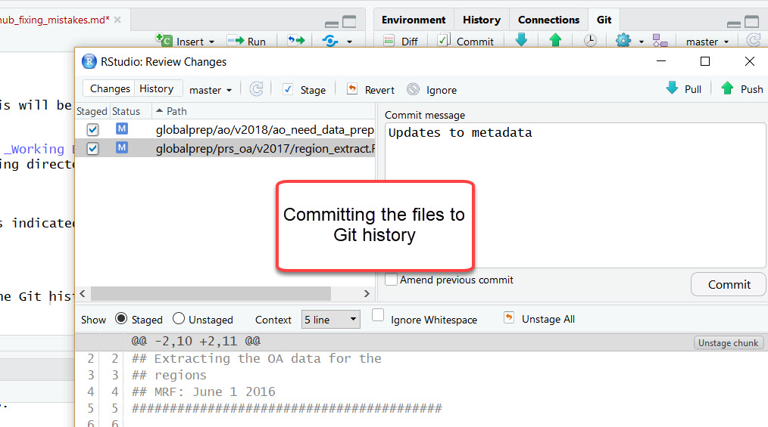

Slide 24
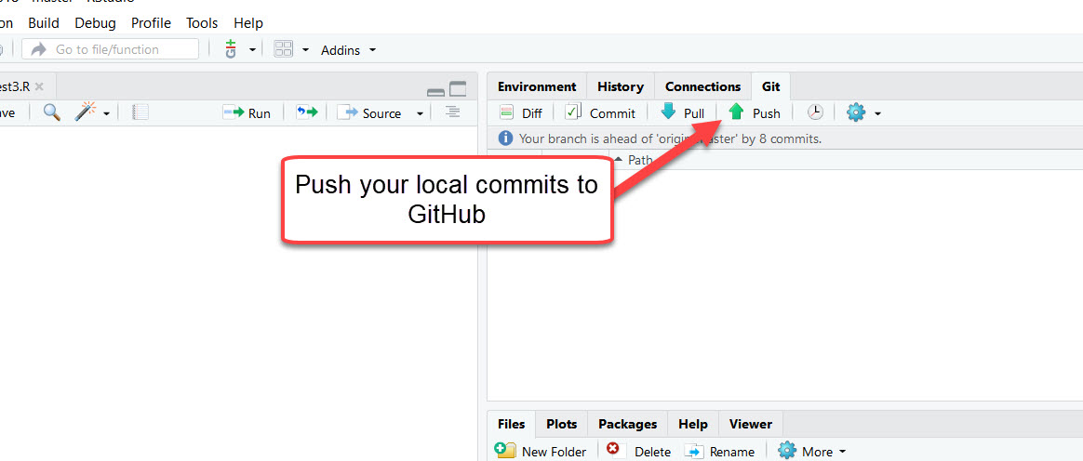
First, pull any commits from the remote repo

Slide 25
Helpful Resources
I find Happy Git with R to be the most helpful resource.
The documentation on GitHub (GitHub docs) is also well done.
If in doubt, Google or ask GenAI!

