Slide 1
Supplier Quality Management App

Slide 2
Appication subjects to control
Supplier certifications (standard and expiration)
Supplier complaints
Supplier score cards
Payments / Subscriptions

Slide 3

Supplier certifications
Supplier must be linked to Customer ID
Must contain field for Supplier certification (ISO, IATF, etc.)
Must have a field for certificate emission and expiration
Option to send notification to Main/User accounts if near expiration
Could be used to link to a Social Network part where Customers can see their scores per several customers (but info of customers is hidden)
Might be possible to add a list of suppliers by updating a list from excel (mostly used) and convert it to a JSON, and “addMany”

Slide 4
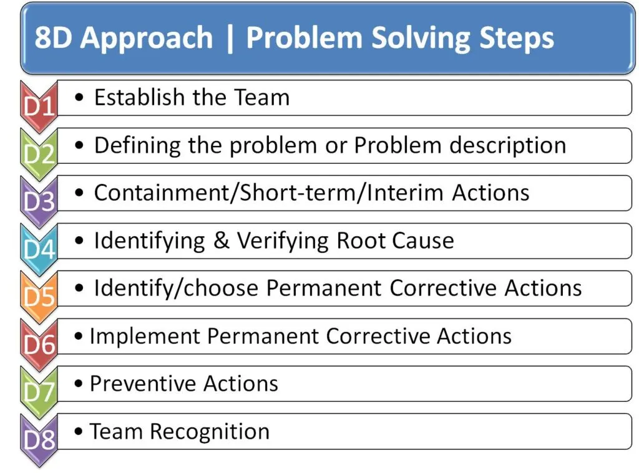
Supplier Complaints
Must be linked to Suppleir ID, Score ID and Customer ID (has it’s own ID)
Has to have 8 steps in industry standard problem solving 8D by sections
Define team
Define problem
Containment action (with due date field) -> (shipment, delivery of parts, etc.)
Root Cause analysis (field to upload the analysis, or to input)
Identification of Corrective actions (due dates)
Implementation/verification of Corrective actions (due dates)
Implementation of preventative actions (due dates)
Sign off of the customer/user for approval -> closure date
All fields should have option to upload files (pdf, excel …)
And also could be possible to add scoring logic (e.g. quality of each step)

Slide 5
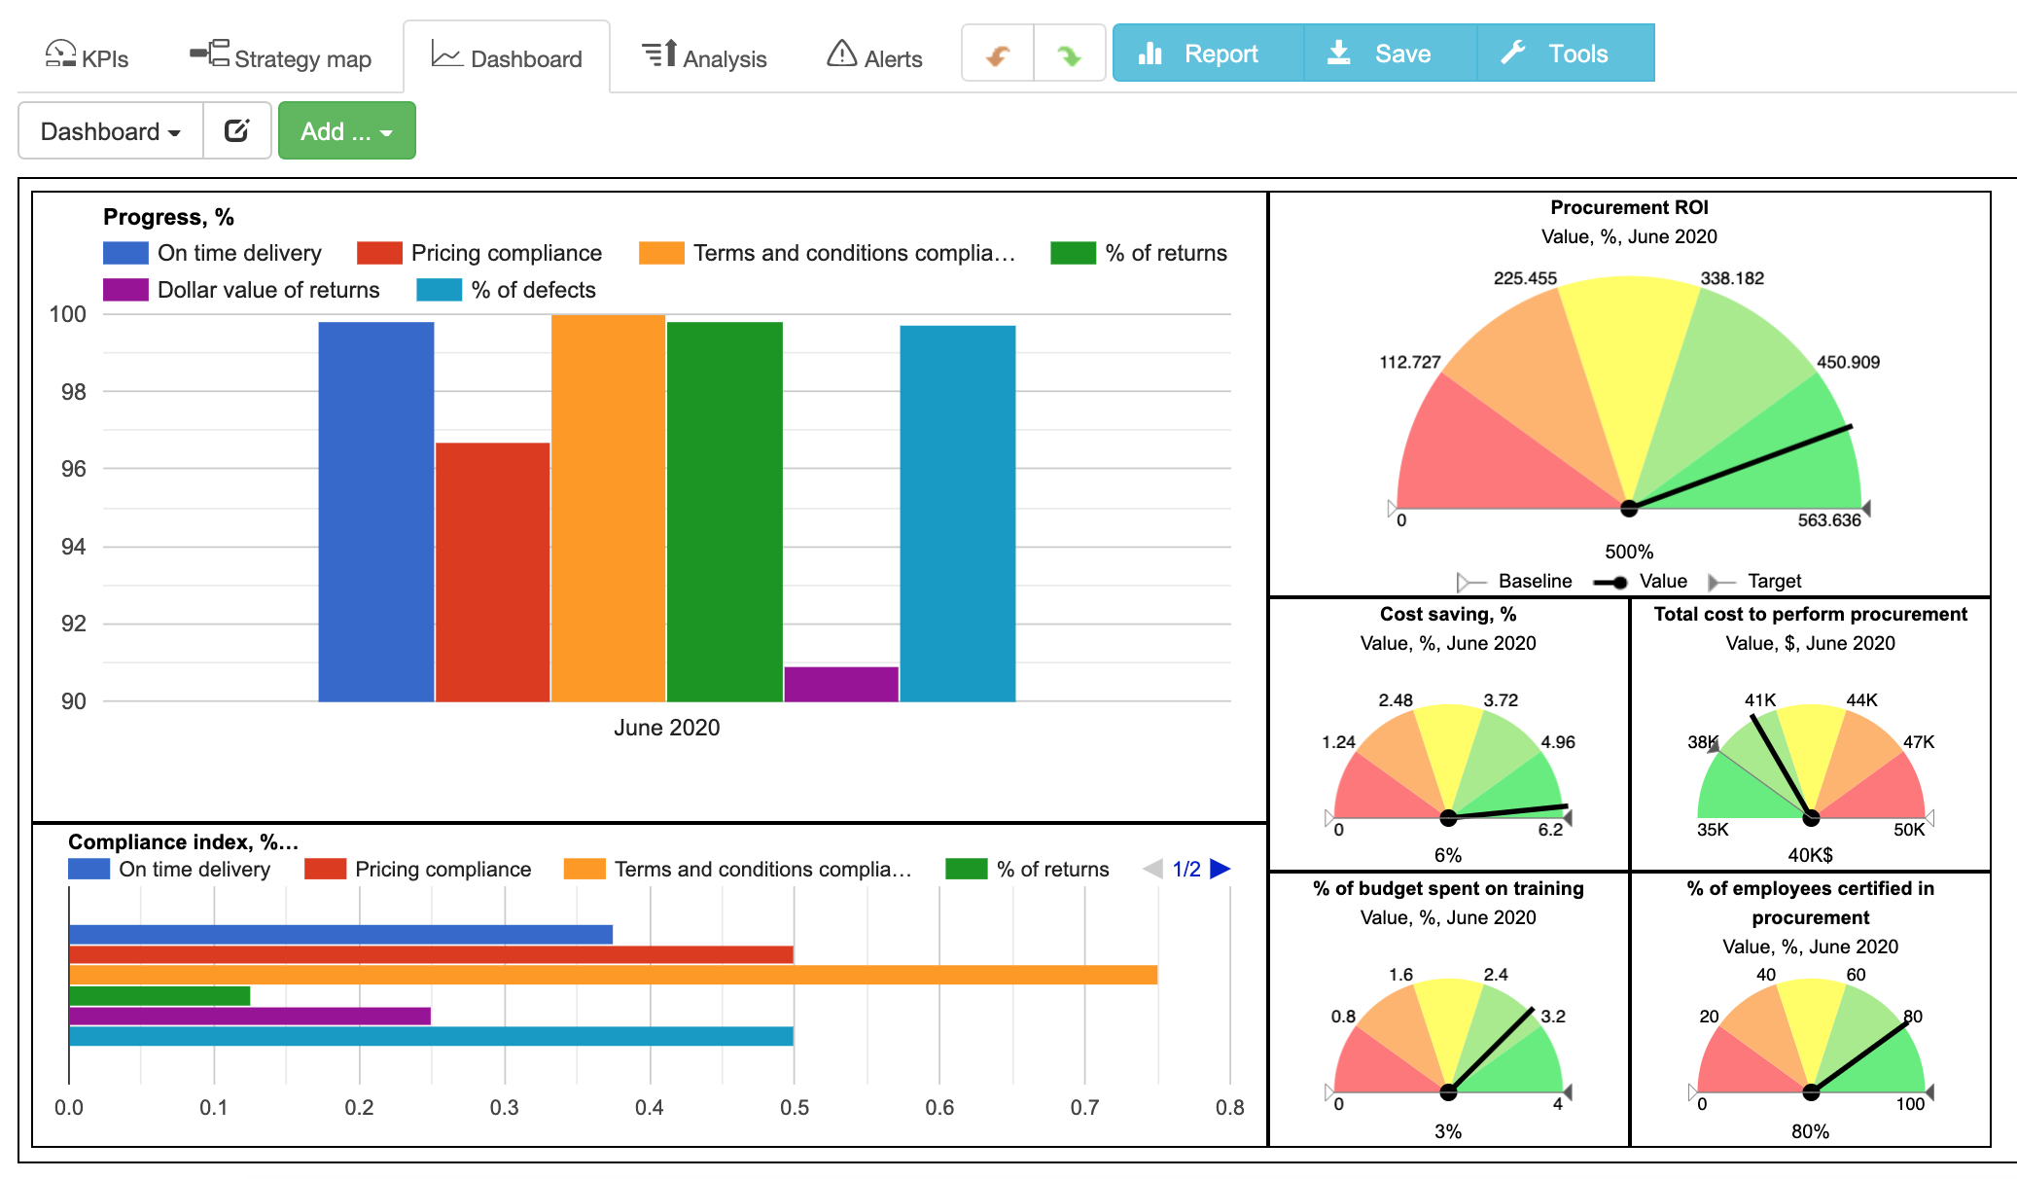
Supplier Score Cards
Linked to Supplier ID and to Customer ID
Must contain Deliveries on time
Quantity delivered by period (monthly)
Defects (Parts per Million)
Complaints opened
Complaints closed
Output of pdf file to send to registered supplier account/ download

Slide 6
Logic Design
Accounts (roles):
MasterDev
Main/Admin (customer)
User (at customer side)
Supplier user (supplier of customer)
Possible Schemes besides User:
Supplier
Complaint
ScoreCard
Report (contains all above, linked specifically to Supplier and Main/Admin/User)

Slide 7
Logic Design
Possible pages:
Main page (just log-in, and brief introduction to app, with login/signup)
Main user page (dashboard with filters of 3 main sections),

Slide 8
What goes first?
A starting point could be just Certification management, the next one in complexity is problem solving, and the top is the Scorecard.
Every starting point could have report section where user can filter (and even see graphs).
The last to add could be the payment/subscription api.

