Slide 1

PROSPERO
Find every vacancy. Reach every hiring manager. First.
Antony Berou | April 2026

Slide 2
What I've Built
800+
29
18,000+
Company career sites
scraped daily
ATS platforms
automatically handled
Jobs discovered
in the last run
39
556
<3 min
Countries
covered
Recruitment agencies
auto-filtered out
Per lead, end to end
(was 30-45 min)
Live today. Not a prototype.

Slide 3
How It Works
1
2
3
4
▶
▶
▶
PASTE A URL
AUTO-SCRAPE
AI DOSSIER
OUTREACH
Any company careers page
Finds every job, daily
Why the role exists,
who to contact, what to say
5-step email sequence
from your Outlook
© 2026 Barclay Simpson Associates Ltd.

Slide 4
First 10 Weeks
Just the AI prompt and SourceWhale. No scraper running yet.
30
4
1
£26K
Campaigns
Jobs Won
Placement
Revenue
We wouldn't have found the job without it.
Campaigns still running. More will convert.

Slide 5
The Ask
5
90
1
Consultants
Days
Decision
3-month pilot
to prove ROI
roll out or walk away
If it works:
Every consultant gets a daily pipeline of scored, qualified leads with AI intelligence
and personalised outreach sent automatically from their Outlook.
If it doesn't: we've lost nothing but time.
ab@barclaysimpson.com

Slide 6
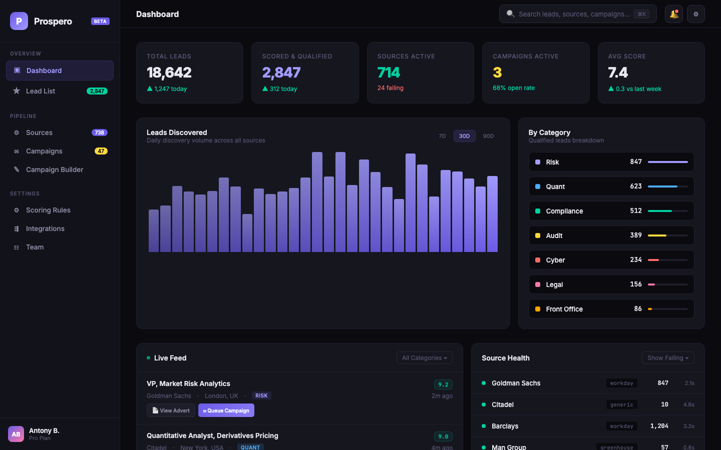
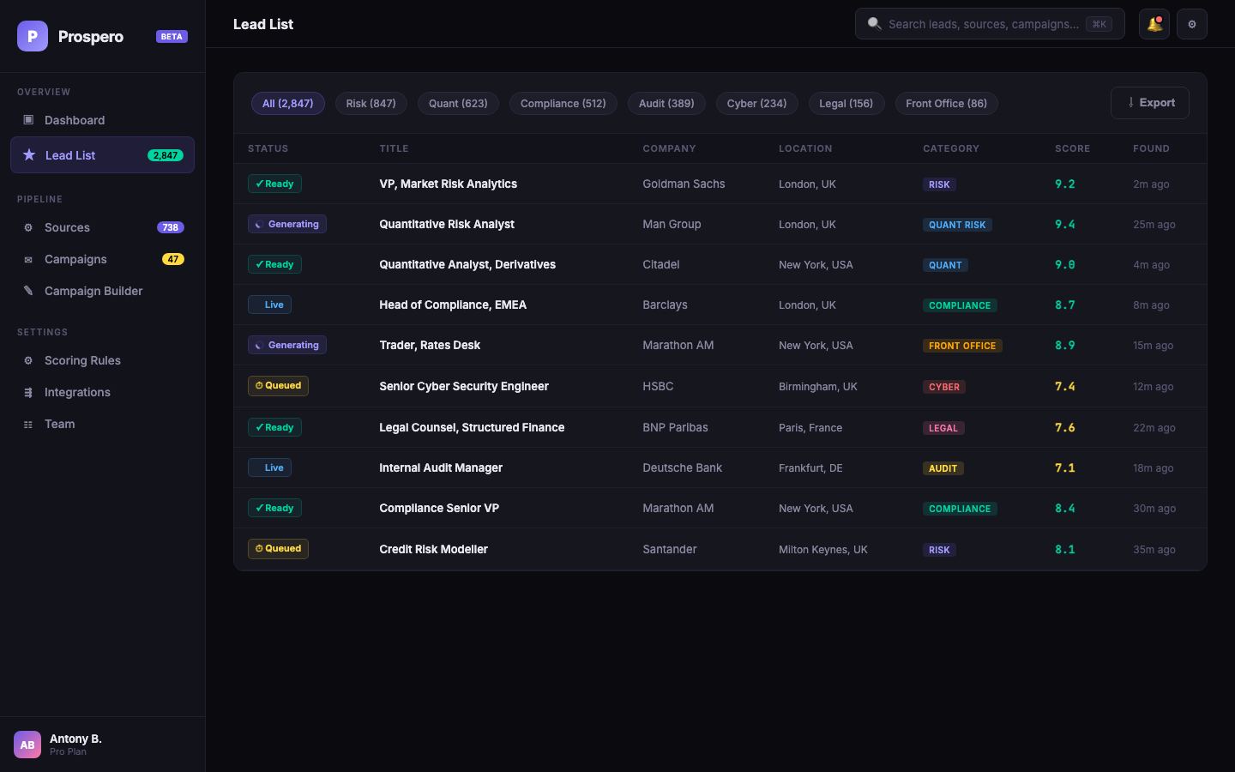
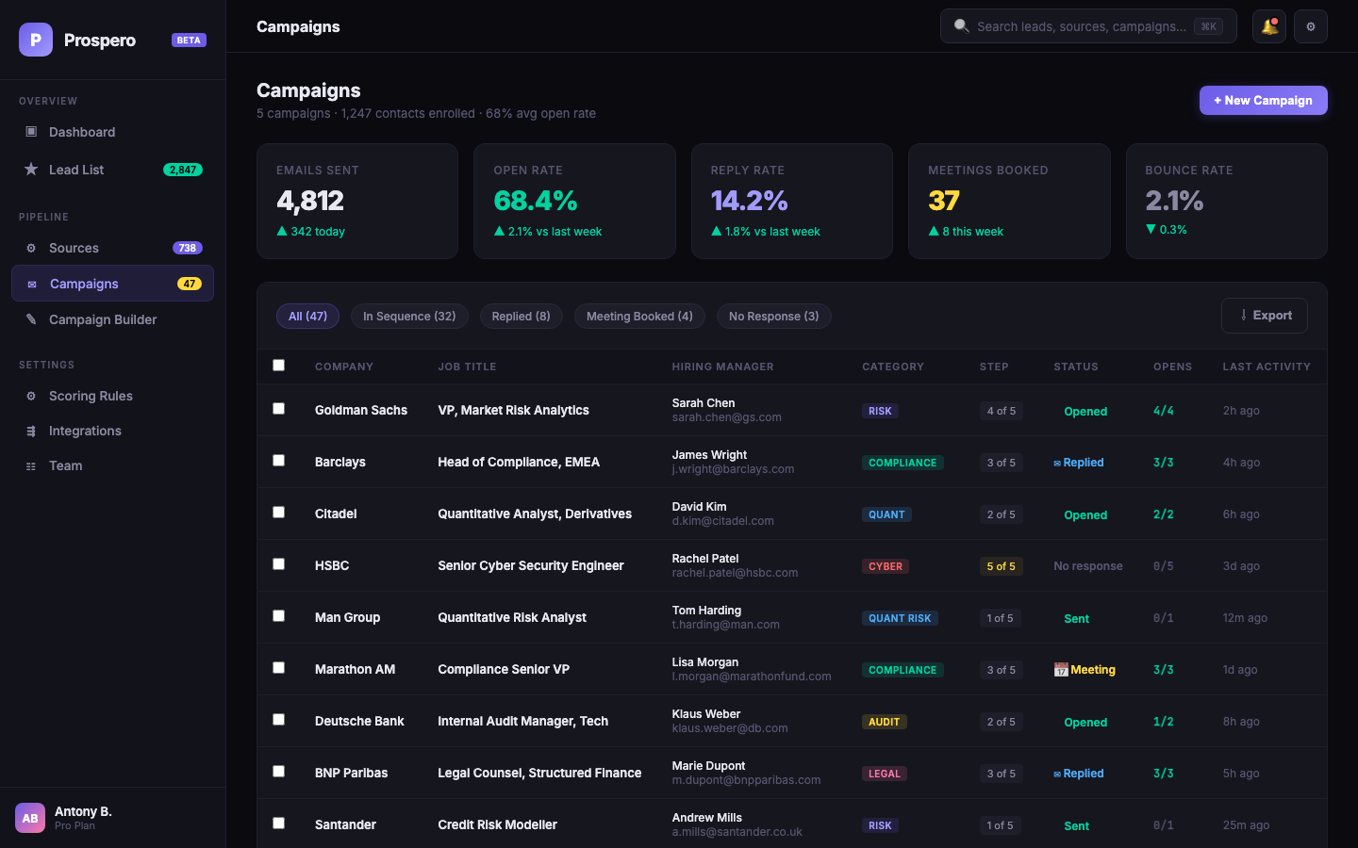
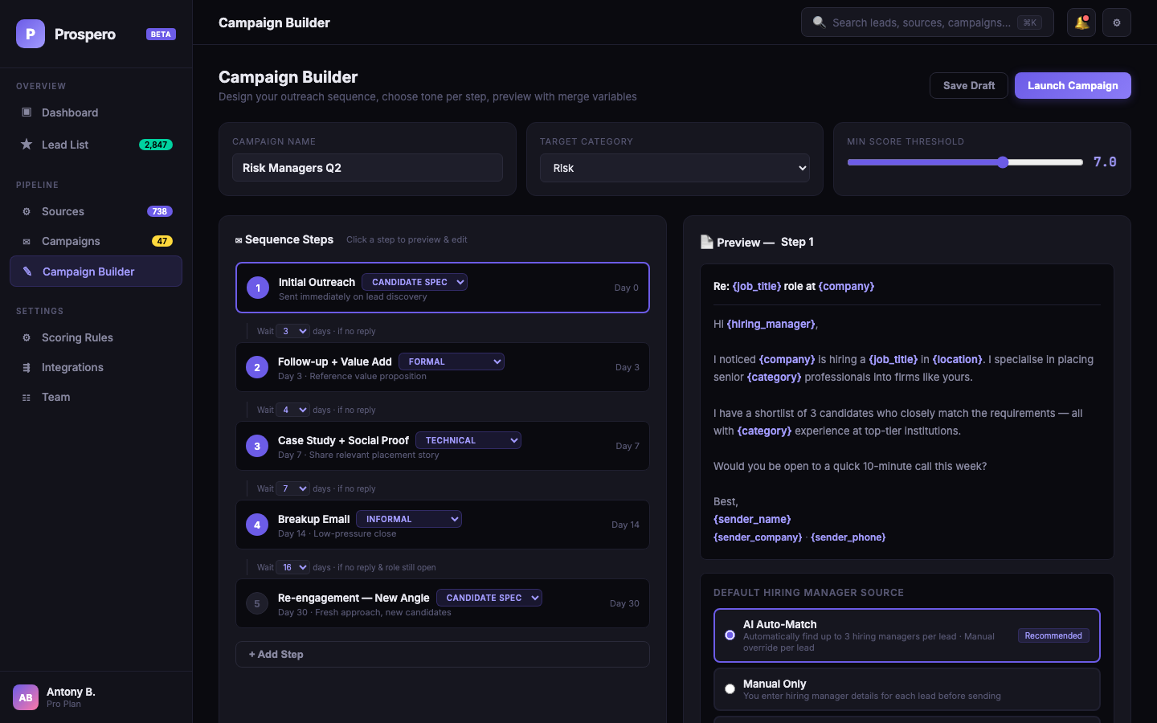
What It Looks Like
UI mockups — built, interactive, ready for development
Dashboard
Lead List
Campaigns
Campaign Builder
© 2026 Barclay Simpson Associates Ltd.

