Slide 1

PROSPERO
From idea to intelligence platform
The journey so far, and where we're going
Antony Berou | Head of Risk | April 2026

Slide 2
The Problem
150+
career sites to monitor manually
72hrs
before we spot a new vacancy
85%
of outreach is generic and ignored
30min
per lead to research and write emails
© 2026 Barclay Simpson Associates Ltd.

Slide 3
What I Built
The scraping engine — working today
780+
Company career
sites scraped
30
ATS platform
adapters built
39
Countries
covered
<3min
Per lead
end to end
© 2026 Barclay Simpson Associates Ltd.

Slide 4
It Works
First 10 weeks — just the AI prompt and SourceWhale
30
4
1
£26K
Campaigns
Jobs Won
Placement
Revenue
We wouldn't have found the job without it.
Campaigns still running. More will convert.

Slide 5
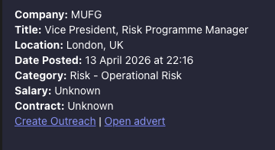
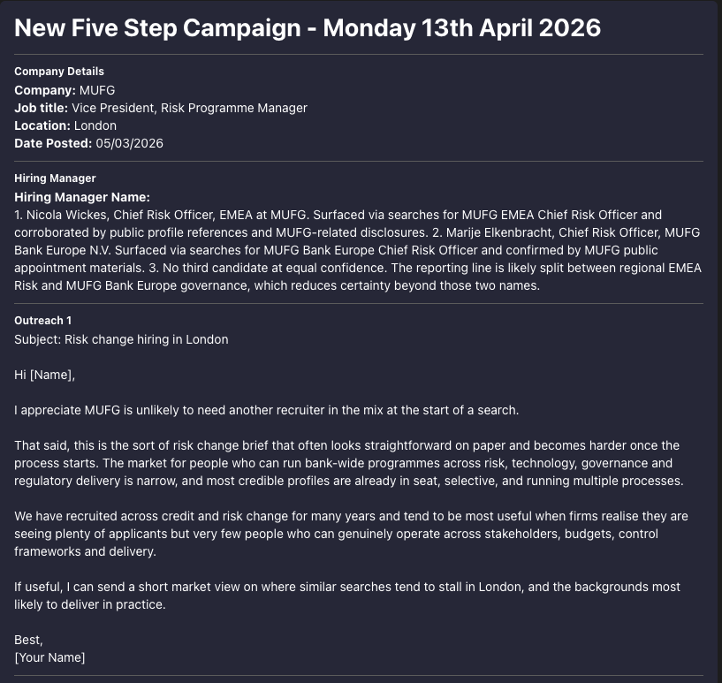
Where I Am Now
Leads served to Teams automatically. Outreach campaigns created on demand.
Daily Lead Feed
AI-Generated Outreach

Slide 6
How It Works
1
2
3
4
▶
▶
▶
PASTE A URL
AUTO-DETECT
SCRAPE & SCORE
INTELLIGENCE
Any company careers page
Platform identified,
jobs counted
Every job classified
into our categories
AI dossier, hiring
manager, outreach
3 seconds
Instant
30 seconds
2 minutes
© 2026 Barclay Simpson Associates Ltd.

Slide 7
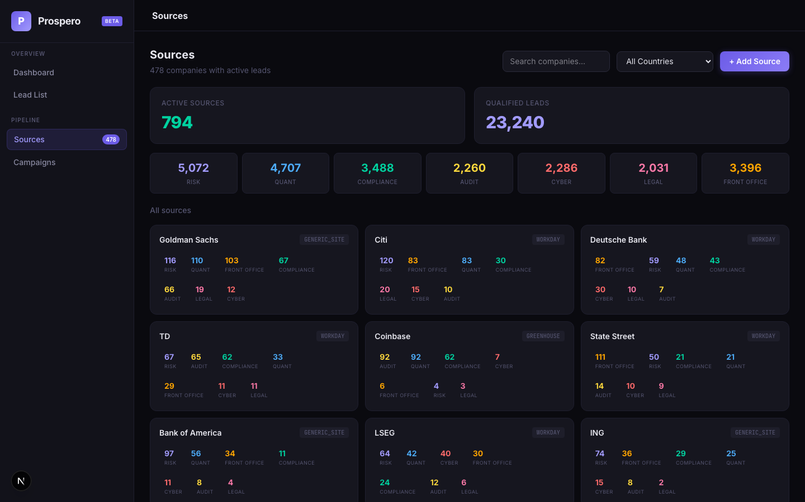
The Platform
Live web application — built and running

Slide 8
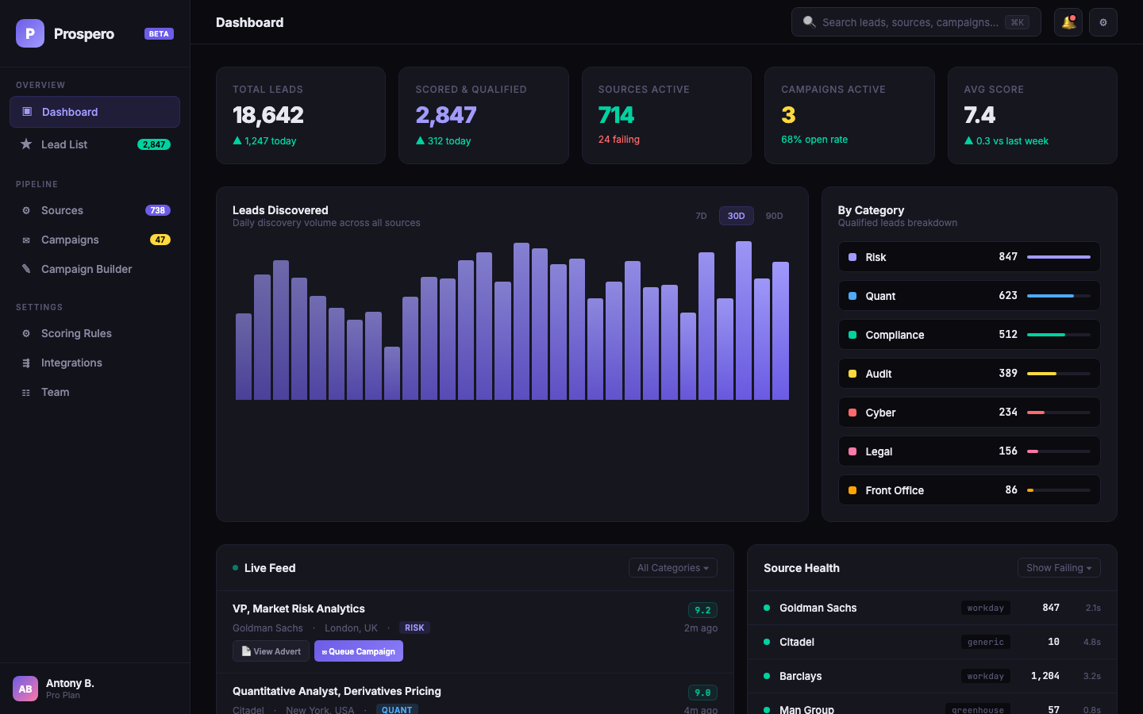
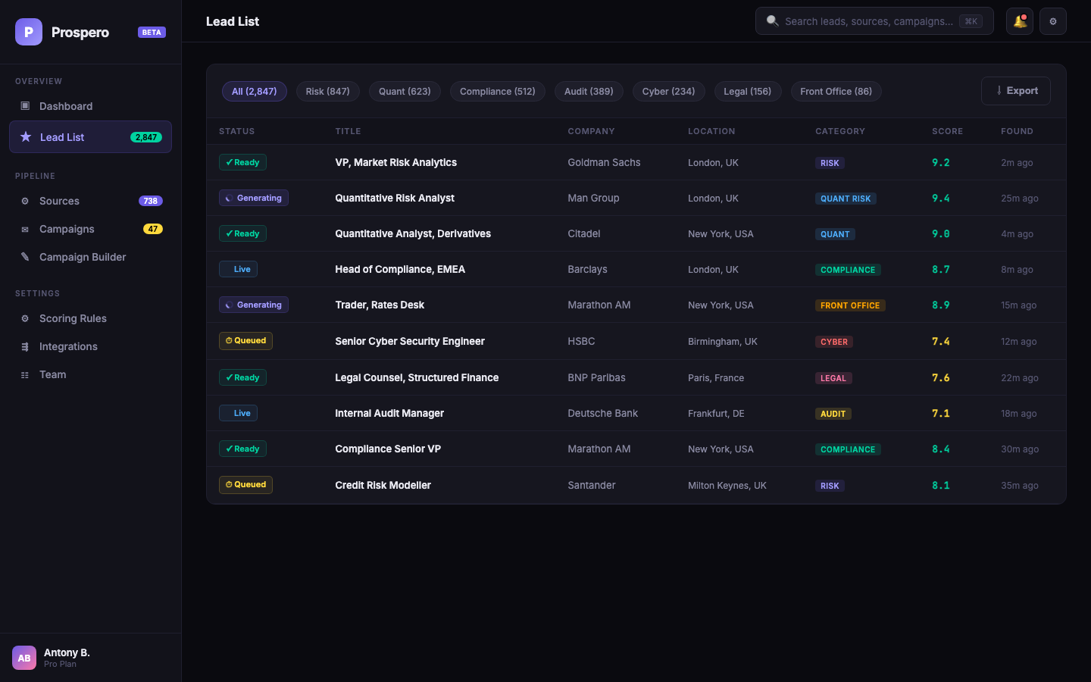
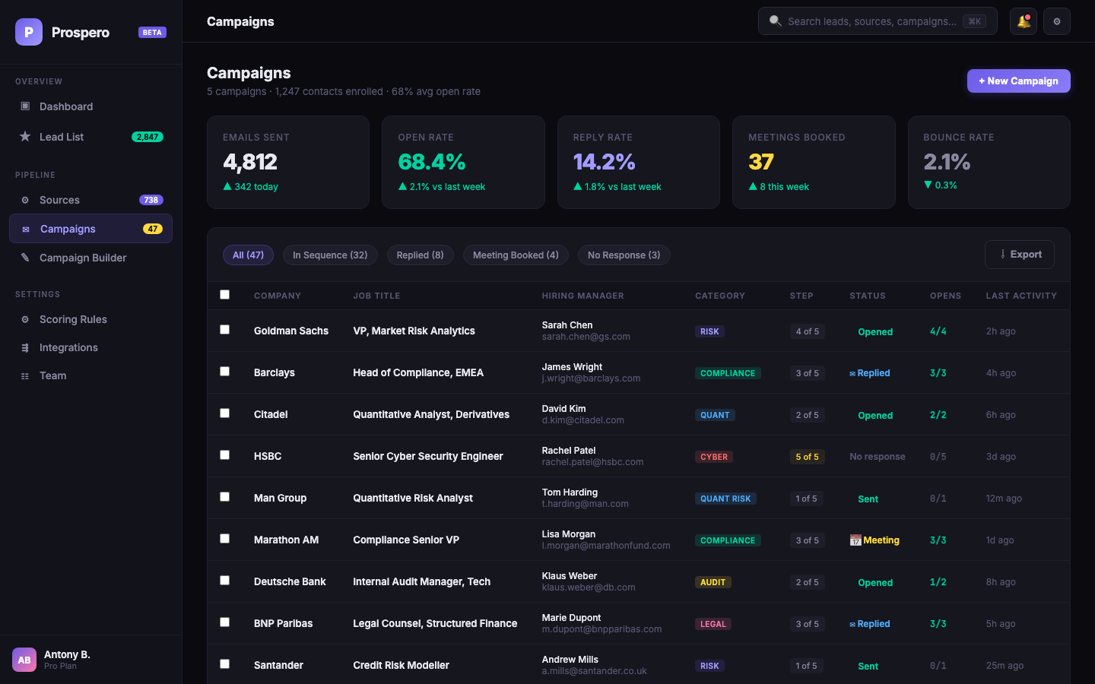
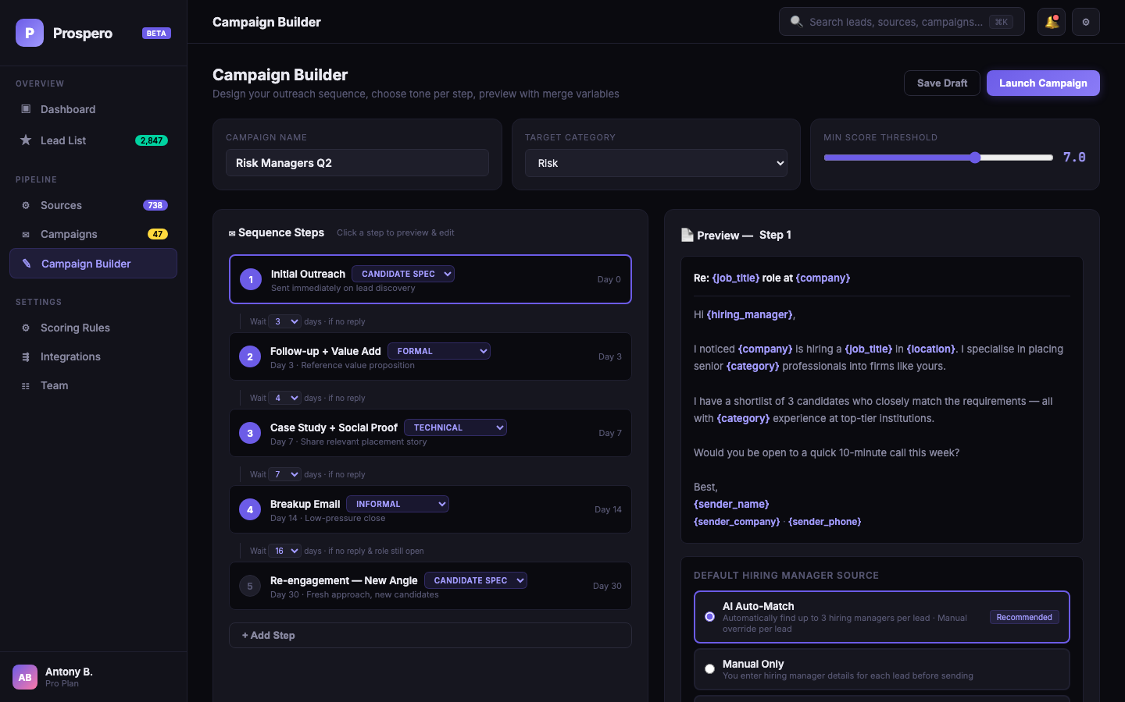
What's Coming
Dashboard, lead management, campaign automation — all designed
Live Dashboard
Lead List
Campaign Tracking
Campaign Builder

Slide 9
The Roadmap
NOW
NEXT
FUTURE
Working Today
Full Platform
Commercial Product
780+ boards scraped daily
Live lead feed + queue to campaign
SaaS for any recruitment agency
AI dossiers + 5-step outreach
Email automation via Outlook
Any vertical, any country
Leads served to Teams
Hiring manager ID + CRM sync
White-labelled per client
Web UI for source management
Consultant dashboard
Contact discovery engine
© 2026 Barclay Simpson Associates Ltd.

Slide 10
The Ask
5
90
1
Consultants
Days
Decision
3-month pilot
to prove ROI
roll out or walk away
The bigger picture:
If the pilot works, every consultant gets a daily pipeline of scored, qualified leads with AI intelligence and automated outreach. From their Outlook. Hands-free. And beyond Barclay Simpson, this becomes a product we can sell to every agency in the market.
ab@barclaysimpson.com | Head of Risk | +44 (0) 207 936 2601

