Slide 1
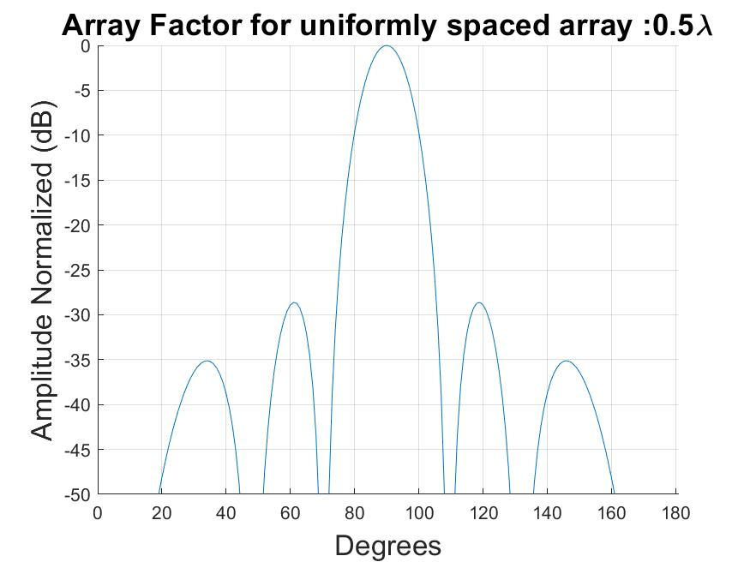
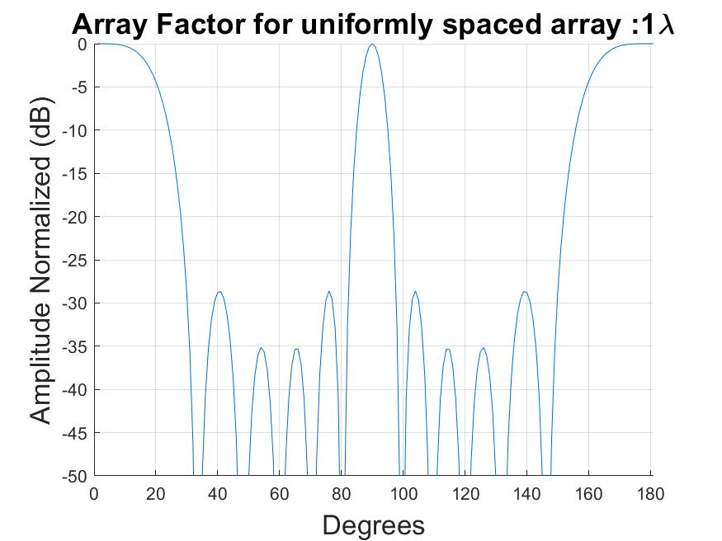
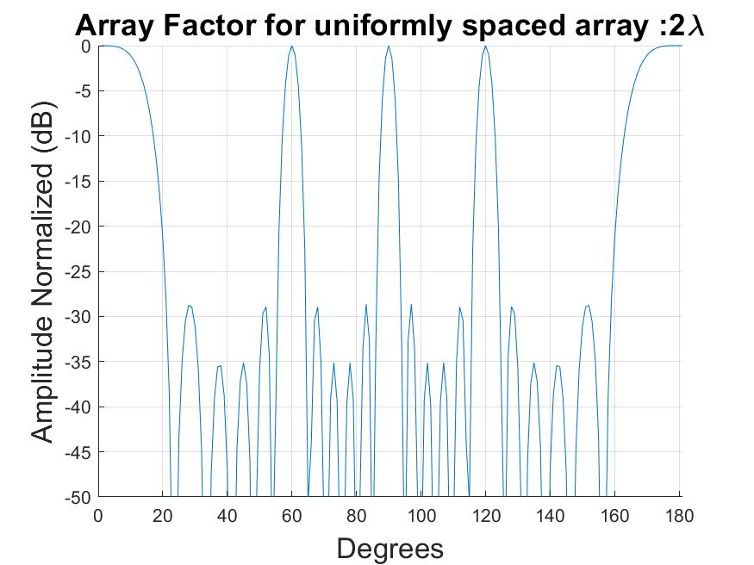
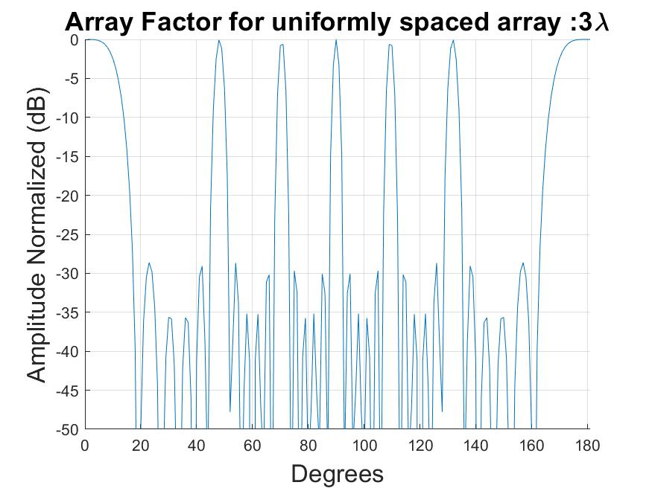
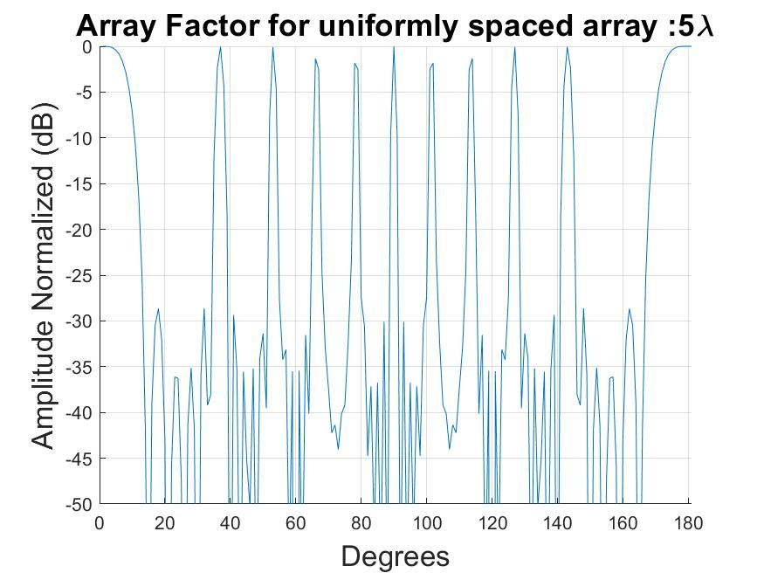
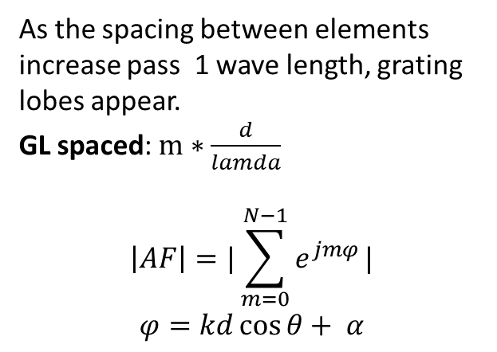
As the spacing between elements increase pass 1 wave length, grating lobes appear.
GL spaced: $m∗\frac{d}{lamda}$
$$\left|AF\right|=|\sum_{m=0}^{N−1}{e^{jmφ}}|$$
$$φ=kd\cos{θ}+ α$$

Slide 2
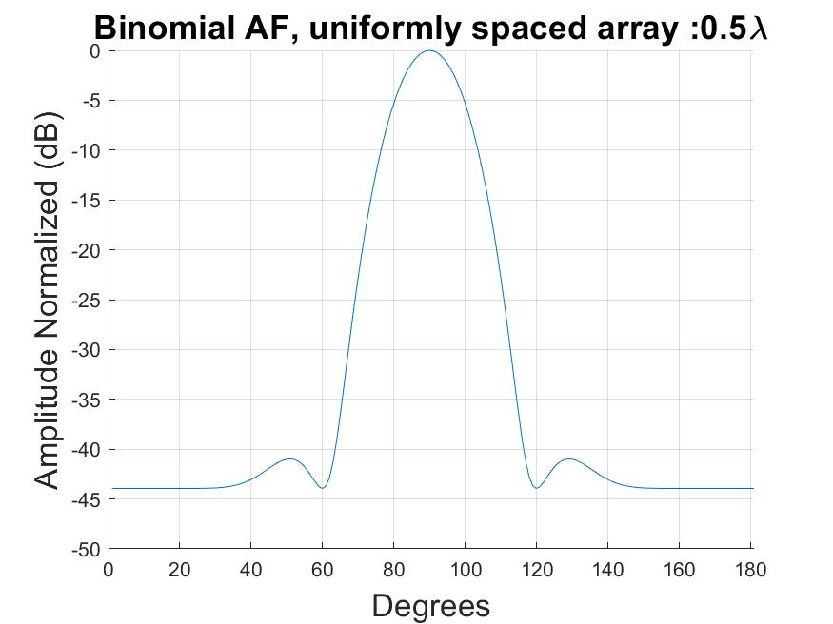
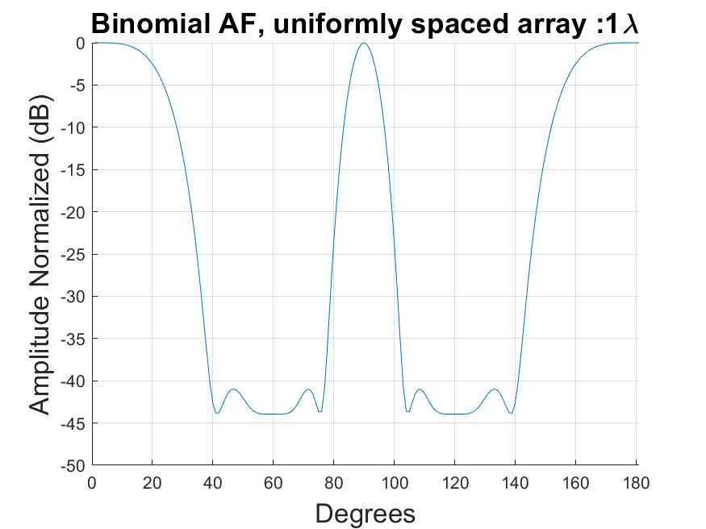
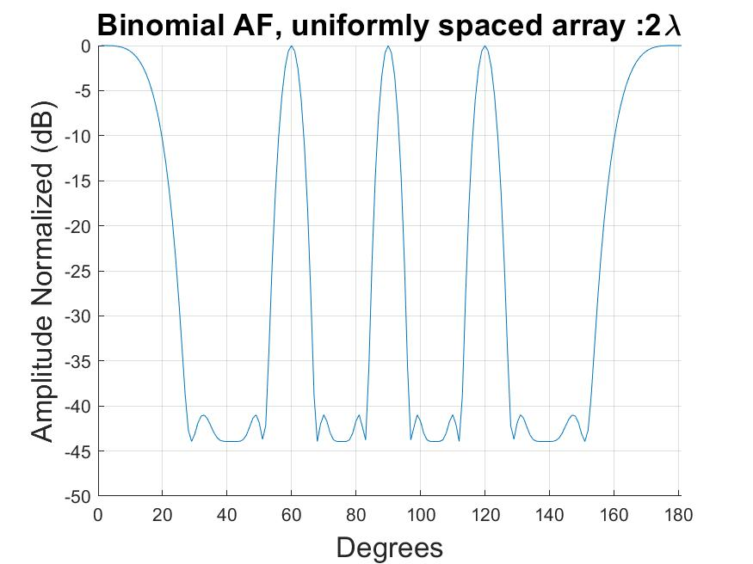
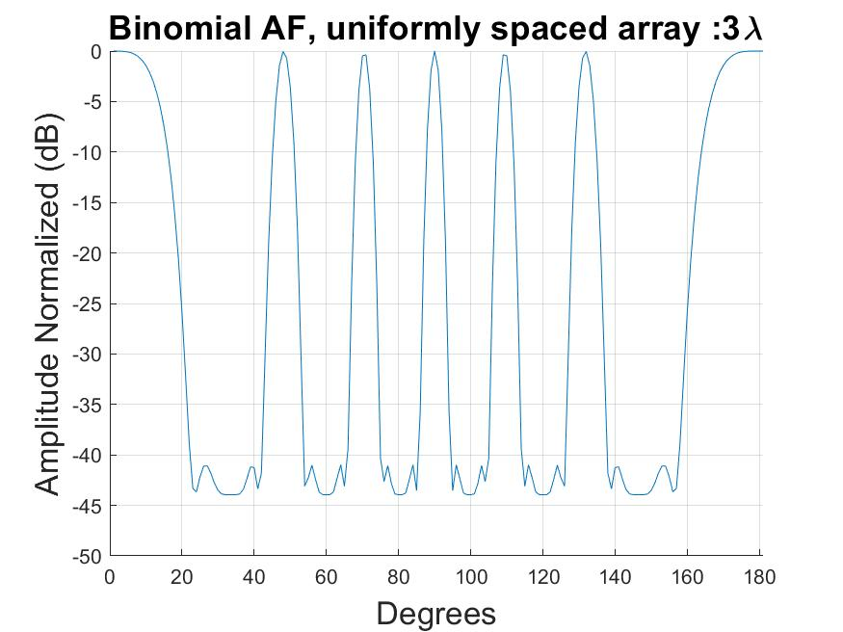
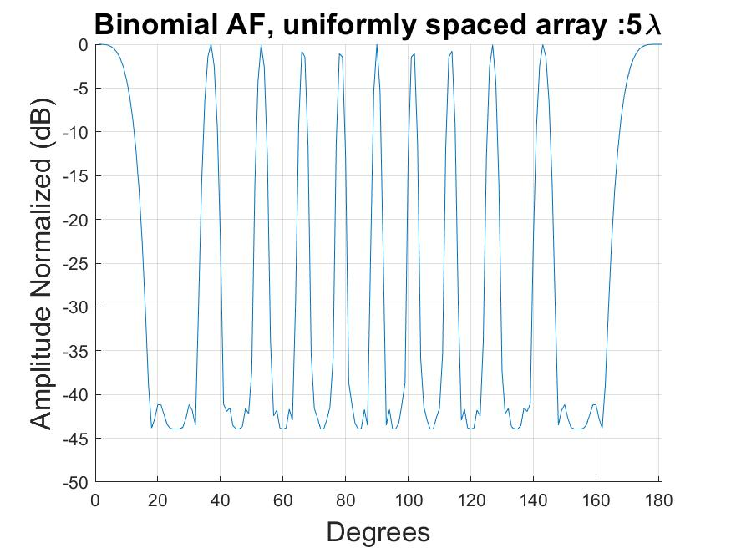
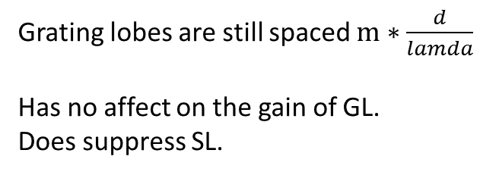
Grating lobes are still spaced $m∗\frac{d}{lamda}$
Has no affect on the gain of GL.
Does suppress SL.

Slide 3
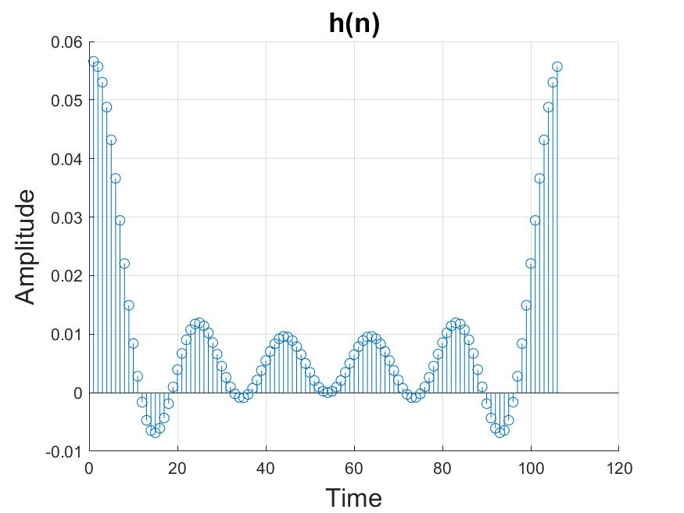
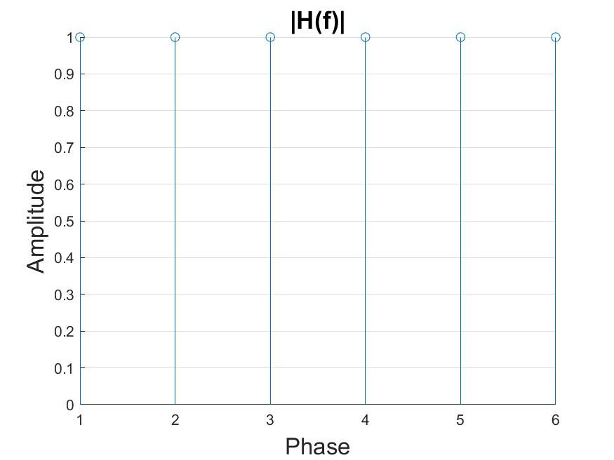
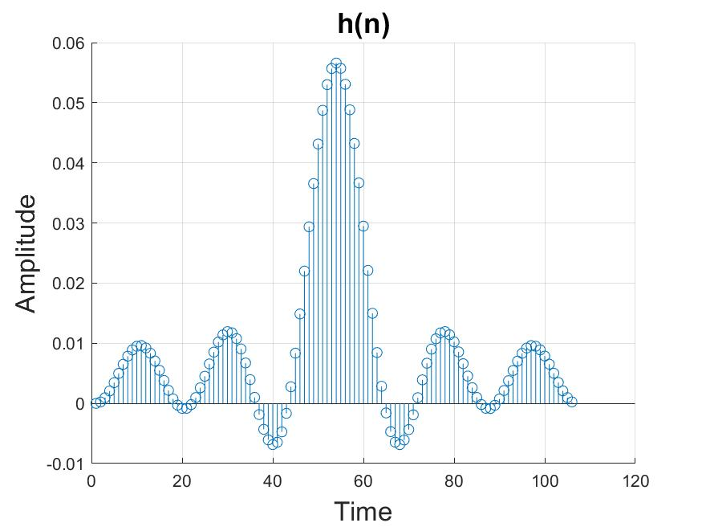

Slide 4
N = 7;
Spacing = [0.711, 1.019, 0.868, 0.98, 0.772, 0.747]
Novel algorithm by:
Khalilpour, Jafar ; Ranjbar, Javad ; Karami, Poorya
My GA for N=6;
Spacing = [1.007, 0.76, 0.892, 0.887, 0,994 ]
5 min

Slide 5
