Slide 1




WALTER ODUR

Slide 2
Antigravity Skills For Computational Drug Discovery
WALTER ODUR
ACE-Uganda
Makerere University

Slide 3
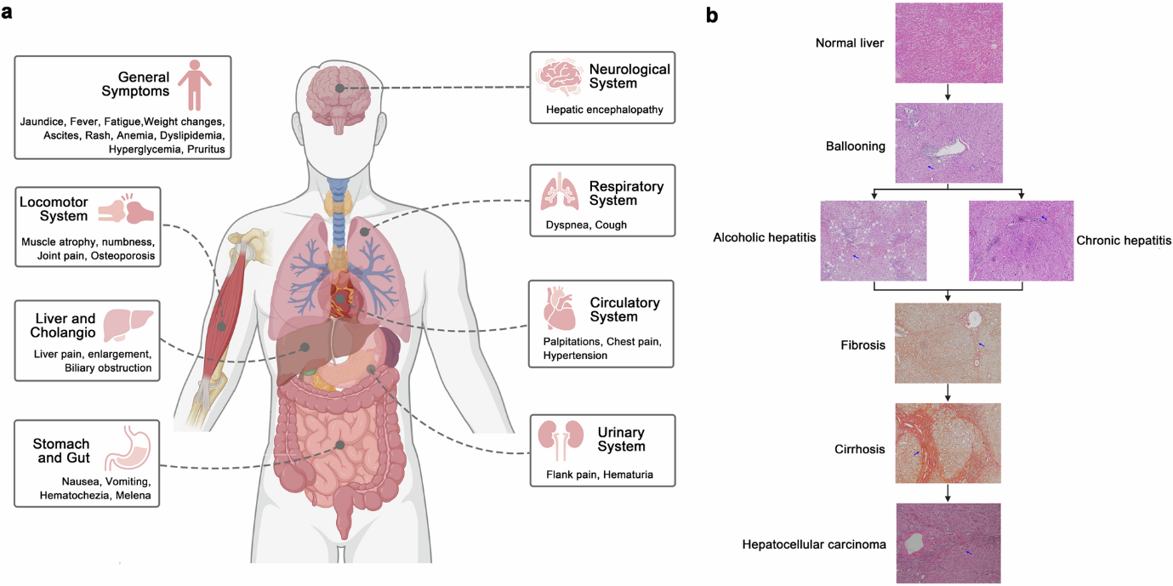

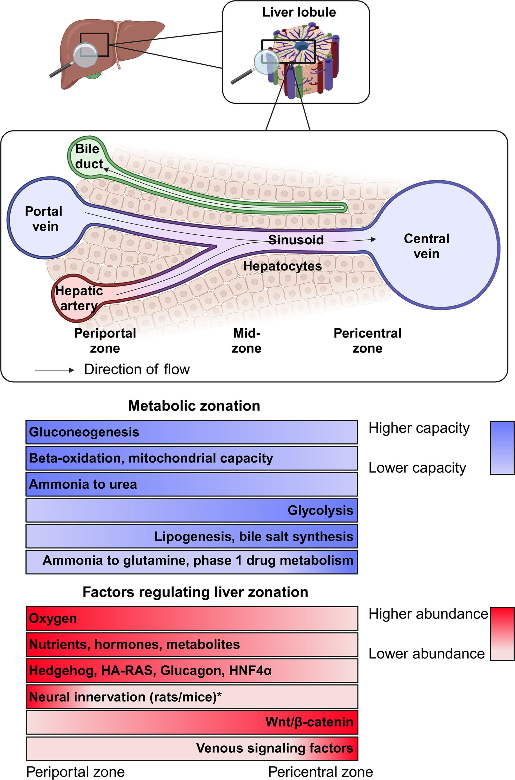
Different conditions damage different liver zones
van de Graaf et al., 2024
Lueckenet al., 2022

Slide 4
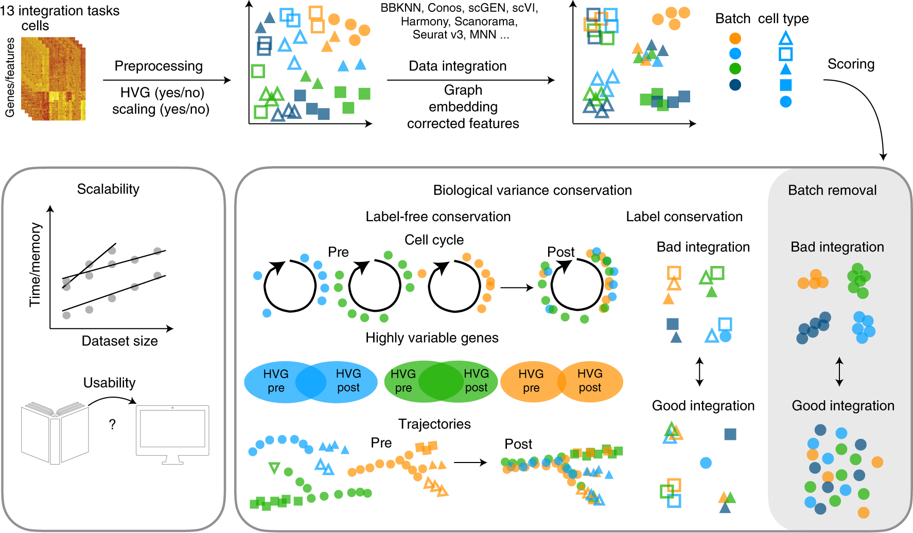


Does integration preserve cell-type-specific biological signals across different injury conditions?
Are biological differences still protected?
Luecken et al., 2022

Slide 5
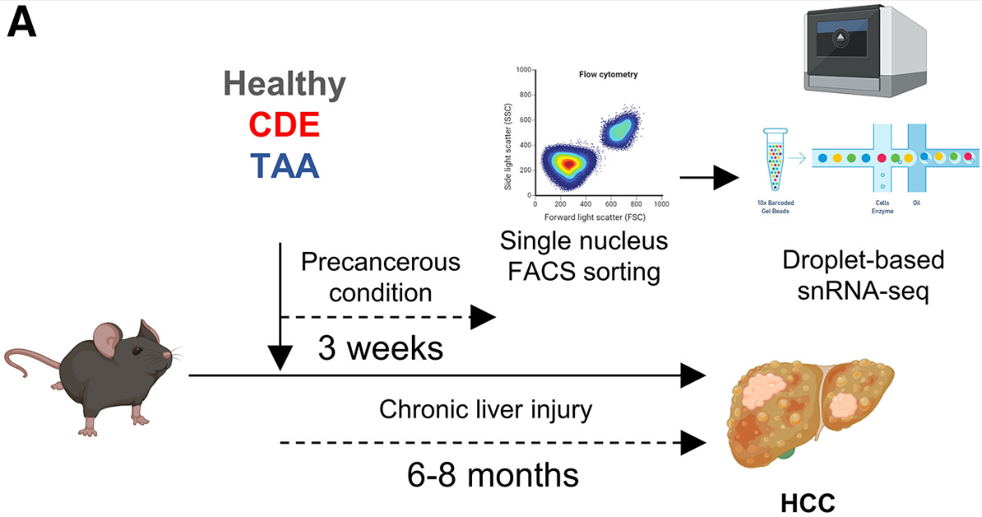

Does integration preserve cell-type-specific biological signals across different injury conditions?
10x Chromium; snRNA-seq
GEO Accession: GSE200366
Male C57BL/6J mice
Carlessi et al., 2023

Slide 6
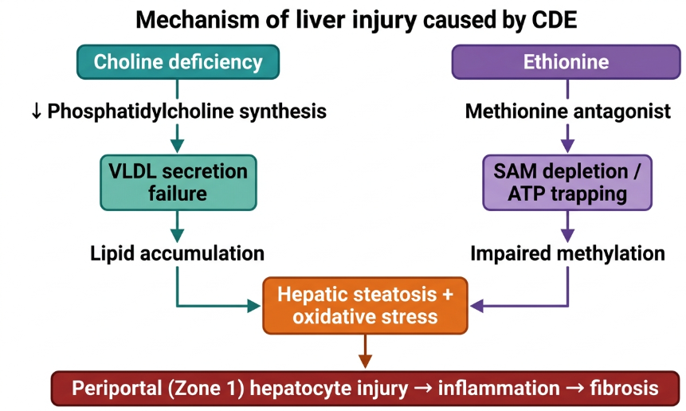
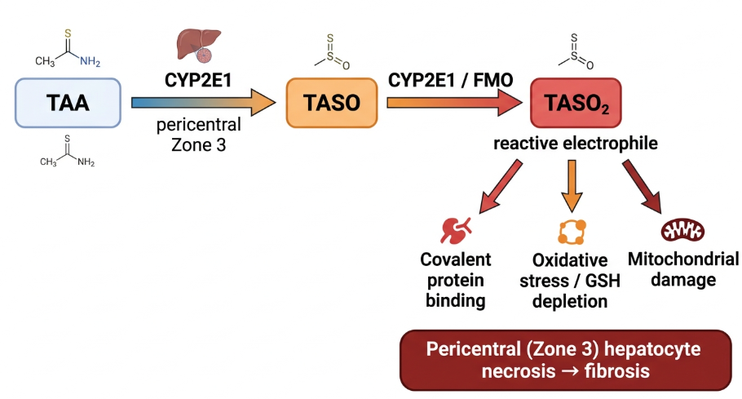

TAA (Thioacetamide) and CDE (Choline-Deficient, Ethionine-supplemented diet) damage different liver zones
CDE
Notes:
CYP2E1=Cyt P450 E21; FMO= Flavin-containing Monooxygenase; TASO = Thioacetamide S-oxide; TASO₂ = thioacetamide S,S-dioxide; SAM: S-adenosylmethionine; GSH: Glutathione

Slide 7
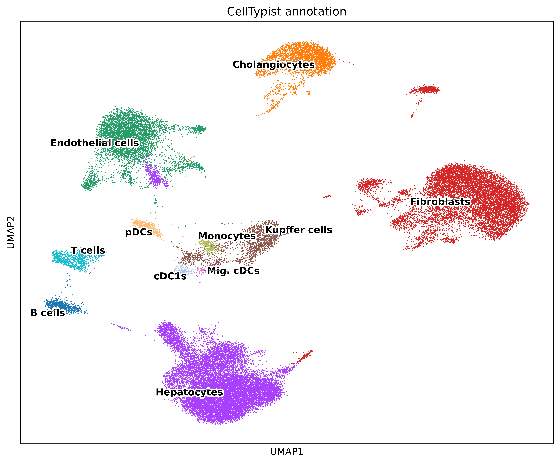
CellTypist identifies 11 cell types
Notes:
UMAP coloured by CellTypist annotation (left) and condition (right).

Slide 8
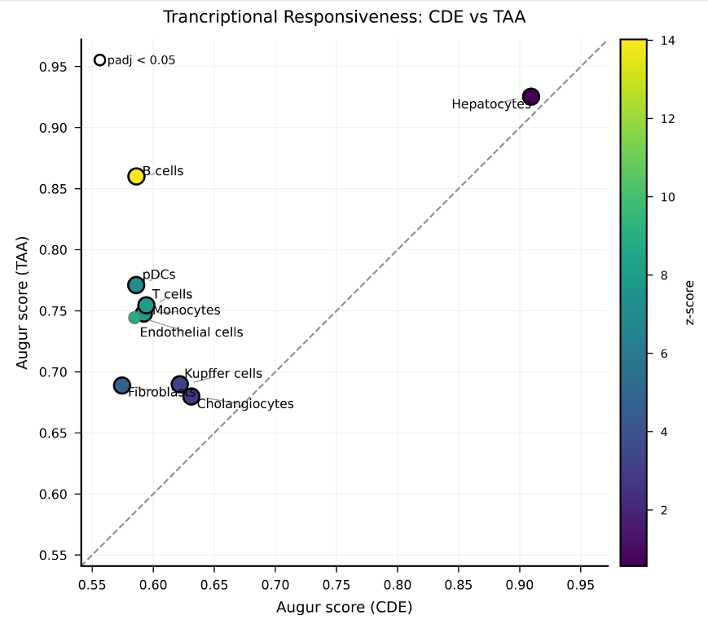
Transcriptional Responsiveness shows that Hepatocytes are the most responsive to both TAA & CDE

Slide 9
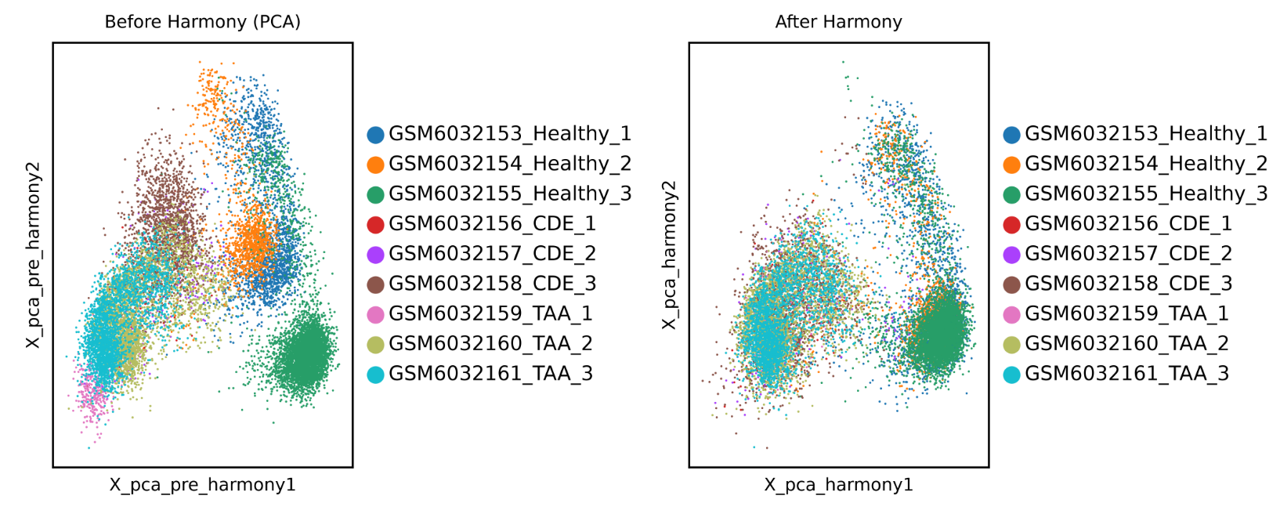
PCA reveals technical variations between samples within the same group

Slide 10

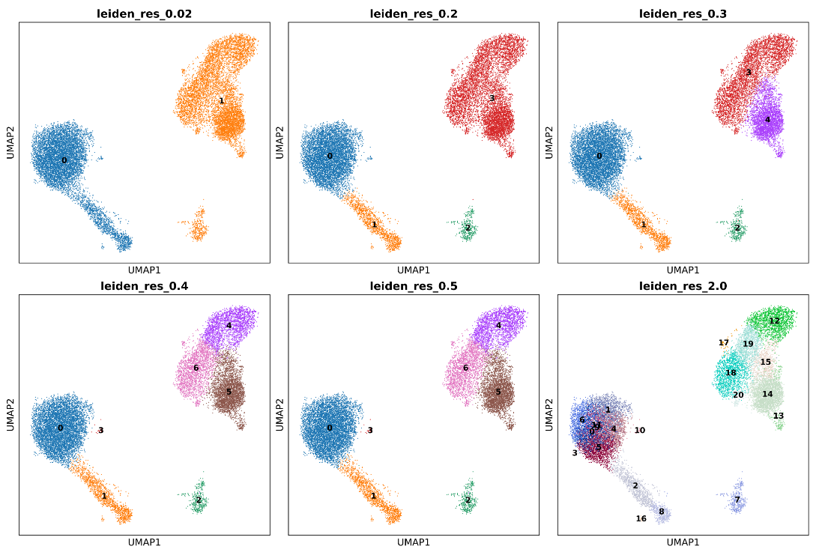
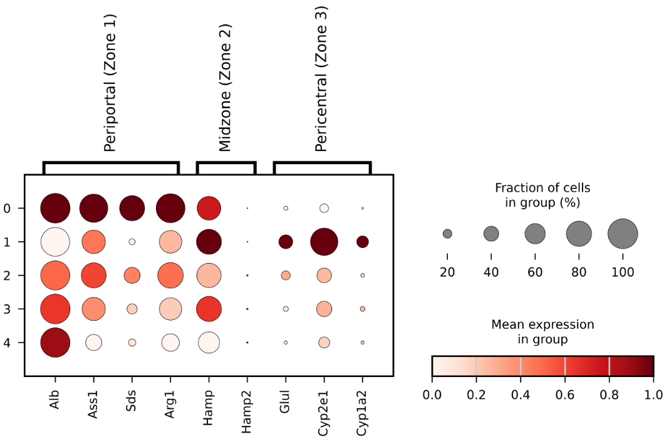
Zonation as a measure of biological conservation
Zone 1: Alb, Ass1, Sds, Arg1
Zone 2: Hamp, Hamp2
Zone 3: Glul, Cyp2e1, Cyp1a2
Halpern et al., 2017

Slide 11
Does harmonization preserve hepatocyte biology?
Harmony (Korsunsky et al., 2019)
Iterative adjustment of PCA embeddings
PCA embedding
+
batch_key = sample
Classical integration
CDE
Scanorama (Hie et al., 2019) - Panoramic stitching
Finds mutual nearest neighbours across batches
expression matrix
+
split by sample
TAA
scVI (Lopez et al., 2018) - Variational autoencoder
Raw count matrix
+
batch_key = sample
Models count distribution, encodes batch as covariate
Healthy
Deep Learning
scANVI (Xu et al., 2021) -
Semi-supervised VAE
Extension of scVI
Raw count matrix
+
batch_key = sample
+
labels_key = cell types
inVAE (Aliee et al.,2024; preprint) - Disentangled VAE
+
+
splits latent into invariant and spurious (batch)
invariant_key = condition
Raw count matrix
spurious_key = sample

Slide 12
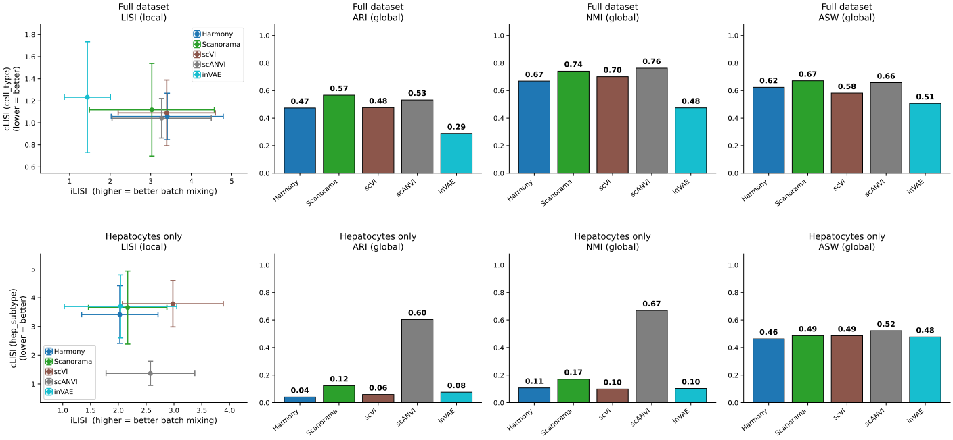
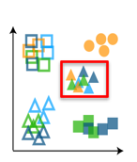
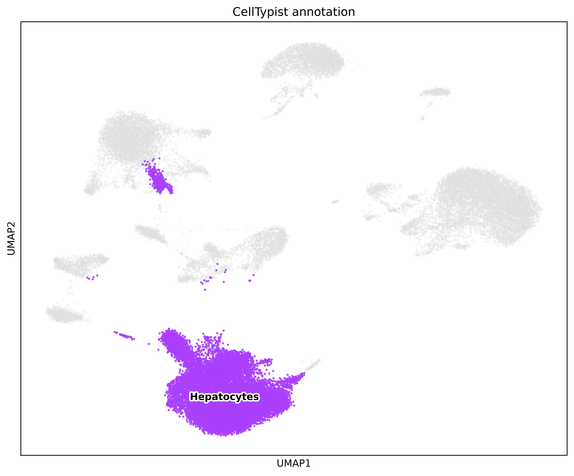
Integration preserves cell structure; cell type specific biology is not always preserved
Notes:
LISI (neighbourhood composition; local) = Local Inverse Simpson's Index; ARI (global; discrete) = Adjusted Rand Index; NMI (discrete) = Normalised Mutual Information; ASW (continuous) = Average Silhouette Width

Slide 13
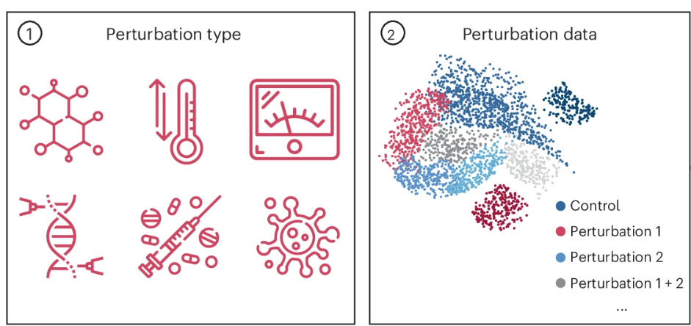
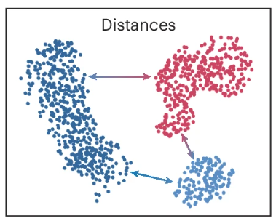

Do we need a different approach?
What if we don’t integrate, but just calculate perturbation distances/vector shift?
Condition A
Control
Condition B
Heumos et al., 2026

Slide 14
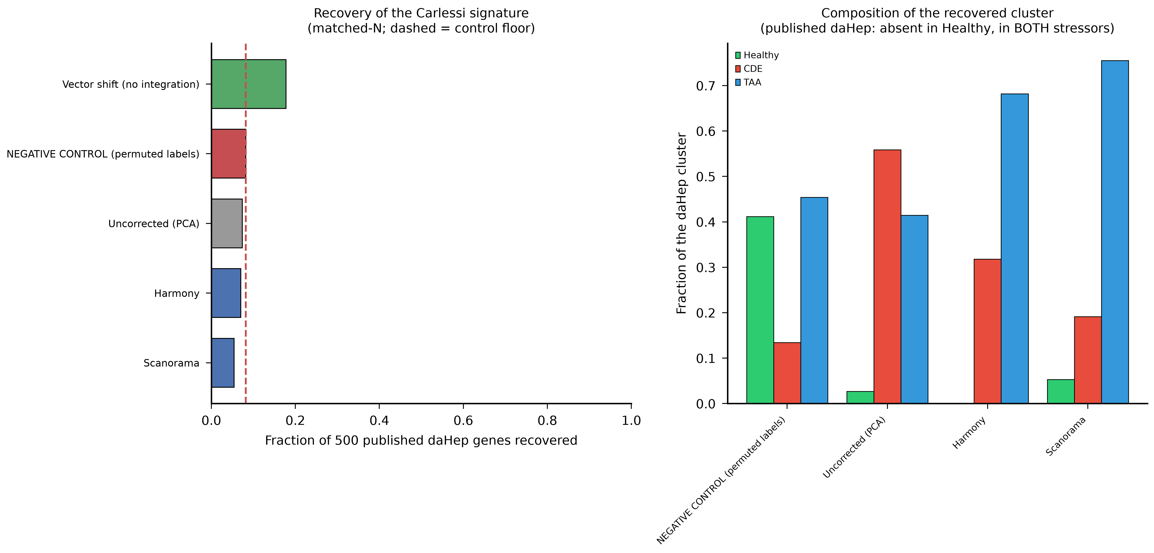
Vector shift outperforms integration in marker gene recovery

Slide 15
Conclusions and prospects
Conclusions
  Integration preserves cell structure; cell type specific biology is NOT ALWAYS preserved
  However, large sample sizes, extensive hyperparameter tuning could improve performance especially for deep learning models
  Vector shift (Better signature discovery)
What next
  Integrate multiple datasets across different labs with more comprehensive hyperparameter tuning
  Build a comprehensive hepatocyte meta-atlas across multiple liver conditions

Slide 16



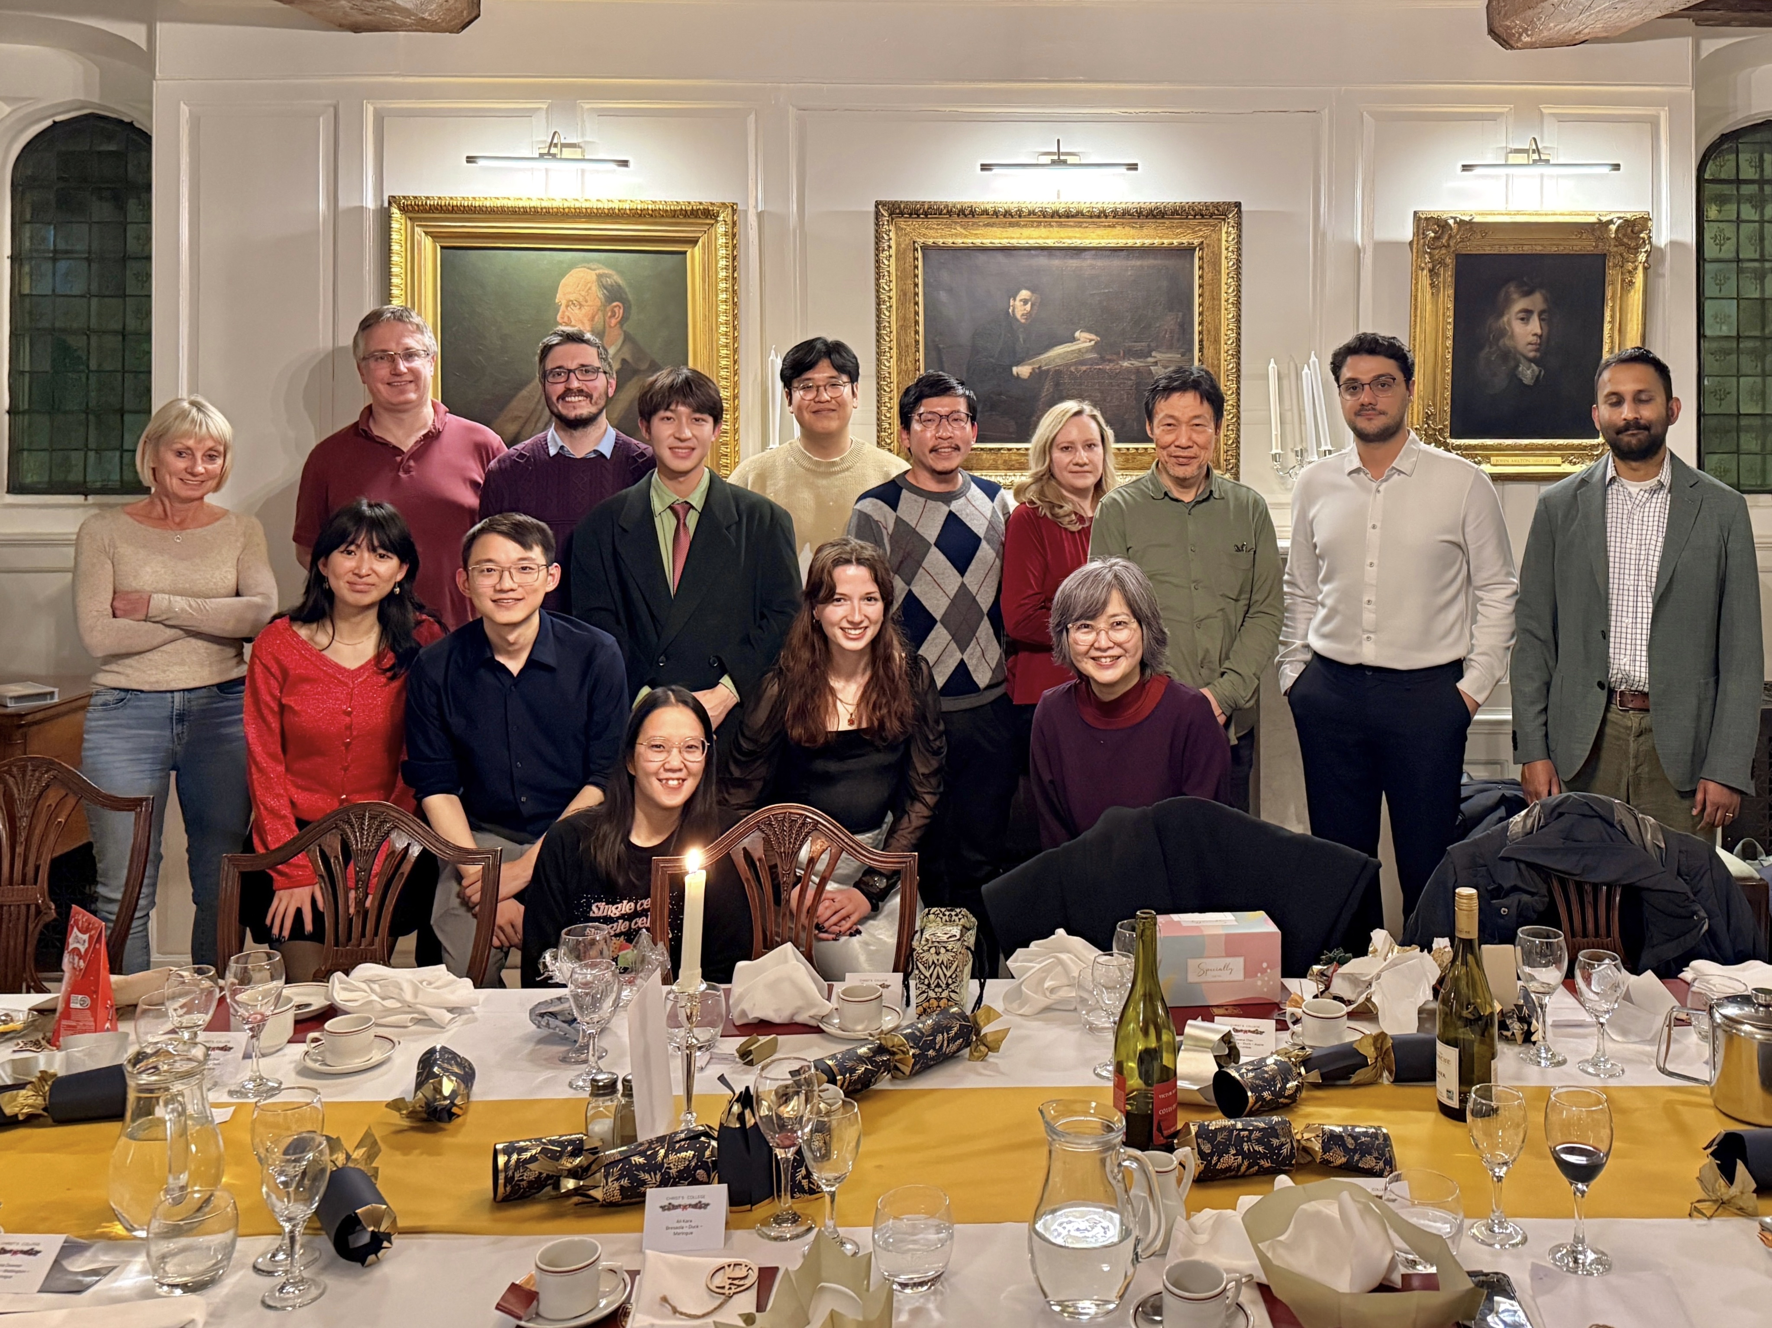
Acknowledgements
Narita Group
Masashi Narita
Masako Narita
Adelyne Chan
George Skalka-Hall
Ioana Olan
Andrew Young
Tetsuya Handa
Iannish Sadien
Jack Zhan
Sheng Yuan Kan
Aya Kimoto
Sandali Malandkar
Weijia Gao
Ali Kara
Maike De La Roche & Nixon Niyonzima
Academic Development Team
HR & Research Administration Team
THANK YOU

