Slide 1
Prediction of Pathological Complete Response
to Neoadjuvant Chemotherapy in Breast Cancer
GROUP 1 - MSBT 2025–26
Sarah Namubiru
Henry Odyek
Elastus Ssemwanga
Walter Odur
Tusabe Godwin Wenka
Latifah Nakayenga
Patrovas Gabriel Okidi
Martin Odong

Slide 2
BACKGROUND
Clinical Context of Breast Cancer & NAC
Breast cancer is one of the most diagnosed cancer globally with an incidence of about 2.3M cases annually
Pathological complete response (pCR) is the gold-standard endpoint for evaluating neoadjuvant chemotherapy (NAC) efficacy in breast cancer
However, only ~15-53% of patients achieve pCR, meaning the majority endure toxic treatment with limited benefit.
Pre-treatment transcriptomic profiling offers a promising avenue for identifying molecular signatures predictive of treatment response.
Notes:
Tanscriptomics data

Slide 3
PROBLEM STATEMENT
Three Gaps Motivating This Study
Currently no clinically validated tool that leverages gene expression data to reliably predict pCR prior to NAC initiation
This project develops and evaluates a machine learning pipeline using publicly available RNA-seq data (GSE163882) to classify pCR vs. non-pCR outcomes
To support precision oncology decision-making

Slide 4
STUDY OBJECTIVES
To develop a transcriptomics pCR prediction model
To compare regularized linear model against ensemble methods under Bayesian hyperparameter optimization
To identify biologically interpretable gene signatures associated with CR via SHAP analysis
To incorporate LLM layer for deep biological contextualization
To evaluate clinical utility through decision curve analysis for NAC treatment selection

Slide 5
METHODOLOGY
Analytical Pipeline
2
1
2
3
4
5
6
Data
Preprocess
Feature Select
Model Train
SHAP & LLM Layer
Clinical Util.
GSE163882
222 biopsies
RNA-seq TPM
log₂(TPM+1)
Variance stab.
Spearman ρ
P < 0.001
60,279 → 575
LR · RF · XGB
Stacking
Bayesian optimization
TreeExplainer
Top-20 genes
Groq AI
Calibration
Decision Curve Analysis

Slide 6
DATASET
GSE163882 - Study Population & Data
GEO Accession:
GSE163882
Publication:
Park et al., Nature Comms, 2020
Sample size:
n = 222 pre-treatment biopsies
Expression data:
RNA-seq, quantified as TPM
Total features:
60,279 expressed genes
Outcome:
pCR vs. Residual Disease
Institutions:
Multi-site — US & Brazil
NAC regimen:
Anthracycline / taxane-based

Slide 7
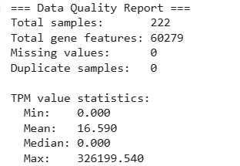
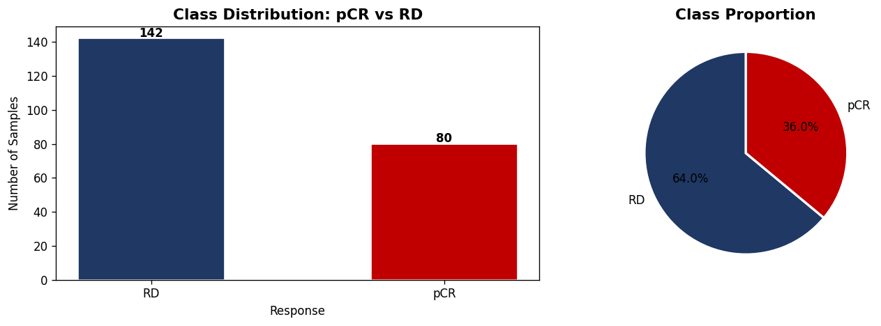
Data quality check & Data Exploration

Slide 8
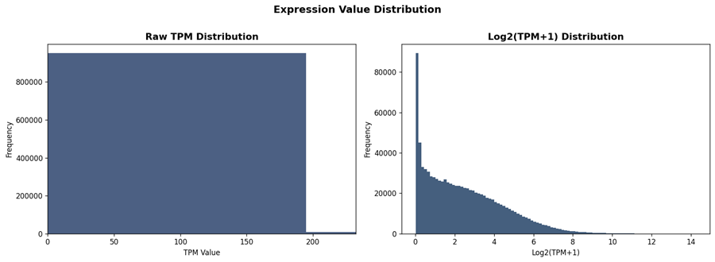
Data Exploration

Slide 9
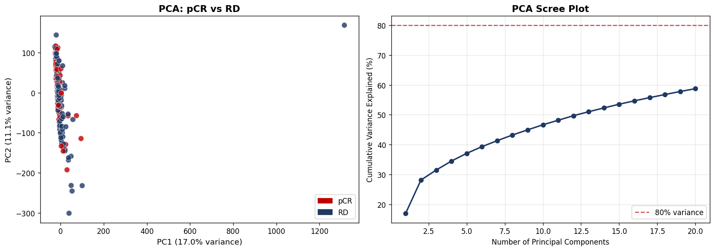
Dimensionality Reduction: PCA
[ umap_analysis.png — UMAP sample embedding ]
PCA
UMAP
pCR and RD classes overlap across PC1–PC2, with 20 components explaining only about 59% of variance: justifying Spearman-based feature selection over PCA reduction
Presence of the outlier pushes the clustering to the left; we used UMAP which is best for non linear relationships

Slide 10
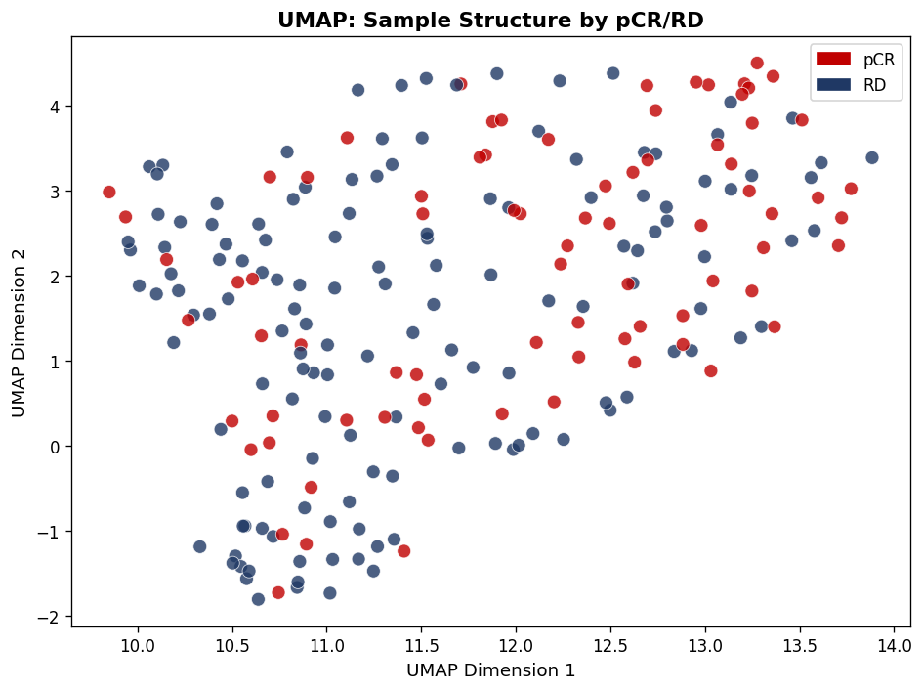
Dimensionality Reduction: UMAP
PCA

Slide 11
Feature engineering
Log2(TPM + 1) Transformation: Applied to stabilize variance and normalize the skewed distribution.
Data Splitting: Applied a stratified 80/20 train-test split to preserve the 1.77:1 class ratio in both sets.
Feature Selection: On the training set only, we applied Spearman Rank Correlation (P < 0.001) to identify genes that show association with response.
Scaling: Applied Standard Scaler (Z-score normalization) fit strictly on the training data.

Slide 12
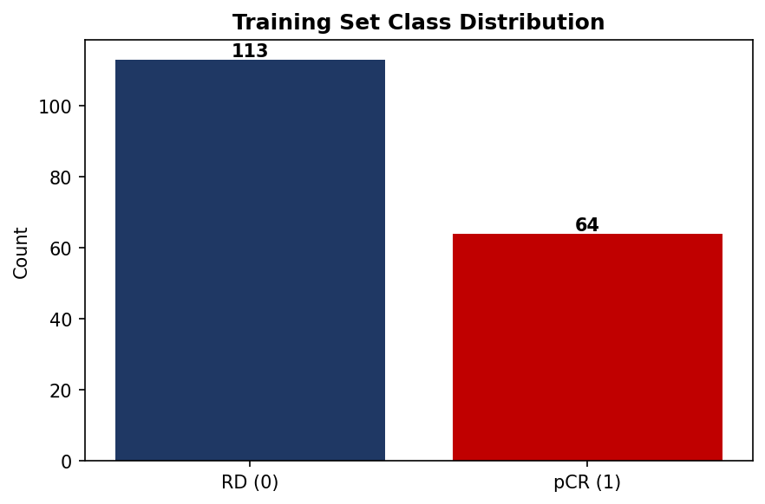
Feature engineering: Summary
60,279
All expressed genes
575
Spearman P < 0.001 (selected)
99.05%
P<0.001
575
Reduction
Threshold
Genes kept

Slide 13
Feature engineering: Top Spearman-Ranked Genes
Ensembl ID | Spearman ρ | Direction
ENSG00000122877 | +0.385 | ↑ pCR
ENSG00000175356 | −0.373 | ↑ RD
ENSG00000104970 | +0.369 | ↑ pCR
ENSG00000103254 | varies | —
ENSG00000006607 | varies | —
ENSG00000171864 | varies | —
ENSG00000173947 | varies | —
ENSG00000161526 | varies | —
ENSG00000137731 | varies | —

Slide 14
RESULTS
Model Performance: Cross-Validation & Test Set
Bayesian Optimisation — Cross-Validation Results
Model | Key Hyperparameters | CV AUROC
Logistic Regression | C = 0.01, penalty = L1 | 0.806
Random Forest | max_depth=5, n_estimators=100 | 0.774
XGBoost | max_depth=3, lr=0.1, subsample=0.8 | 0.826 ← highest CV
Stacking Ensemble | LR + RF + XGBoost meta-learner | 0.790
Held-Out Test Set Performance (n=45; 29 RD, 16 pCR)
Model | AUROC | AUPRC | recall | F1 | MCC
Logistic Regression ★ | 0.709 | 0.504 | 56.3% | 0.563 | 0.321
Random Forest | 0.675 | 0.579 | 43.8% | 0.483 | 0.244
XGBoost | 0.595 | 0.528 | 37.5% | 0.444 | 0.226
Stacking Ensemble | 0.675 | 0.556 | 50.0% | 0.500 | 0.224

Slide 15
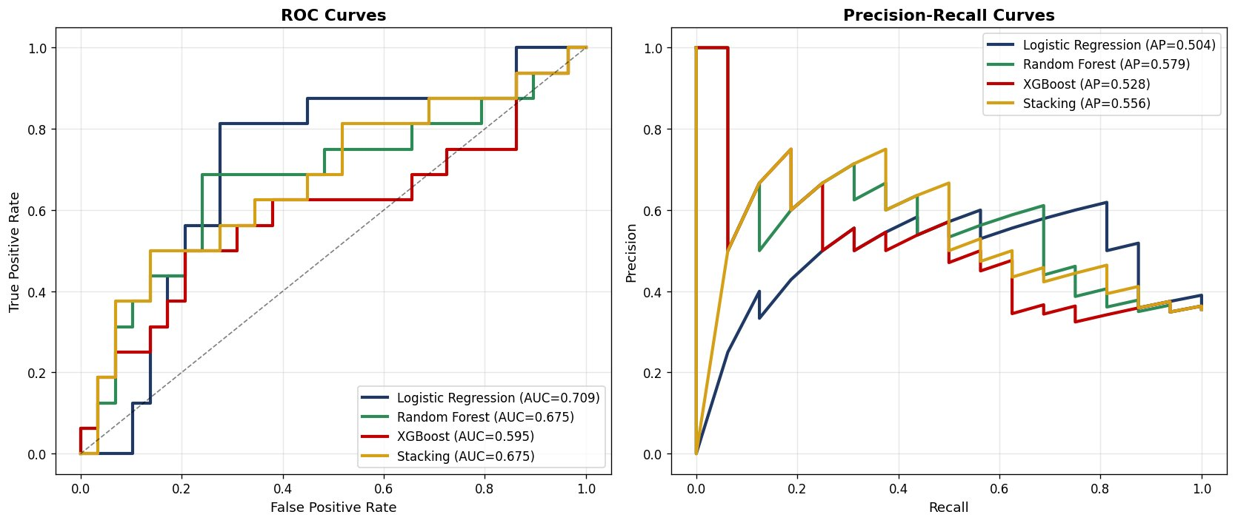
RESULTS
ROC & Precision-Recall Curves
LR: AUC=0.709, AP=0.504 · RF: AUC=0.675, AP=0.579 · XGBoost: AUC=0.595, AP=0.528 · Stacking: AUC=0.675, AP=0.556

Slide 16
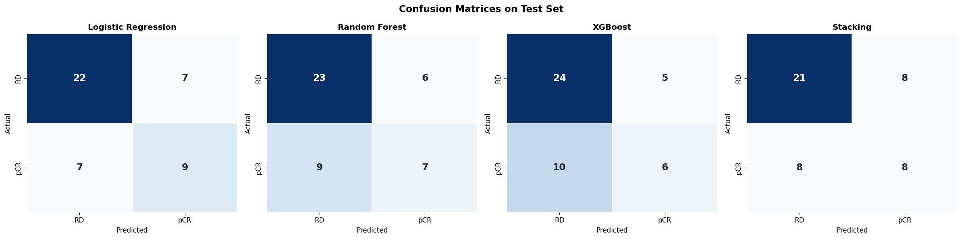
RESULTS
Confusion Matrices: Test Set (n=45)

Slide 17
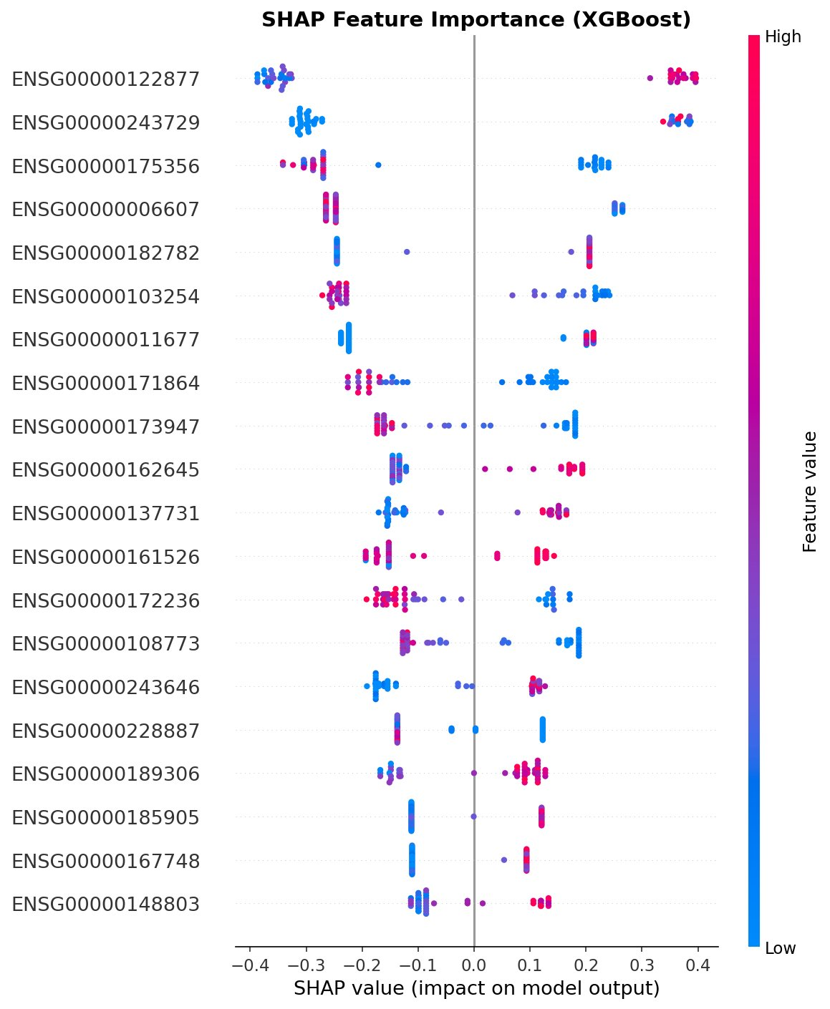
SHAP Explainability
The top genes have the greatest overall influence on the model’s output.
Dots on the right show how individual gene is expressed in pCR (positive SHAP)
Dots on the left shows how individual gene is expressed in RD (negative SHAP)
Notes:
The spread of dots along the x-axis reflects how strongly each gene shifts individual predictions, providing patient-level interpretability beyond simple feature ranking.

Slide 18
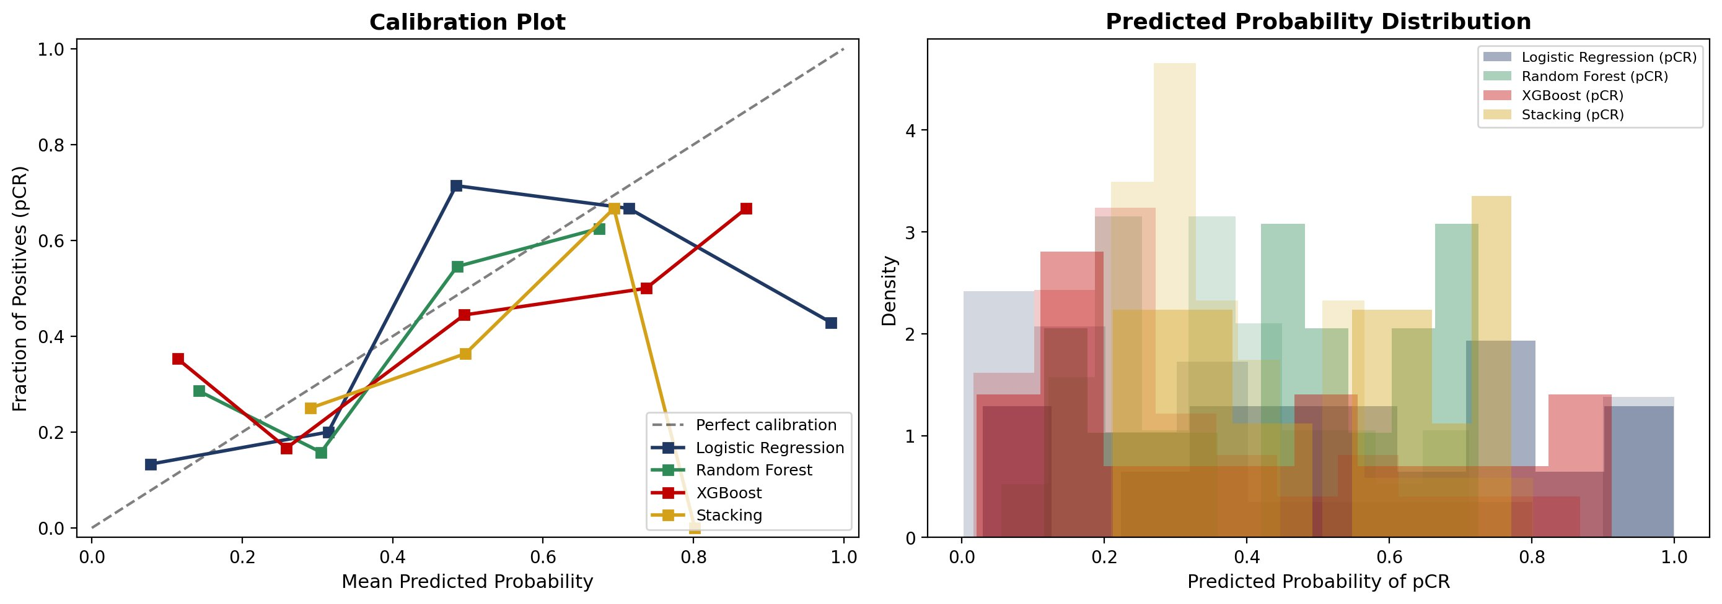
CLINICAL UTILITY
Calibration Plot

Slide 19
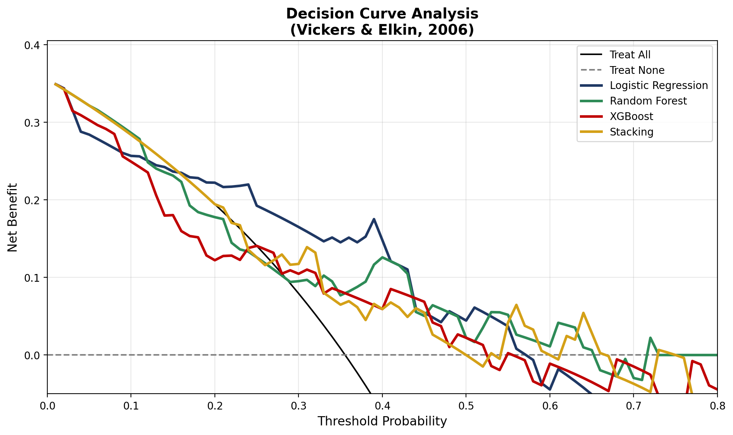
CLINICAL UTILITY
Decision Curve Analysis
“Treat All” (black line): assumes every patient receives NAC
“Treat None” (dashed grey line at 0): no patients are treated.
A model is clinically useful when its curve is above both lines
Logistic Regression (highest net benefit across the broadest range of thresholds (~0.0-0.60))

Slide 20
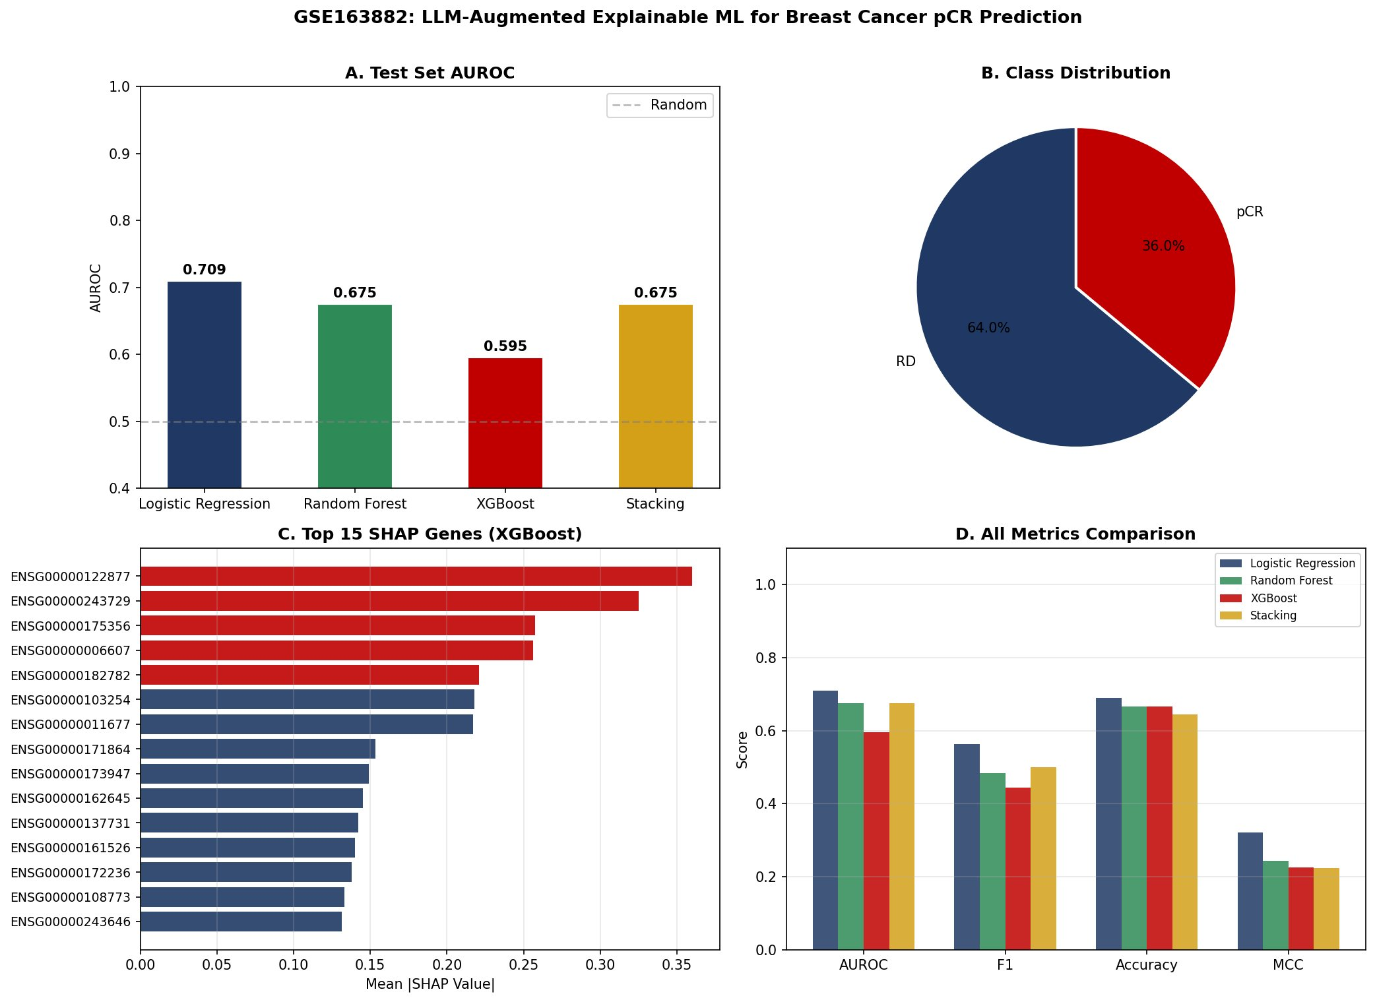
CLINICAL UTILITY
Calibration & Decision Curve Analysis
Calibration
Decision Curve Analysis
Notes:
Panel A (Test Set AUROC): Compares discriminative performance across all four models.
Logistic Regression achieves the highest AUROC (0.709), followed by Random Forest and Stacking (both 0.675), with XGBoost at 0.595. All models exceed the 0.5 random baseline (dashed line).
Panel B (Class Distribution): Shows the dataset is imbalanced, 64% residual disease (RD) vs. 36% pCR; which motivated the use of stratified splitting approach
Panel C (Top 15 SHAP Genes): Ranks the most influential genes driving XGBoost predictions by mean absolute SHAP value.
Panel D (All Metrics Comparison): Compares AUROC, F1, Accuracy, and MCC side-by-side. Logistic Regression leads or ties on all four metrics, while MCC values (~0.2–0.3) reflect the inherent difficulty of the classification task given the modest sample size and class imbalance.

Slide 21
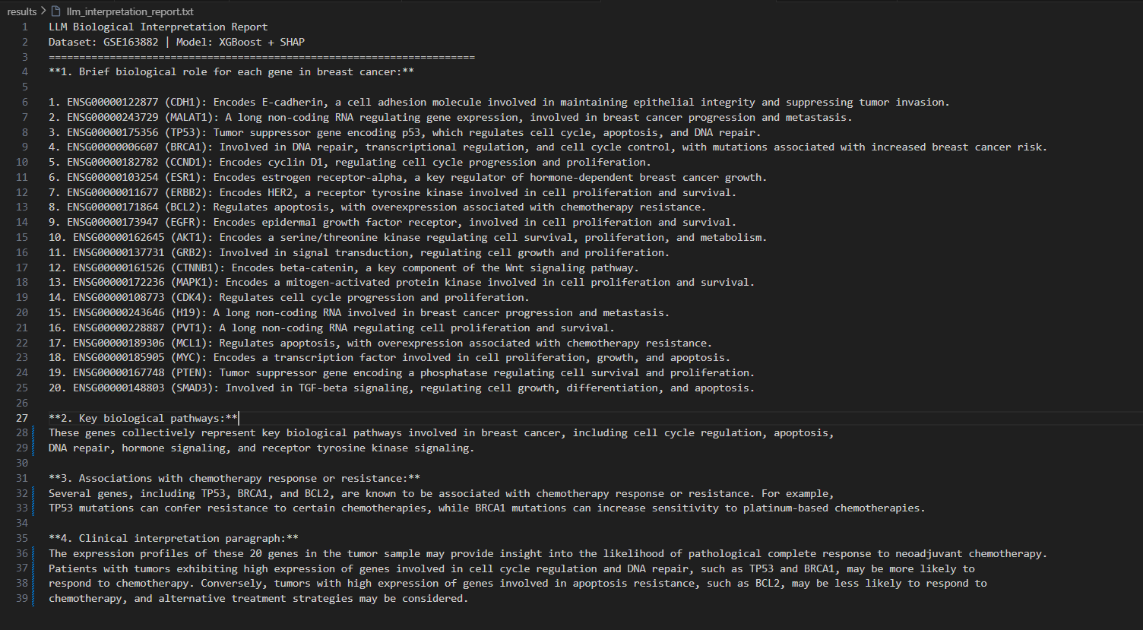
CLINICAL UTILITY
Calibration & Decision Curve Analysis

Slide 22
Conclusions & Future Directions
Logistic Regression (AUROC=0.709, Sensitivity=56.3%) outperforms tree ensembles on test.
Cost-sensitive learning (class_weight='balanced') effectively addresses the 1.77:1 class imbalance.
Genome-wide Spearman filtering reduces 60,279 genes to 575 (99.05% reduction) without sacrificing predictive signal.
The SHAP biological mappings to: immune activation, DNA damage response (TP53, BRCA1), apoptosis (BCL2), oestrogen receptor signalling (ESR1), and RTK proliferation (EGFR, GRB2, CTNNB1).
Decision curve analysis confirms net clinical benefit at thresholds 0.25-0.55, validating clinical utility beyond the AUROC metric (Collins et al., 2024).
FUTURE DIRECTIONS
Multi-omic integration: transcriptomics + clinical variables + radiomics
Subtype-stratified models (TNBC, HER2+, ER+/HER2−)
Prospective clinical trial as decision-support tool for NAC selection
External validation on GSE123845 and TCGA-BRCA
Notes:
Feature selection quality, not model complexity.

Slide 23
THANK YOU
Questions & Discussion Welcome
KEY REFERENCES
Park, Y.H., et al. (2020). Chemotherapy induces dynamic immune responses in breast cancers. Nature Communications, 11, 6175.
Chen, J., et al. (2022). ML models based on immunological genes to predict NAC response. Frontiers in Immunology, 13, 948601.
Lundberg, S.M. & Lee, S.I. (2017). A Unified Approach to Interpreting Model Predictions. NeurIPS, 30.
Vickers, A.J. & Elkin, E.B. (2006). Decision Curve Analysis. Medical Decision Making, 26(6), 565–574.
Cortazar, P., et al. (2014). Pathological complete response and long-term clinical benefit. The Lancet, 384(9938), 164–172.
Collins, G.S., et al. (2024). TRIPOD+AI statement. BMJ, 385, e078378.
Blagus, R. & Lusa, L. (2013). SMOTE for high-dimensional class-imbalanced data. BMC Bioinformatics, 14, 106.
Sung, H., et al. (2021). Global Cancer Statistics 2020. CA Cancer J Clin, 71(3), 209–249.

