Slide 1
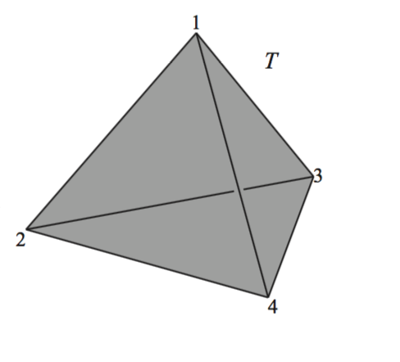


$$(V_{1},Σ_{1})$$
1
$$(V_{2},Σ_{2})$$
2
3

Slide 2





$$u_{5}$$
$$x∈inside(Δ_{\{2,3,5\}})$$
$$x=\frac{1}{3}(u_{2}+u_{3}+u_{5})$$
$$u_{2}$$
$$u_{3}$$

Slide 3
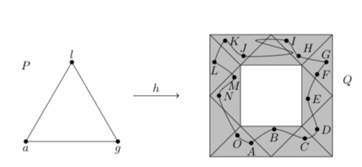



$$|K|$$
$$|g|$$
$$|L|$$

Slide 4
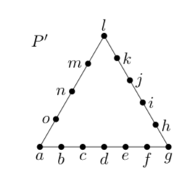


$$|K′|$$
$$|f|$$
$$|L|$$

Slide 5
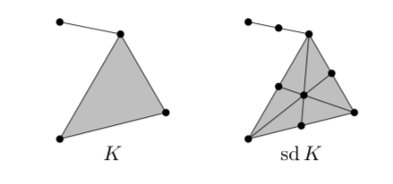


$$K$$
$$K′$$

Slide 6








$$b$$
$$a$$
f(4)
$$e$$
$$K$$
f(5)
f(3)
$$L$$
1
2
3
4
5
f(2)
$$d$$
f(1)
$$c$$
$$b$$

Slide 7
$$b$$
$$a$$
$$e$$
$$K$$
f(2)
$$L$$
1
2
$$d$$
f(1)
$$c$$
$$b$$

Slide 8


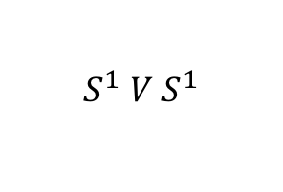

No Interior
$$≃$$
$$≃$$
$R^{2}$ minus two points
$$S^{1} V S^{1}$$

Slide 9

$$≃$$
$$S^{1} V S^{1}$$
The Torus with one point removed

