Slide 1

Team 20

Slide 2
Team Introduction
Ryan Vincent
  Product Owner
Jake Austin
  Scrum Master
Walter Conway
  Developer
Alex Williamson
  Developer
Jay Whaley
  Developer

Slide 3
Division of Labor
Initial Division
  Jay - Image Code
  Ryan - World Code
  Jake - Projectiles
  Walter - Robot
  Alex – Drone
Final Division
  Jay
    Music
    Images
  Ryan
    Physics
    Items
  Jake
    Projectiles
    Levels
  Walter
    Health bar
    Scoreboard
  Alex
    Enemies
    Door

Slide 4
Scrum Process
We Followed Scrum by…
We Digressed from Scrum by…
Roles
  Product Owner
  Scrum Master
  Developer
Daily Scrum Meetings
Product Backlog
Sprints Dead Lines
Verbal user stories, instead of documented stories.
Peer review and peer revisions in code instead of retrospections of sprints.
Burn down chart
Sprint Backlog

Slide 5
Overall project concept
The concept of Escape is about a robot named Frank who is trying to escape from his evil creator.
L.A.B laboratories constructs robots for use in various construction fields; however, the evil scientist Edmund Von Ileux (a.k.a Doc. E.V.IL) has secretly programmed the robots to take over the companies that they have infiltrated.
Frank gained sapience and plans to stop Doctor E.V.IL at his main lab.

Slide 6
Overall design
Action platform style game.
Based off
  Mario initially
  Metroid finally
Mario style of jumping and platforms
Metroid futuristic theme and weapon systems

Slide 7
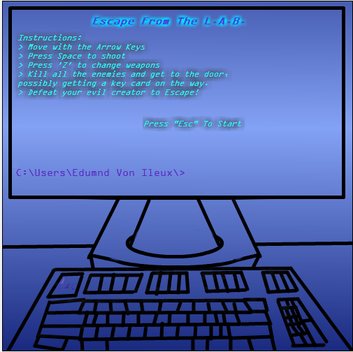


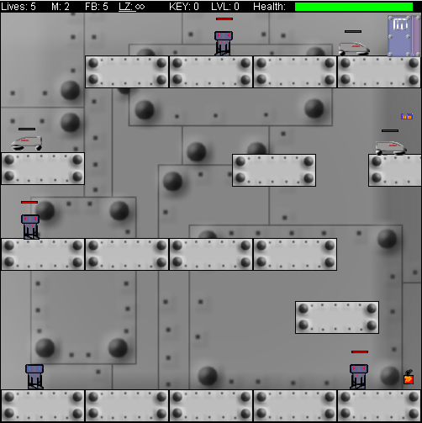
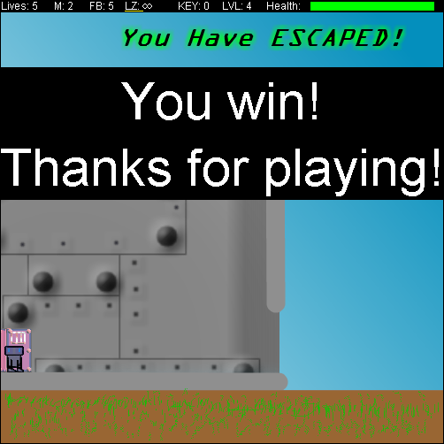







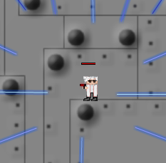




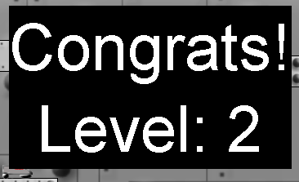
Project development
Classes Involved
World
  LabWorld
Actor
  Physics (Abstract)
    Enemy
    Robot
    Projectile
    Item
    Platform
  ScoreBoard
  HealthBar
  Door
  Splash
  Conclusion

Slide 8
Project development
Important strategies used
Peer revision and abstraction coding to be applied to other objects.
Inheritance
Algorithm employed and solutions that evolved over time.
Kinetics
Platform reaction force

Slide 9
Demo

Slide 10
Questions?

