Slide 1
Ticket Price Modeling for Big Mountain Resort November 28, 2020 (Springboard assignment by Walter Piper)

Slide 2
Problem Identification
What is the optimal ticket price for Big Mountain Resort’s unique set of characteristics given the values of similar features at other ski resorts?
Are there viable improvements to increase revenue,
or safe expenditure cuts that would not undermine ticket price?

Slide 3
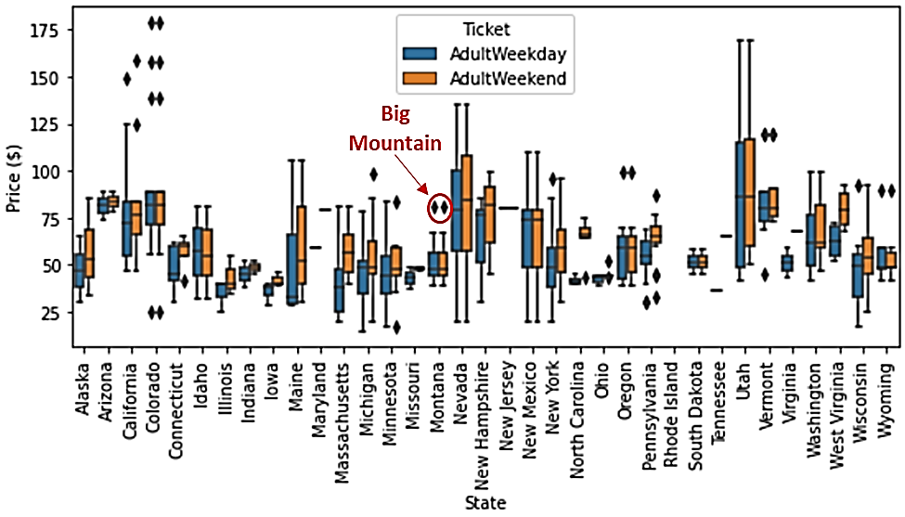
Ticket prices in context
Big Mountain Resort
Current Ticket Price = $81.00
Relative to the nationwide market, Big Mountain Resort is 81st percentile for weekend pricing.
What is our suggested ticket price?
Mean: $95.87 (92nd percentile)
Range (+/- MAE):
$85.48 - $106.26
85th - 95th percentile
Ticket prices grouped by state

Slide 4
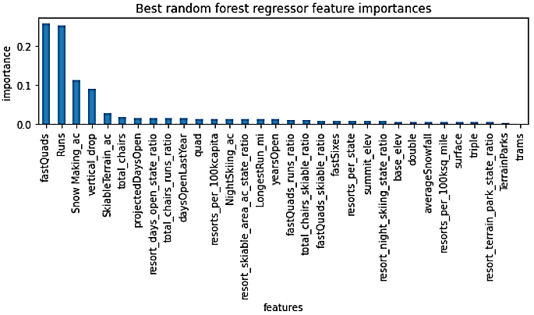
Price-predictive features
Most reliable model was a random forest model
Using 32 total features to predict ‘AdultWeekend’ price
Including resort data and state-level data
Best predictors of price:
Number of Fast Quad chairlifts
Number of Runs
Acres of snow-making
Vertical drop distance
Skiable acres
Total chairs

Slide 5
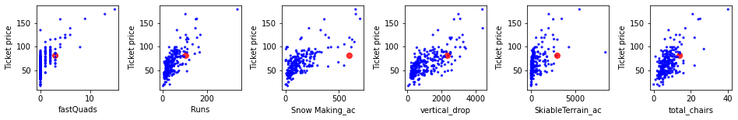
Big Mountain is strong on key features
Variable | Big Mountain Resort’s value | Percent of ski resorts less than or equal to Big Mountain Resort
AdultWeekend ticket price | $81.00 | 81st percentile
Fast Quads | 3 | 95th percentile
Runs | 105 | 93rd percentile
Snow-making acreage | 600 | 98th percentile
Vertical drop (feet) | 2353 | 90th percentile
Skiable acreage | 3000 | 99th percentile
Total chairs | 14 | 95th percentile
What is our suggested ticket price?
Mean: $95.87 (92nd percentile)
Range (+/- MAE):
$85.48 - $106.26
85th - 95th percentile

Slide 6
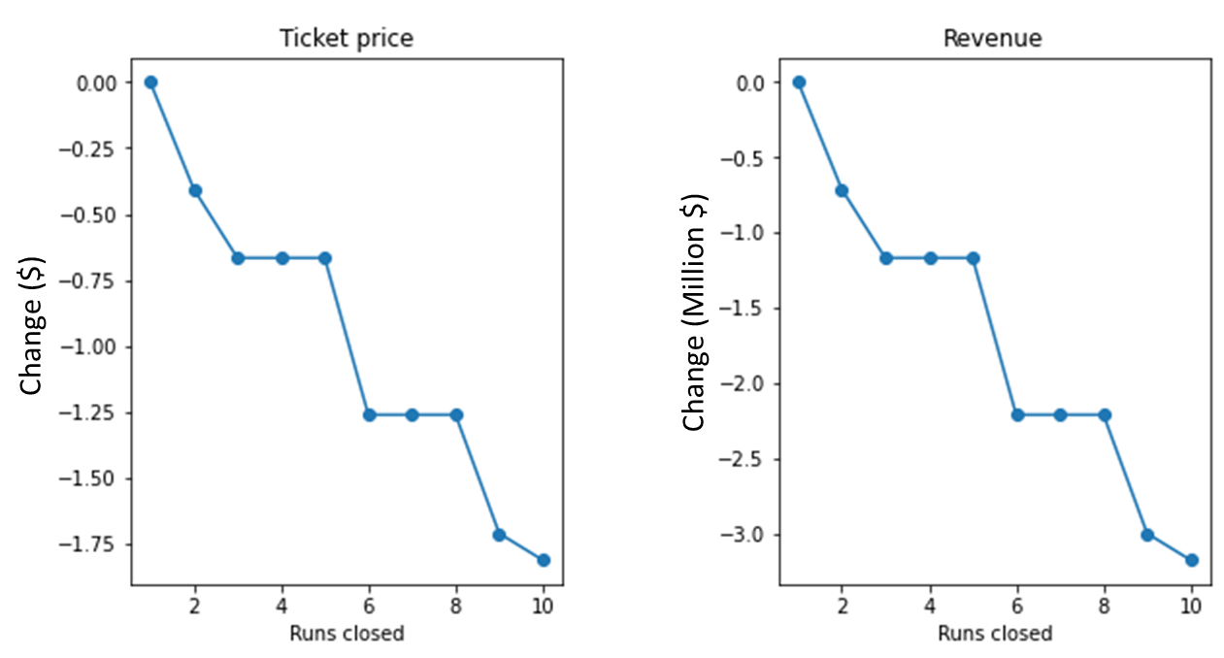
Scenario 1 – Close up to 10 runs
Loss of up to -$1.81 per ticket and -$3.17 Million in annual revenue.
One run could probably be closed without undermining price

Slide 7
More scenarios
Scenario 2 – Add a run and a chair lift to extend vertical drop by 150 ft
Estimated gain of $1.99 per ticket and $3.47 Million in annual revenue.
Scenario 3 – As above plus 2 acres of snow-making to cover new run.
Same gain as Scenario 2. No added benefit of snow-making.
Scenario 4 – Increase longest run by 0.2 miles and add 4 acres snow-making.
No gain.

Slide 8
Conclusions
Current price of $81.00 is underestimating the true value when compared with ski resorts nationwide.
We recommend a ticket price of $95.87 (Range: $85.48 - $106.26)
Of the short-listed improvement scenarios, scenario 2 (extending the vertical drop) is the best option for supporting a higher ticket price.

