Slide 1
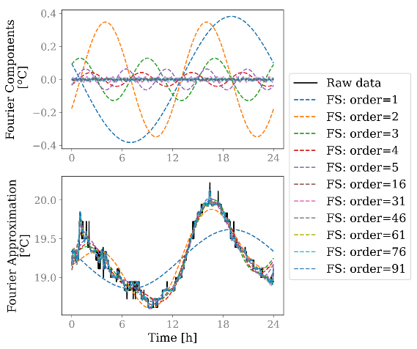
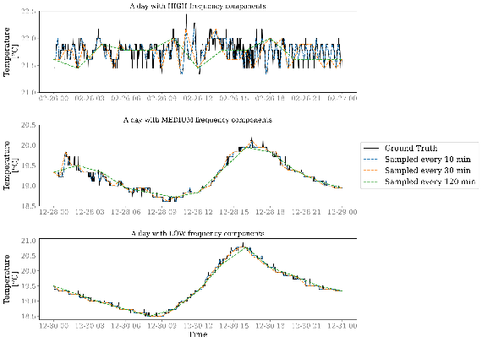
Step 1
Fourier Analysis
Step 2
Shannon-Nyquist Sampling Theorem
Step 3
Validation
Identify the highest frequency Component of daily indoor temperature fluctuation
Determine the sampling rate of indoor temperature sensing
Validate the theoretical sampling rate using a 3-year high-temporal-resolution temperature measurement

Slide 2
“Real” data
(measured every 1 min)
“Measured” data
(down-sampled using the selected sampling rate)
Reconstructed data
(reconstruct to 1 min interval from the “measured” rate)
Evaluation
(Calculate the CVRMSE of the reconstructed and the real data)
Down sampling
Reconstruct
Compare

