Slide 1
Things thought about and decided on choosing certain plots, etc.

Slide 2
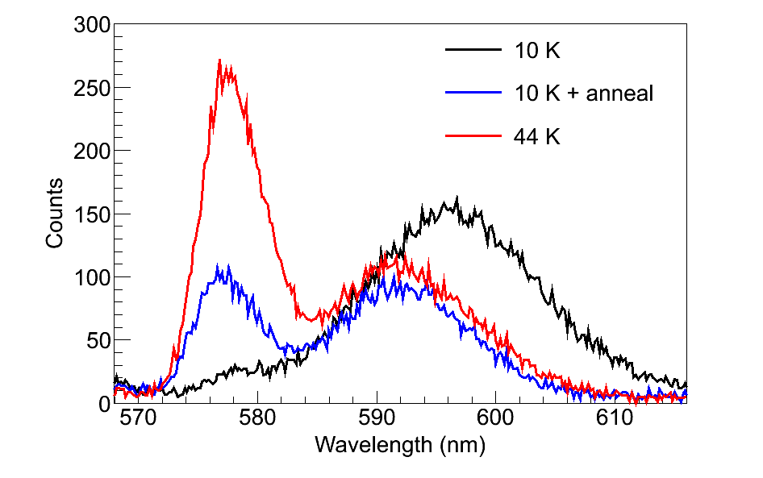
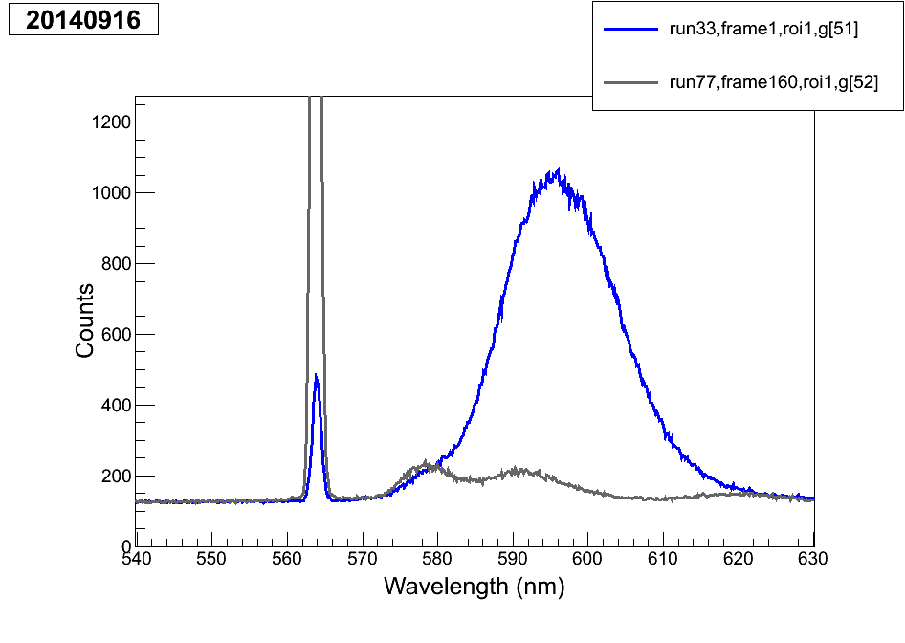
In considering a more comprehensive (including 619 etc.) version of this plot, I looked at the 2014-09-16 data, but nothing is quite as good. The 40K deposit for run 77 etc. is not similar to the other ones, because this day had long WL deposits. Here is a comparison of same-excitation for 11 K and 40 K, but again I don’t think they’re similar enough, and you should just use a separate day’s tests for seeing the 619 magnitude vs. deposit temp.

